Slide 1
The Cultural Landscape: An Introduction to Human Geography
Thirteenth Edition
Chapter 2 Lecture
Population & Health
Copyright © 2020 Pearson Education, Inc. All Rights Reserved
Notes:
If this PowerPoint presentation contains mathematical equations, you may need to check that your computer has the following installed:
1) MathType Plugin
2) Math Player (free versions available)
3) NVDA Reader (free versions available)

Slide 2
Population and Health: Key Issues
2.1 Where Are People Distributed?
2.2 Why Is Population Increasing?
2.3 Why Does Health Vary by Region?
2.4 Why Might Population Change in the Future?

Slide 3
Key Issue 1: Where Are People Distributed?
2.1.1 Population and Geography
2.1.2 Population Concentrations
2.1.3 Population Density

Slide 4
Reasons to study population geography
More people are alive at this time than at any other point in Earth’s long history.
Virtually all global population growth is concentrated in developing countries.
The world’s population increased at a faster rate during the second half of the twentieth century than ever before in history; the rate has slowed in the twenty-first century but is still high by historical standards.

Slide 5
2.1.1 Population and Geography (1 of 3)
The scientific study of population characteristics is demography
Carrying capacity is the maximum population size of a species that the environment can sustain indefinitely
Overpopulation occurs when the number of people exceeds the capacity of the environment to support life at a decent standard of living

Slide 6
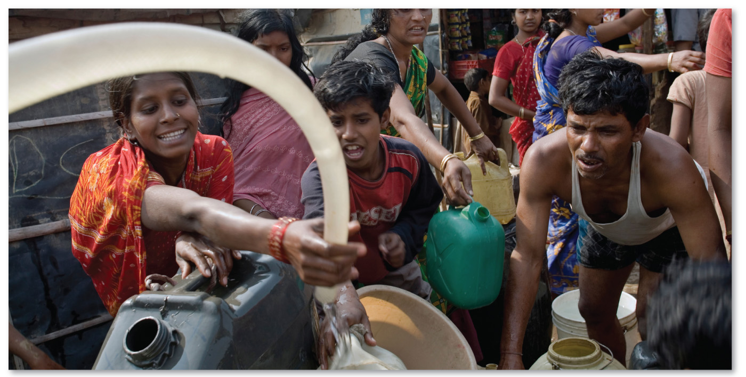
2.1.1 Population and Geography (2 of 3)
Figure 2-1: Residents of Delhi collecting water from a truck.

Slide 7
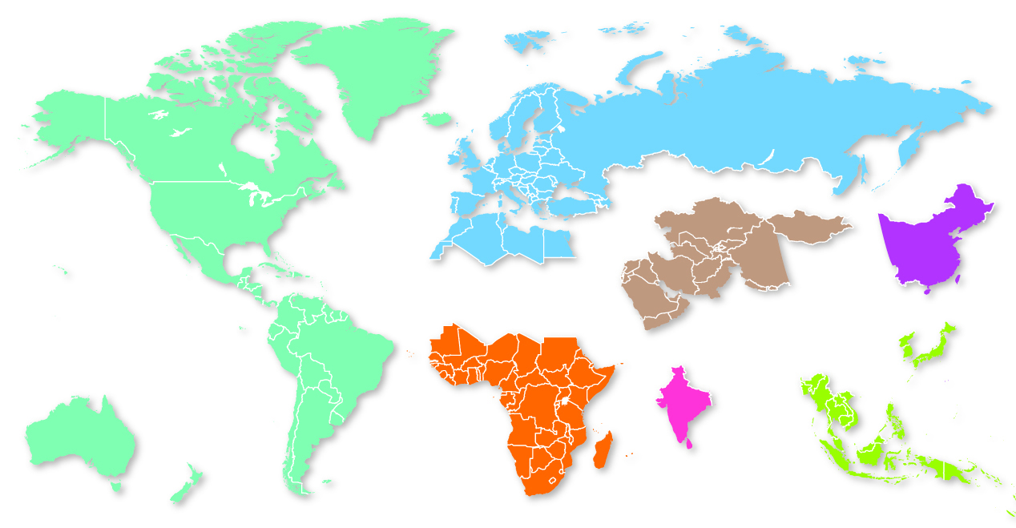
2.1.1 Population and Geography (3 of 3)
Figure 2-2: World Population Portions: Each color has approximately 1 billion total population.
GREENLAND
FINLAND
GERMANY
RUSSIA
CANADA
UNITED
KINGDOM
UNITED
STATES
FRANCE
TURKEY
SPAIN
ITALY
KAZAKHSTAN
MONGOLIA
MOROCCO
EGYPT
IRAQ
CUBA
CHINA
CHINA
MEXICO
ALGERIA
LIBYA
IRAN
GUATEMALA
VENEZUELA
SAUDI
ARABIA
NEPAL
TAIWAN
COSTA RICA
MALI
NIGER
CHAD
PAKISTAN
NORTH
KOREA
COLOMBIA
SUDAN
YEMEN
PERU
BRAZIL
ETHIOPIA
MYANMAR
SOUTH
KOREA
JAPAN
BOLIVIA
NIGERIA
INDIA
VIETNAM
DEM. REP. CONGO
KENYA
LAOS
PHILIPPINES
AUSTRALIA
CHILE
ARGENTINA
ANGOLA
THAILAND
NAMIBIA
SRI
LANKA
MALAYSIA
NEW
ZEALAND
MADAGASCAR
SOUTH AFRICA
INDONESIA

Slide 8
2.1.2 Population Concentrations (1 of 4)
There are four major population clusters:
East Asia
South Asia
Europe
Southeast Asia
Much of the Earth is sparsely populated:
too dry (e.g., Sahara)
too wet (e.g., Amazon)
too cold (e.g., Arctic)
too high (e.g., Himalayas)

Slide 9
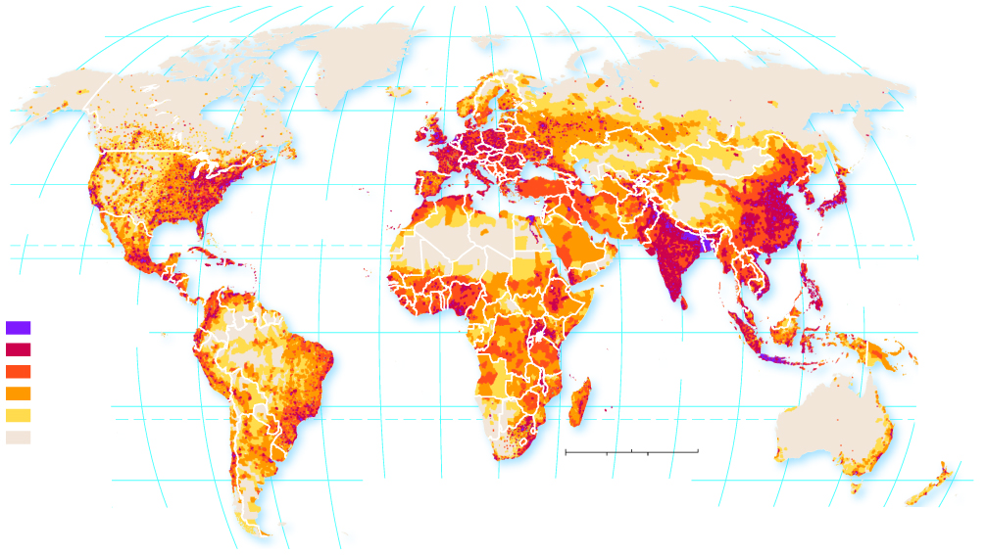
2.1.2 Population Concentrations (2 of 4)
Figure 2-4: Clusters in East Asia, South Asia, Europe, and Southeast Asia are evident.
160°
140°
120°
100°
80°
60°
40°
0°
20°
40°
60°
80°
100°
120°
140°
180°
80°
ARCTIC OCEAN
ARCTIC OCEAN
80°
60°
40°
40°
PACIFIC
OCEAN
ATLANTIC
OCEAN
20°
TROPIC OF CANCER
140°
120°
PACIFIC
OCEAN
20°
Persons per square
kilometer
1,000 and above
0°
EQUATOR
250–999
INDIAN
OCEAN
0°
25–249
5–24
20°
20°
1–4
TROPIC OF CAPRICORN
below 1
0
1,500
3,000 Miles
20°
0°
20°
0
1,500
3,000 Kilometers
40°
40°
60°
80°
40°
100°
100°
120°
140°
160°
180°
80°
60°
40°

Slide 10
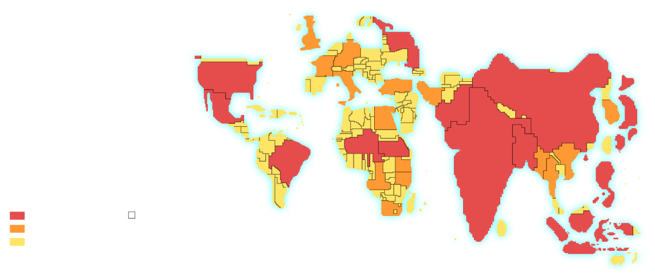
2.1.2 Population Concentrations (3 of 4)
Figure 2-5: World Population Cartogram: Country size proportional to population size.
UNITED
KINGDOM
RUSSIA
GERMANY
UNITED STATES
FRANCE
ITALY
TURKEY
IRAN
MEXICO
PAKISTAN
CHINA
SOUTH
KOREA
JAPAN
EGYPT
NIGERIA
ETHIOPIA
BANGLADESH
BRAZIL
INDIA
MYANMAR
VIETNAM
KENYA
DEM. REP.
OF THE CONGO
TANZANIA
THAILAND
PHILIPPINES
Population
SOUTH
AFRICA
100 million and above
Each square represents
10 million people
50–99 million
INDONESIA
below 50 million

Slide 11
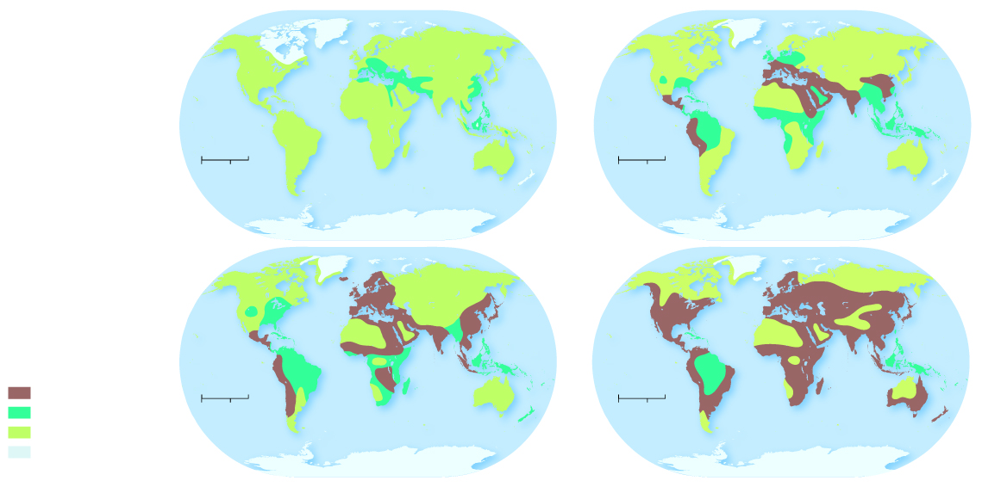
2.1.2 Population Concentrations (4 of 4)
The portion of Earth’s surface occupied by permanent human settlement is known as the ecumene
Figure 2-6: The portion of Earth’s surface occupied by permanent human settlement has increased.
0
3,000 Miles
0
3,000 Miles
0
3,000 Kilometers
0
3,000 Kilometers
5000 B.C.E.
1 C.E.
Intensive settlement
0
3,000 Miles
0
3,000 Miles
Small-scale agriculture
0
3,000 Kilometers
0
3,000 Kilometers
Hunting and gathering
Uninhabited
(mainly ice)
1500 C.E.
1900 C.E.

Slide 12
2.1.3 Population Density (1 of 6)
There are three measures of population density frequently used by geographers:
Arithmetic density: people/land area
Physiological density: people/arable land
Agricultural density: farmers/arable land

Slide 13
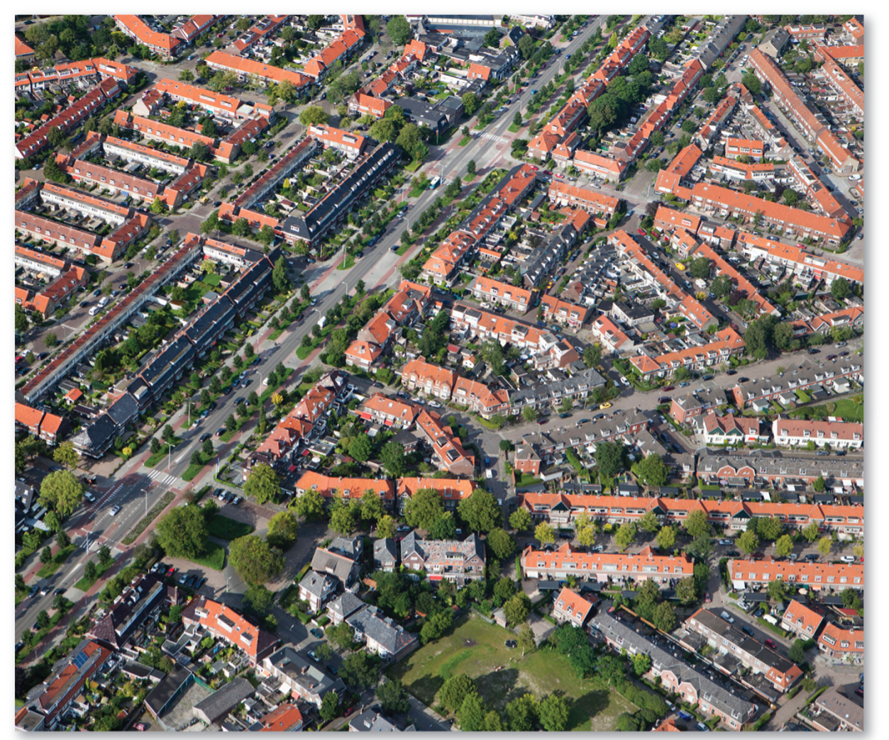
2.1.3 Population Density (2 of 6)
Figure 2-7: The Netherlands has high arithmetic density.

Slide 14
2.1.3 Population Density (3 of 6)
Table 2-1: Canada, Egypt, the Netherlands, and the United States have vastly different arithmetic, physiological, and agricultural population densities.
Country | Arithmetic Density | Physiological Density | Agricultural Density | Percentage Farmers | Percentage Arable Land
Canada | 4 | 85 | 0.8 | 2 | 5
Egypt | 97 | 3,350 | 208 | 25 | 4
The Netherlands | 511 | 1,668 | 9 | 2 | 30
United States | 36 | 215 | 0.4 | 1 | 17

Slide 15
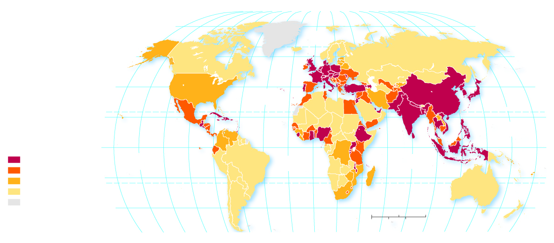
2.1.3 Population Density (4 of 6)
Figure 2-8: Arithmetic density is a measurement of population/land area.
80°
160°
140°
120°
100°
80°
60°
40°
20°
0°
20°
40°
60°
80°
100°
120°
140°
160°
180°
80°
ARCTIC
OCEAN
60°
60°
40°
ATLANTIC
OCEAN
40°
20°
TROPIC OF CANCER
20°
PACIFIC
OCEAN
Persons per square
kilometer
0°
EQUATOR
0°
100 and above
PACIFIC
OCEAN
ATLANTIC
OCEAN
INDIAN
OCEAN
50–99
20°
20°
25–49
TROPIC OF CAPRICORN
below 25
no data
40°
40°
0
1,500
3,000 Miles
0
1,500
3,000 Kilometers
160°
140°
120°
100°
80°
60°
40°
20°
0°
20°
40°
60°
80°
100°
120°
140°
160°
180°

Slide 16
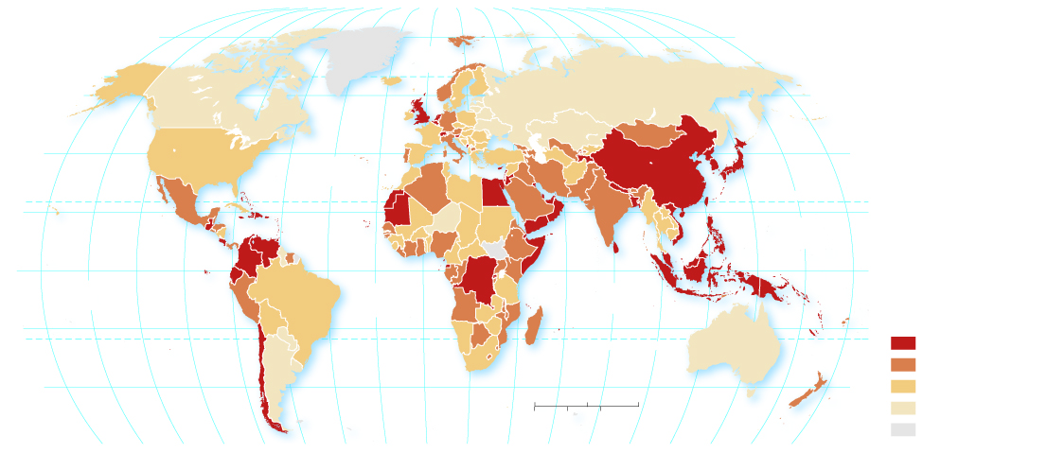
2.1.3 Population Density (5 of 6)
Figure 2-9: Physiological density is a measurement of population/arable land area.
80°
160°
140°
120°
100°
80°
60°
40°
20°
0°
20°
40°
60°
80°
100°
120°
140°
160°
180°
80°
ARCTIC
OCEAN
60°
60°
40°
ATLANTIC
OCEAN
40°
20°
TROPIC OF CANCER
20°
PACIFIC
OCEAN
0°
EQUATOR
0°
PACIFIC
OCEAN
ATLANTIC
OCEAN
INDIAN
OCEAN
Persons per square
kilometer of arable land
20°
TROPIC OF CAPRICORN
20°
1,000 and above
500–999
40°
0
1,500
3,000 Miles
40°
200–499
0
1,500
3,000 Kilometers
below 200
160°
140°
120°
100°
80°
60°
40°
20°
0°
20°
40°
60°
80°
100°
120°
140°
160°
180°
no data

Slide 17
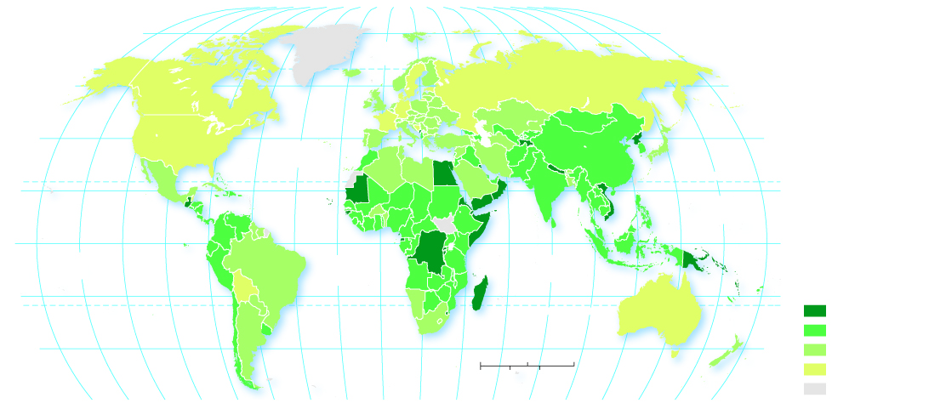
2.1.3 Population Density (6 of 6)
Figure 2-10: Agricultural density is a measurement of the number of farmers/arable land area.
80°
160°
140°
120°
100°
80°
60°
40°
20°
0°
20°
40°
60°
80°
100°
120°
140°
160°
180°
80°
ARCTIC
OCEAN
60°
60°
40°
ATLANTIC
OCEAN
40°
20°
TROPIC OF CANCER
20°
PACIFIC
OCEAN
0°
EQUATOR
0°
PACIFIC
OCEAN
ATLANTIC
OCEAN
INDIAN
OCEAN
Farmers per square
kilometer of arable land
20°
TROPIC OF CAPRICORN
20°
500 and above
100–499
40°
0
1,500
3,000 Miles
40°
10–99
0
1,500
3,000 Kilometers
below 10
160°
140°
120°
100°
80°
60°
40°
20°
0°
20°
40°
60°
80°
100°
120°
140°
160°
180°
no data

Slide 18
Key Issue 2: Why Is Population Increasing?
2.2.1 Natural Increase
2.2.2 Births and Deaths
2.2.3 The Demographic Transition

Slide 19
2.2.1 Natural Increase (1 of 6)
The natural increase rate (N I R) is the percentage by which a population grows in a year
The global N I R is currently 1.2, meaning the world is growing at a rate of 1.2% annually
More than 95% of natural increase currently occurs in developing countries
The number of years needed to double a population is called doubling time

Slide 20
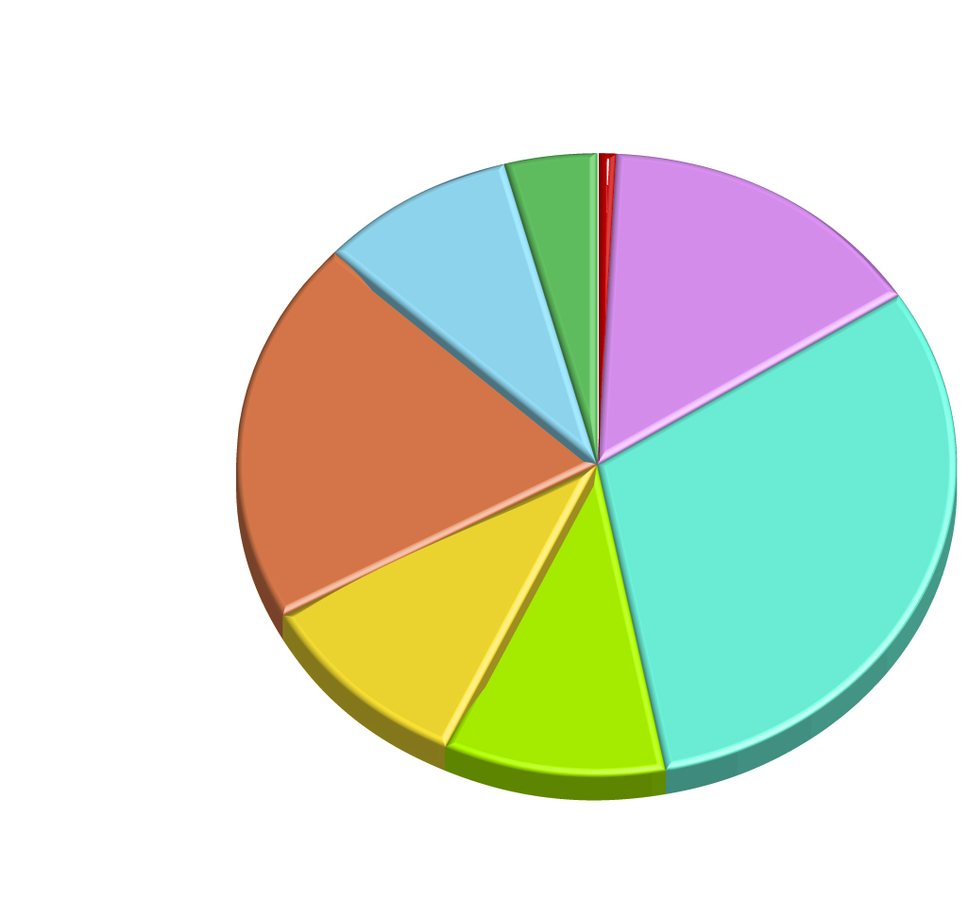
2.2.1 Natural Increase (2 of 6)
Figure 2-11: The majority of population growth is in the developing world.
Europe and Russia 1%
North America 4%
Latin America
9%
15%
East Asia
20%
31%
South Asia
10%
10%
Southwest Asia &
North Africa, and
Central Asia.
Southeast Asia and
South Pacific

Slide 21
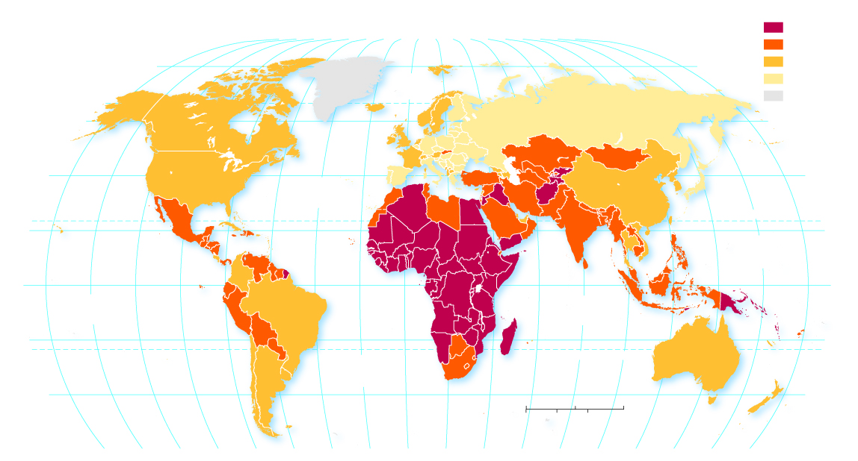
2.2.1 Natural Increase (3 of 6)
Figure 2-12: World map of natural increase rates (NIR).
Percent per year
2.0 and above
160°
140°
120°
100°
80°
60°
40°
20°
0°
20°
40°
60°
80°
100°
120°
140°
160°
180°
1–1.9
80°
80°
0.1–0.9
ARCTIC
OCEAN
0 and below
no data
60°
60°
40°
ATLANTIC
OCEAN
40°
20°
TROPIC OF CANCER
20°
PACIFIC
OCEAN
0°
EQUATOR
0°
PACIFIC
OCEAN
INDIAN
OCEAN
20°
TROPIC OF CAPRICORN
20°
ATLANTIC
OCEAN
40°
0
1,500
3,000 Miles
40°
0
1,500
3,000 Kilometers
160°
140°
120°
100°
80°
60°
40°
20°
0°
20°
40°
60°
80°
100°
120°
140°
160°
180°

Slide 22
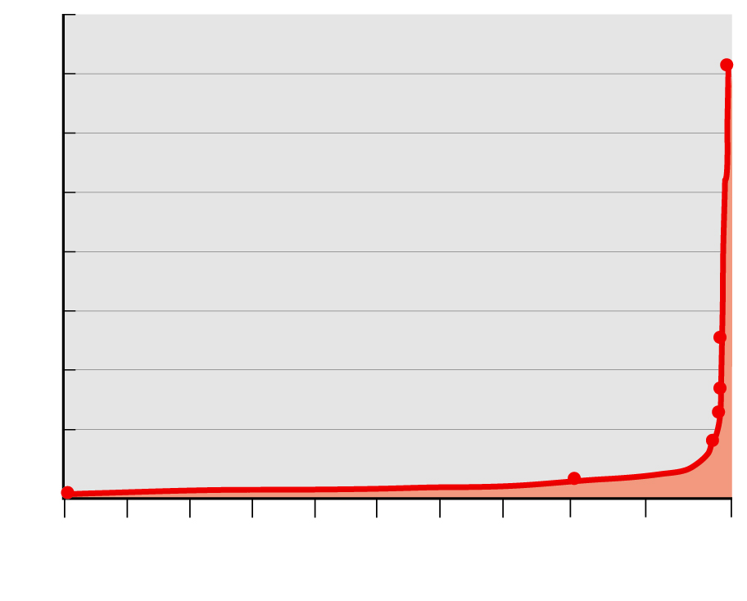
2.2.1 Natural Increase (4 of 6)
Figure 2-13: Human population grew very slowly until the 1700s and then accelerated in the last two centuries.
8
2017 population–
7,795,482,309
7
6
5
4
Population (billions)
3
1950 population–2,516,000,000
2
1900 population–1,656,000,000
1
1850 population–1,266,000,000
8000 B.C.E. population–
500,000
1800 population–985,000,000
1 B.C.E. population–300,000,000
0
8000
7000
6000
5000
4000
3000
2000
1000
0
1000
2020
B.C.E.
C.E.
Year

Slide 23
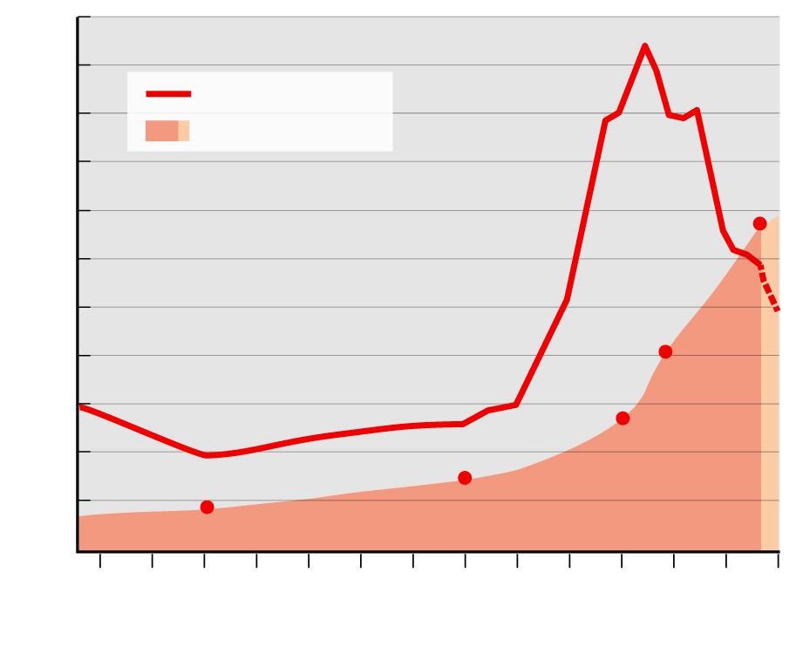
2.2.1 Natural Increase (5 of 6)
Figure 2-14: Human population grew very slowly until the 1700s and then accelerated in the last two centuries.
2.2
2.0
1.8
Annual growth rate
World population
1.6
7.4
billion
1.4
1.2
Population growth (%)
1.0
4.4 billion
0.8
0.6
3.0 billion
0.4
1.65 billion
0.2
0.9 billion
0.0
1760
1780
1800
1820
1840
1860
1880
1900
1920
1940
1960
1980
2000
2020
Year

Slide 24
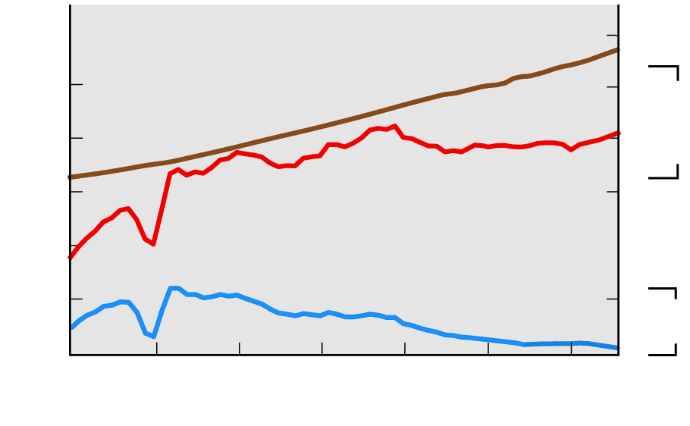
2.2.1 Natural Increase (6 of 6)
Figure 2-16: Even with a declining NIR, annual increase is about 85 million per year.
8
100
World population (billions)
6
Population
(billion)
80
4
Population increase (million)
Annual increase (millions)
2
60
40
20
Natural increase rate (%)
2
NIR
(%)
1
1950
1960
1970
1980
1990
2000
2010
2017
Year

Slide 25
2.2.2 Births and Deaths (1 of 5)
Natural increase occurs when births (fertility) exceed deaths (mortality)
Crude Birth Rate (C B R):
Crude Death Rate (C D R):
Total Fertility Rate (T F R) is the average number of children a woman will have throughout her childbearing years
The infant mortality rate (I M R) is the annual number of deaths of infants under one year of age

Slide 26
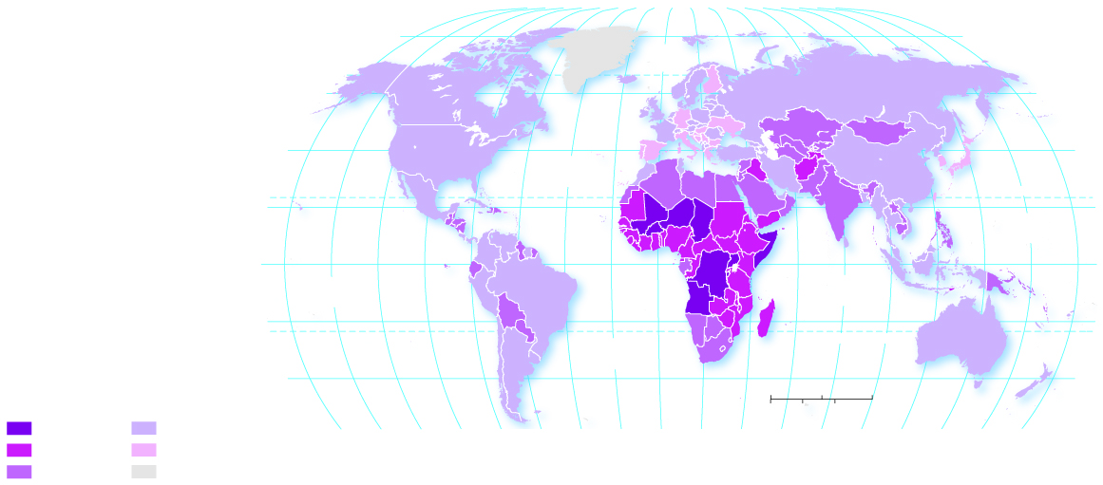
2.2.2 Births and Deaths (2 of 5)
Figure 2-17: The highest birth rates are concentrated in Africa and Southwest Asia.
80°
160°
140°
120°
100°
80°
60°
40°
20°
0°
20°
40°
60°
80°
100°
120°
140°
160°
180°
80°
ARCTIC
OCEAN
60°
60°
40°
ATLANTIC
OCEAN
40°
20°
TROPIC OF CANCER
20°
PACIFIC
OCEAN
0°
EQUATOR
0°
PACIFIC
OCEAN
INDIAN
OCEAN
20°
TROPIC OF CAPRICORN
20°
ATLANTIC
OCEAN
Births per
1,000 persons
40°
0
1,500
3,000 Miles
40°
40 and above
10–19
160°
140°
120°
100°
80°
60°
40°
20°
0°
20°
40°
0
1,500
3,000 Kilometers
30–39
below 10
60°
80°
100°
120°
140°
160°
180°
20–29
no data

Slide 27
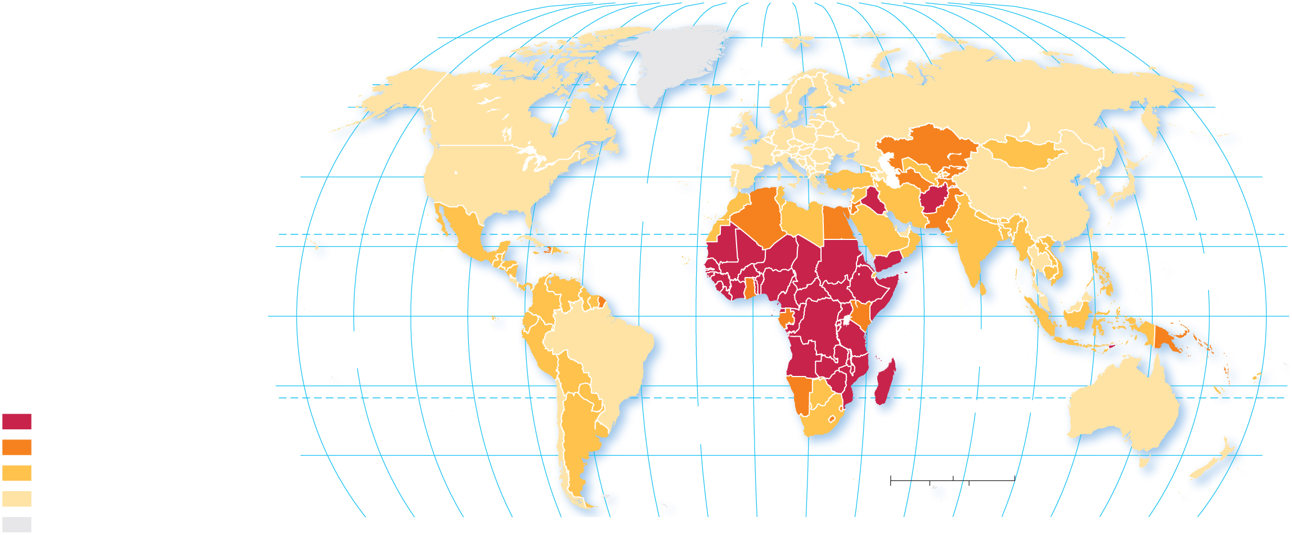
2.2.2 Births and Deaths (3 of 5)
Figure 2-18: : The highest TFR are in Africa and Southwest Asia.
80°
160°
140°
120°
100°
80°
60°
40°
20°
0°
20°
40°
60°
80°
100°
120°
140°
160°
180°
80°
ARCTIC
OCEAN
60°
60°
40°
ATLANTIC
OCEAN
40°
20°
TROPIC OF CANCER
20°
PACIFIC
OCEAN
0°
EQUATOR
0°
PACIFIC
OCEAN
INDIAN
OCEAN
Children per
childbearing years
20°
20°
40 and above
ATLANTIC
OCEAN
TROPIC OF CAPRICORN
3.0–3.9
40°
0
1,500
3,000 Miles
40°
2.0–2.9
0
1,500
3,000 Kilometers
below 2
no data
160°
140°
120°
100°
80°
60°
40°
20°
0°
20°
40°
60°
80°
100°
120°
140°
160°
180°

Slide 28
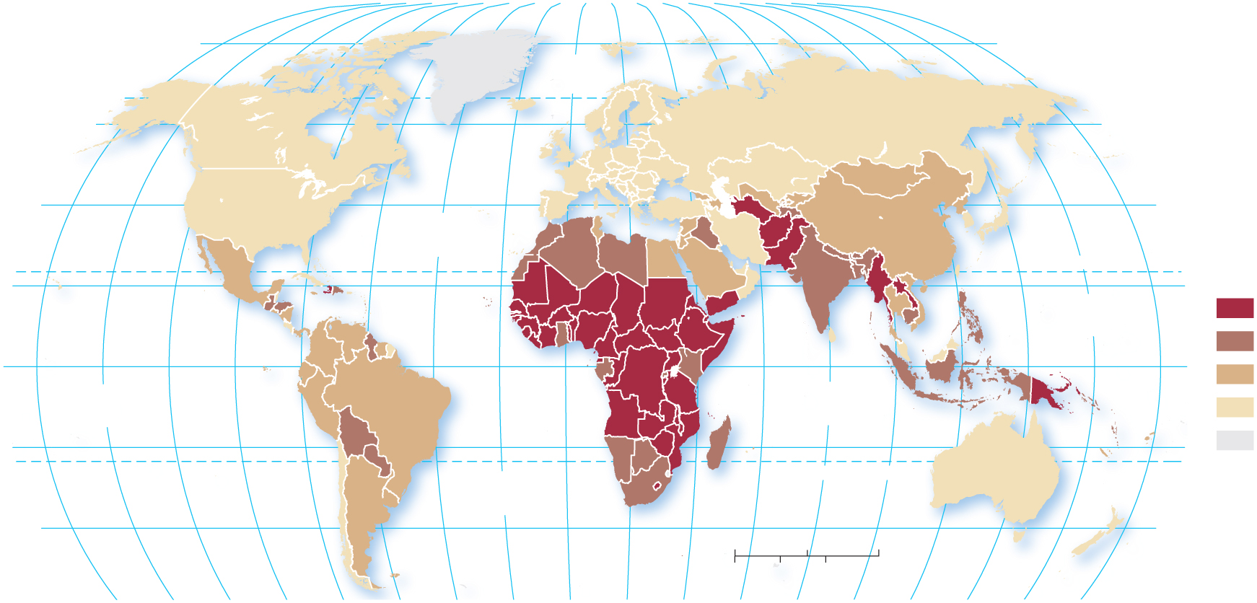
2.2.2 Births and Deaths (4 of 5)
Figure 2-19: The highest IMRs in 2018 are in Sub-Saharan Africa, and the lowest are in Europe
80°
160°
140°
120°
100°
80°
60°
40°
20°
0°
20°
40°
60°
80°
100°
120°
140°
160°
180°
80°
ARCTIC
OCEAN
60°
60°
40°
ATLANTIC
OCEAN
40°
TROPIC OF CANCER
Infant mortality rate
per 1,000 live births
20°
PACIFIC
OCEAN
20°
40 and above
EQUATOR
20–39
0°
0°
10–19
PACIFIC
OCEAN
INDIAN
OCEAN
below 10
20°
20°
no data
ATLANTIC
OCEAN
TROPIC OF CAPRICORN
40°
0
1,500
3,000 Miles
40°
0
1,500
3,000 Kilometers
160°
140°
120°
100°
80°
60°
40°
20°
0°
20°
40°
60°
80°
100°
120°
140°
160°
180°

Slide 29
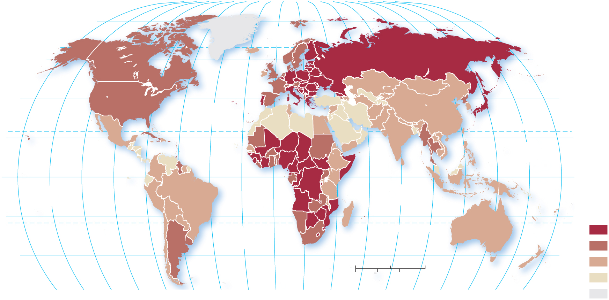
2.2.2 Births and Deaths (5 of 5)
Figure 2-20: : Crude death rates do not follow the pattern of many other demographic statistics.
80°
160°
140°
120°
100°
80°
60°
40°
20°
0°
20°
40°
60°
80°
100°
120°
140°
160°
180°
80°
ARCTIC
OCEAN
60°
60°
40°
ATLANTIC
OCEAN
40°
20°
TROPIC OF CANCER
20°
PACIFIC
OCEAN
0°
EQUATOR
0°
PACIFIC
OCEAN
INDIAN
OCEAN
Deaths per
1,000 persons
20°
20°
10 and above
ATLANTIC
OCEAN
TROPIC OF CAPRICORN
40°
40°
8–9
0
1,500
3,000 Miles
6–7
0
1,500
3,000 Kilometers
below 6
160°
140°
120°
100°
80°
60°
40°
20°
0°
20°
40°
60°
80°
100°
120°
140°
160°
180°
no data

Slide 30
2.2.3 The Demographic Transition (1 of 9)
The demographic transition is a process of change in a society’s population from high crude birth and death rates and low rate of natural increase to a condition of low crude birth and death rates, low rate of natural increase, and higher total population

Slide 31
2.2.3 The Demographic Transition (2 of 9)
There are four stages in the demographic transition:
Stage 1: Low Growth (very high C B R and C D R, very low N I R)
Stage 2: High Growth (high C B D, rapidly declining C D R, very high N I R)
Stage 3: Moderate Growth (rapidly declining C B R, moderately declining C D R, moderate N I R)
Stage 4: Low Growth (very low C B R, low or slightly increasing C D R, low or negative N I R)

Slide 32
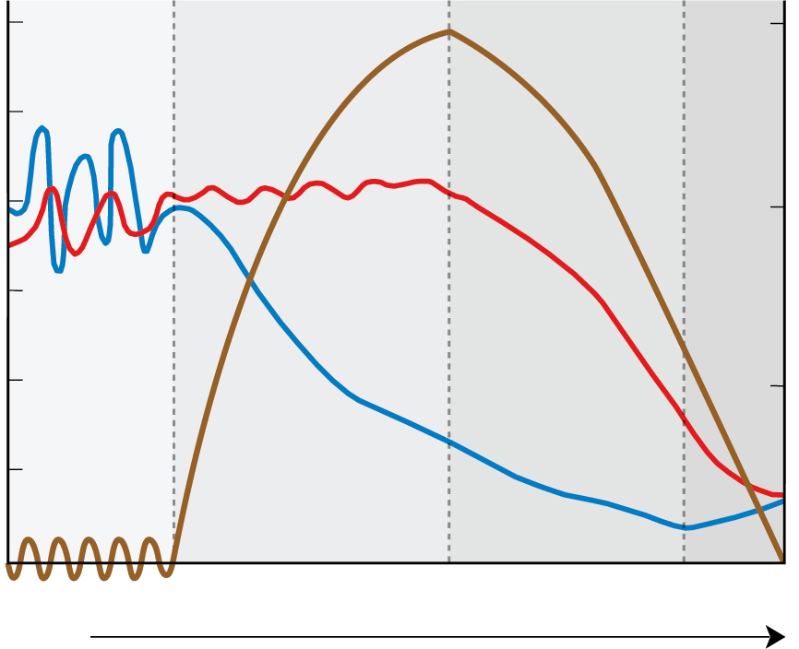
2.2.3 The Demographic Transition (3 of 9)
Figure 2-21: The Demographic Transition Model goes through four distinct stages.
Stage 1
Stage 2
Stage 3
Stage 4
60
3
50
Natural increase
40
Birth
2
Crude birth and death rates (per 1,000)
Natural increase rate (%)
30
20
Death
1
10
0
0
Low growth
High growth
Decreasing growth
Low growth
Time

Slide 33
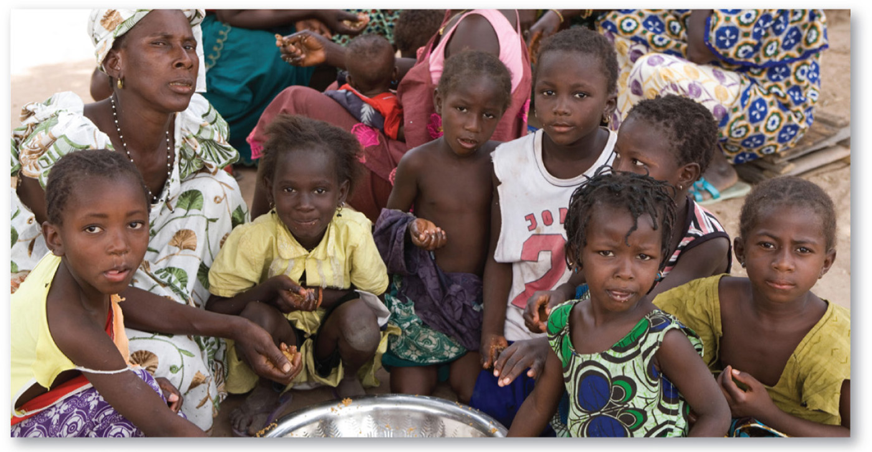
2.2.3 The Demographic Transition (4 of 9)
Figure 2-22: The Gambia has a very high crude birth rate.

Slide 34
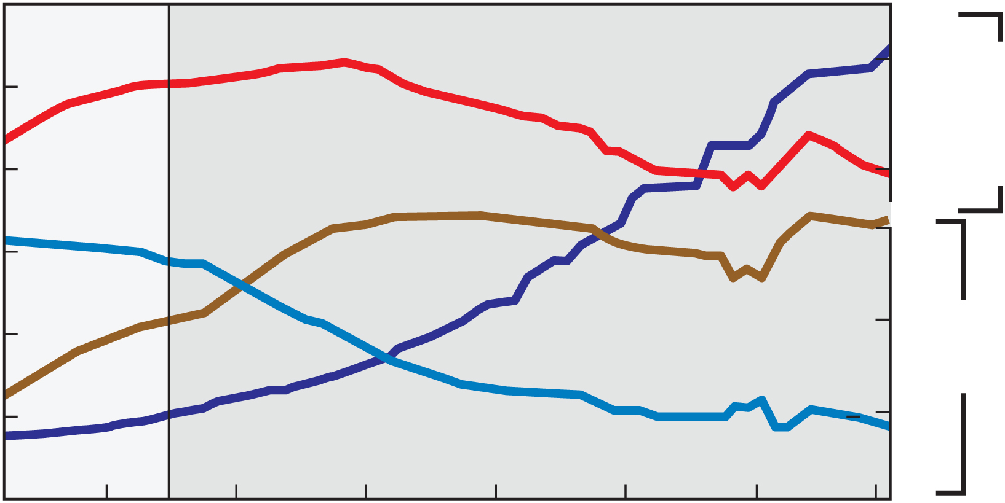
2.2.3 The Demographic Transition (5 of 9)
Figure 2-23: Stage 2 of the demographic transition: The Gambia.
Stage 1
Stage 2
Birth
2.0
50
Population
(millions
40
1.5
Birth and death rates (per 1,000)
Natural increase
3
30
Population
2
20
N I R
Death
10
1
1960
1970
1980
1990
2000
2010
2017

Slide 35
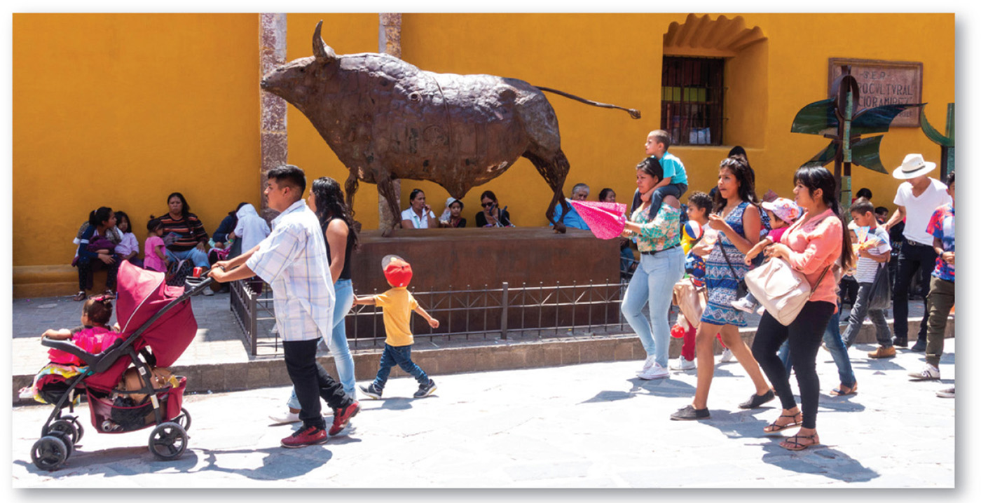
2.2.3 The Demographic Transition (6 of 9)
Figure 2-24: Mexico has a declining crude birth rate and moderate NIR.

Slide 36
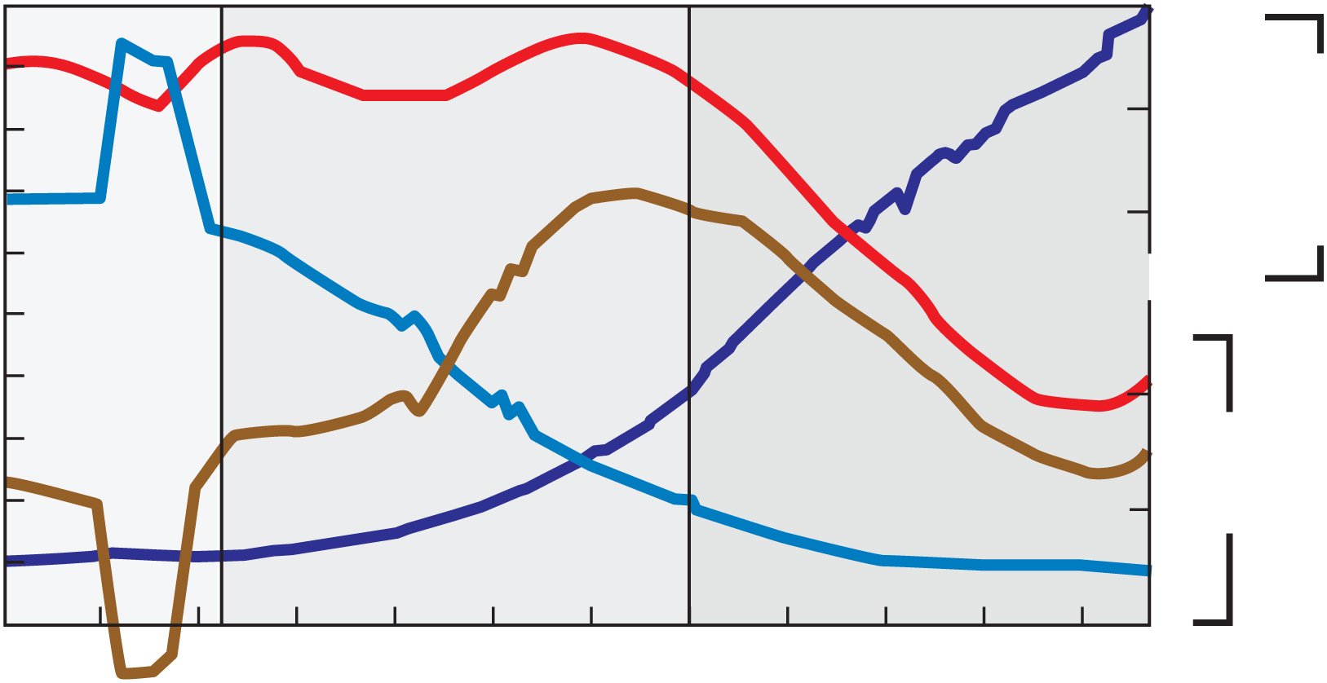
2.2.3 The Demographic Transition (7 of 9)
Figure 2-25: Stage 3 of the demographic transition: Mexico.
Stage 1
Stage 2
Stage 3
50
Birth
100
40
Population
(millions)
80
30
Death
Birth and death rates (per 1,000)
20
Natural increase
2
N I R
10
Population
1
1900
1920
1940
1960
1980
2000
2017

Slide 37
2.2.3 The Demographic Transition (8 of 9)
Figure 2-26: Denmark has a very low crude birth rate and an aging population.

Slide 38
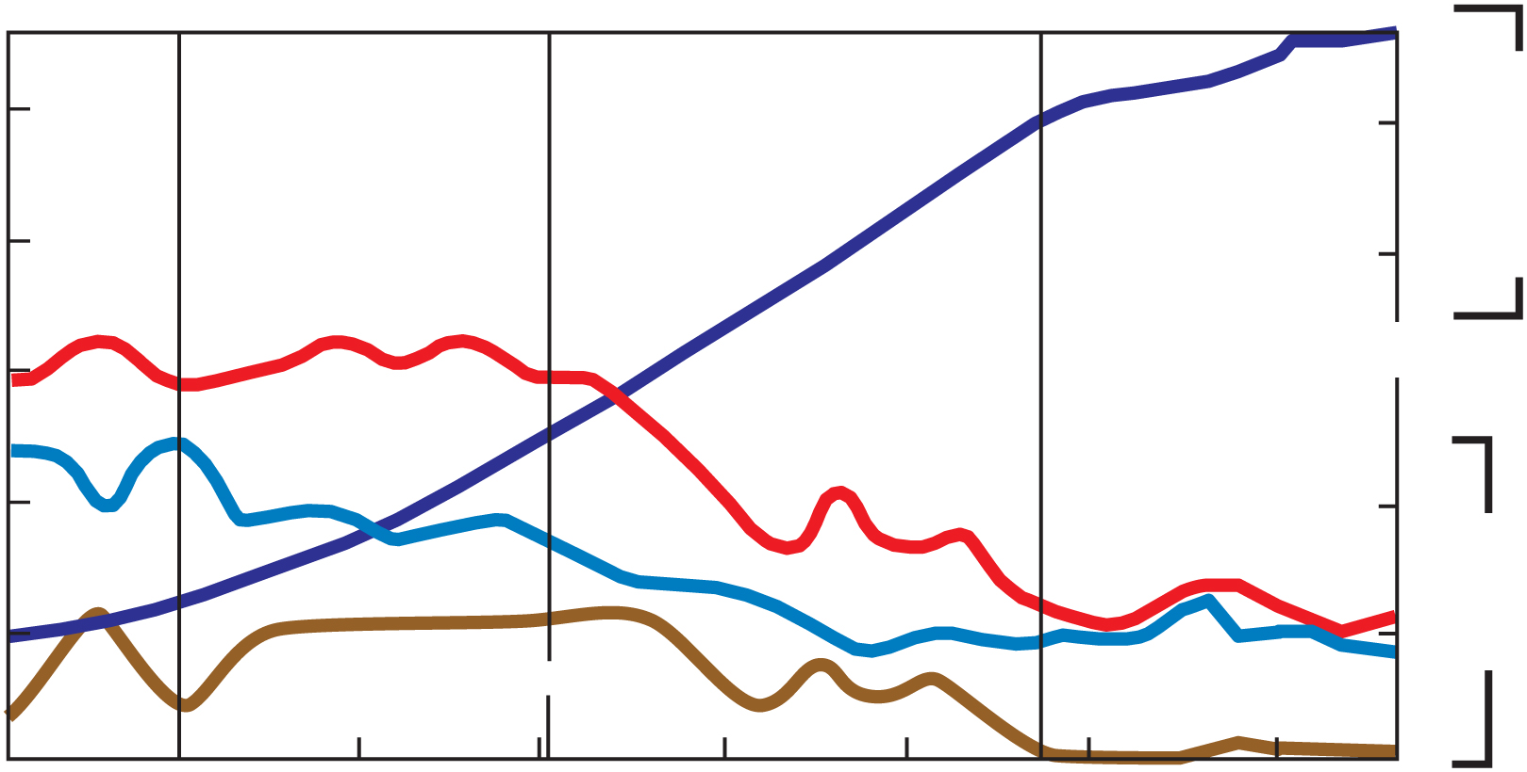
2.2.3 The Demographic Transition (9 of 9)
Figure 2-27: Stage 4 of the demographic transition: Denmark.
Stage 1
Stage 2
Stage 3
Stage 4
50
5
Population
(millions)
40
Population
4
30
Birth and death rates (per 1,000)
Birth
20
2
Death
N I R
10
Natural increase
1
1830
1860
1890
1920
1950
1980
2010
2017

Slide 39
Key Issue 3: Why Does Health Vary by Region?
2.3.1 Medical Services
2.3.2 Health and Gender
2.3.3 Health and Aging
2.3.4 Epidemiologic Transition

Slide 40
2.3.1 Medical Services (1 of 4)
Health conditions vary dramatically between developed nations and developing nations
Developed nations spend >$1,000 per person on health care annually
Developing nations spend <$100 per person on health care annually

Slide 41
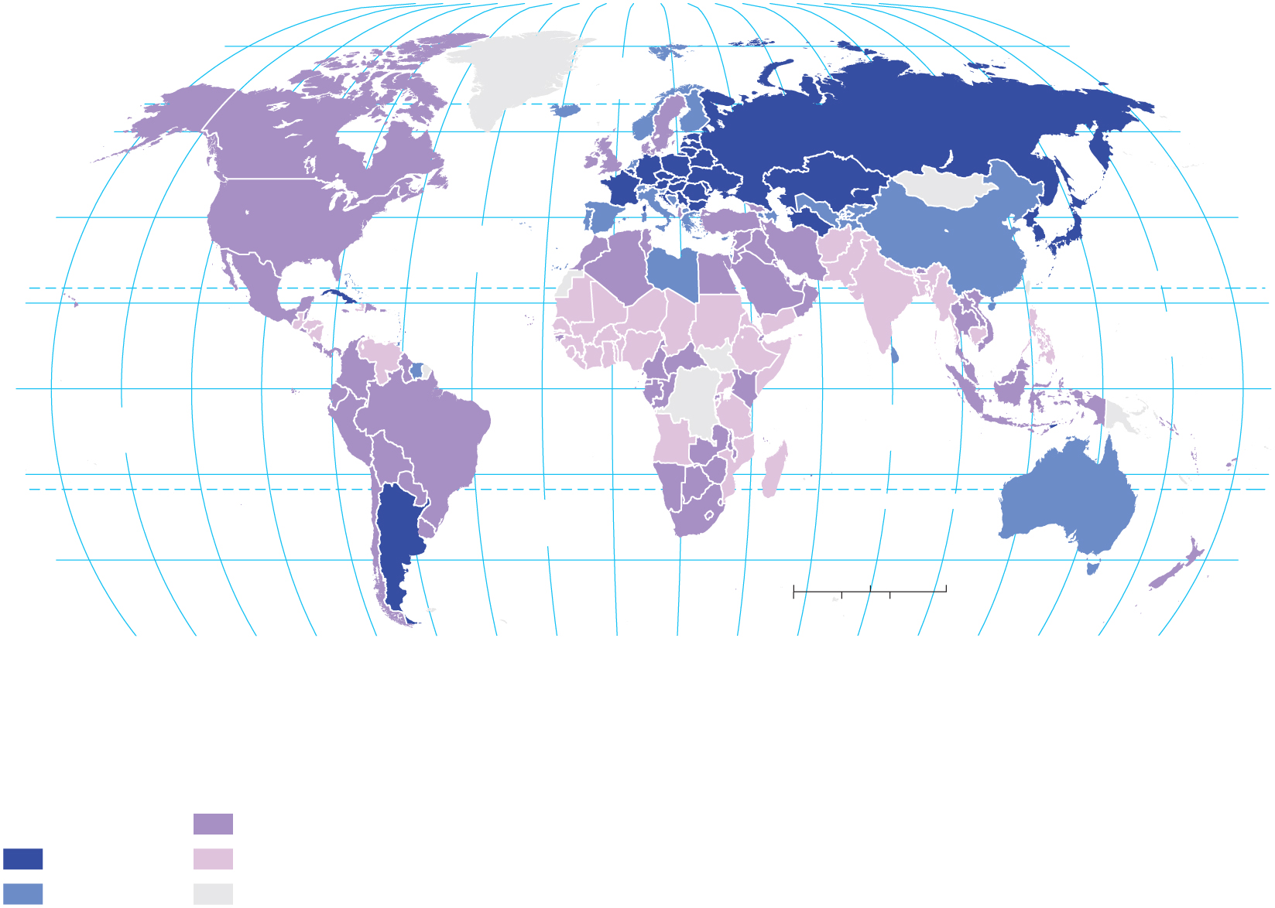
2.3.1 Medical Services (2 of 4)
Figure 2-28: Hospital beds per 10,000 people provide an estimate of medical care availability.
160°
140°
80°
20°
60°
100°
120°
140°
160°
180°
80°
120°
100°
60°
40°
0°
20°
40°
80°
80°
ARCTIC
OCEAN
60°
60°
40°
ATLANTIC
OCEAN
40°
20°
TROPIC OF CANCER
20°
PACIFIC
OCEAN
EQUATOR
0°
PACIFIC
OCEAN
INDIAN
OCEAN
0°
20°
TROPIC OF CAPRICORN
20°
ATLANTIC
OCEAN
40°
0
1,500
3,000 Miles
40°
160°
140°
120°
100°
80°
60°
40°
20°
0°
20°
40°
0
1,500
3,000 Kilometers
180°
60°
80°
100°
120°
140°
160°
Hospital beds
per 10,000 people
10–29
50 and above
below 10
30–49
no data

Slide 42
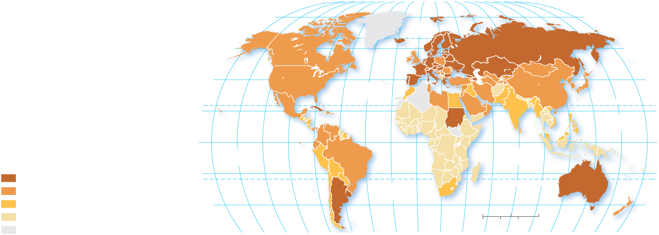
2.3.1 Medical Services (3 of 4)
Figure 2-29: Physicians per 10,000 people are another estimate of medical care availability.
80°
160°
140°
120°
100°
80°
60°
40°
20°
0°
20°
40°
60°
80°
100°
120°
140°
160°
180°
80°
ARCTIC
OCEAN
60°
60°
40°
ATLANTIC
OCEAN
40°
20°
TROPIC OF CANCER
20°
PACIFIC
OCEAN
0°
EQUATOR
0°
Physicians per
10,000 population
PACIFIC
OCEAN
INDIAN
OCEAN
30 and above
20°
TROPIC OF CAPRICORN
20°
15–29
ATLANTIC
OCEAN
5–14
40°
0
1,500
3,000 Miles
40°
below 5
0
1,500
3,000 Kilometers
no data
160°
140°
120°
100°
80°
60°
40°
20°
0°
20°
40°
60°
80°
100°
120°
140°
160°
180°

Slide 43
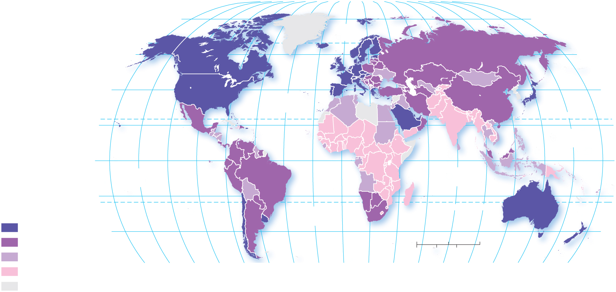
2.3.1 Medical Services (4 of 4)
Figure 2-30: Health care expenditures are generally associated with longer life expectancies
80°
160°
140°
120°
100°
80°
60°
40°
20°
0°
20°
40°
60°
80°
100°
120°
140°
160°
180°
80°
ARCTIC
OCEAN
60°
60°
40°
ATLANTIC
OCEAN
40°
20°
TROPIC OF CANCER
20°
PACIFIC
OCEAN
0°
EQUATOR
0°
PACIFIC
OCEAN
INDIAN
OCEAN
Health–care
expenditures
per capita
20°
20°
ATLANTIC
OCEAN
TROPIC OF CAPRICORN
$1,000 and above
40°
40°
$300–$999
0
1,500
3,000 Miles
$100–$299
0
1,500
3,000 Kilometers
below $100
160°
140°
120°
100°
80°
60°
40°
20°
0°
20°
40°
60°
80°
100°
120°
140°
160°
180°
no data

Slide 44
2.3.2 Health and Gender (1 of 5)
Cultural and economic factors put women at risk
More males than expected in places
Sex ratio:
A normal sex ratio is 105:100
Maternal mortality rate:

Slide 45
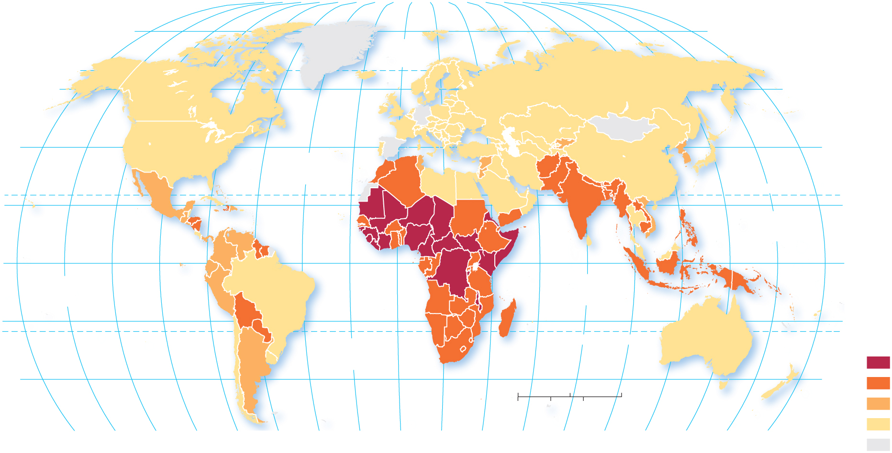
2.3.2 Health and Gender (2 of 5)
Figure 2-33: Worldwide maternal mortality range is dramatic, from fewer than 10 deaths to more than 500 per 100,000 live births.
80°
160°
140°
120°
100°
80°
60°
40°
20°
0°
20°
40°
60°
80°
100°
120°
140°
160°
180°
80°
ARCTIC
OCEAN
60°
60°
40°
ATLANTIC
OCEAN
40°
20°
TROPIC OF CANCER
20°
PACIFIC
OCEAN
0°
EQUATOR
0°
PACIFIC
OCEAN
INDIAN
OCEAN
20°
20°
Maternal mortality rate
(per 100,000 live births)
ATLANTIC
OCEAN
TROPIC OF CAPRICORN
500 and above
40°
0
1,500
3,000 Miles
40°
100–499
0
1,500
3,000 Kilometers
50–99
160°
140°
120°
100°
80°
60°
40°
20°
0°
20°
40°
60°
80°
100°
120°
140°
160°
180°
below 50
no data

Slide 46
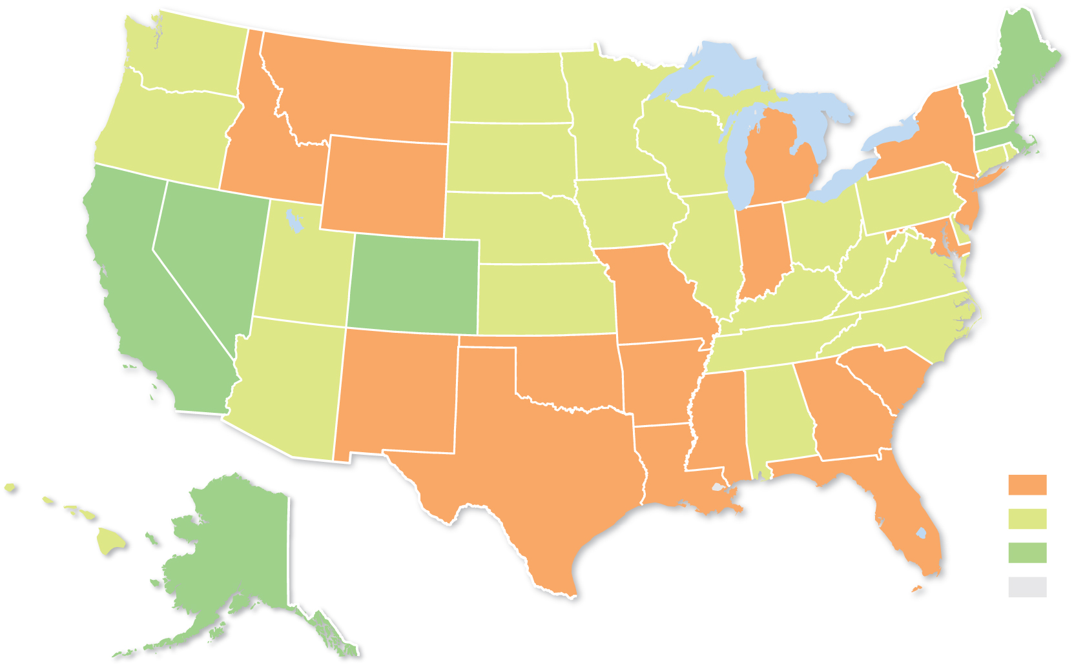
2.3.2 Health and Gender (3 of 5)
Figure 2-34: Maternal mortality range is pronounced in the United States.
Maternal mortality rate
(per 100,000 live births)
20 and above
10–19
below 10
no data

Slide 47
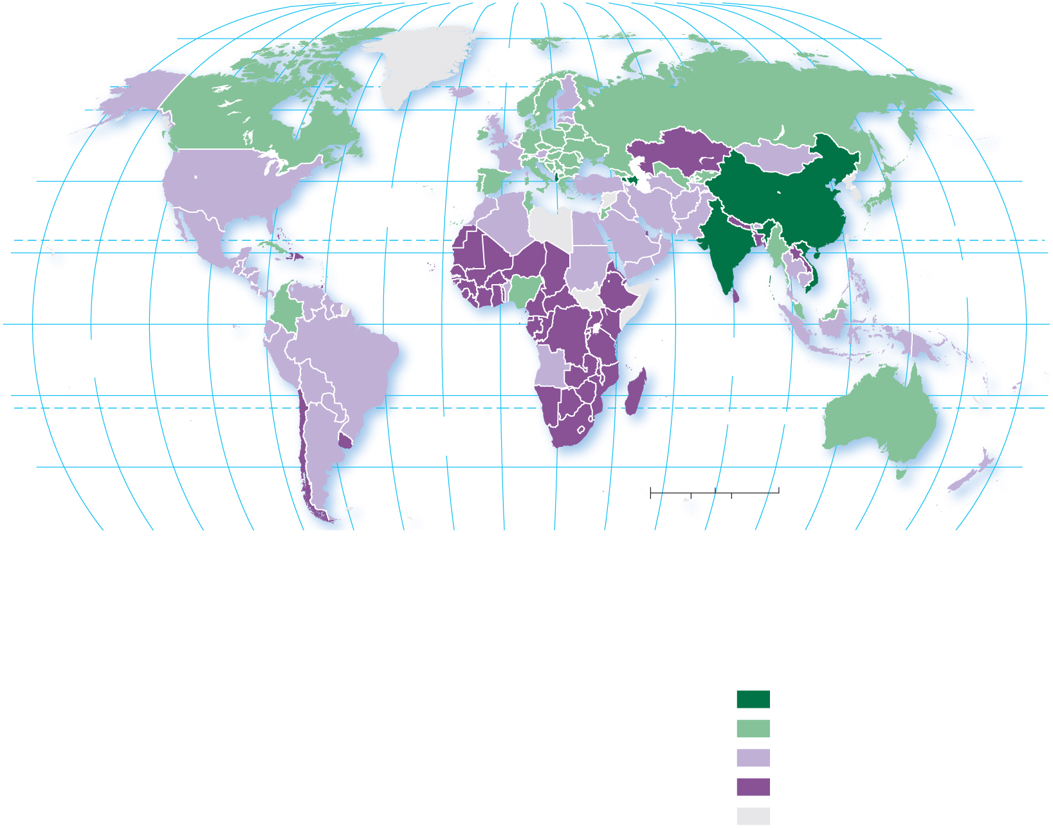
2.3.2 Health and Gender (4 of 5)
Figure 2-35: Lavender represents what we would expect from biology, green represents more male children than expected.
160°
140°
80°
20°
60°
100°
120°
140°
160°
180°
80°
120°
100°
60°
40°
0°
20°
40°
80°
80°
ARCTIC
OCEAN
60°
60°
40°
ATLANTIC
OCEAN
40°
20°
TROPIC OF CANCER
20°
PACIFIC
OCEAN
0°
EQUATOR
0°
PACIFIC
OCEAN
INDIAN
OCEAN
20°
ATLANTIC
OCEAN
TROPIC OF CAPRICORN
20°
40°
0
1,500
3,000 Miles
40°
160°
140°
120°
100°
80°
60°
40°
20°
0°
20°
40°
0
1,500
3,000 Kilometers
180°
60°
80°
100°
120°
140°
160°
Sex ratio at birth
(male(s) per female)
1.10 and above
1.06–1.09
1.05
below 1.05
no data

Slide 48
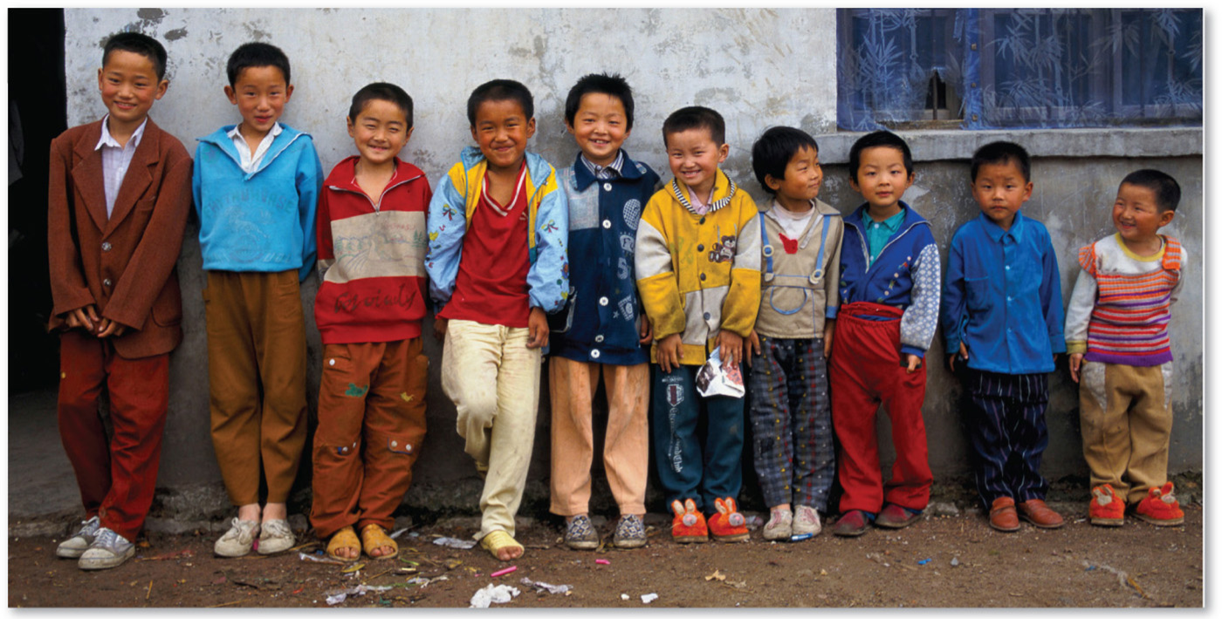
2.3.2 Health and Gender (5 of 5)
Figure 2-36: China has a sex ratio of 114:100, indicating a cultural preference for boys.

Slide 49
2.3.3 Health and Aging (1 of 8)
Life expectancy is the average number of years an individual can be expected to live
The elderly support ratio is the number of working-age people (ages 15 to 64) divided by the number of persons 65 and older

Slide 50
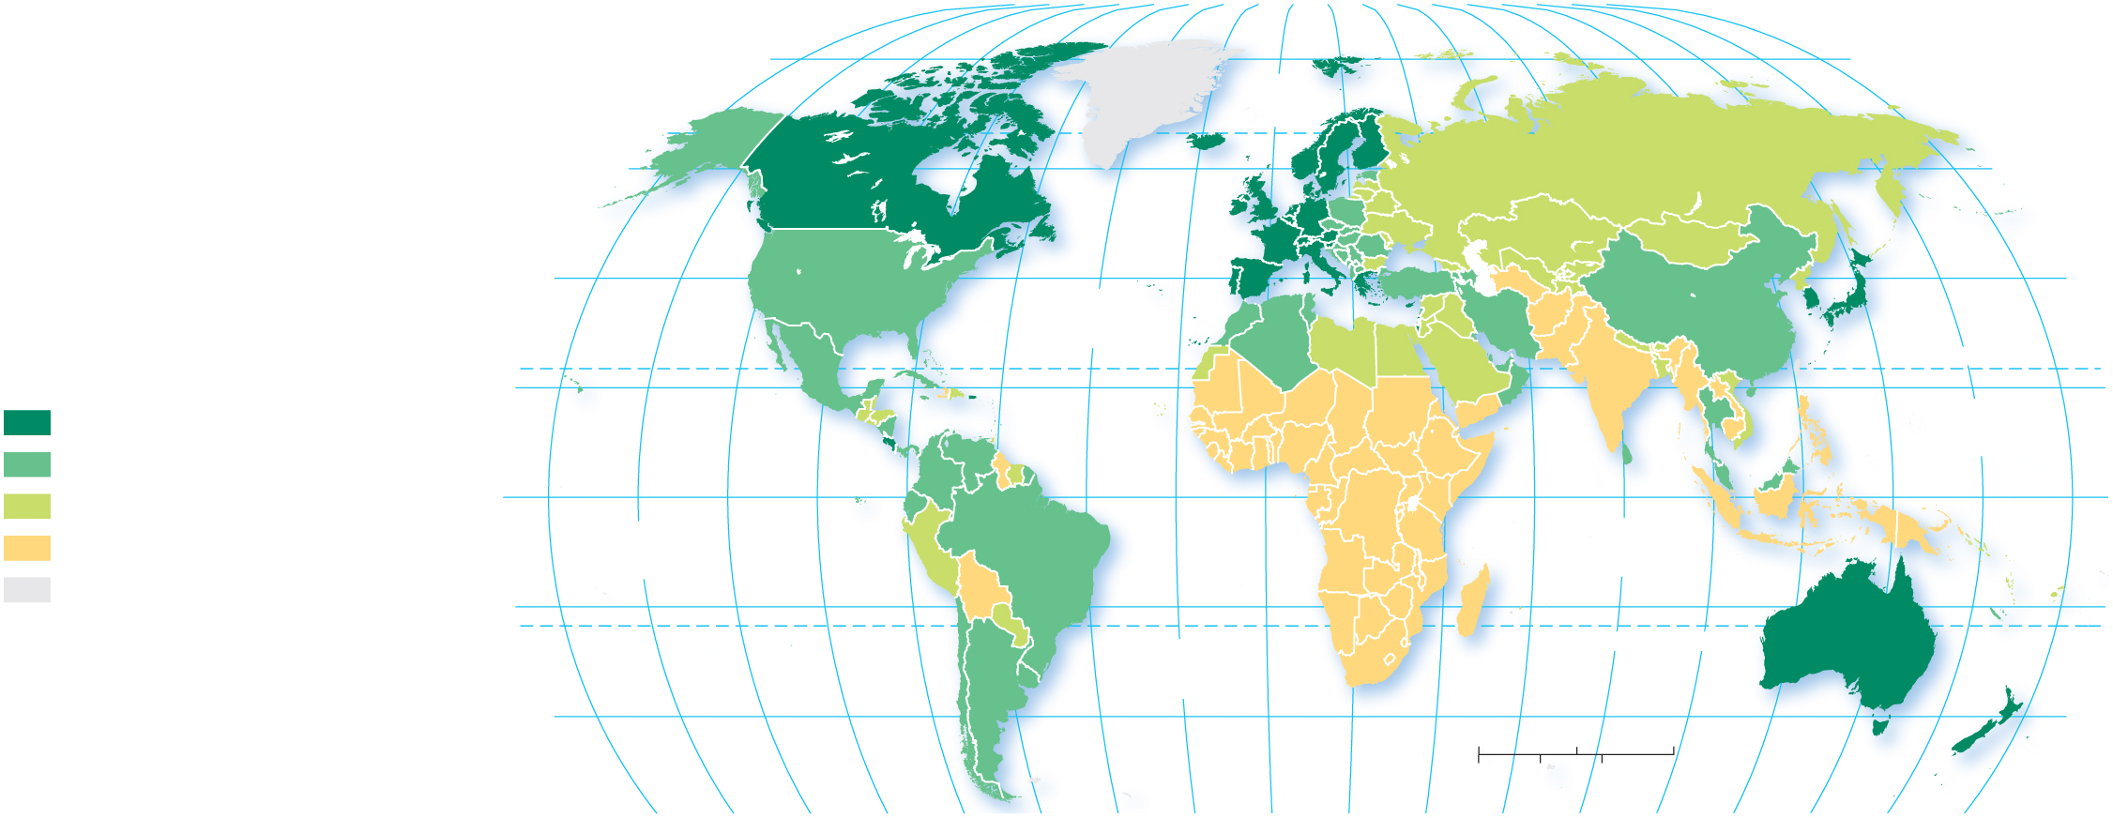
2.3.3 Health and Aging (2 of 8)
Figure 2-37: Worldwide there is more than a 20 year difference between the shortest and longest lived countries.
80°
160°
140°
120°
100°
80°
60°
40°
20°
0°
20°
40°
60°
80°
100°
120°
140°
160°
180°
80°
ARCTIC
OCEAN
60°
60°
40°
ATLANTIC
OCEAN
40°
Life expectancy
at birth in years
TROPIC OF CANCER
80 and above
20°
PACIFIC
OCEAN
20°
75–79
EQUATOR
0°
70–74
0°
PACIFIC
OCEAN
INDIAN
OCEAN
below 70
no data
20°
20°
ATLANTIC
OCEAN
TROPIC OF CAPRICORN
40°
0
1,500
3,000 Miles
40°
0
1,500
3,000 Kilometers
160°
140°
120°
100°
80°
60°
40°
20°
0°
20°
40°
60°
80°
100°
120°
140°
160°
180°

Slide 51
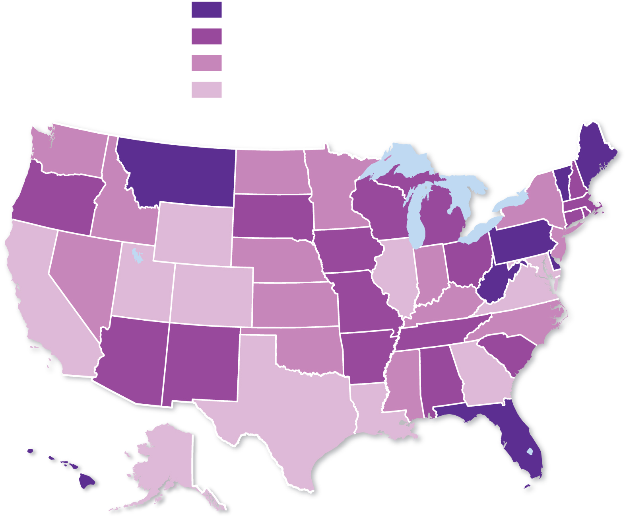
2.3.3 Health and Aging (3 of 8)
Figure 2-38: The United States displays significantly different age structures in different states.
Percent over 65
16 and above
15
14
below 14

Slide 52
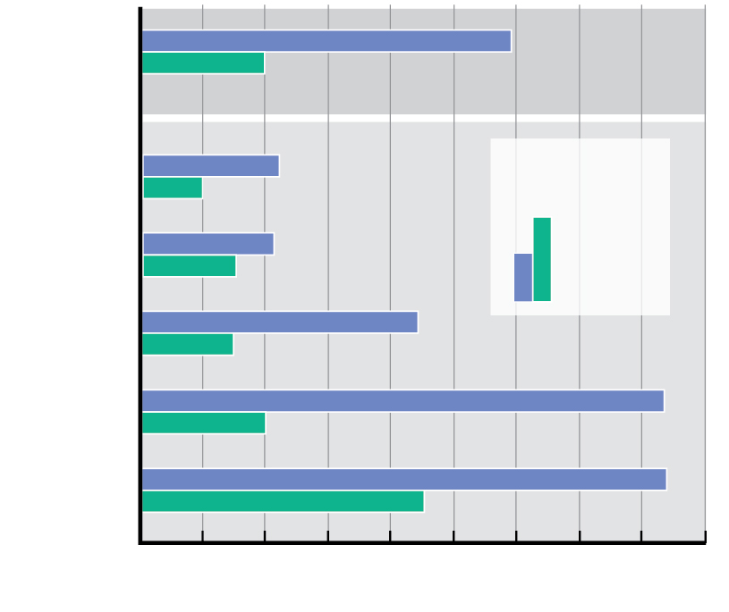
2.3.3 Health and Aging (4 of 8)
Figure 2-39: There are currently nine people working for every elderly person. That number is expected to decline to four people working for every elderly person by 2050.
World
Europe
2017
2050*
North
America
Latin
America
*forecast
Asia
Africa
0
2
4
6
8
10
12
14
16
18
Ages 15 to 64 divided by ages 65 and above

Slide 53
2.3.3 Health and Aging (5 of 8)
The dependency ratio is the number of people who are too young or too old to work compared to the number of people in their productive years
Stage 2 countries have large populations under the age of 15.
Stage 4 have large populations over the age of 65.

Slide 54
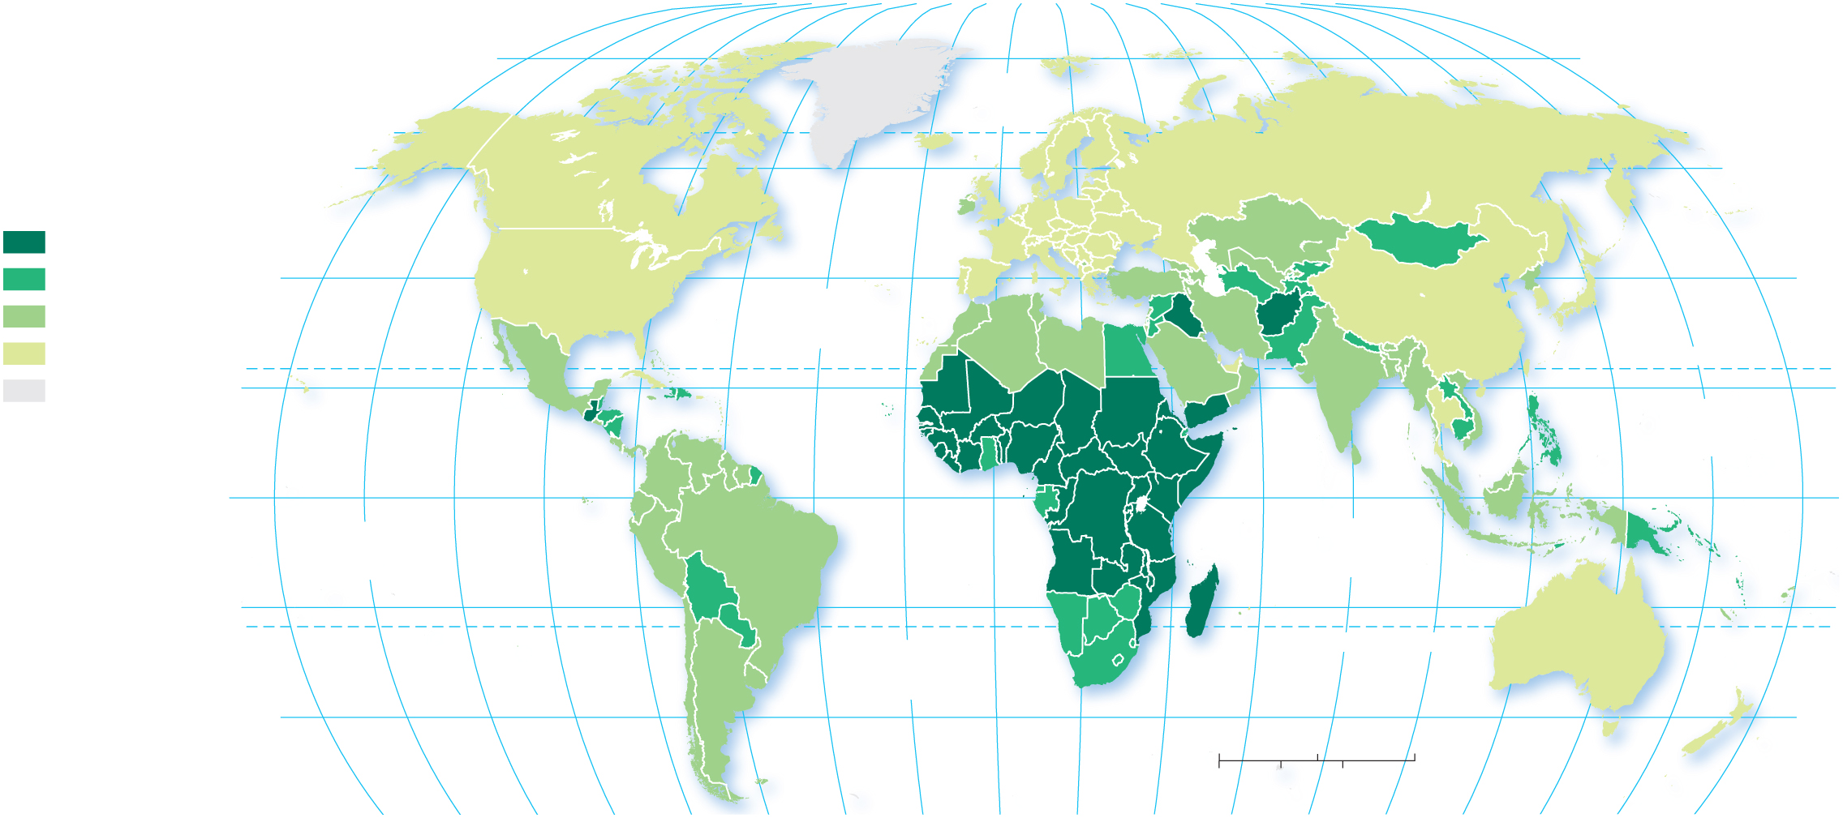
2.3.3 Health and Aging (6 of 8)
Figure 2-40: Sub-Saharan Africa has high percentages of the population under age 15.
160°
140°
120°
100°
80°
60°
40°
20°
0°
20°
40°
60°
80°
100°
120°
140°
160°
180°
80°
ARCTIC
OCEAN
80°
Percent persons
under age 15
60°
60°
40 and above
30–39
40°
ATLANTIC
OCEAN
40°
20–29
below 20
TROPIC OF CANCER
no data
20°
PACIFIC
OCEAN
20°
0°
EQUATOR
0°
PACIFIC
OCEAN
INDIAN
OCEAN
20°
20°
ATLANTIC
OCEAN
TROPIC OF CAPRICORN
40°
0
1,500
3,000 Miles
40°
0
1,500
3,000 Kilometers
160°
140°
120°
100°
80°
60°
40°
20°
0°
20°
40°
60°
80°
100°
120°
140°
160°
180°

Slide 55
2.3.3 Health and Aging (7 of 8)
A population pyramid is a bar graph that displays the percentage of a place’s population for each age and gender
A Stage 2 country will have a population pyramid with a wide base, indicating a young population
A Stage 4 country will have a relatively wide top, indicating a country with a large elderly population

Slide 56
2.3.3 Health and Aging (8 of 8)
Figure 2-41: Population pyramids display a population’s age and sex structure.
(a)
UNITED STATES
(b)
THE GAMBIA
(c)
MEXICO
(d)
DENMARK
Age
Male
Female
Male
Female
100+
Male
Female
Male
Female
95–99
90–94
85–89
80–84
75–79
70–74
65–69
60–64
55–59
50–54
45–49
40–44
35–39
30–34
25–29
20–24
15–19
10–14
5–9
0–4
4
2
0
2
4
10
8
6
4
2
0
2
4
6
8
10
6
4
2
0
2
4
6
4
2
0
2
4
Percent of total population
Percent of total population
Percent of total population
Percent of total population

Slide 57
2.3.4 Epidemiologic Transition (1 of 5)
The epidemiologic transition focuses on distinctive health threats in each stage of the demographic transition:
Stage 1: Pestilence and Famine
Stage 2: Receding Pandemics
Stage 3: Degenerative Diseases
Stage 4: Delayed Degenerative and Lifestyle Diseases

Slide 58
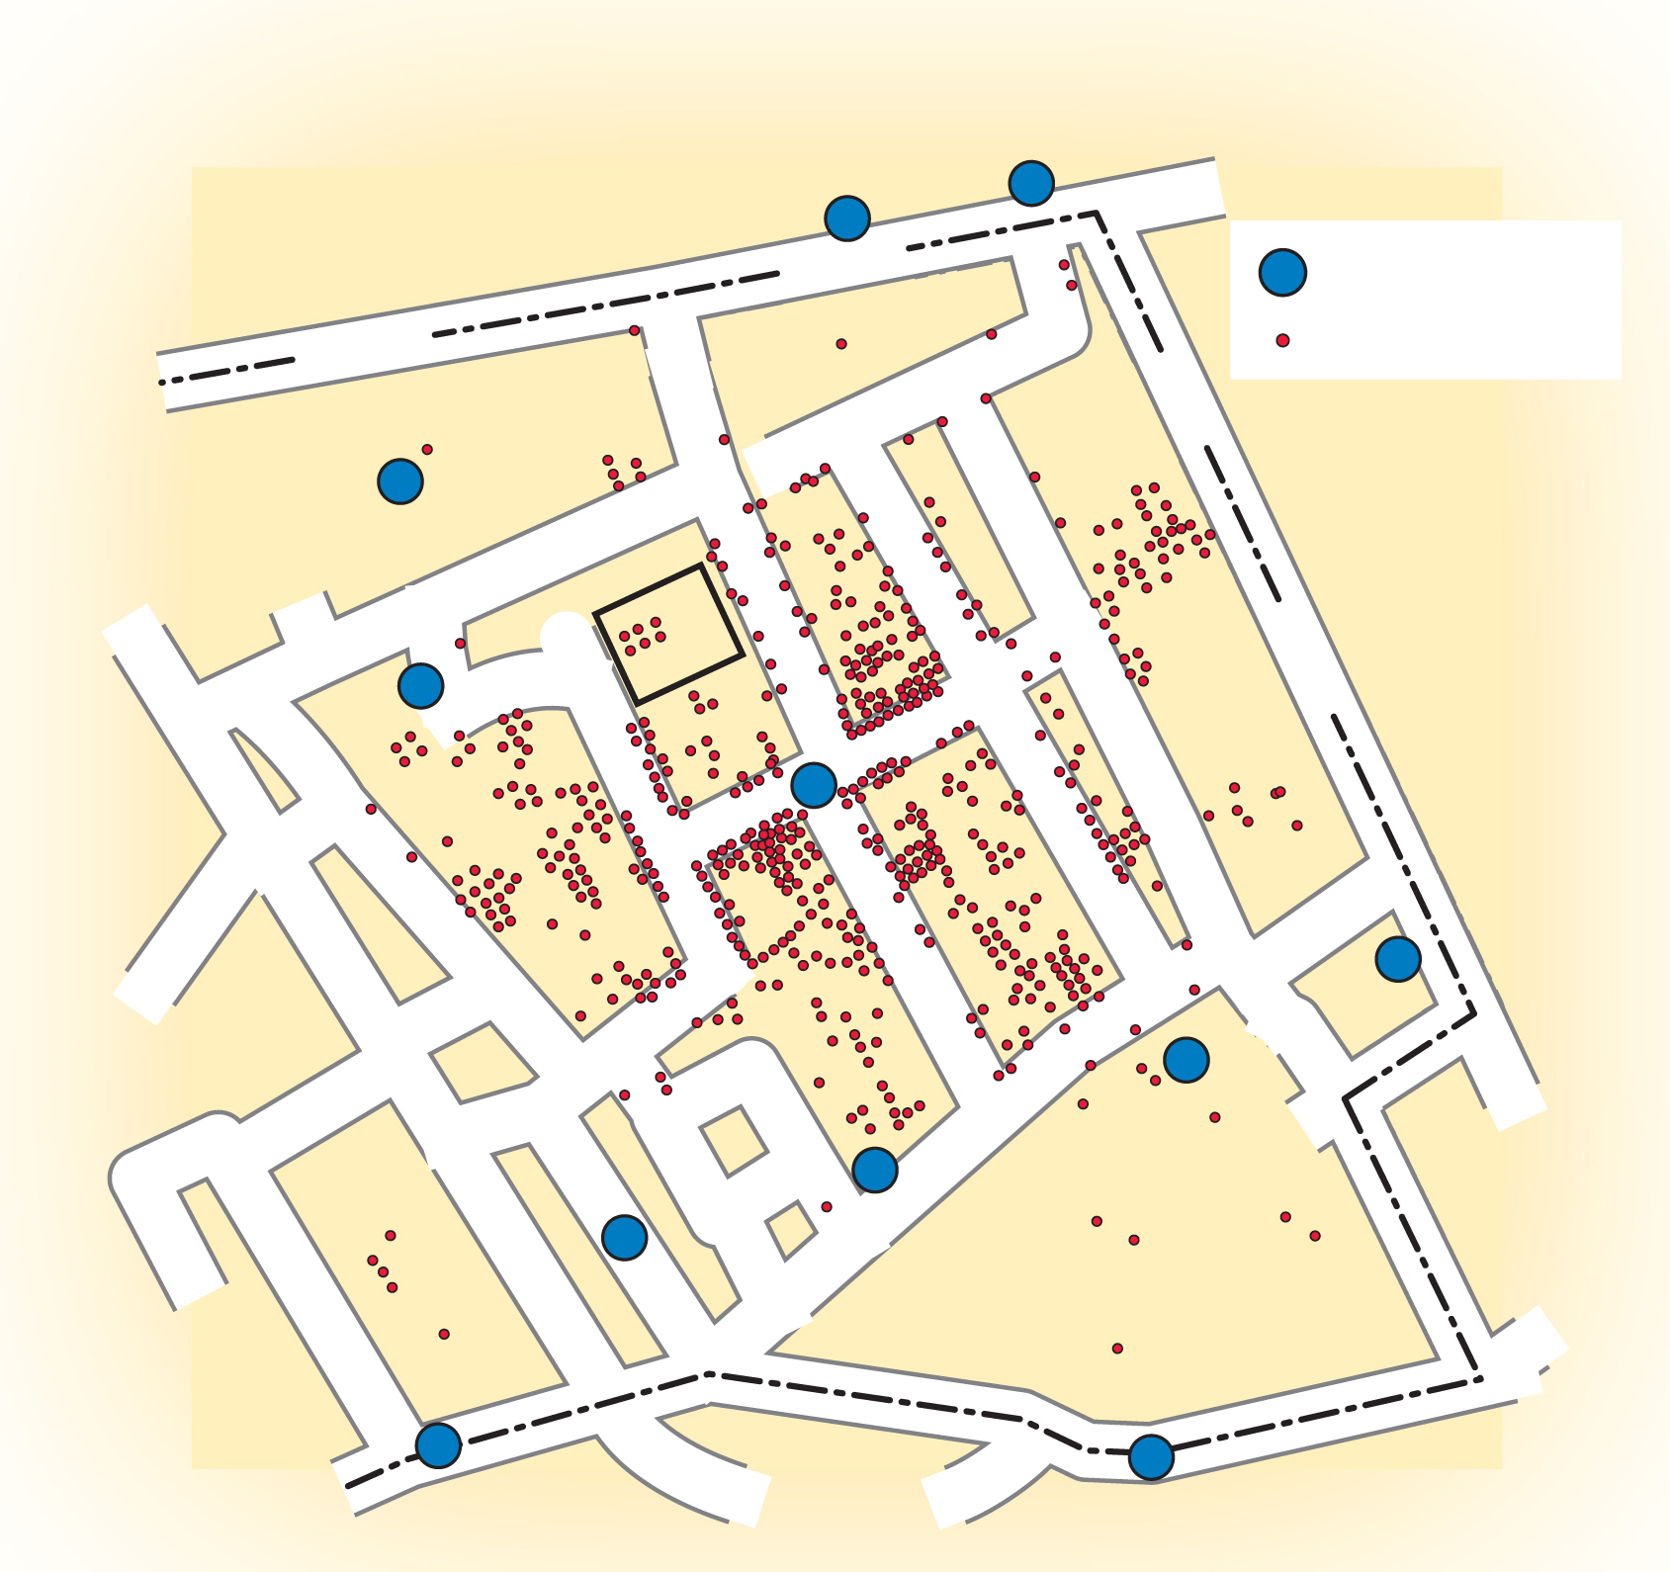
2.3.4 Epidemiologic Transition (2 of 5)
Figure 2-42: The Broad Street pump was identified as the source of the disease.
STREET
Water Pump
OXFORD
Cholera victim
DEAN
GT. MARLBOROUGHSTREET
WARDOUR STREET
STREET
BERWICK STREET
STREET
REGENT
BROAD
KING STREET
LEXINGTON STREET
GOLDEN
SQ.
STREET
WARWICK
BREWER STREET
SAVILLE ROW
STREET

Slide 59
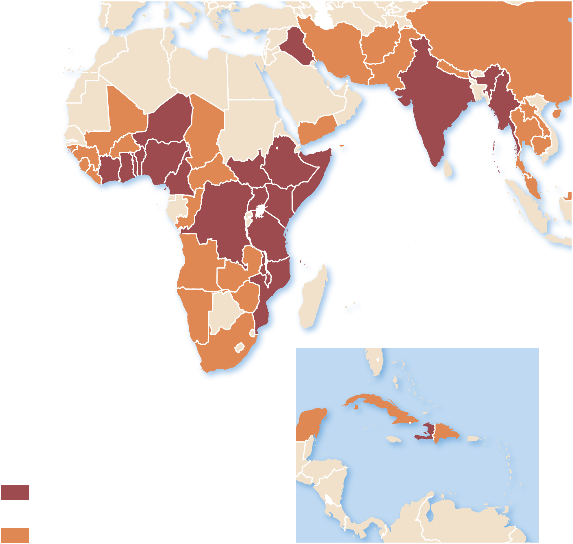
2.3.4 Epidemiologic Transition (3 of 5)
Figure 2-43: Cholera outbreaks have recently occurred in Sub-Saharan Africa, South Asia, and the Caribbean.
(a)
Cholera outbreaks 2010–2015
New and continuing
outbreaks, 2015
Outbreaks, 2010–2014
(b)

Slide 60
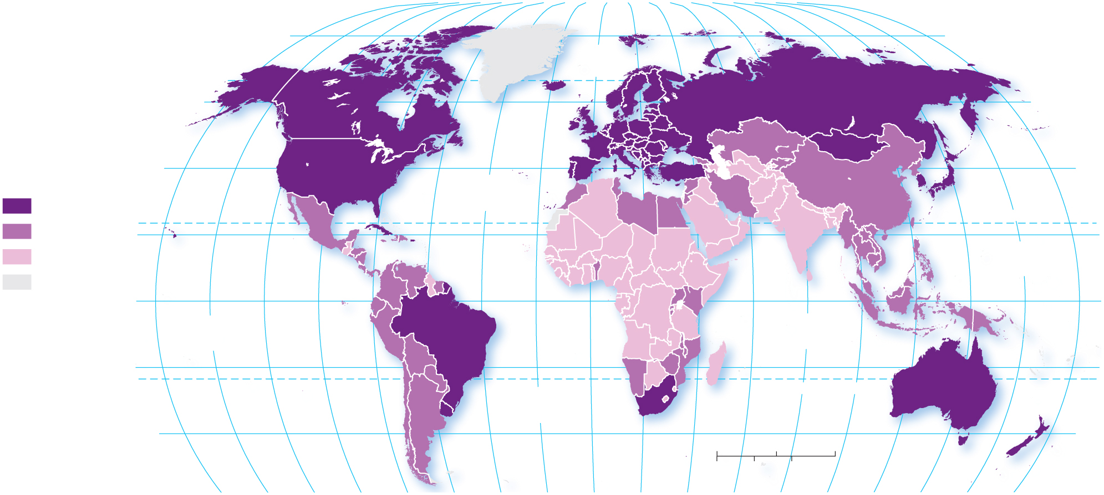
2.3.4 Epidemiologic Transition (4 of 5)
Figure 2-44: Cancer is a more common cause of death in countries that are in stage 3 or later of the demographic transition.
160°
140°
120°
100°
80°
60°
40°
20°
0°
20°
40°
60°
80°
100°
120°
140°
160°
180°
80°
ARCTIC
OCEAN
80°
60°
60°
Male cancer incidence
rate per 100,000
population, 2018
40°
ATLANTIC
OCEAN
40°
240 and above
TROPIC OF CANCER
125–239
20°
20°
below 125
PACIFIC
OCEAN
no data
EQUATOR
0°
0°
PACIFIC
OCEAN
INDIAN
OCEAN
20°
20°
ATLANTIC
OCEAN
TROPIC OF CAPRICORN
40°
0
1,500
3,000 Miles
40°
0
1,500
3,000 Kilometers
160°
140°
120°
100°
80°
60°
40°
20°
0°
20°
40°
60°
80°
100°
120°
140°
160°
180°

Slide 61
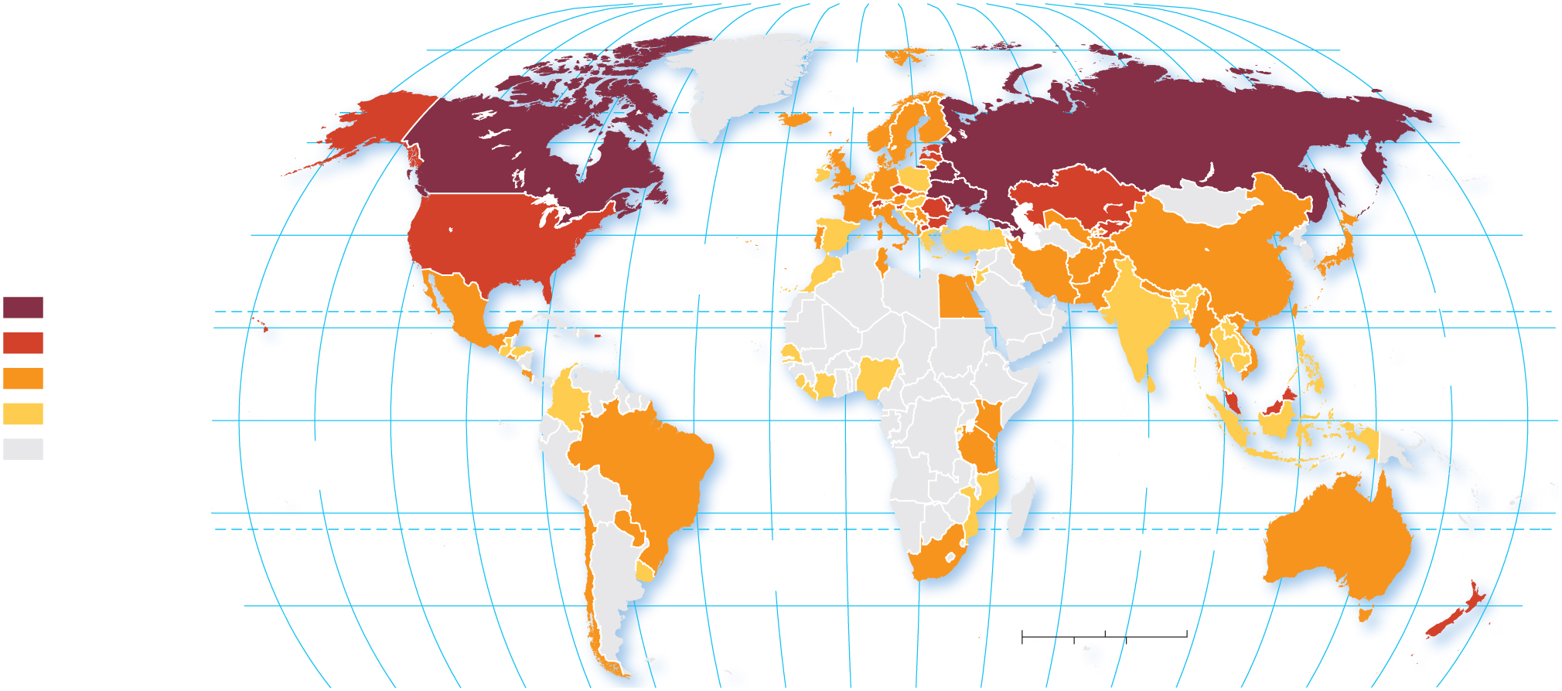
2.3.4 Epidemiologic Transition (5 of 5)
Figure 2-45: Opioid addiction-related deaths occur almost exclusively in countries that are in stage 4 of the demographic transition.
160°
140°
120°
100°
80°
60°
40°
20°
0°
20°
40°
60°
80°
100°
120°
140°
160°
180°
80°
ARCTIC
OCEAN
80°
60°
60°
Percentage using
injecting drugs
40°
ATLANTIC
OCEAN
40°
above 1.00
TROPIC OF CANCER
0.50–0.99
20°
PACIFIC
OCEAN
20°
0.10–0.49
below 0.10
0°
EQUATOR
0°
no data
PACIFIC
OCEAN
INDIAN
OCEAN
20°
20°
ATLANTIC
OCEAN
TROPIC OF CAPRICORN
40°
0
1,500
3,000 Miles
40°
0
1,500
3,000 Kilometers
160°
140°
120°
100°
80°
60°
40°
20°
0°
20°
40°
60°
80°
100°
120°
140°
160°
180°

Slide 62
Key Issue 4: Why Might Population Change in the Future?
2.4.1 Population Futures
2.4.2 Family Futures
2.4.3 Epidemiologic Futures
2.4.4 Population and Resources

Slide 63
2.4.1 Population Futures (1 of 6)
Demographers predict a possible Stage 5 of the demographic transition for some developed countries. This will entail the following:
very low C B R
increasing C D R
declining N I R

Slide 64
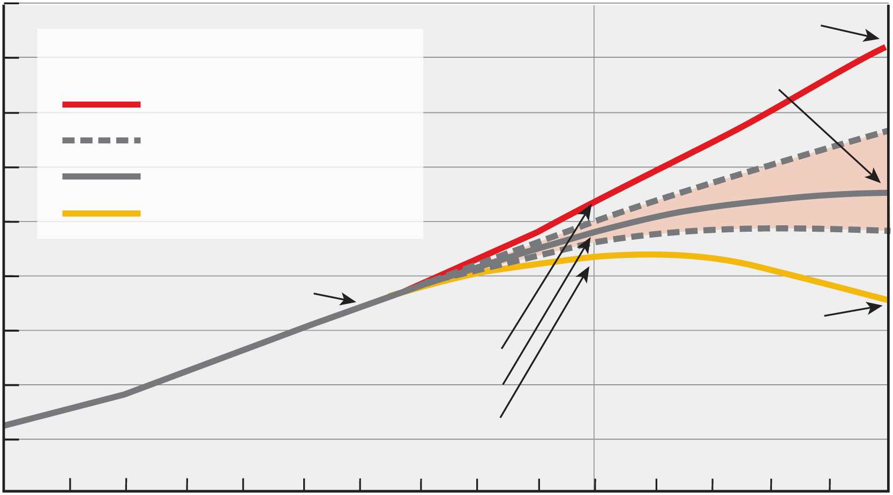
2.4.1 Population Futures (2 of 6)
Figure 2-46: Projections are based on three possible future world TFRs.
18
16.2 billion
16
Fertility assumption
High, + 0.5 child
11.2 billion
14
95% prediction interval
12
Median
10
Low, - 0.5 child
Population (billions)
8
7 billion
6
7.2 billion
10.6 billion
4
9.3 billion
8.1 billion
2
1960
1980
2000
2020
2040
2060
2080
2100
Year

Slide 65
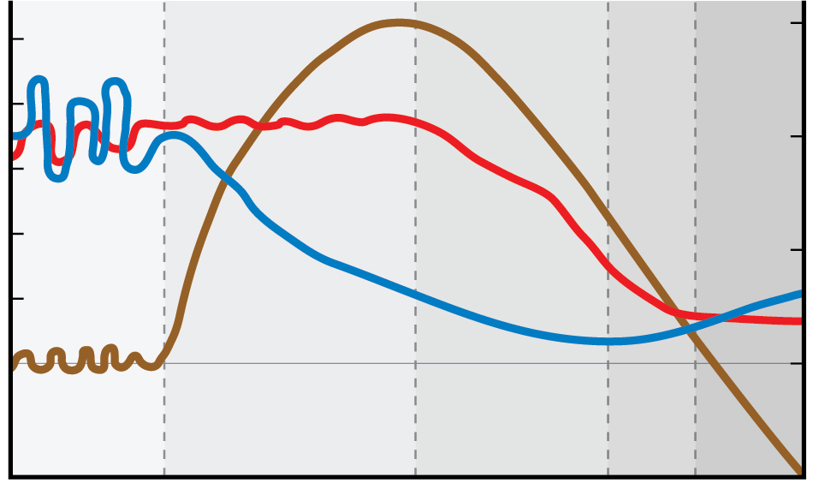
2.4.1 Population Futures (3 of 6)
Figure 2-47: The fifth stage of the demographic transition will feature a negative NIR.
Stage 1
Stage 2
Stage 3
Stage 4
Stage 5
50
3
40
Natural increase
Birth
5
30
Birth and death rates (per 1,000)
20
Natural increase rate (%)
1
10
Death
0
0
–1
Low growth
High growth
Decreasing
growth
Low
growth
Decline

Slide 66
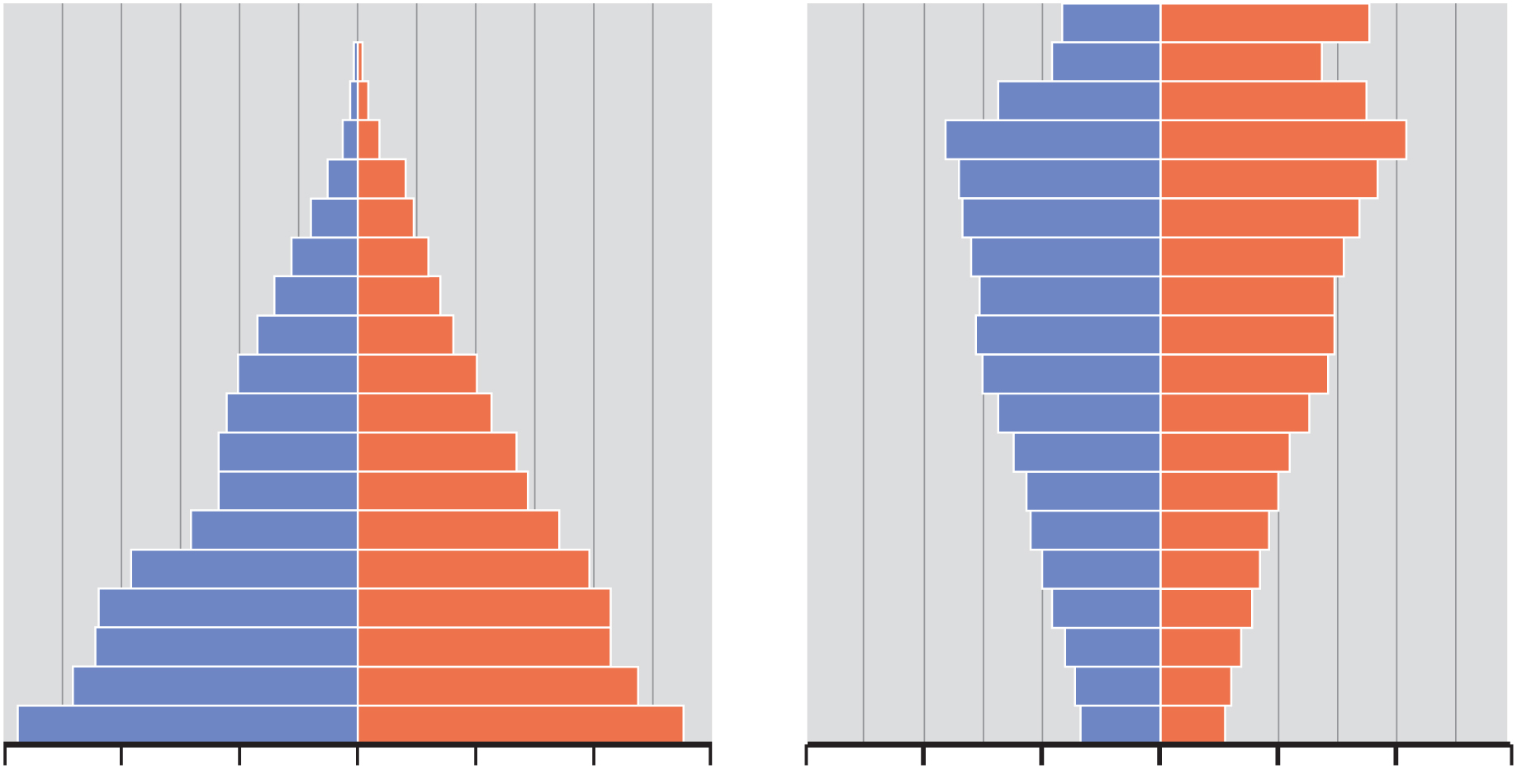
2.4.1 Population Futures (4 of 6)
Figure 2-48: Japan faces a population structure with many older people and few of working age.
1950
Age
2050
(projected)
90+
85–89
80–84
75–79
70–74
65–69
60–64
55–59
50–54
Male
Female
45–49
Male
Female
40–44
35–39
30–34
25–29
20–24
15–19
10–14
5–9
0–4
6
4
2
0
2
4
6
6
4
2
0
2
4
6
Percent of total population

Slide 67
2.4.1 Population Futures (5 of 6)
A pronatalist policy is a government policy that supports higher birth rates (e.g., China, India)
An antinatalist policy is a government policy that supports lower birth rates (e.g., Japan)

Slide 68
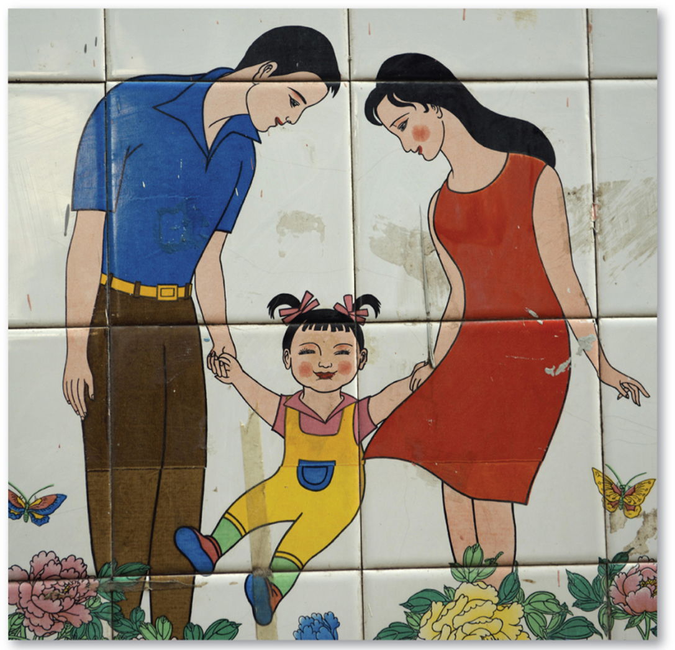
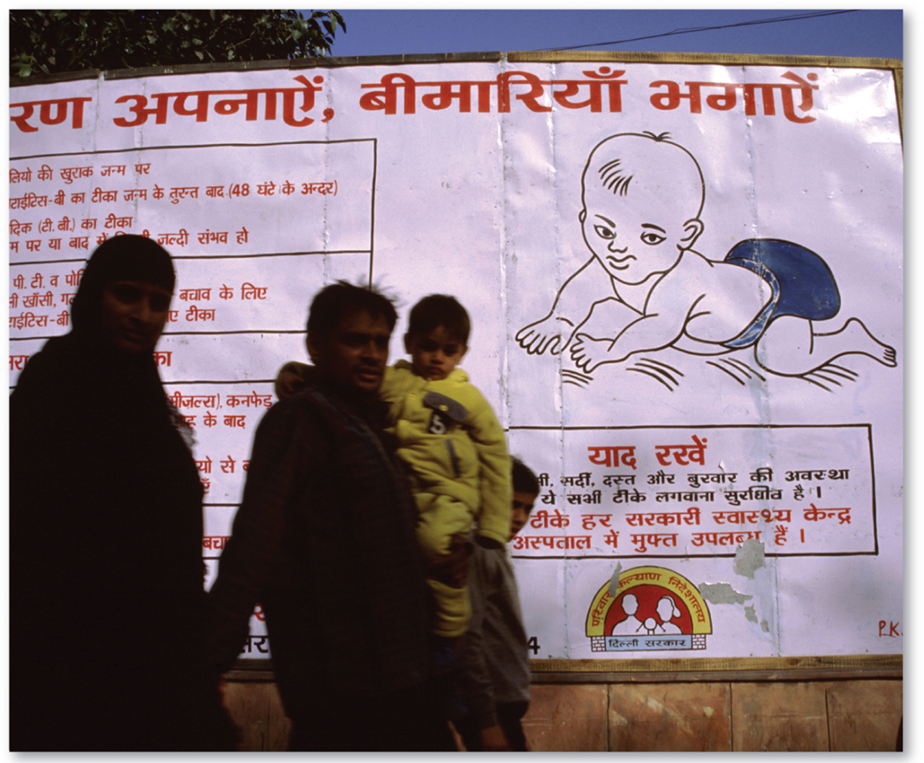
2.4.1 Population Futures (6 of 6)
Figure 2-49: Chinese and Indian family planning wall art.
Figure 2-50: Chinese and Indian family planning wall art.

Slide 69
2.4.2 Family Futures (1 of 5)
What causes C B R to decrease?
Education and health care: women empowered; higher investment in each child
Contraception: not always available; supply can help decrease C B R

Slide 70
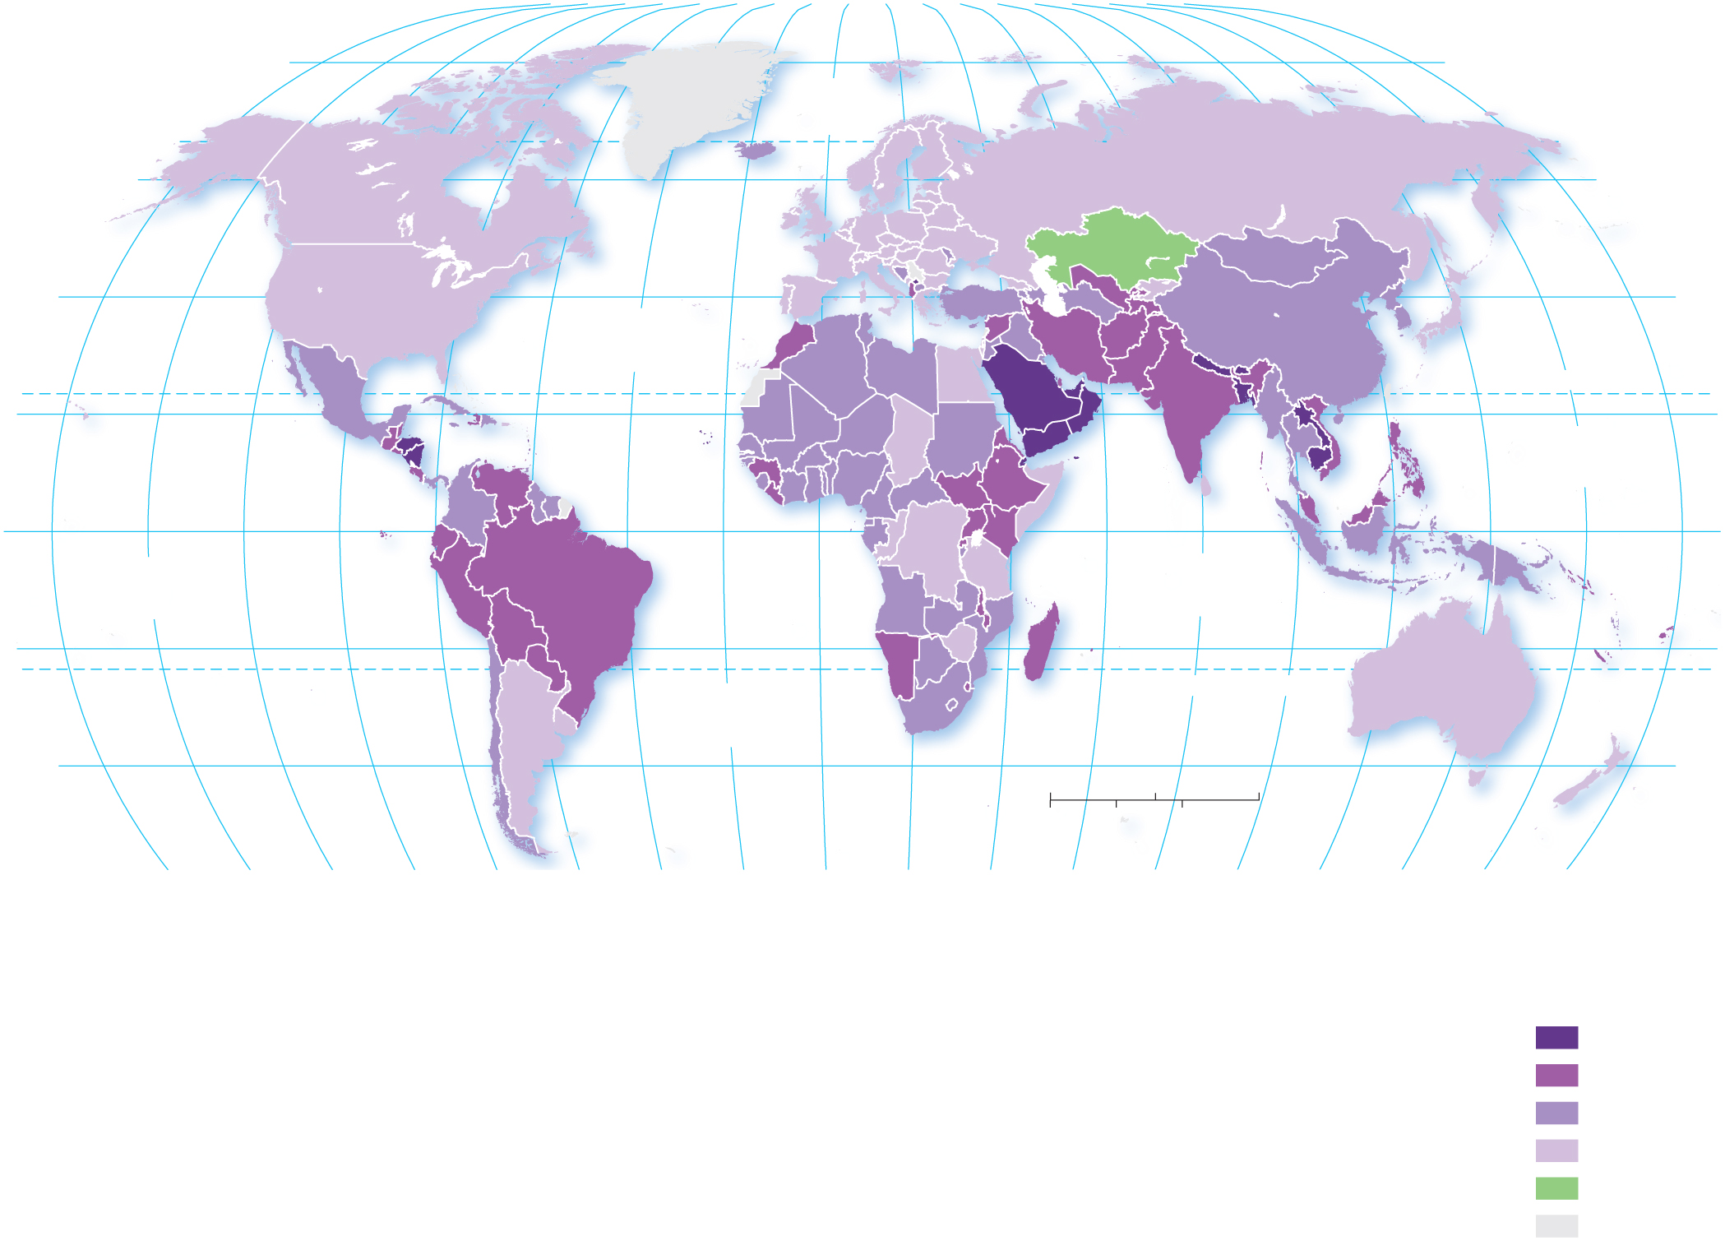
2.4.2 Family Futures (2 of 5)
Figure 2-51: CBRs have declined around the world with few exceptions.
80°
160°
140°
120°
100°
80°
60°
40°
20°
0°
20°
40°
60°
80°
100°
120°
140°
160°
180°
80°
ARCTIC
OCEAN
60°
60°
40°
ATLANTIC
OCEAN
40°
20°
TROPIC OF CANCER
20°
PACIFIC
OCEAN
0°
EQUATOR
0°
PACIFIC
OCEAN
INDIAN
OCEAN
20°
TROPIC OF CAPRICORN
20°
ATLANTIC
OCEAN
40°
0
1,500
3,000 Miles
40°
0
1,500
3,000 Kilometers
160°
140°
120°
100°
80°
60°
40°
20°
0°
20°
40°
60°
80°
100°
120°
140°
160°
180°
Crude birth rate decline
per 1,000 population,
1990–2018
15 and above
10–14.9
5–9.9
0–4.9
increase
no data

Slide 71
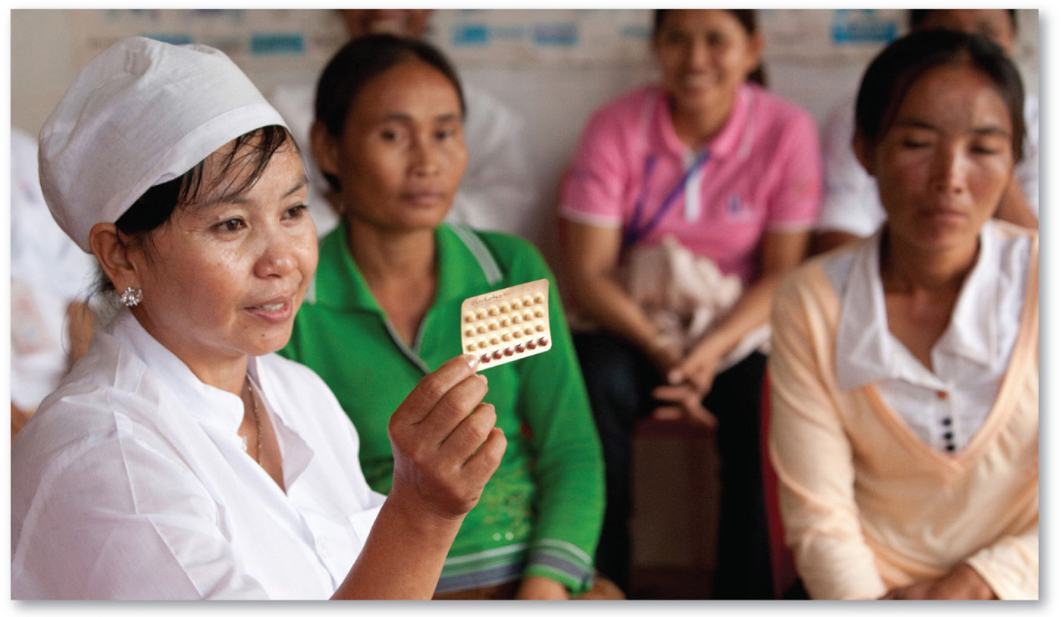
2.4.2 Family Futures (3 of 5)
Figure 2-52: Women talk about birth control at a reproductive health clinic in Kampong Cham, Cambodia.

Slide 72
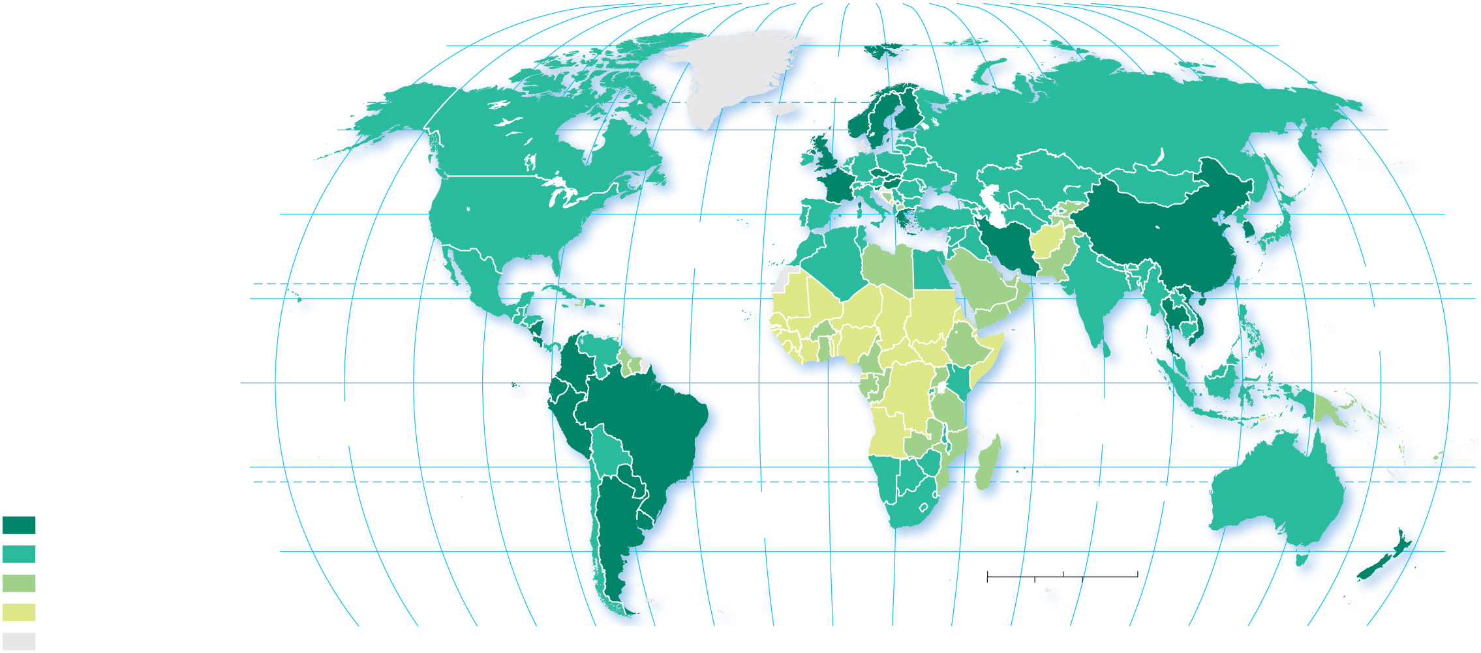
2.4.2 Family Futures (4 of 5)
Figure 2-53: The lowest rates of family planning correlate with the highest NIR, CBR, and TFR.
160°
140°
120°
100°
80°
60°
40°
20°
0°
20°
40°
60°
80°
100°
120°
140°
160°
180°
80°
ARCTIC
OCEAN
80°
60°
60°
40°
ATLANTIC
OCEAN
40°
20°
TROPIC OF CANCER
20°
PACIFIC
OCEAN
0°
EQUATOR
0°
PACIFIC
OCEAN
INDIAN
OCEAN
Percent of
women using
family planning
20°
20°
ATLANTIC
OCEAN
TROPIC OF CAPRICORN
75 and above
50–74
40°
0
1,500
3,000 Miles
40°
25–49
0
1,500
3,000 Kilometers
below 25
160°
140°
120°
100°
80°
60°
40°
20°
0°
20°
40°
60°
80°
100°
120°
140°
160°
180°
no data

Slide 73
2.4.2 Family Futures (5 of 5)
Figure 2-54: Preferred methods of family planning vary from place to place.
1.8%
1.1%
2.1%
0.3%
Family Planning Method
6.7%
3.2%
Pill
8%
9.3%
5.9%
0.4%
IUD
33.8%
0.5%
Condom
37.2%
0.2%
Female sterilization
1.2%
4.3%
Male sterilization
0.6%
Abstinence and withdrawal
7.3%
Injectable
0.5%
50.3%
85.1%
Implant
0.8%
Vaginal barrier
0.7%
5.9%
Not using a method
4.7%
8.3%
6.2%
2.4%
(a) GERMANY
(b) CHINA
(c) NIGERIA

Slide 74
2.4.3 Epidemiologic Futures (1 of 5)
Stage 5 of epidemiologic transition: infections and parasitic diseases re-emerge
Evolution: antibiotic resistance
Poverty: lack access to medicine
Connections: globalization helps transmission

Slide 75
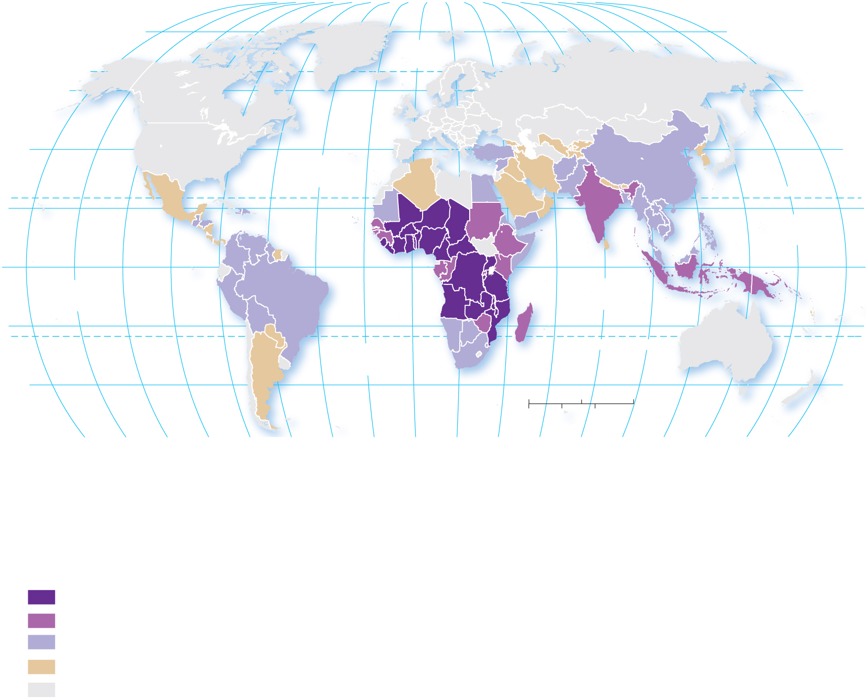
2.4.3 Epidemiologic Futures (2 of 5)
Figure 2-55: Malaria is found primarily in tropical regions of developing countries and has become more drug-resistant.
160°
140°
120°
100°
80°
60°
40°
20°
0°
20°
40°
60°
100°
120°
140°
160°
80°
80°
180°
80°
ARCTIC
OCEAN
60°
60°
40°
ATLANTIC
OCEAN
40°
20°
TROPIC OF CANCER
20°
PACIFIC
OCEAN
0°
INDIAN
OCEAN
EQUATOR
0°
PACIFIC
OCEAN
20°
ATLANTIC
OCEAN
TROPIC OF CAPRICORN
20°
40°
0
1,500
3,000 Miles
40°
0
1,500
3,000 Kilometers
160°
140°
120°
100°
80°
60°
40°
20°
0°
20°
40°
60°
80°
100°
120°
140°
160°
180°
Number of deaths due to malaria
1,000 and above
100–999
1–99
none reported
no data

Slide 76
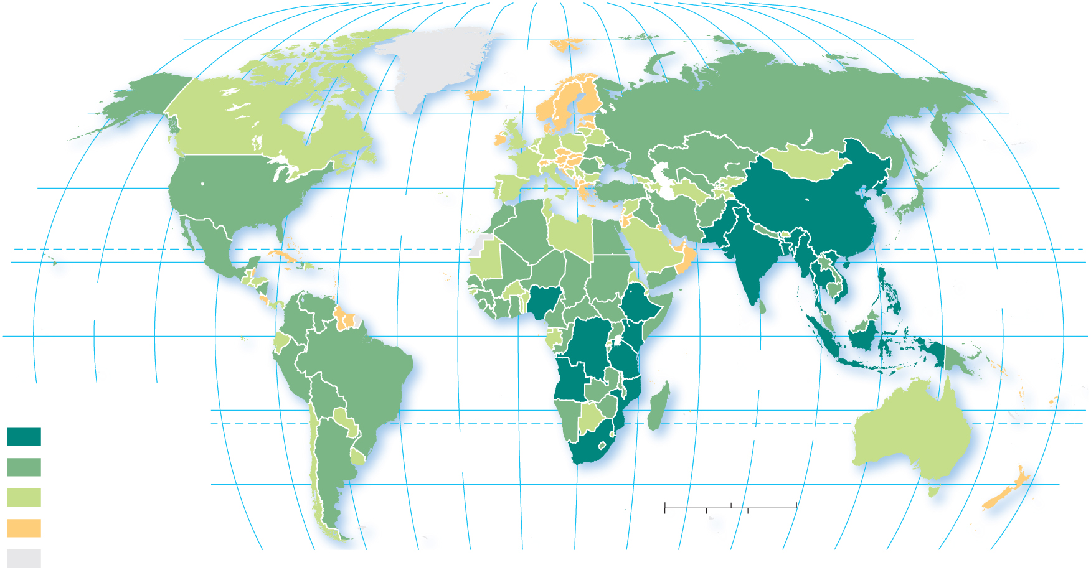
2.4.3 Epidemiologic Futures (3 of 5)
Figure 2-56: Tuberculosis is expensive to treat, so deaths are concentrated in the world’s poorer regions.
160°
140°
120°
100°
80°
60°
40°
20°
0°
20°
40°
60°
80°
100°
120°
140°
160°
180°
80°
ARCTIC
OCEAN
80°
60°
60°
40°
ATLANTIC
OCEAN
40°
TROPIC OF CANCER
20°
PACIFIC
OCEAN
20°
PACIFIC
OCEAN
0°
EQUATOR
0°
160°
140°
120°
INDIAN
OCEAN
Number of cases of TB
20°
20°
100,000 and above
ATLANTIC
OCEAN
TROPIC OF CAPRICORN
10,000–99,999
40°
40°
1,000–9,999
0
1,500
3,000 Miles
below 1,000
0
1,500
3,000 Kilometers
no data
100°
80°
60°
40°
20°
0°
20°
40°
60°
80°
100°
120°
140°
160°
180°

Slide 77
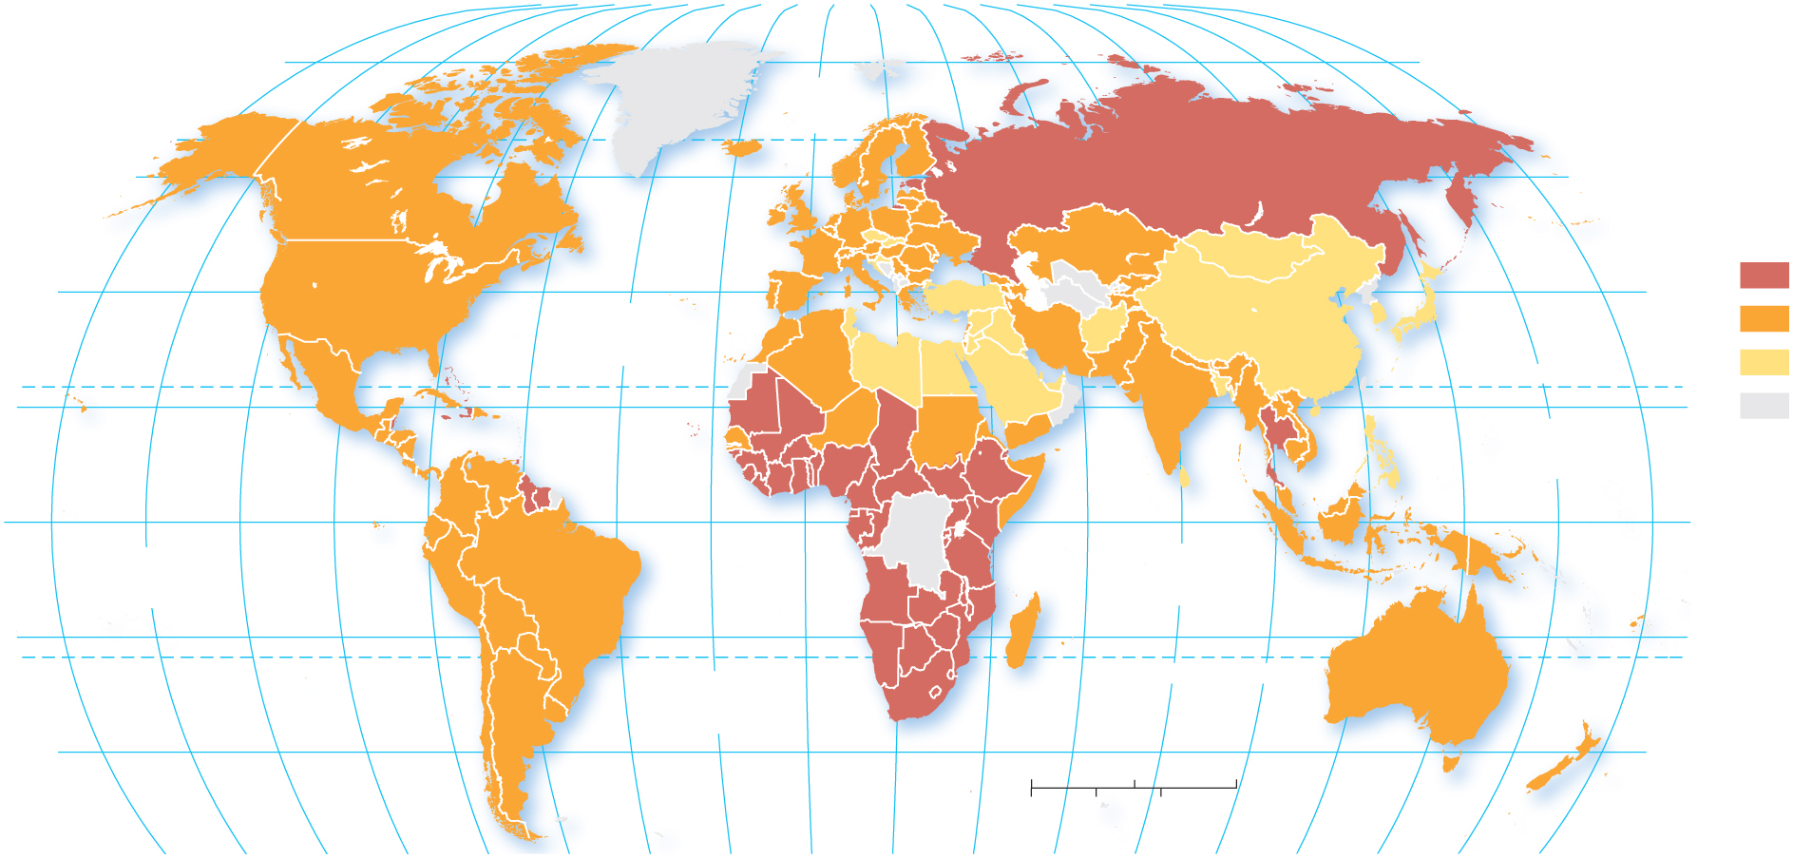
2.4.3 Epidemiologic Futures (4 of 5)
Figure 2-57: HIV has diffused around the world through people moving and traveling.
160°
140°
120°
80°
20°
60°
100°
120°
140°
160°
80°
100°
60°
40°
0°
20°
40°
80°
180°
80°
ARCTIC
OCEAN
60°
60°
Percent HIV–positive,
ages 15–49 years
40°
40°
1.0 and above
ATLANTIC
OCEAN
0.1–0.9
TROPIC OF CANCER
below 0.1
20°
PACIFIC
OCEAN
20°
no data
0°
EQUATOR
0°
PACIFIC
OCEAN
INDIAN
OCEAN
20°
20°
ATLANTIC
OCEAN
TROPIC OF CAPRICORN
40°
0
1,500
3,000 Miles
40°
0
1,500
3,000 Kilometers
160°
140°
120°
100°
80°
60°
40°
20°
0°
20°
40°
60°
80°
100°
120°
140°
160°
180°

Slide 78
2.4.3 Epidemiologic Futures (5 of 5)
Figure 2-58: HIV diffused through the United States through major international connections such as airports
(a)
(b)
Boston
Boston
5.84
Detroit
New
York
New York
43.06
Chicago
Washington
San Francisco
11.83
Chicago
11.92
Washington
7.12
San Francisco
Las Vegas
Atlanta
11.19
Los Angeles
Atlanta
Los Angeles
22.18
Dallas-Fort Worth
7.82
San
Diego
Dallas
Houston
Houston
10.78
Ft. Lauderdale
5.64
Honolulu
Orlando
Honolulu
5.08
Orlando
5.42
Miami
Miami
19.69
International arrivals
in millions, 2016
Cumulative AIDS diagnoses, 1981–2015
100,000 and above
1,000–9,999
50,000–99,999
below 1,000
10,000–49,999

Slide 79
2.4.4 Population and Resources (1 of 4)
Malthus 1798: Population will exceed food supply. Malthus argued that food production would increase arithmetically (e.g., 1,2,3,4,5), but population would grow geometrically (e.g., 1,2,4,8,16)
Neo-Malthusians today: Population will ultimately exceed food or another resource (and already has in selected regions of the developing world)

Slide 80
2.4.4 Population and Resources (2 of 4)
Figure 2-59: Malthus predicted population would grow faster than the resource of food.
16
14
Population
Resources
12
10
8
Population and resources (units)
6
4
2
0
2000
2025
2050
2075
2100
Year

Slide 81
2.4.4 Population and Resources (3 of 4)
Figure 2-60: China’s food production has outpaced population growth, while African food production is barely enough to outpace population growth.
140
Production Index
120
Production per capita
Population
100
80
Production
60
40
20
0
1960
1965
1970
1975
1980
1985
1990
1995
2000
2005
2010
2015

Slide 82
2.4.4 Population and Resources (4 of 4)
Figure 2-61: China’s food production has outpaced population growth, while African food production is barely enough to outpace population growth.
140
Production Index
120
Production per capita
Population
100
80
Production
60
40
20
0
1960
1965
1970
1975
1980
1985
1990
1995
2000
2005
2010
2015

Slide 83
Copyright
This work is protected by United States copyright laws and is provided solely for the use of instructors in teaching their courses and assessing student learning. Dissemination or sale of any part of this work (including on the World Wide Web) will destroy the integrity of the work and is not permitted. The work and materials from it should never be made available to students except by instructors using the accompanying text in their classes. All recipients of this work are expected to abide by these restrictions and to honor the intended pedagogical purposes and the needs of other instructors who rely on these materials.

