Slide 1
The Cultural Landscape: An Introduction to Human Geography
Thirteenth Edition
Chapter 12 Lecture
Services & Settlements
Copyright © 2020 Pearson Education, Inc. All Rights Reserved
Notes:
If this PowerPoint presentation contains mathematical equations, you may need to check that your computer has the following installed:
1) MathType Plugin
2) Math Player (free versions available)
3) NVDA Reader (free versions available)

Slide 2
Services and Settlements: Key Issues
12.1 Where Are Services Distributed?
12.2 Where Are Consumer Services Distributed?
12.3 Where are Business Services Distributed?
12.4 Why Do Services Cluster in Settlements?

Slide 3
Key Issue 1: Where Are Languages Distributed?
12.1.1 Services, Settlements, and Geography

Slide 4
12.1.1 Services, Settlements, and Geography (1 of 5)
A service is any activity that fulfills a human want or need and returns money to those who provide it. The three types of services are consumer, business, and public
consumer services provide services to individual consumers (e.g., hairdresser)
business services facilitate the activities of other businesses (e.g., transportation, I T)
public services provide security and protection for citizens and businesses (e.g., federal employees)

Slide 5
12.1.1 Services, Settlements, and Geography (2 of 5)
A settlement is a permanent collection of buildings where people reside, work, and obtain services. Services cluster in settlements, especially in developed countries
The developed world has seen a shift away from primary sector employment (agriculture, mining) and secondary sector employment (manufacturing) into tertiary sector employment (services)

Slide 6
12.1.1 Services, Settlements, and Geography (3 of 5)
Figure 12-1: Approximately one-half of jobs in the United States are in consumer services and one-fourth in business services. The remainder are in public services, manufacturing, and agriculture.
Percent of
all U.S. jobs
SERVICES
CONSUMER SERVICES
14.6%
Retail and Wholesale
Department stores, grocers, and motor vehicle sales and service account
for nearly one-half of this sector. Another one-fourth are wholesalers that
provide merchandise to retailers.
13.1%
Health and Social Services
One-third are in hospitals, one-half in other health-care services, such
as doctors’ offices and nursing homes, and one-sixth in social assistance.
9.4%
Education Services
This figure includes educators at both public and private schools.
10.7%
Leisure and Hospitality Services
Three-fourths of these jobs are in restaurants, bars, and lodging;
the other one-fourth are in the arts and entertainment.
3.9%
Other Consumer Services
BUSINESS SERVICES
Professional Services
13.9%
Technical services, including law, management, accounting, architecture, engineering, design, and consulting, comprise 60 percent of professional service jobs. Support services, such as clerical, secretarial, and custodial work, account for the other 40 percent.
Transportation and Information Services
5.6%
Transportation, primarily trucking and warehousing, account for 60 percent of these jobs. The other 40 percent are in information services such as publishing and broadcasting as well as utilities such as water
and electricity.
5.7%
Financial Services
This sector is often called “FIRE,” an acronym for finance, insurance,
and real estate. One-half of the financial services jobs are in banks
and other financial institutions, one-third in insurance companies,
and the remainder in real estate.
8.0%
PUBLIC SERVICES
13.0%
MANUFACTURING AND CONSTRUCTION
2.0%
AGRICULTURE AND MINING

Slide 7
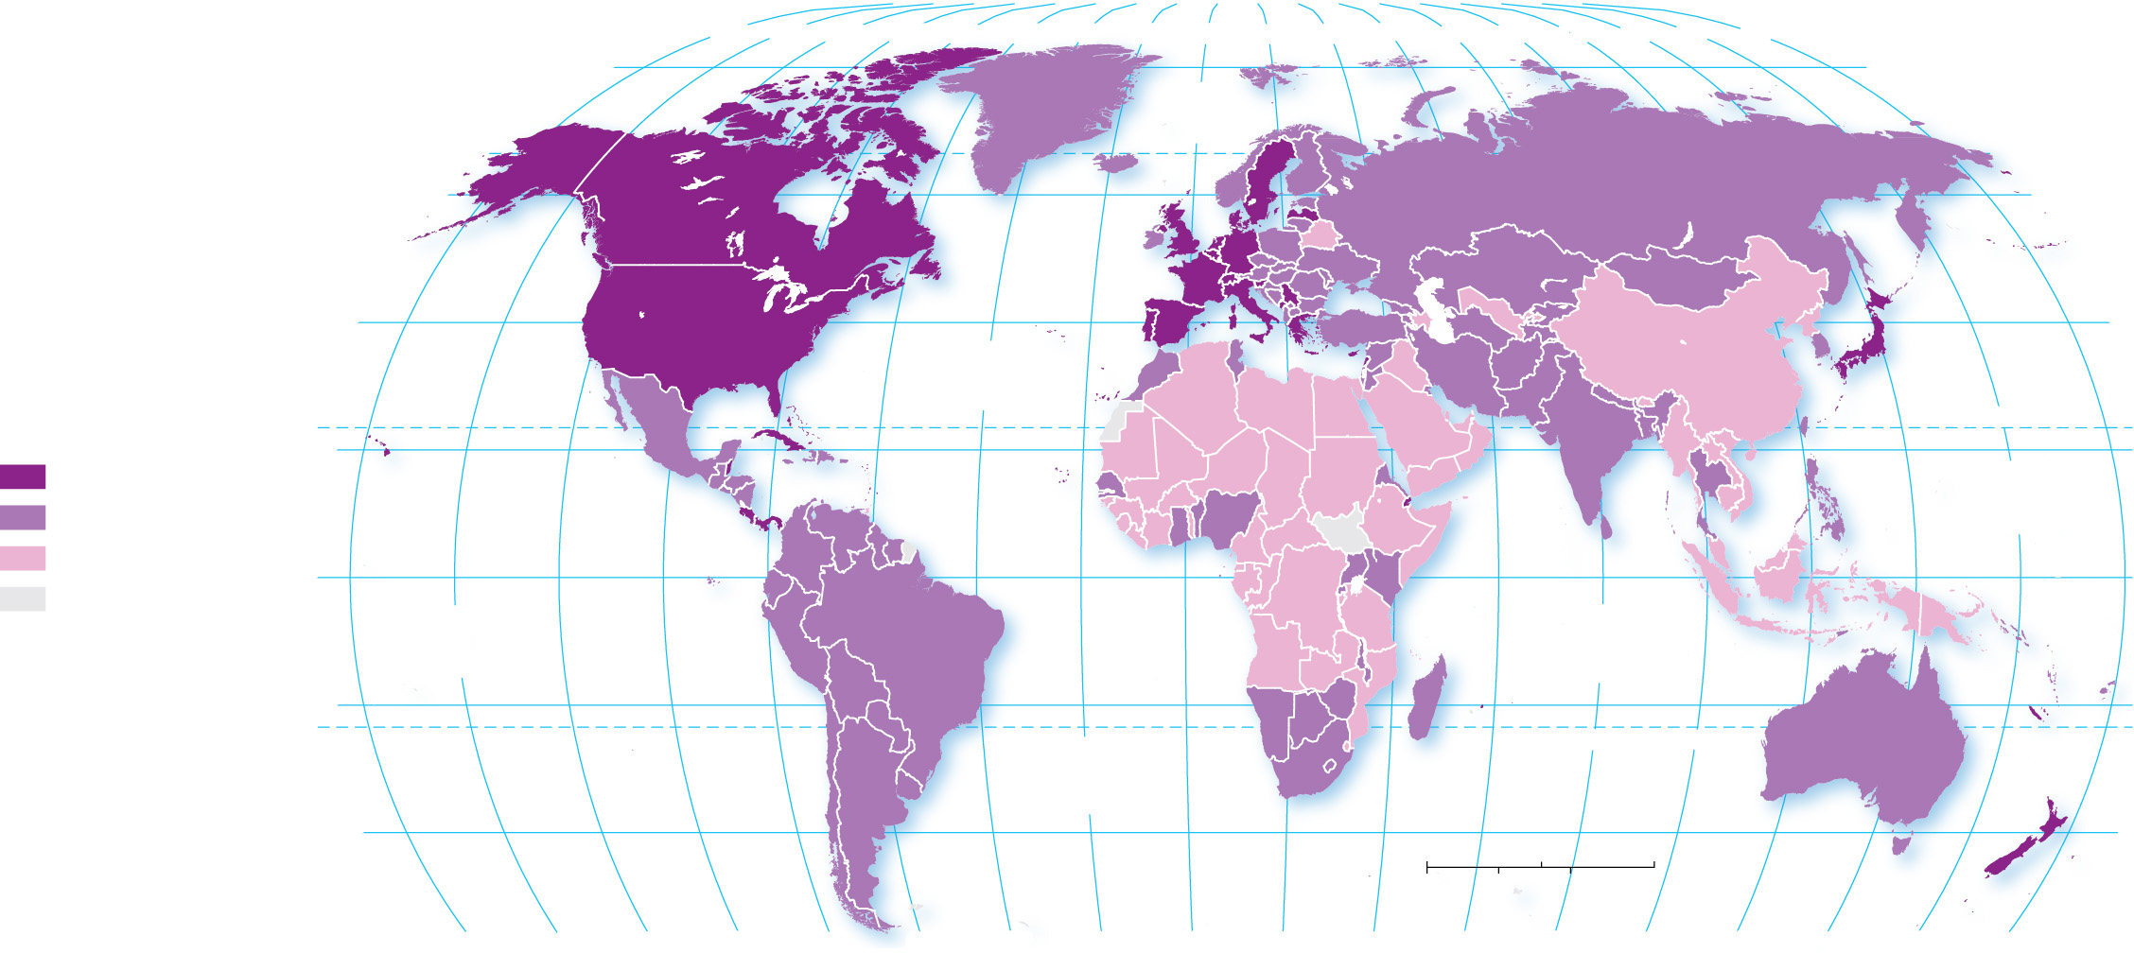
12.1.1 Services, Settlements, and Geography (4 of 5)
Figure 12-2: Services are the major contributor to G D P in developed countries.
80°
160°
140°
120°
100°
80°
60°
40°
20°
0°
20°
40°
60°
80°
100°
120°
140°
160°
180°
80°
ARCTIC
OCEAN
60°
60°
40°
ATLANTIC
OCEAN
40°
Percent GDP
from services
TROPIC OF CANCER
70 and above
20°
PACIFIC
OCEAN
20°
50–69
below 50
0°
EQUATOR
0°
no data
PACIFIC
OCEAN
INDIAN
OCEAN
20°
20°
ATLANTIC
OCEAN
TROPIC OF CAPRICORN
40°
0
1,500
3,000 Miles
40°
0
1,500
3,000 Kilometers
160°
140°
120°
100°
80°
60°
40°
20°
0°
20°
40°
60°
80°
100°
120°
140°
160°
180°

Slide 8
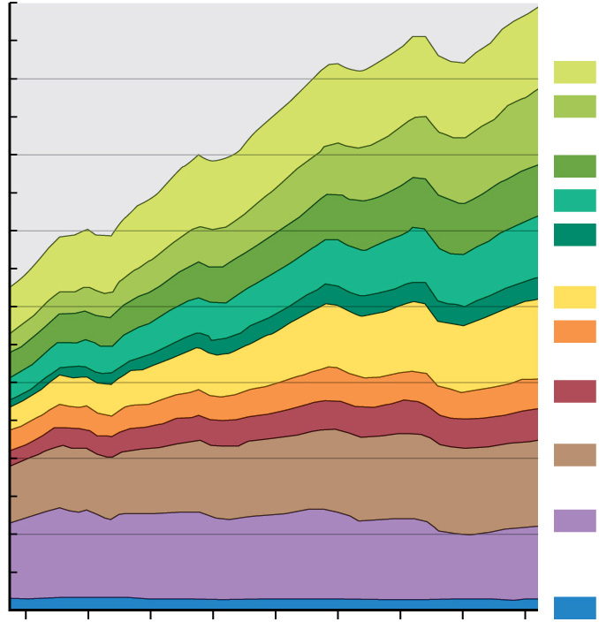
12.1.1 Services, Settlements, and Geography (5 of 5)
Figure 12-3: Recent employment growth in the United States has been in the tertiary (service) sector, especially consumer services.
160
TERTIARY SECTOR
Consumer services
140
Retail and wholesale
Health and social
services
120
Education
Leisure and hospitality
100
Other services
Business services
Number of jobs (millions)
Professional
80
Transportation
and information
60
Financial
Public services
40
Government
SECONDARY SECTOR
20
Manufacturing
and construction
PRIMARY SECTOR
0
Agriculture and mining
1975
1980
1985
1990
1995
2000
2005
2010
2015
Year

Slide 9
Key Issue 2: Where Are Consumer Services Distributed?
12.2.1 Central Place Theory
12.2.2 Hierarchy of Consumer Services
12.2.3 Market Area Analysis
12.2.4 Periodic and Sharing Services

Slide 10
12.2.1 Central Place Theory (1 of 4)
Central place theory is used to determine the most profitable location for a business is identified
A central place is a market center where people exchange goods and services
The area surrounding a service from which customers are attracted is the market area
The range is the maximum distance people are willing to travel to use a service
The threshold is the minimum number of people needed to support a service

Slide 11
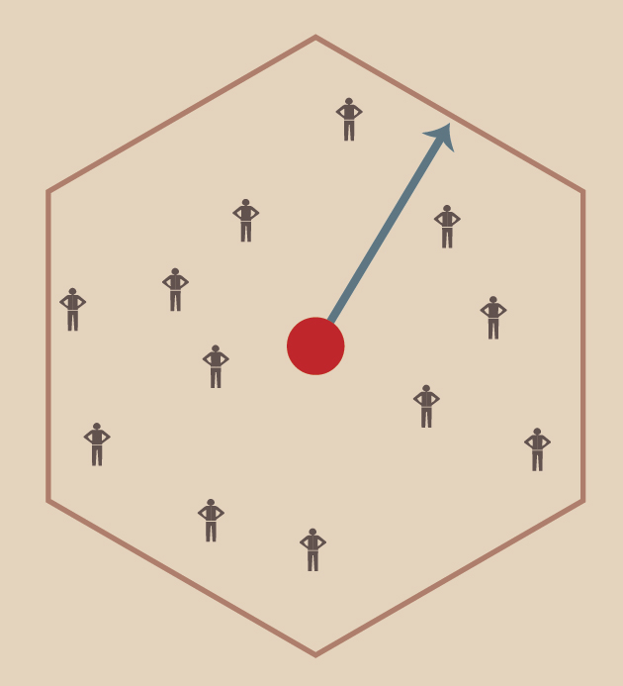
12.2.1 Central Place Theory (2 of 4)
Figure 12-4: Threshold is the number of people required to support a particular service, and range is the maximum distance a person is willing to travel for that distance.
Market area
RANGE
THRESHOLD
SERVICE

Slide 12
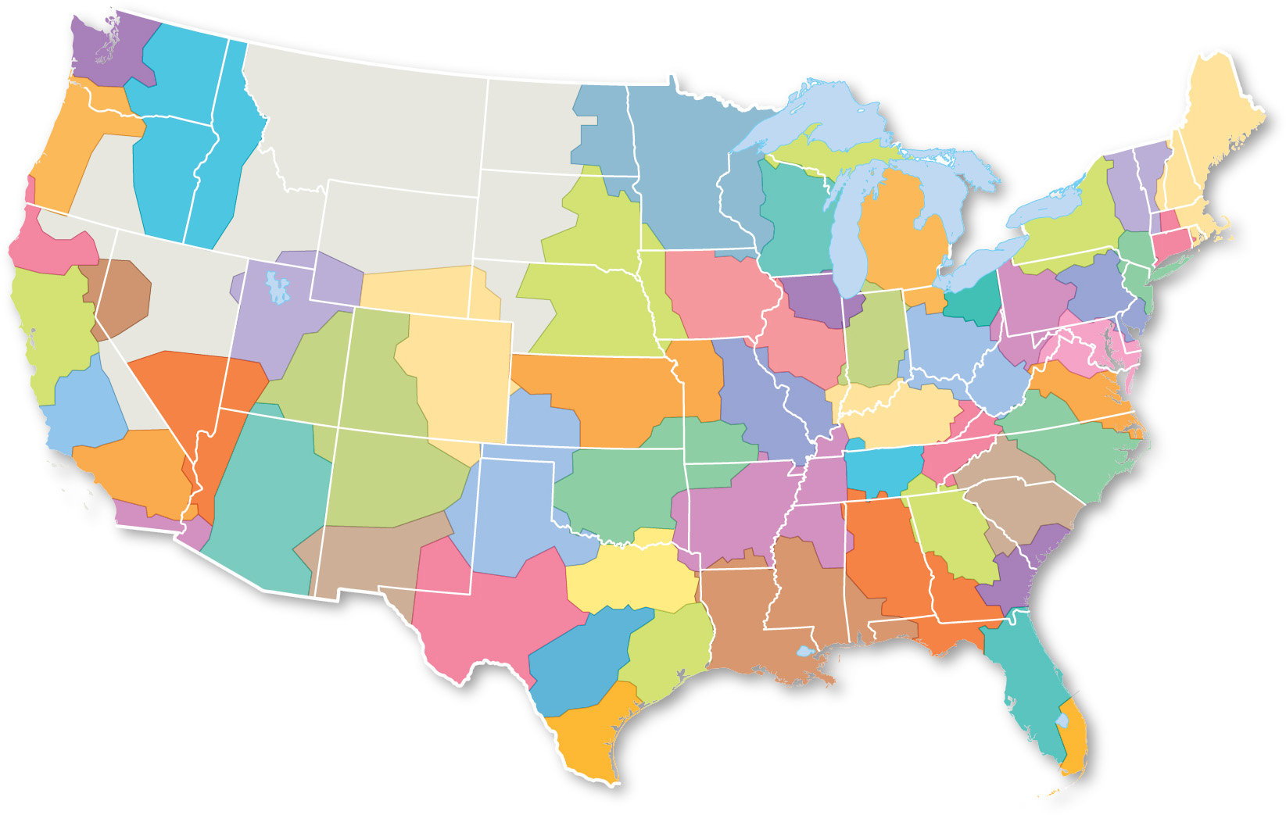
12.2.1 Central Place Theory (3 of 4)
Figure 12-5: Daily urban systems regions represent functional ties, which can be considered market areas for some services.
Seattle
Portland
Columbia
Plateau
Twin Cities
Upper Peninsula
Hudson
Valley
Boston
New England
NorCal
Milwaukee
Madison
Detroit
Toledo
Upstate
NY
Connecticut
Valley
Reno
Omaha
Great Plains
Corn Belt
Chicago
Cleveland
New York City
Bay Area
Sacramento
Salt Lake
Pittsburgh
Philadelphia
Denver
Front Range
Indianapolis
Cincinnati
Columbus
DC-Baltimore
Fresno
Las Vegas
Albuquerque
Plateaus
K
ansas City
St. Louis
Louisville
Richmond-Tidewater
Blue
Ridge
Raleigh-Roanoke
Los Angeles
OK City-Tulsa
Nashville
San Diego
Phoenix
Amarillo
Lubbock
Memphis-Litte Rock
Charlotte
Deep
South
Atlanta
El Paso
Dallas-Ft. Worth
Savannah
Charleston
West Texas
New Orleans-Delta
San Antonio
Austin
Houston
Central FL
Rio
Grande
Miami

Slide 13
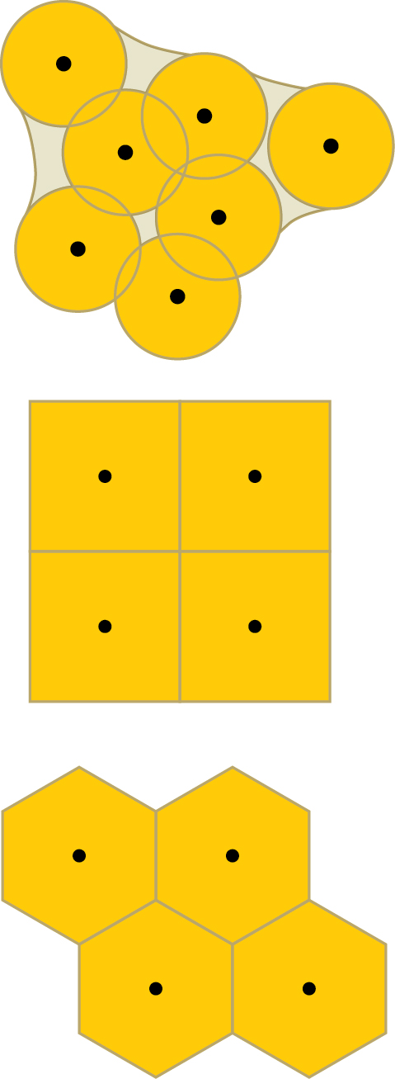
12.2.1 Central Place Theory (4 of 4)
Figure 12-6: Hexagons approximate a circle without leaving gaps, so are used to symbolize market areas in central place theory.
(a)
(b)
(c)

Slide 14
12.2.2 Hierarchy of Consumer Services (1 of 5)
Central place theory predicts that small settlements will have a small threshold and small range of services, while large settlements will have services with large thresholds and large ranges
Developed countries often follow the rank-size rule where the n^{th} -largest settlement is 1/n the population of largest settlement. Developing countries are more likely to contain primate cities where services are disproportionately concentrated

Slide 15
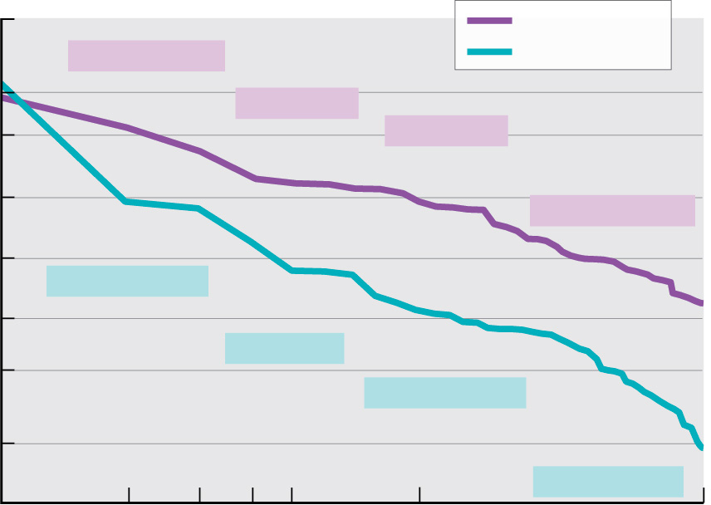
12.2.2 Hierarchy of Consumer Services (2 of 5)
Figure 12-7: Rank-size rule predicts the 10th largest city should have about 1/10th the population of the largest city. This is observed in the United States, but not as closely in Mexico.
50,000,000
United States
#2 Los Angeles
Mexico
20,000,000
#5 Houston
10,000,000
#10 Boston
5,000,000
#40 Jacksonville
Population
2,000,000
#2 Guadalajara
1,000,000
#5 Tolouca
500,0000
#10 Querétaro
200,000
100,000
#40 Monclova
1
2
3
4
5
10
50
Rank

Slide 16
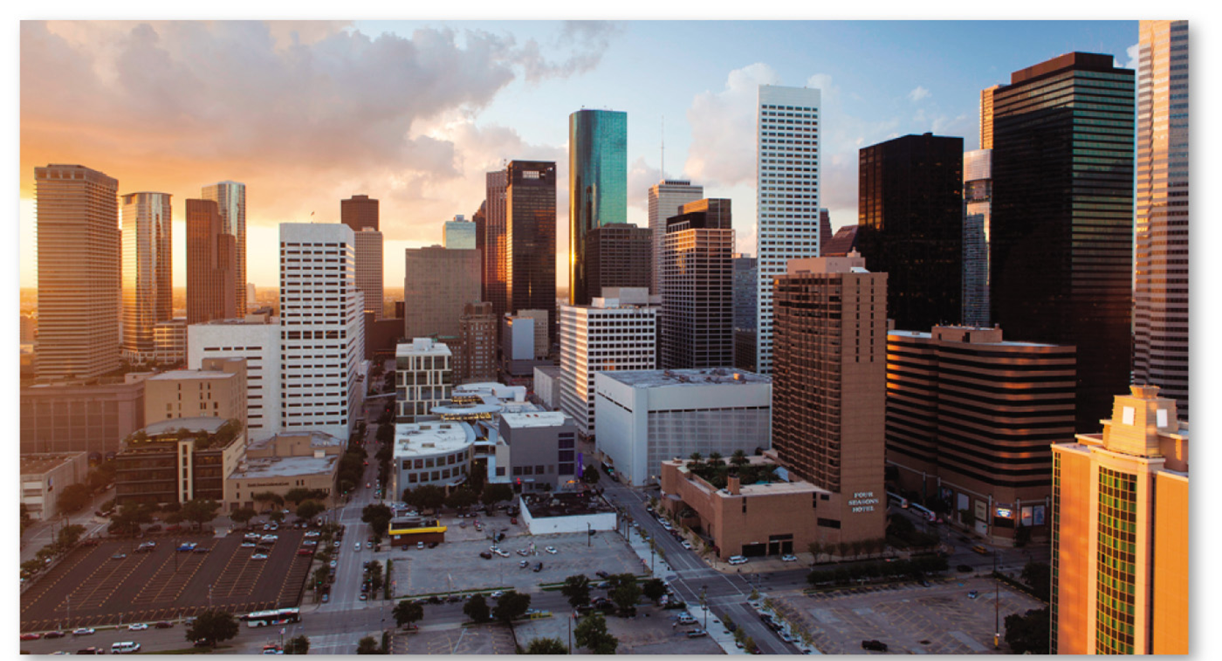
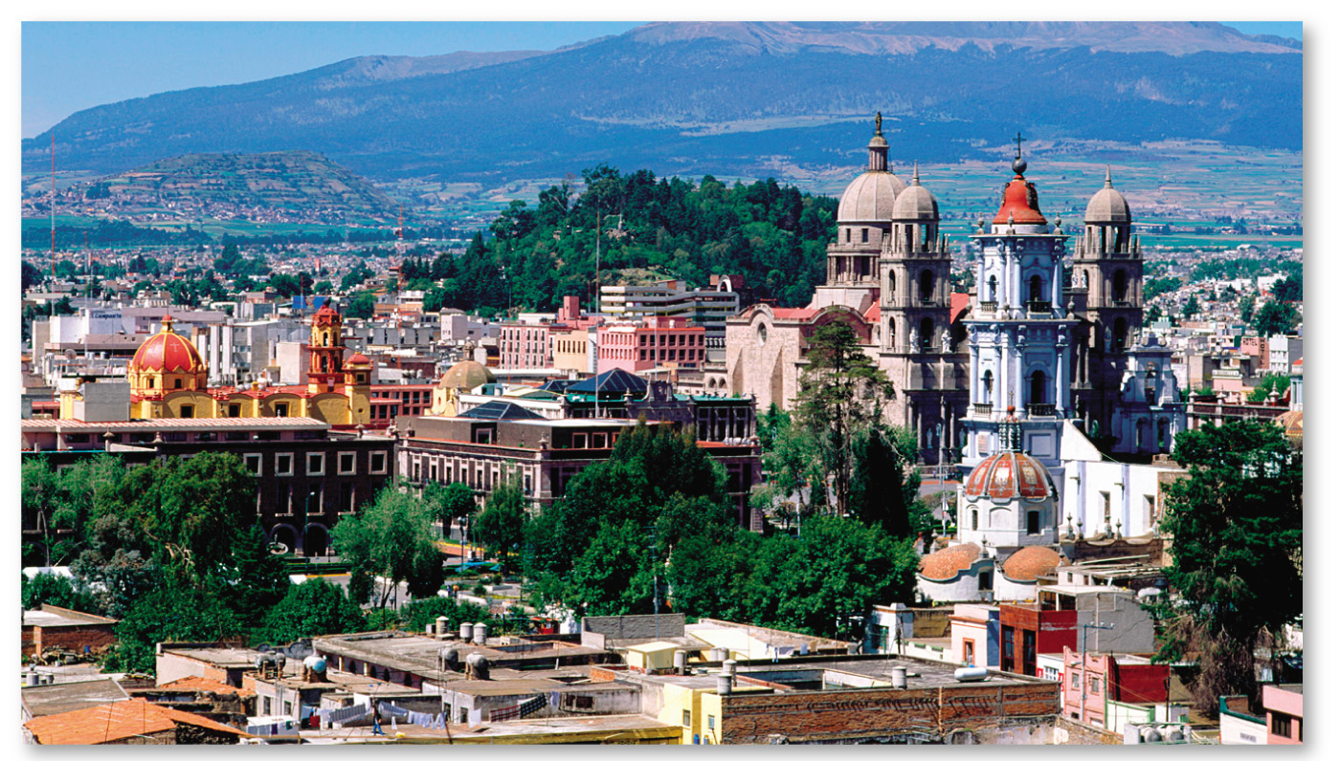
12.2.2 Hierarchy of Consumer Services (3 of 5)
Figures 12-8 and 12-9: Houston (left) is the 5th largest settlement in the United States and has an even larger population than the rank-size rule predicts. Toluca (right) is Mexico’s 5th largest settlement but has a smaller population than the rank-size rule would suggest.

Slide 17
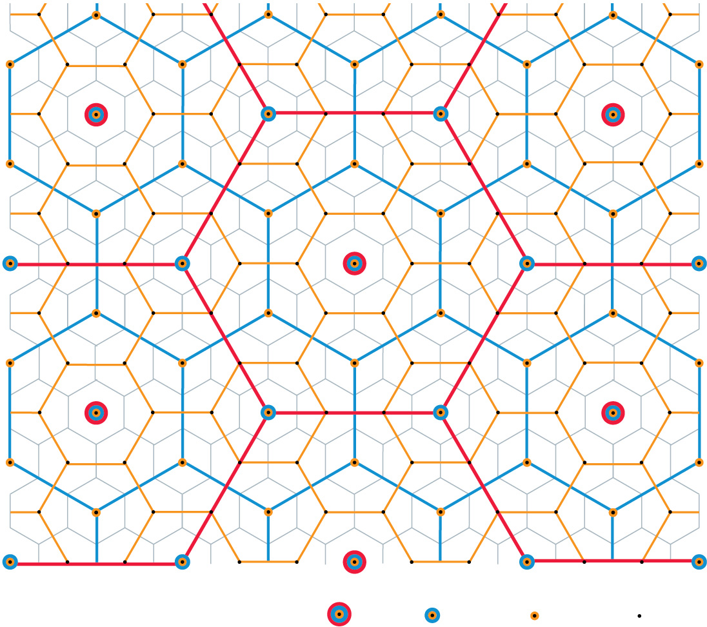
12.2.2 Hierarchy of Consumer Services (4 of 5)
Figure 12-10: An abstract model of central place theory shows that the market areas of small settlements are nested within the market areas of larger settlements, and so on.
City
Town
Village
Hamlet

Slide 18
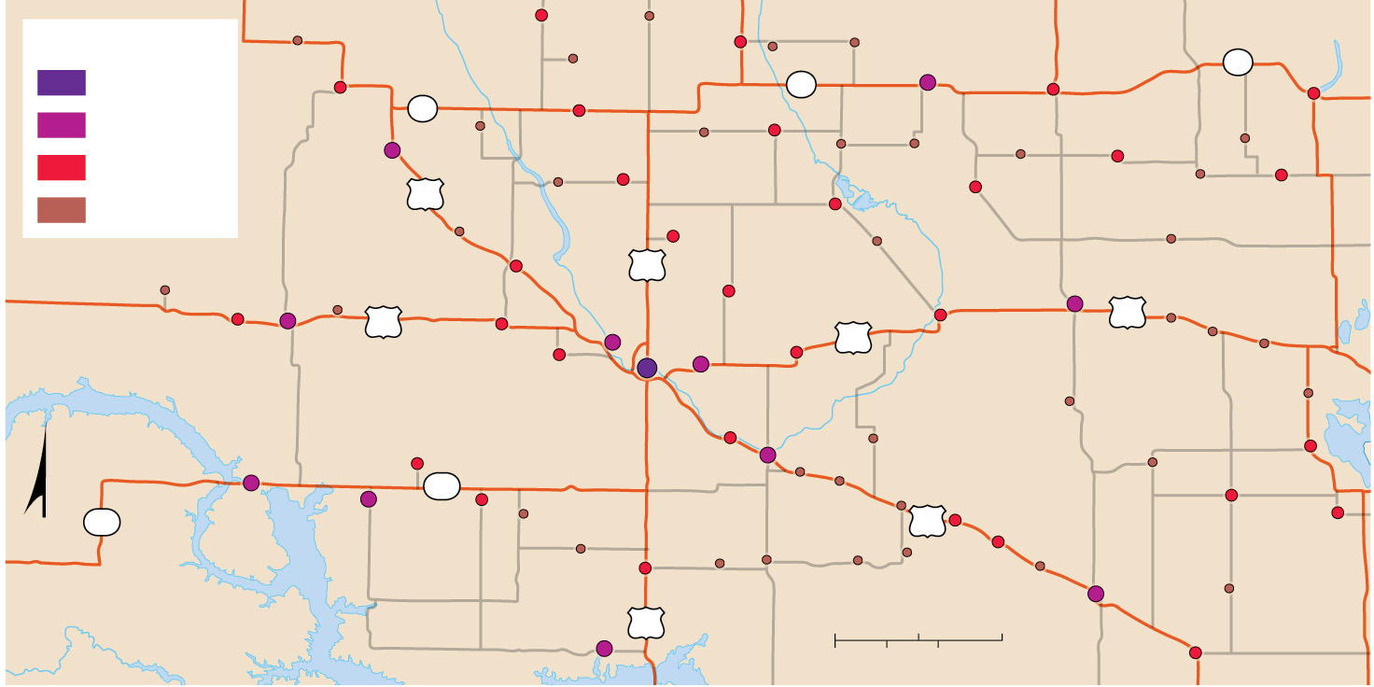
12.2.2 Hierarchy of Consumer Services (5 of 5)
Figure 12-11: Following the predictions of central place theory, there are many hamlets, fewer villages, even fewer small towns, and only one city (Minot) in the region mapped here.
Flaxton
Sherwood
Antler
Landa
Souris
Settlements
Westhope
Bottineau
City
Bowbells
Loraine
5
Dunseith
5
5
Mohall
Maxbass
Rocklake
Small town
Tolley
Newburg
Overly
Rolette
Perth
Village
Kenmare
Grano
Lansford
Kramer
Gardena
Mylo
Bisbee
52
Willow City
Hamlet
Upham
Bantry
Wolford
Donnybrook
Carpio
Glenburn
White Earth
Stanley
Palermo
83
Deering
Rugby
2
Berthold
Burlington
2
Knox
Leeds
Ross
2
Towner
York
Des Lacs
Granville
Minot
Surrey
Balta
Brinsmade
New Town
Plaza
Sawyer
Velva
Karlsruhe
NORTH
DAKOTA
Minnewaukan
23
Voltaire
Bergen
Esmond
23
Parshall
Makoti
Ryder
Balfour
52
Drake
Maddock
Oberon
N
Benedict
Ruso
Anamoose
Douglas
Max
Butte
Kief
Martin
Harvey
Hamberg
Garrison
83
0
10
20 Miles
0
10
20 Kilometers
Fessenden

Slide 19
12.2.3 Market Area Analysis (1 of 4)
Four factors taken into consideration when determining site location for a service:
Define the market area
Estimate the range
Estimate the threshold
Predict the market share
The gravity model predicts the optimal location of a service is directly related to the number of people in the area and inversely related to the distance people must travel to access it

Slide 20
12.2.3 Market Area Analysis (2 of 4)
Nutritionists are concerned with people who live relatively far from sources of healthy food. An area that has limited access to affordable and nutritious food is known as a food desert. Poorer urban areas and rural areas quite often are located in food deserts

Slide 21
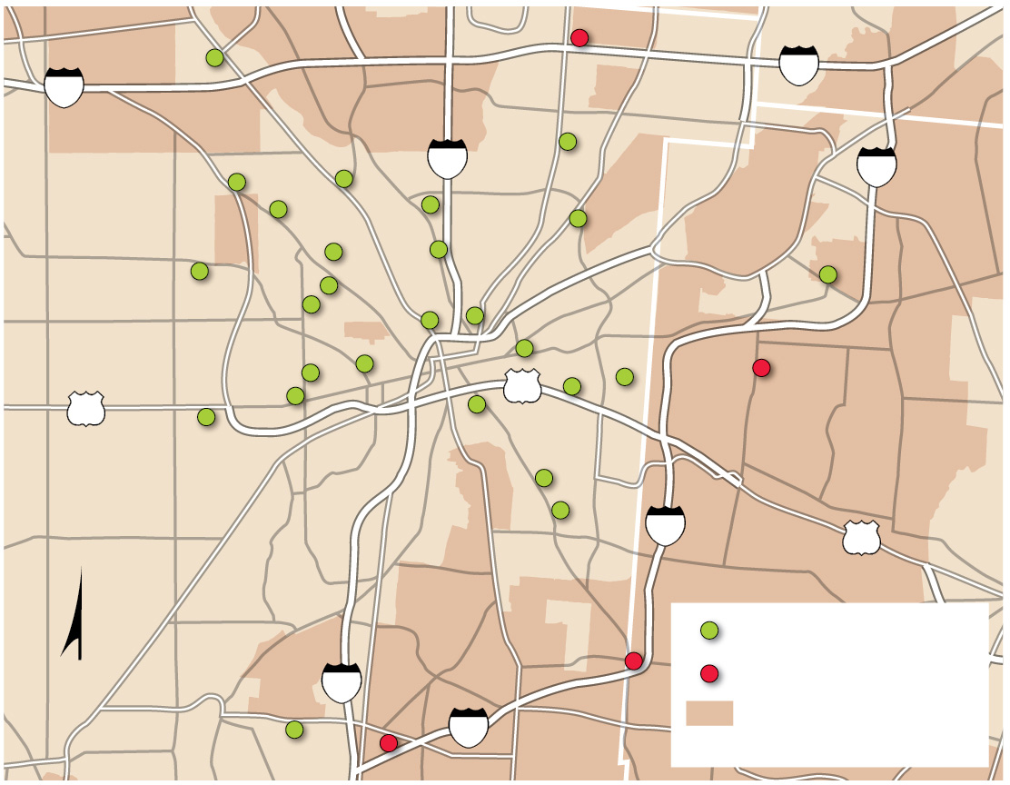
12.2.3 Market Area Analysis (3 of 4)
Figure 12-13: Compared with Target, Family Dollar has a lower threshold and lower range. Target stores are more likely to be located in higher income areas than are Family Dollar stores.
Englewood
Vandalia
70
70
Clayton
Huber Heights
75
Wright-
Patterson
AFB
675
Trotwood
Fairborn
MONTGOMERY CO.
Dayton
Riverside
35
35
GREENE CO.
Oakwood
Beavercreek
Moraine
Kettering
675
35
Moraine
West
Carrollton
Family Dollar store
N
Miamisburg
75
Target store
675
Median household income over $50,000
Centerville

Slide 22
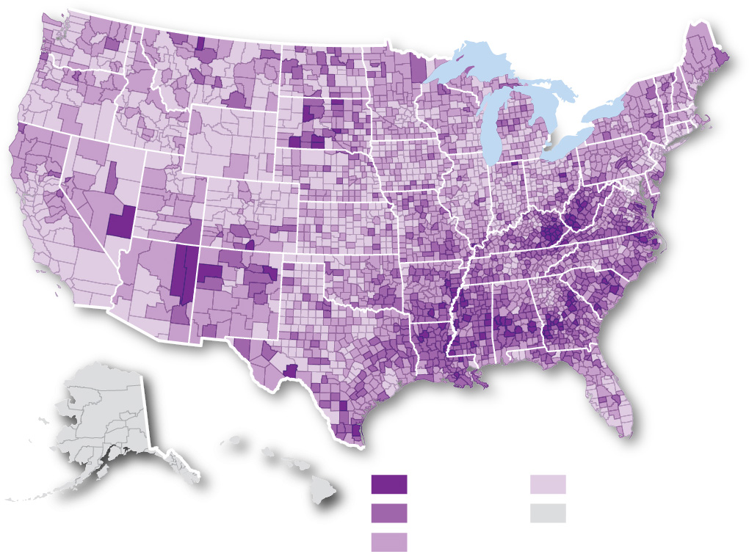
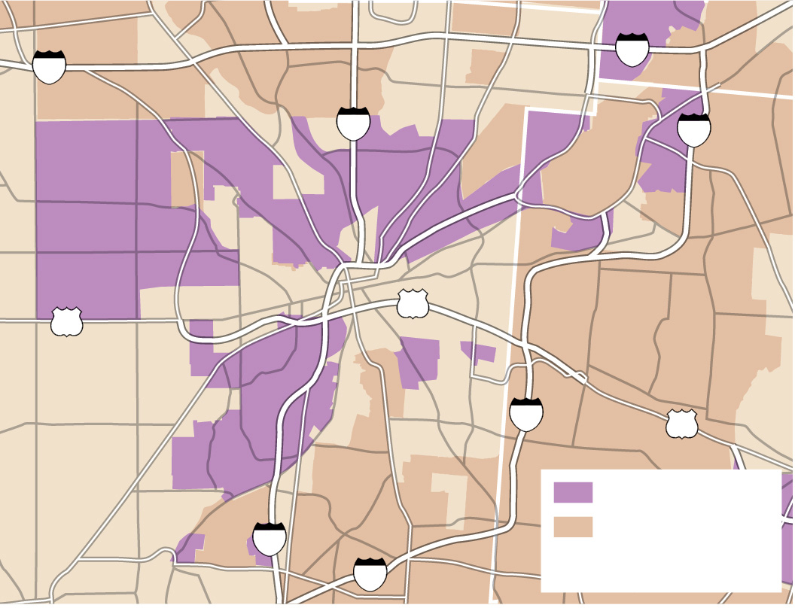
12.2.3 Market Area Analysis (4 of 4)
Figures 12-16 and 12-17: Food deserts are defined as areas with low-income residents and poor access to groceries. Food deserts at the national scale (left) are located in rural areas, whereas food deserts at the local urban level (right, Dayton, Ohio) correspond to local-income neighborhoods.
Englewood
Vandalia
70
Huber Heights
70
Clayton
75
Wright-
Patterson
AFB
675
Trotwood
Fairborn
MONTGOMERY CO.
Dayton
Riverside
35
35
GREENE CO.
Oakwood
Beavercreek
Moraine
Kettering
675
35
Percent with no car and
no supermarket within a mile
Moraine
West
above 10
below 2.5
Carrollton
Food desert
5.1–10
no data
Miamisburg
Family Dollar store
Median household
income over
$50,000
75
2.5–5
675
Centerville

Slide 23
12.2.4 Periodic and Sharing Services (1 of 3)
A periodic market is a collection of individual vendors who come together to offer goods and services in a location on specified days
Sharing services have become very popular in recent years. Airbnb, Uber, and Lyft are popular examples of shared services

Slide 24
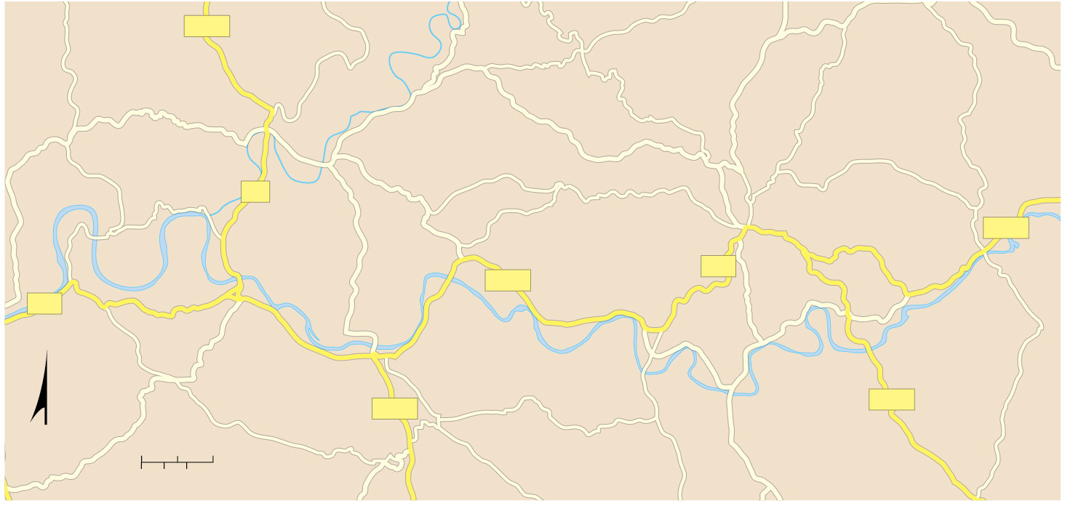
12.2.4 Periodic and Sharing Services (2 of 3)
Figure 12-18: Fifteen small towns within 30 kilometers (20 miles) of each other have periodic markets in rural France.
D710
Sainte-Alvère
Les Eyzies-de-
Tayac-Sireuil
Marquay
Monday
Le Bugue
Tuesday
Tuesday, Saturday
Monday
Sante-Nathalène
Meyrals
Wednesday
Carlux
E1
Thursday
Sarlat-la-Canéda
Wednesday
Trémolat
Wednesday, Saturday
D703
Tuesday
Calviac-en-
Périgord
D703
D57
D29
Le Buisson-de-Cadouin
Beynac-et-Cazenac
Carsac-Aillac
Sunday
Friday
Dordogne R.
Monday
Sunday
La Roque-Gageac
Friday
D710
Veyrines-de-Domme
D704
N
0
1
2 Miles
Thursday
0
1
2 Kilometers

Slide 25
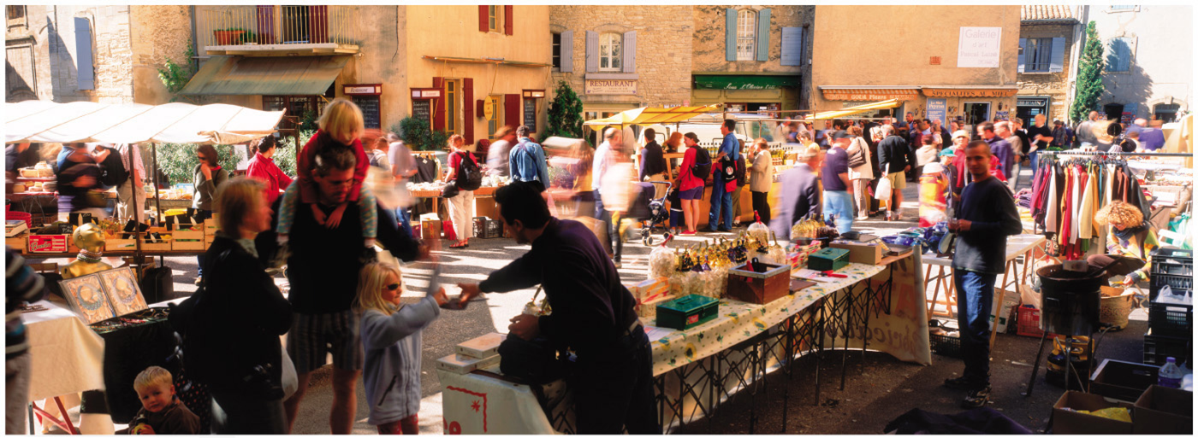
12.2.4 Periodic and Sharing Services (3 of 3)
Figure 12-19: Periodic markets are common in many rural parts of Europe, such as seen here in France.

Slide 26
Key Issue 3: Where are Business Services Distributed?
12.3.1 Hierarchy of Business Services
12.3.2 Business Services in Developing Countries
12.3.3 Economic Specialization of Settlements

Slide 27
12.3.1 Hierarchy of Business Services (1 of 4)
A global city is a major center for the provision of services in the global economy. Business services cluster in global cities, such as:
Financial institutions
Corporate headquarters
Law, accounting, and other professional services
Global cities defined by combination of factors on their importance: economic, political, cultural, infrastructure, and transportation

Slide 28
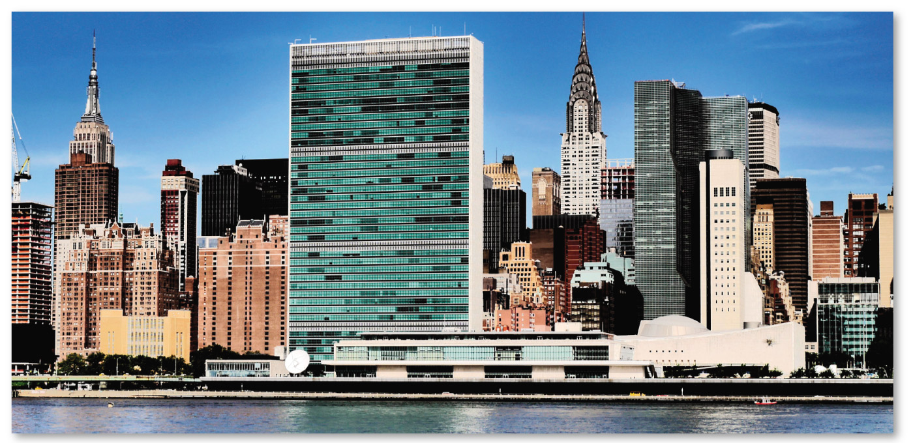
12.3.1 Hierarchy of Business Services (2 of 4)
Figure 12-22: New York is a classic example of a global city as the headquarters of the United Nations.

Slide 29
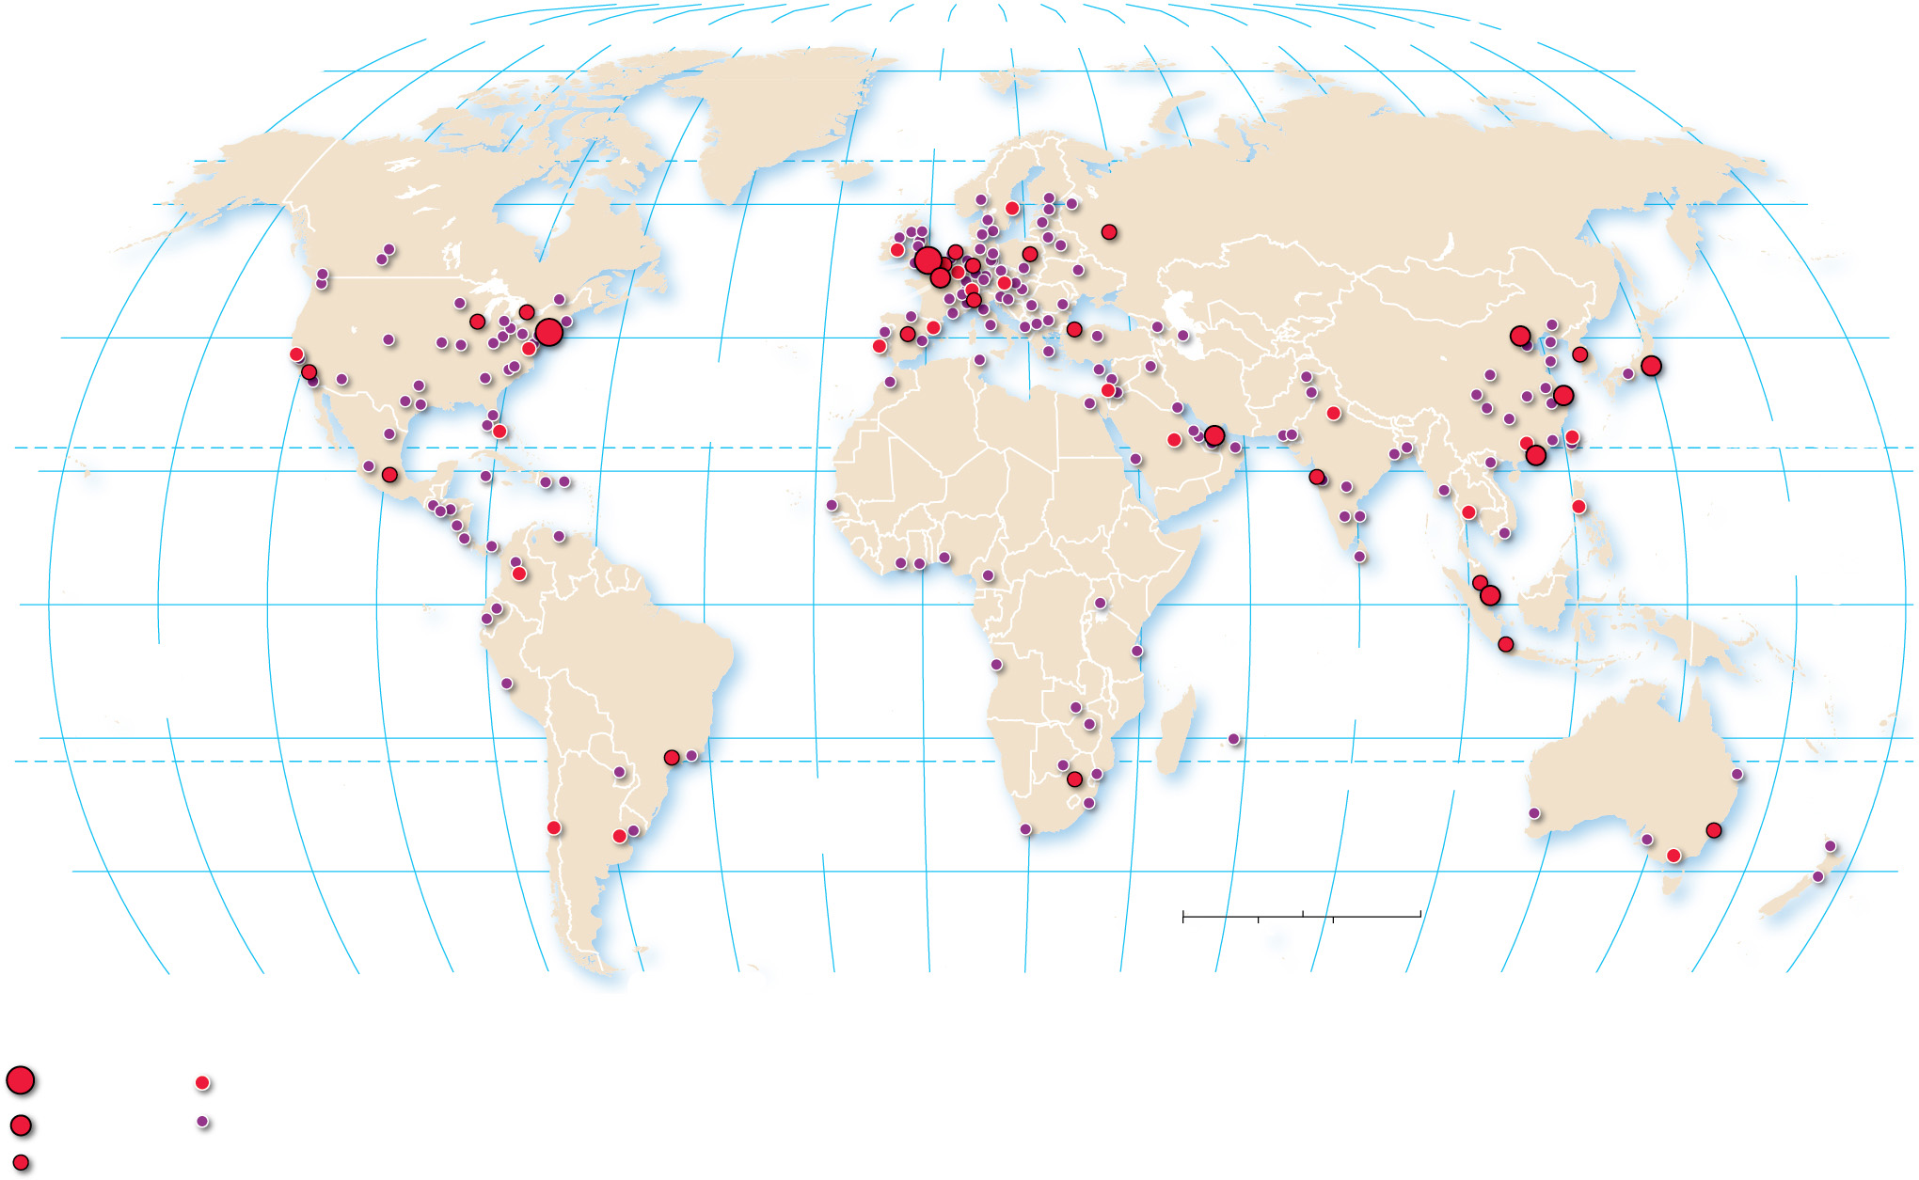
12.3.1 Hierarchy of Business Services (3 of 4)
Figure 12-23: Global cities follow a hierarchy where the most globally influential world cities, London and New York, are ranked highest.
80°
160°
140°
120°
100°
80°
60°
40°
20°
0°
20°
40°
60°
80°
100°
120°
140°
160°
180°
80°
ARCTIC
OCEAN
60°
60°
London
40°
New York
Paris
40°
ATLANTIC
OCEAN
Beijing
Tokyo
Dubai
Shanghai
TROPIC OF CANCER
20°
Hong Kong
PACIFIC
OCEAN
20°
0°
Singapore
EQUATOR
0°
PACIFIC
OCEAN
INDIAN
OCEAN
20°
20°
ATLANTIC
OCEAN
TROPIC OF CAPRICORN
40°
0
1,500
3,000 Miles
40°
0
1,500
3,000 Kilometers
Global city
hierarchy
160°
140°
120°
100°
80°
60°
40°
20°
0°
20°
40°
60°
80°
100°
120°
140°
160°
180°
Alpha++
Alpha–
Alpha+
Beta and
Gamma
Alpha

Slide 30
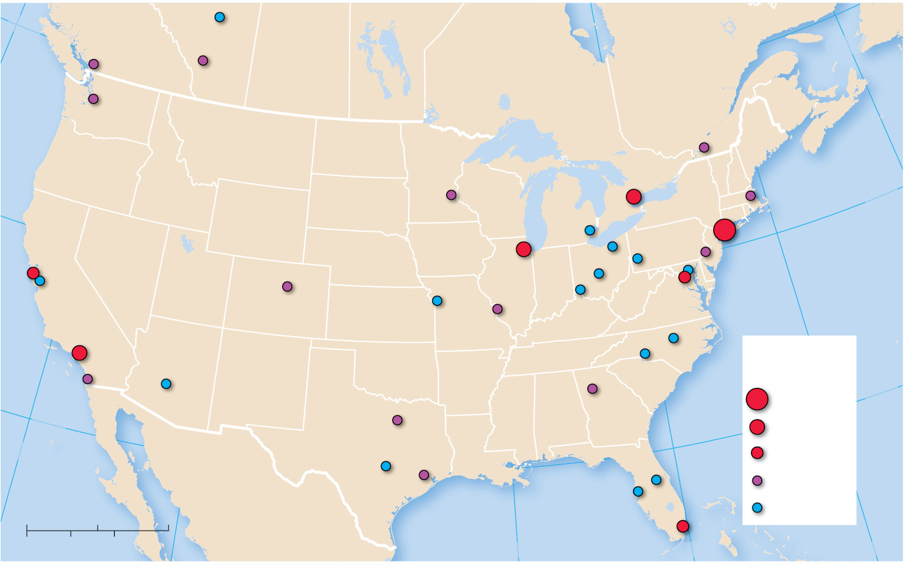
12.3.1 Hierarchy of Business Services (4 of 4)
Figure 12-24: Atop the hierarchy of business services is New York, followed by Chicago, Los Angeles, and Toronto.
50°N
Edmonton
Vancouver
Calgary
60°W
Seattle
Montréal
Minneapolis
Toronto
Boston
40°N
Chicago
Detroit
Pittsburgh
New York
San Francisco
Cleveland
Philadelphia
San Jose
Denver
Columbus
Baltimore
Kansas City
Cincinnati
Washington, D.C.
Los Angeles
St. Louis
Raleigh
Charlotte
Global city
hierarchy
San
Diego
Phoenix
Atlanta
Alpha++
30°N
30°N
Dallas
Alpha
120°W
Austin
Orlando
Alpha–
Houston
Tampa
Beta
0
250
500 Miles
Gulf of Mexico
Miami
Gamma
0
250
500 Kilometers
90°W
80°W
70°W

Slide 31
12.3.2 Business Services in Developing Countries (1 of 3)
In the global economy, developing countries specialize in two distinctive types of business services: offshore financial services and back-office functions
Offshore financial services provide two important functions in the global circulation of capital: low (or nonexistent) taxes and privacy
Business-process outsourcing locations are selected for their low wages and the ability of their employees to speak fluent English

Slide 32
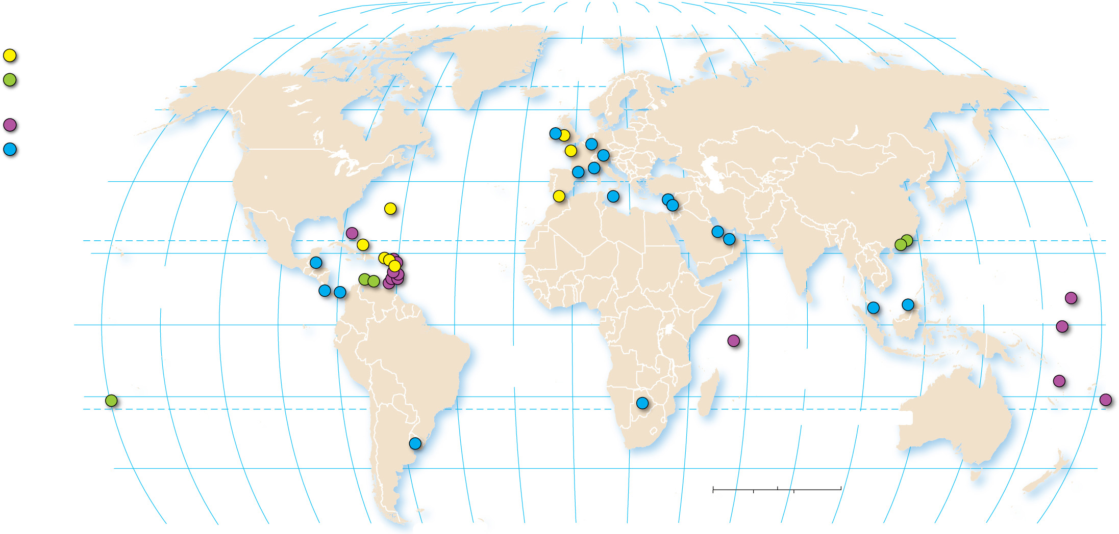
12.3.2 Business Services in Developing Countries (2 of 3)
Figure 12-25: Offshore financial service centers are mostly microstates or dependencies, and most microstates are small islands.
Dependencies
80°
160°
140°
120°
100°
80°
60°
40°
20°
0°
20°
40°
60°
80°
100°
120°
140°
160°
180°
United Kingdom
ARCTIC
OCEAN
80°
other countries
Independent
60°
Isle of Man
60°
island countries
Ireland
Luxembourg
other countries
Jersey
Liechtenstein
40°
Andorra
Monaco
Cyprus
40°
Bermuda
Gibraltar
Malta
Lebanon
Bahamas
British Virgin Is.
Bahrain
United Arab
Hong Kong
Anguilla
Emirates
Macau
TROPIC OF CANCER
20°
Turks & Caicos
St. Kitts & Nevis
20°
Belize
Dominica
Antigua & Barbuda
PACIFIC
OCEAN
Aruba
Montserrat
PACIFIC
OCEAN
Marshall Is.
Costa Rica
St. Lucia
Panama
Barbados
Malaysia
Brunei
0°
Curaçao
St. Vincent & the Grenadines
EQUATOR
0°
Grenada
Seychelles
Nauru
ATLANTIC
OCEAN
INDIAN
OCEAN
Vanuatu
20°
Cook Islands
Botswana
Samoa
TROPIC OF CAPRICORN
Uruguay
40°
0
1,500
3,000 Miles
40°
0
1,500
3,000 Kilometers
160°
140°
120°
100°
80°
60°
40°
20°
0°
20°
40°
60°
80°
100°
120°
140°
160°
180°

Slide 33
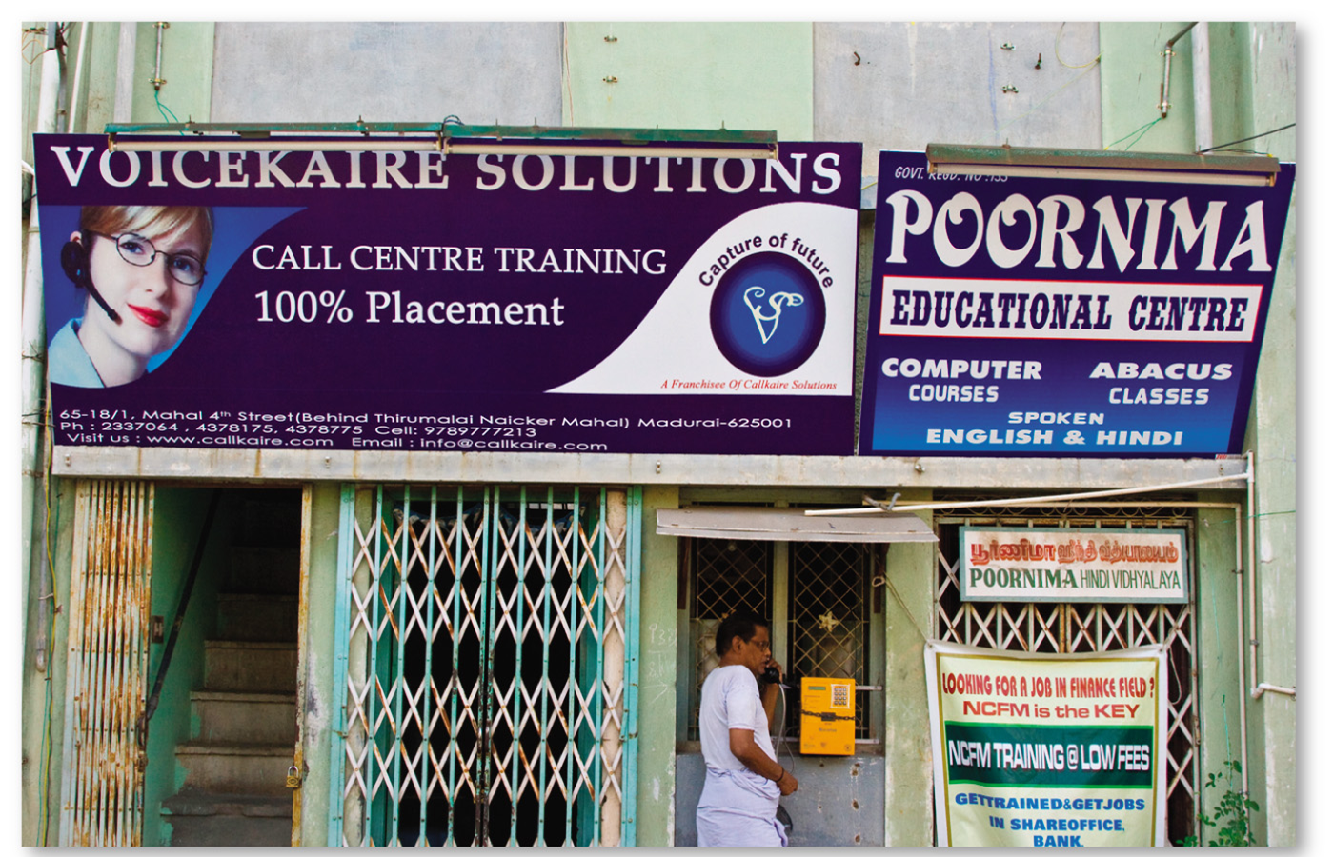
12.3.2 Business Services in Developing Countries (3 of 3)
Figures 12-26 and 12-27: India is a popular location for businesses to outsource their call center work because of low wages and workers who speak English. Kolkata (left) and Madurai (right).

Slide 34
12.3.3 Economic Specialization of Settlements (1 of 4)
The economic activities in a settlement can be divided into two types:
Basic businesses export primarily to customers outside the settlement
Nonbasic businesses serve primarily customers living in the same settlement
The unique cluster of basic businesses in a settlement is its economic base
Talented workers not randomly distributed. They are attracted to job opportunities, but cultural factors often remain most important

Slide 35
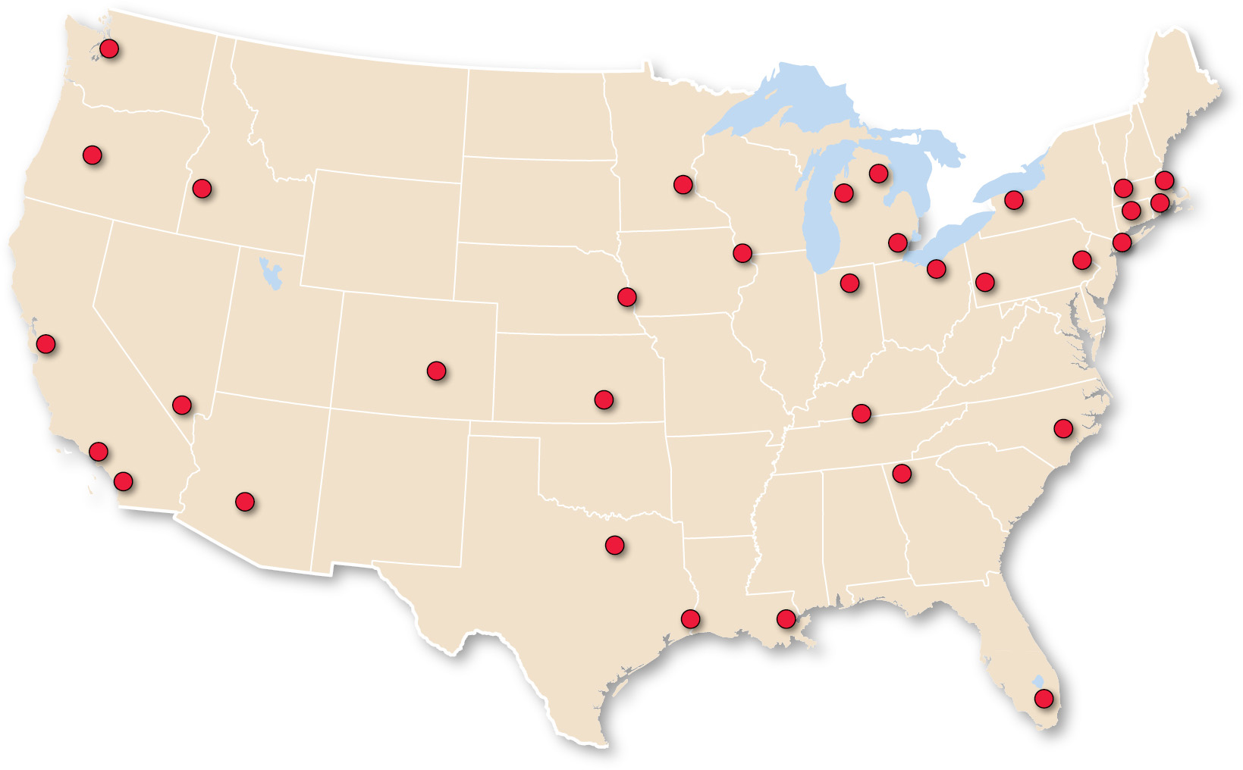
12.3.3 Economic Specialization of Settlements (2 of 4)
Figure 12-28: Settlements specialize in different economic activities.
Seattle
Wisconsin/
Iowa/Illinois
Detroit
Boston
• Aircraft equipment and design
• Agricultural
equipment
• Auto equipment
and parts
• Mutual funds
• Boat and ship building
Western
Michigan
Rochester
• Biotechnology
• Metal fabrication
Minneapolis
• Imaging
equipment
• Software and networking
• Computer software
• Cardiovascular
equipment
and services
• Office and
institutional
furniture
Western
Massachusetts
• Venture capital
Oregon
• Polymers
• Electrical measuring equipment
Michigan
• Woodworking equipment
• Logging and lumber supplies
Boise
• Clocks
• Sawmills
• Farm machinery
Omaha
Providence
• Telemarketing
• Jewelry
• Hotel reservations
• Marine equipment
Silicon Valley
• Credit card processing
Hartford
• Microelectronics
Las Vegas
• Insurance
• Biotechnology
• Amusements
and casinos
Wichita
• Venture capital
• Light aircraft
Warsaw, IN
New York City
• Small airlines
• Farm equipment
• Orthopedic
devices
• Financial services
Los Angeles area
Pittsburgh
• Advertising
• Defense and aerospace
Cleveland
• Publishing
• Entertainment
• Paints and
coatings
• Advanced
materials
• Multimedia
Dallas
• Energy
Pennsylvania/
New Jersey
• Real estate
Carlsbad
development
Dalton, GA
• Pharmaceuticals
• Golf equipment
Southeastern
Texas/Louisiana
• Carpets
North Carolina
• Chemicals
• Household furniture
Phoenix
• Synthetic fibers
• Helicopters
Nashville/
Louisville
• Hosiery
• Semiconductors
• Hospital
management
• Electronic testing labs
Colorado
Baton Rouge/
New Orleans
Southern Florida
• Optics
• Computer-integrated systems and programming
• Health technology
• Engineering services
• Specialty foods
• Computers
• Mining and oil and gas exploration

Slide 36
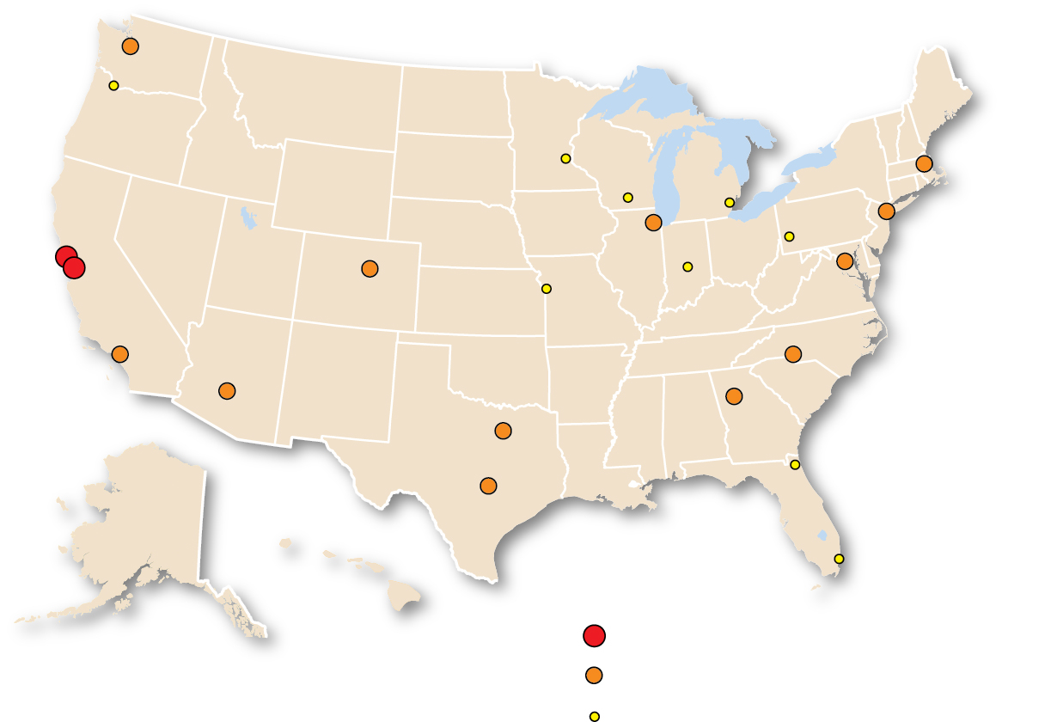
12.3.3 Economic Specialization of Settlements (3 of 4)
Figure 12-29: High-tech jobs cluster in a few selected settlements.
Seattle
Boston
San Francisco
Chicago
New York
San Jose
Denver
Washington, D.C.
Charlotte
Los
Angeles
Phoenix
Atlanta
Dallas-
Fort Worth
Austin
Percent of
national growth
9.0 and above
2.0–5.9
1.0–1.9

Slide 37
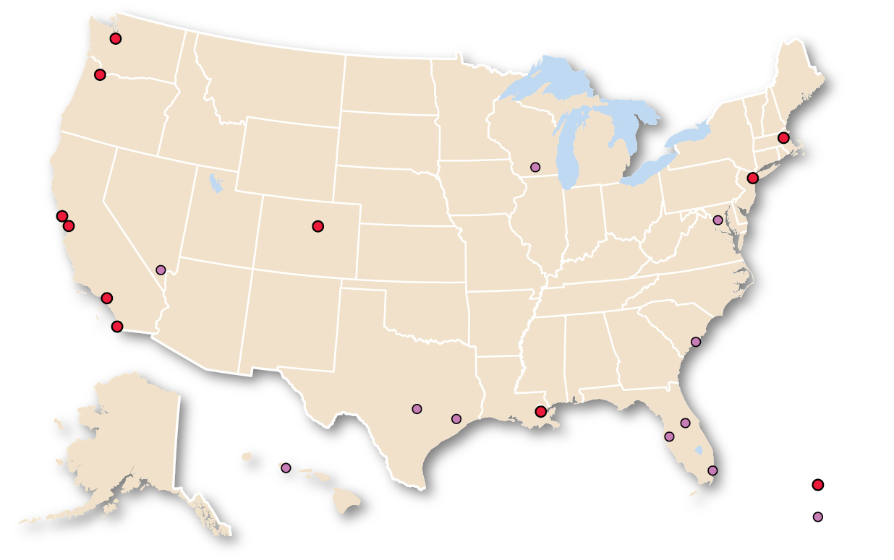
12.3.3 Economic Specialization of Settlements (4 of 4)
Figure 12-30: Talented professionals gravitate to cities with a lot of cultural attractions.
Seattle
Portland
Boston
Madison
New York
San Francisco
San Jose
Denver
Washington, D.C.
Los
Angeles
Las Vegas
San Diego
New
Orleans
Charleston
Austin
America’s
“coolest”
cities rank
Houston
Orlando
Honolulu
Tampa
Miami
1–10
11–20

Slide 38
Key Issue 4: Why Do Services Cluster in Settlements?
12.4.1 Services in Rural Settlements
12.4.2 Services in Early Urban Settlements
12.4.3 Urbanization
12.4.4 Megacities

Slide 39
12.4.1 Services in Rural Settlements (1 of 6)
There are two types of rural settlements:
A clustered rural settlement is an agricultural-based community in which a number of families live in close proximity with fields surrounding the collection of houses and farm buildings. They can be circular or linear
A dispersed rural settlement is characterized by farmers living on individual farms isolated from neighbors rather than alongside other farmers in settlements

Slide 40
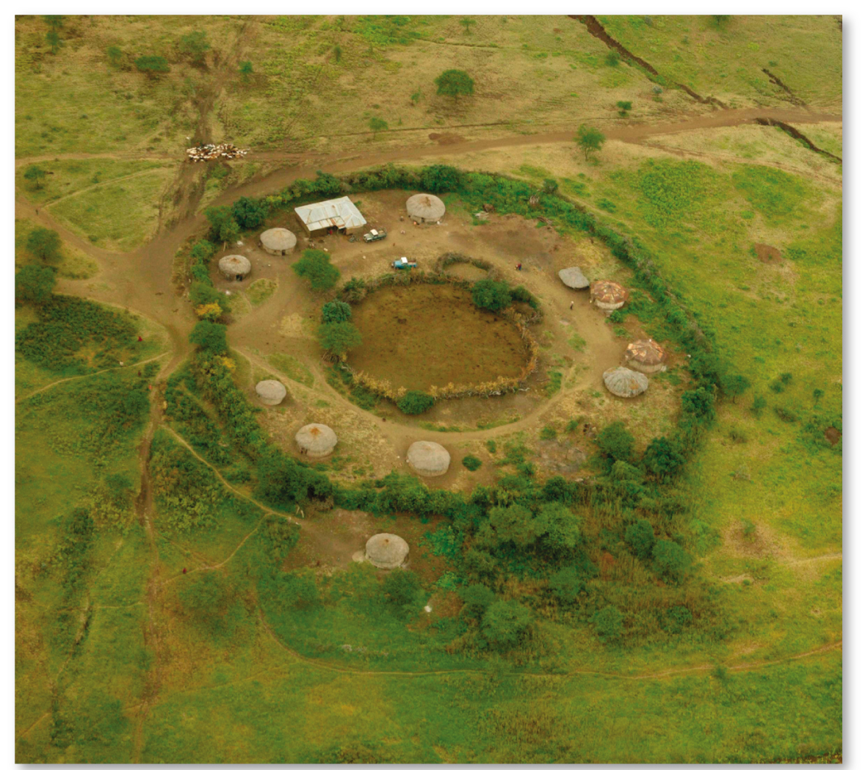
12.4.1 Services in Rural Settlements (2 of 6)
Figure 12-31: A small circular rural settlement in Kenya is called a kraal.

Slide 41
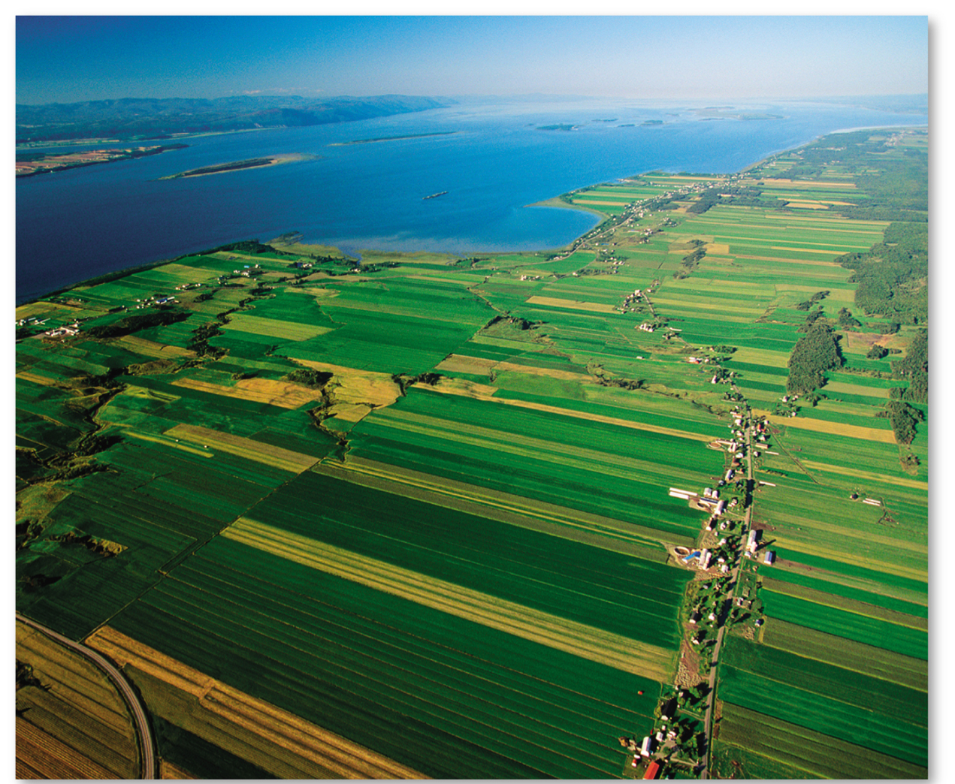
12.4.1 Services in Rural Settlements (3 of 6)
Figure 12-32: A linear rural settlement in Quebec, which follows the French long-lot tradition.

Slide 42
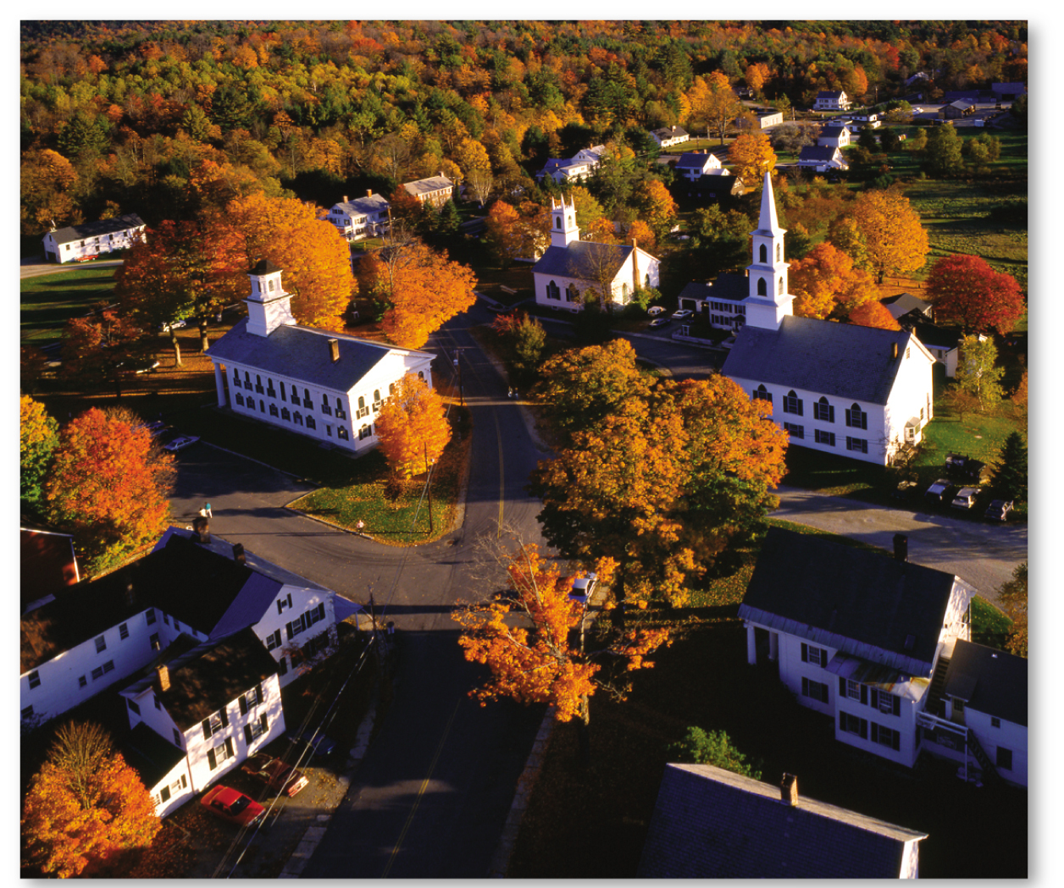
12.4.1 Services in Rural Settlements (4 of 6)
Figure 12-33: A clustered rural settlement in Newfane, Vermont.

Slide 43
12.4.1 Services in Rural Settlements (5 of 6)
Figure 12-34: An isolated farm in southern Wisconsin.

Slide 44
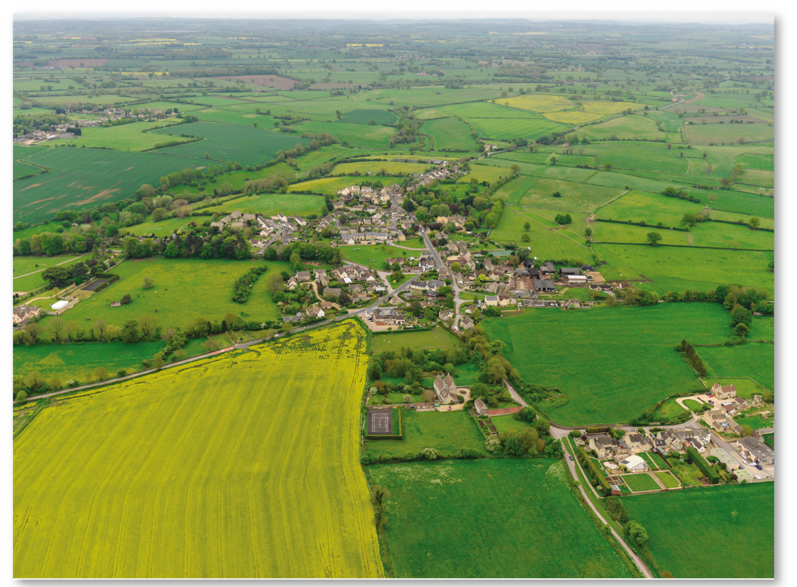
12.4.1 Services in Rural Settlements (6 of 6)
Figure 12-35: Luckington was originally a clustered rural settlement, but during the enclosure movement, the surrounding fields were consolidated into large farms.

Slide 45
12.4.2 Services in Early Urban Settlements (1 of 4)
Prehistoric urban settlements likely engaged in religious services (burial of the dead), business services (trade/storage of food, clothing, tools), and public services (defense)
Mesopotamia is the likely origin of the first settlements. Ancient settlements peaked with the Roman Empire. Urban settlements revived in medieval Europe with a renewed emphasis on trade and public services

Slide 46
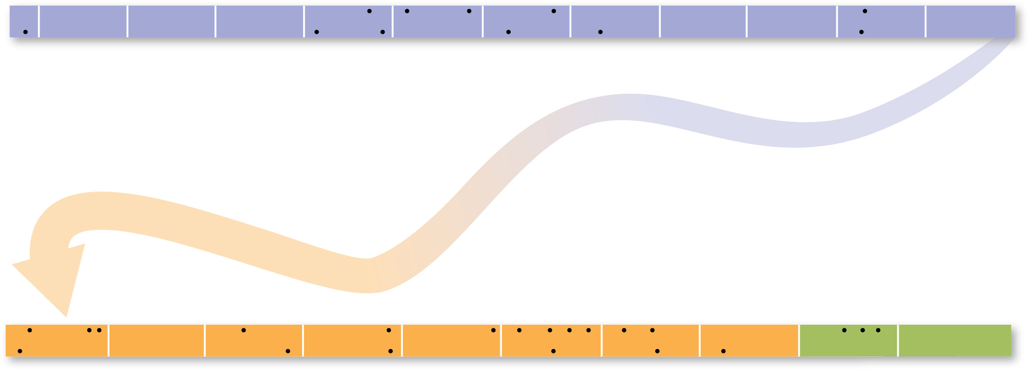
12.4.2 Services in Early Urban Settlements (2 of 4)
Figure 12-36: The original settlements came from Mesopotamia and Egypt.
LAGASH,
BABYLONIA
(Iraq)
BABYLON,
BABYLONIA (Iraq)
NINEVEH,
ASSYRIA (Iraq)
THEBES,
Egypt
MEMPHIS, Egypt
3000
B.C.E.
2750
B.C.E.
2500
B.C.E.
2250
B.C.E.
2000
B.C.E.
1750
B.C.E.
1500
B.C.E.
1250
B.C.E.
1000
B.C.E.
750
B.C.E.
500
B.C.E.
MEMPHIS, Egypt
population over 30,000
AKKAD,
BABYLONIA (Iraq)
THEBES, Egypt
BABYLON, BABYLONIA
(Iraq)
UR, BABYLONIA
(Iraq)
population 65,000
FIRST POPULATION ABOVE 200,000
AVARIS, Egypt
CONSTANTINOPLE
(ISTANBUL), Turkey
NEW YORK
PATALIPUTRA
(PATNA), India
FIRST POPULATION ABOVE
10 MILLION
BAGHDAD, Iraq
CONSTANTINOPLE
(ISTANBUL), Turkey
FEZ (FES),
Morocco
LONDON, UK
TOKYO
FIRST POPULATION ABOVE 1 MILLION
FIRST POPULATION ABOVE
5 MILLION
FIRST POPULATION ABOVE
20 MILLION
CH’ANG-AN (XI’AN), China
population 400,000
HANGZHOU, China
population 255,000
CONSTANTINOPLE
(ISTANBUL), Turkey
population 400,000
CORDOBA,
Spain
CAIRO, Egypt
ROME
population 450,000
HANGZHOU, China
250
B.C.E.
0
250
500
C.E.
750
C.E.
1000
C.E.
1250
C.E.
1500
C.E.
1750
C.E.
2000
C.E.
ALEXANDRIA
CTESIPHON, Iraq
MERV (MARY),
Turkmenistan
population: 200,000
CONSTANTINOPLE
(ISTANBUL), Turkey
KAIFENG, China
population 400,000
NANKING,
China
population: 487,000

Slide 47
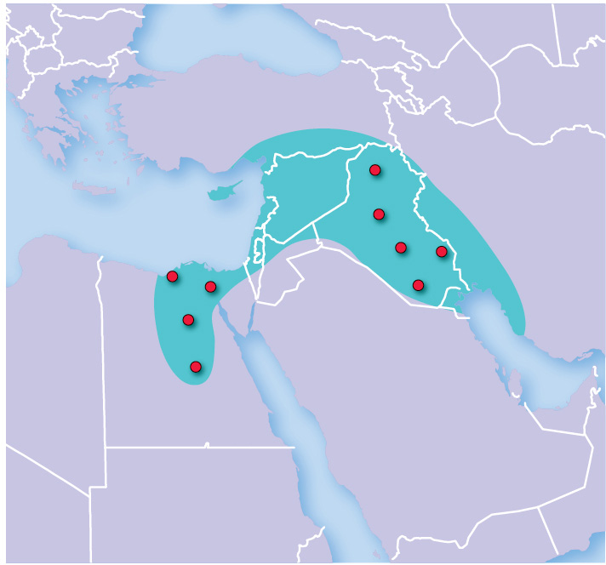
12.4.2 Services in Early Urban Settlements (3 of 4)
Figure 12-37: Large urban settlements before the time of Christ were located in the Fertile Crescent.
FERTILE
CRESCENT
Nineveh
Akkad
Babylon
Lagash
Alexandria
Avaris
Ur
Memphis
Thebes
EGYPT

Slide 48
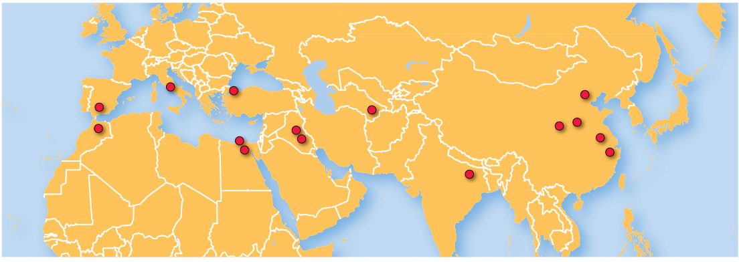
12.4.2 Services in Early Urban Settlements (4 of 4)
Figure 12-38: Large urban settlements spread across Asia, Europe, and North Africa.
Rome
Constantinople
Beijing
Cordoba
Merv
Kaifeng
Baghdad
Ch’ang-an
Fez
Alexandria
Nanking
Cairo
Ctesiphon
Hangzhou
Pataliputra

Slide 49
12.4.3 Urbanization (1 of 5)
The process by which the population of urban settlements grows is known as urbanization. The urbanization process has two dimensions:
An increase in the percentage of people living in urban settlements
An increase in the number of people living in urban settlements
Urban settlements differ from rural ones in that they have a larger size, higher density, and social heterogeneity

Slide 50
12.4.3 Urbanization (2 of 5)
The percentage the world living in urban areas has increased and continues to grow
The pace of urbanization is occurring quicker in the developing world than in the developed world
A greater percentage of the developed world (79%) lives in an urban area than the developing world (50%)
The population of Earth’s urban settlements exceeded that of rural settlements for the first time in human history around 2008

Slide 51
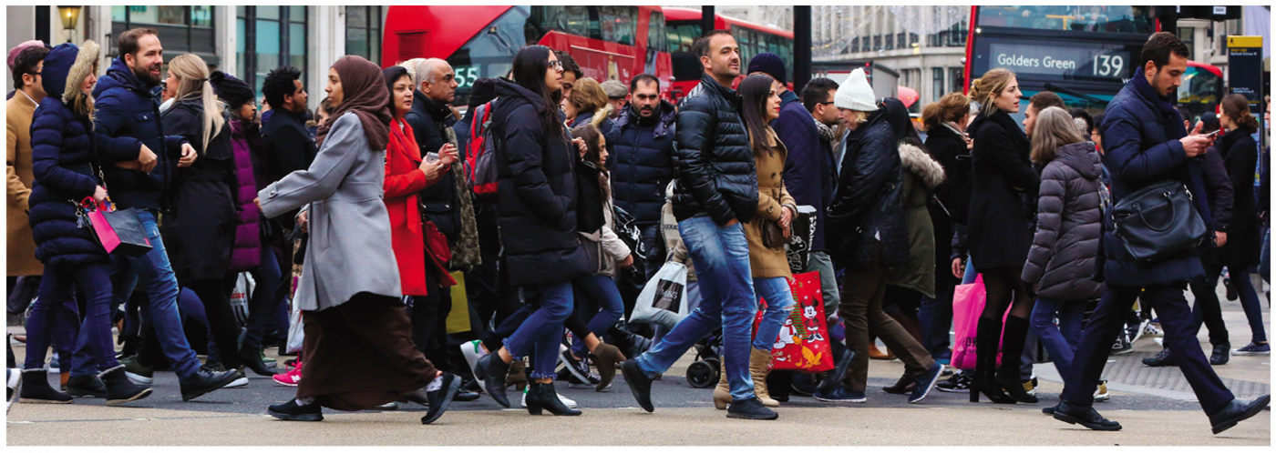
12.4.3 Urbanization (3 of 5)
Figure 12-39: Major urban areas are large, dense, and socially heterogeneous, such as seen here in London.

Slide 52
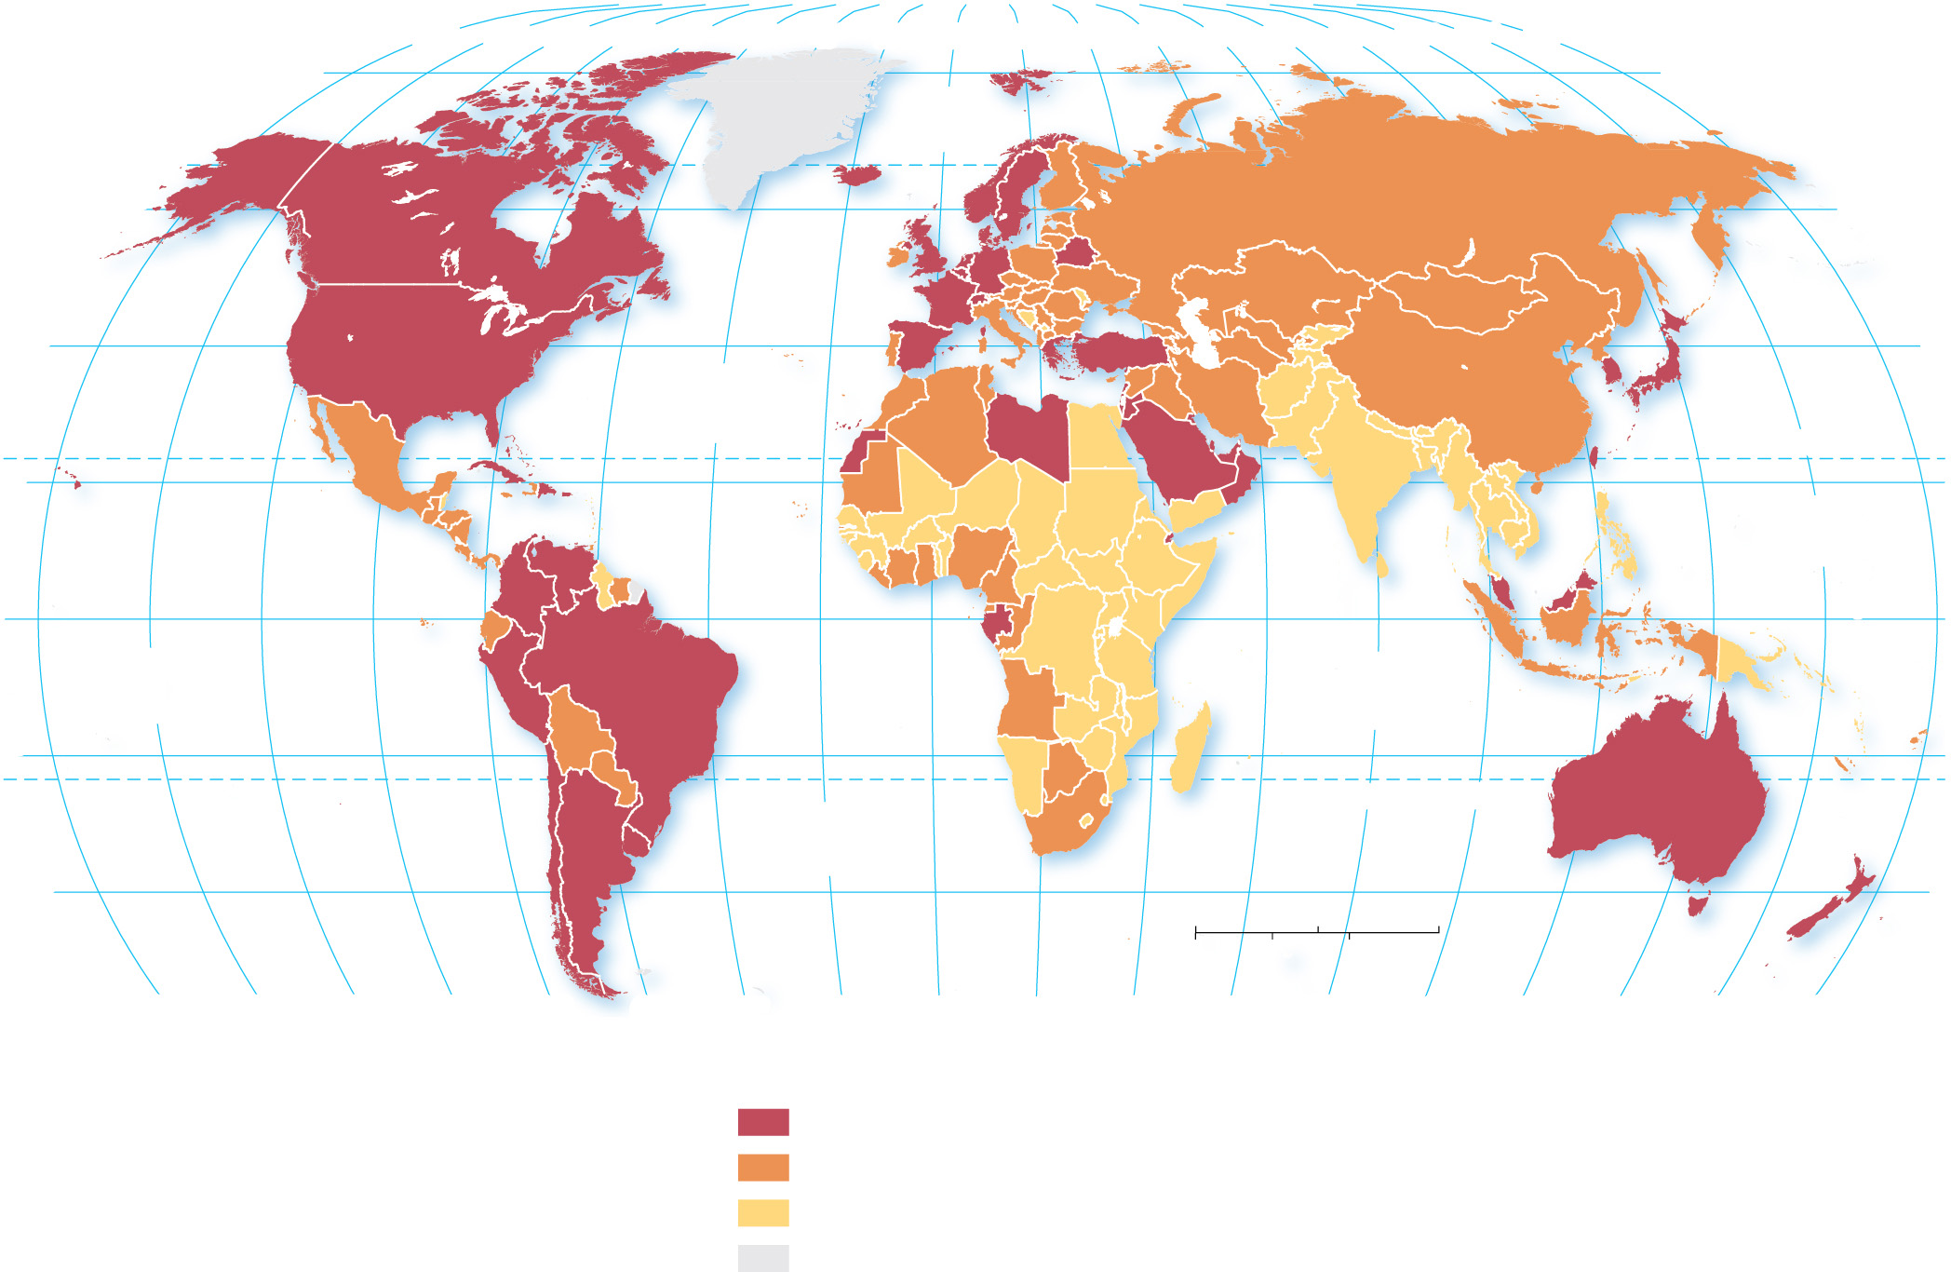
12.4.3 Urbanization (4 of 5)
Figure 12-40: The world is on average more than half urbanized; developed countries are generally more urbanized than developing countries.
80°
160°
140°
120°
100°
80°
60°
40°
20°
0°
20°
40°
60°
80°
100°
120°
140°
160°
180°
80°
ARCTIC
OCEAN
60°
60°
40°
ATLANTIC
OCEAN
40°
20°
TROPIC OF CANCER
20°
PACIFIC
OCEAN
0°
EQUATOR
0°
PACIFIC
OCEAN
INDIAN
OCEAN
20°
TROPIC OF CAPRICORN
20°
ATLANTIC
OCEAN
40°
0
1,500
3,000 Miles
40°
0
1,500
3,000 Kilometers
160°
140°
120°
100°
80°
60°
40°
20°
0°
20°
40°
60°
80°
100°
120°
140°
160°
180°
Percent urban
75 and above
50–74
below 50
no data

Slide 53
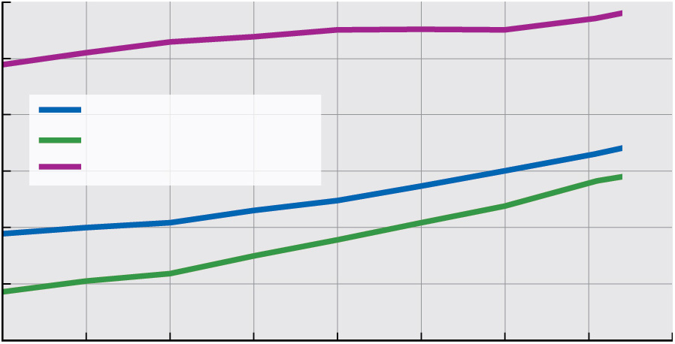
12.4.3 Urbanization (5 of 5)
Figure 12-41: Urbanization has increased in both developed and developing countries, but the pace is faster in the developing world.
80
70
60
World
Developing countries
Percent urban
Developed countries
50
40
30
20
1980
1985
1990
1995
2000
2005
2010
2015
2020
Year

Slide 54
12.4.4 Megacities (1 of 6)
Most of the world’s largest cities are now in developing countries
Fastest-growing urban settlements are also in developing countries
A megacity is an urban settlement with a total population in excess of 10 million people and a metacity has more than 20 million people

Slide 55
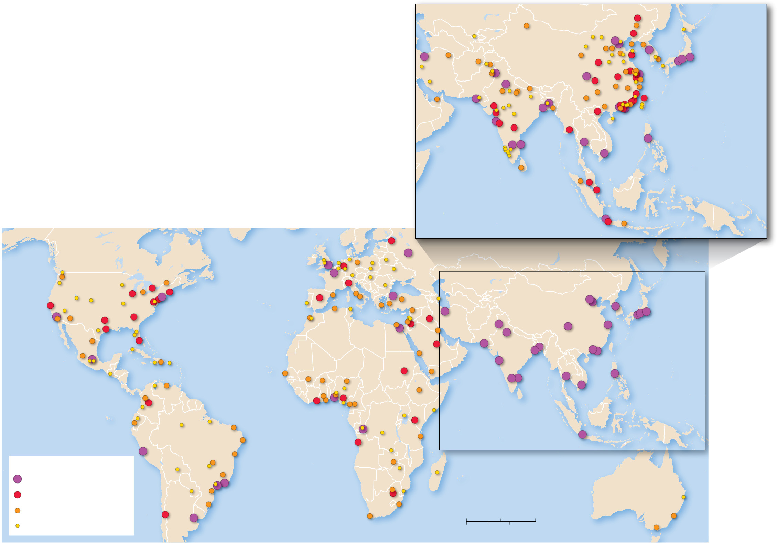
12.4.4 Megacities (2 of 6)
Figure 12-42: While developed countries are generally more urban as a percentage, most of the world’s largest settlements are in developing countries, especially in East and South Asia and Latin America.
Shenyang-Fushun
Harbin
Tehran
Tianjin
Beijing
Seoul-
Incheon
Xi’an
Qingdao
Nanjing
Tokyo-Yokohama
Lahore
Wuhan
Shanghai
Nagoya
Delhi
Chengdu
Suzhou
Osaka-Kobe-Kyoto
Karachi
Chongqing
Fuzhou
Taipei
Hangzhou
Ahmadabad
Kolkata
Dhaka
Hanoi
Wuhan
Quanzhou
Surat
Zhengzhou
Mumbai
Yangon
Dongguan
Guangzhou-Foshan
Pune
Hyderabad
Shenzhen
Hong Kong
Manila
PACIFIC
OCEAN
Bengaluru
Chennai
Bangkok
Ho Chi Minh
City
INDIAN
OCEAN
Kuala Lumpur
Singapore
Jakarta
St. Petersburg
Bandung
Essen-Dusseldorf
Moscow
London
Chicago
Toronto
Boston-Providence
Paris
Milan
Istanbul
See inset above for detail
Seoul-
Nagoya
San Francisco
New York
Madrid
Baghdad
Beijing
Incheon
Tokyo-
Yokohama
Dallas-
Fort Worth
Philadelphia
Tehran
Tianjin
Los Angeles
Houston
Atlanta
Washington D.C.
Cairo
Amman
Lahore
Delhi
Chengdu
Shanghai
Osaka-Kobe- Kyoto
Miami
ATLANTIC
OCEAN
Riyadh
Karachi
Kolkata
Dhaka
Shenzhen
Mexico City
Khartoum
Mumbai
Guangzhou-Foshan
Bengaluru
Chennai
Bangkok
Manila
PACIFIC
OCEAN
PACIFIC
OCEAN
Bogotá
Abidjan
Onitsha
Ho Chi Minh City
Lagos
Nairobi
Kinshasa
Jakarta
Lima
Luanda
Urban settlements
INDIAN
OCEAN
10.0 million and above
Rio de Janeiro
5.0 million–9.9 million
São Paulo
ATLANTIC
OCEAN
Johannesburg
3.0 million–4.9 million
Santiago
Buenos Aires
0
1,000
2,000 Miles
2.0 million–2.9 million
0
1,000
2,000 Kilometers

Slide 56
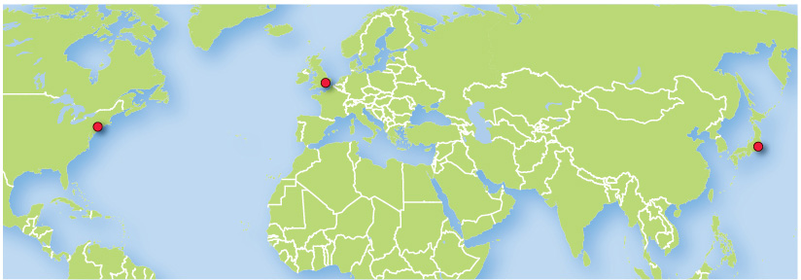
12.4.4 Megacities (3 of 6)
Figure 12-43: London was the largest city in the world during the 19th century. New York eclipsed London in the 20th century. The largest city in the world in 2018 is Tokyo.
London
Largest
in 1800s
New York
Largest in
mid-1900s
Tokyo
Largest
in 2018

Slide 57
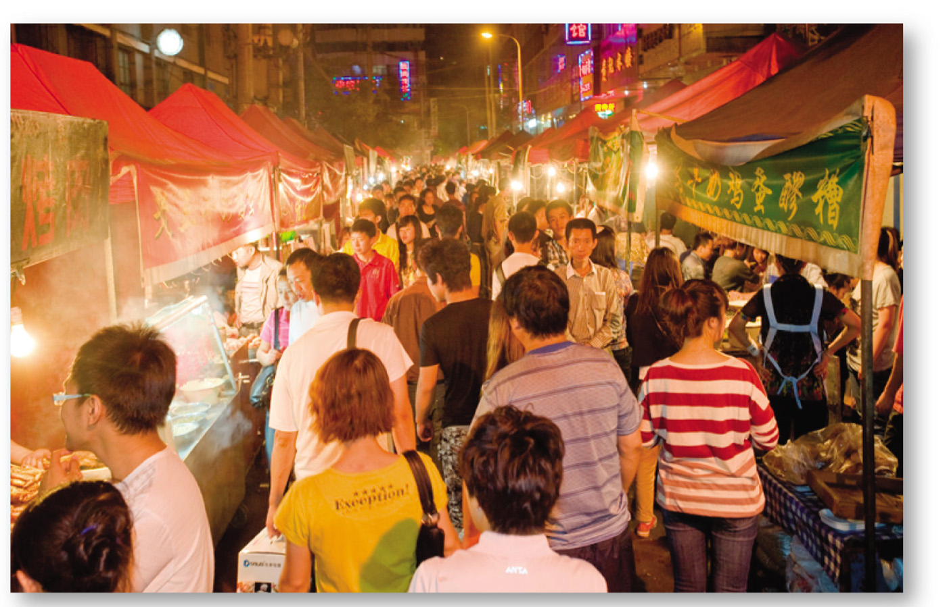
12.4.4 Megacities (4 of 6)
Figure 12-44: Jakarta may become the world’s next largest city in the mid-21st century.

Slide 58
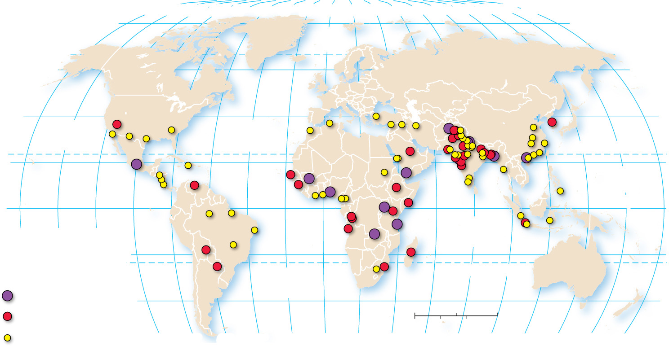
12.4.4 Megacities (5 of 6)
Figure 12-45: Nearly all of the world’s fastest growing cities are in developing countries.
160°
140°
120°
100°
80°
60°
40°
20°
0°
20°
40°
60°
80°
100°
120°
140°
160°
180°
80°
ARCTIC
OCEAN
80°
60°
60°
40°
PACIFIC
OCEAN
ATLANTIC
OCEAN
40°
TROPIC OF CANCER
20°
PACIFIC
OCEAN
20°
0°
EQUATOR
0°
160°
140°
120°
INDIAN
OCEAN
Annual growth
(percent)
20°
20°
ATLANTIC
OCEAN
TROPIC OF CAPRICORN
4.0 and above
40°
40°
3.0–3.9
0
1,500
3,000 Miles
below 3.0
0
1,500
3,000 Kilometers
100°
80°
60°
40°
20°
0°
20°
40°
60°
80°
100°
120°
140°
160°
180°

Slide 59
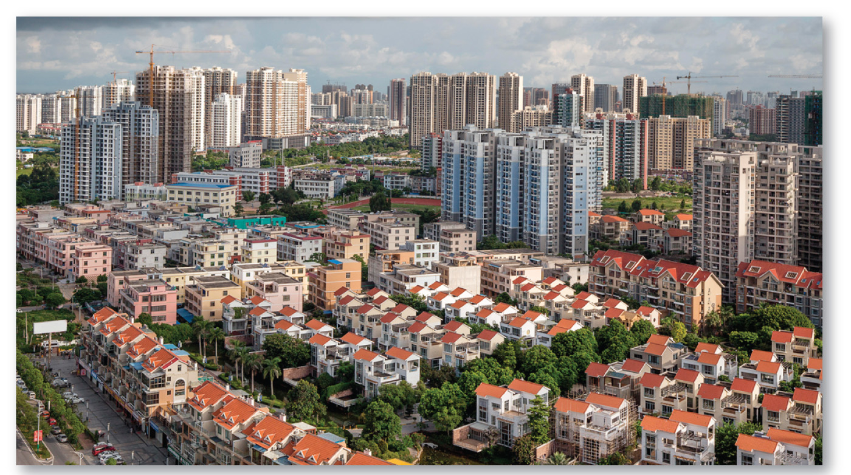
12.4.4 Megacities (6 of 6)
Figure 12-46: The world’s fastest-growing urban settlement is Beihai, located in southeastern China.

Slide 60
Copyright
This work is protected by United States copyright laws and is provided solely for the use of instructors in teaching their courses and assessing student learning. Dissemination or sale of any part of this work (including on the World Wide Web) will destroy the integrity of the work and is not permitted. The work and materials from it should never be made available to students except by instructors using the accompanying text in their classes. All recipients of this work are expected to abide by these restrictions and to honor the intended pedagogical purposes and the needs of other instructors who rely on these materials.

