Slide 1
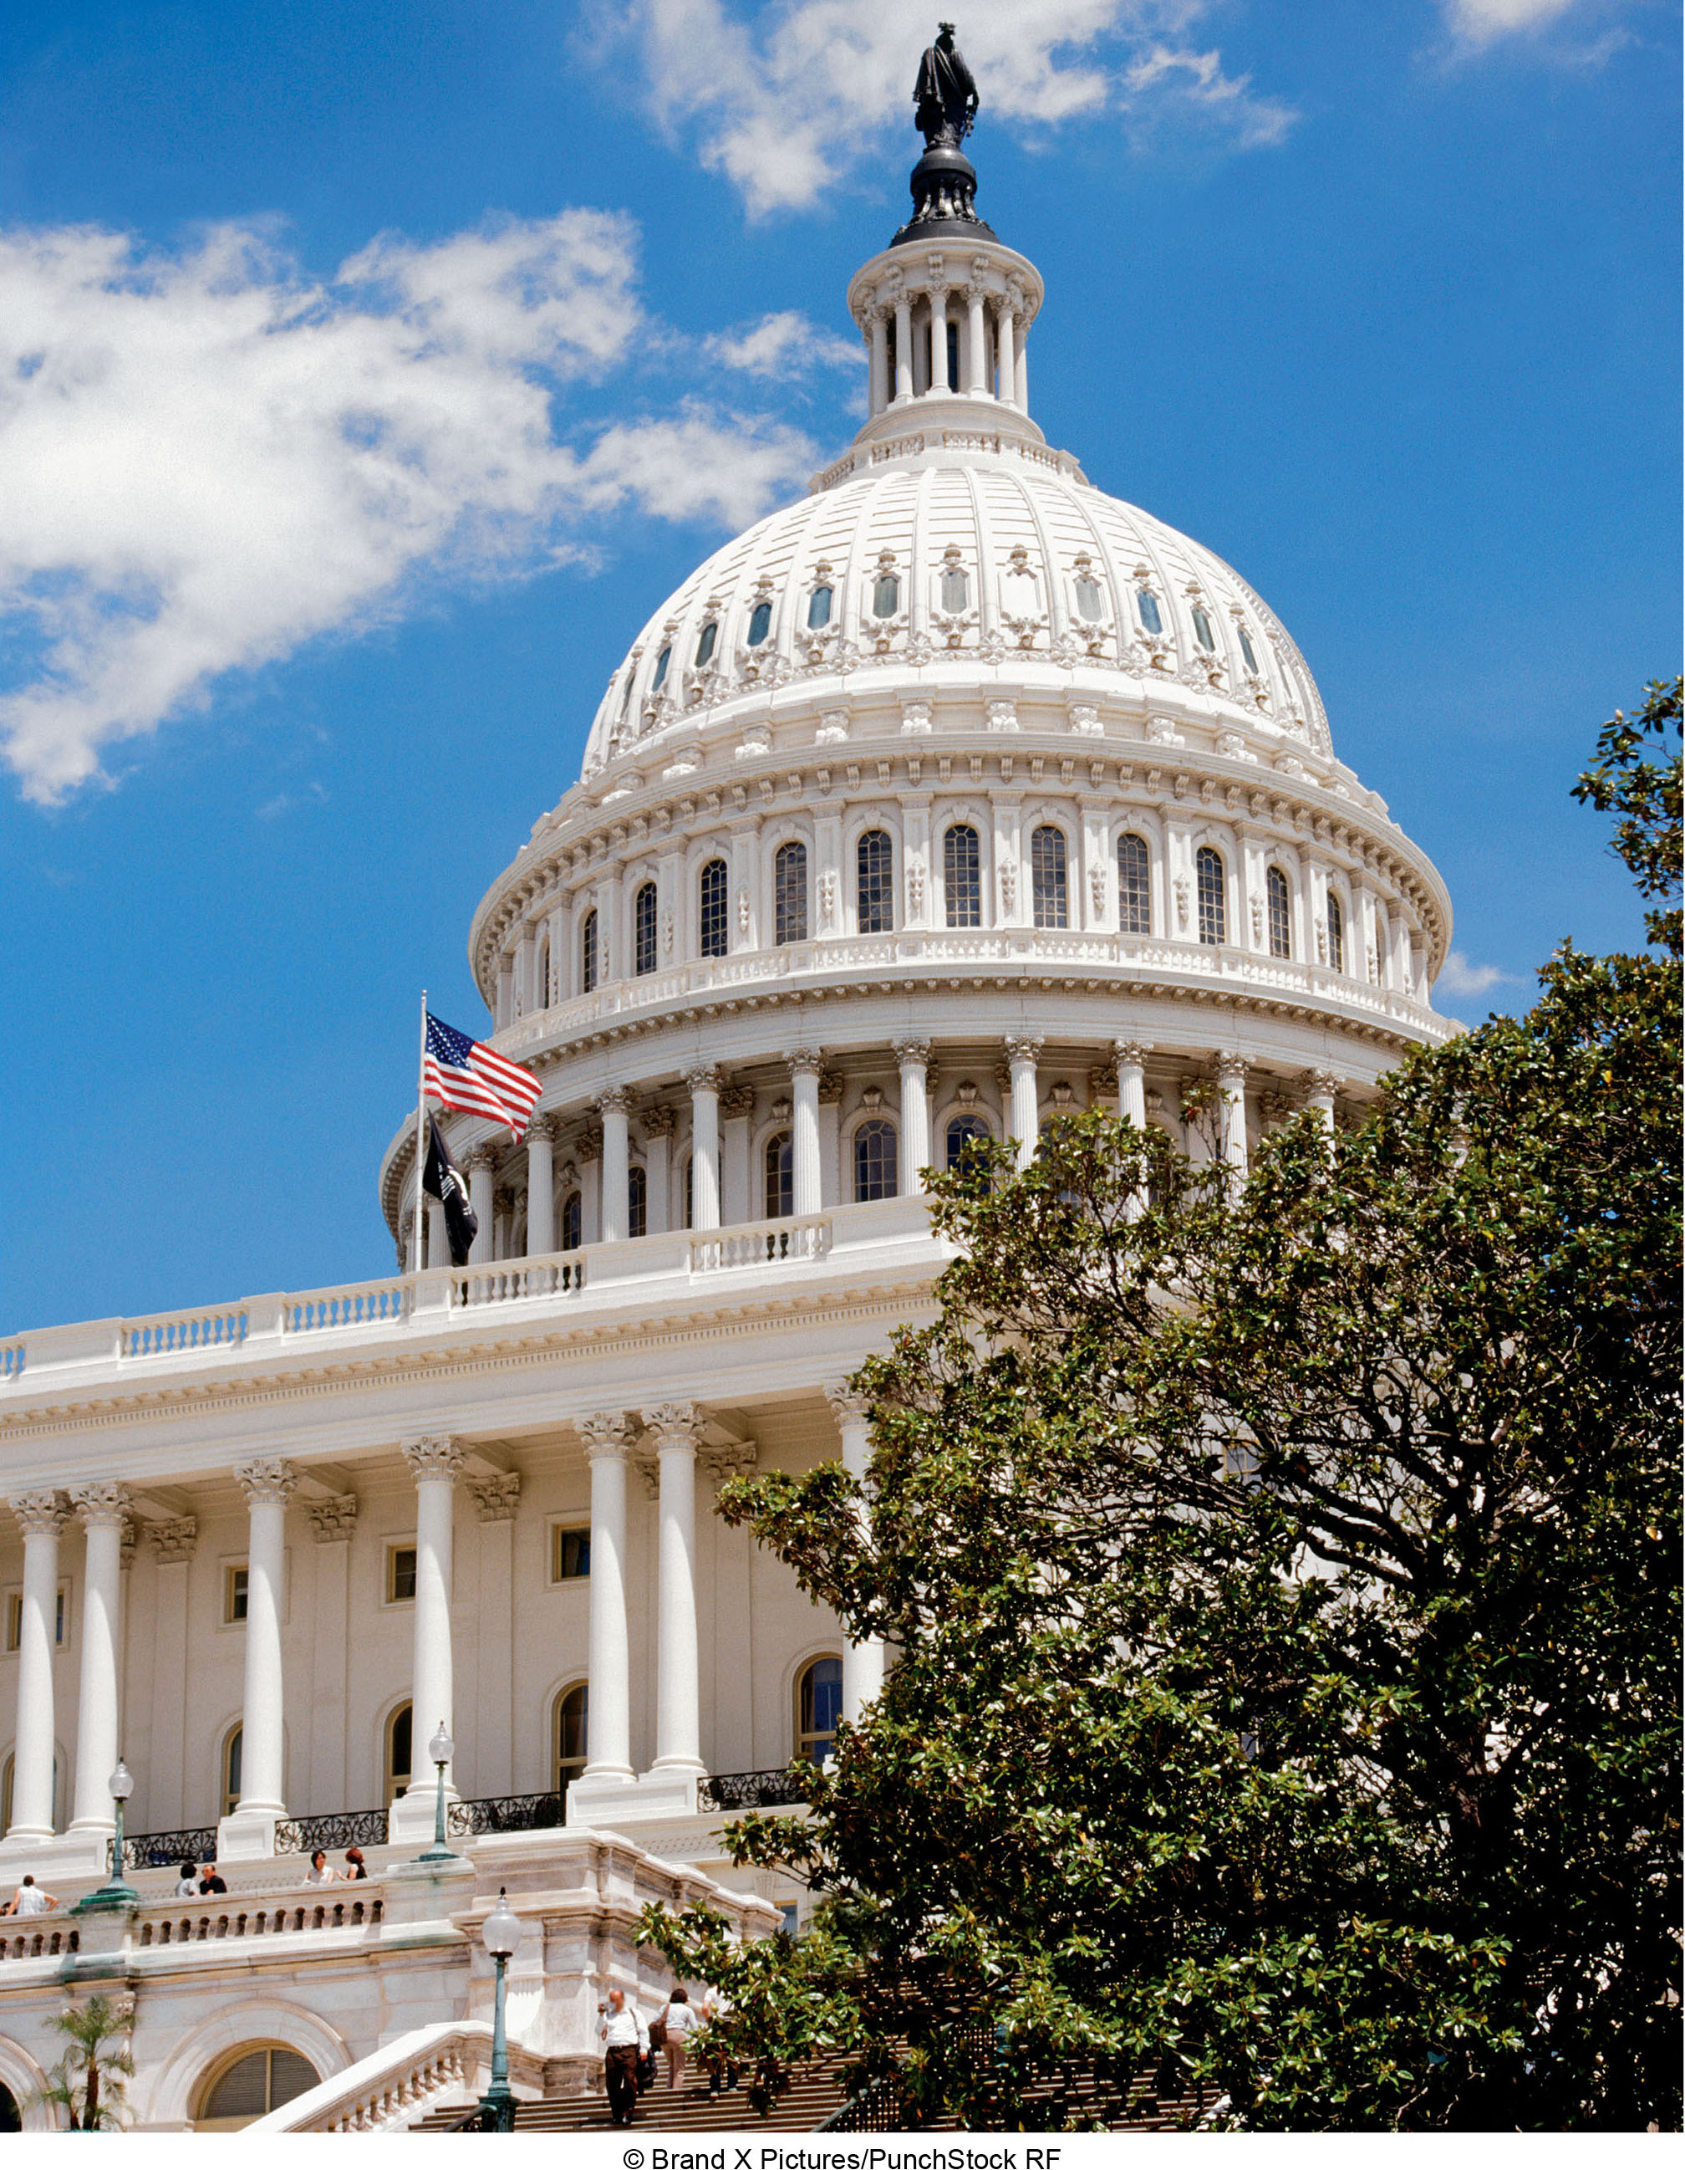
Chapter 11 LECTURE OUTLINE Geography of Governance and Representation
Human Geography by Malinowski & Kaplan

Slide 2
Chapter 11 Modules
11A Territoriality
11B Political Economy and Functions of the Modern State
11C Theories of the State
11D Citizenship
11E Subdividing the State
11F Cores and Capitals
11G Peripheral and Special Regions
11H Electoral Geography
11I Electoral Systems and Manipulation

Slide 3
11A: Territoriality
Organizations divide territory into smaller pieces, or political subunits
Pros:
Basic efficiency
Greater flexibility
Greater degree of responsiveness
Cons:
Subdividing territory can restrict access to some regions
Proliferation of subdivisions can lead to a mismatch between the problems and the ability to deal with them

Slide 4
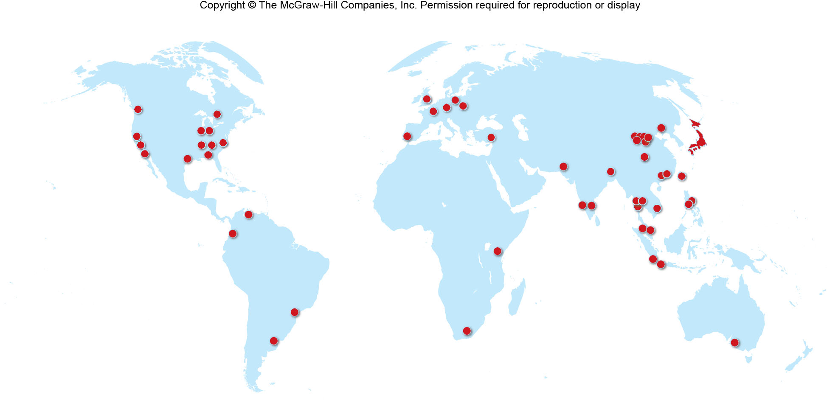
Toyota Manufacturing Plans
Figure 11A.1

Slide 5
11B: Political Economy & Functions of the Modern State
Political economy
the relationship among the state, the members of the state, and the economic activities contained within the state
States practice a mixed economy of both private and public sectors

Slide 6
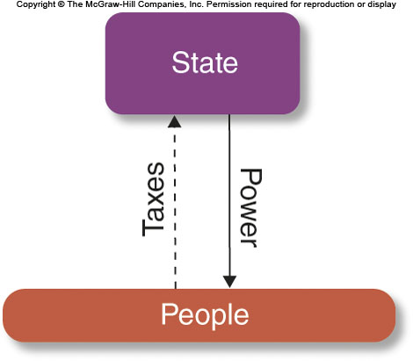
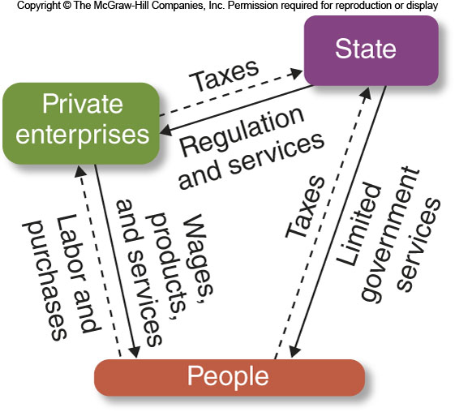
Types of Economies 1
Figures 11B.1 & 11B.2
EXTRACTION ECONOMY
CAPITALIST ECONOMY

Slide 7
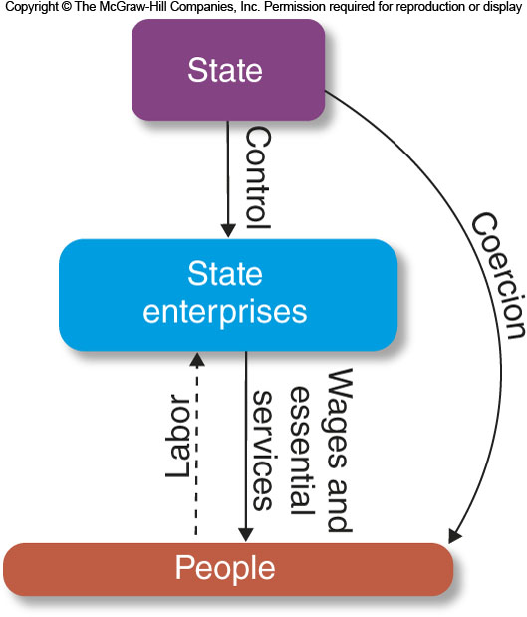
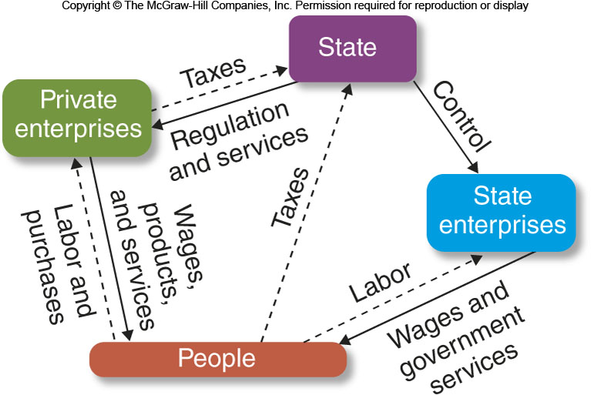
Types of Economies 2
Figures 11B.3 & 11B.4
COMMUNIST ECONOMY
MIXED ECONOMY

Slide 8
11C: Theories of the State 1
Pluralist theories of the state
View government as a neutral arbiter of all stakeholders
Neoliberalism: a set of policies that favor minimal government interference in markets and promotion of free trade
Elite theories of the state
See governments as likely to support an elite class of people

Slide 9
11C: Theories of the State 2
Marxist theories of the state
See government as a vehicle promoting capitalism and capitalist systems

Slide 10
11C: Types of Governments
Authoritarian, or autocratic, states
Concentration of political power in a single individual
Or in a few, termed an oligarchy
Totalitarianism is a type of autocracy associated with fascism, communism, and religious fundamentalism

Slide 11
11D: Citizenship
In the past, residents of a state were subjects
Citizenship is rooted in ancient Greece & Rome
Implies that some or all citizens have certain rights & responsibilities
Citizenship can be determined in two ways:
Jus sanguinis (“right of blood”) means citizenship is based on your parents
Jus soli (“right of the soil”) means citizenship based on birth within a state’s territory
United States has a jus soli system
Some states allow dual citizenship

Slide 12
11E: Subdividing the State
States divide territory into political subunits
Unitary states
Nearly all power resides in the central government
Federal states
Subunits have a certain amount of their own authority
Helps stability
Sometimes there is asymmetrical federalism, when some subunits have more power than others
Quebec in Canada
Confederations
Sovereign states agree to abridge some of their independent powers in order to work together as a group

Slide 13
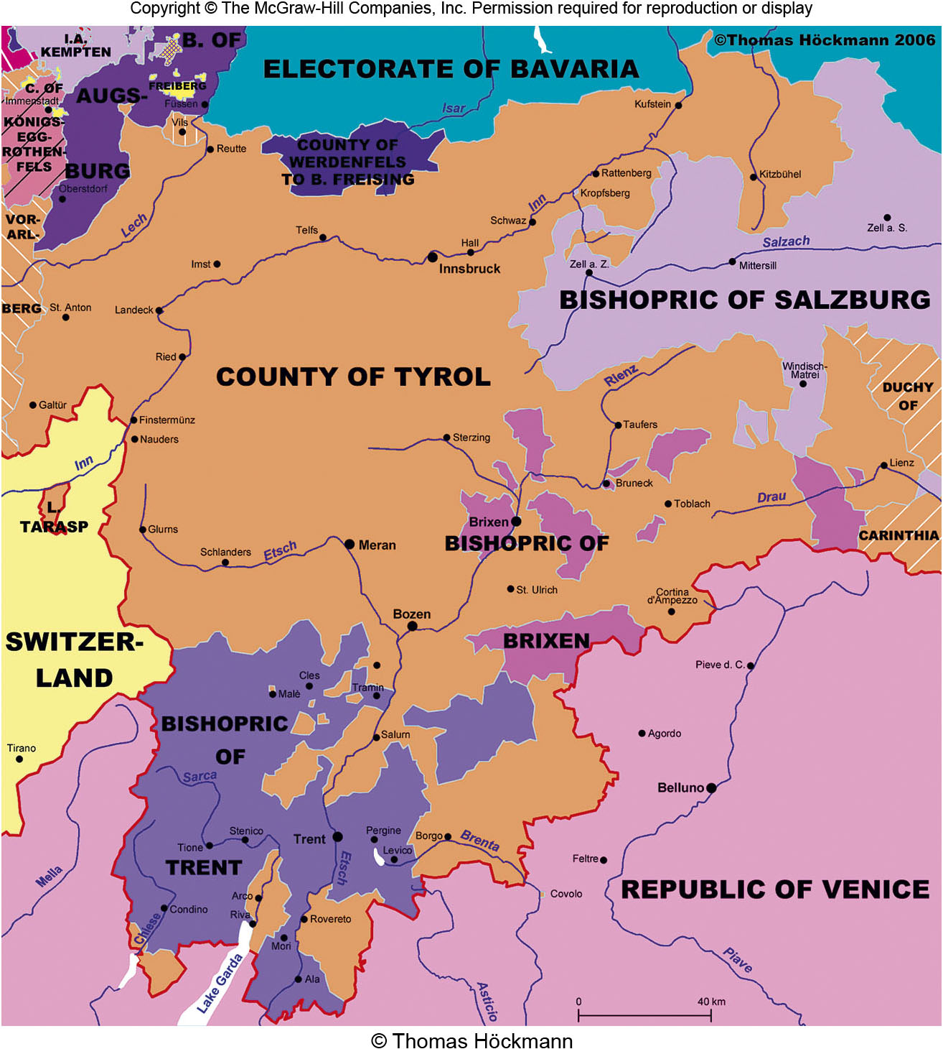
Tirol
Figure 11E.2

Slide 14
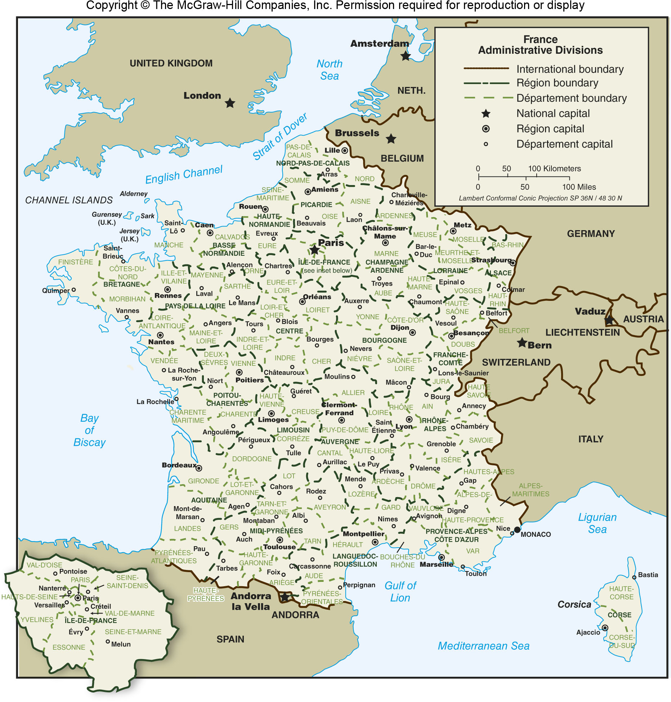
Provinces of France
Figure 11E.4

Slide 15
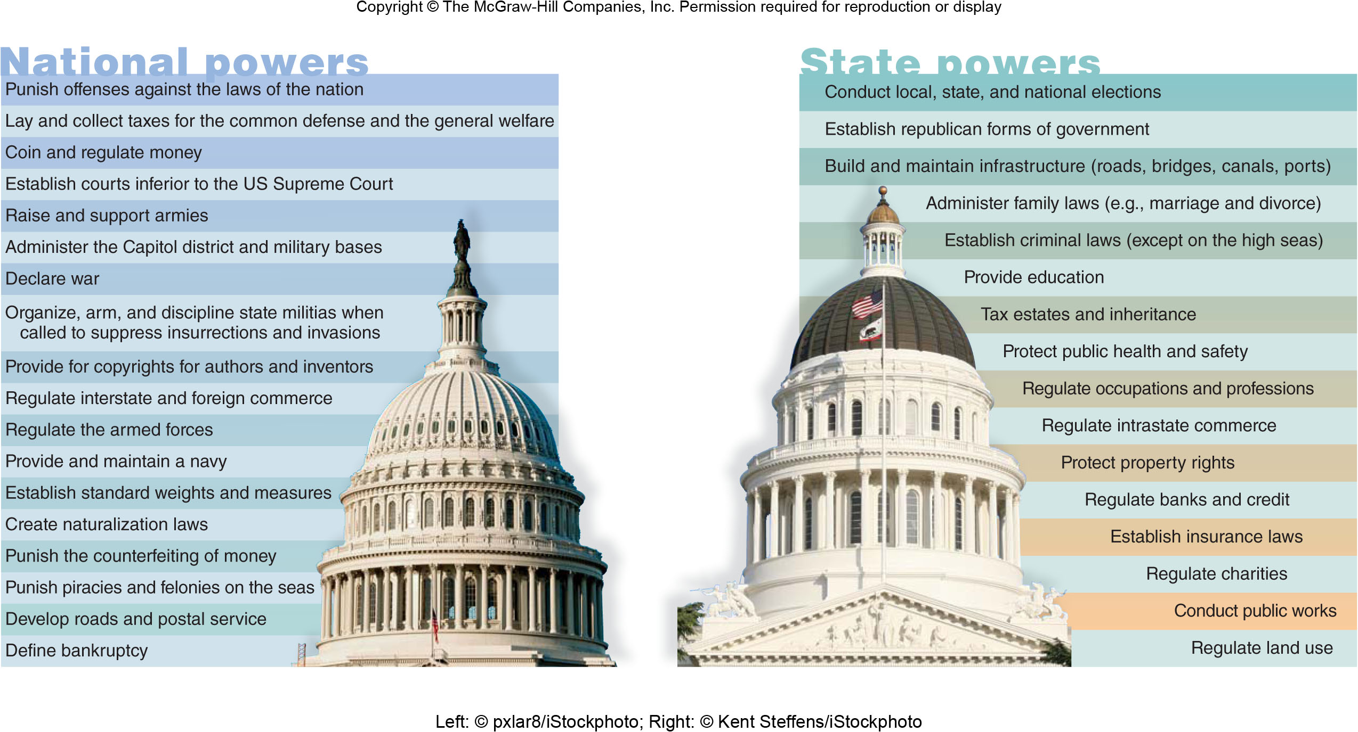
National vs. State Powers
Figure 11E.5

Slide 16
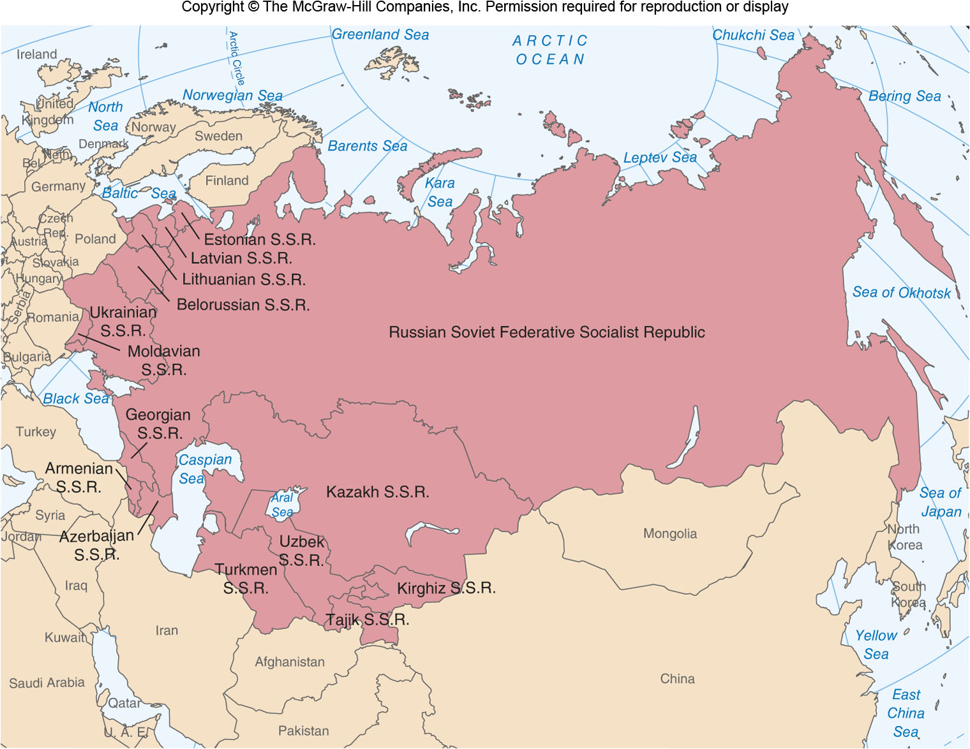
U.S.S.R.
Figure 11E.7

Slide 17
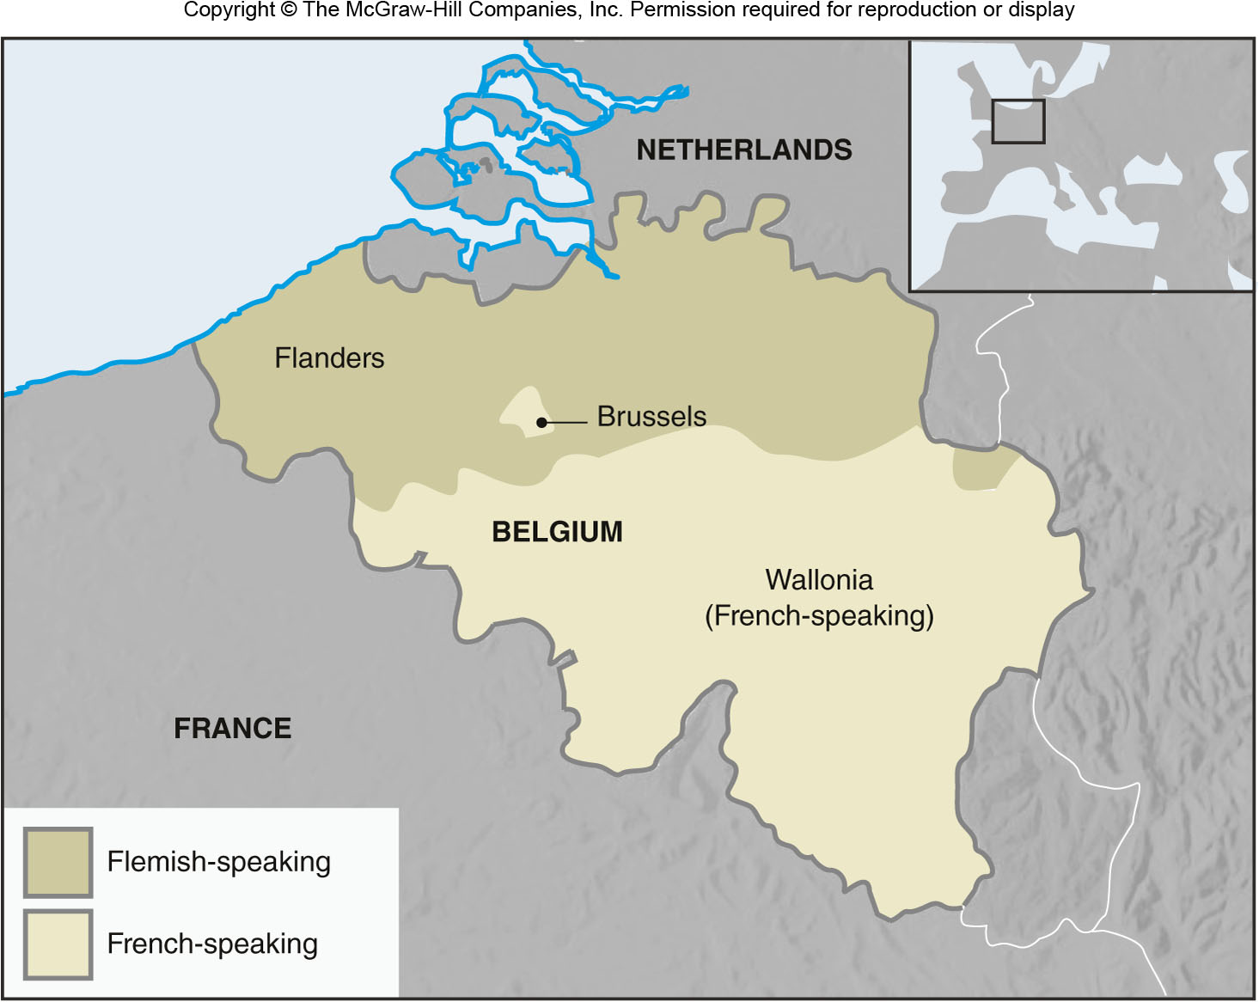
Belgium
Figure 11E.9

Slide 18
11F: Cores & Capitals
Core Region
Place or region where the state and the dominant nationality emerged or is concentrated
Capital city & capital region
The capital may or may not be the core region
In about 50% of countries, the capital is also the largest city
A capital’s location can be controversial

Slide 19
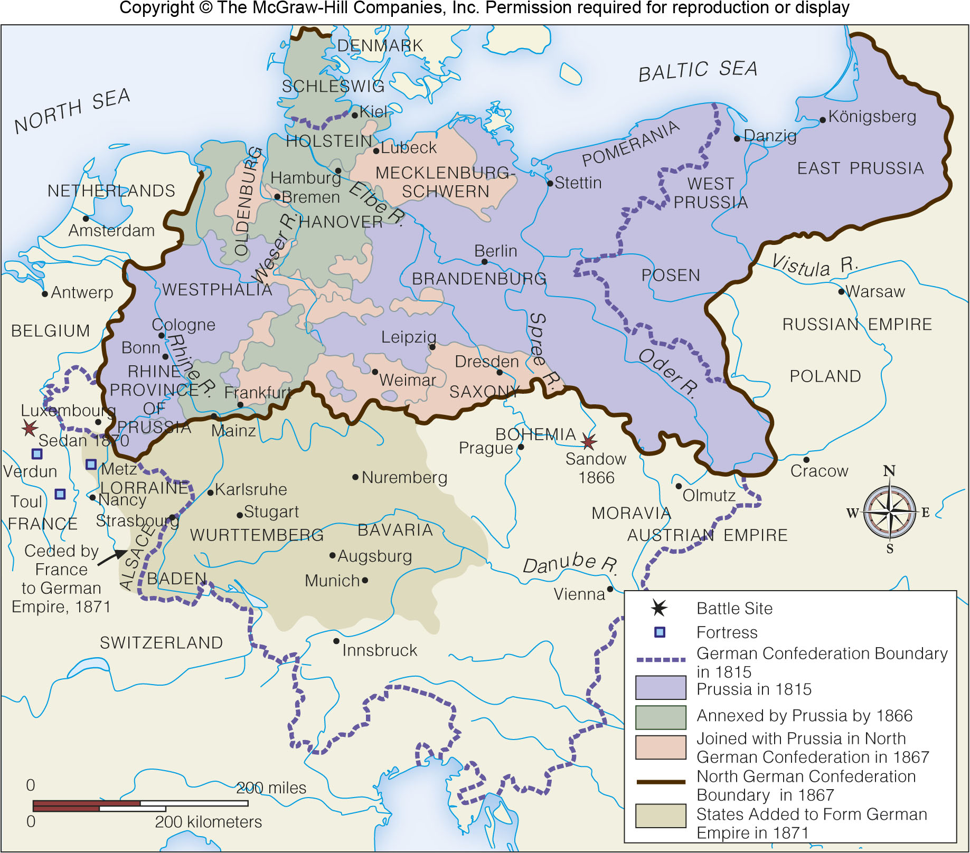
Germany’s Lack of a Core Area
Figure 11F.2

Slide 20
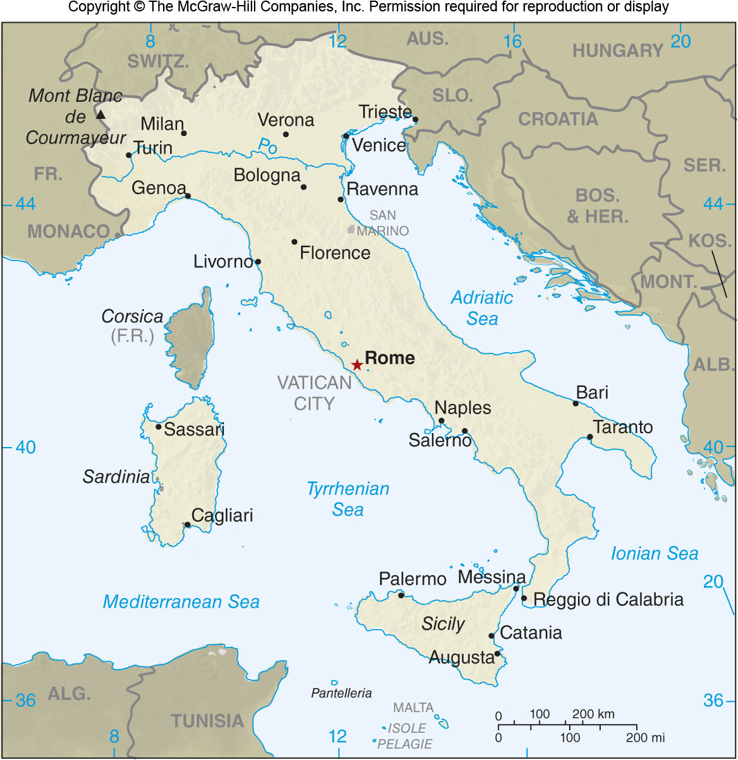
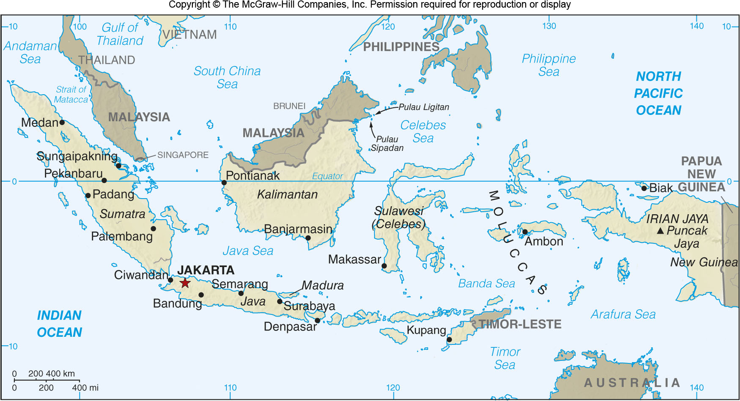
Capitals 1
Figures 11F.5 & 11F.6

Slide 21
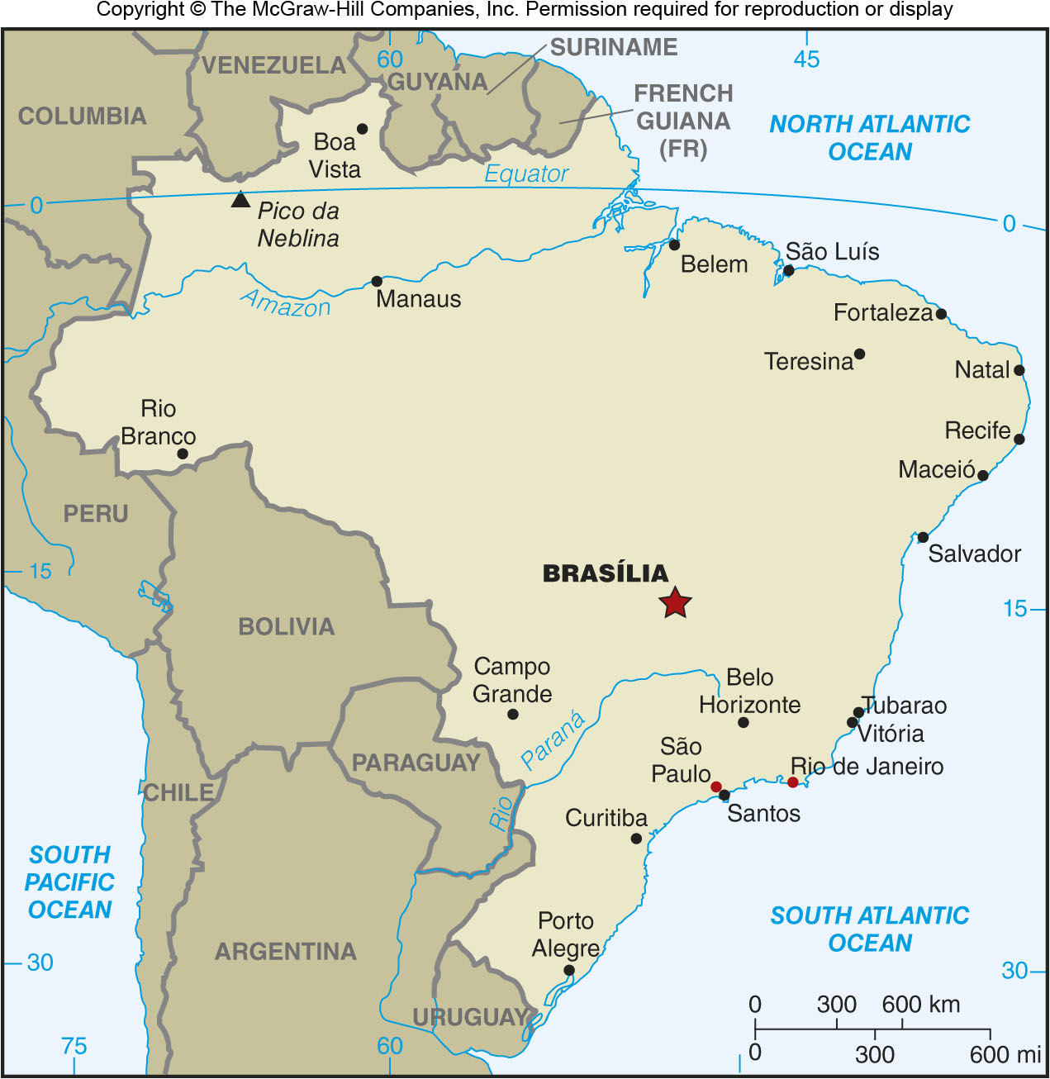
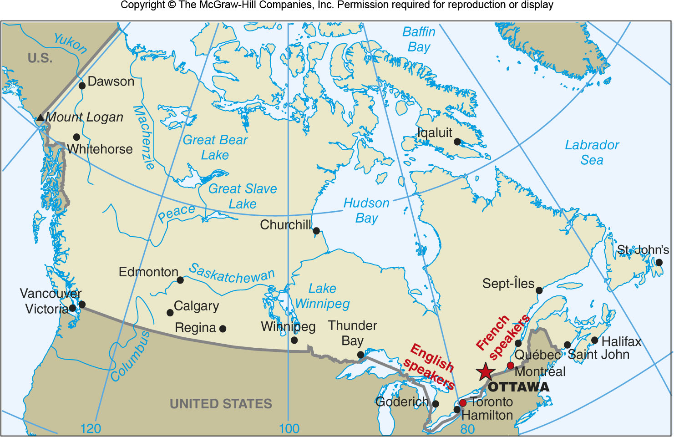
Capitals 2
Figures 11F.7 & 11F.8
[insert Figure 11F.7 here]

Slide 22
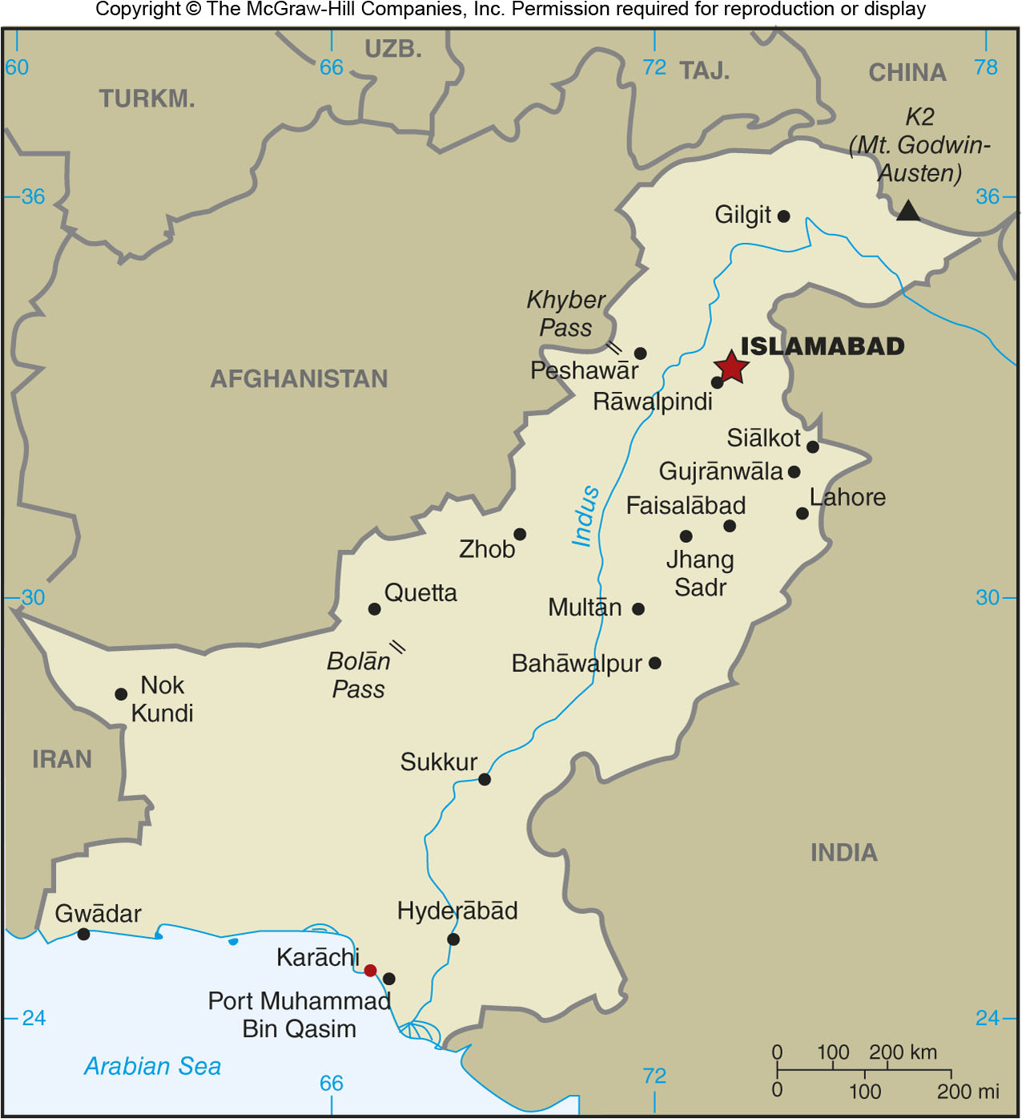
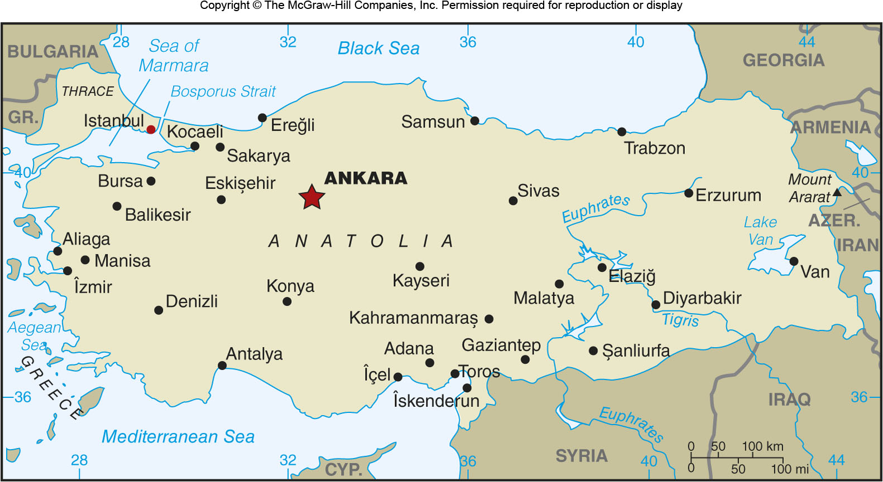
Capitals 3
Figures 11F.9 & 11F.10

Slide 23
11G: Peripheral & Special Regions
Peripheral Regions
Can be at the edge of effective political control, areas recently added to the state, areas that are culturally distinct, or they may be exclaves
Special Regions
Political subunits that are granted different powers than regular subunits
Some countries have various types of subunits, like provinces and territories (Canada)
Reservations for indigenous peoples are an example of a special region

Slide 24
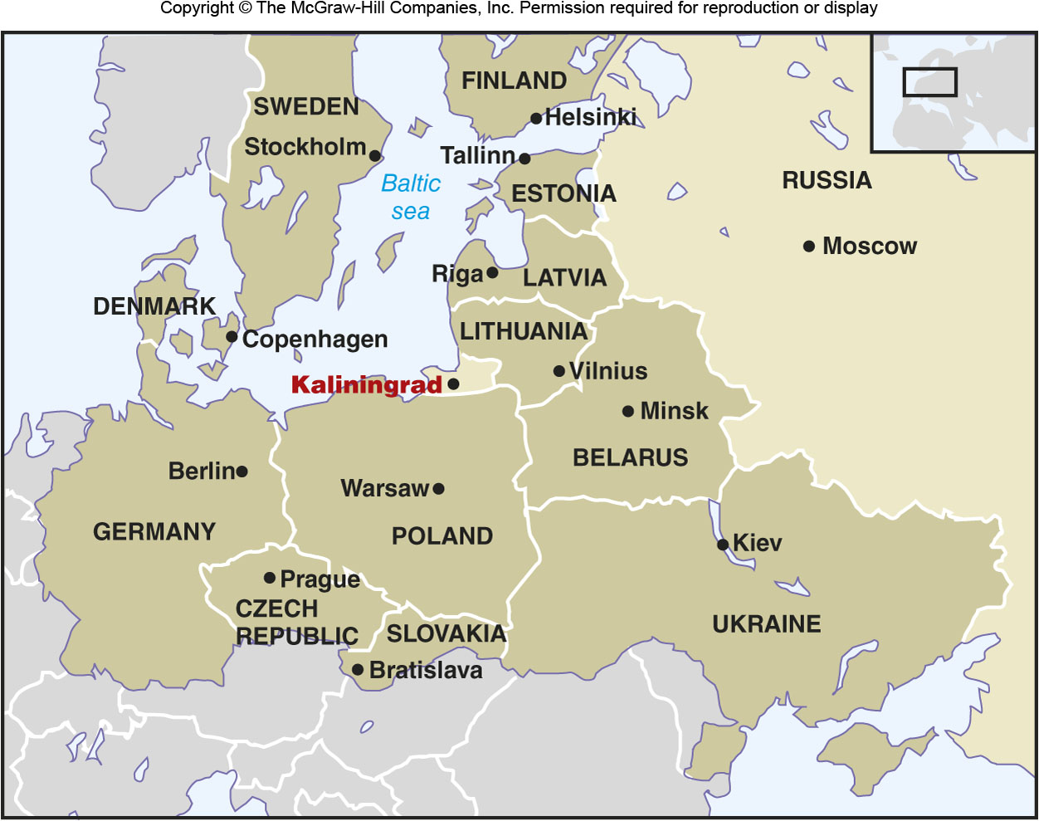
Exclave
When part of a state’s territory is geographically separated by another country.
Figures 11G.2

Slide 25
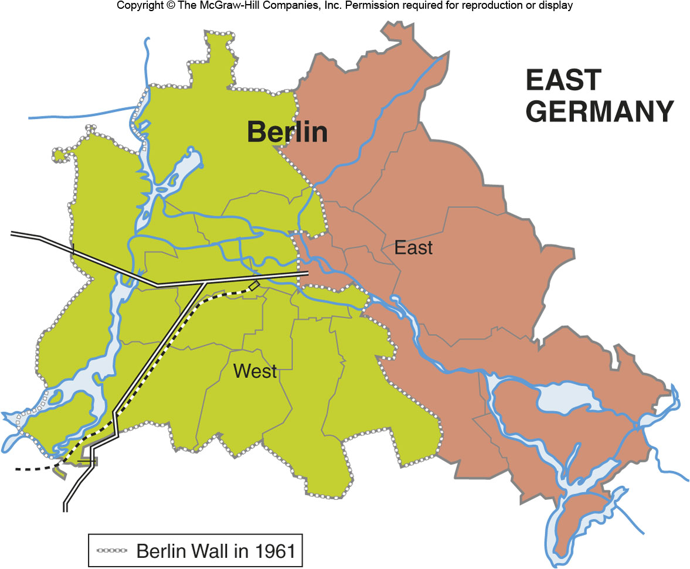
Enclave
A part of a country or an entire country that is surrounded by another country.
Figures 11G.3

Slide 26
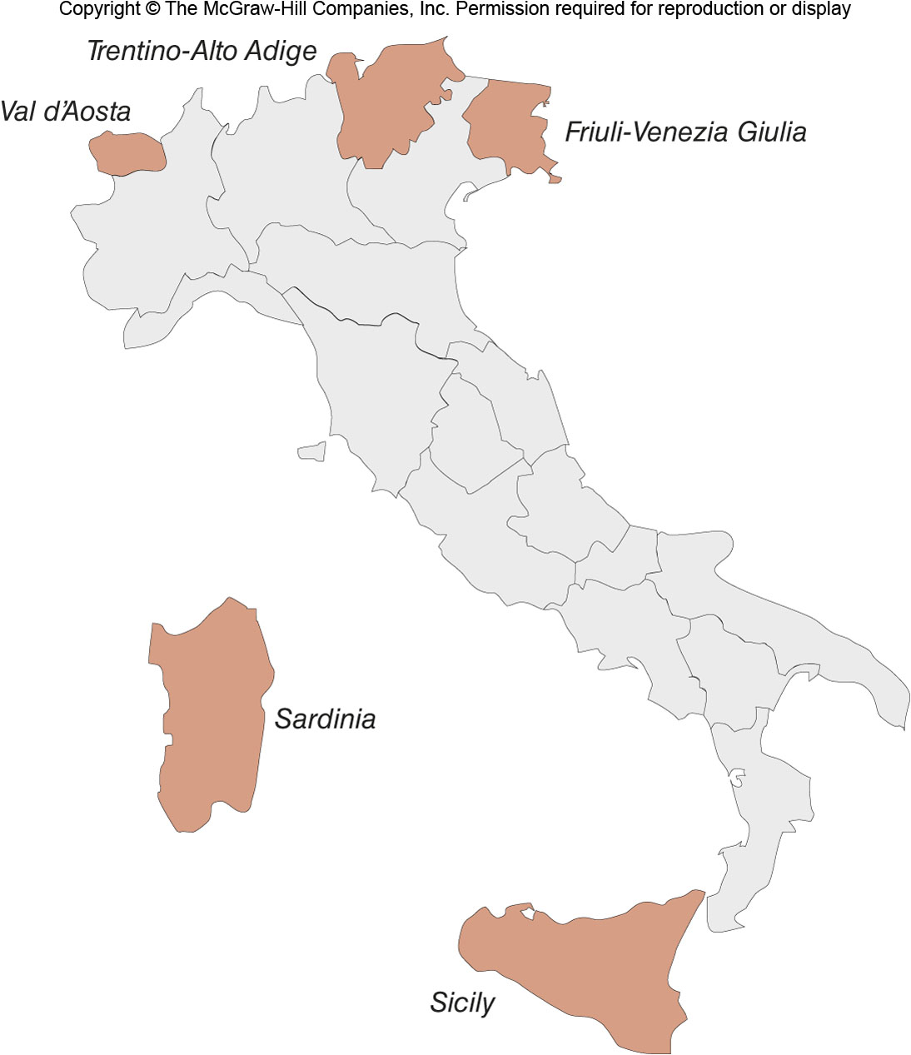
Italy’s Autonomous Regions
Figures 11G.6

Slide 27
11H: Electoral Geography
Most democratic societies are representative democracies, not pure democracies
Electoral geography examines how people’s political preferences are manifested in representation
Geography of election outcomes
Where support is strongest, weakest, etc.

Slide 28
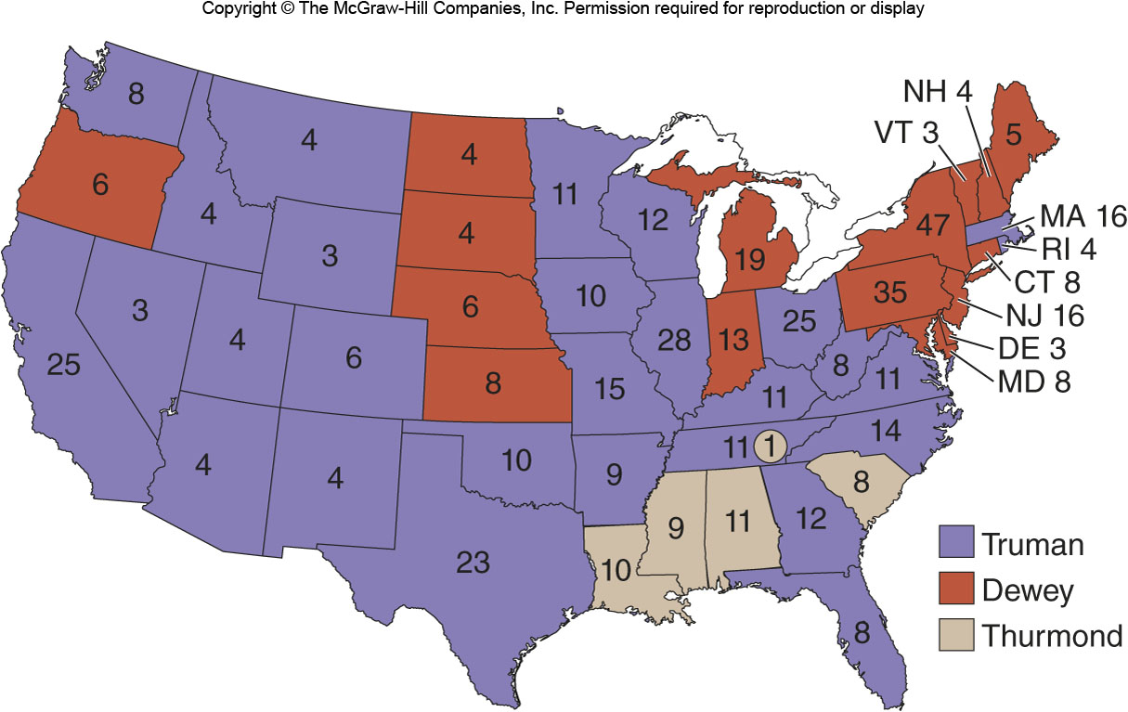
Presidential Election of 1948
Figures 11H.1

Slide 29
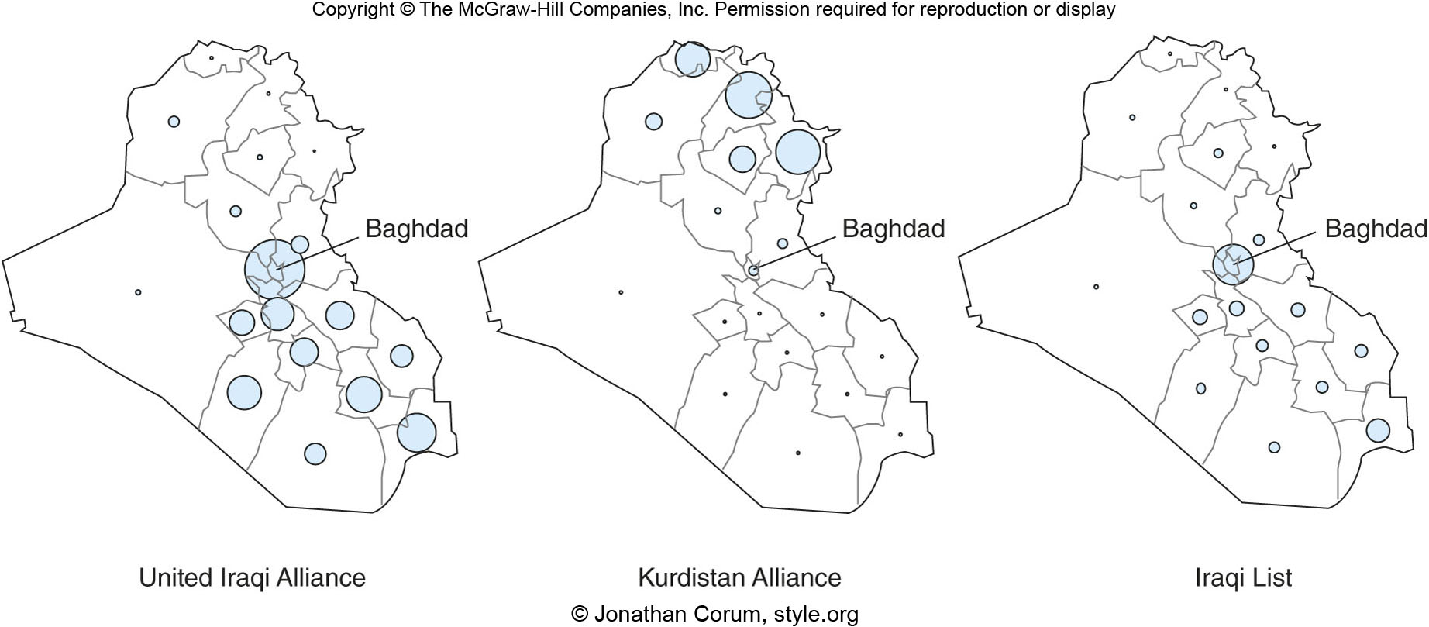
Iraq’s First Election
Figures 11H.2

Slide 30
11I: Electoral Systems & Manipulation
Electoral districts can be manipulated to produce results that favor one party or political interest
Malapportionment
Manipulation in which some electoral districts vary in size even though they are equal in representation
U.S. Senate
Supreme Court 1962: “one person, one vote”

Slide 31
11I: Types of Electoral Systems
Single member plurality system
The most votes wins
Majoritarian system
Winner must have a majority
List system of proportional representation
An electoral system can have more than one representative if a certain threshold is met
Mixed system
Includes proportional voting and a plurality system

Slide 32
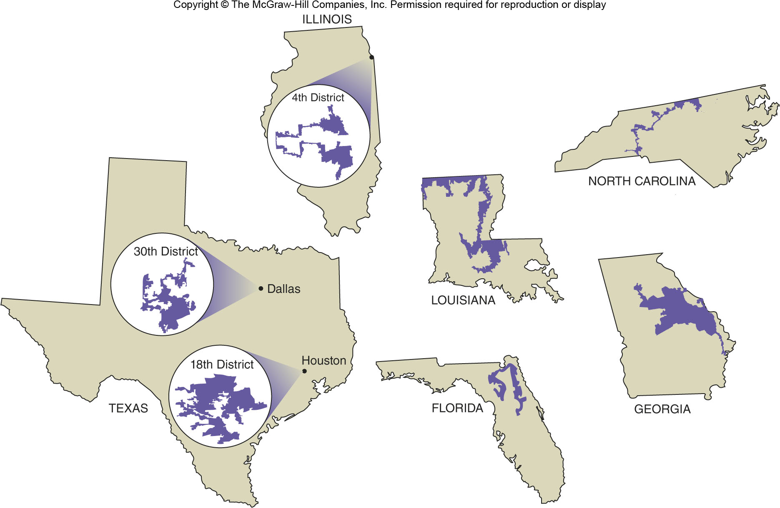
11I: Gerrymandering
Manipulation that concentrates the support of one party or one group of people in one district and dilutes their support throughout a number of other districts.

