Slide 1
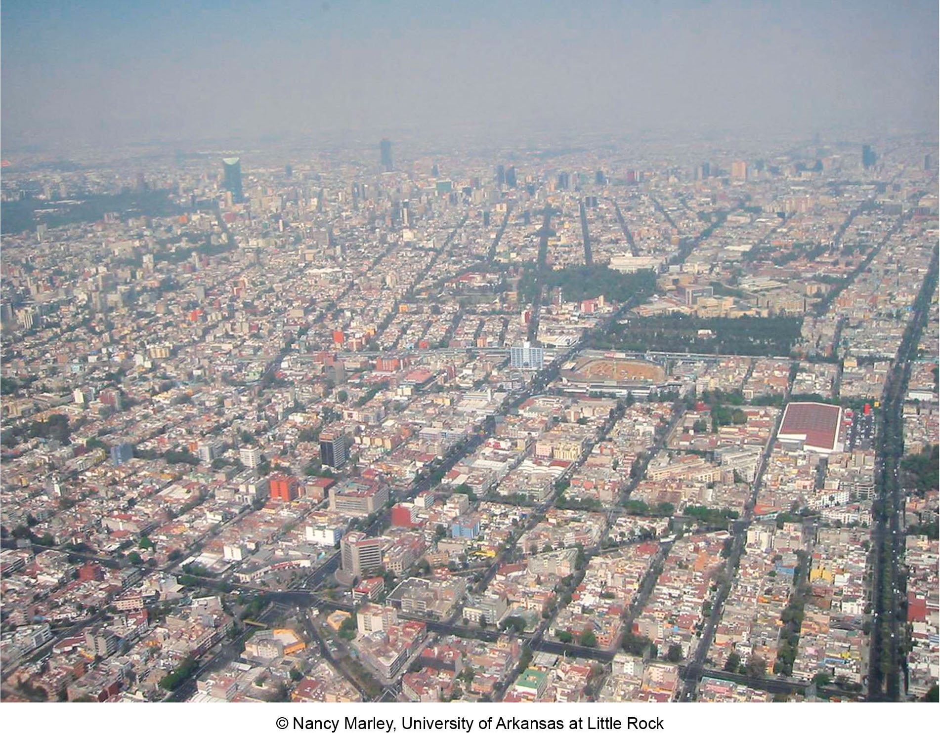
Chapter 13 LECTURE OUTLINE urbanization & urban networks
Copyright © The McGraw-Hill Companies, Inc. Permission required for reproduction or display.
Human Geography by Malinowski & Kaplan

Slide 2
Chapter 13 Modules
13A Urban Beginnings
13B Early Spread of Urbanism
13C Urbanization in an Era of Capitalism
13D Industrial Cities
13E The Urbanization Curve
13F Urbanization Patterns around the World
13G Agglomeration Economies and Urban Functions
13H Urban Hierarchies and the Rank-Size Relationship
13I Globalization and World Cities

Slide 3
13A: Urban Beginnings
Cities are relatively new in human history
Domestication of agriculture led to permanent settlements
More food led to higher population densities
Food surpluses led to institutions to store, tax, distribute, and trade food
Agriculture is on a schedule, leading to planning, religion to predict rainfall, etc.
More division of labor in areas with irrigation because someone need to dig channels, etc.

Slide 4
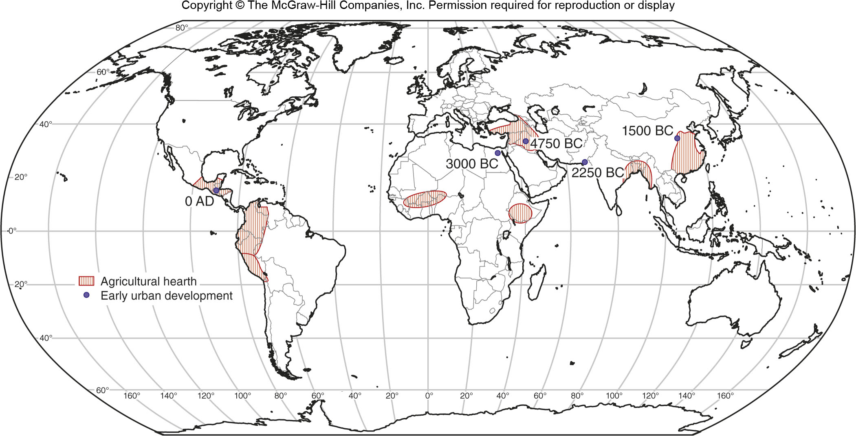
Early Urbanization
Figure 13A.1

Slide 5
13B: Early Spread of Urbanism
After the core urban hearths were established, the idea of cities spread
Early cities developed hinterlands to support themselves
River locations were critical for farming and for transportation, but technology changes allowed cities in other areas to form
City-states evolved into territorial states which sometimes became empires
Empires developed huge capital cities and promoted the growth of provincial capitals

Slide 6
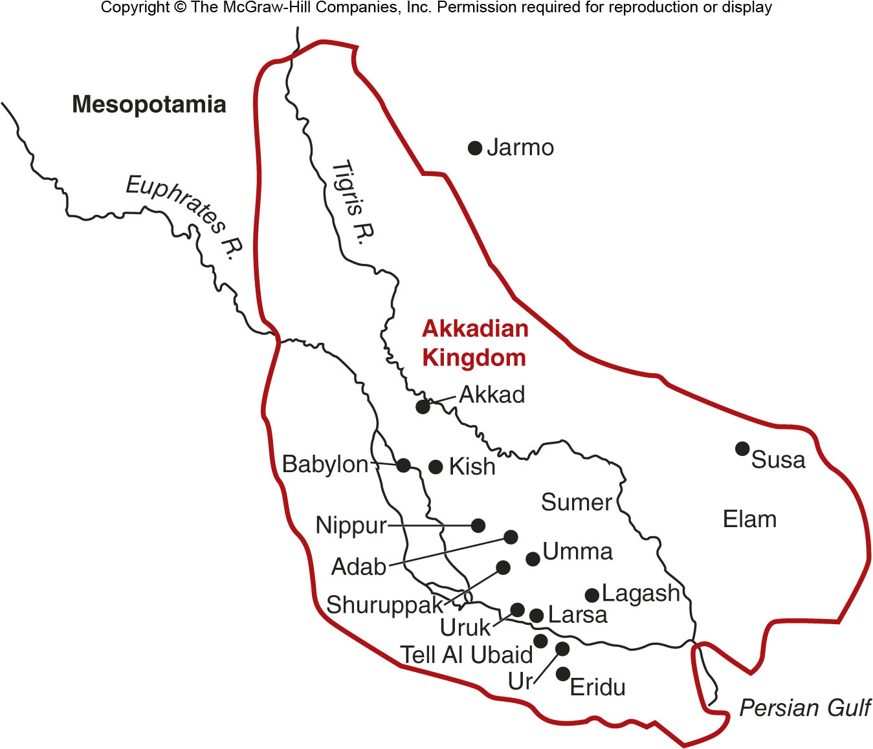
Sumerian Cities
Figure 13B.2

Slide 7
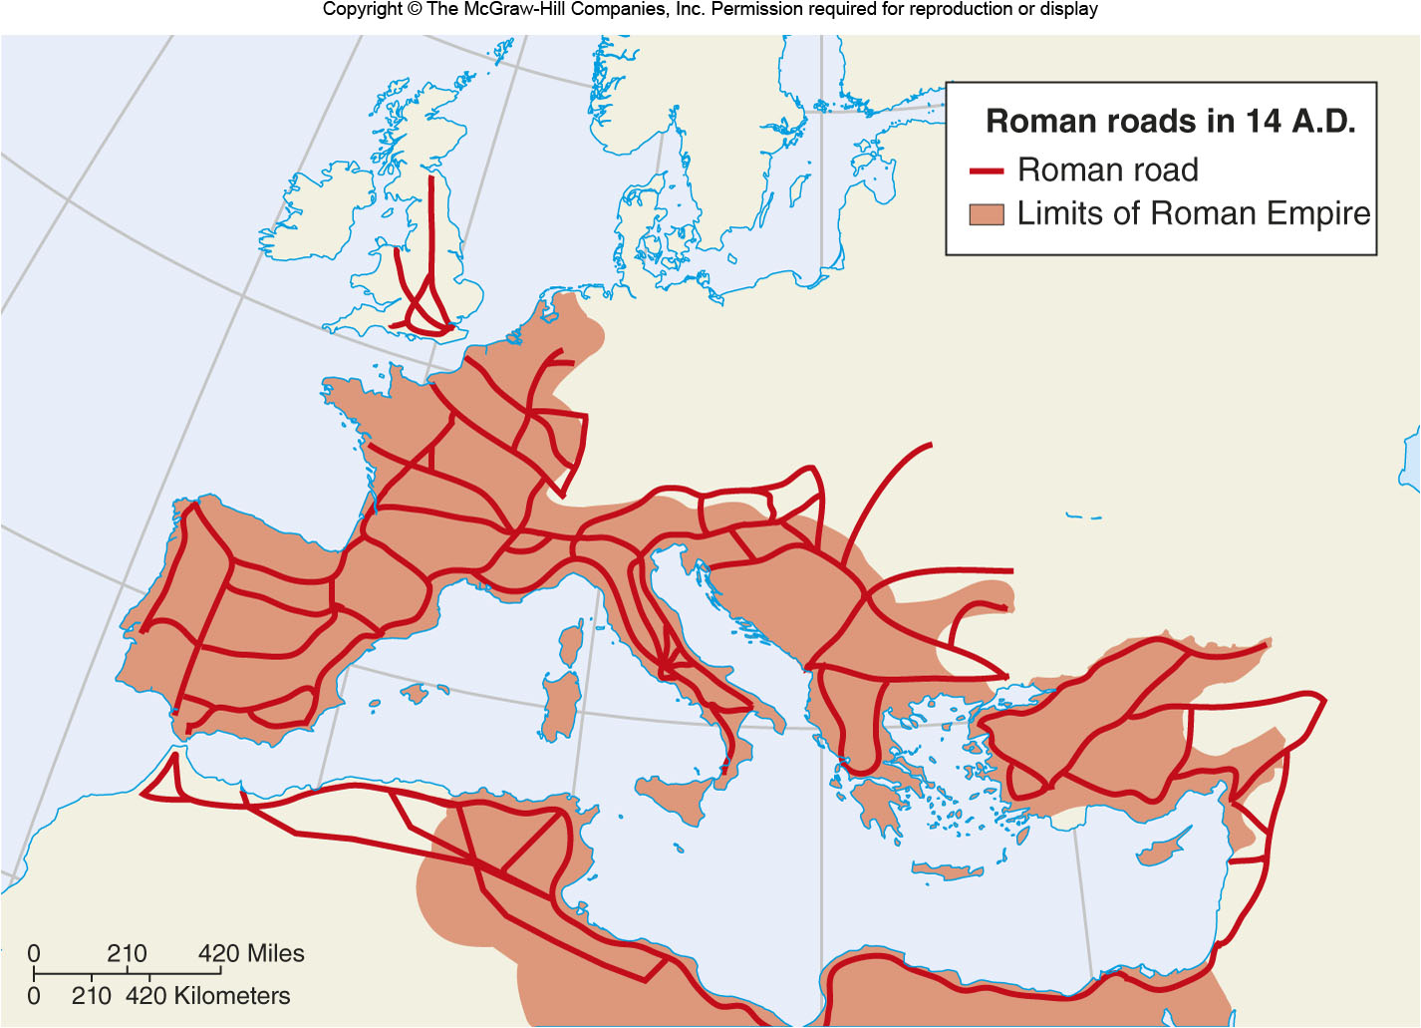
Roman Empire in 14A.D.
Figure 13B.4

Slide 8
13C: Urbanization in an Era of Capitalism
Urbanization
The increase in the percentage of people who live in cities
Not the same as an increase in the size of a city
A city’s situation is critical because it needs to rely on and protect its hinterland
Capitalism led to cities that relied more on the activities of merchants than politicians
Capitalist cities formed into urban networks with strong functional linkages to other cities and areas

Slide 9
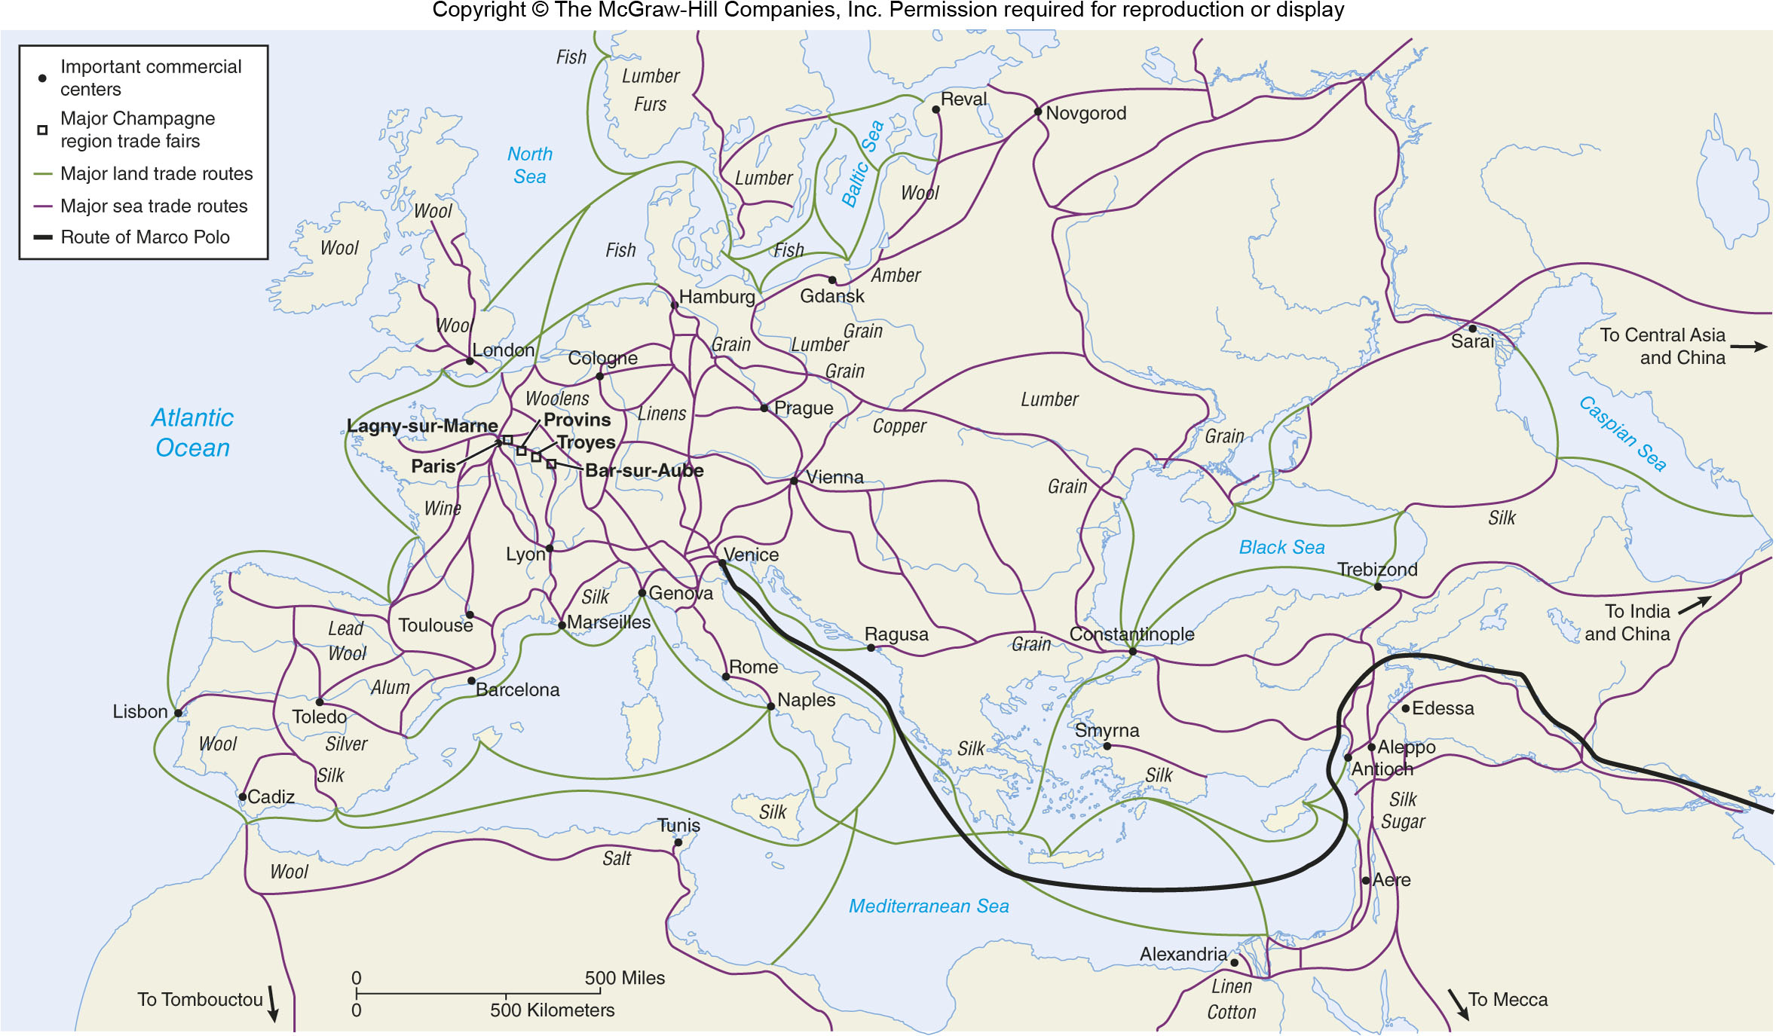
Medieval Trade Networks
Figure 13C.2

Slide 10
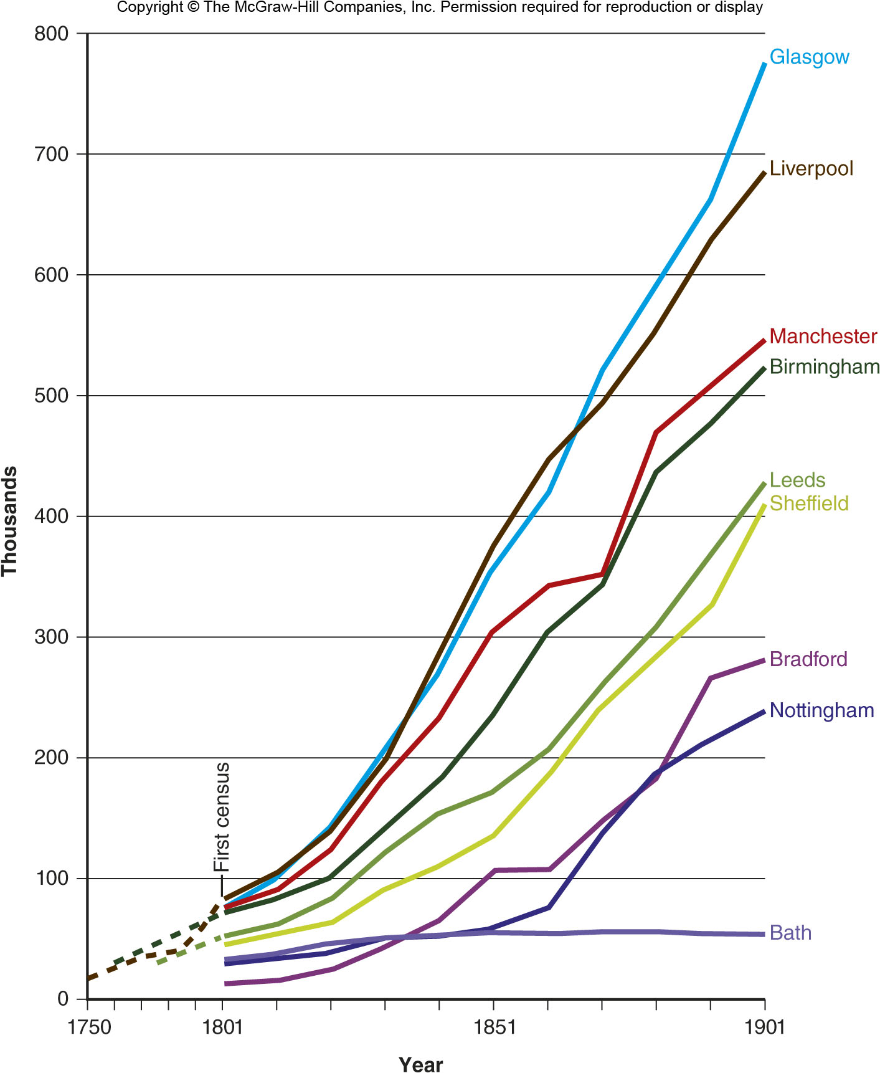
13D: Industrial Cities
Industrialization required a lot of labor
Which required more efficient agriculture
Better transportation allowed cities to get food and resources from farther away

Slide 11
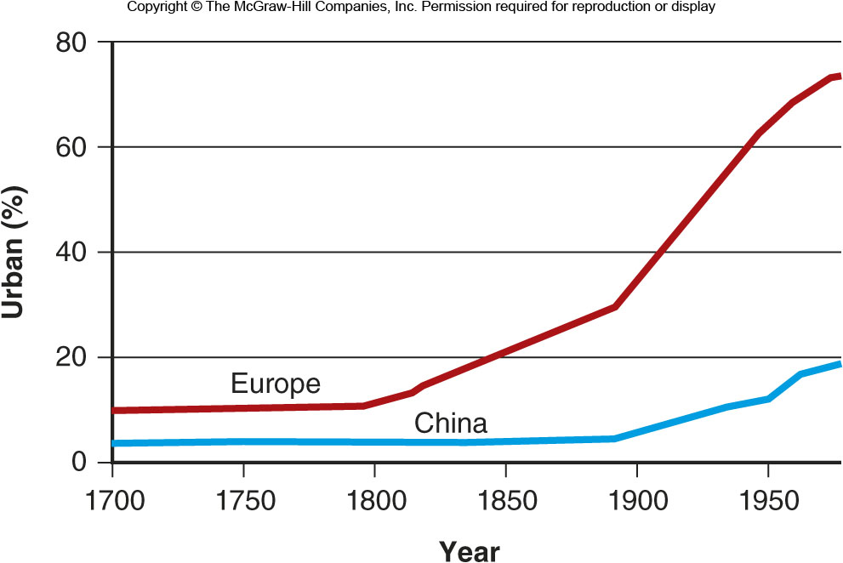
Urbanization in Europe
Figure 13D.3

Slide 12
13E: The Urbanization Curve
A way to describe the process by which a society becomes more urban
An S-curve, meaning that urbanization starts slowly, then accelerates, then levels off

Slide 13
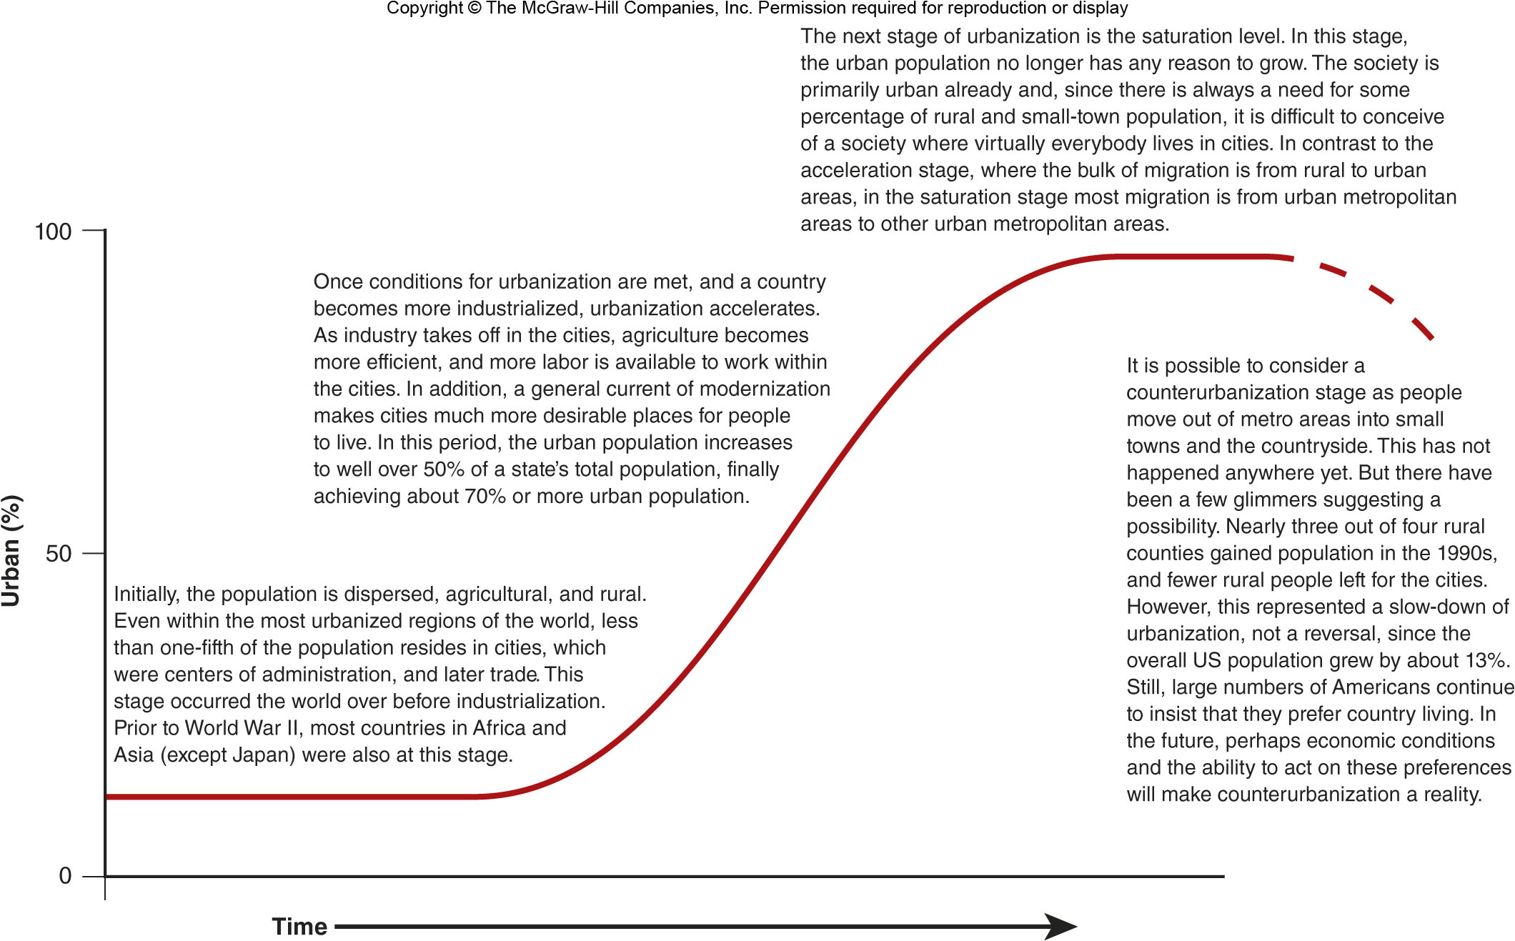
The Urbanization Curve
Figure 13E.1

Slide 14
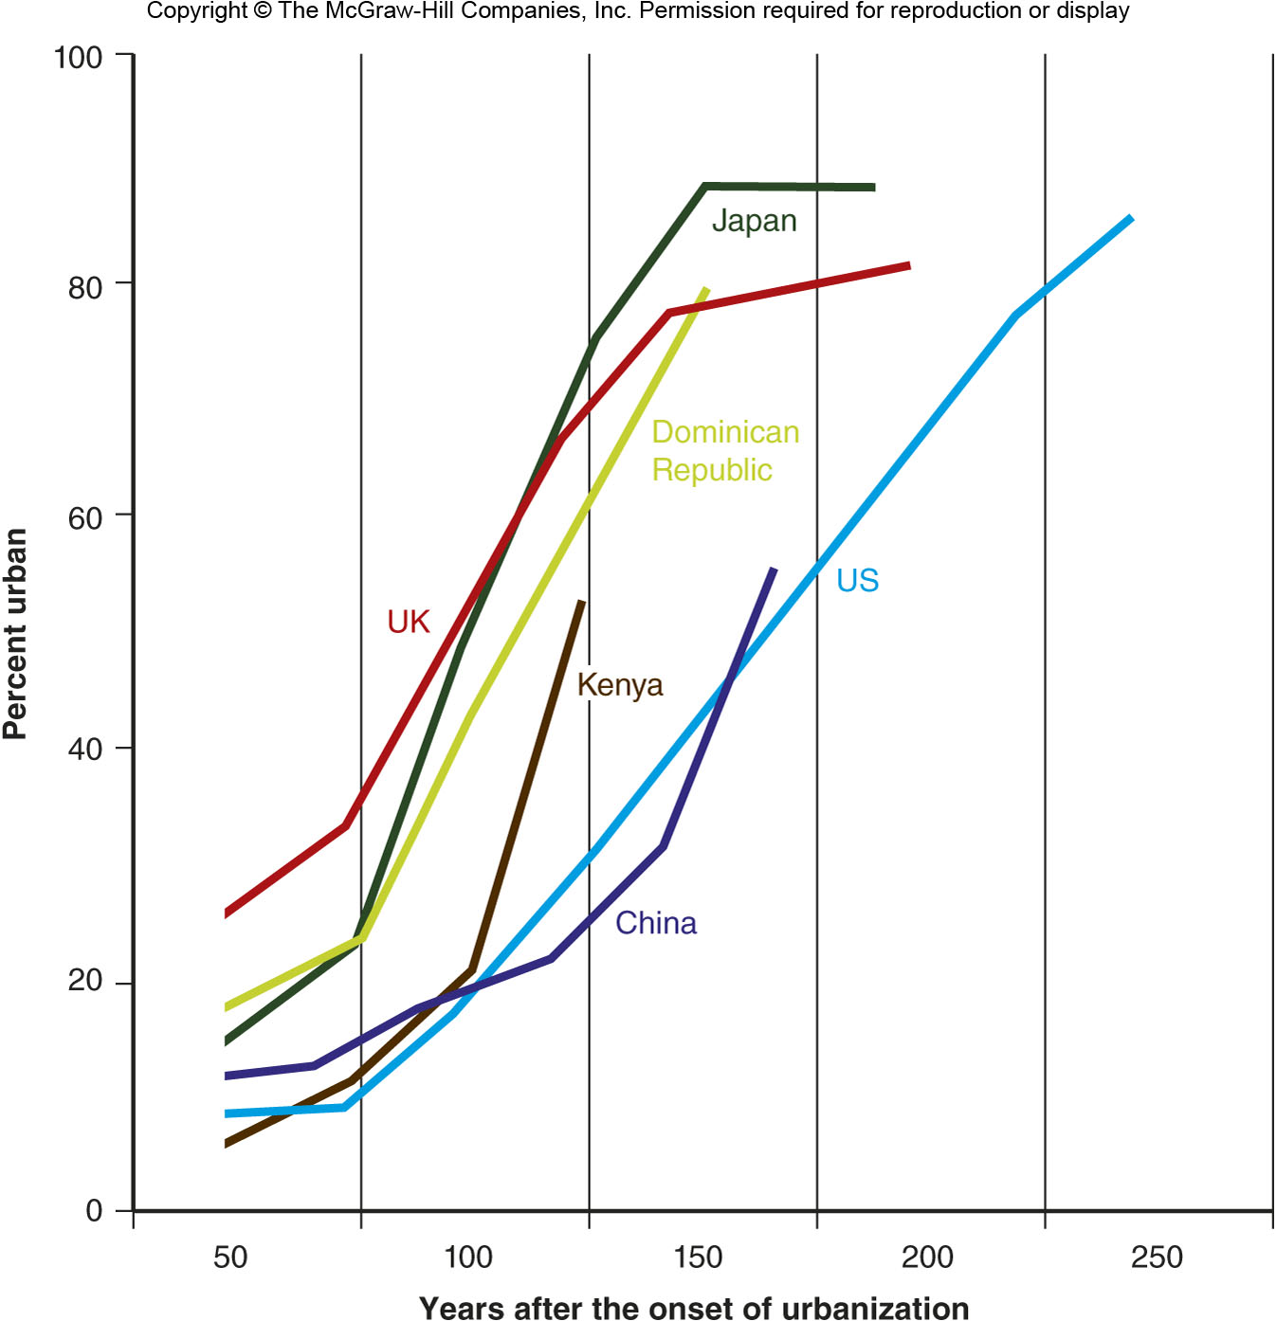
Urbanization in Select Countries
Figure 13E.2

Slide 15
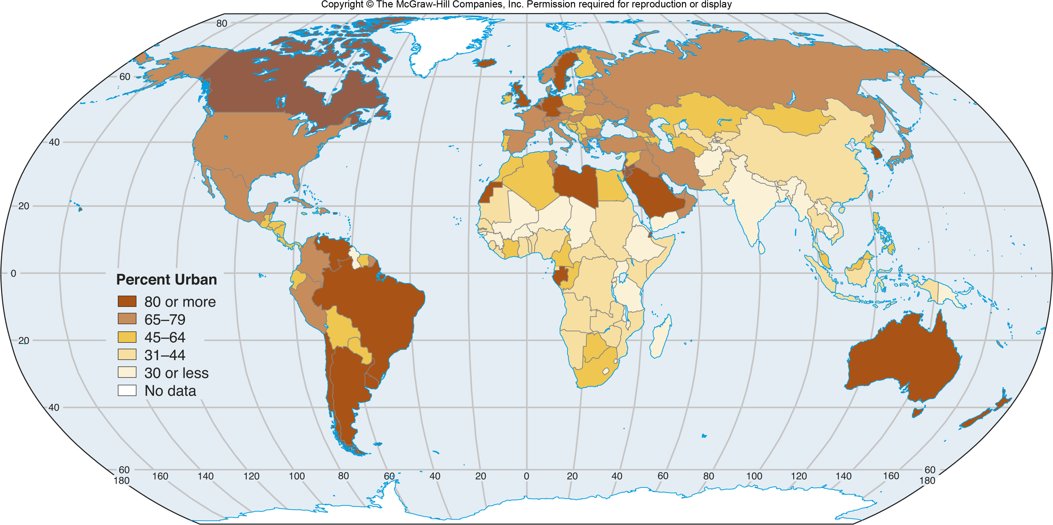
13F Urbanization Patterns Globally
Figure 13F.1

Slide 16
13G: Agglomeration Economies & Urban Functions
Different economic activities tend to locate near each other, which in turn can attract other activities (see Module 16.E)
The linkages between urban functions within a city were complemented by more connections among cities
More and more cities began specializing in a particular industry
Boston: Universities
Pittsburgh: Steel
Los Angeles: Film & TV

Slide 17
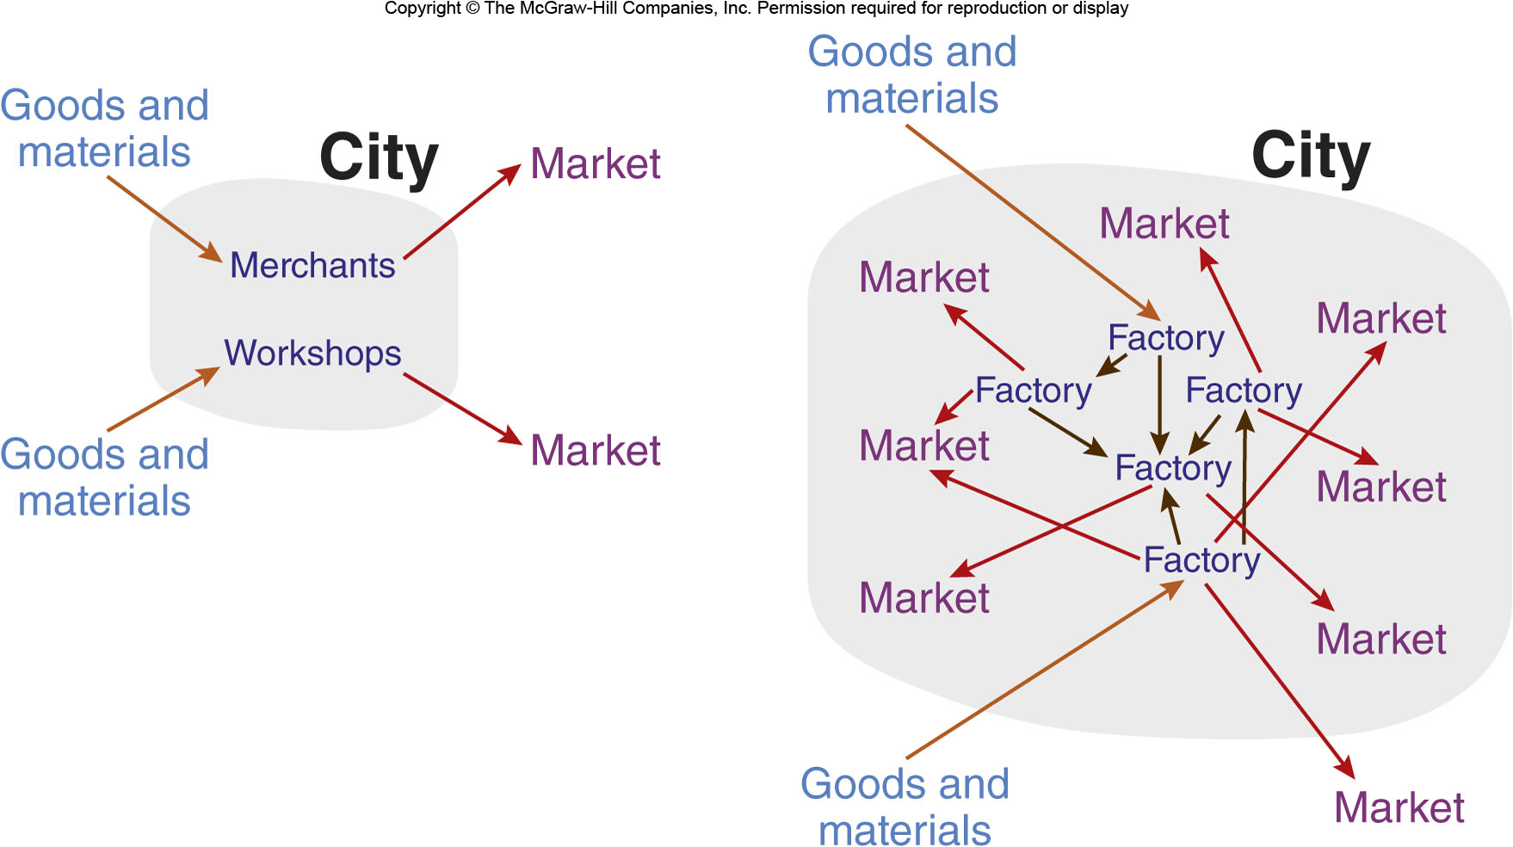
Agglomeration & Rural Areas
Figure 13G.1

Slide 18
13H: Urban Hierarchies & the Rank-Size Relationship 1
Within an urban network there is an urban hierarchy, i.e. not all cities are of equal size or importance
Some regions have an urban hierarchy represented by a rank-size relationship
Population of City_{r}=Population of City¹/r

Slide 19
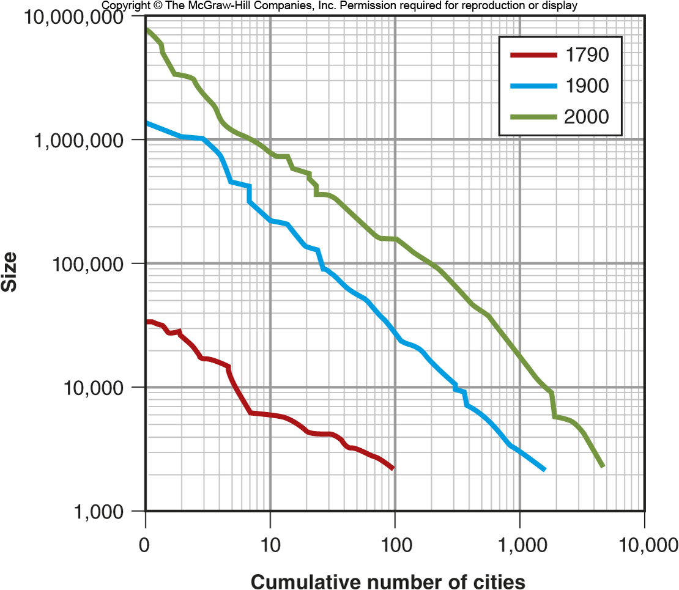
U.S. City Size Distribution
Figure 13H.1

Slide 20
13H: Urban Hierarchies & the Rank-Size Relationship 2
Some countries have one city that is disproportionally large, called a primate city
Primate cities are often the cultural and economic hub
Primate can form because they were once the capital of a larger area or because there is uneven development in the country
Other countries have binary trinary rank-size distributions, where 2 or 3 cities dominate

Slide 21
13I: Globalization & World Cities
Globalization is a greater integration of peoples, companies, and governments around the world
Today, there is a world system of cities
A world city is a city at the top of the global hierarchy
New York, London, Tokyo

Slide 22
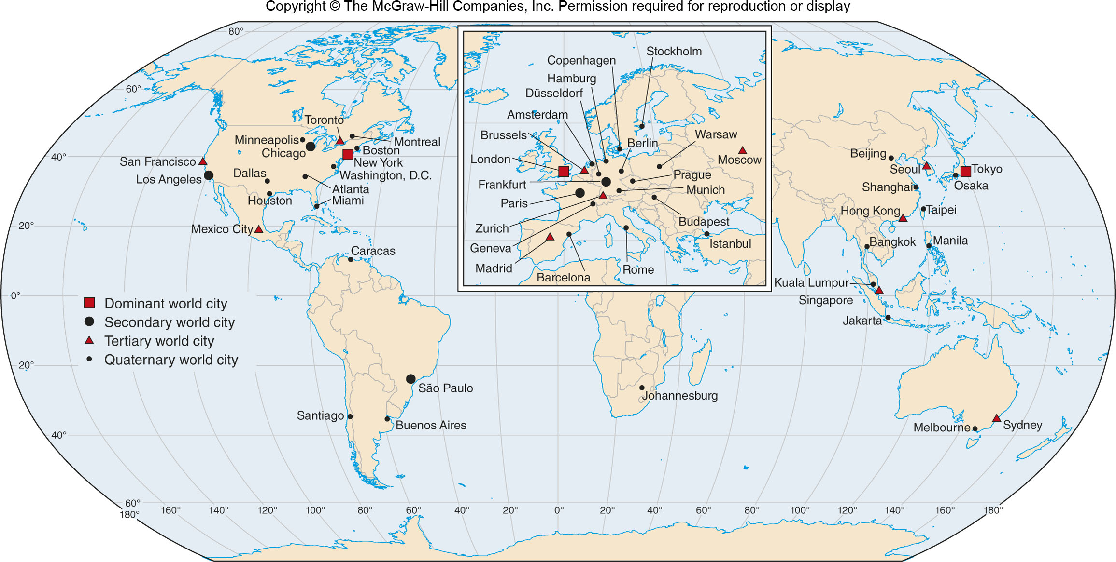
World Cities
Figure 13I.1

