Slide 1
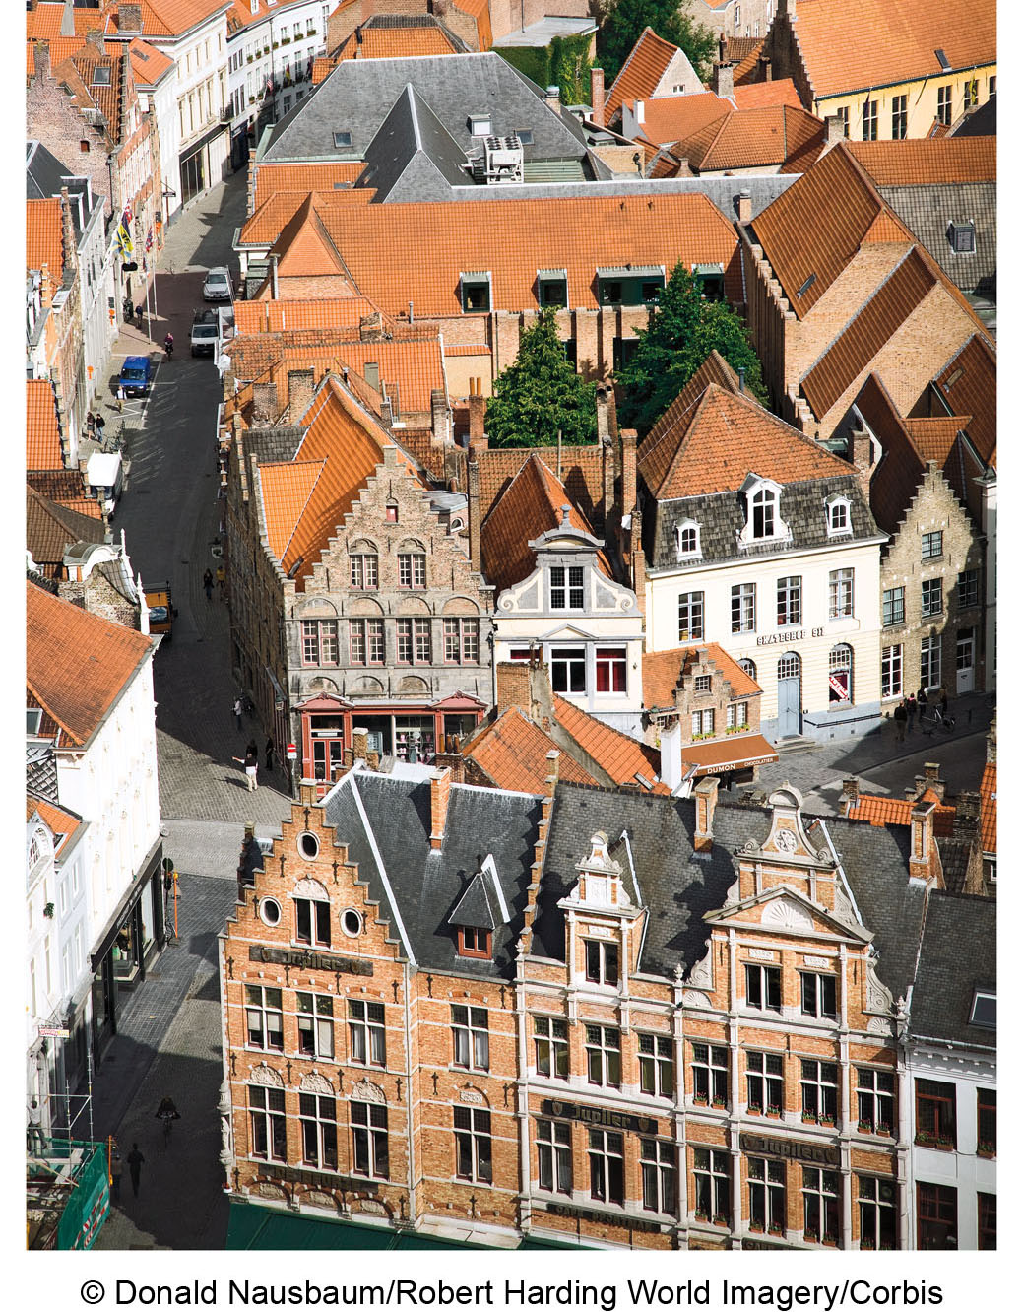
Chapter 14 LECTURE OUTLINE The CHANGING STRUCTURE OF THE CITY
Human Geography by Malinowski & Kaplan

Slide 2
Chapter 14 Modules
14A Early Urban Morphology
14B Three Historical Urban Types
14C Land Values, Densities, and Urban Form
14D Transportation and Modern Urban Growth
14E Housing the City
14F Urban Development in Europe and Japan
14G Cities in Less Developed Countries

Slide 3
14A: Early Urban Morphology 1
Morphology means form or shape
All cities share:
An urban population
An urban center
A perimeter, such as a wall and gates
A transportation network

Slide 4
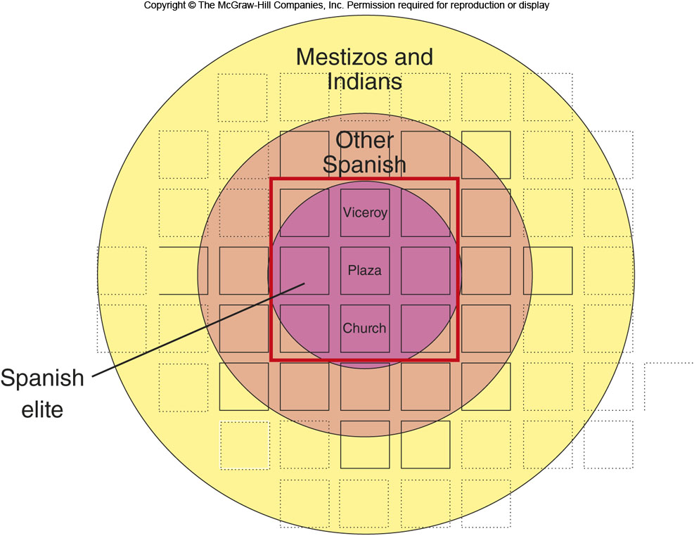
The Law of the Indies
Figure 14A.2

Slide 5
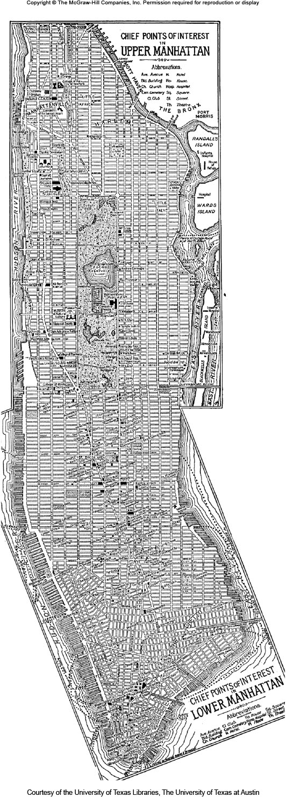
14A: Early Urban Morphology 2
Transportation networks can be
Organic
Street systems develop as the city grows, even if the pattern is odd
Planned
Grid systems like Manhattan

Slide 6
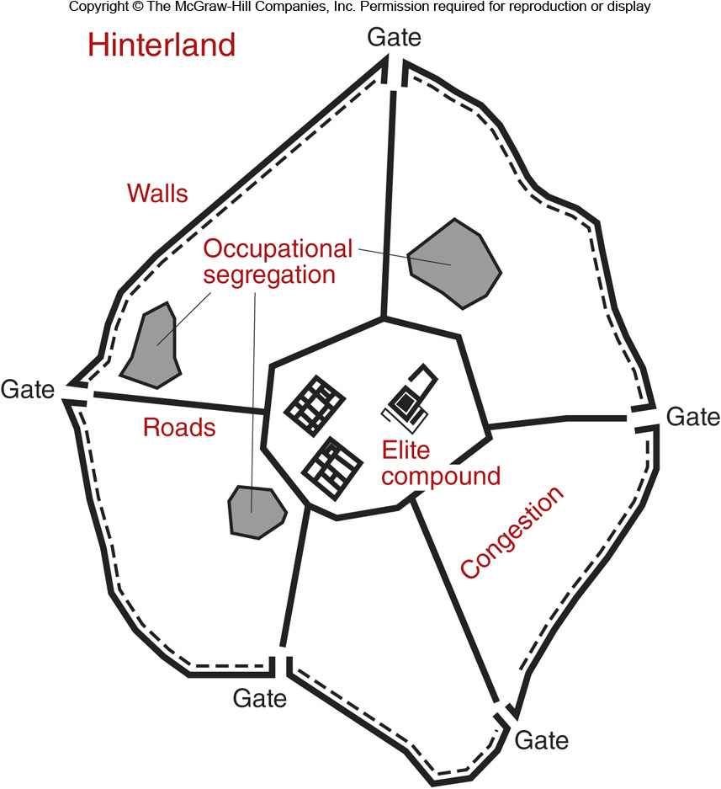
14B: Three Historical Urban Types 1
Ancient City
Perimeter wall
Elite compound at center for temple, key government functions
Roads were planned and unplanned
Structures were rarely tall

Slide 7
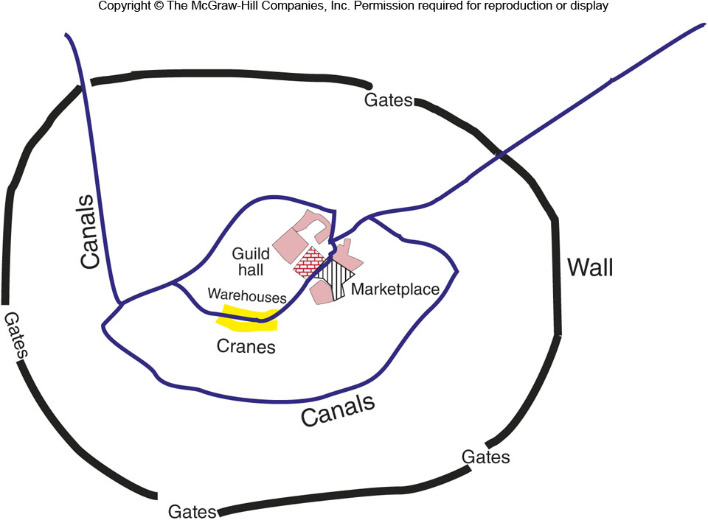
14B: Three Historical Urban Types 2
Trading City
Centered on a marketplace
Central square
Market near the town gates
Street patterns were meant to help merchants
Warehouses nearby
Guild halls

Slide 8
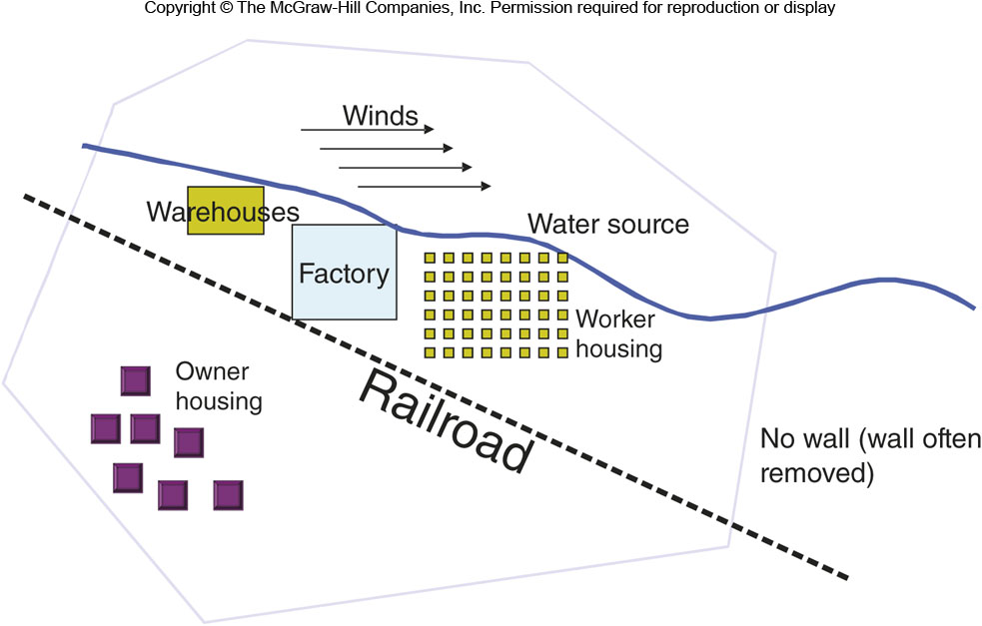
14B: Three Historical Urban Types 3
Industrial City
Focused on factories
Factories located near water
Warehouses with nearby hotels
Railroads connecting city to main ports
Tenements and worker housing

Slide 9
14C: Land Values, Densities, & Urban Form
Land values are generally highest near the Central Business District (CBD)
Often has a peak value intersection (PVI)
Nodal point
Land Value = function ( site, internal situation)
Internal situation relates to access
Cities can have daytime and nighttime densities

Slide 10
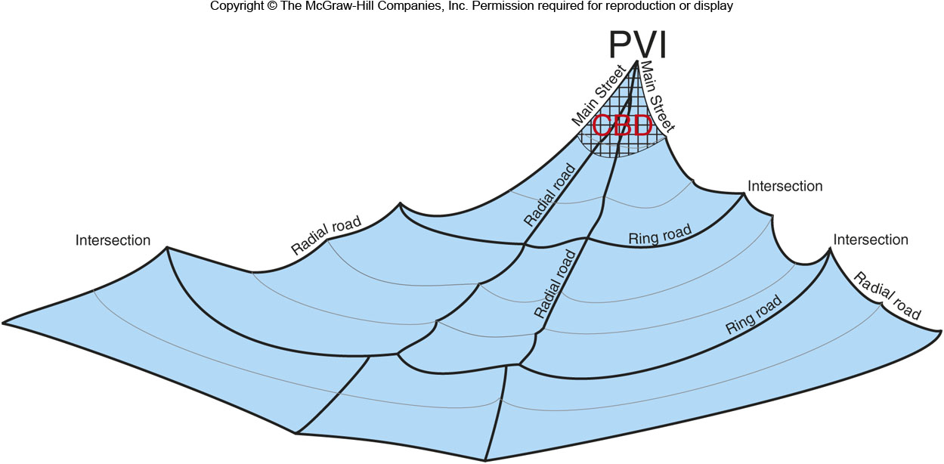
Land Values in the City
Figure 14C.1

Slide 11
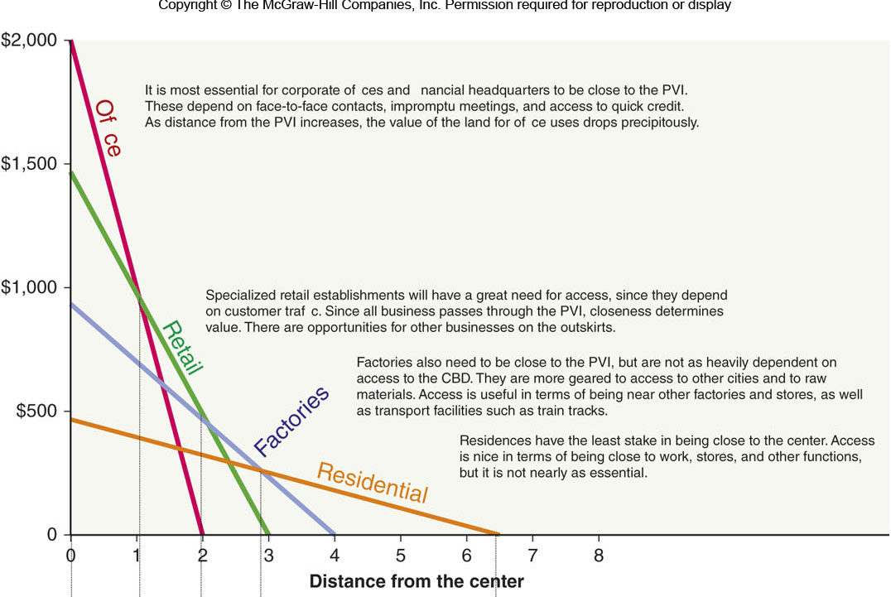
Urban Functions & Land Values
Figure 14C.2
[insert figure 14C.2 here]

Slide 12
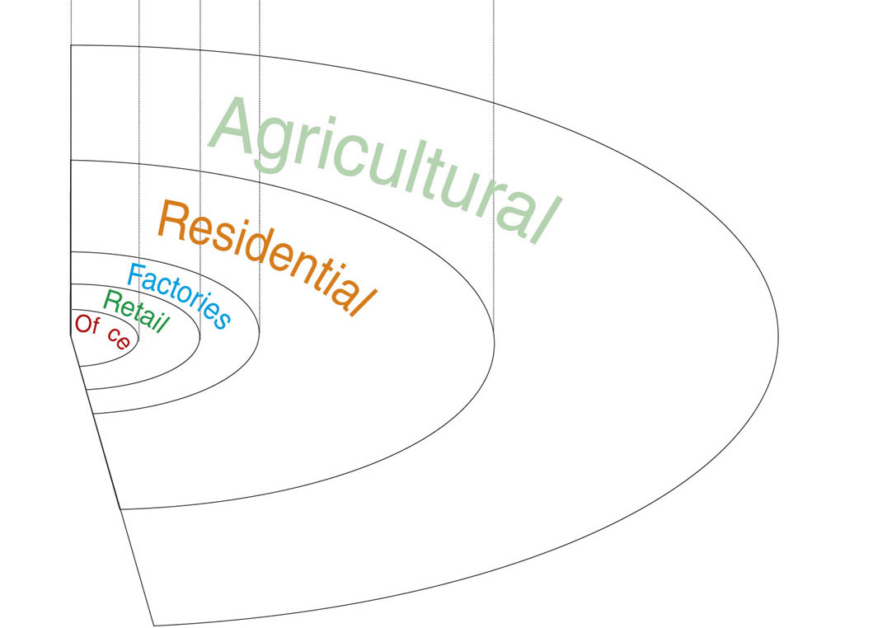
Urban Functions & Land Values
Figure 14C.3

Slide 13
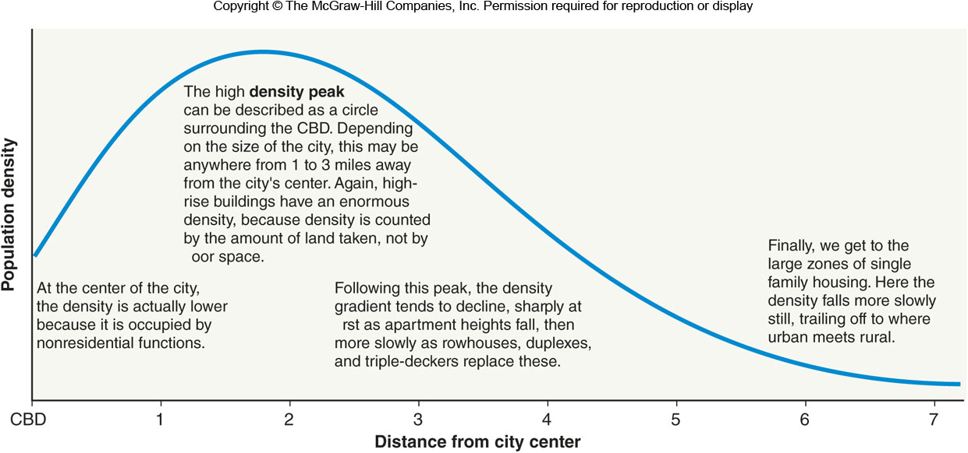
The Density Gradient
Figure 14C.5

Slide 14
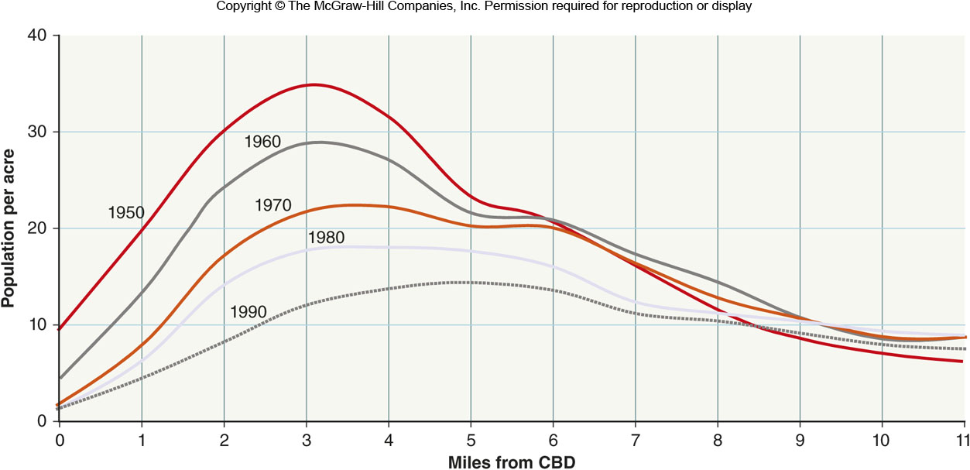
Density in Cleveland
Figure 14C.6

Slide 15
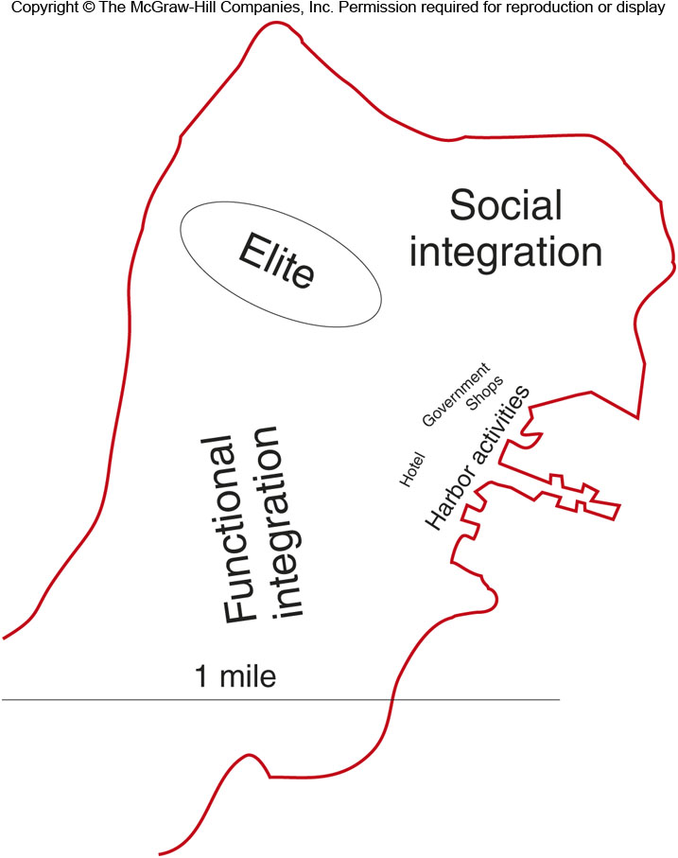
14D: Transportation & Modern Urban Growth 1
Transportation affected the shaping of American cities
The walking city before 1850 only had a radius of about 2 miles

Slide 16
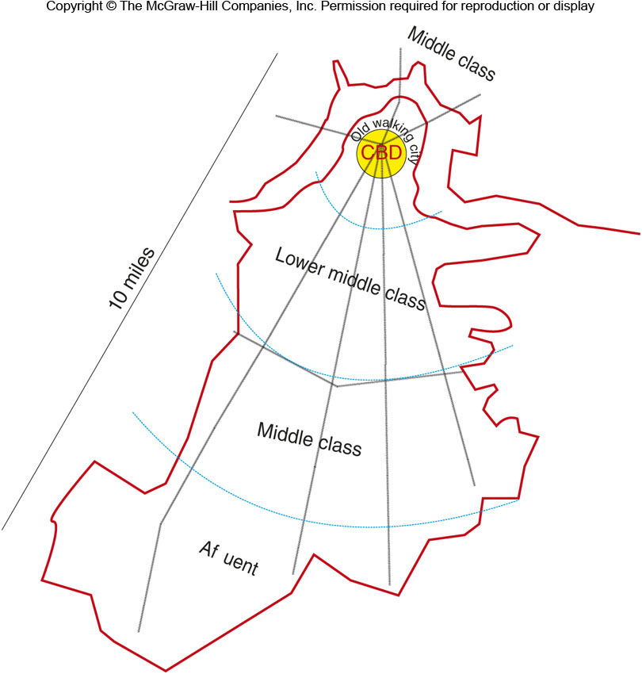
14D: Transportation & Modern Urban Growth 2
The streetcar city started with horse-drawn omnibuses that were replaced horse-drawn streetcars and finally with electric streetcars at the end of the 19th century

Slide 17
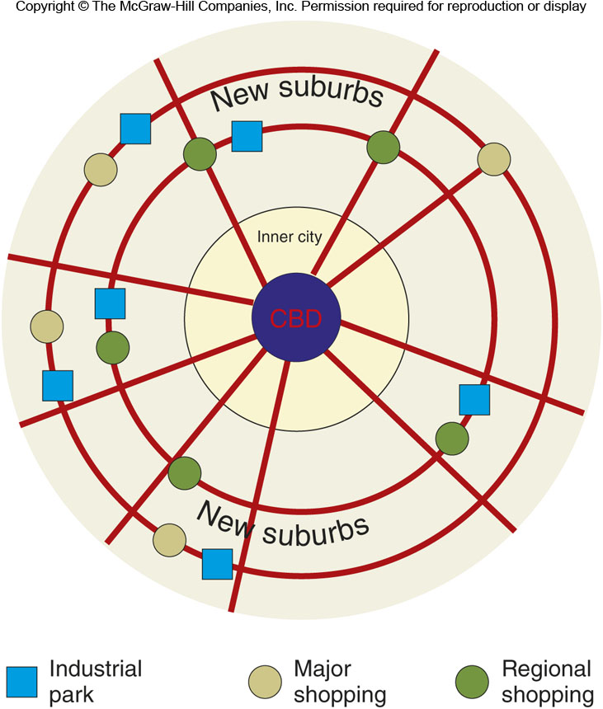
14D: Transportation & Modern Urban Growth 3
The auto-centered is distinct from earlier forms.
CBD surrounded by an inner city that were the streetcar suburbs
On the outskirts, a ring of edge cities that are shopping and business districts among near suburban housing
Bedroom communities

Slide 18
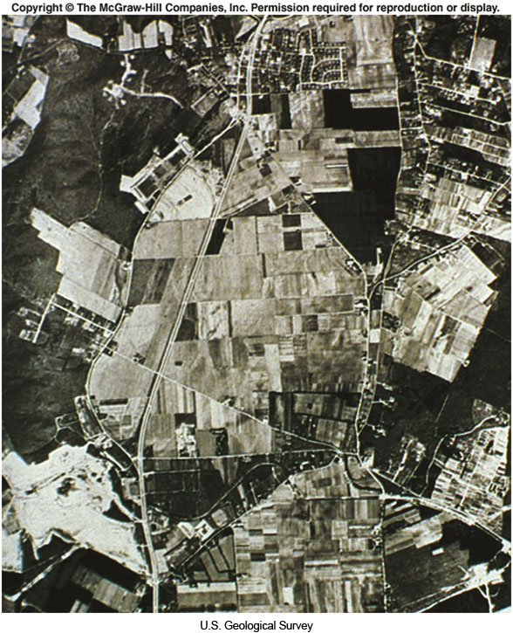
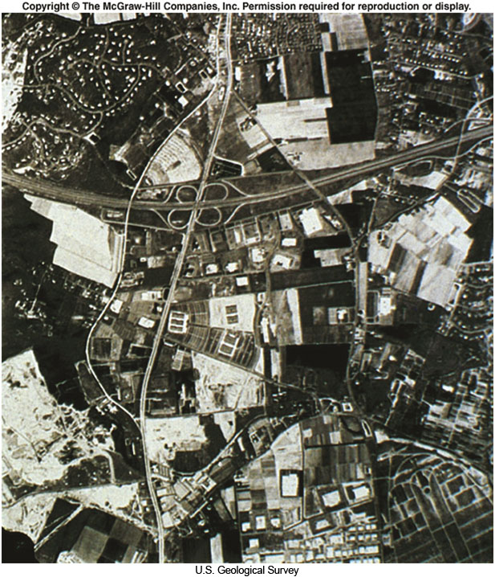
Interstate Highway System
Figure 14D.6

Slide 19
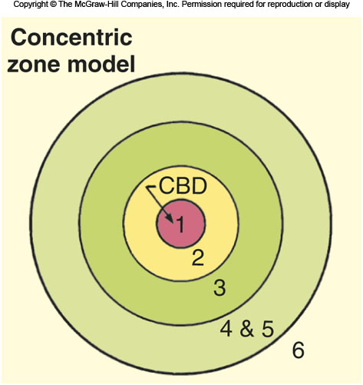
14D: Concentric Zone Model
Early model of the modern city
CBD
CBD fringe
Zone of transition
Zone of independent workingmen’s homes
Residential zone
Commuters zone

Slide 20
14D: Sector Model
A modification of the concentric zone model
High-rent areas (5) are far from factories (2)
Low-rent areas (3) are next to undesirable factories and warehouses
Middle-income areas (4) are in-between high- and low-rent areas

Slide 21
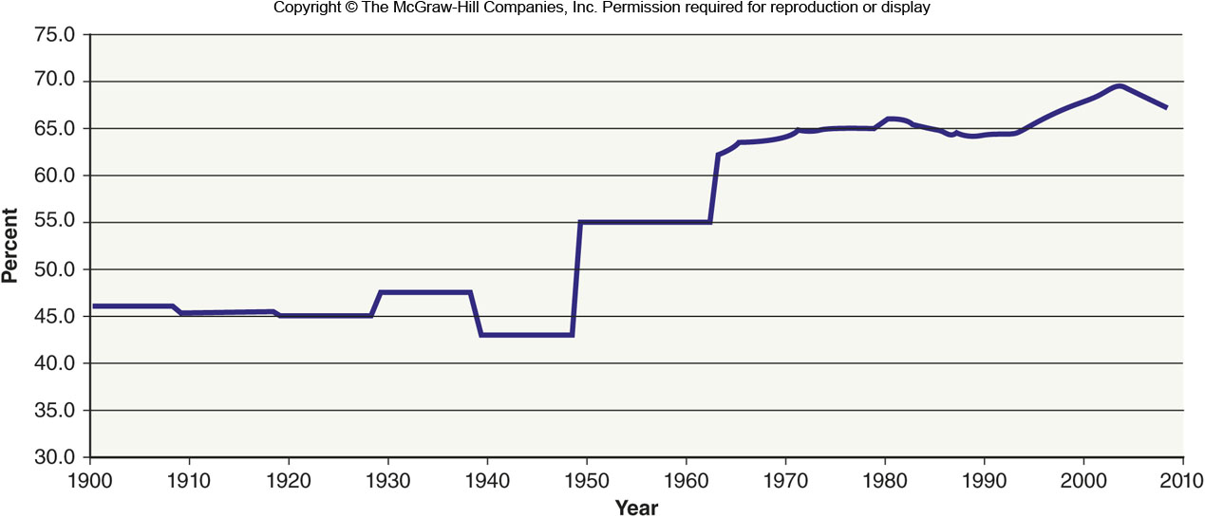
Homeownership Over Time
Figure 14E.1

Slide 22
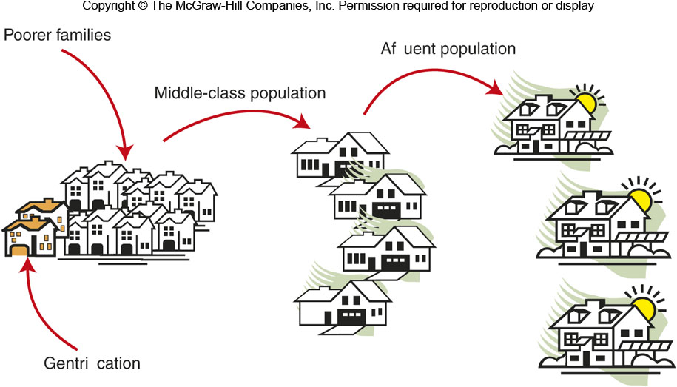
14E: Housing the City
Over time, wealthier families move from older housing into newer housing (“filtering”)
Vacancies are filled by less prosperous families
Older housing may be subdivided and turned into rental units
Over time, some poorer areas become wealthy again through gentrification

Slide 23
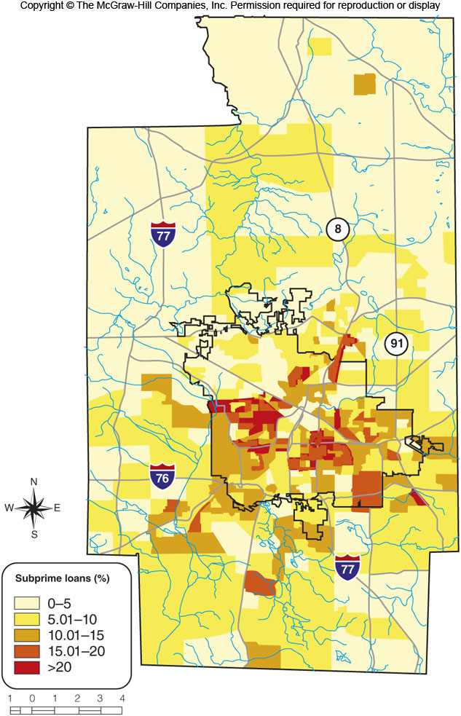
14E: Housing the City
Subprime lending refers to mortgages made to people who do not qualify for regular mortgages
If the rates are unfair, it can be predatory lending

Slide 24
14F: Urban Development in Europe & Japan
A mix of old and new buildings because of World War II
Because of the rebuilding, there are often experimental areas
More government control over cities than the U.S.
Cities end abruptly and transition to the countryside in some areas
Green belts in some areas
Many European cities are compact

Slide 25
14G: Cities in Less Developed Countries
High growth rates but also high poverty make urban planning a challenge
Formal sector
Jobs in industry, established services, and government
Informal sector
Selling items on the street, gambling, scavenging, trade in illegal substances or activities
Temporary structures for immigrants are sometimes called squatter settlements
Poor population, little or no water, sanitation infrastructure, or electricity

Slide 26
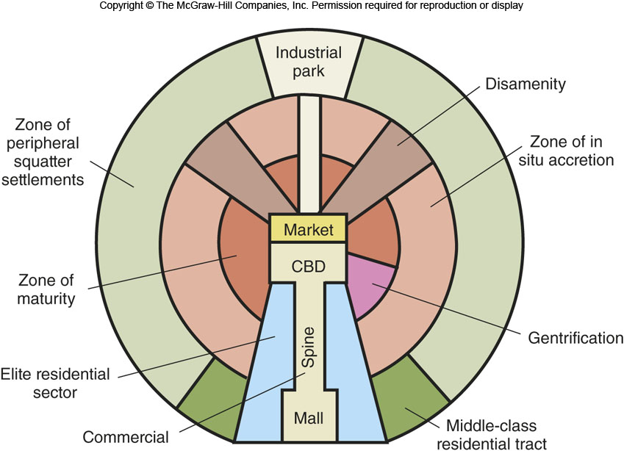
Latin America City Model
Figure 14G.4

