Slide 1
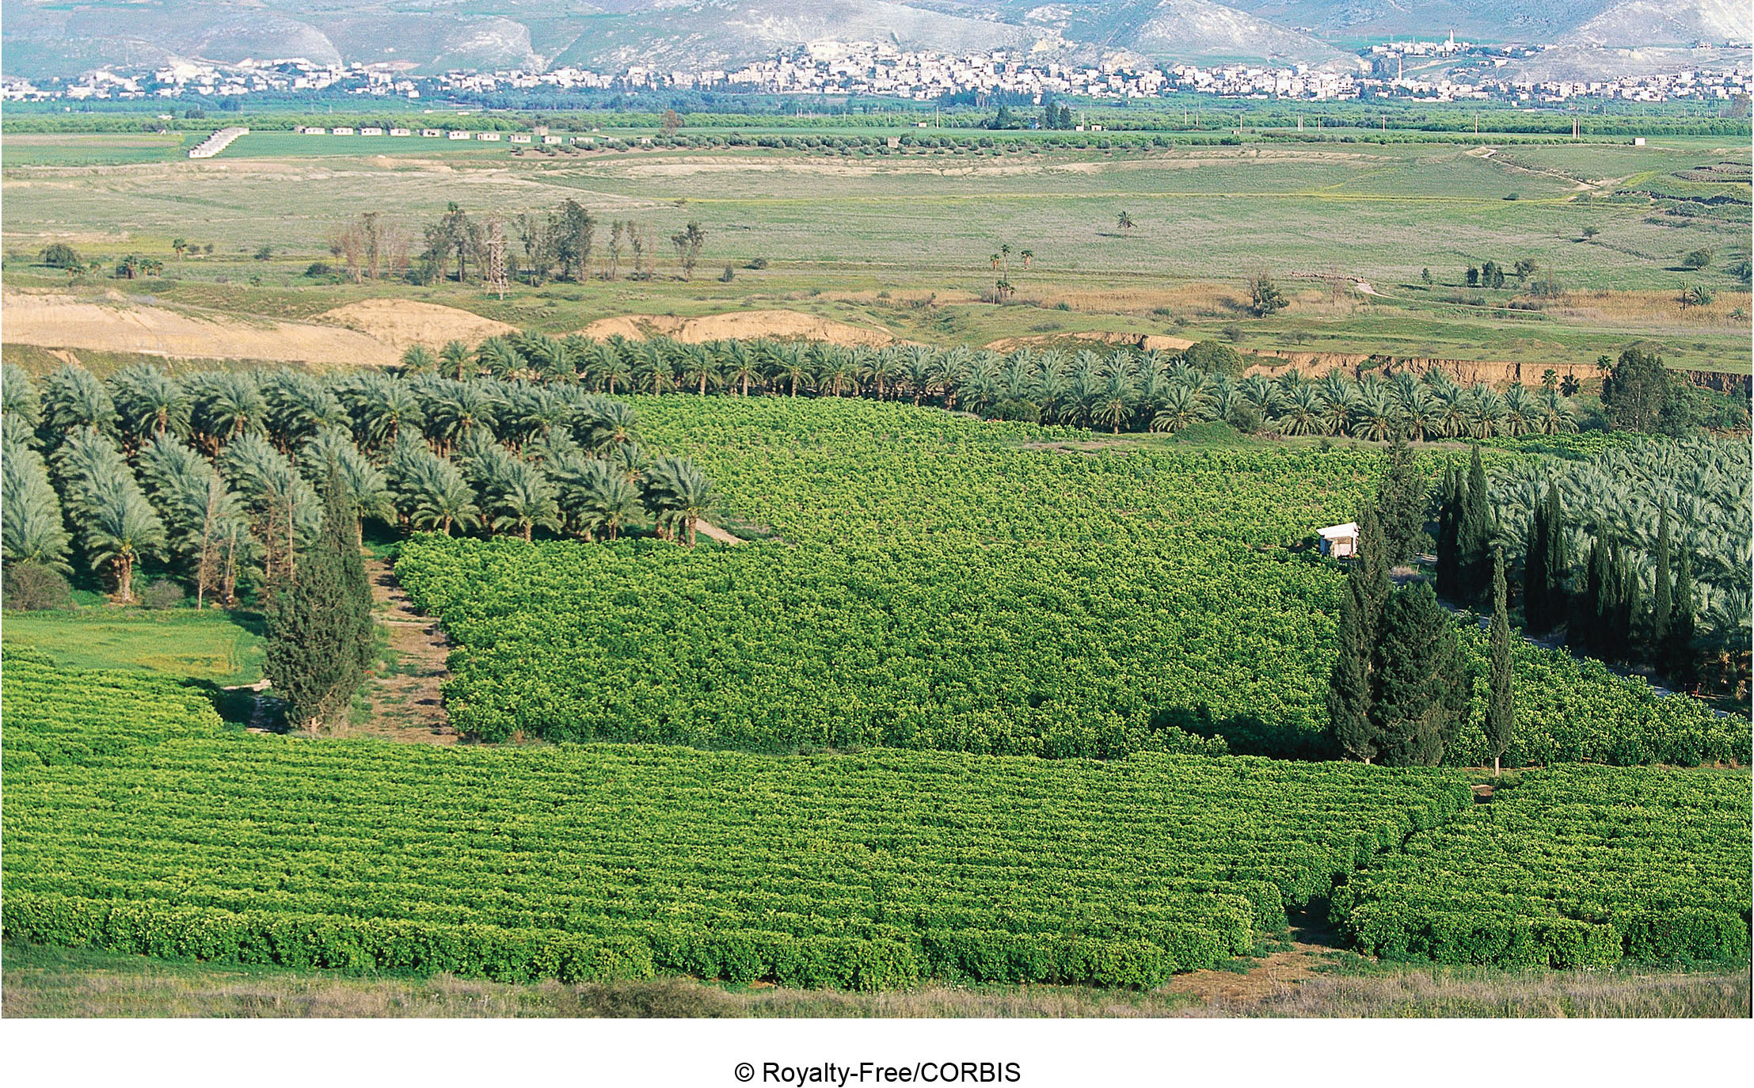
Chapter 15 LECTURE OUTLINE The Geography of Economic Activity and Agriculture
Human Geography by Malinowski & Kaplan

Slide 2
Chapter 15 Modules
15A Small-Scale Economic Systems
15B Large-Scale Economic Systems
15C Economic Categories and Measures of the Economy
15D Origins of Agriculture and the Process of Domestication
15E Different Types of Agriculture
15F Theory of Rural Land Use
15G Agricultural Globalization, Then and Now

Slide 3
15A: Small-Scale Economic Systems 1
All economic activity takes place within an economic system
Earliest economic systems were marked by:
Reliance on subsistence food gathering or agriculture
Most activities took place within small groups
Small-scale production
Extensive use of bartering

Slide 4
15A: Small-Scale Economic Systems 2
In prehistoric times, humans were hunters and gatherers
The Neolithic period (“New Stone Age”) began the transition to primitive agriculture
Gradual process beginning about 11,000 years ago
Primitive agriculture was subsistence-based
Any surpluses would likely be bartered

Slide 5
15A: Small-Scale Economic Systems 3
Surpluses led to occupational specialization
In other words, people provided services in exchange for food
In time, feudalism developed
Farming was done by serfs on a manor
Surplus was ceded to the lord of the manor, who had to pay for defense
The medium of exchange was surplus, not money
Very little trade because production and consumption stayed within the manor

Slide 6
15B: Large-Scale Economic Systems 1
Larger political units led to imperial economies, which dominated until 1300
The size of imperial economies meant they were much more complex and therefore quite diverse
Imperial economies included some capitalism
Buying and selling goods to make a profit
Merchants and artisans

Slide 7
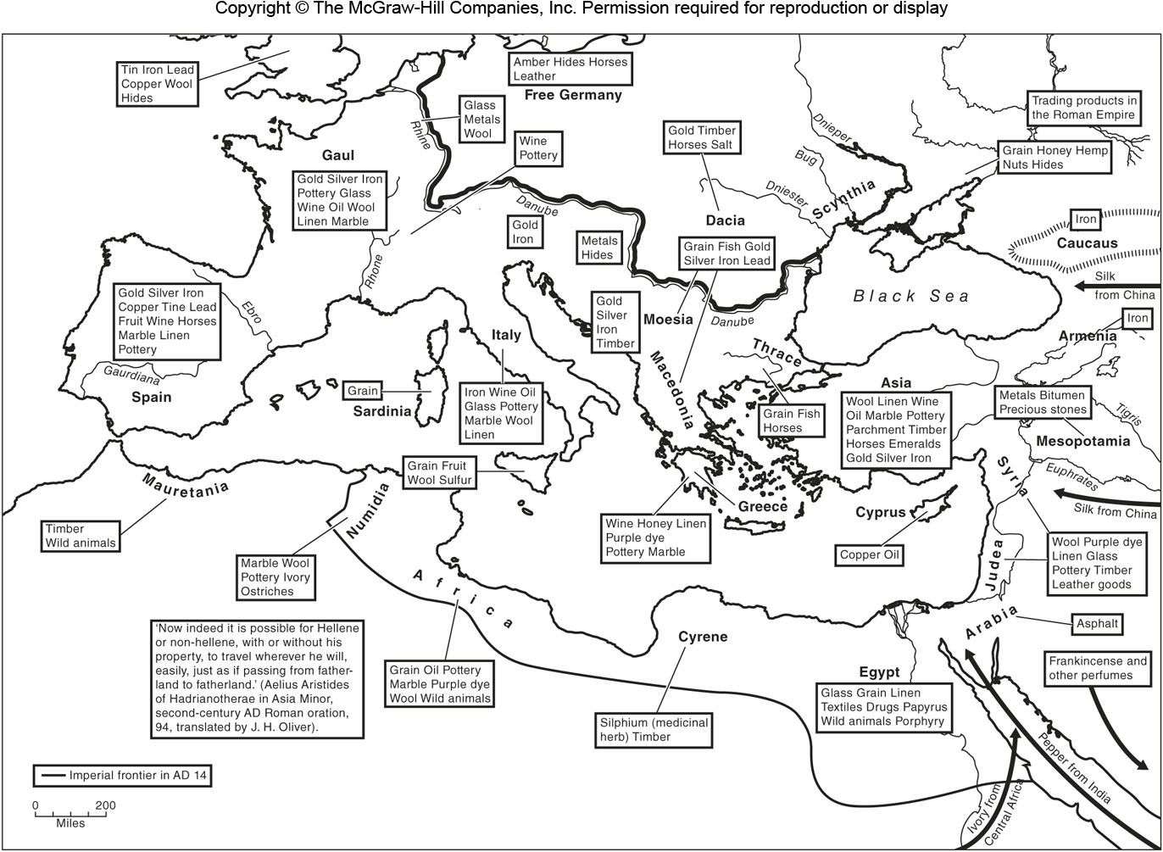
Economy of the Roman Empire
Figure 15B.1

Slide 8
15B: Large-Scale Economic Systems 2
In time, capitalist economic systems take hold:
Capitalist commercial economies came first, primarily concerned with the buying and selling of commodities
Capitalist industrial economic systems are based on highly specialized industrial products sold for profits
The need for raw materials created a different relationship among regions. Places that produced goods made profits while places that provided raw materials were poorer

Slide 9
15B: Large-Scale Economic Systems 3
Alternatives to capitalist economic systems include:
Planned economies
All factories, farms, and services are publically owned and decisions are made by the state
Examples include Maoist China, the USSR, etc.
Mixed economies
Capitalist with frequent government intervention
Such as free public education, health care, restrictions on certain activities, etc.

Slide 10
15C: Economic Categories & Measures of the Economy 1
Gross Domestic Product (GDP)
the total of all goods and services produced within a country
Gross National Product (GNP)
The total of goods and services produced by the citizens of a country whether at home or abroad
Gross National Income (GNI)
GNP except it does not include taxes, depreciation, and subsidies

Slide 11
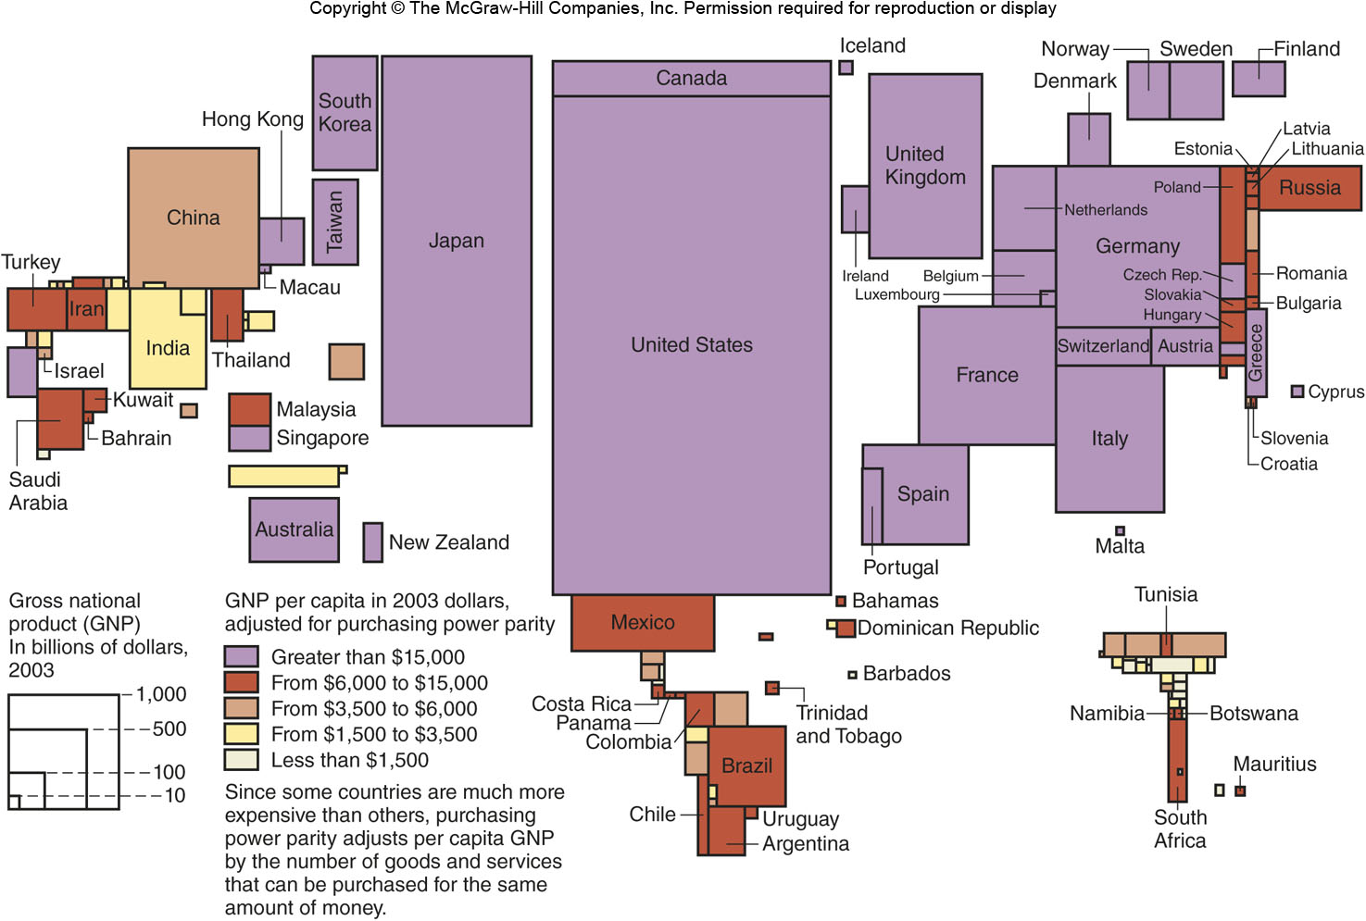
GNP PER CAPITA
Figure 15C.1

Slide 12
15C: Economic Categories & Measures of the Economy 2
Recession
When measures of the economy decline for a sustained period of time, such as six months
Depression
A more severe downturn for a longer time
Public Sector
All output produced by the government at all levels
Private Sector
All output by individuals or privately-owned businesses

Slide 13
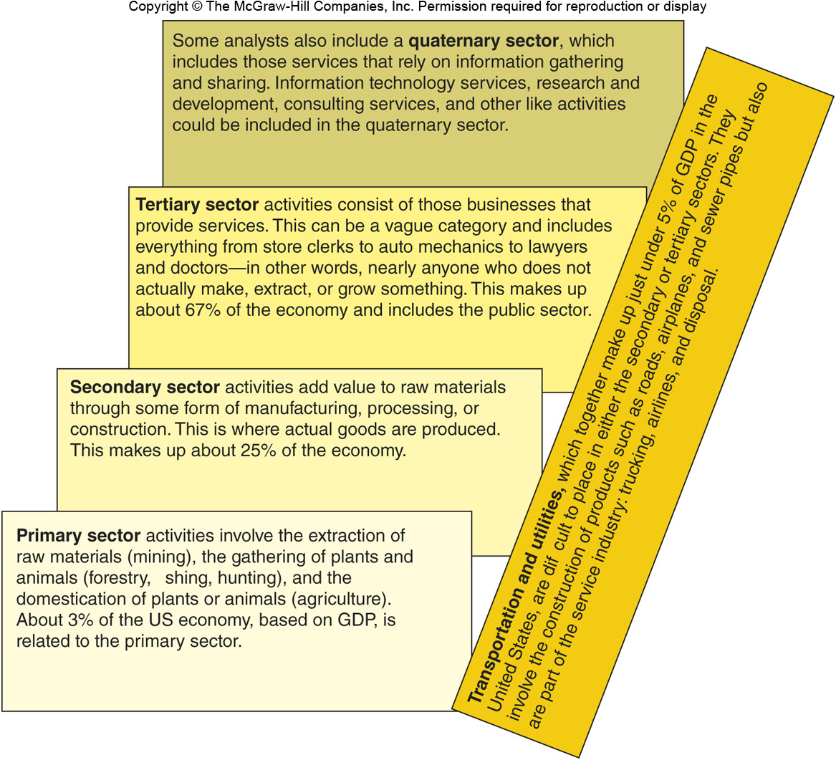
ECONOMIC SECTORS
Figure 15C.2

Slide 14
15D: Origins of Agriculture & the Process of Domestication 1
The watershed moment in human development, but why?
Theory 1: Domestication started in well-watered, fertile areas where pieces of plants could easily be buried to make grow new plants
Theory 2: A time of environmental stress, perhaps global warming, led humans to search for new food sources because areas had reached their carrying capacity

Slide 15
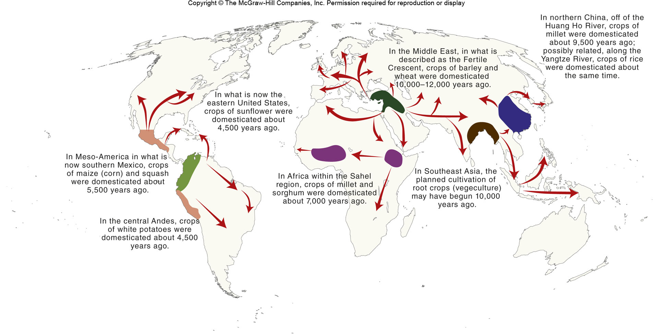
Agricultural Domestication
Figure 15D.1

Slide 16
15D: Origins of Agriculture & the Process of Domestication 2
Complex foraging in ecotones resulted in greater knowledge of and intervention in the natural environment
Humans chose which plants to grow, and thus human selection often replaced natural selection
The downside is that agriculture is a lot more work than hunting or gathering
Over time, regions developed their own crop complexes consisting of different plants, which led to today’s regional cuisines

Slide 17
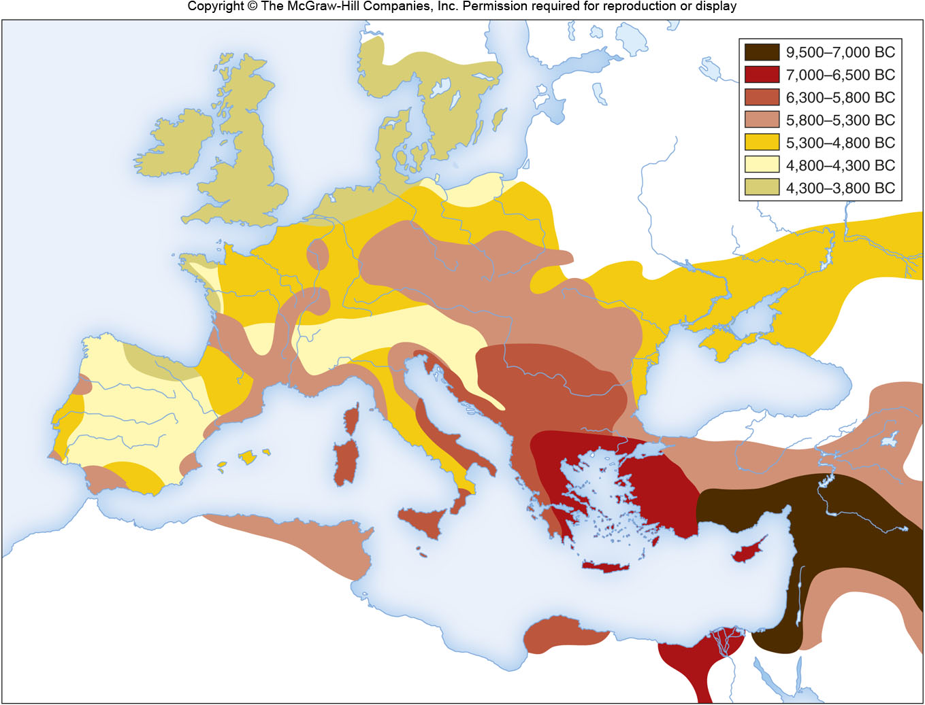
Expansion of Agriculture in Europe
Figure 15D.6

Slide 18
15E: Different Types of Agriculture 1
First, realize that some areas are arable, and others are not
Some areas are too dry, some too cold
Some areas are animal-centered, others are plant-centered
Some areas are focused on subsistence agriculture and others are focused on commercial agriculture

Slide 19
15E: Different Types of Agriculture 2
Pastoral nomadism
Moving around with animals
Mixed agricultural economy
Both plants and animals
Agribusiness
A company owns the land and hires farmers to work it

Slide 20
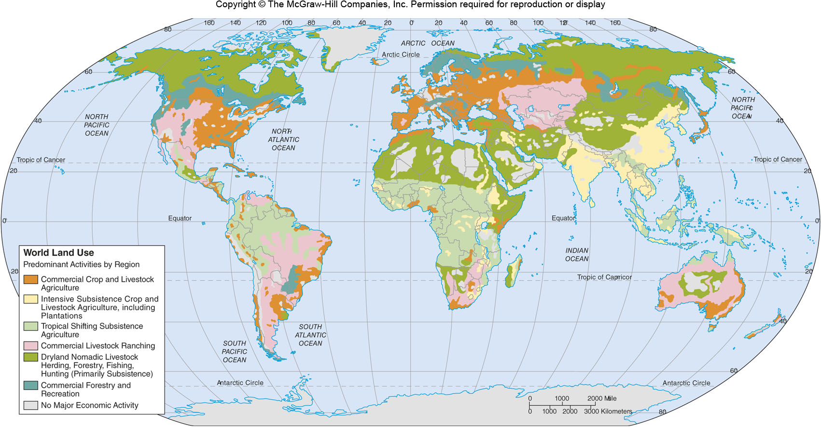
Agricultural Regions of the World
Figure 15E.4

Slide 21
15F: Theory of Rural Land Use
Comparative advantage leads to regional differences in agricultural production because of better environment, the skill of local farmers, and proximity to markets
Land rent refers to the profitability of land
Theory of Rural Land Use:
Land rent = (output × (price – production costs)) – (output × transport costs × distance from market)

Slide 22
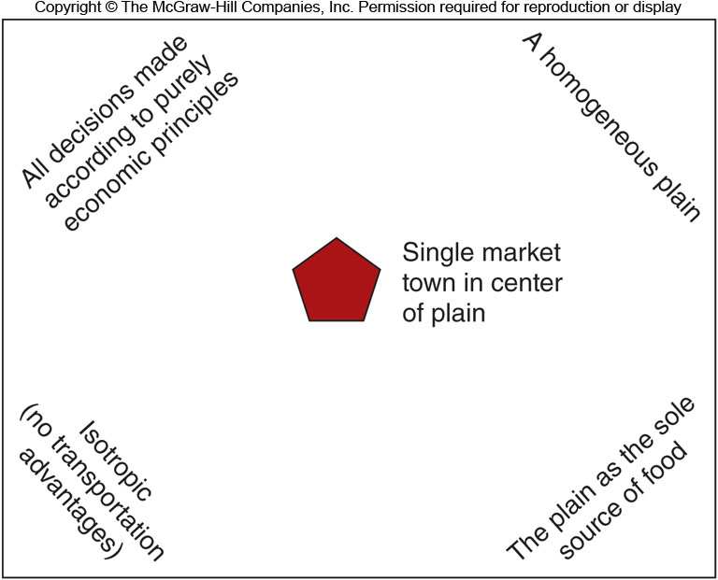
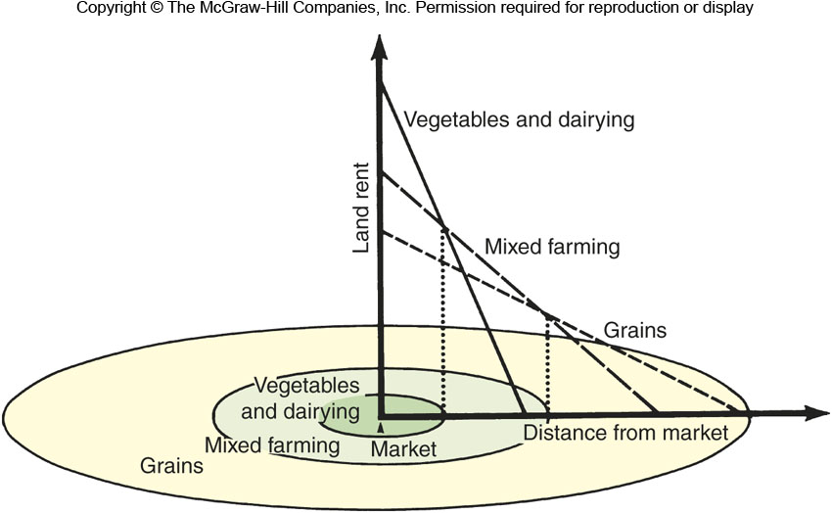
Theory of Rural Land Use
Figure 15F.1 & 15F.2

Slide 23
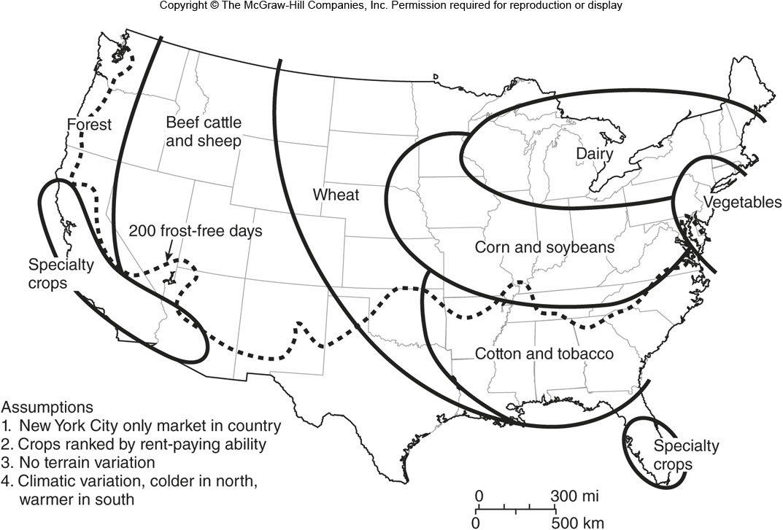
Hypothetical Land Use Model for the United States
Figure 15F.3

Slide 24
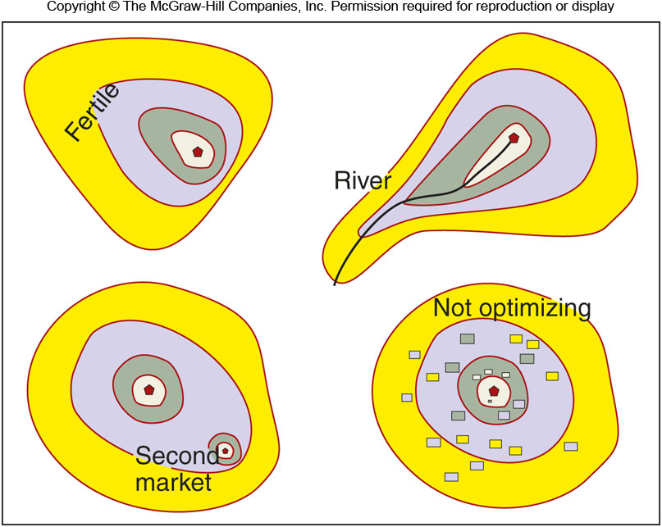
Land Use in the Real World
Figure 15F.4

Slide 25
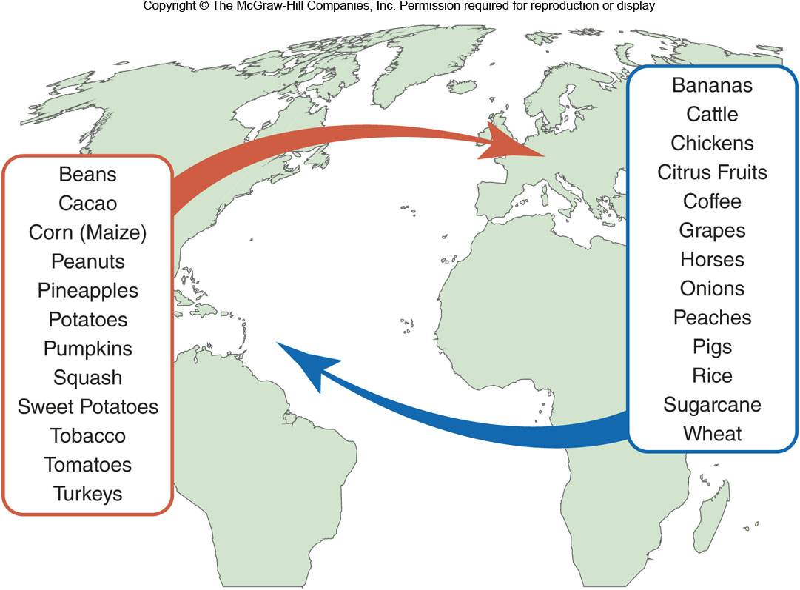
15G: Agricultural Globalization 1
The Great Columbian Exchange
The exchange of crops between the Americas and Europe after 1492

Slide 26
15G: Agricultural Globalization 1
Modern farming is different:
Traditional fertilizers have been replaced by synthetic nitrogen
Farmers purchase hybrid seeds that can quadruple yields
Vast amounts of herbicides and pesticides are needed
Large farms require expensive equipment

Slide 27
15G: Agricultural Globalization 2
Green Revolution
Introduction of Western agricultural practices to Asia, Latin America, and Africa
Genetically-modified strains of rice, wheat, and corn
Large irrigation projects
But, expensive and resource intensive
Food distribution is also more globalized

Slide 28
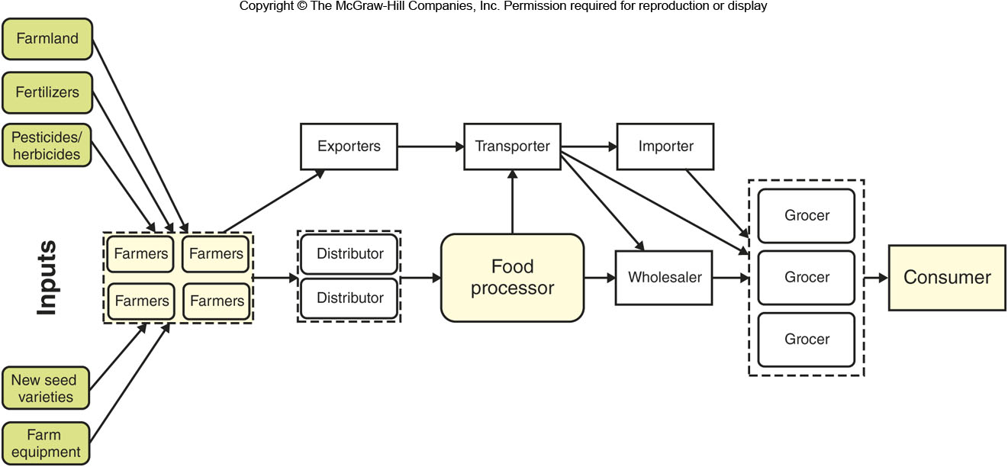
Globalization of Agriculture
Figure 15G.2

