Slide 1
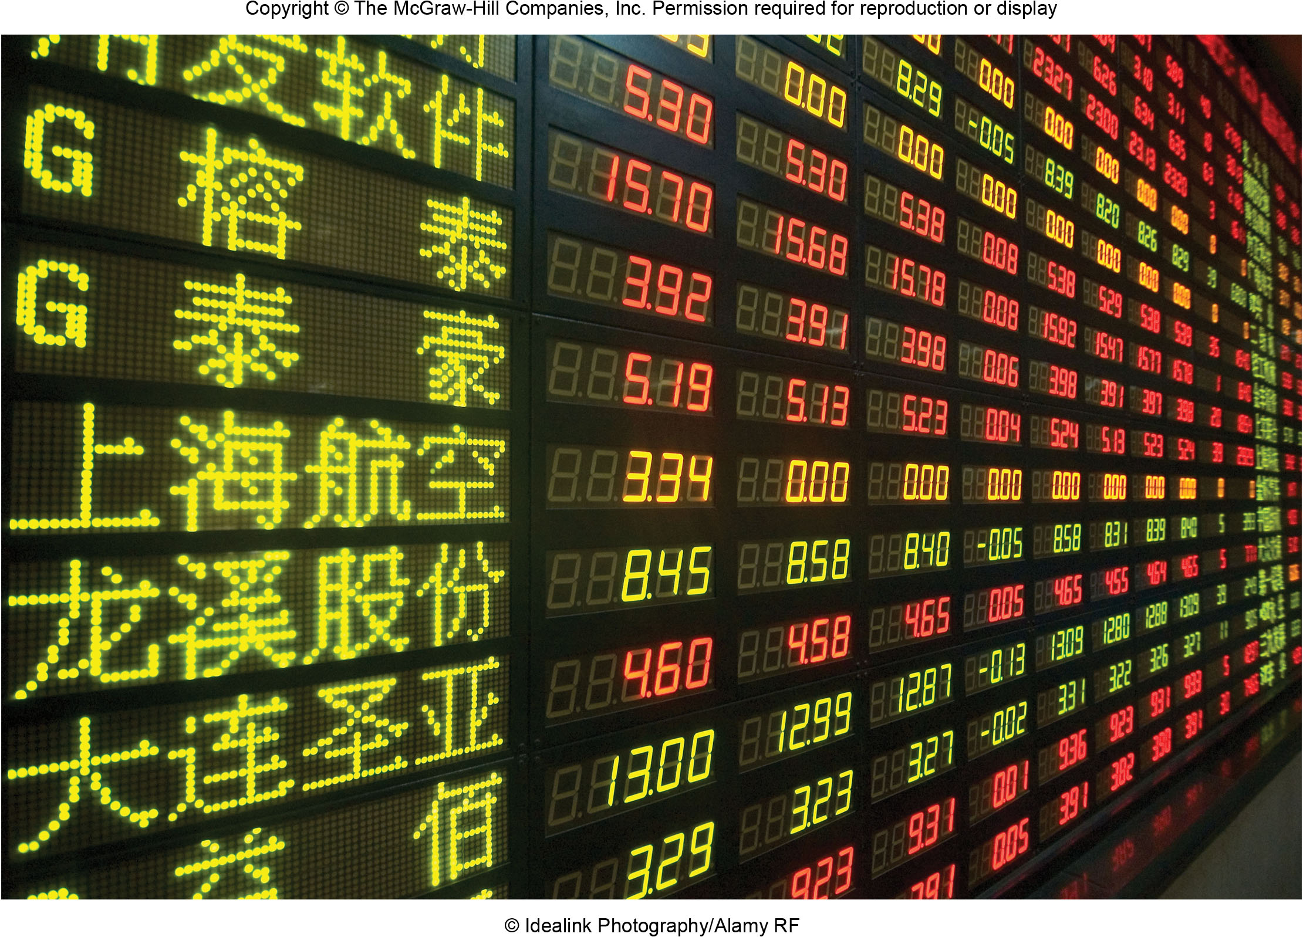
Chapter 17 LECTURE OUTLINE DISTRIBUTION & TRANSPORTATION
Human Geography by Malinowski & Kaplan

Slide 2
Chapter 17 Modules
17A Growth of Trade
17B Reasons for International Trade
17C What Determines the Flow of Trade?
17D Concepts in Transportation
17E Developing Transportation Networks in the United States
17F Modern Urban Daily Transportation
17G Geographic Aspects of US Retailing
17H Changing Geographies of Retailing in the Internet Age

Slide 3
17A: Growth of Trade 1
Barter gave way over time to cash exchanges
Today, the term trade usually means international trade
Maritime trade in the Mediterranean goes back as far as 9,000 years
Trade regulations were already in place in some areas 4,000 years ago

Slide 4
17A: Growth of Trade 1
Barter gave way over time to cash exchanges
Today, the term trade usually means international trade
Maritime trade in the Mediterranean goes back as far as 9,000 years
Trade regulations were already in place in some areas 4,000 years ago

Slide 5
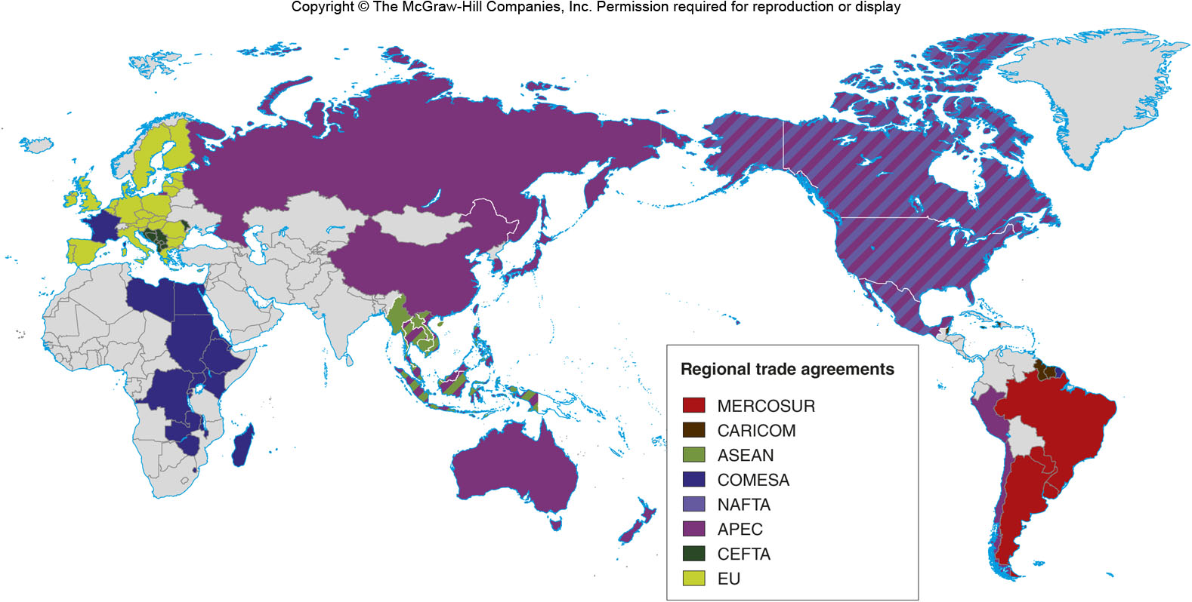
Regional Trade Agreements
Figure 17A.3

Slide 6
17B: Reasons for International Trade
Countries have different views of trade:
Autarky: A self-sufficient country
Protectionism: When a country limits trade
Advantages of trade:
Able to get resources that you wouldn’t normally have at a good price
Competitive advantage:
A modification of comparative advantage that takes into account the mix of infrastructure, skilled labor, government, domestic demand, levels of domestic competition, agglomeration economies, and other items

Slide 7
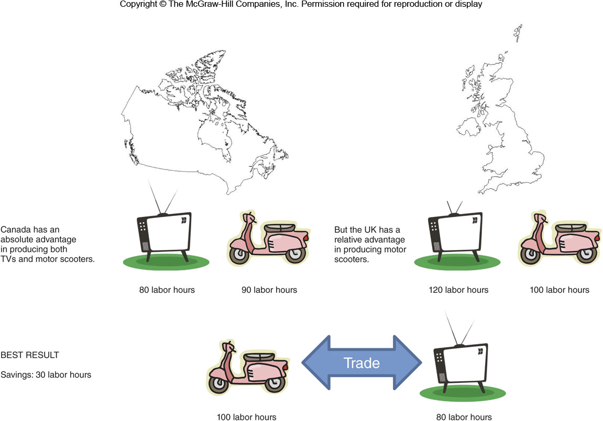
Comparative Advantage
Figure 17B.2

Slide 8
17C: What Determines the Flow of Trade?
Elements of Supply
Quality of raw materials
Labor & Productivity
Financial, Fixed, & Human Capital
Entrepreneurship
Barriers
Distance
Bad transportation
Trade barriers
Tariffs
Currency Manipulation
Demand Conditions
Wealth
Discretionary income
Preferences
Flow of Trade

Slide 9
17D: Concepts in Transportation
Transportation is required for the military, for freight, and for personal mobility
Conveyances are modes of travel
Transportation facilities: Improvements in the ease and volume of travel, such as airports or the upgrading of roadways
Transportation systems are composed of nodes and links that form a network

Slide 10
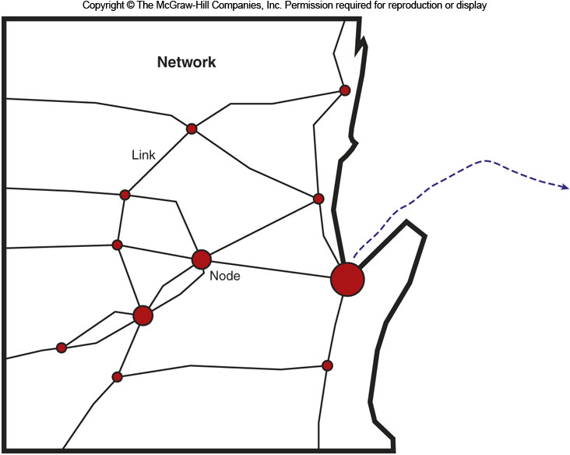
A Transportation System
Figure 17D.1

Slide 11
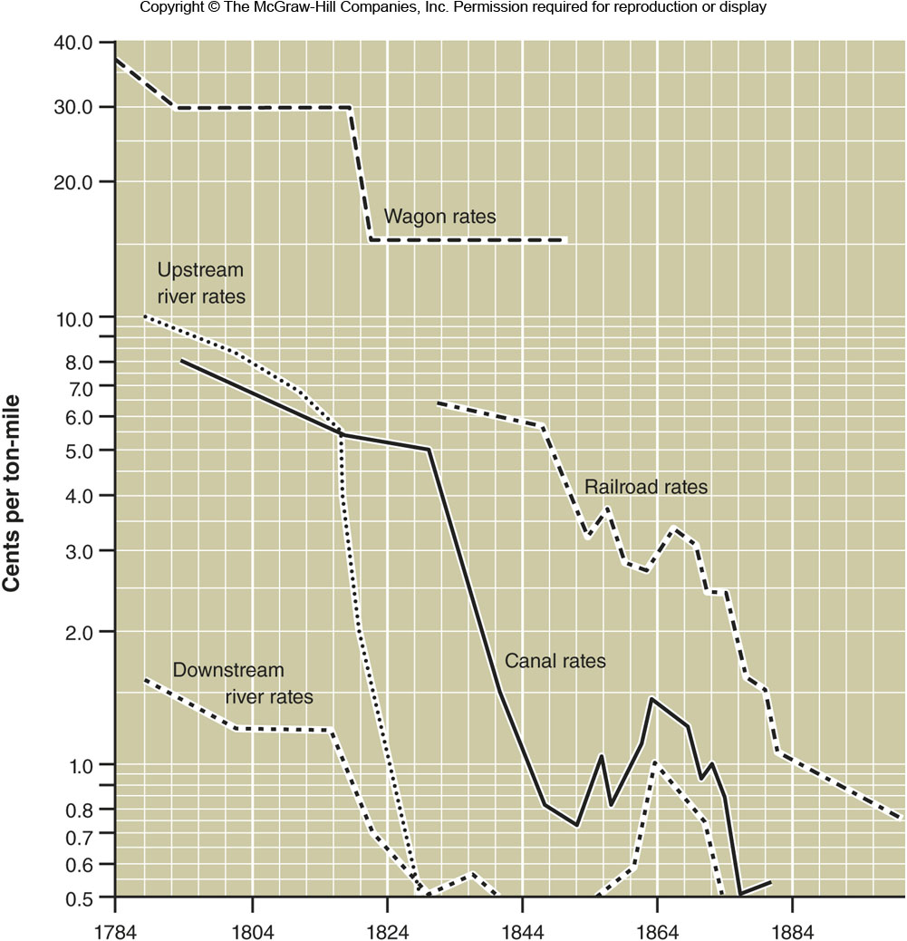
The Cost of Moving Goods
Figure 17D.3

Slide 12
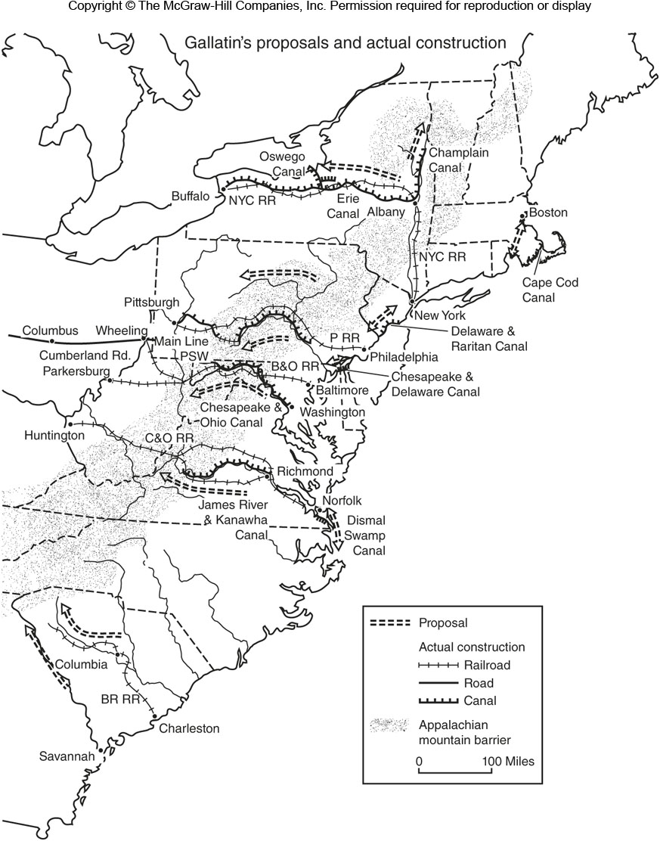
Gallatin’s Proposals & Construction
Figure 17E.1

Slide 13
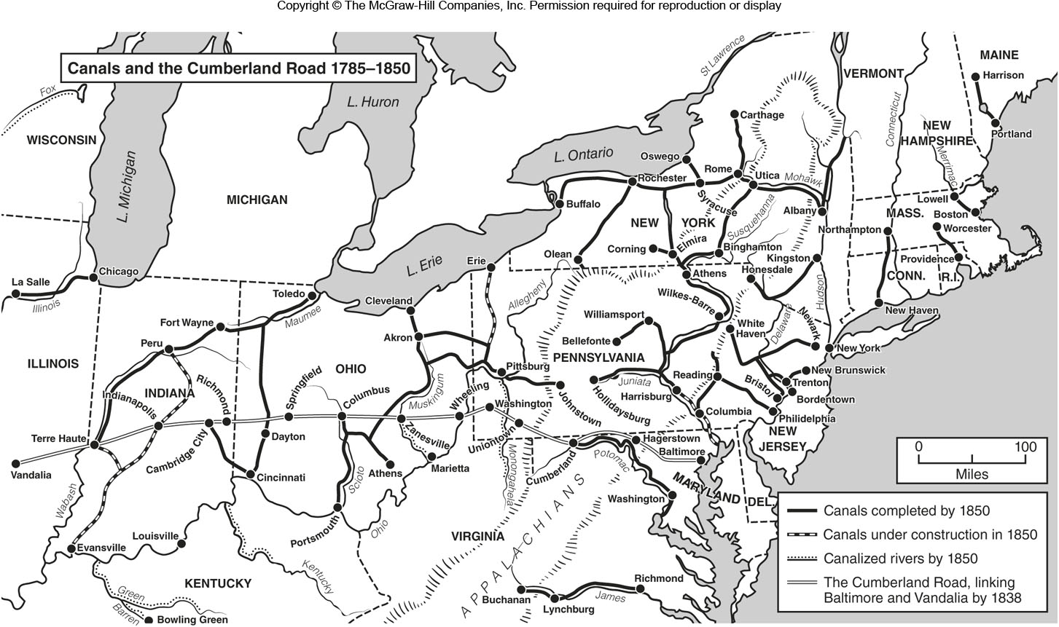
Canals & the Cumberland Road 1785-1850
Figure 17E.2

Slide 14
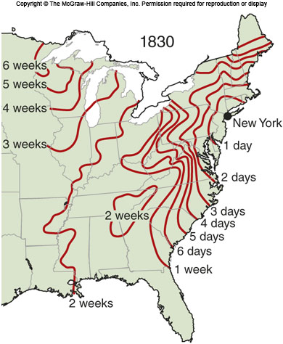
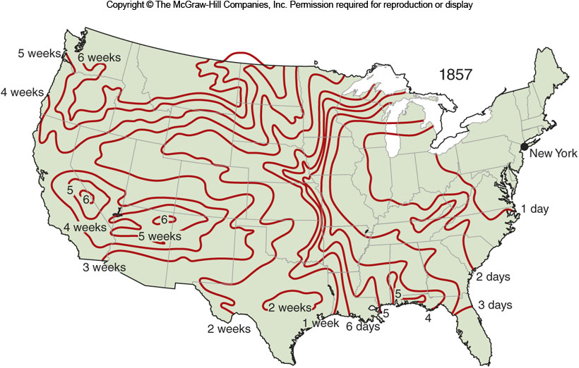
Travel Times 1830 & 1857
Figure 17E.3

Slide 15
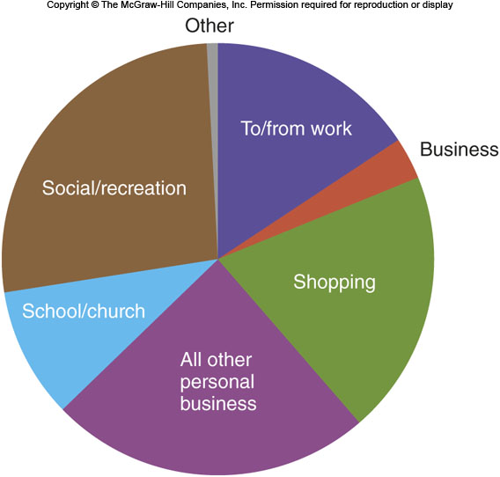
What do People Travel For?
Figure 17F.1

Slide 16
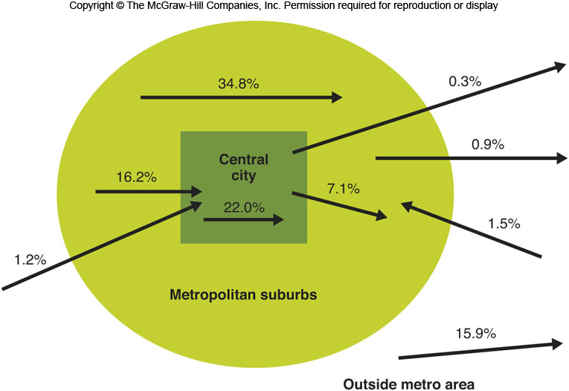
Commuting Patterns in the U.S.
Figure 17F.2

Slide 17
17G: Geographic Aspects of US Retailing
Christaller’s Central Place Model
Stores cluster into central places
Each store type needs a certain size hinterland
Smaller hinterlands (gas stations) are nested in larger ones (big box store)
Small towns thus have only basic businesses that have small hinterlands and large cities have nearly every type of business

Slide 18
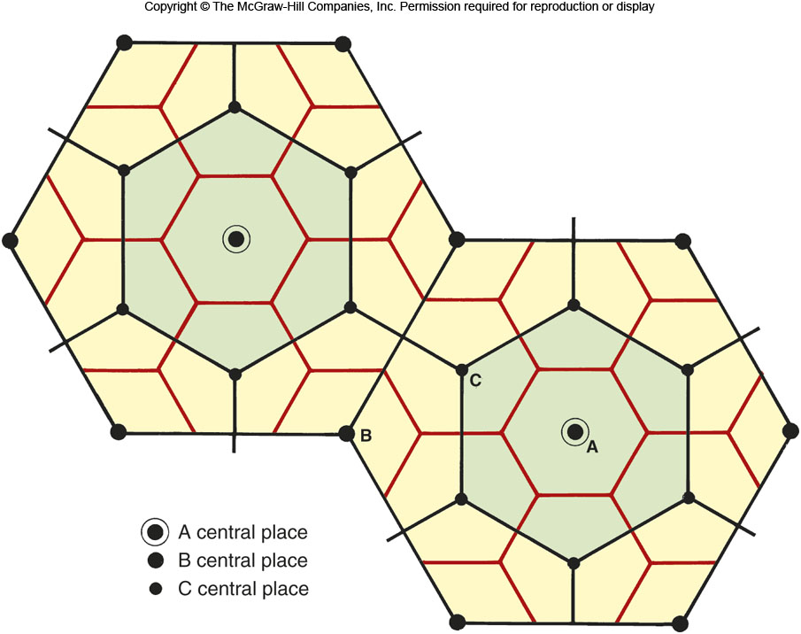
Central Places
Figure 17G.2

Slide 19
17G: Geographic Aspects of US Retailing
Changes in retailing are related to a few factors
Retail outlets have gotten larger
A Walmart Supercenter is about 4 acres
Retail stores are more likely to be in the suburbs today compared to the past, when they were in the city
We now have retail chains

Slide 20
17G: Geographic Aspects of US Retailing 2
Types of retail development:
Pedestrian-oriented commercial strips
Enclosed malls
Neighborhood/community centers & strips
Specialty shopping centers
Mix retail with tourism
Power centers
Mostly big “category killer” stores
Open-air “lifestyle” centers

Slide 21
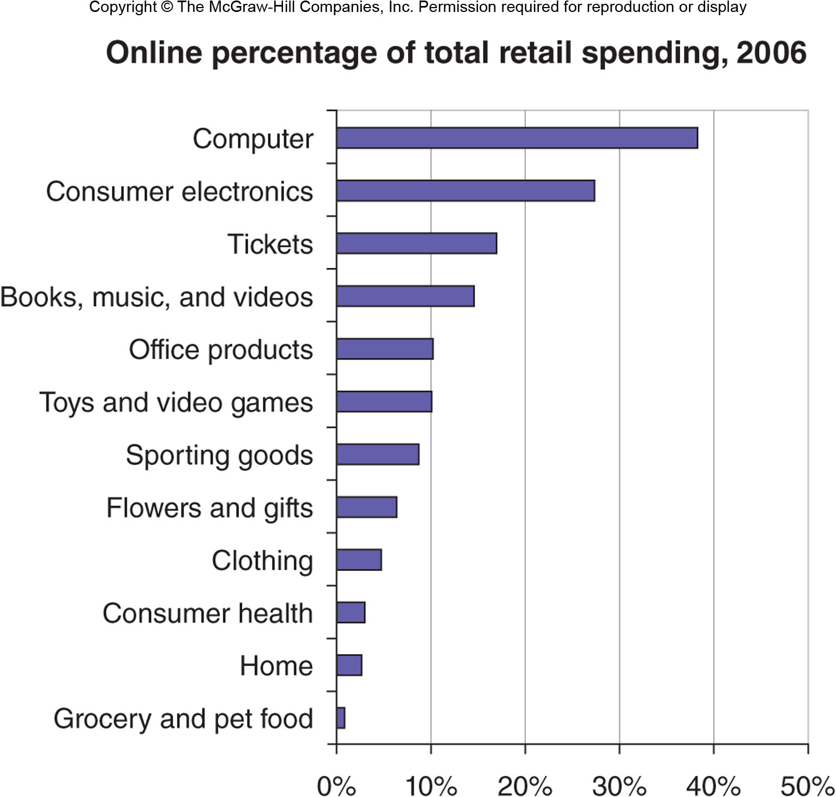
17H: Changing Geographies of Retailing in the Internet Age
Nonstore retailing
Door-to-door salespeople
Catalogs, such as Sears-Roebuck
In recent decades, niche marketing, such as Lands’ End
Home shopping channels
With the Internet, the rise of e-tailing

