Slide 1
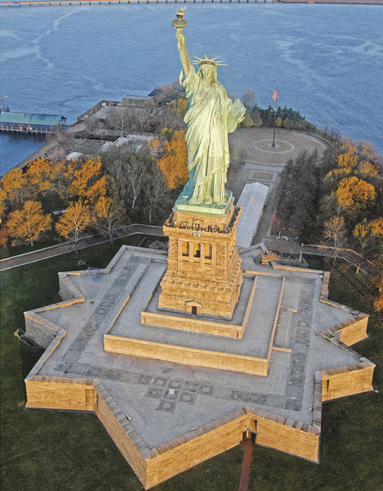
Chapter 1 LECTURE OUTLINE MAJOR GEOGRAPHIC CONCEPTS
Photo © Jon Malinowski.
All rights reserved. Used with permission
Human Geography by Malinowski & Kaplan

Slide 2
Chapter 1 Modules
1A Pattern and Process
1B Absolute and Relative Location
1C Place and Space
1D Place Attributes and Significance
1E Mapping Spatial Distributions
1F Spatial Interactions and Distance
1G Regions
1H Idea of Landscape

Slide 3
1A: Pattern & Process
Pattern
a spatial arrangement of a phenomenon
Process
the action that brings about a particular pattern
in human geography, processes tend to be probabilistic
may be multivariate and multiscalar

Slide 4
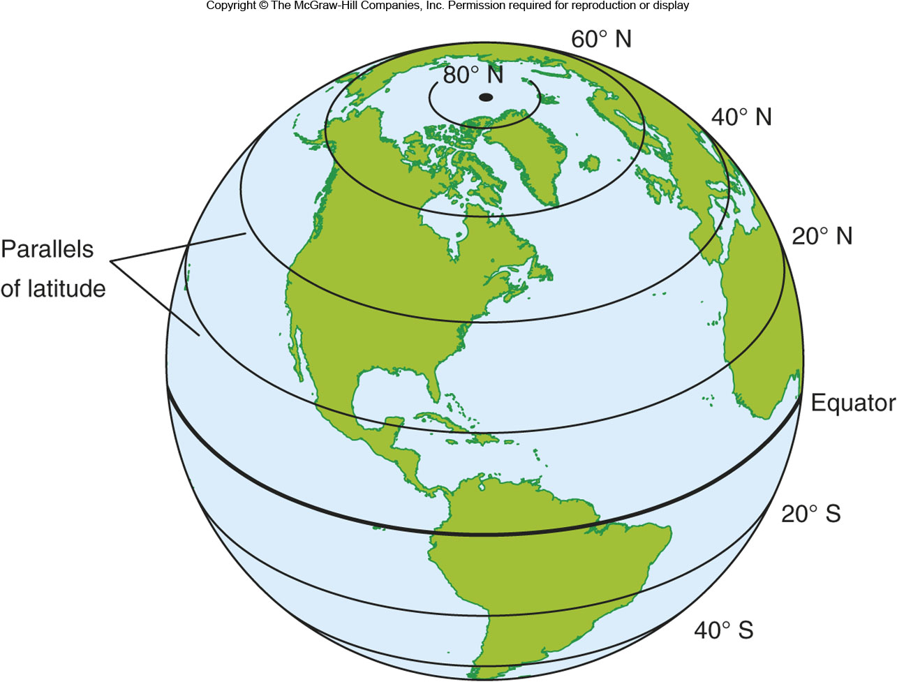
1B: Absolute & Relative Location
Insert Figure 1B.1
Absolute Location
where something exists on a reference system
Relative Location
Location compared to other places or in context
Site vs. Situation

Slide 5
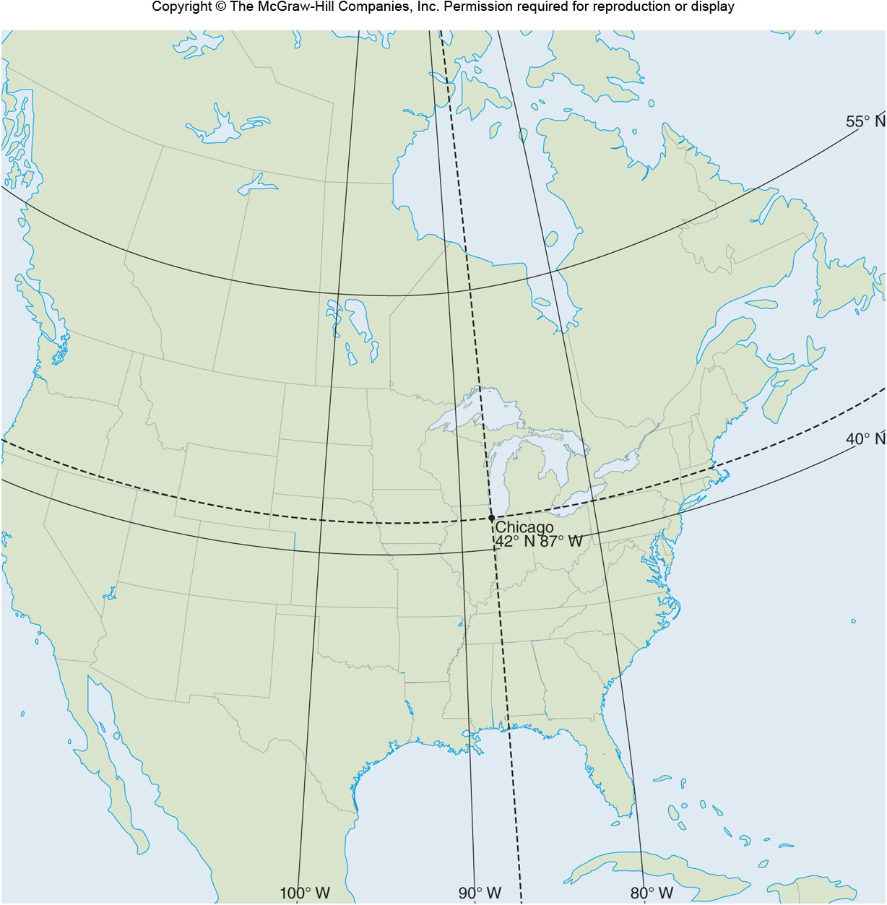
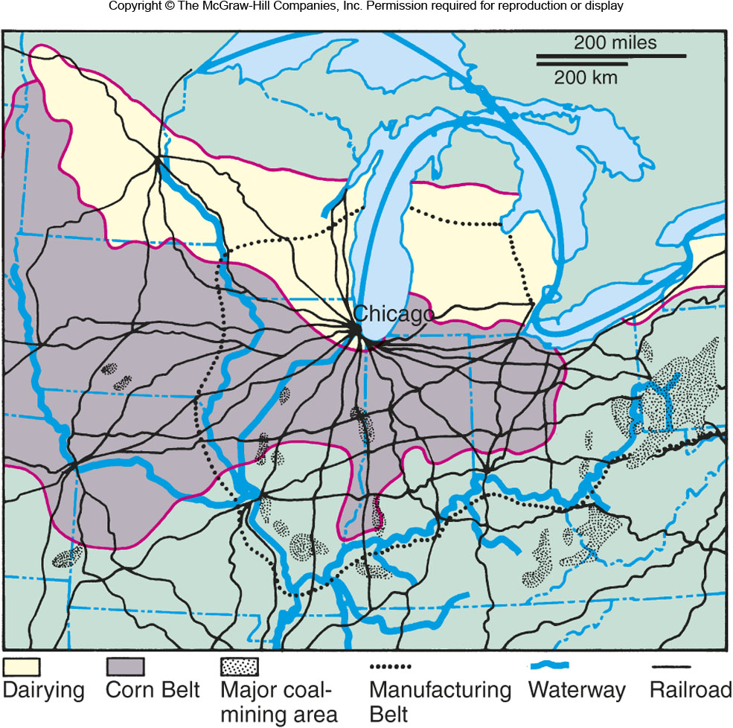
Figures 1B.2 & 1B.3

Slide 6
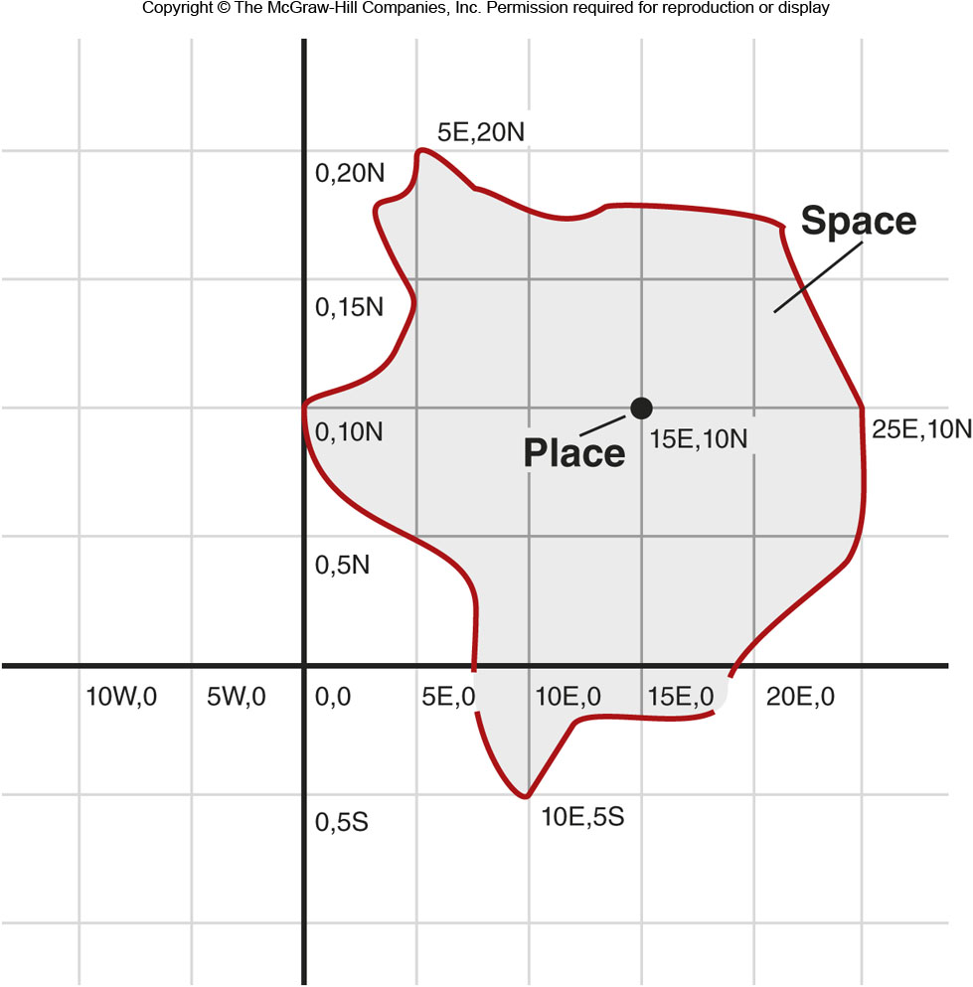
1C: Place & Space
Place
Can refer to a series of concrete attributes or can imply diverse meanings attached to a location
Space
A two-dimensional area that contains a number of places and boundaries that may or may not be clearly defined.

Slide 7
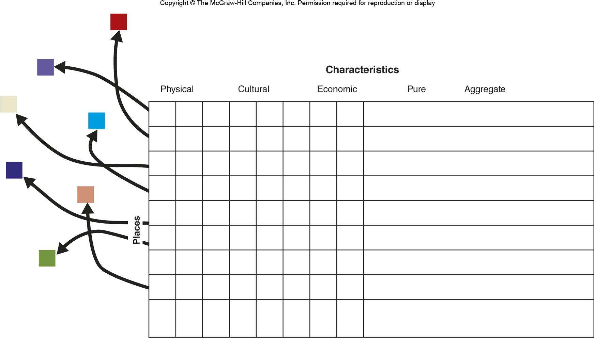
Figure 1D.1

Slide 8
1E: Mapping Spatial Distributions
Thematic Maps
show the distribution, flow, or connection of one or more characteristics
Point Pattern Map
each incident is displayed as a point
can show whether a distribution is dispersed or clustered
Choropleth Maps
show the quantity or type of phenomena by area

Slide 9
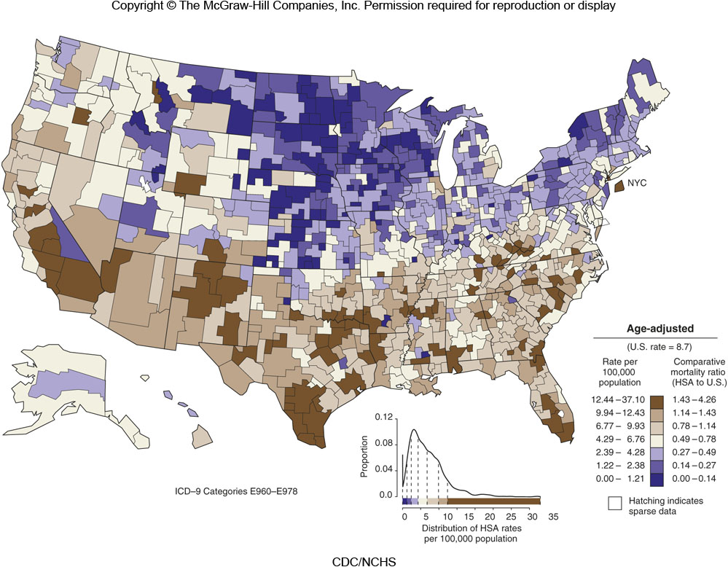
Figure 1E.2

Slide 10
1F: Spatial Interactions & Distance
Spatial Interaction
the movement and interconnections between places.
Influenced by accessibility
Distance
Absolute / Euclidean distance
Travel distance
Travel time
Cognitive distance

Slide 11
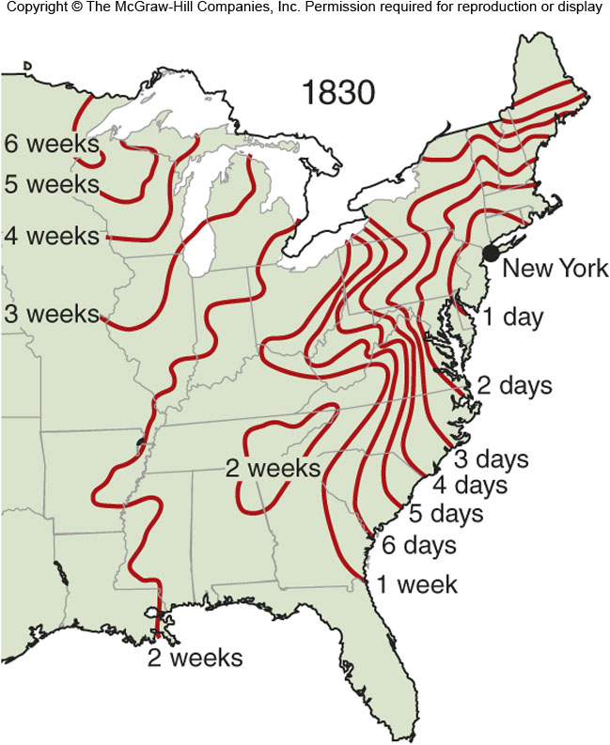
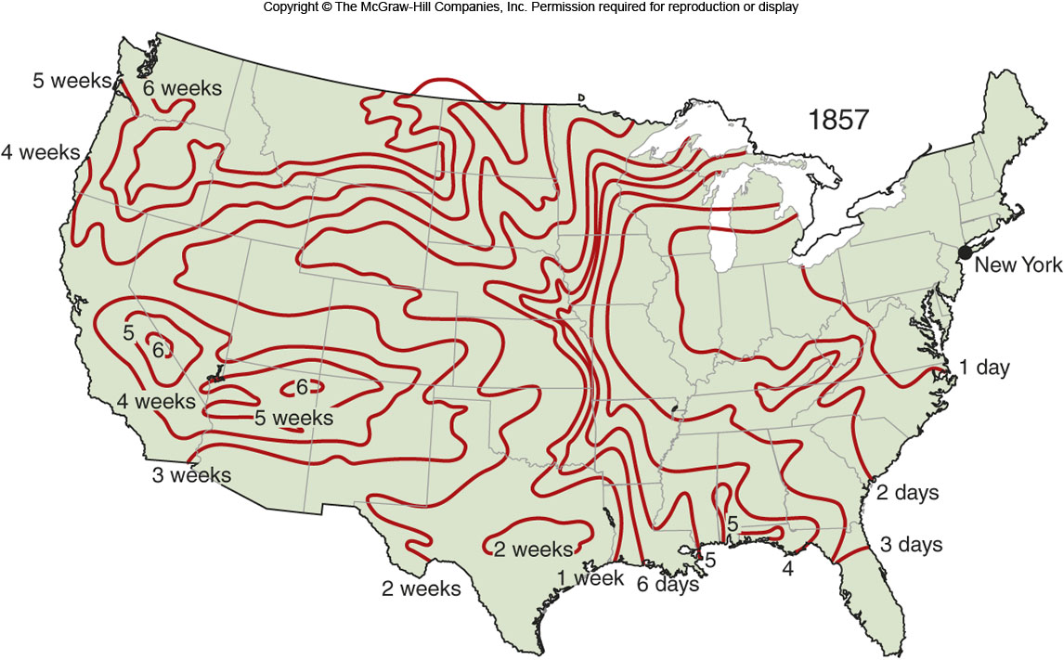
Travel Time
Figure 1F.4

Slide 12
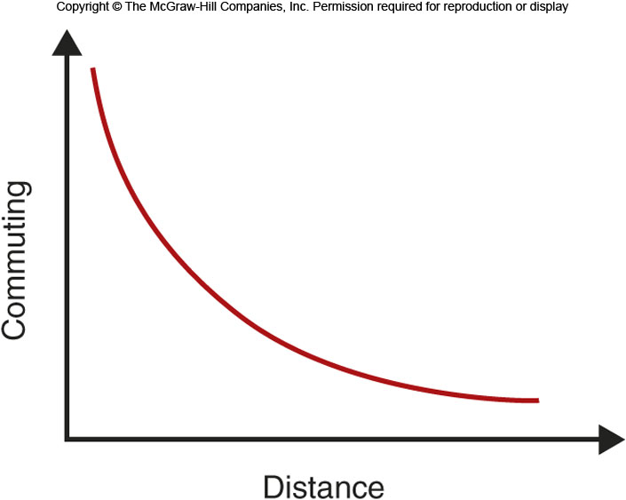
Distance Decay
Figure 1F.5

Slide 13
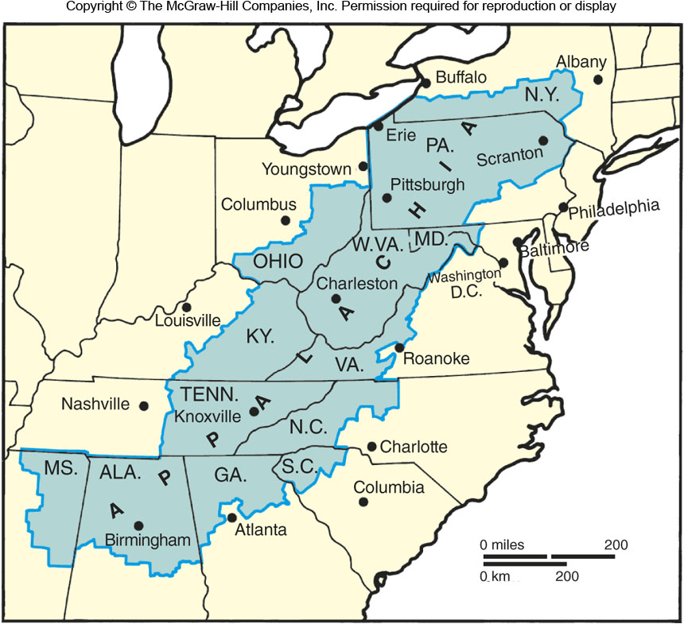
1G: Regions
A way of subdividing space into categorizable geographic units.
Types:
Formal
Functional
Vernacular

Slide 14
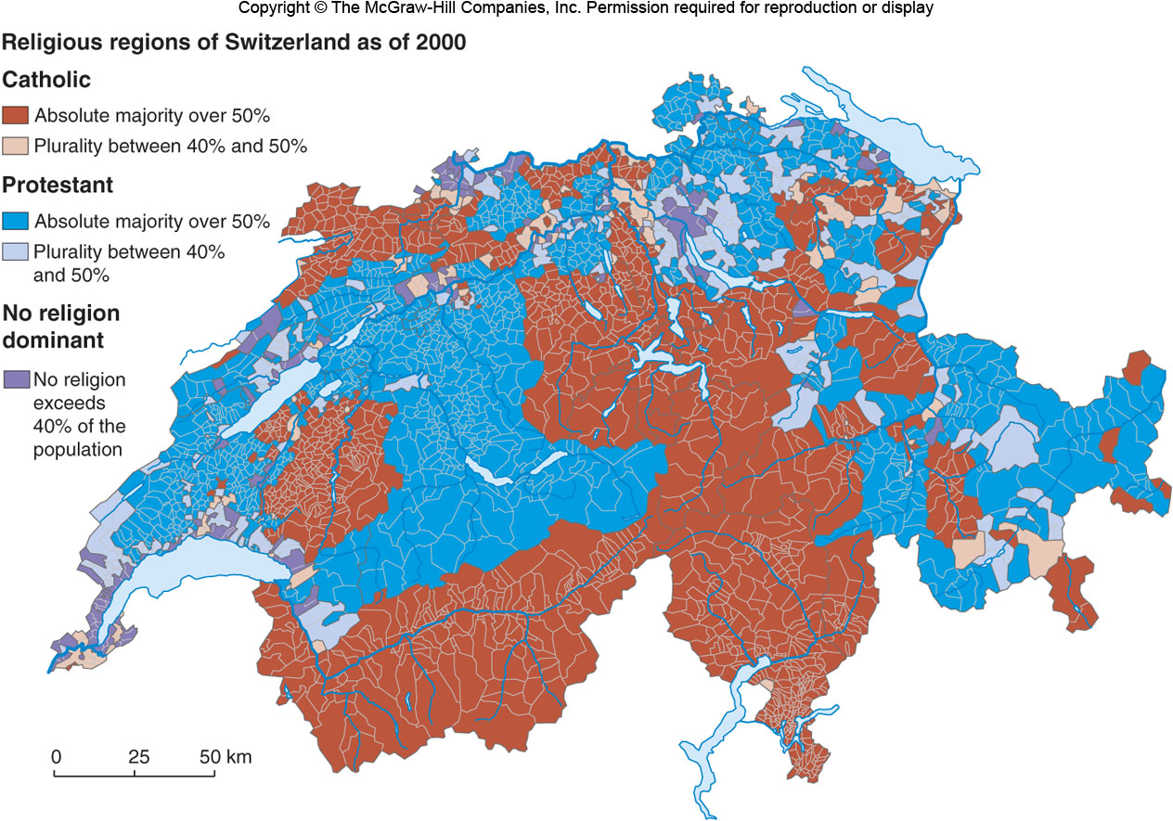
Formal Regions
Composed of places that have one or more characteristics in common.
Figure 1G.4

Slide 15
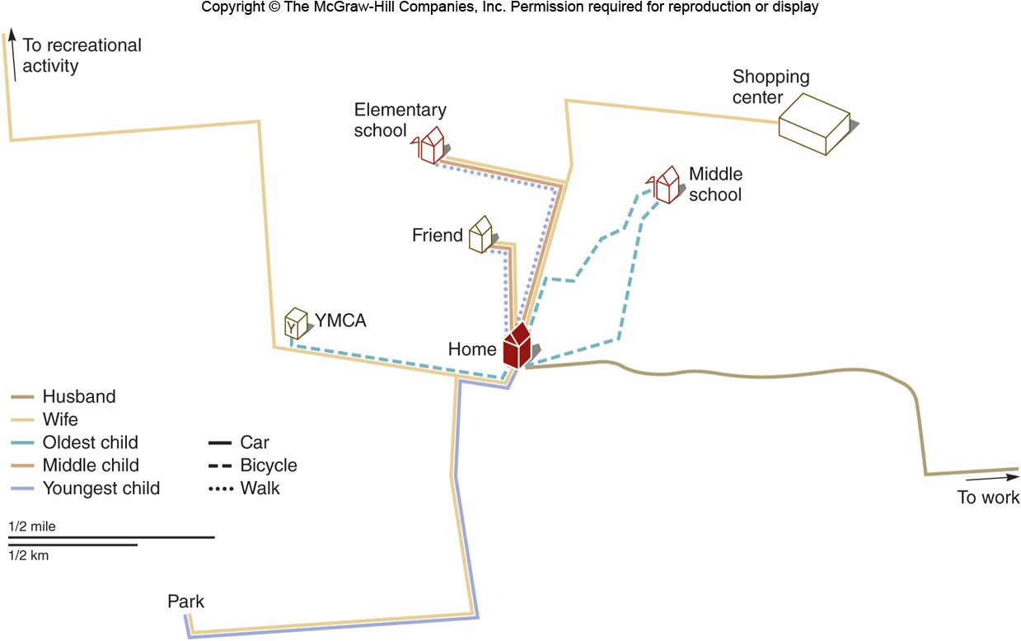
Functional Regions
Regions constructed out of places that interact.
Figure 1G.6
Activity space

Slide 16
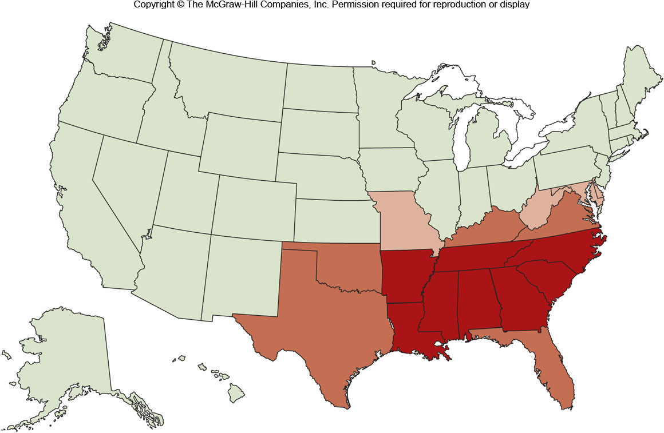
Vernacular Regions
Regions that people construct in their mind.
Figure 1G.8

Slide 17
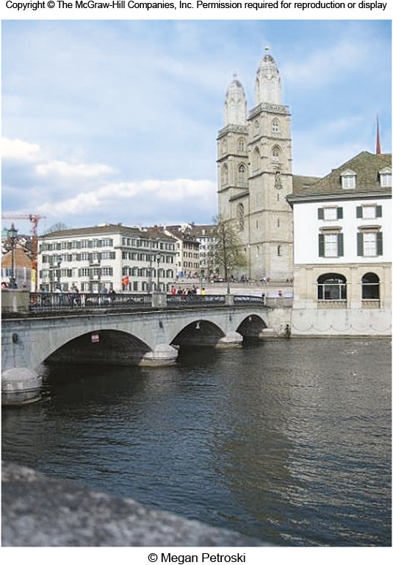
1H: Idea of Landscape
An area that is less defined than a region and is described in an abstract manner.
Types:
Ordinary
Iconic
Interior

