Slide 1
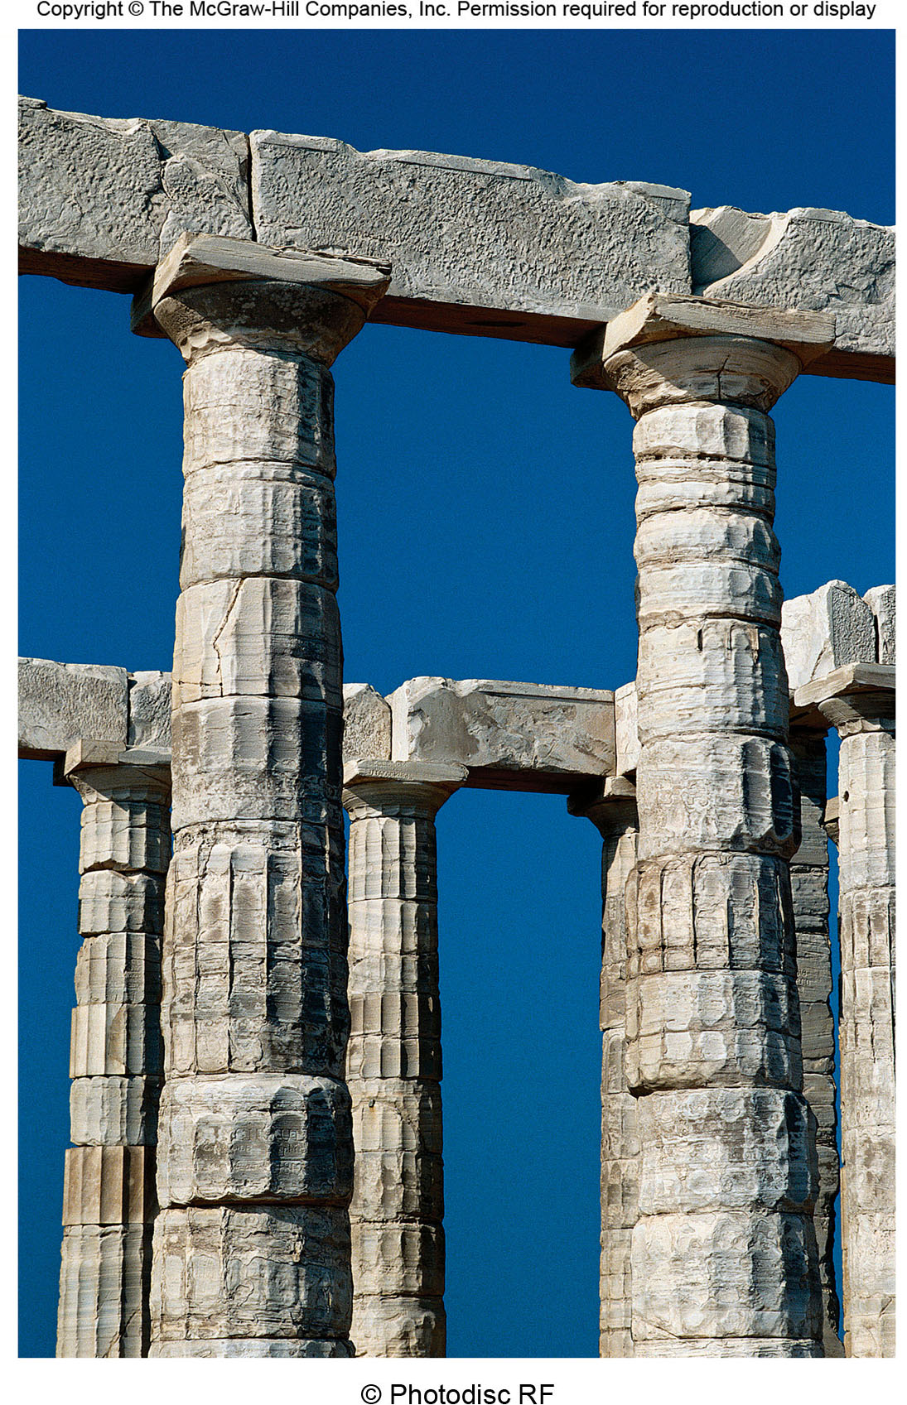
Chapter 2 LECTURE OUTLINE GEOGRAPHY THROUGH THE AGES
Human Geography by Malinowski & Kaplan

Slide 2
Chapter 2 Modules
2A Ancient Geography
2B The Middle Ages
2C The Age of Exploration
2D The Birth of Modern Geography
2E The Twentieth Century
2F Behavioral and Humanistic Geography
2G Structuralist Geographies
2H Recent Decades

Slide 3
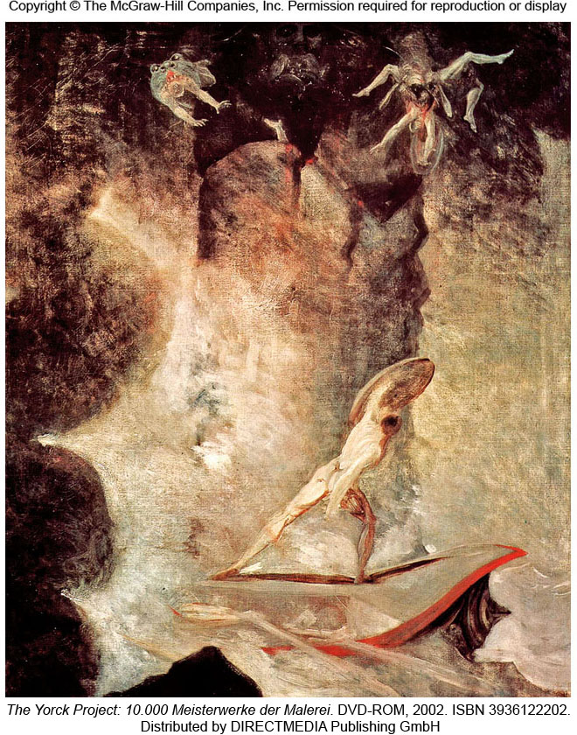
2A: Ancient Geography
Early geography focused on description & measurement

Slide 4
Early Geographic Figures
Homer
Works such as The Odyssey described Mediterranean areas
Hecataeus
Wrote Ges Periodos, a coastal survey
Herodotus
Included detailed geographic descriptions in his writings
Ptolemy
Wrote an extensive geography of the world in the 2nd century AD
Eratosthenes
Calculated the circumference of the world

Slide 5
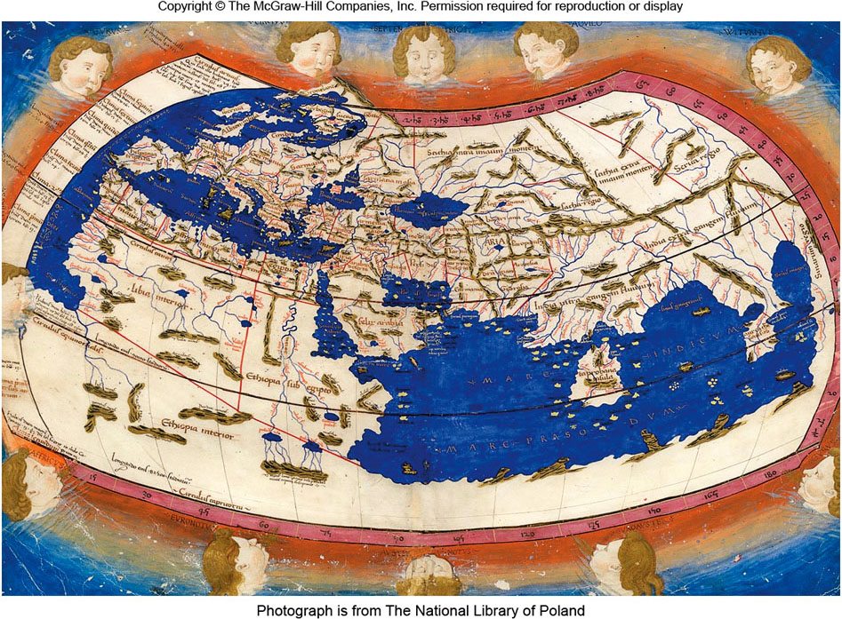
Ptolemaic World Map
Figure 2A.3

Slide 6
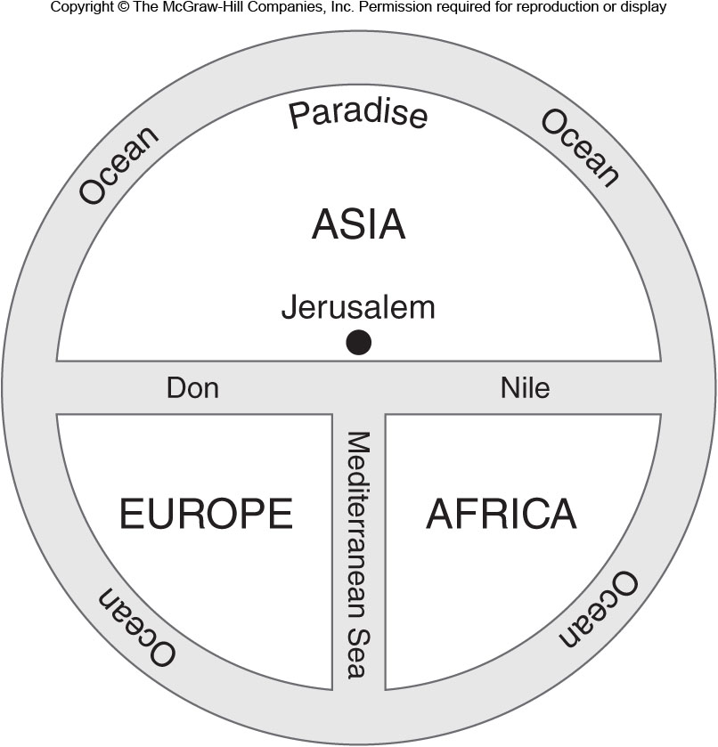
2B: The Middle Ages
Geographic understanding stagnated in Christian Europe compared to Islamic world and China

Slide 7
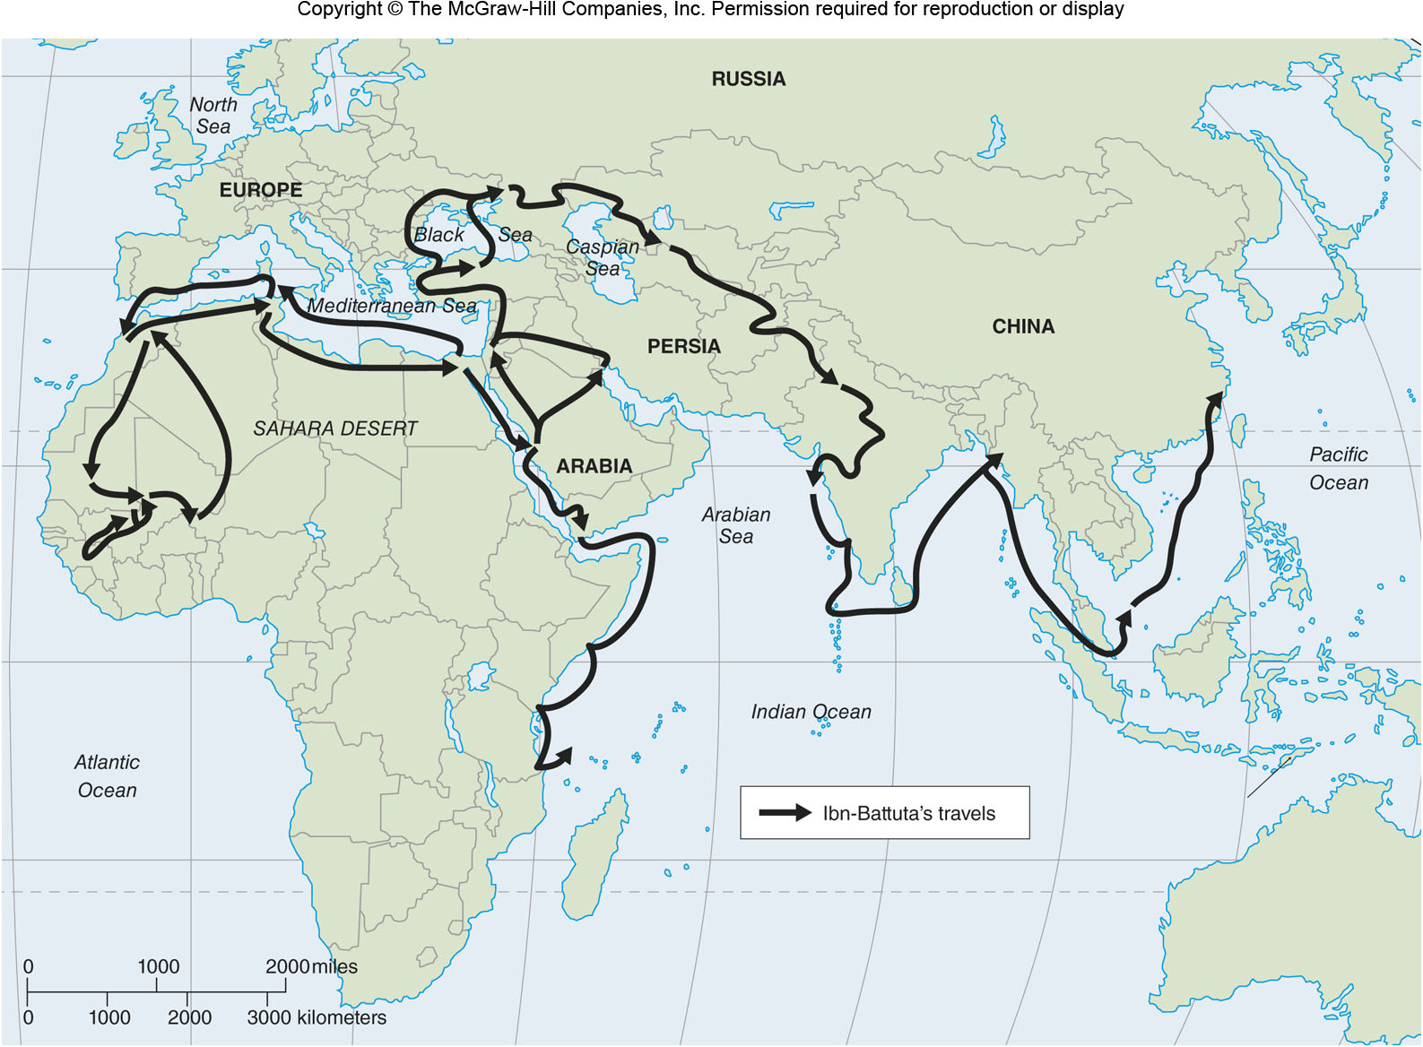
Travels of Ibn-Battuta
Figure 2B.2

Slide 8
2C: The Age of Exploration
Wide-reaching expansion of European overseas interest
Prince Henry the Navigator
Employed geographers, cartographers, astronomers and other experts
Long distance navigation was aided by improvements in measuring latitude
John Harrison’s clock (late 18th century)

Slide 9
The Columbian Exchange
Important interaction between the Eastern & Western Hemispheres
Crops
Livestock
Disease

Slide 10
2D: The Birth of Modern Geography
Alexander von Humboldt
Traveled, collected, & categorized plants / rocks
Promoted appreciation of scientific inquiry
Carl Ritter
Pushed academic geography toward scientific observation
Searched for interconnections among things

Slide 11
Environmental Determinism
Theory that human culture is caused the environment a society lives in
Used to overgeneralize people, races, and areas of the world
Generally discredited today as racist and imperialist
Challenged by the “possibilists” led by French geographer Vidal de la Blache

Slide 12
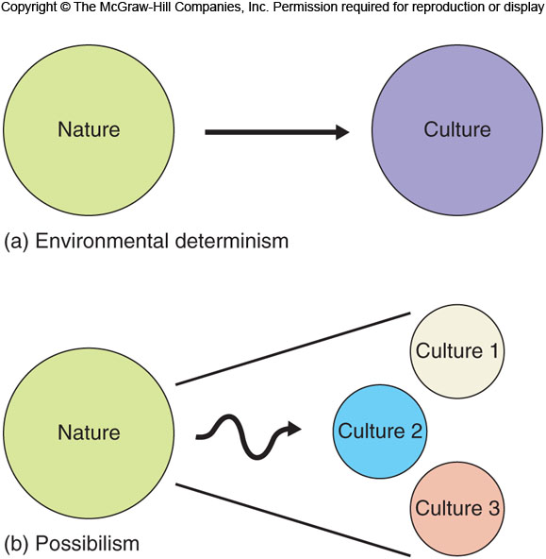
Environmental Determinism
Figure 2D.3
Possibilism

Slide 13
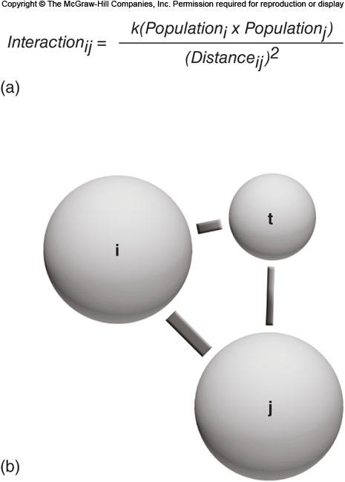
2E: The Twentieth Century
1920s: Carl Sauer emphasizes the changing cultural landscape
1930s: Increasing focus on regional geography
Mid-Century: Rise in systematic geography
1950s: Quantitative revolution
Positivism

Slide 14
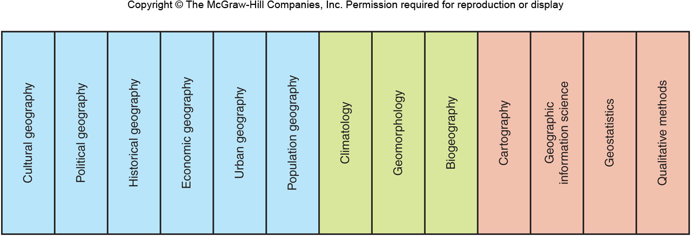
Subdisciplines of Geography
Figure 2E.2

Slide 15
2F: Behavioral & Humanistic Geography
Behavioral Geography
focus on the psychological processes that underlie geographic decisions
Mental Maps
representations of the real world that we have in our heads
Humanistic Geography
a greater emphasis on the meaning that humans places on the environment & surroundings

Slide 16
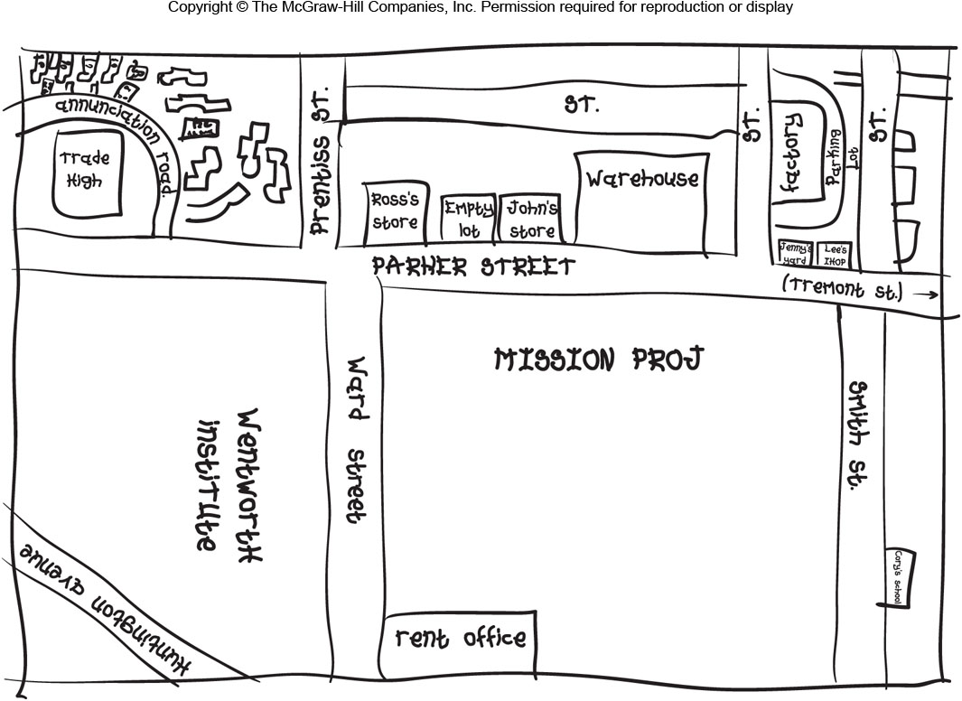
Mental Map
Figure 2F.1

Slide 17
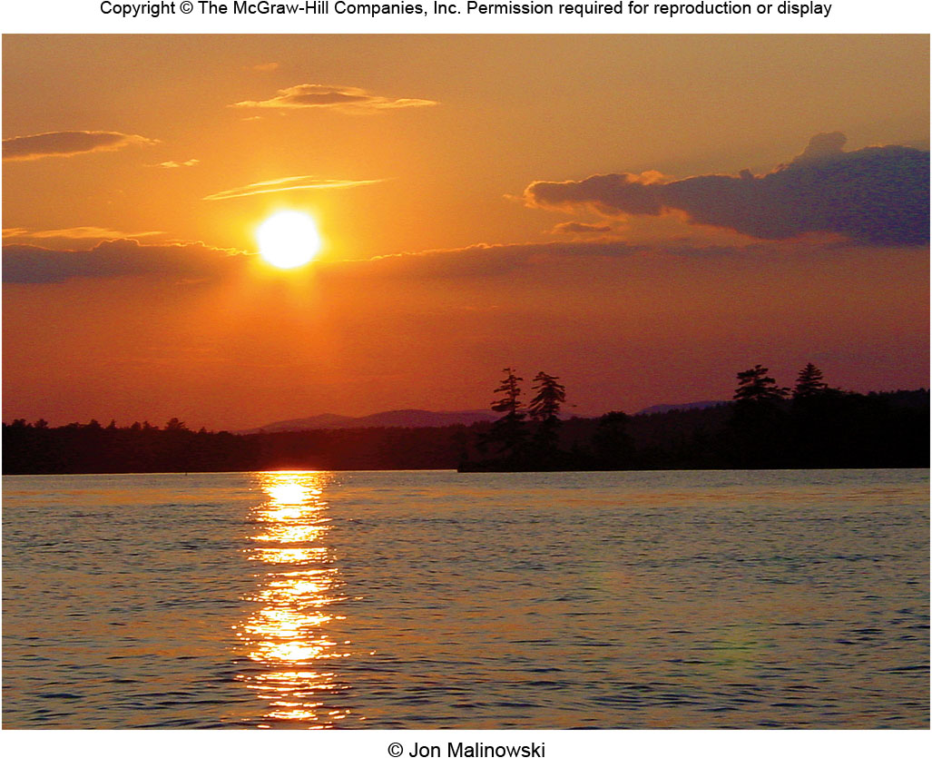
Yi-Fu Tuan
Topophilia
love of place
Topophobia
fear of place

Slide 18
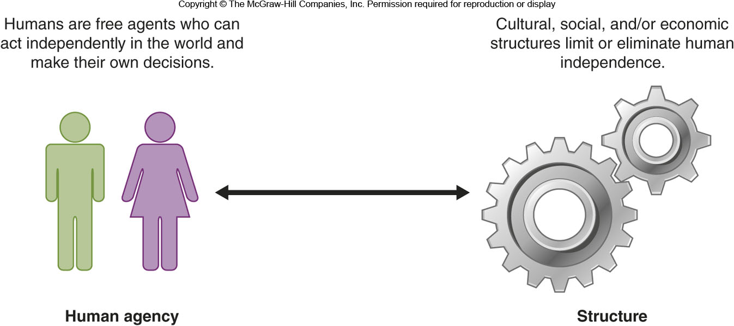
2G: Structuralist Geographies 1
Structuralism
A set of social theories that generally look for deep structures or theories that guide human actions and societies
Structure vs. Agency

Slide 19
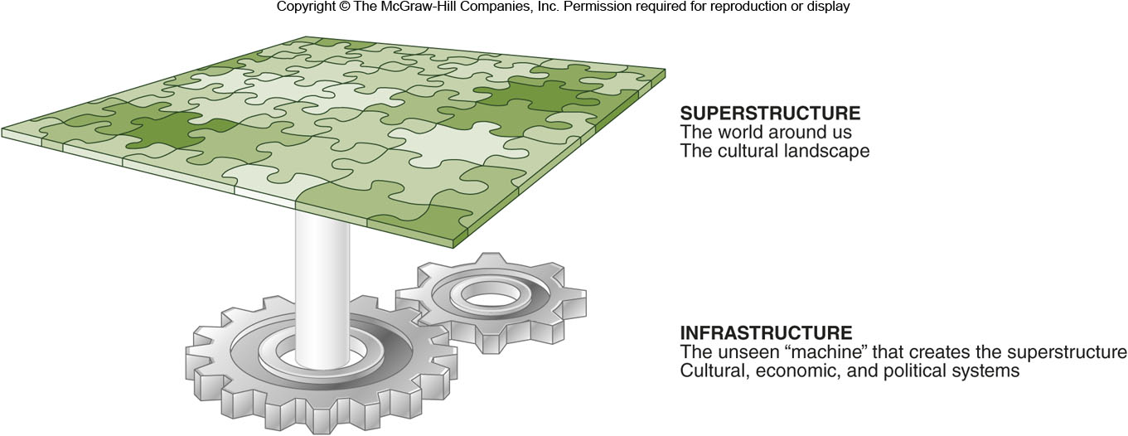
Figure 2G.1

Slide 20
2G: Structuralist Geographies 2
Structuration
A theory that human action is partly constrained by social structures governed by laws and social norms and that societies can choose to either reproduce or change their behaviors.
Geographic focus on locales
Marxism
For geographers, a focus on spatial inequality and how capitalism influences the world around us

Slide 21
2H: Recent Decades 1
Modernism
20th century trends in art, architecture, & literature that broke from tradition
Postmodernism
A complex set of ideas that arose as a criticism of modernism and that, in general, rejects that everything in the world is rational or neatly categorized.

Slide 22
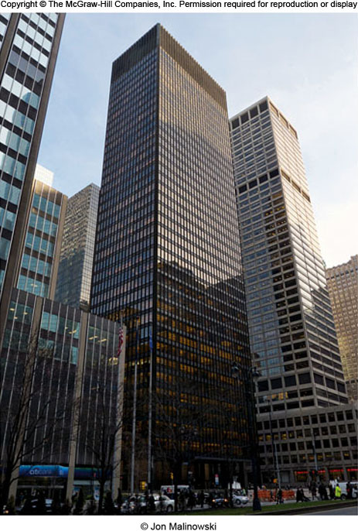
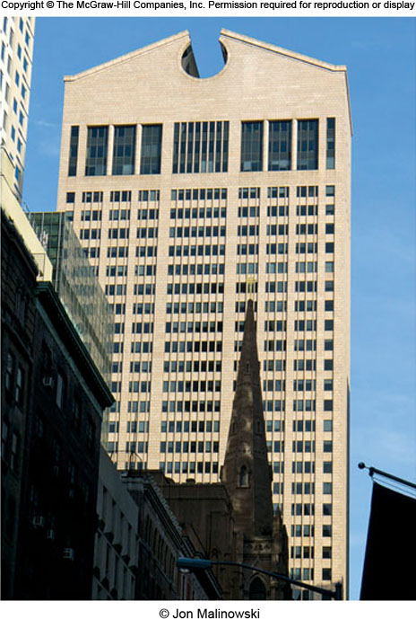
Modernist vs. Postmodernist
Figure 2H.1

Slide 23
2H: Recent Decades 2
Poststructuralism
Social theories that question structuralism’s search for deep structures and focus on individuals and local differences.
In geography, many poststructuralists focus on how marginalized groups view and use landscapes.
Feminism
Theories and philosophies that focus on the status and rights of women.

Slide 24
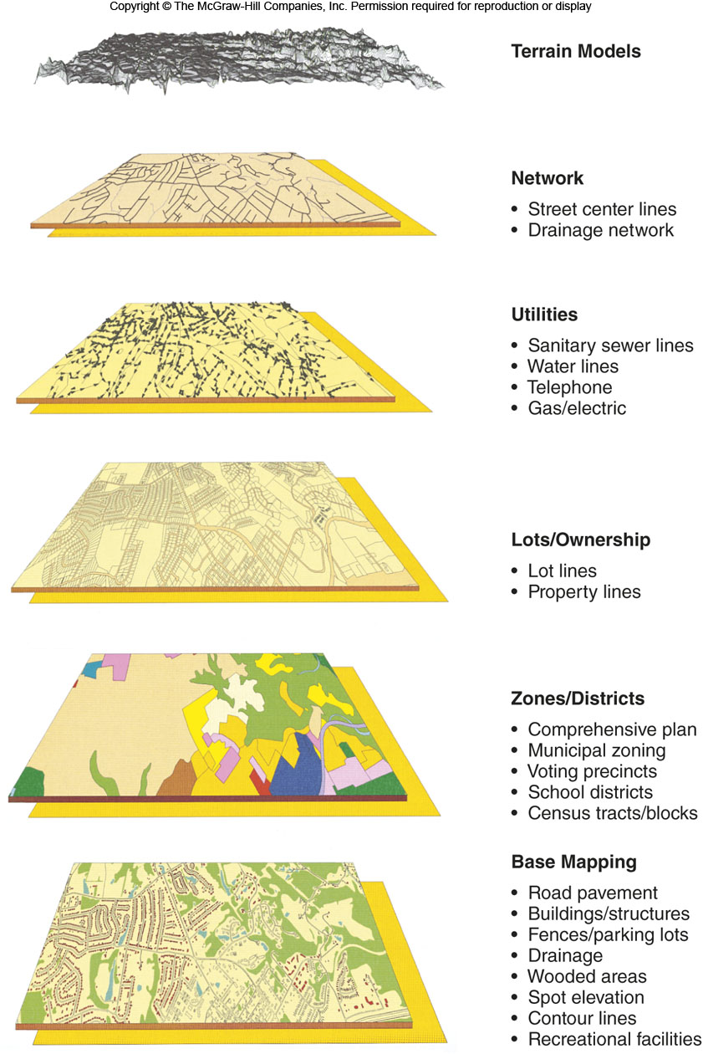
Geographic Information Systems
“GIS”
Computer systems that can capture, store, analyze, and output geographic information

