Slide 1
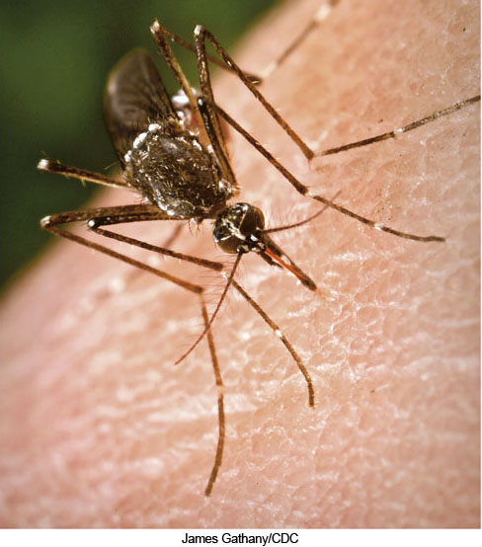
Chapter 4 LECTURE OUTLINE GEOGRAPHY of health & DISEASE
Human Geography by Malinowski & Kaplan

Slide 2
Chapter 4 Modules
4A Health and Geography
4B Human Ecology of Disease
4C Disease Basics
4D HIV/AIDS
4E Common Diseases
4F Snapshot of Global Health
4G Geography of Health Care

Slide 3
Medical Geography
The application of geographic ideas, information, and theories to the study of disease, health, and health care.
Also called Health Geography

Slide 4
4A: Health and Geography
Approaches:
Human-Environment relationships
Poor environments can negatively affect health
Pollution and other human-made problems
Culture
Religious or other cultural attitudes/practices can affect how diseases or other ailments are dealt with
Movement
Diffusion of diseases

Slide 5
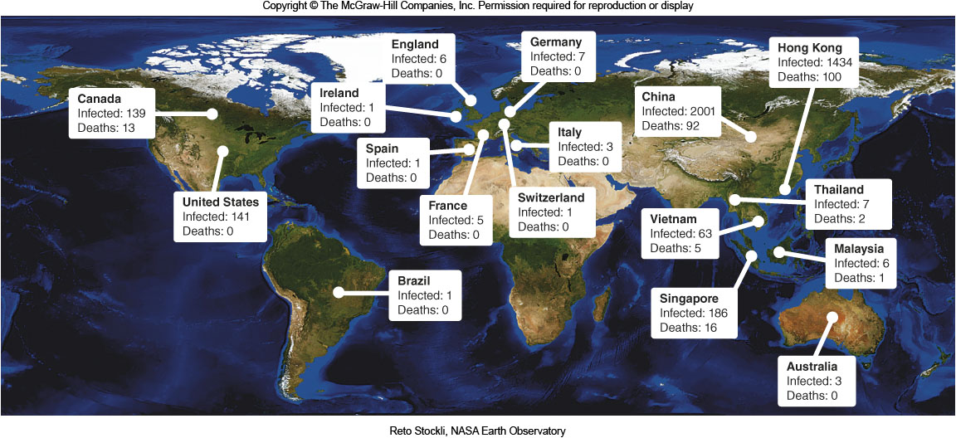
SARS 2002-2003
Figure 4A.3

Slide 6
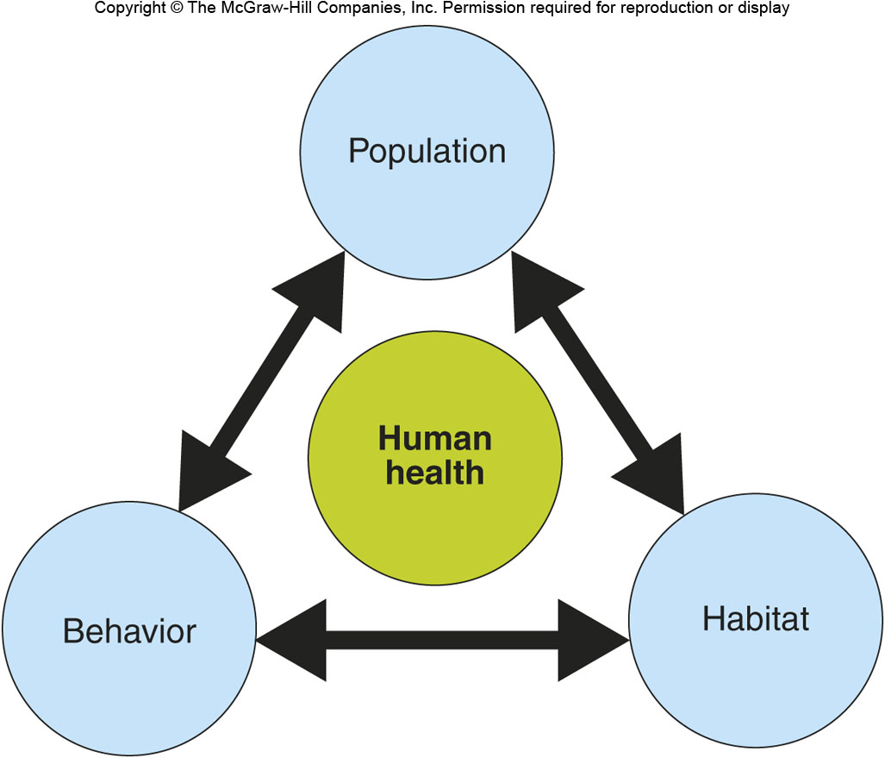
4B: Human Ecology of Disease
Human Ecology:
the interconnections between human populations and the physical world
Triangle of Human Ecology:
Population
Behavior
Habitat

Slide 7
Insults and Stimuli on Health
Chemical Insults:
Drugs, exposure to chemicals or gases
Physical Insults:
Trauma from accidents, radiation, shock
Psychosocial Insults:
Crowding, anxiety, love, sense of belonging
Infectious Stimuli:
Viruses, bacteria, protozoa

Slide 8
4C: Disease Basics 1
Endemic:
A disease that’s always present in a population
Epidemic
A disease that occurs in larger #s than normal
Pandemic
A worldwide epidemic

Slide 9
4C: Disease Basics 2
Agent:
The organism that causes a disease
Bacteria, viruses, protozoa, worms, etc.
Host:
The life form, animal or human, that has the disease caused by an agent
Vector:
The means by which the agent is transmitted to the host
Such as mosquitoes, flies, ticks, bats, or rodents

Slide 10
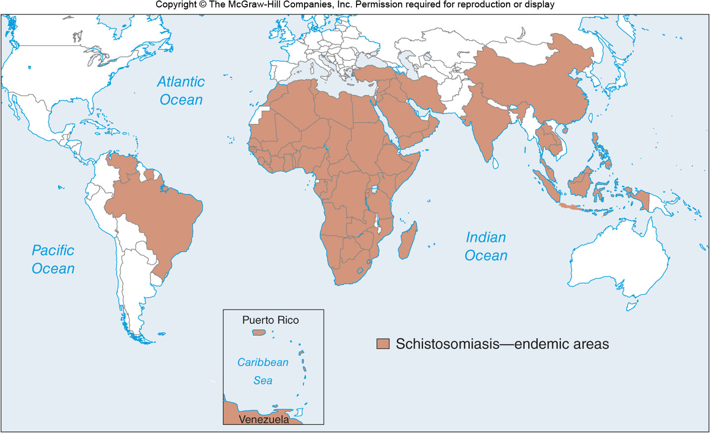
Schistosomiasis
Figure 4C.3

Slide 11
4D: HIV/AIDS
Pandemic:
Over 25 million deaths since 1981
Different geographies around the world
Prevention measures:
Sex education
Retroviral drugs
Free syringes in high drug-use areas
Affordable testing

Slide 12
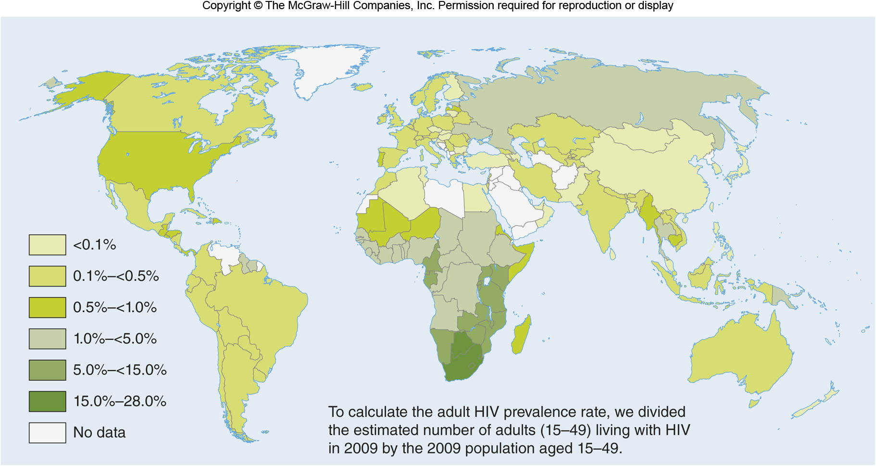
HIV/AIDS
Figure 4D.1

Slide 13
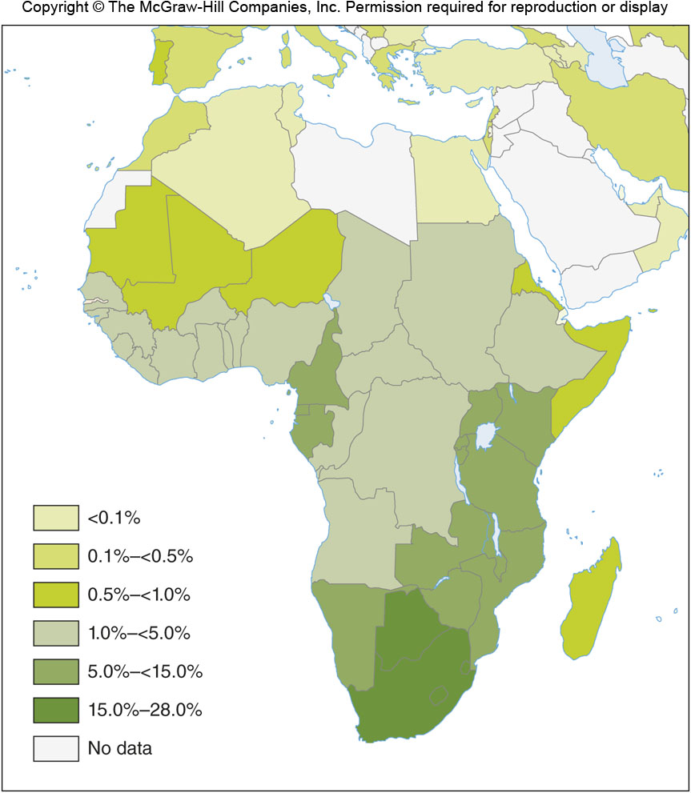
HIV/AIDS IN AFRICA
Figure 4D.2

Slide 14
4E: Common Diseases 1
Malaria
40% of the world’s population is at risk
500,000,000 cases per year
Caused by Plasmodium parasites spread by mosquitoes
Proximity to water is a key factor

Slide 15
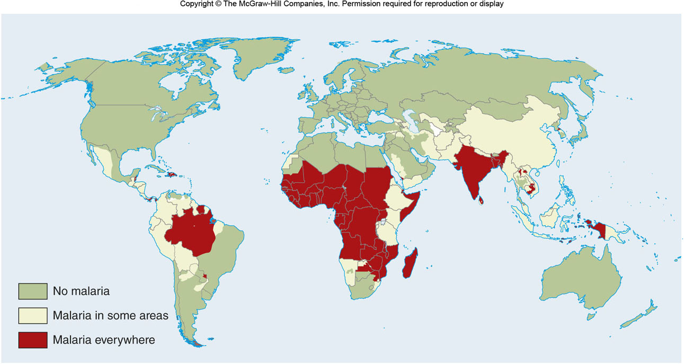
DISTRIBUTION OF MALARIA
Figure 4E.1

Slide 16
4E: Common Diseases 2
Tuberculosis (TB)
Pulmonary disease
9 million new cases a year
1/3 of the world’s population has been exposed
Hard to control because it is transmitted person-to-person
Single sneeze can release 40,000 droplets of infected spit

Slide 17
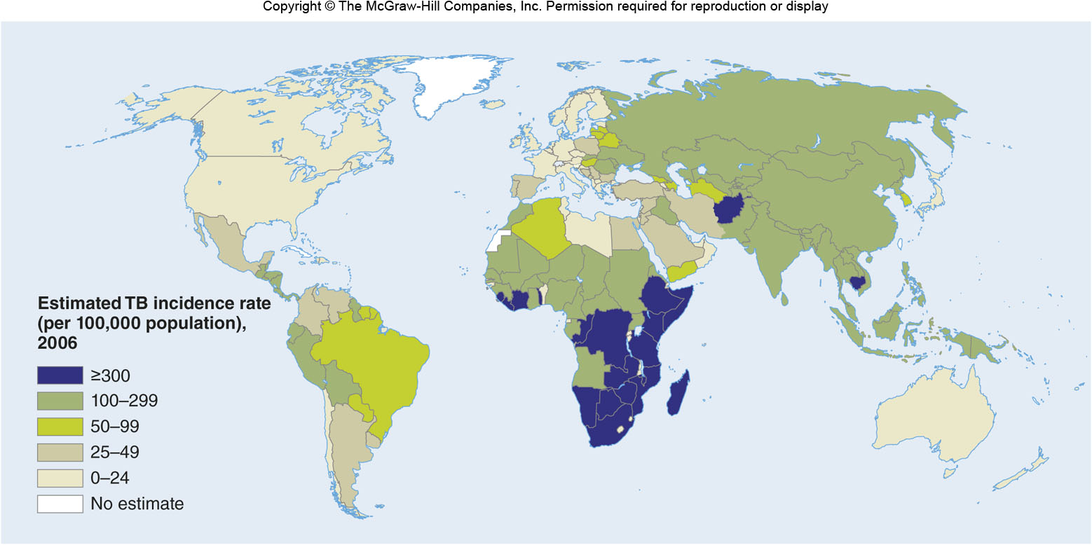
DISTRIBUTION OF TB
Figure 4E.2

Slide 18
4E: Common Diseases 3
Yellow Fever
Mosquito-transmitted viral disease
Endemic in Africa & Latin America
200,000 cases & 30,000 deaths a year
Diarrhea
A leading killer worldwide
Kills 2 million children under 5 each year
Influenza
Killed 100 million people during 1916-1918
Continues to be a major health concern

Slide 19
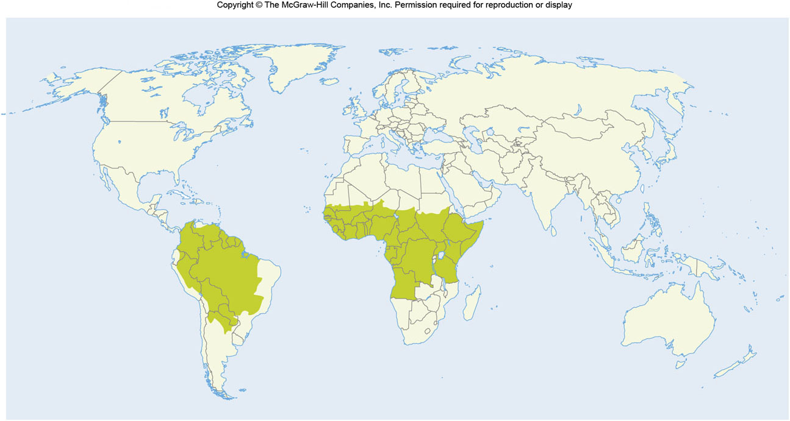
YELLOW FEVER
Figure 4E.3

Slide 20
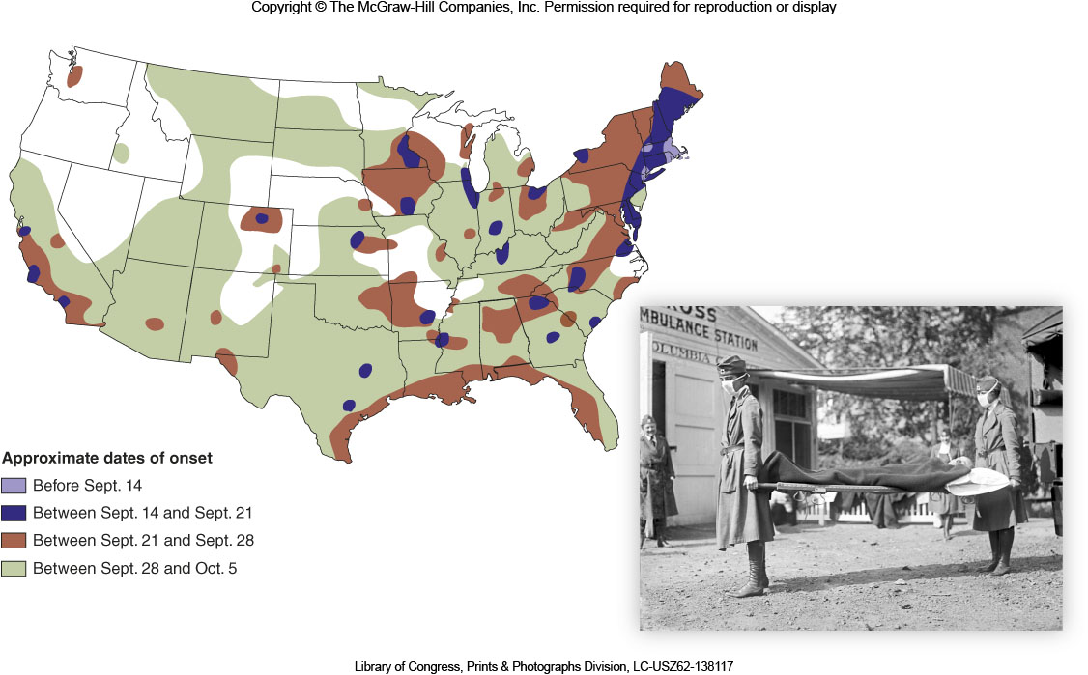
INFLUENZA in the U.S., 1918-1920
Figure 4E.5

Slide 21
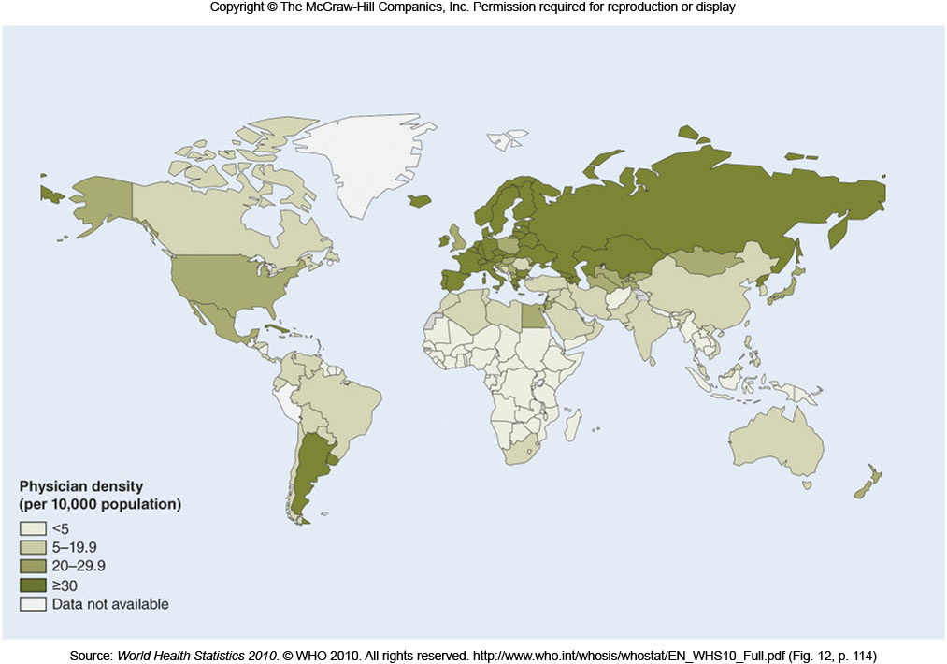
PHYSICIANS / 10,000 PEOPLE
Figure 4F.1

Slide 22
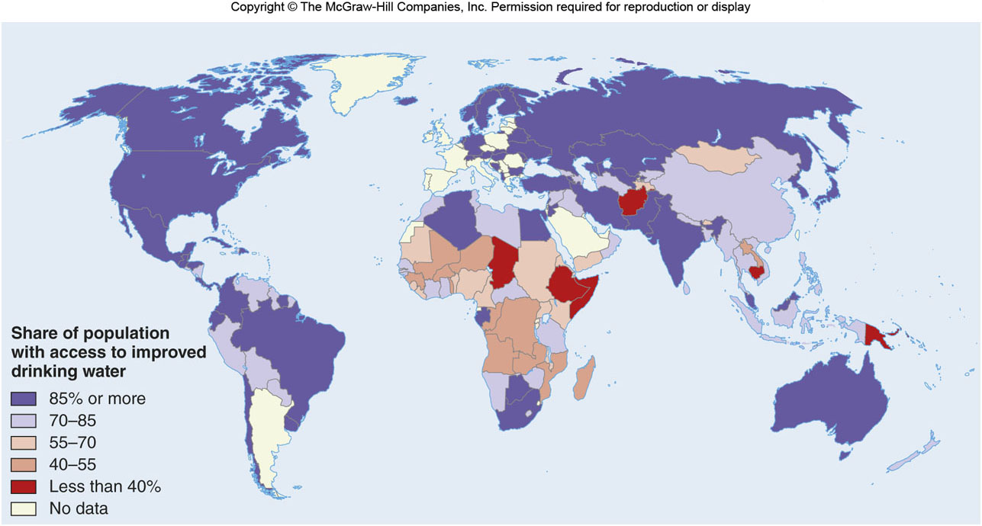
SAFE DRINKING WATER
Figure 4F.2

Slide 23
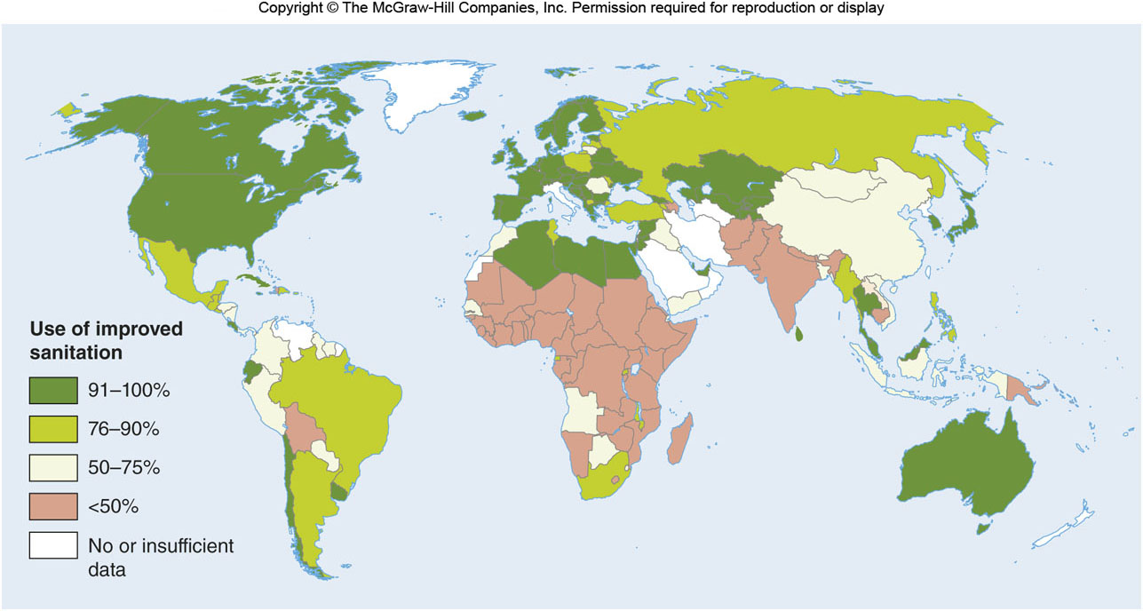
PROPER SANITATION
Figure 4F.3

Slide 24
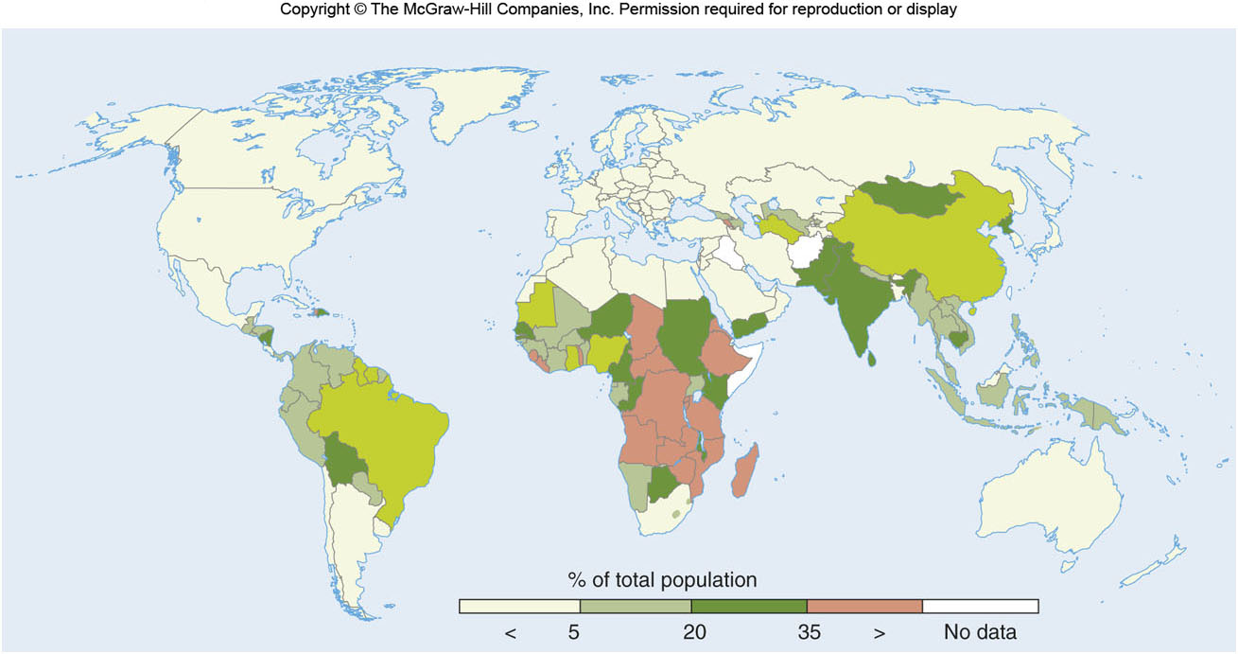
UNDERNOURISHED POPULATION
Figure 4F.4

Slide 25
4G: Geography of Health Care
Access to health care can be limited by:
Functional factors
Absence or presence of health care resources
Geographic factors
Proximity to resources
Social factors
Racism, sexism
Financial factors
Limited access to the poor in some areas

Slide 26
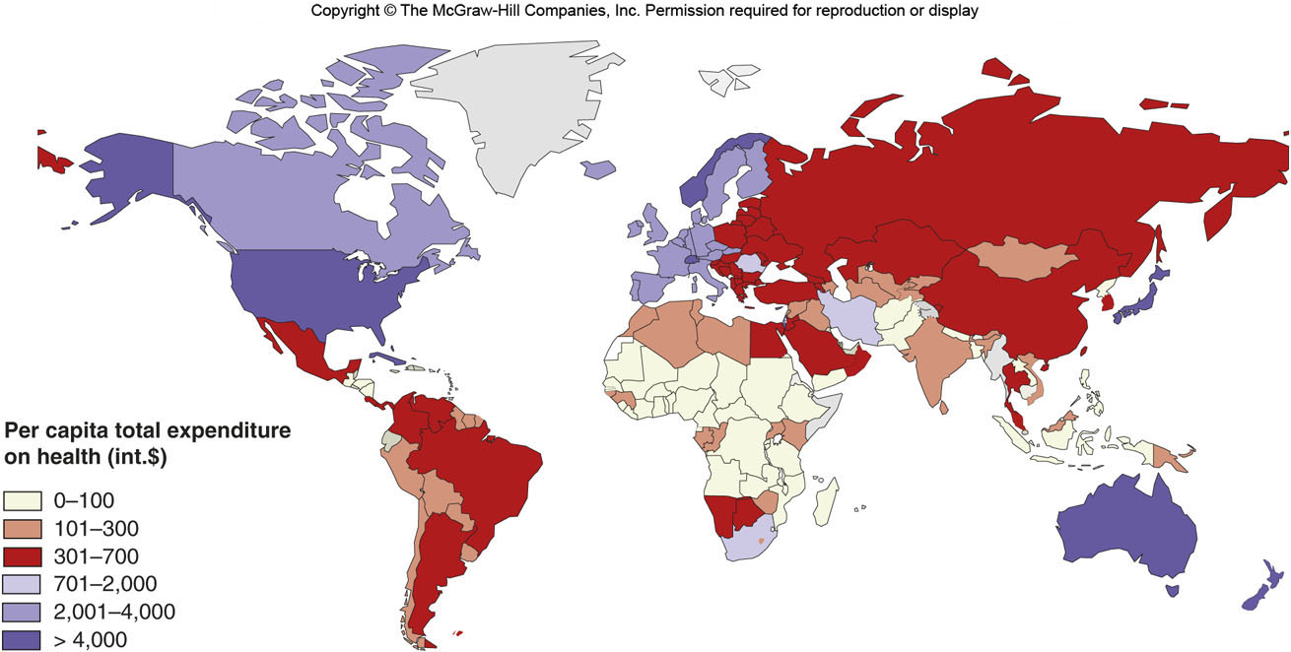
PUBLIC HEALTH EXPENDITURES
Figure 4G.1

Slide 27
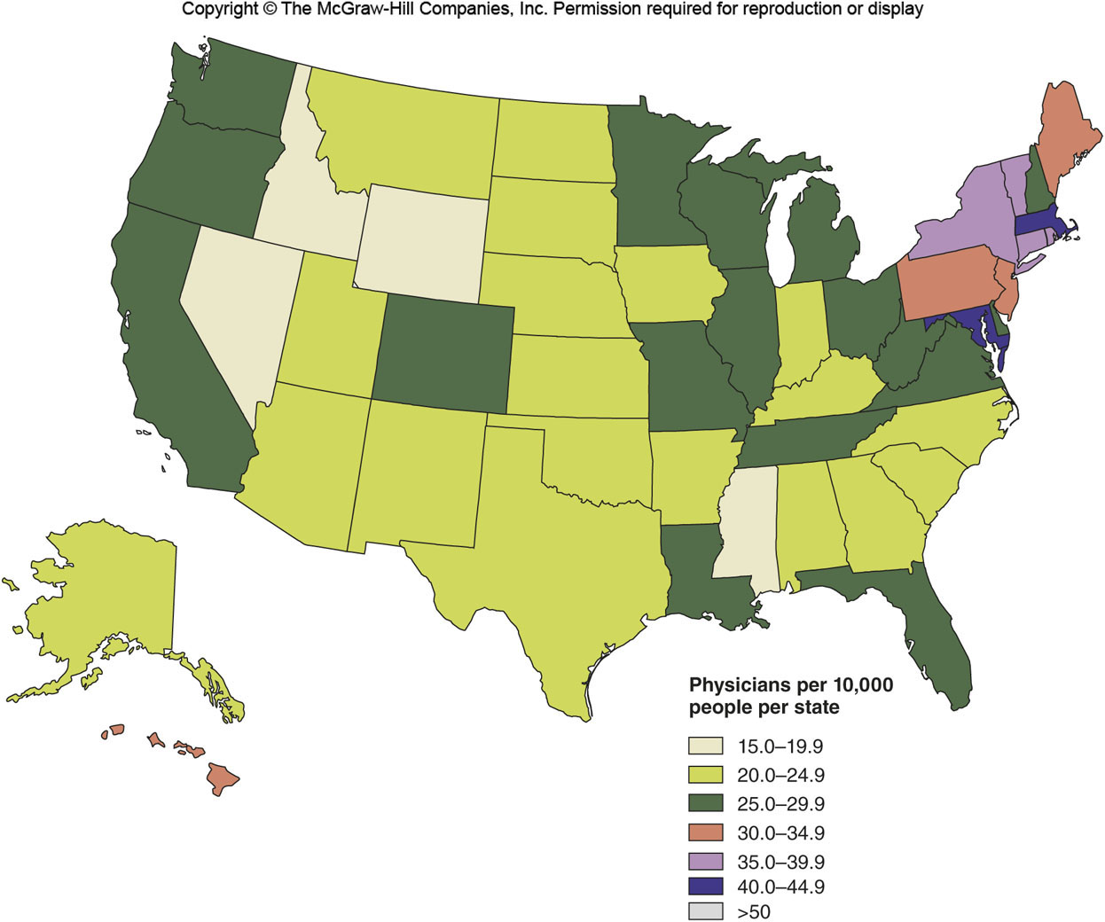
DOCTORS PER CAPITA
Figure 4G.2

