Slide 1
Imperialism around the World

Slide 2
The Berlin Conference
1880s – nations were fighting over territory
1884 – Otto von Bismarck called a conference in Berlin to partition – divide up Africa by formal treaty
14 European nations and the US were invited, not a single African nation or person was invited
Africa is divided by these countries to be used for their natural resources. The European countries could rule with the help of African rulers or without.

Slide 3
The Berlin Conference

Slide 4
The Scramble for Africa
(1880-1900) was a period of rapid colonization of the African continent by European powers
1850 = small colonies along the coast
1914 = only Ethiopia and Liberia remained independent

Slide 5
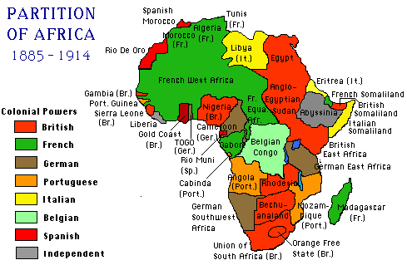

Slide 6
Economic Impact of Scramble for Africa
Shift from subsistence farming (growing your crops and then eating them with your family, this is your only job and you make no income) to cash crops (growing crops and then selling them for income)
Creation of plantations and mines
Exploitation of raw materials and resources
European control of markets – economic control

Slide 7
India
Europeans colonies first competed for colonies in India
1600s – British East India Company began trading in India and elsewhere in Asia
By the 1850s, more than 60 percent of India was under control of the East India Company

Slide 8
East India Company
Made life in India better by:
Setting up schools
Improving and building railroads
Kept peace between rival local leaders
While doing all of this they made sure to make plenty of $$ from Indian resources and labor

Slide 9
East India Company
The company had its own army and forts to protect its property and British citizens
Hired Indian soldiers called sepoys
1857 – company gave sepoys new rifles – to load them, soldiers had to bite off the end of the powder cartridge with their teeth
So what’s wrong with that???

Slide 10
Sepoy Rebellion
The cartridges were greased with fat from cows (sacred to Hindus) or pigs (Muslims are forbidden to eat)
The sepoys refused to put the cartridges in their mouths and were sent home without pay – they rebelled against this unfair treatment and slaughtered British men, women, and children
More violence – the British responded by burning villages and slaughtering Indians

Slide 12
Effect of the Sepoy Rebellion
British parliament ended the East India Company’s control of India
1858 – India was ruled by Parliament
Political Impact
Colonial governors
Viceroys
Some areas remained under control of local rajas
Lower level government officials and workers were native Indians

Slide 13
Economic Impact
Cash crops – cotton, indigo, tea, opium
British control the textile and salt markets
Destroys Indian textile producers
Starvation
Industrialization moves backwards

Slide 14
Cultural Impact
Language
Education – “Brown Englishmen”
Disrupted traditional culture actually increased Indian national identity
Racism

Slide 15
China
Background: Early 1800s, Brits were importing opium from India to China
Chinese Government asked Britain to stop(opium is a very addictive drug)
When the British did not stop, China tried to stop the trade… this led to first Opium War in 1840
Britain won and the opium trade continued

Slide 16
Effects of the Opium War
Open door policy- all countries have equal trading rights in the area
Caused foreign pressure/ message of weakness
Spheres of influence – area where only the foreign power had the right to trade with a country

Slide 17
Spheres of Influence
Foreign countries controlled areas of China – lived and traded under their own laws, not China’s
While this led to the creation of markets, it also led to the exploitation of resources.

Slide 19
The Boxer Rebellion
1900 - Rebellion in China against imperialism and the open door policy there
Chinese “boxers” (guys who studied martial arts) formed a secret society to rebel against the foreigners in their country
Japan, Russia, Britain, France, the United States, Germany, Italy and Austria-Hungary bring forces to fight the Boxers on Chinese soil
Two month siege – eventually were defeated

