Slide 1
Chapter 19
The Increasing Influence of Europe

Slide 2
The Late Byzantine Empire
Eleventh century, wealthy landowners undermine the theme system
Free peasants become dependent agricultural laborers
Diminished tax receipts

Slide 3
Challenges from the West
Western European economic development
Normans from Scandinavia press on Byzantine territories
Crusades of twelfth and thirteenth centuries rampage through Byzantine territory
Constantinople sacked, 1204

Slide 4
Challenges from the East
Muslim Saljuqs invade Anatolia
Threatens grain supply
Defeat of Byzantine army in 1071 creates civil conflict
Period of steady decline until Ottoman Turks capture Constantinople in 1453
Renamed Istanbul

Slide 5
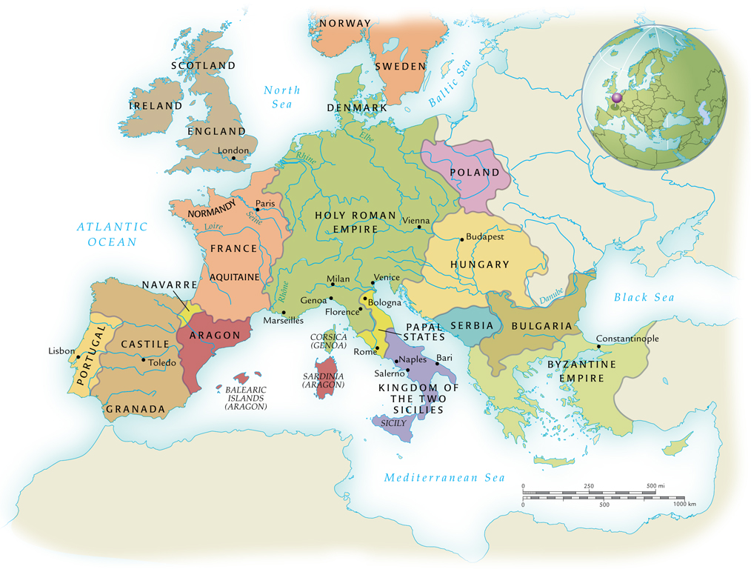
The Regional States of Medieval Europe, 1000-1300 C.E.

Slide 6
The Holy Roman Empire
Otto I of Saxony takes advantage of decline of Carolingian empire to establish kingdom in north Germany, mid-tenth century C.E.
Military forays into eastern Europe
Twice enters Italy to aid Roman Catholic church
Pope John XII names Otto emperor of Holy Roman Empire, 962 C.E.

Slide 7
Tensions between Emperors and the Church
Investiture Contest, late eleventh to early twelfth century
Pope Gregory VII (1073-1085) attempts to end practice of lay investiture
Excommunicates Emperor Henry IV (1056-1106)
German peoples take opportunity to rebel
Quashed with difficulty

Slide 8
Frederick Barbarossa (r. 1152-1190 C.E.)
Frederick I, “red beard”
Attempt to absorb Lombardy (northern Italy)
Popes did not want him to gain that much power, enlisted aid from other states
Frederick forced to back down

Slide 9
Regional Monarchies: France and England
Capetian France
Hugh Capet succeeds last Carolingian Emperor, 987 C.E.
Slowly expands authority out from Paris
Normans in England
Invade England in 1066 under William the Conqueror
Dominate Angles, Saxons, and other Germanic groups

Slide 10
Italy
Series of ecclesiastical states, city-states, and principalities
Papal State directly controlled by Pope, good-sized territory in central Italy
By twelfth century, city-states increasingly displace church control in northern Italy
Normans invade southern Italy, displace Byzantine and Muslim authorities

Slide 11
Iberian Peninsula
Muslims control Iberian peninsula, eighth to twelfth century
From eleventh century on, Christian conquest of Spanish Muslim territories
Late thirteenth century, Muslims remain only in Granada

Slide 12
Growth of the Agricultural Economy
Increasing development of arable lands
Minimized threat of invading nomads
Clearing of swamps, forests
Improved agricultural techniques
Crop rotation
New crops, especially beans
Horseshoes, horse collars (horses faster than oxen)

Slide 13
European Population Growth, 800-1300 C.E.

Slide 14
Revival of Towns and Trade
Urbanization follows increase in food supply
Specialization of labor
Textile production
Mediterranean trade
Italy well-positioned for sea trade
Italian colonies established in major ports of Mediterranean, Black Sea

Slide 15
The Hanseatic League
“Hansa,” association of trading cities
Trade in Baltic and North seas
Poland, northern Germany, Scandinavia

Slide 16
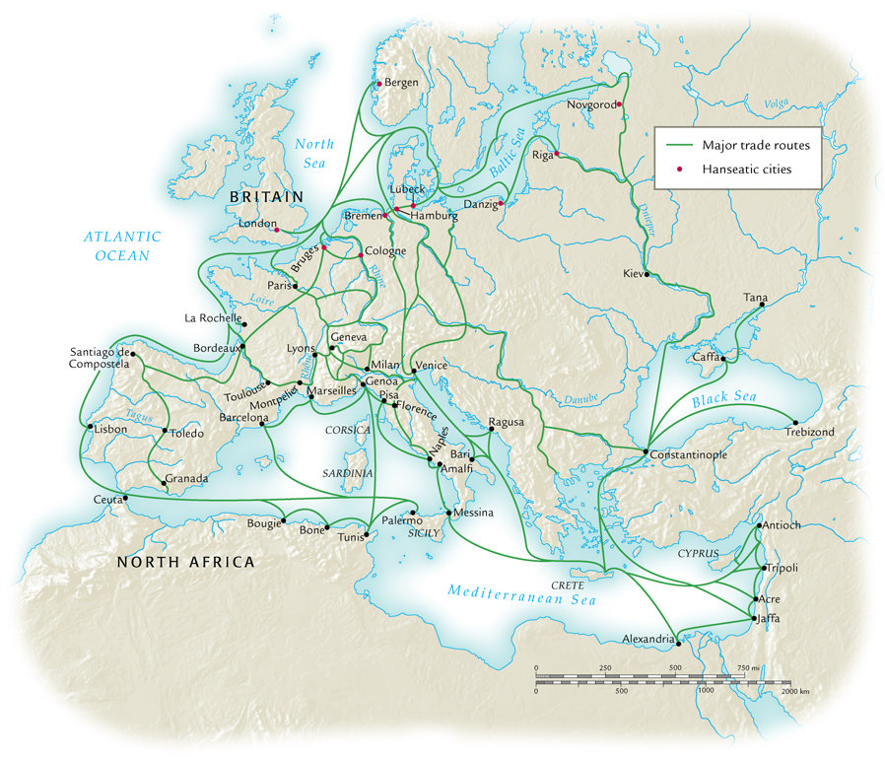
Major Trade Routes of Medieval Europe

Slide 17
Social Change
The Three Estates
Those who pray: clergy
Those who fight: knights
Those who work: peasants
Oversimplification of complex social reality

Slide 18
Chivalry
Code of conduct for nobles
Sponsored by Church to minimize fighting among Christians
Technically, knight to dedicate his efforts to promotion of Christianity
Protection of women

Slide 19
Troubadours
Class of traveling poets, minstrels, entertainers
Borrowed Islamic traditions of love poetry
Spread of cultural ideas to Europe
Popular among aristocratic women
Eleanor of Aquitaine (1122-1204) major supporter
Popularization of idea of romantic love, refinement of European knights

Slide 20
Independent Cities
Additions to class of “those who work”
Merchants, artisans, physicians, lawyers, etc.
Awkward fit into in the framework of medieval political order
By late eleventh century, towns demand charters of integration for greater self-government

Slide 21
Guilds
Organizations of merchants, workers, artisans
By thirteenth century, guilds control good portion of urban economy
Price and quality control
Membership
Created social support network

Slide 22
Urban Women
New economic opportunities for women
Dominated needle trade
Representation in wide variety of trades
Admitted to most guilds
Some guilds for women only

Slide 23
Cathedral Schools
During early middle ages, European society too unstable to provide institutions of advanced learning
Some rudimentary education at monasteries, occasional scholars at courts
High middle ages (1000-1300 C.E.), increasing wealth makes education possible
Schools based in cathedrals
Curriculum of Latin writings
Literature, philosophy, some law, medicine, theology

Slide 24
Universities
Academic guilds formed in twelfth century
Both student and faculty organizations
Higher standards of education promoted
Treatment of students in town major source of concern

Slide 25
The Influence of Aristotle
Latin translations of Byzantine Greek texts circulate in Europe
Jewish and Muslim scholars provide other translations from Arabic translations
St. Thomas Aquinas (1225-1274), major proponent of Scholasticism
Synthesis of Christianity and Aristotle
University of Paris

Slide 26
Popular Religion
Population at large remained unaffected by Scholasticism
The seven sacraments gain ritual popularity
Especially Eucharist
Devotion to saints
Heavenly intercession, pilgrimages, veneration of relics
The Virgin Mary

Slide 27
Religious Movements
Rebellion against perceived materialism of Roman Catholic church
St. Dominic (1170-1221) and St. Francis (1182-1226) create orders of mendicants
Vows of poverty
Popular preachers
Religious zealots, very opposed to heretical movements

Slide 28
Popular Heresy
Waldensians (southern France, northern Italy)
Urged more lay control of preaching, sacraments
Bogomils; Cathars (Albigensians)
Flourished in both Byzantium and western Europe
Ascetic regimes; rejection of official church
Government and church mount campaign to destroy both
By fourteenth century, only around in a few remote locations

Slide 29
Medieval Expansion of Europe
Atlantic and Baltic colonization
Scandinavians explore North Atlantic Ocean
Iceland, Greenland, Vinland (Canada)
Canadian settlements do not succeed
Kings of Denmark nominally convert to Christianity; Sweden and Finland follow

Slide 30
Crusading Orders
Religious Christians form military-religious orders
Templars, Hospitallers, Teutonic Knights
Religious vows of opposition to Islam, paganism
Founded churches and monasteries

Slide 31
The Reconquest of Sicily and Spain
Sicily taken by Muslims in ninth century, reconquered by Normans in eleventh century
Slow displacement of Islam
Opportunity for cross-cultural fertilization
Two small Christian states survive Muslim conquest
Become nucleus of reconquest, 1060s-1492
Rapid, forceful assertions of Christian authority

Slide 32
The Beginning of the Crusades
Pope Urban II calls for liberation of Jerusalem from Muslim control, 1095
Council of Clermont
“Deus vult” – “God wills it!”

Slide 33
The First Crusade
1096-1099, more organized expedition
Captures Jerusalem, largely due to poor Muslim organization
Salah al-Din (Saladin) recaptures Jerusalem in 1187

Slide 34
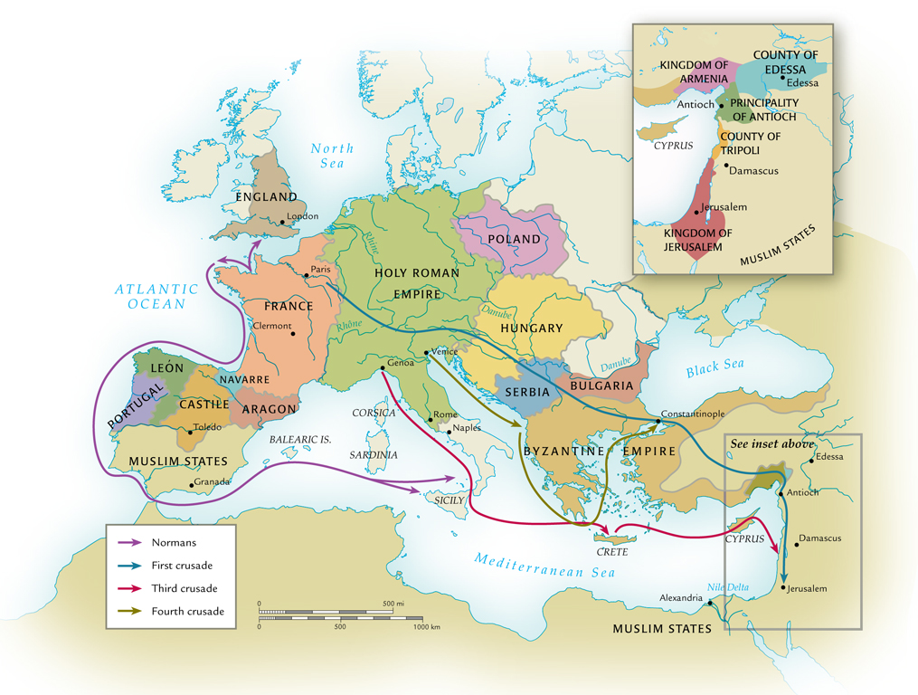
The Medieval Expansion of Europe, 1000-1250 C.E.

Slide 35
Later Crusades and Their Consequences
Five crusades by mid-thirteenth century, none successful
Fourth crusade destroys Constantinople, 1202-1204
Yet Crusades provide direct contact with Muslim ideologies, trade
Aristotle, “Arabic” numerals, paper production

