Slide 1
Chapter 20
Worlds Apart: The Americas and Oceania

Slide 2
States and Empires in Mesoamerica and North America
Societies had limited or no contact with Africa, Asia, Europe
Brief presence of Scandinavians in Newfoundland, Canada
Some Asian contact with Australia
Mesoamerica in period of war and conquest, eighth century C.E.

Slide 3
The Toltecs
Regional states in central Mexican valley
Religious and cultural influence of collapsed Teotihuacan
Intense warfare
Toltecs migrate from northwest Mexico, settle at Tula (near modern Mexico city)
High point of civilization: 950-1150 C.E.
Urban population of 60,000; another 60,000 in surrounding area
Subjugation of surrounding peoples
Civilization destroyed by internal strife, nomadic incursions, 1175 C.E.

Slide 4
The Mexica
One of several groups of migrants, mid-thirteenth century C.E.
Tradition of kidnapping women, seizing cultivated lands
Settled ca. 1345 C.E. in Tenochtitlan (later becomes Mexico City)
Dredged soil from lake bottom to create fertile plots of land
Chinampas, up to seven crops per year

Slide 5
The Aztec Empire
Mexica develop tributary empire by fifteenth century
Itzcóatl (1428-1440), Motecuzoma I (Montezuma, 1440-1469)
Joined with Texcoco and Tlacopan to create Aztec empire

Slide 6
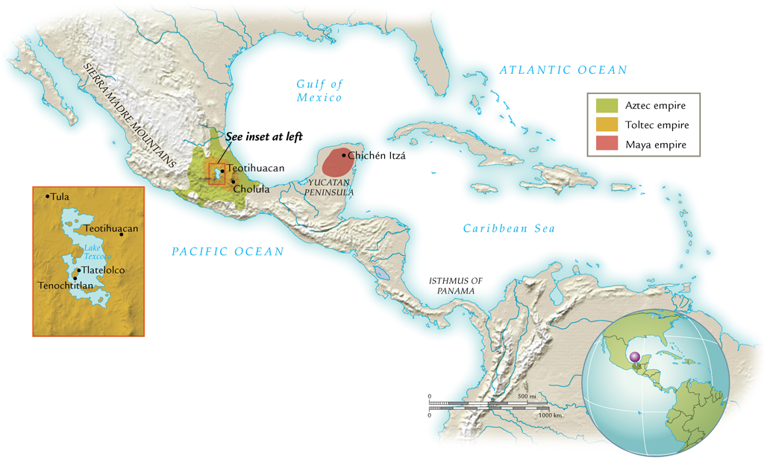
The Toltec and Aztec Empires, 950-1520 C.E.

Slide 7
Mexica Society
Hierarchical social structure
High stature for soldiers
Mainly drawn from aristocratic class
Land grants, food privileges
Sumptuary privileges, personal adornment

Slide 8
Mexica Women
Patriarchal structure
Emphasis on child-bearing
Especially future soldiers
Mothers of warriors especially lauded

Slide 9
Priests
Masters of complex agricultural/ritual calendars
Ritual functions
Read omens, advised rulers
Occasionally became rulers as well

Slide 10
Cultivators and Slaves
Communal groups: calpulli
Originally kin-based
Management of communal lands
Work obligation on aristocratic lands
Slave class
Debtors
Children sold into slavery

Slide 11
Mexica Religion
Influenced by indigenous traditions from the Olmec period
Ritual ball game
Solar calendar (365 days) and ritual calendar (260 days)
Not as elaborate as Maya calendar

Slide 12
Mexica Gods
Tezcatlipoca (“the Smoking Mirror”)
Powerful god of life and death
Patron god of warriors
Quetzalcóatl (“the Feathered Serpent”)
Arts, crafts, agriculture
Huitzilopochtli
Fourteenth-century popularity, patron of Mexica
Emphasis on blood sacrifices

Slide 13
Ritual Bloodletting
More emphasis on human sacrifice than predecessor cultures
Sacrificial victims had tips of fingers torn off before death, ritual wounds
Victims: Mexica criminals, captured enemy soldiers
Personal rituals: piercing of penis, earlobes

Slide 14
Aztec Human Sacrifice

Slide 15
Peoples and Societies of the North
Pueblo and Navajo societies
American southwest
Maize farming 80% of diet
By 700 C.E., construction of permanent stone or adobe dwellings; 125 sites discovered
Iroquois peoples
Settled communities in woodlands east of Mississippi
Mound-building peoples
Ceremonial platforms, homes, burial grounds
Cahokia large mound near east St. Louis, 900-1250 C.E.

Slide 16
Trade
No written documents survive regarding northern cultures
Archaeological evidence indicates widespread trade
River routes exploited

Slide 17
States and Empires in South America
No writing before arrival of Spaniards, sixteenth century C.E.
Unlike Mesoamerican cultures, writing from fifth century C.E.
Archaeological evidence reveals Andean society from first millennium B.C.E.
Development of cities 1000-1500 C.E.

Slide 18
Before the Coming of the Incas
After displacement of Chavín, Moche societies
Development of autonomous regional states in Andean South America
Kingdom of Chucuito
Lake Titicaca (border of Peru and Bolivia)
Potato cultivation, herding of llamas, alpacas
Kingdom of Chimu (Chimor)
Peruvian coast
Capital Chanchan

Slide 19
The Inca Empire
From valley of Cuzco
Refers to people who spoke Quechua language
Settlement around Lake Titicaca mid-thirteenth century
Ruler Pachacuti (r. 1438-1471) expands territory
Modern Peru, parts of Ecuador, Bolivia, Chile, Argentina
Population 11.5 million

Slide 20
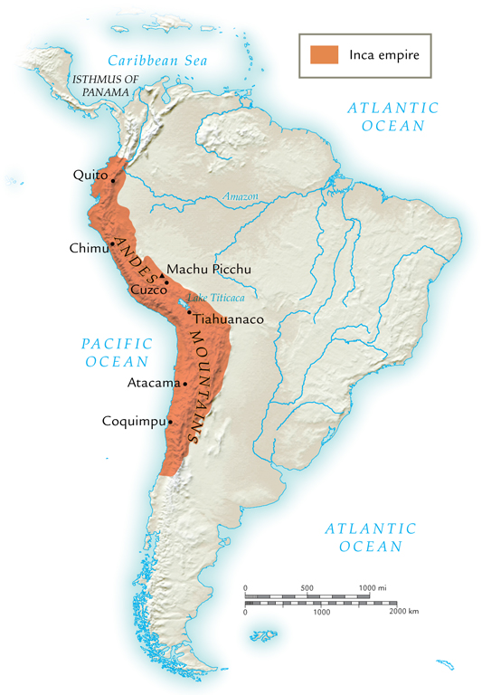
The Inca Empire, 1471-1532 C.E.

Slide 21
Inca Administration and Quipu
Incas ruled by holding hostages, colonization
No writing; used system of cords and knots called quipu
Mnemonic aid

Slide 22
Cuzco
Capital of Inca empire
Residents high nobility, priests, hostages
Gold facades on buildings

Slide 23
Inca Roads
Massive road-building system
Two north-south roads, approximately 10,000 miles
Mountain route
Coastal route
Paved, shaded, wide roads
Courier and messenger services
Limited long-distance trade, held by government monopoly

Slide 24
Inca Society and Religion
Social elites dominated by infallible king
Claimed descent from the sun
Worship of ancestors
Remains preserved in mummified form
Regularly consulted
Sacrifices offered
Paraded on festive occasions

Slide 25
Aristocrats, Priests, and Peasants
Aristocrats receive special privileges
Earlobe spools as adornment
Priestly class ascetic, celibate
Peasants organized into community groups called ayllu
Land, tools held communally
Mandatory work details on land of aristocrats
Public works

Slide 26
Inca Religion
Inti sun god
Viracocha creator god
Temples as pilgrimage sites
Peasant sacrifices usually produce and animals (not humans)
Sin understood as disruption of divine order

Slide 27
The Societies of Oceania
Nomadic foragers of Australia
Virtually static culture
No agriculture
New Guinea
Swine herding, root cultivation ca. 5000 B.C.E.
Small-scale trade of surplus food, some goods
Pearly oyster shells, spears, boomerangs

Slide 28
Aborigine with Boomerang

Slide 29
Cultural and Religious Traditions
Loosely tied to environment
Myths, stories about geological features
Rituals to ensure continuing food supply

Slide 30
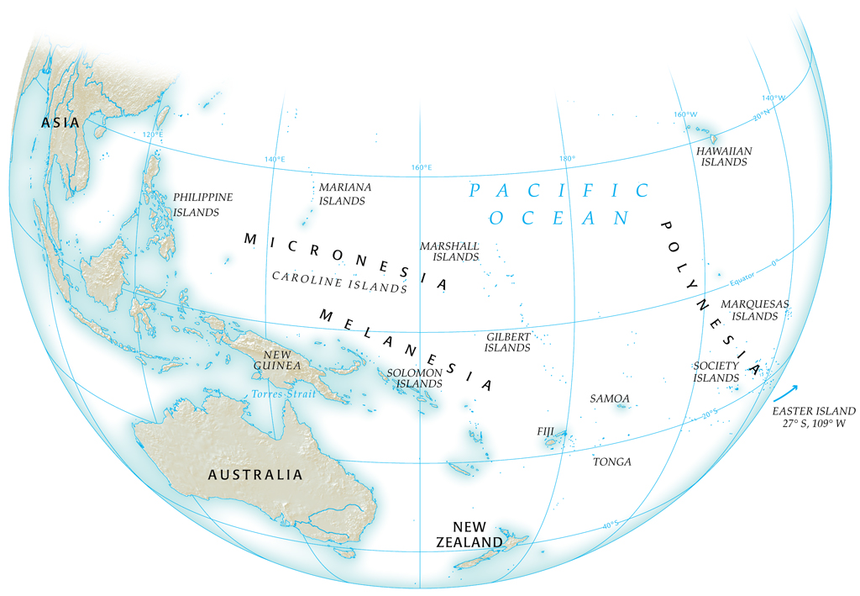
The Societies of Oceania

Slide 31
The Development of Pacific Island Societies
Established in almost all islands in early centuries B.C.E.
Trade between island groups
Long-distance voyaging on intermittent basis
Brought sweet potatoes from South America ca. 300 C.E.
Voyages preserved in oral traditions

Slide 32
Population Growth
Extensive cultivation
Fishing innovations
Fishponds allow small fish through, trap larger fish
Population density leads to social strife, economic degradation
Fierce fighting, cannibalism, ca. 1500 C.E.

Slide 33
Development of Social Classes
Complexity of population leads to articulation of distinct classes
High chiefs, lesser chiefs, commoners, artisans, peasants
Small multi-island empires form
Limited before nineteenth century
Yet controlled land allocation, labor and military conscription

Slide 34
Polynesian Religion
Priests as intermediaries to divine
Gods of war, agriculture most prominent
Ceremonial precinct or temple: marae (heiau in Hawaiian)

