Slide 1
The 1950s: An American Economic Miracle
Mr. Ermer
U.S. History Honors
Miami Beach Senior High

Slide 2
The Economic Miracle
1945-1960: GNP grows 250%, $200 billion to $500 billion
1950-1963: Unemployment 5% or below, inflation 3% or below
Government spending fuels economic success
Construction of new schools, interstate highway program, veterans’ benefits, military spending
1950-60: Baby Boom increases population by 20%, from 150 to 179 million
Shift in population from cities to suburbs, suburban growth rate 47%
Construction and automobile industry boom with suburbs
1960 Americans have more than 20% the purchasing power of 1940, and twice as much as in the 1920s
Americans enjoyed the highest standard of living in the world
Western United States grows in population and economically
Petroleum industry, dry climate, wartime factories draw population from East

Slide 3
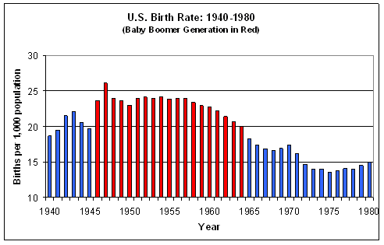
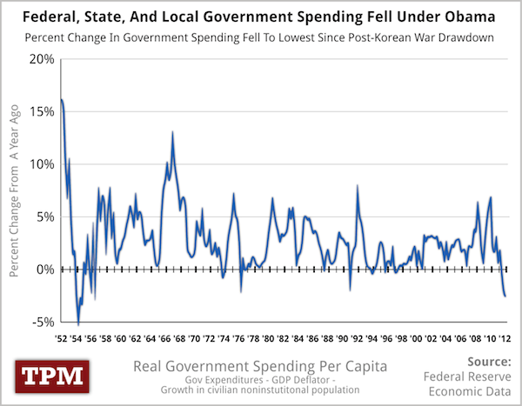

Slide 4
The New Economy
Confidence in power of American economy overshadows fear of communism
Doubt in capitalism disappears, faith in Keynesian Economics is the norm
John Maynard Kaynes, British economist, offers economic “middle road”
Government can control economy without intruding in private sector
Manage monetary supply, cut or increase spending/taxation
Many argue that to end poverty, the country only needs to produce more abundance
Corporate consolidation creates ever bigger businesses
Rise of agribusiness, small farmers unable to compete with larger agribusinesses
“Postwar Contract,” businesses increase wages and benefits, unions agree not to strike
Two largest unions, AFL and CIO, merge to create AFL-CIO

Slide 5
Science & Technology
Use of antibiotics, penicillin allow extremely successful combat of bacterial infections, vaccinations fight pervasive viral infections—greatly increase health
Polio vaccine eliminates polio in the United States, world
Increased use of chemical pesticides (DDT) raises crop yields
DDT later found to be toxic to humans, contaminate water supplies
Invention of television revolutionizes communication and entertainment
UNIVAC is first computer to recognize numerical and alphabetical data
International Business Machines Co. (IBM) follows with newer, faster comp.

Slide 6
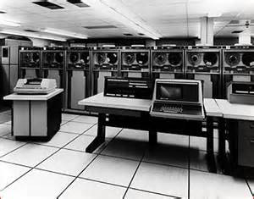
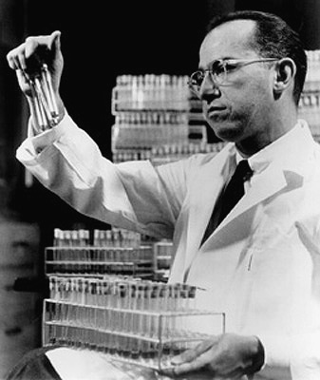
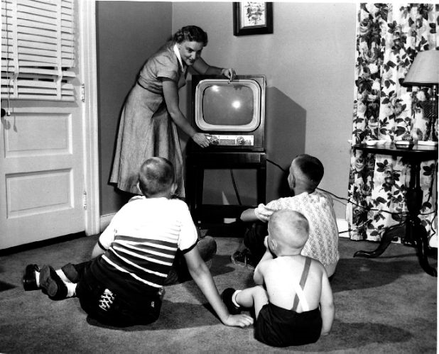

Slide 7
A People of Plenty
1950s Middle Class culture based on consumerism, consumption
High product availability, sophisticated advertising, cheap credit
Consumer crazes popularize automobile models, Disney, hula hoops
Increase in automobile ownership requires better highways—Interstate Highway System
Highways allow for people to liver further from work, suburbs explode
Home garages, roadside motels, fast food proliferate the suburbs
Levittown, Long Island, NY was nations first suburb
Suburban life centered on the family and “traditional” gender roles
Men expected to work, women expected to stay home
Dr. Benjamin Spock’s Baby and Child Care
Television makes immediate, pervasive, and profound impact on American society
Television networks come from radio, and like radio depend on advertising
Advertising sponsors have great influence on program, message homogenized
TV shows spread Middle class values and lifestyles

Slide 8
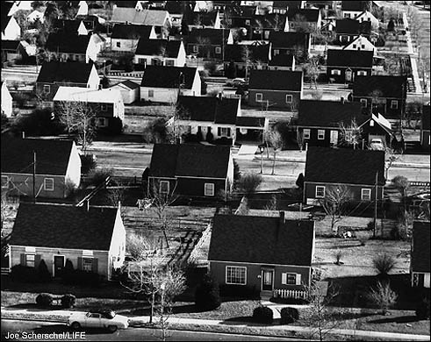
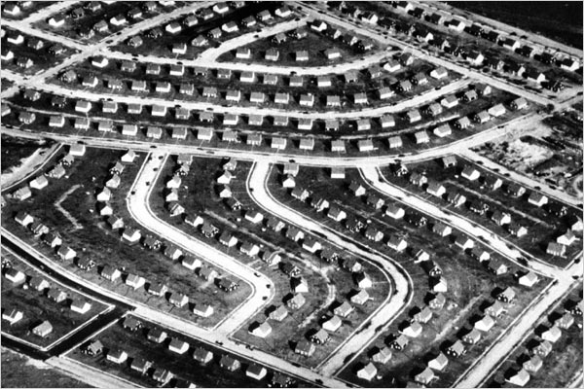
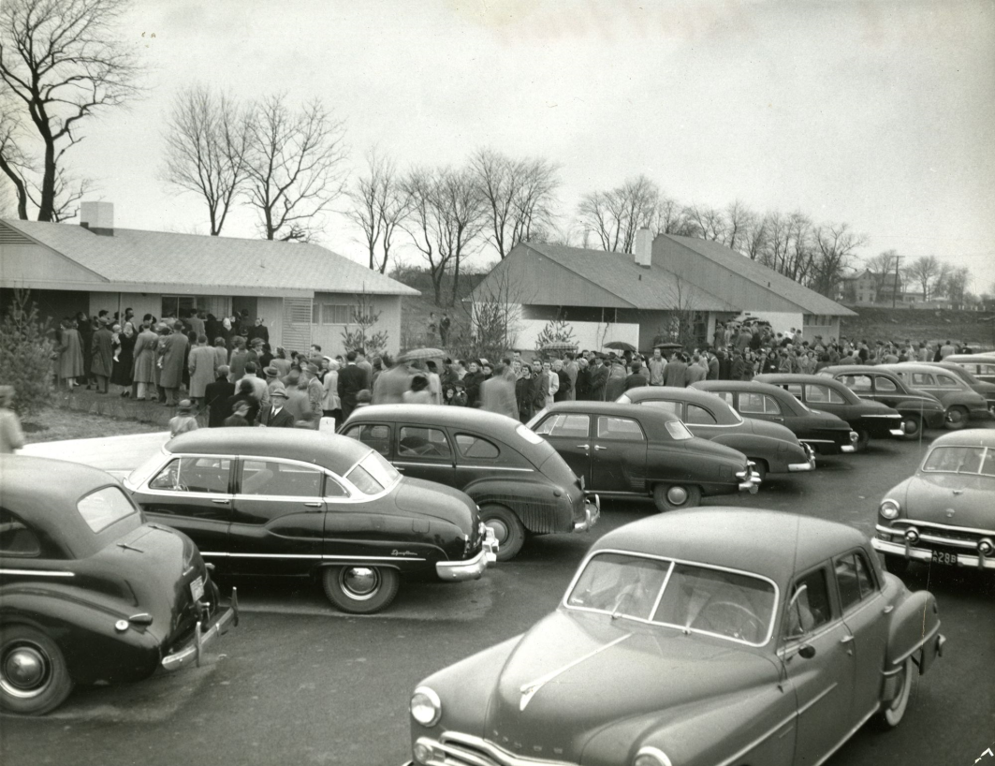
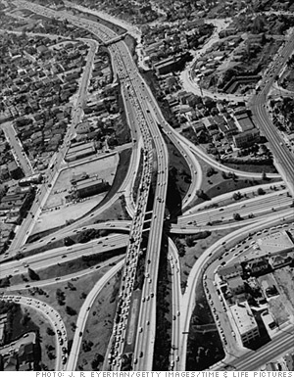

Slide 9
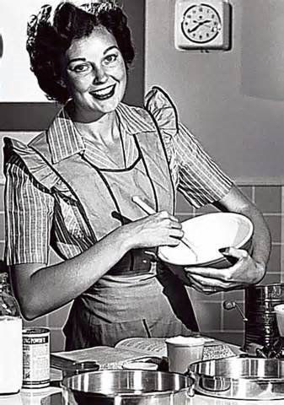
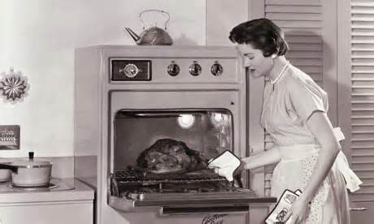
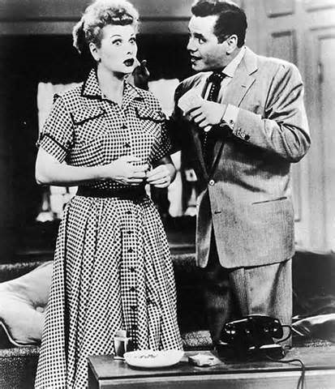
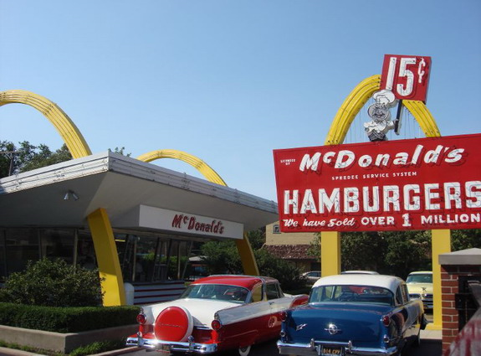

Slide 10
The counter-Culture
The Beat Generation
Poets, writers, and artists critical of middle class, bureaucratic society
Jack Kerouac’s On The Road (1957), Alan Ginsberg’s Howl (1955)
Fear of “juvenile delinquency” and loss of traditional values of thrift, restraint
Films depict teens rebelling against parents, in sexual situations, racing cars
Rock n’ Roll, draws on black rhythm and blues, mixes “white” and “black” music
Elvis Presley’s style of dress and suggestive dancing scandalizes white adults
Black musicians gain acceptance among white, teenage audiences
Dick Clark’s American Bandstand brings Rock n’ Roll to television
Music executives caught paying DJs and advertisers to play certain songs
Payola Scandal

Slide 11
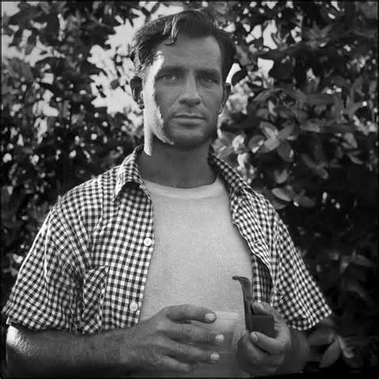
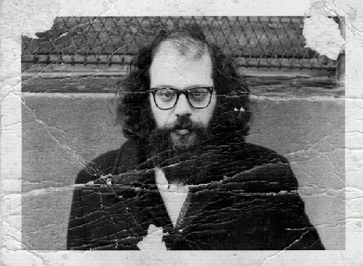
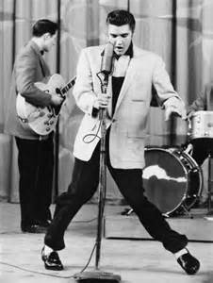

Slide 12
The Other America
Prosperity does not rid the country of poverty, Harrington’s The Other America
Persistent poverty affects 20% of lower level job market
Mostly elderly, African-Americans, Hispanics, and Native-Americans
Declining agricultural prices drive many farmers to margins of poverty
Surpluses in staple crops, decrease in demand for cotton
Migrant workers, mainly Asian and Mexican, live in dire conditions
Inner cities become “ghettoized” as white families move to suburbs
African Americans move from southern countryside to northern cities
3 million move to Detroit, NYC, Chicago, Cleveland
Hispanics from Puerto Rico, Mexico also migrate to cities
Urban renewal projects destroy 400,000+ buildings, build public housing

Slide 13
Eisenhower Republicanism
Business approach to politics, government
“what was good for the country, was good for General Motors, and vise versa”
Ike appoints business executives and corporate lawyers to government posts
Ike’s policies attempt to limit federal activities and encourage private business
Creates $1 billion budget surplus
Eisenhower White House maintains the New Deal safety net, expands Social Security
Federal Highway Act of 1956 funded by fuel, automobile, tire taxes

Slide 14
Eisenhower Foreign Policy
May 14, 1948: State of Israel declares independence, with UN help
Truman administration recognizes Israel, creates greater conflict in Middle East
Iranian Prime Minister Muhammad Mossedegh attempts to limit western oil companies
CIA stages coup, elevates constitutional monarch, Shah Reza Pahlevi, to power
Egypt’s Gen. Gamal Abdel Nasser is unaligned in Cold War
Nasser moves to nationalize the Suez Canal (belongs to British)
Britain and France invade Egypt, USA sides with Egyptians/UN and negotiates a peace deal between Egypt and Israel, ending years of conflict in the Sinai Peninsula
Dulles believes Guatemala’s new president, Jacobo Arbenz Guzman to be communist
CIA topples Arbenz Guzman government
1959: Cuban Revolution brings communist Fidel Castro to power
Eisenhower cuts ties with Castro’s Cuba, Castro cozies up to USSR

Slide 15
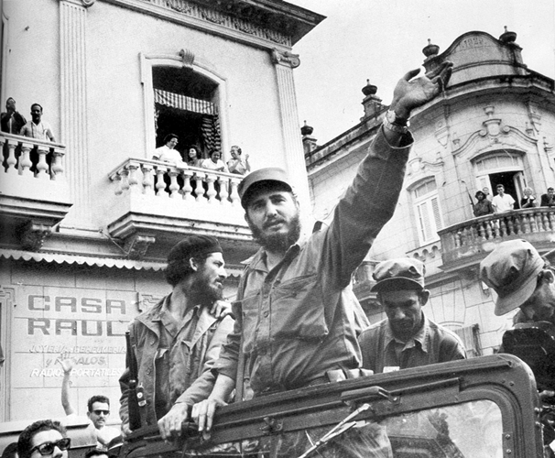
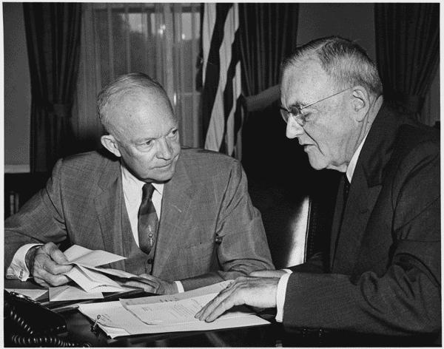
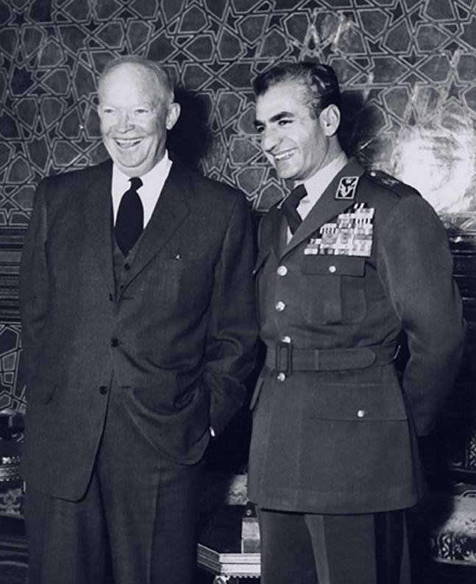
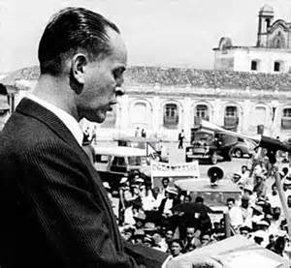

Slide 16
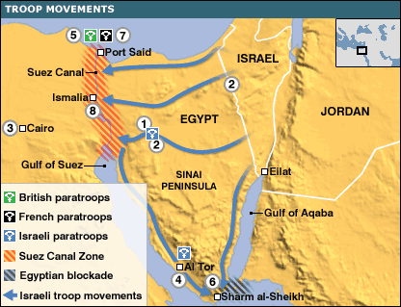
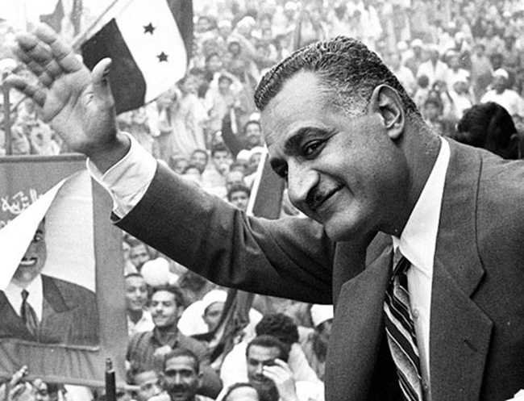
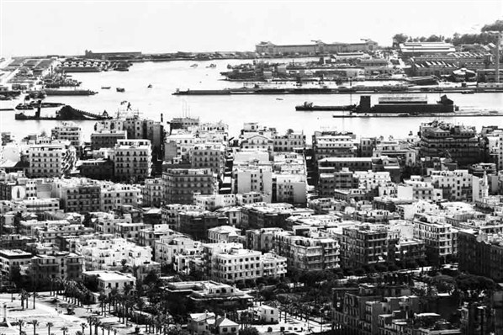

Slide 17
Eisenhower’s Policy toward the USSR
1955: Eisenhower meets with Soviet premier Nikolai Bulganin in Geneva, Switzerland, NATO leaders also attend
When Foreign ministers meet, mood sours and relations break
1956: Soviet tanks intervene in Hungarian Revolution
Berlin Wall
U-2 Crisis
Khrushchev and Nixon’s “Kitchen Debate”
Farewell Address: Beware “unwarranted influence” of the “military-industrial conference”

Slide 18
