Slide 1
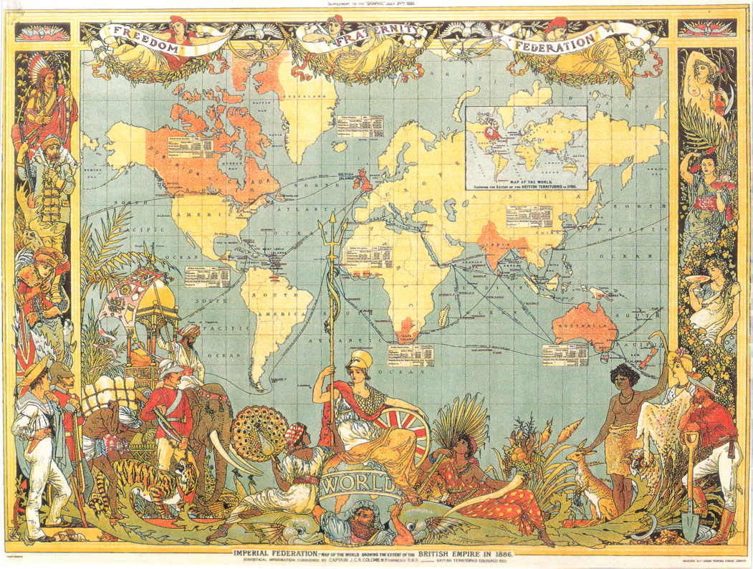
Ch.24 Africa, India, and the New British Empire

Slide 2
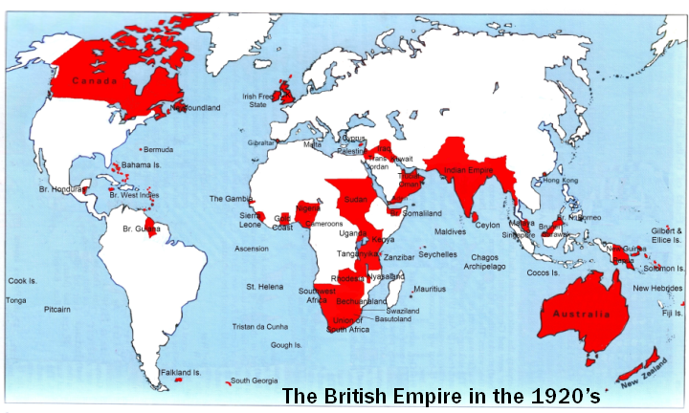

Slide 3
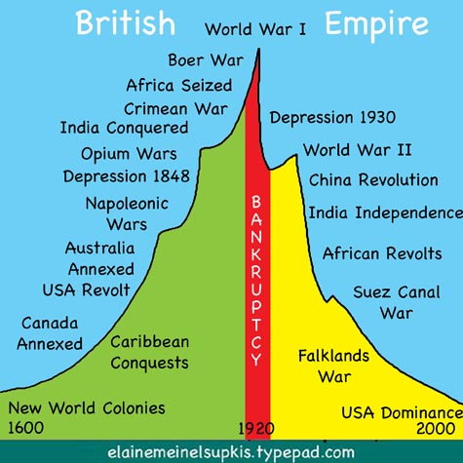

Slide 4
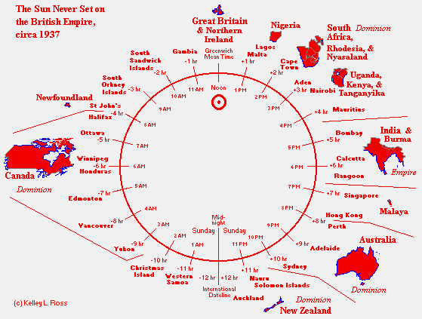

Slide 5
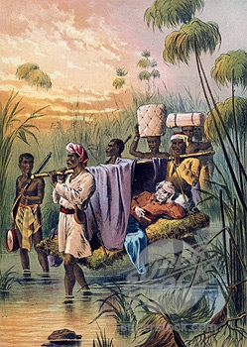
“White Man’s Burden”-duty of Europeans to civilize and uplift the primitive people of the world

Slide 6
Main Idea | Details | Notemaking
Changes & Exchanges in Africa 1750-1850 | Internal forces gave rise to new states in sub-Saharan Africa, the two most powerful were the Sokoto Caliphate (inspired by Islam) in West Africa and the Zulu Kingdom in southern Africa. The Zulu kingdom was the most powerful and feared in Southern Africa. Used spears and shields. Shaka Zulu, military genius, began conflict over grazing and farming land. The Lesotho and Swazi states were created by refugees from Zulu raids. The Zulu succeeded in creating a strong national identity.

Slide 7
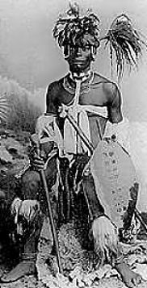
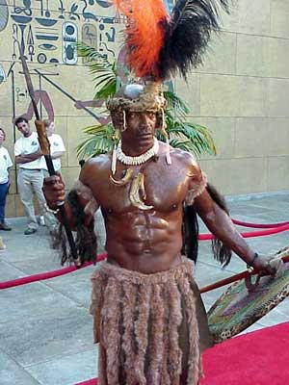
Shaka Zulu
Then & Now

Slide 8
Main Idea | Details | Notemaking
Modernization in Egypt & Ethiopia | Muhammad Ali ruled Egypt from 1805-1848 after Napoleon’s army withdrew. Wanted to modernize Egypt’s military to prevent another European invasion. Increased agriculture Headed the strongest state in the Muslim world and was the first to use western technology. Required Egyptian peasants to grow cotton to pay for modernization. In 1840s Ethiopia began purchasing European weapons and manufacturing them locally. Helped to prevent European invasions.

Slide 9
Main Idea | Details | Notemaking
European Penetration (don’t laugh, get your mind out of the gutter) North Africa West and Central Africa | France attacked Algeria in 1830 because of an Algerian ruler hit a French ambassador with a fly swatter. France broke Algerian resistance by destroying farms and massacring villagers. Poor Europeans rushed in to take control of Algeria’s rich coast. European explorers more peacefully penetrated central Africa’s geography and rivers. They wanted to find the course of the Niger and Congo river, access the mineral wealth of Africa and convert the natives to Christianity. Scottish missionary and explorer, David Livingstone, traced the upper Congo River, converting the natives along the way. He was met by Henry Stanley who later traced the source of the Congo. Stanley’s expeditions were much more violent than Livingstone’s.

Slide 10
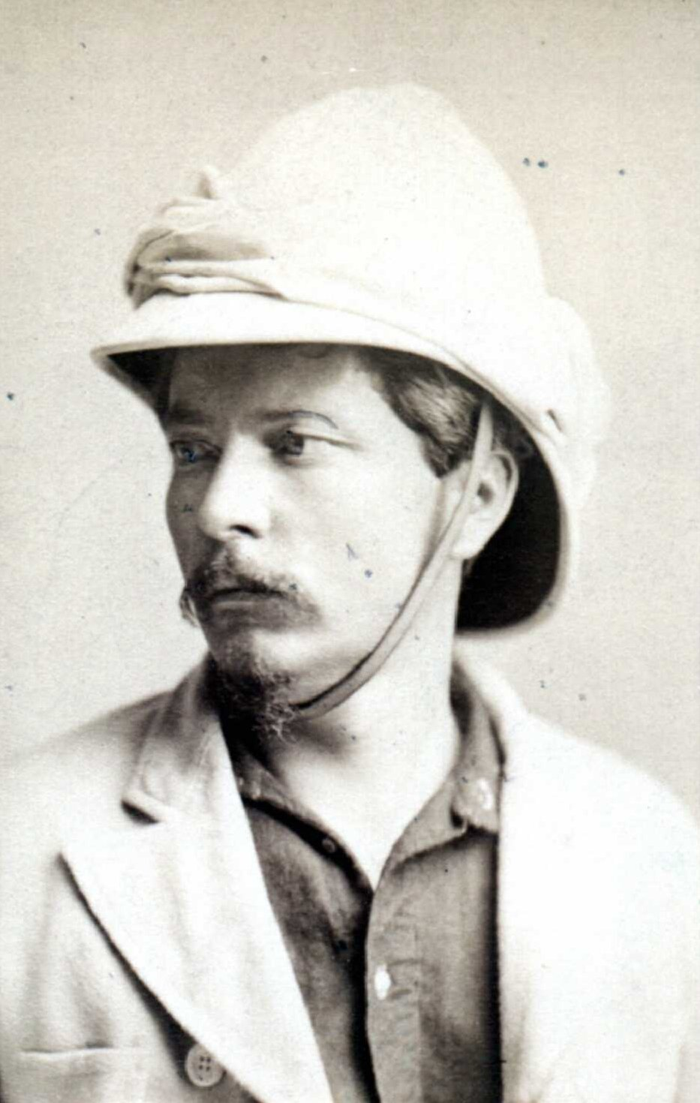
Henry Stanley

Slide 11
Main Idea | Details | Notemaking
Abolition and Legitimate Trade East African Slave Trade | 1808 both Britain and the US banned the slave trade with Britain taking the lead in the abolition of slavery because of slave revolts and humanitarian reasons. Cuba and Brazil continued to import huge amounts of slaves and African kings wanted to keep the slave trade going. The trans-Atlantic slave trade did not end until 1867. After 1825, West Africa’s main exports to the Atlantic were palm oil (most important), ivory, and gold. The British took over Sierra Leone in 1808 to serve as a base for their anti-slave trade activities and as a place to return captured slaves. Missionaries resettled the “recaptives” and spread western culture. 1821 Liberia was founded as a home for freed black Americans and after emancipation in 1865 many moved there. As the slave trade decreased in West Africa it increased in East Africa. Many slaves were taken to Zanzibar to work on clove plantations. Swahili slave trader Tippu Tip carved out an empire in central Africa.

Slide 12
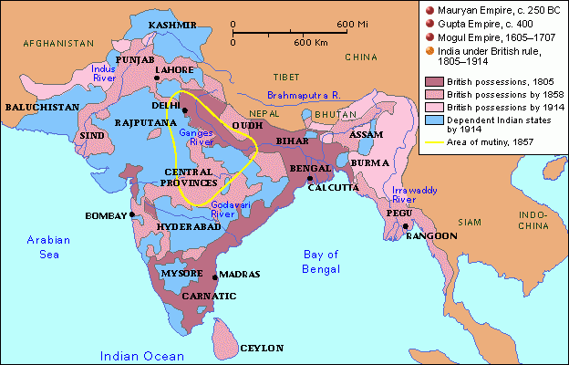
India under British Raj

Slide 13
Main Idea | Details | Notemaking
India Under British Rule 1765-1885 | As Mughal power weakened in the 18th century, foreign powers invaded India (Iran, France, the Dutch, most importantly Britain). To protect trading posts, European companies hired Indian soldiers called sepoys. The British East India Company began ruling Bengal in 1765. By 1818 the British East India Company ruled over more people in India than in all of western Europe. The British raj (reign) wanted to remodel India after the British and instituted social, economic, and technological reforms. The Indian elite conspired with the British to rule over the unfortunate masses who’s suffering increased. Britain created jobs in the opium, coffee and tea trade but ruined India’s textile industry with cheap imports.

Slide 14
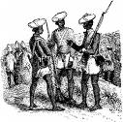
Sepoy Rebellion

Slide 15
Main Idea | Details | Notemaking
Political Reform and Industrial Impact | The Sepoy Rebellion of 1857 was caused by a new rifle which was greased with animal fat and marks the beginning of modern India by creating an Indian national identity as opposed to the British who began direct rule of India after the revolt. The Mughals lost power after 1857 and the British tried to portray themselves as the rightful successors using a mix of tradition and reform. (British administrators lived in luxury to convince Indians they were like emperors yet Britain also guaranteed equal protection in law and freedom of religion). Queen Victoria named “Empress of India” in 1877. Viceroys put on elaborate pageants known as durbars to impress the natives. The Indian Civil Service (all British) governed over the Indian masses. Britain held racist contempt for the people they ruled. India exported sugar, silk, tea, opium and cotton and imported industrial goods. Britain introduced railroads (among the largest), steamboats and telegraph lines. Freer movement of Indian pilgrims led to the spread of cholera. Sati was outlawed in 1829. 1885 the Indian National Congress was founded by western educated middle class Indians who wanted more opportunity, unity, and secularism.

Slide 16
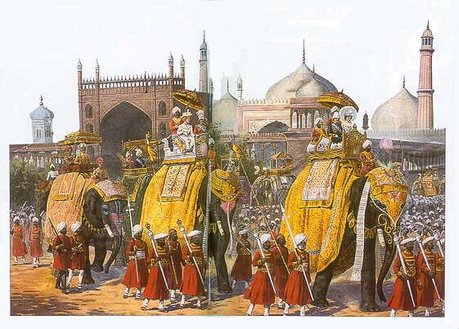
British Durbar

Slide 17
Main Idea | Details | Notemaking
Britain’s Eastern Empire | In 1750 Britain’s empire was centered on slave based plantations and colonies in the Americas, by 1850 it was centered on commercial networks in the East. Britain defeated its French and Dutch rivals and claimed the Dutch Cape Colony in South Africa and the Dutch port of Malacca and the island of Ceylon. Cape Colony important because of strategic position in refueling of ships between voyage from Britain to India. Dutch settlers in South Africa referred to themselves as “Afrikaners”. From 1836-39 Afrikaners embarked on a “Great Trek” leaving Cape Colony for the fertile lands to the North. Firearms allowed them to subdue Zulu warriors. The British East India Company established the port of Singapore in 1824 which served as a trade center between the Indian Ocean and China. In 1852 Britain annexed Burma.

Slide 18
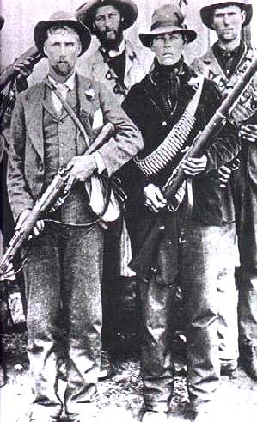
Afrikaners

Slide 19
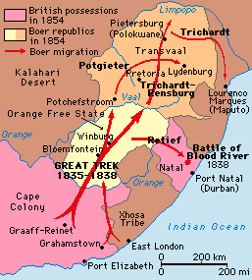
The Great Trek

Slide 20
Main Idea | Details | Notemaking
Imperial Policies and Shipping | British imperial expansion during the 19th century was more interested in trade than territory. Reflected change from mercantilist policies to free trade and the needs of its industrial economy. Africa supplied palm oil, ivory, and trees for pianos and decorations in middle class European homes, the Americas and Asia provided sugar, coffee, cotton and tea. In return British factories supplied manufactured goods at cheap prices. Fast clipper ships after 1850 could complete trips in half the time as earlier ships. Faster and bigger ships meant increased profits and further stimulated trade.

Slide 21
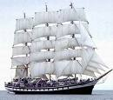
Clipper Ship

Slide 22
Main Idea | Details | Notemaking
Colonization of Australia and New Zealand | James Cook explored the coast of Australia and New Zealand in 1769 and British settlers followed soon after. Like in the Americas, the settler population wiped out most of the indigenous people unlike in India where a few British elite ruled over a large Indian population. Australia was inhabited by Aborigines and New Zealand by Maori. Because of isolation, both had little resistance to disease. First permanent British settlers in Australia were convicts. After a gold rush, many other settlers followed. Improved sailing made the trip possible. Special ships hunted whales and seals off the coast of New Zealand for oil to be used in soap, lamps and bones for women’s corsets causing a decline in their numbers Britain encouraged self governing (as with Canada) by 1867.

Slide 23

Whale Bone Corset

Slide 24
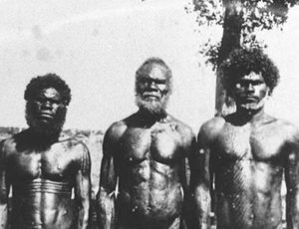
Australian Aborignes

Slide 25
Main Idea | Details | Notemaking
New Labor Migration | Between 1834-1870 many Indians, Chinese, Pacific Islanders and Africans were recruited by the British to work oversees on sugar plantations because slavery had been abolished and locals didn’t want to do the work. Americans recruited Chinese and Japanese to work on Hawaii. All laborers worked under contracts of indenture which bound them to work from 5-7 years in exchange for a passage overseas. Like European emigrants, both groups wanted to better their economic and social conditions abroad.

