Slide 1
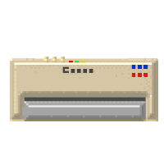
Unit 2, Lesson 6 Learning about Peripherals
AOIT Principles of Information Technology
Copyright © 2007–2014 National Academy Foundation. All rights reserved.

Slide 2
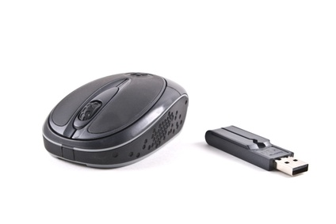
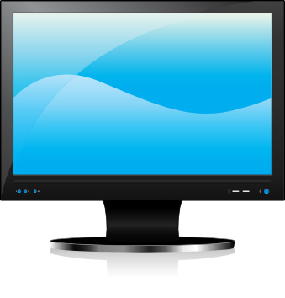
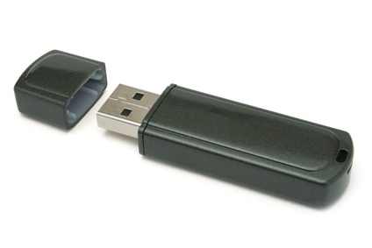
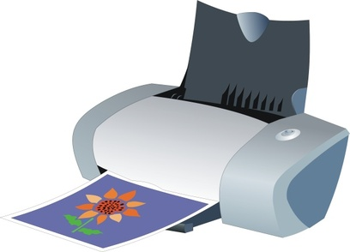
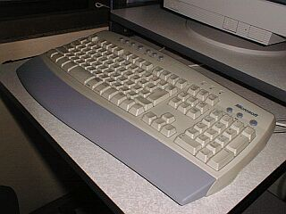
Peripherals are devices used for computer input and output
Why are the objects on this slide called peripherals?

Slide 3
The keyboard is an input device
A computer keyboard reports each key press to a software program that interprets the keystrokes.
A keyboard also gives commands to the operating system of a computer, such as the Windows Ctrl-Alt-Delete combination, which brings up a task window.
What makes a keyboard an “input device”?

Slide 4
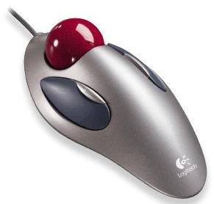
Most mice use either optical or laser technology
USB wireless optical mouse
Trackball mouse
What kind of mouse do you have?

Slide 5
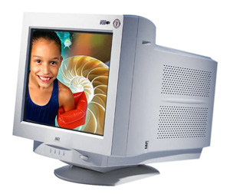
Monitors are output devices
LCD monitor
CRT monitor
What makes a monitor an output device?
Could an LCD ever be an input device too?

Slide 6
Many games and videos require high-definition (HD) monitors
High-definition monitors have better resolution, which means a clearer picture.
A pixel (picture element) is the smallest colored dot that can be displayed on the screen.
More pixels = more detail.
Standard resolution: 1280 x 720 pixels (width x height)
High definition: 1920 x 1080 pixels
Does your monitor have HD? Have you ever noticed the difference between HD and standard resolution?

Slide 7
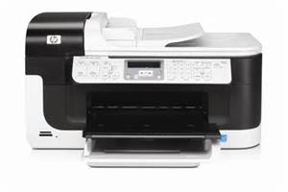
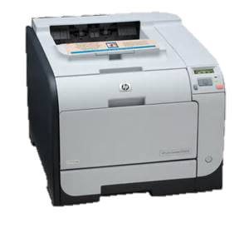
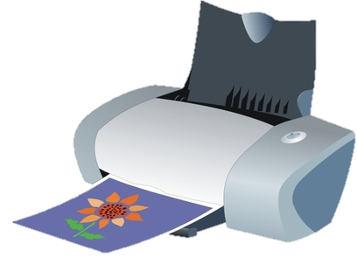
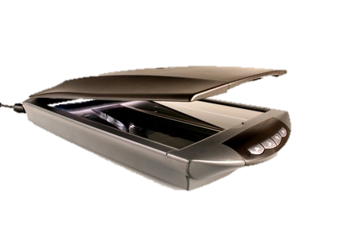
Printers and scanners add value to systems
Multifunctional Printers
Laser Printers
Inkjet
Scanner
Is a printer an input device or an output device? What about a scanner?

Slide 8
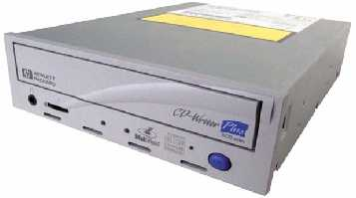
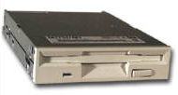
Drives have changed considerably over 20 years
3½ in. floppy drive
CD-ROM drive
DVD drive
Blu-ray drive

Slide 9
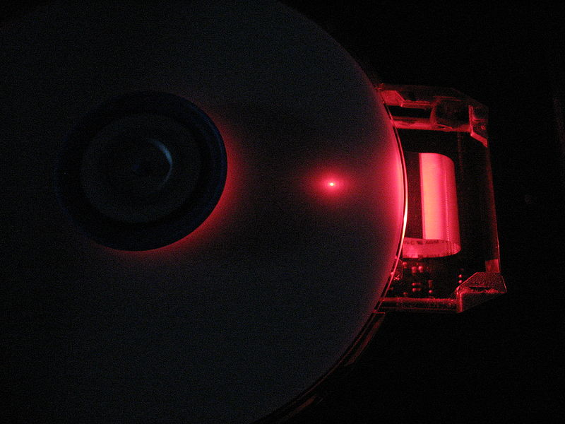
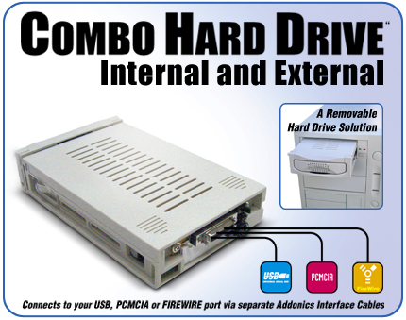
External drives give users more storage options
DVD drive with laser light
Which of these external devices have you used?
USB drive

Slide 10
Storage in the Cloud
In the past 2 years Adobe and Microsoft has develop space for users to store their files in huge large servers in many parts of the United States. Users can get their files on-line through OneDrive and Google.docs.
What is the advantages and disadvantages using the cloud for storage?

Slide 11
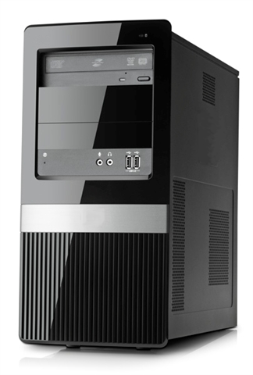
Tower cases have expansion bays
Towers usually have at least one bay for an optical drive, such as a DVD or Blu-ray drive.
Different sizes and types of drives can all be loaded into the same tower case.
What kind of drives do computers in your classroom have?

Slide 12
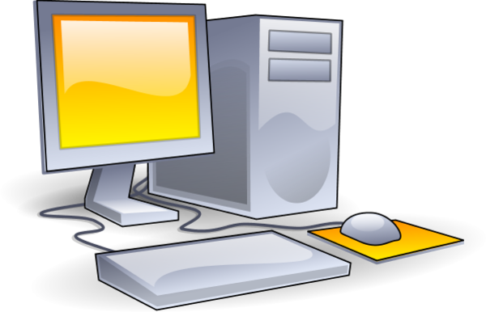
Your dream computer needs peripherals
Keyboard
Mouse
Monitor
Printer
Scanner
Storage drives
Game controllers/joysticks
Can you think of anything else?

