Slide 1

International Baccalaureate Diploma Program
Miami Beach Senior High School
IB- Scholar’s Academy Presentation
October 20,2016

Slide 2


Program Administrators
Principal: Mr. John Donohue
Assistant Principal: Dr. Blanca Correa-Cespedes
IB Coordinator: Mr. Carlos Rodriguez
Pre-IB/ Scholars Coordinator: Ms. Sylvia Carro
Secretary: Ms. Shandese Mott
District Supervisor: Ms. Renee Ilhardt

Slide 3
What is the International Baccalaureate Diploma Program?
The IB Diploma Programme is designed as an academically challenging and balanced programme of education with final examinations that prepares students, normally aged 16 to 19, for success at university and life beyond.
The programme is taught during the student’s junior and senior years and has gained recognition and respect from the world's leading universities.

Slide 4
IB Student Characteristics
Inquirers
Knowledgeable
Thinkers
Communicators
Principled
Open-minded
Caring
Risk-takers
Balanced
Reflective

Slide 5

IB around the world
More than 4,000 schools so far have chosen to teach International Baccalaureate® (IB) programmes, with their unique academic rigour and their emphasis on students’ personal development.
In Miami- Dade County there are six public high schools offering the IB Diploma Program. Miami Beach High School is the only non-magnet program.
The program is free for all students that are admitted into the program.

Slide 7
IB Program at Miami Beach High School
Students apply and enter in 9th grade to the Pre-IB Scholars Program.
The First two years are a preparatory program that prepares students for the rigor and expectations of the International Baccalaureate Diploma Program.
In December of their sophomore year, the student applies and meets with the IB Coordinator and chooses the two year IB course path that best meets their needs.
During their junior year the student has the opportunity to take AP exams in their subjects and will take all their IB exams in their senior year.

Slide 8
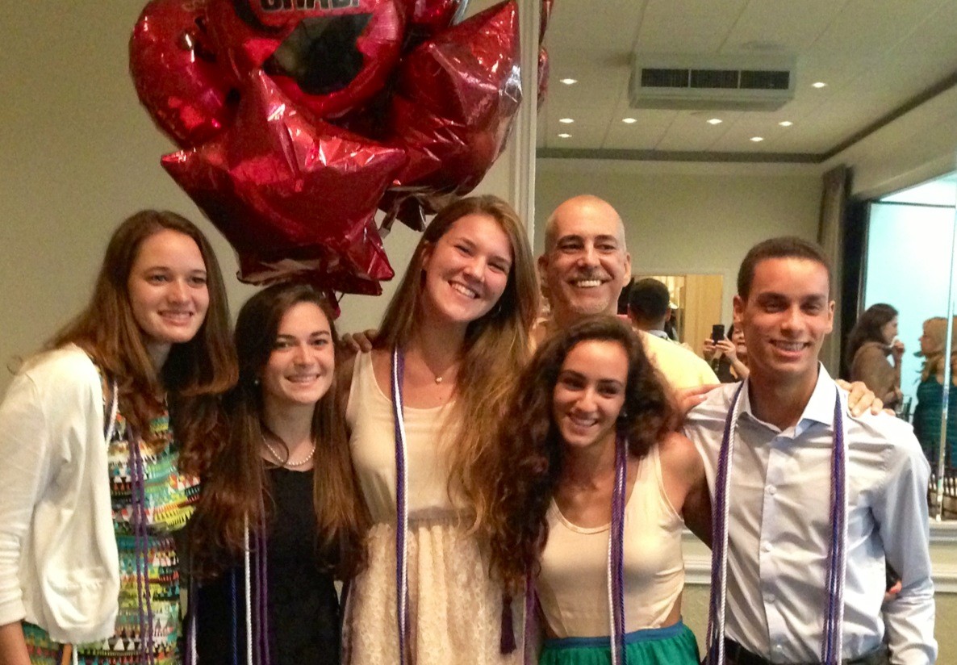
In the Five years of the International Diploma Program at Miami Beach Senior High School
220 IB Students have completed the program
168 received their IB Diplomas
76.4% IB Diploma rate
1312 IB exams taken
1062 IB exams passed
80.9% exam passing rate
100% College acceptance

Slide 9




What are the advantages of IB?

Slide 10


Slide 11
Pre-IB/ Scholars Years
9th Grade
Honors English 1
Honors Geometry or Honors Algebra 2
AP World History
Honors Biology or Honors Chemistry
Spanish, French or Portuguese Level 1 or higher
Pre-IB Inquiry Skills
Personal Fitness/ Health
Elective
10th Grade
AP English Language
Honors Algebra 2 or Honors Pre-Calculus
AP European History or AP Government/ Econ.
Honors Chemistry or Honors Physics
Spanish, French or Portuguese Level 2 or higher
Elective
Elective
Elective

Slide 12
IB Diploma Years
11th Grade
AP English Literature
AP Spanish Language , IB Spanish 3, AP French Language , IB French 3, IB Portuguese 3
AP U.S. History
AP Biology or AP Chemistry or AP Physics
AP Calculus AB or IB Pre-Calculus
AP Psychology or AP Human Geography
Extended Essay-CAS and Theory of Knowledge 1
Elective

Slide 13
IB Diploma Years
12th Grade
IB World Literature HL
IB Spanish HL- IB Spanish SL- IB French HL- IB French SL- IB Portuguese SL
IB History of the Americas HL
IB Biology SL- IB Chemistry SL- IB Physics HL/SL
IB Mathematics SL- IB Math Studies SL
IB Psychology HL/SL- IB Geography HL/SL
Theory of Knowledge 2
Elective

Slide 14
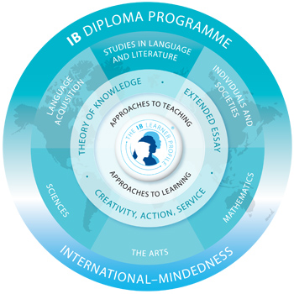
What is the International Baccalaureate Diploma Program?
  The Diploma Programme Curriculum Framework is made up of the following:
    Students study concurrently:
    •Three subjects at Higher Level (HL) (240 hours each).
    •Three subjects at Standard Level (SL) (150 hours each).
    •All three elements of the core (Extended Essay - 4,000 word essay; Theory of Knowledge; Creativity, Action and Service – CAS 150 hours across 2 years).

Slide 15
What are the Requirements?
    Incoming 9th graders must have completed Honors Physical Science and Honors Algebra 1. Must have a 3.00 gpa.
    Incoming 11th graders must have completed at least Honors Algebra 2 and maintained at least a 2.75 avg in their High School Classes.
    Applications for both the Pre-IB Scholars and the IBDP Program are available online on the school website starting December 1st.
    Hard copy applications must be received at the IB-Scholars Office no later than February 1st
    Link to applications
      miamibeachhigh.schoolwires.com
      Under IB- Scholars Academy

Slide 16
Colleges Acceptances
Harvard University
Cornell University
U.Penn-Wharton
Vanderbilt University
Barnard College
Mc Gill University
NYU
University of Florida
University of Miami
University of Colorado
U. California-Berkely
Duke University
University of South Florida
Florida State University
Brandeis University
Boston University
Emory University
Boston College
U. North Carolina
Tulane University
University of Michigan
University of Chicago
USC
Syracuse University

Slide 17
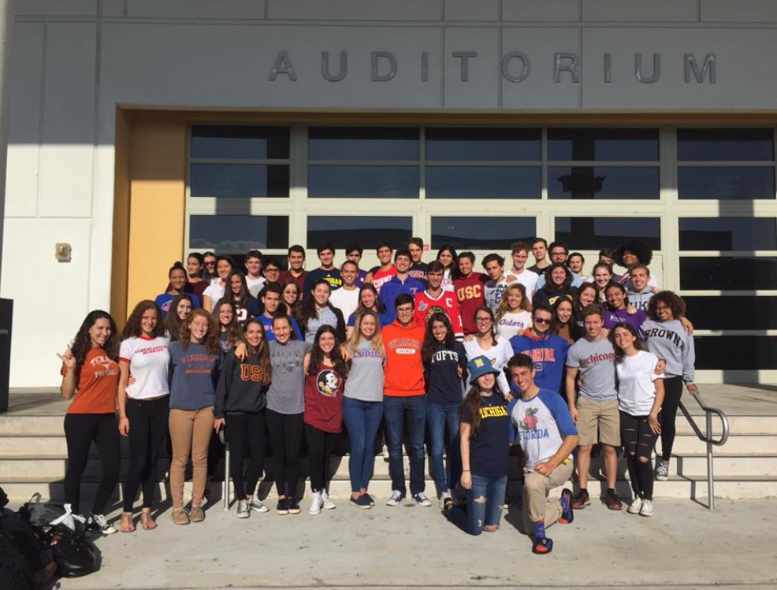

Slide 18
Questions and Answers

