Slide 1
Ideal Gases and the Ideal Gas Law:
PV = nRT
Temperature in K
*gas constant 0.0821 L•atm = 62.37 L•torr
mol•K mol•K
moles of gas
volume in L
pressure in units to match *R units
Note: there is only one set of conditions.

Slide 2
Avogadro’s Law:
Equal volumes of any two gases (ideal) at the same temperature and pressure contain the same number of molecules (they also occupy equal volumes).
STP
Pressure 1 atm (760 mm Hg)
Temperature 0ºC (273 K)
Standard
At STP one mole of ideal gas occupies 22.4 L

Slide 3
A 12.25 L cylinder contains 75.5 g of neon at 24.5 ºC. Determine the pressure in the cylinder.

Slide 4
What is the density of carbon dioxide gas at 25 ºC and 725 mmHg pressure?

Slide 5
A 2.50 gram sample of a solid was vaporized in a 505ml vessel. If the vapor pressure of the solid was 755 mmHg at 155ºC, what is the molecular weight of the solid?

Slide 6
So Density is g/L (g ÷ L)
and
molar mass
is g/mol (g ÷ mol).

Slide 7
Dalton’s Law of Partial Pressures:
He
H₂ N₂
P_{total} = P₁ + P₂ + P₃ +...

Slide 8
A 250.0 mL flask contains 1.00 mg of He and 2.00 mg of H₂ at 25.0ºC. Calculate the total gas pressure in the flask in atmospheres.

Slide 11
Molecular diffusion and effusion:
Diffusion:
“gas molecules spreading out to fill a room are diffusing.”
Its not easy since an average gas
molecule at room temperature and
pressure will experience about
10 billion collisions per second!
It only travels about 60 nm
between collisions!

Slide 13
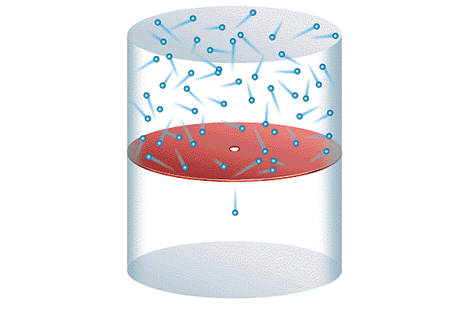
Effusion:
“A Helium filled balloon loses He by effusion.”
escaping molecule
Small hole or pore

Slide 14
Which molecules will effuse faster from this semiporous
container?
Graham’s Law of effusion: effusion rate is inversely proportional to the square root of its molar mass.
For 2 gases:

Slide 15
Compare the rates of effusion of He and N₂.

Slide 16
He
N₂
Which balloon will lose pressure sooner?

Slide 17
N₂
He
Big molecules
Little molecules
(escape more
easily)
Which balloon will lose pressure sooner?

