Slide 1
Cowboys vs. Indians: Struggle of the western Native Americans

Slide 2
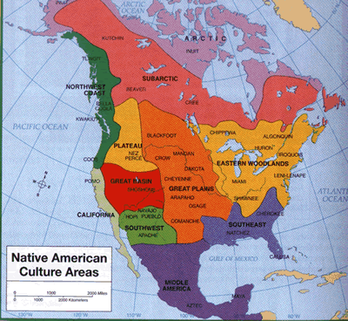
Native American Tribes

Slide 3
The Plains Indians
Many tribes of the Great Plains were nomads
Followed buffalo herds for food, shelter, tools
Americans forced natives to relocate, or move off lands that were promised to them through treaties
Sometimes in exchange for money, or annuities
Many natives forced to live in poverty
Many tribes, esp. Dakota tribe, fight back

Slide 4
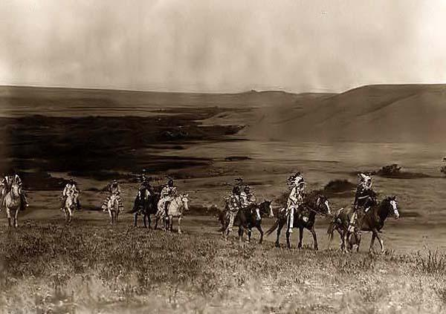
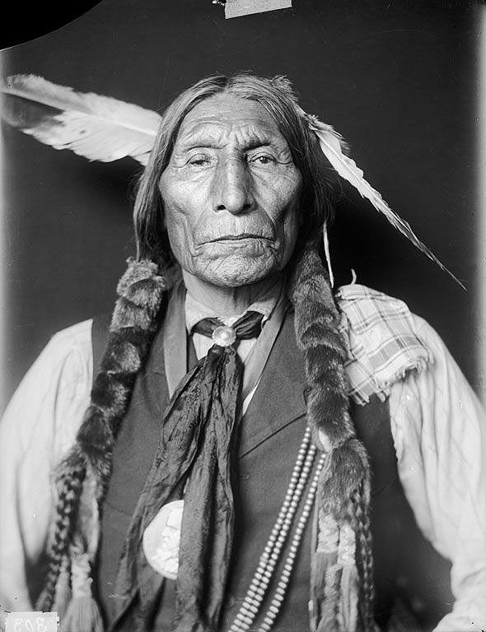
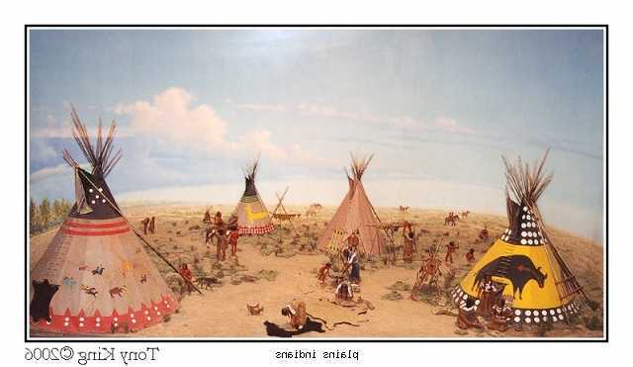

Slide 5
Western War
A Sioux tribe called the Lakota go to war against U.S. troops under the leadership of chiefs Red Cloud, Sitting Bull, and Crazy Horse
Trick troops into ambush under Capt. Will Fetterman
The army abandons Bozeman Trail post in 1868
Chief Black Kettle of the Sand Creek tribe, after much war, rides to army post in CO
U.S. troops massacre Sand Creeks riding under American and White Truce Flag

Slide 6
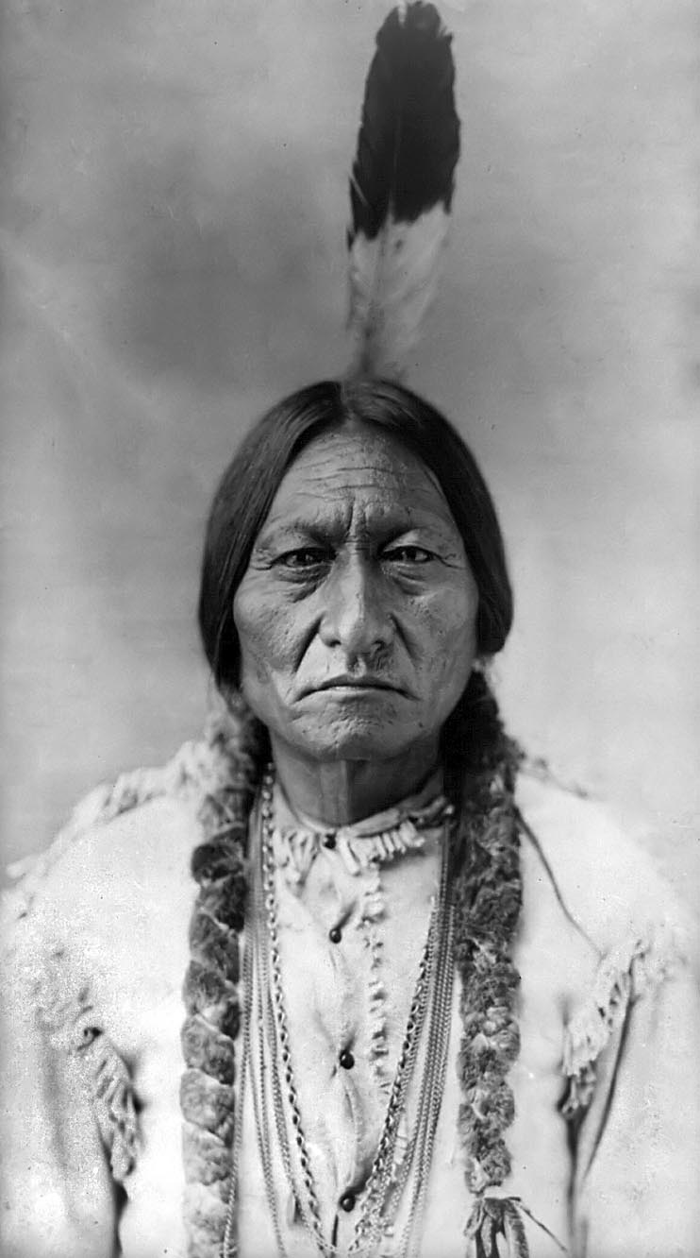
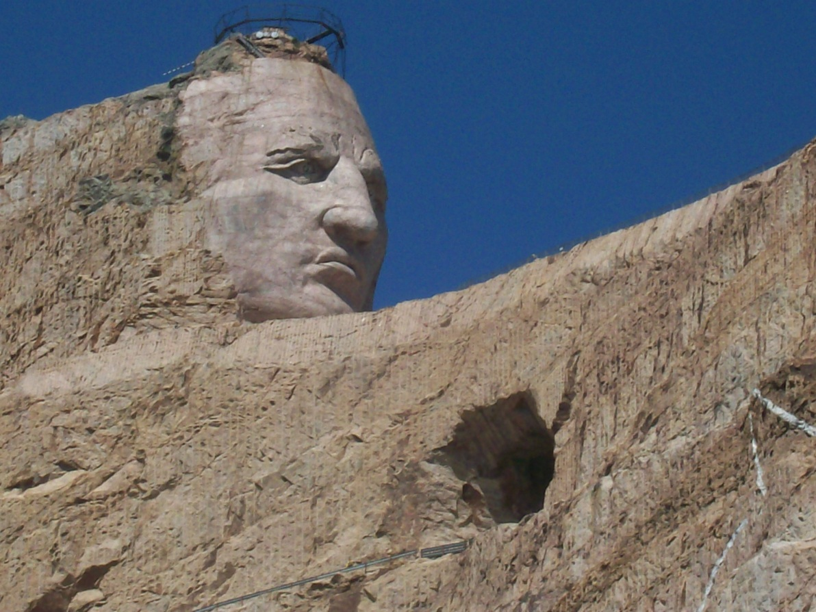
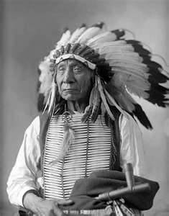

Slide 7
Attempts At Peace
1867: Congress forms Indian Peace Commission
Plan: create two reservations, if Indians refuse the army will attack
Chiefs forced to sign treaties, Americans ignored the terms, settlers occupied “Indian Land”
Americans kill buffalo to get rid of Indians

Slide 8
Big Battles
Battle of Little Big Horn: US Lt. Col. Custer lead troops against Lakota & Cheyenne against orders, slaughtered
Newspapers paint battle as a massacre on the part of the Indians, the army is dispatched to deal with them
Battle of Nez Perce: Indians refuse to leave southern land for a smaller reservation in Idaho, army attacks, tribe relocated to Oklahoma
Wounded Knee: Chief Sitting Bull defies U.S. orders, continues Ghost Dance, and is attacked—200 Lakota dead

Slide 9
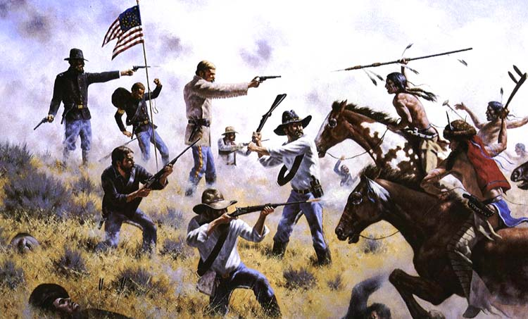
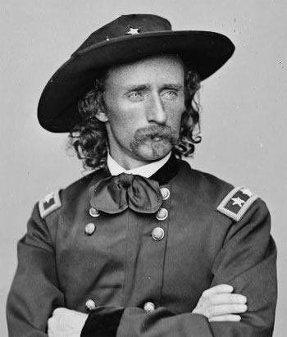

Slide 10
The Dawes Act
1881: A Century of Dishonor published
Changes American thinking about Indians
New goal is to assimilate Indians
1887: Congress passes the Dawes Act—Fails
Divides reservations into individual farm lands
1924: Citizenship Act
1934: Indian Reorganization Act
Reversed Dawes Act, restored reservation lands, allow Indians to elect their own governments

