Slide 1
Urbanization

Slide 2
Growth of American Cities
1860-1900: NYC grows from 800,000 to 3.5 Mil.
Farmers and Immigrants move to cities
Rising land prices= steel frame skyscrapers
Everglades drained to open up southern FL
Public transportation improves
Subways
Streetcars/Cable Cars

Slide 3
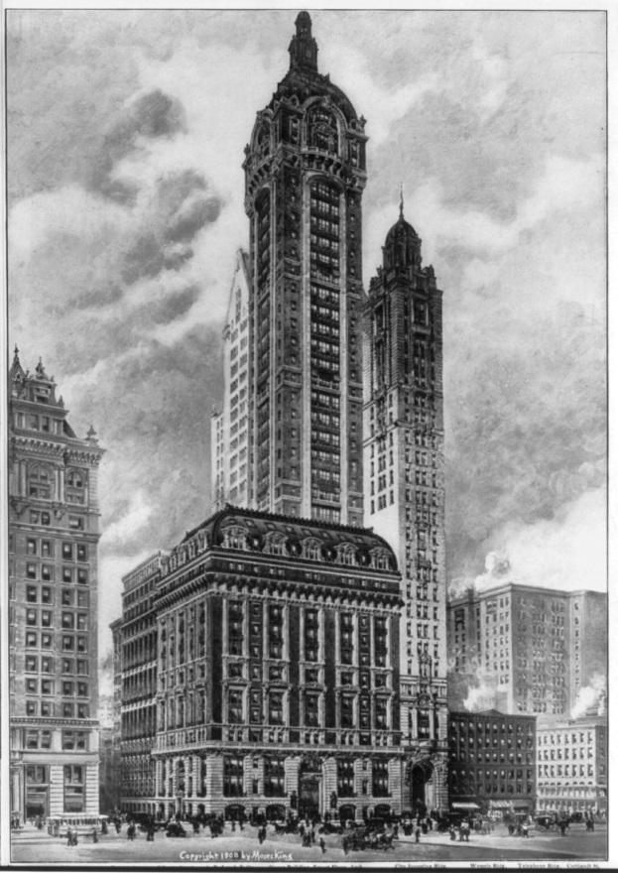
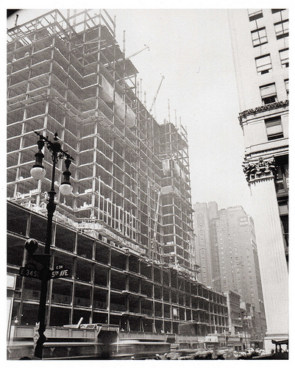
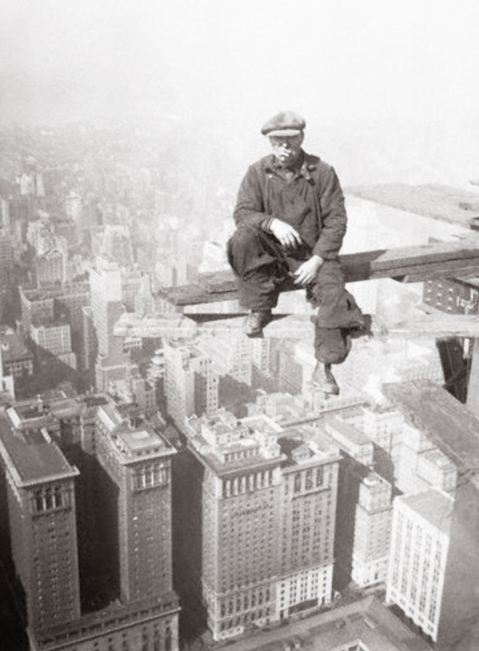
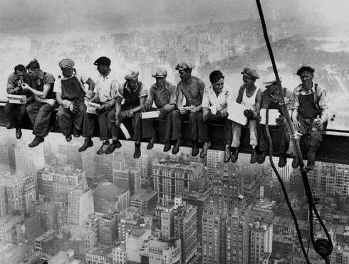

Slide 4
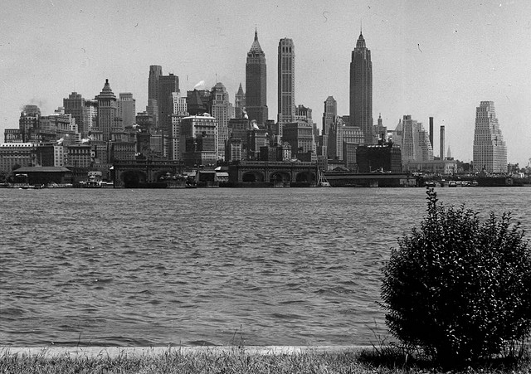
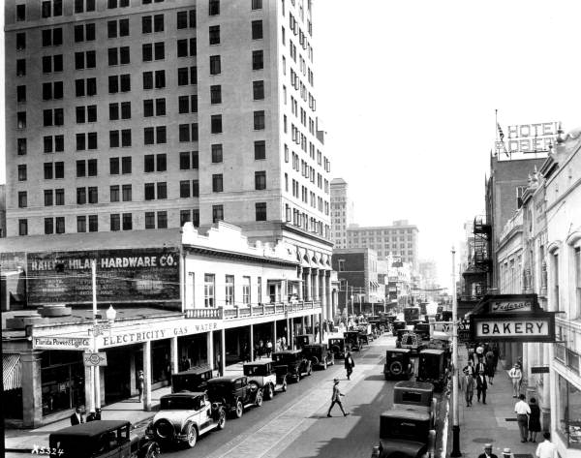
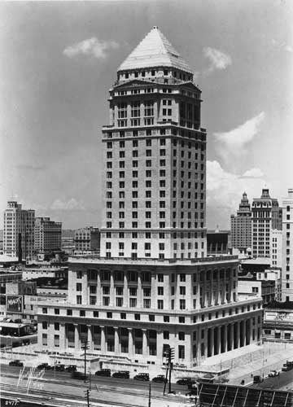
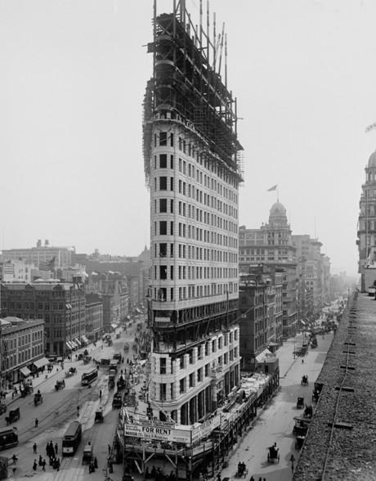
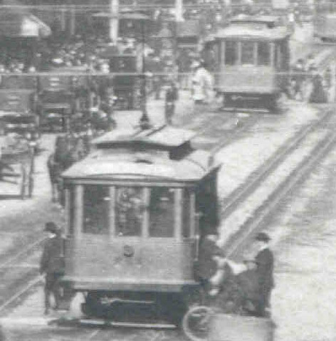

Slide 5
Urban Class Relations
Classes lived in separate districts
The rich lived at the city center
Rich homes grew large, required many servants
Middle class move to “streetcar suburbs”
“clubs” become charitable organizations
Working class move into tenements
Poor, crowded living conditions
As prices rise, more women go to work
Teachers, nurses, clerks, maids

Slide 6
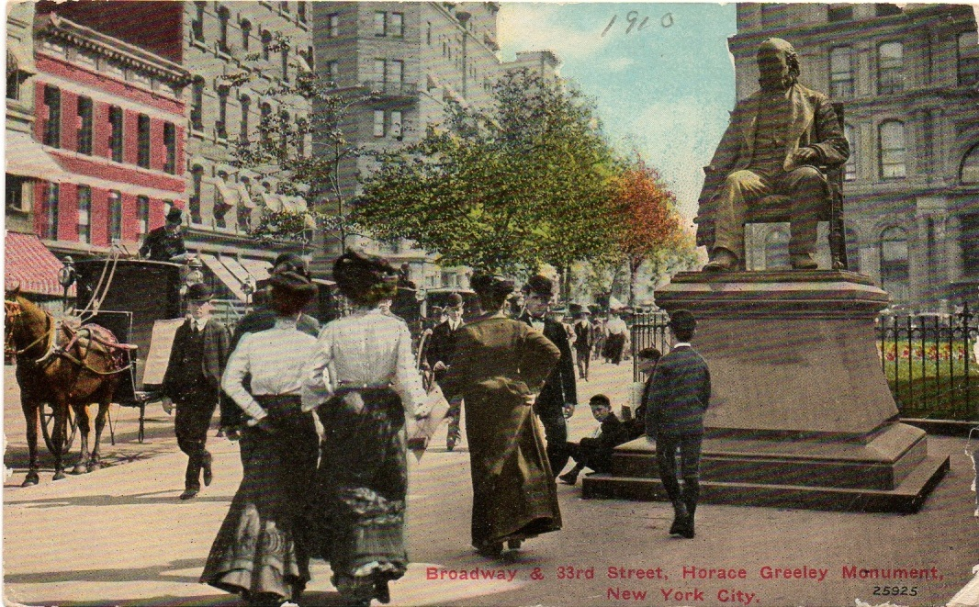
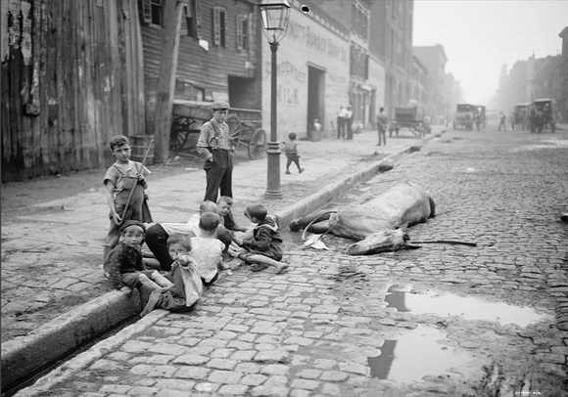
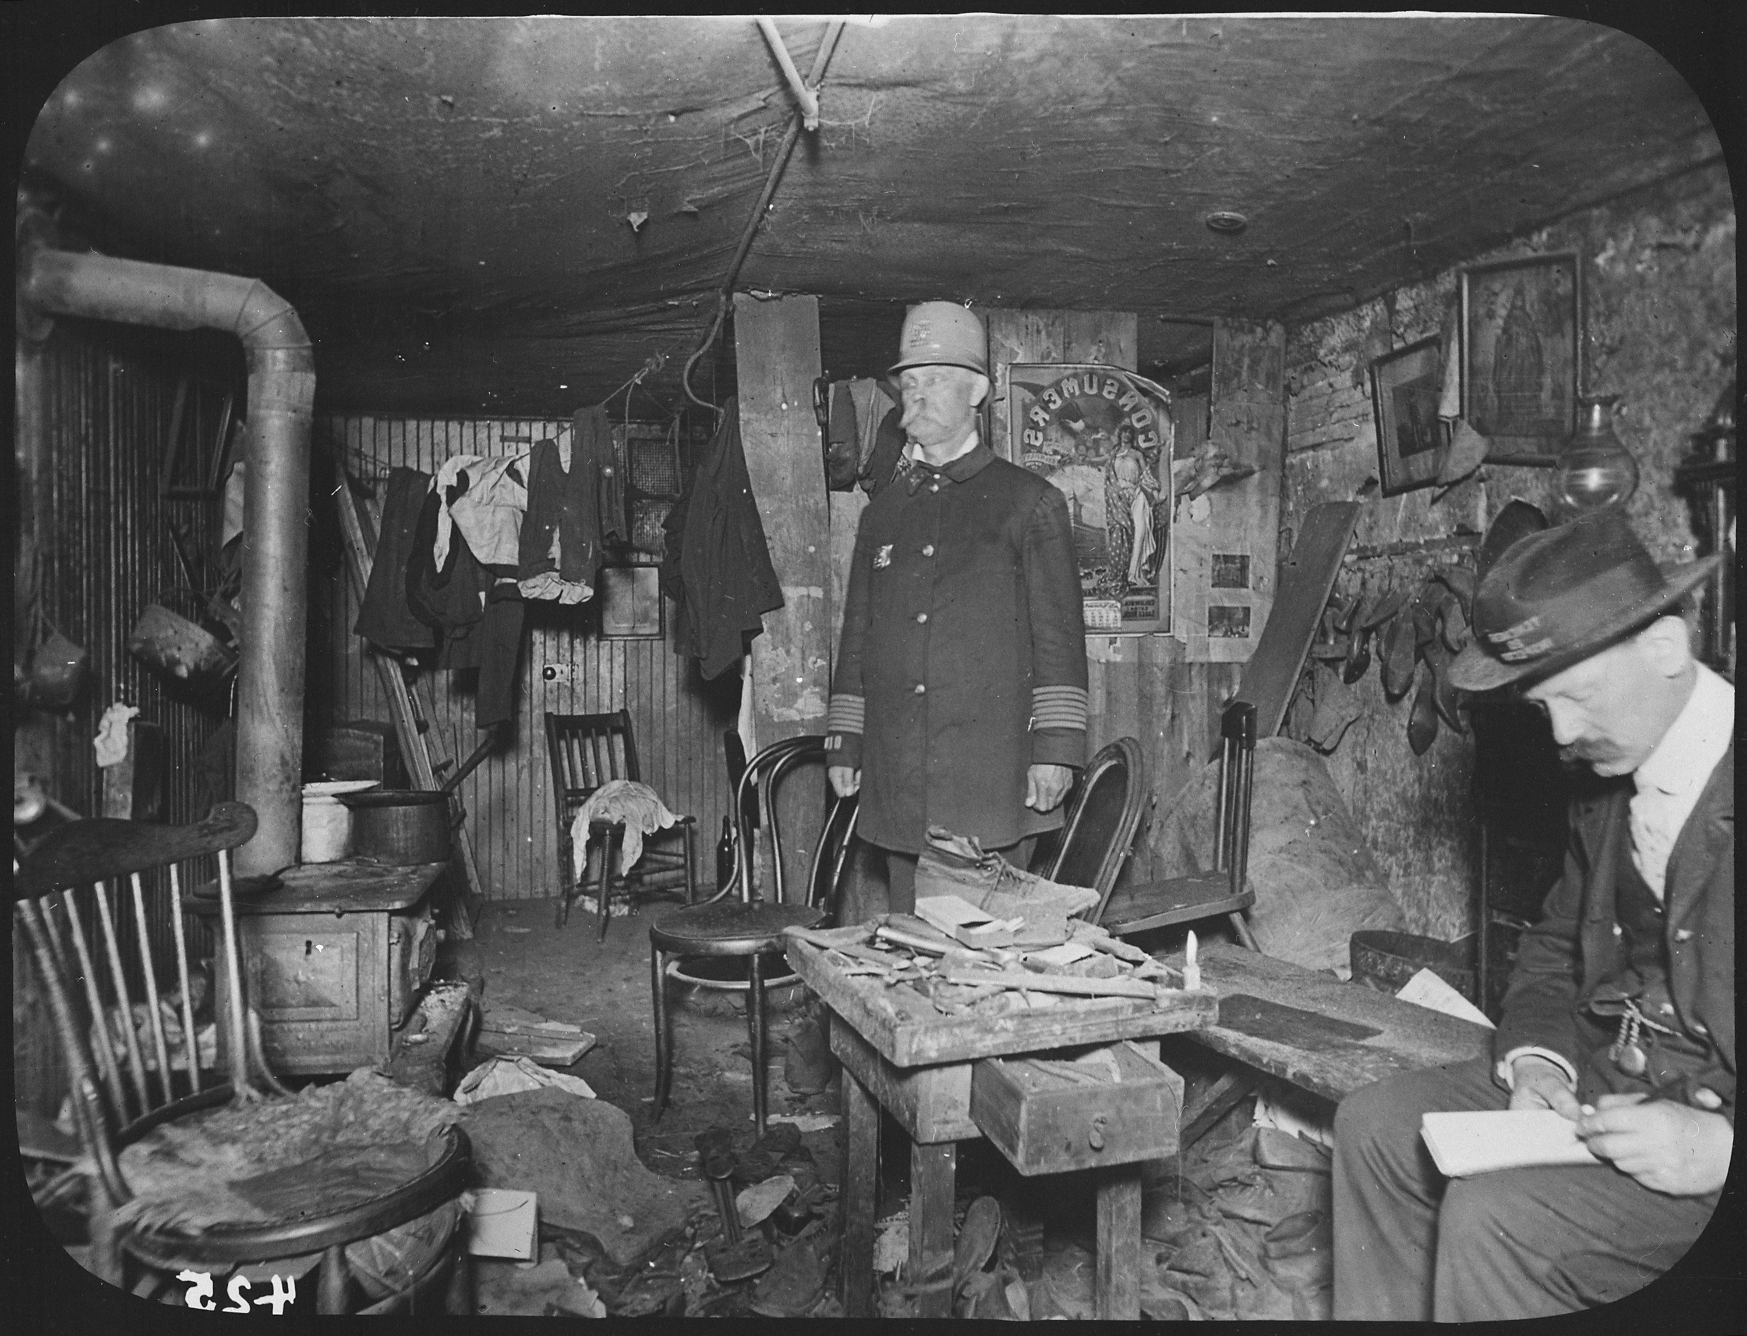
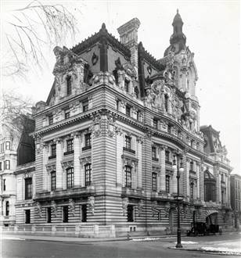

Slide 7
Urban Problems
Crime, violence, fire, disease, pollution
Political Machines
City governments corrupt, but supply jobs, housing
Graft is way for party bosses to get/stay rich
Thomas Nast, cartoonist, criticizes political machines

Slide 8
