Slide 1
From Imperialism To Diplomacy

Slide 2
America In Asia
US Navy= 3rd largest in world, bases all over Pacific
Navy supported American trade interests in region
War breaks between China and Japan over Korea
Japan’s modern army crushes much larger Chinese army
Korea & Manchuria freed from Chinese control
Russia, Germany, France block Japan from taking land
Russia works lease agreement with China for Man.
France, Britain, and Germany also want China leases
Each establishes a sphere of influence
US negotiate “Open Door Policy” for trade in China

Slide 3
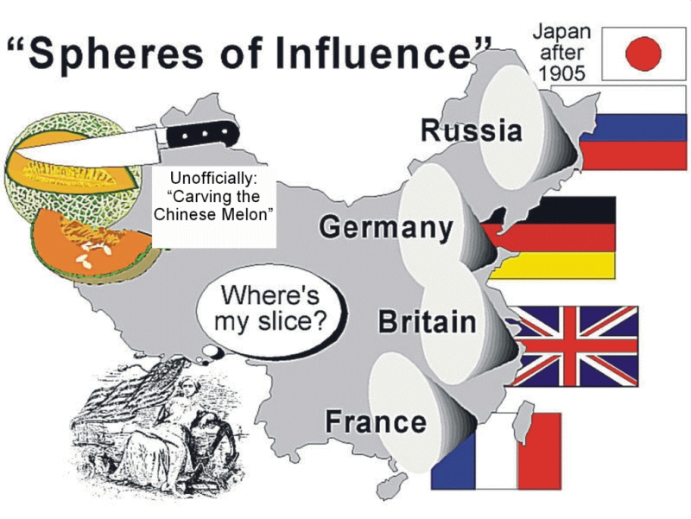

Slide 4
The Boxer Rebellion
Secret Chinese societies fight back against foreigners
Society of Righteous an Harmonious Fists—”Boxers”
Thought foreigners and Christians corrupted China
Boxers and Chinese troops target foreigners
Coalition of 8 nations: Germany, Austria-Hungary, Britain, France, Italy, Japan, Russia, and the U.S. come to aid of foreigners and stop rebellion
US Sec. of State John Hay negotiates the peace, China is not to be colonized, but must only pay back Western nations for damages—Chinese trade still open to US

Slide 5
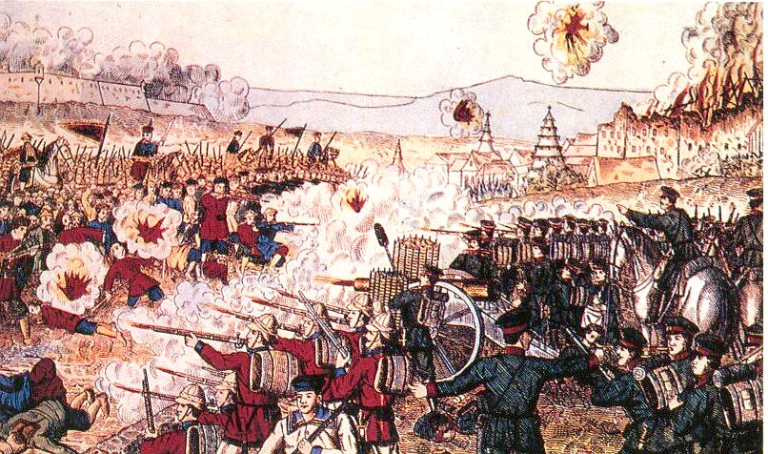
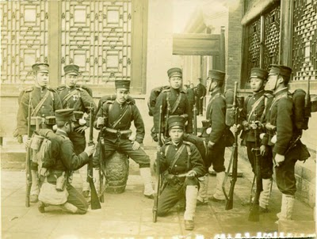

Slide 6
Theodore Roosevelt
McKinley assassinated, VP Roosevelt is president
Anglo-Saxonist, US must teach uncivilized how to live
Negotiated peace between Russia and Japan
Foreign Policy: “Speak softly and carry a big stick”
Builds Panama Canal
Panama = province of Columbia
French company wants to build a canal, fail
U.S. offers to rent land from Columbia, buy French assets, and build canal to increase trade—Col. Refuses
1903: U.S. Warships support Panamanian revolt
Malaria & Yellow Fever kill many American canal workers
Canal Zone created where mosquitoes cannot live

Slide 7
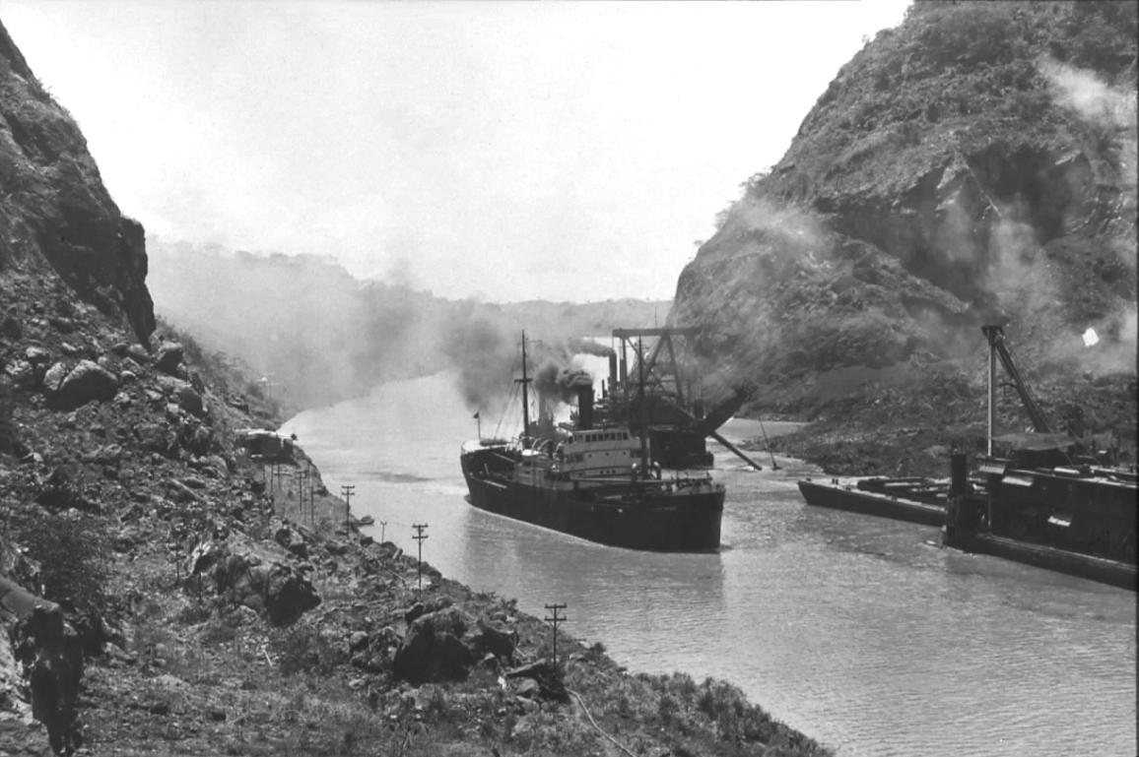
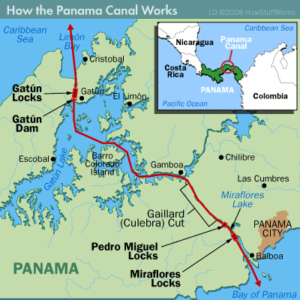
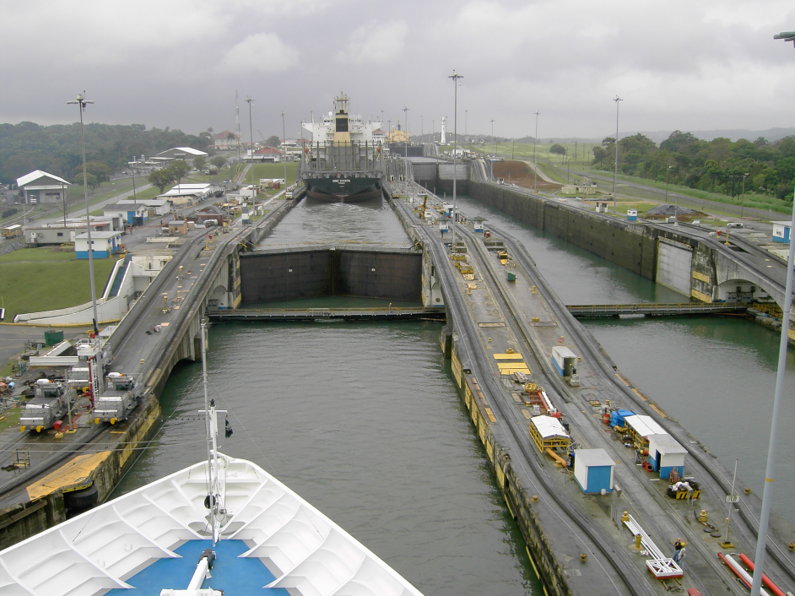
The Panama Canal

Slide 8
The Roosevelt Corollary & Dollar Diplomacy
Latin American countries in debt trouble
Venezuela defaults, Europeans move troops in
U.S. negotiates peace between parties
Roosevelt gives speech to Congress, the U.S. is in charge of intervening in L.A., not Europe
First place Roosevelt Corollary is used is Dominican Republic
President Taft applies Roosevelt Corollary to economics, “dollar diplomacy”
Nicaragua

Slide 9
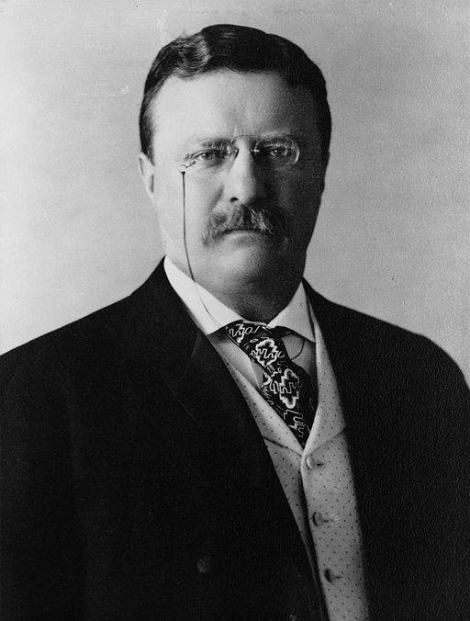
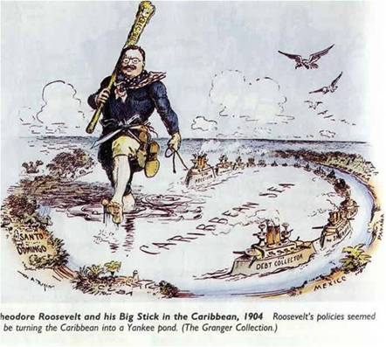

Slide 10
Woodrow Wilson
Foreign Goals: promote democracy, oppose imperialism, international cooperation
Mexico undergoing brutal revolution
Wilson says U.S. recognizes only lawful governments
Wilson uses Tampico incident to overthrow Huerta
Sends troops to stop German arms shipment
Carranza is new president, Pancho Villa fights back
General John J. Pershing sent to subdue Villa
Europeans unhappy with U.S. aggression
Sends troops to Haiti and Dominican Republic

Slide 11
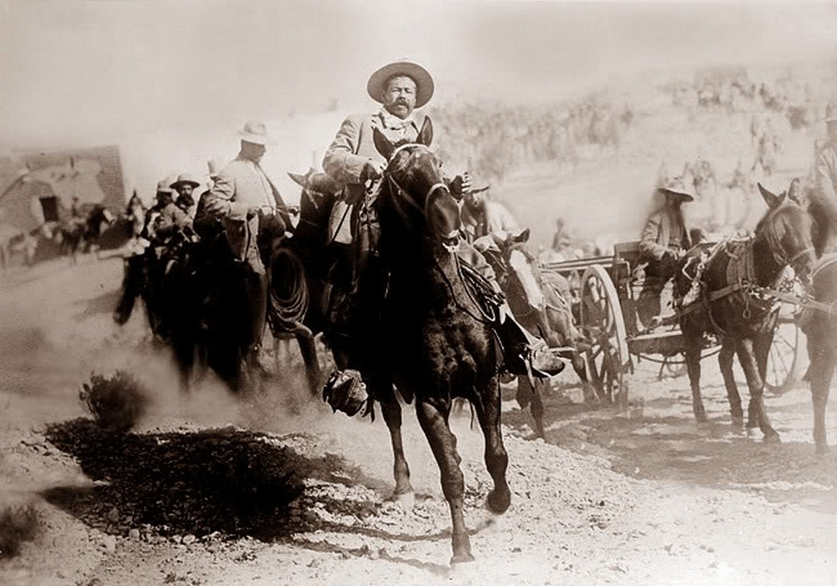
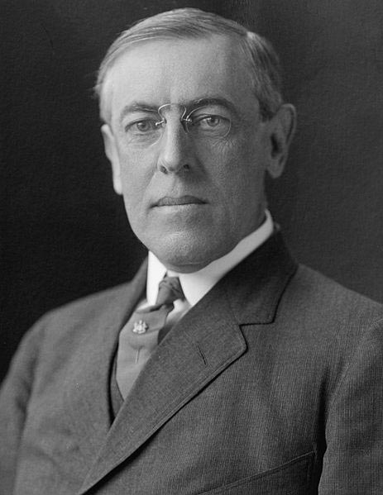
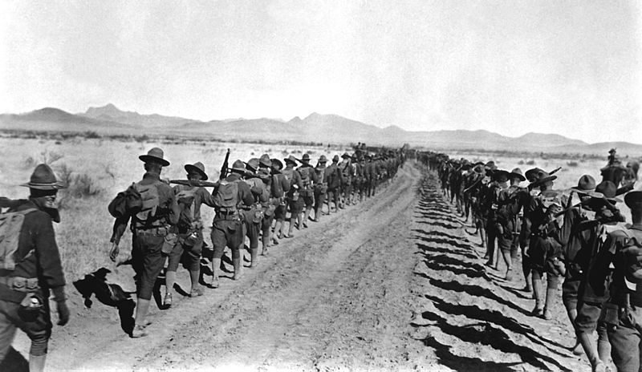

Slide 12
On page 157, write and answer questions 1-5

