Slide 1
Precalculus
Sixth Edition
Chapter 9
Conic Sections and Analytic Geometry
Copyright © 2018, 2014, 2010 Pearson Education, Inc. All Rights Reserved
Notes:
If this PowerPoint presentation contains mathematical equations, you may need to check that your computer has the following installed:
1) MathType Plugin
2) Math Player (free versions available)
3) NVDA Reader (free versions available)

Slide 2
9.1 The Ellipse

Slide 3
Objectives
Graph ellipses centered at the origin.
Write equations of ellipses in standard form.
Graph ellipses not centered at the origin.
Solve applied problems involving ellipses.

Slide 4
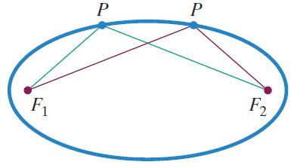
Definition of an Ellipse
An ellipse is the set of all points, P, in a plane the sum of whose distances from two fixed points, F₁ and F₂, is constant. These two fixed points are called the foci (plural of focus). The midpoint of the segment connecting the foci is the center of the ellipse.

Slide 5
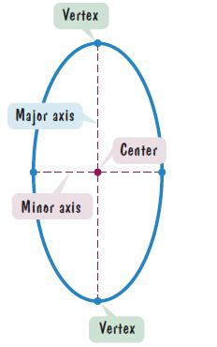
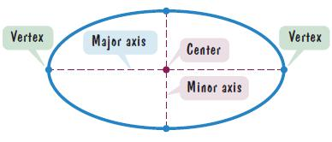
Horizontal and Vertical Elongation of an Ellipse
An ellipse can be elongated in any direction. The line through the foci intersects the ellipse at two points, called the vertices (singular: vertex). The line segment that joins the vertices is the major axis. The midpoint of the major axis is the center of the ellipse. The line segment whose endpoints are on the ellipse and that is perpendicular to the major axis at the center is called the minor axis of the ellipse.

Slide 6
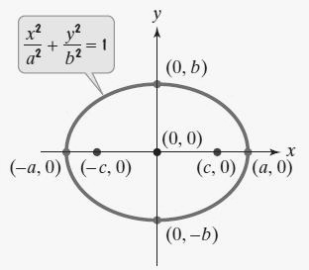
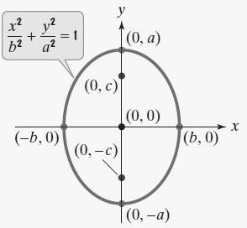
Standard Form of the Equations of an Ellipse (1 of 2)

Slide 7
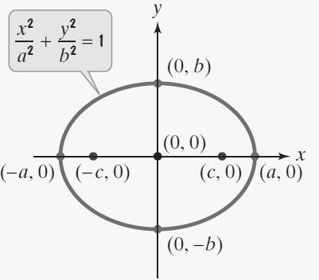
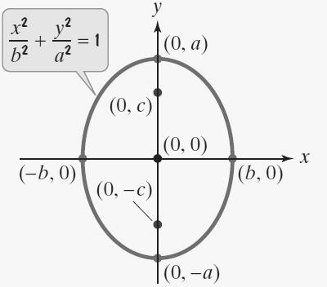
Standard Form of the Equations of an Ellipse (2 of 2)

Slide 8
Example: Graphing an Ellipse Centered at the Origin (1 of 3)
Solution:
Express the equation in standard form.
Find the vertices.

Slide 9
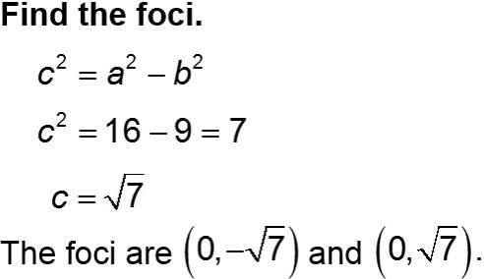
Example: Graphing an Ellipse Centered at the Origin (2 of 3)
Find the endpoints of the (horizontal) minor axis.
The endpoints of the minor axis are (0, −3) and (0, 3).

Slide 10
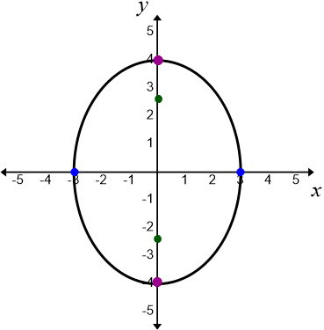
Example: Graphing an Ellipse Centered at the Origin (3 of 3)
The major axis is vertical.
The vertices are (0, −4) and (0, 4).
The endpoints of the minor axis are (−3, 0) and (3, 0).

Slide 11
Example: Finding the Equation of an Ellipse from Its Foci and Vertices (1 of 2)
Find the standard form of the equation of an ellipse with foci at (−2, 0) and (2, 0) and vertices at (−3, 0) and (3, 0).
Solution:
Because the foci, (−2, 0) and (2, 0), are located on the x-axis, the major axis is horizontal. The center of the ellipse is midway between the foci, located at (0, 0). Thus the form of the equation is
The distance from the center, (0, 0) to either vertex, (−3, 0) or (3, 0), is 3. Thus a = 3.

Slide 12
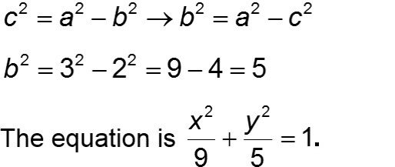
Example: Finding the Equation of an Ellipse from Its Foci and Vertices (2 of 2)
The distance from the center, (0, 0) to either focus, (−2, 0) or (2, 0), is 2, so c = 2.

Slide 13
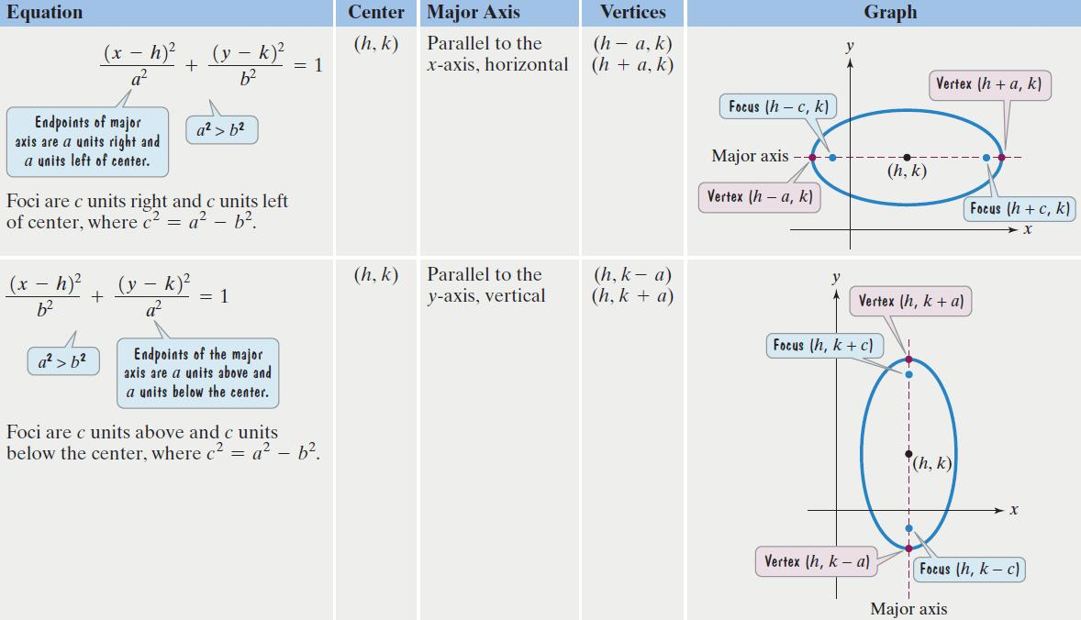
Standard Forms of Equations of Ellipses Centered at (h, k)

Slide 14
Example: Graphing an Ellipse Centered at (h, k) (1 of 4)
Solution: The form of the equation is
h = −1, k = 2. Thus, the center is (−1, 2).

Slide 15
Example: Graphing an Ellipse Centered at (h, k) (2 of 4)
The center is at (−1, 2).
The endpoints of the major axis (the vertices) are 3 units right and 3 units left from center.
3 units right (−1 + 3, 2) = (2, 2)
3 units left (−1 − 3, 2) = (−4, 2)
The vertices are (2, 2) and (−4, 2).

Slide 16
Example: Graphing an Ellipse Centered at (h, k) (3 of 4)
The center is at (−1, 2).
The endpoints of the minor axis are 2 units up and 2 units down from the center.
2 units up (−1, 2 + 2) = (−1, 4)
2 units down (−1, 2 − 2) = (−1, 0)
The endpoints of the minor axis are (−1, 4) and (−1, 0).

Slide 17
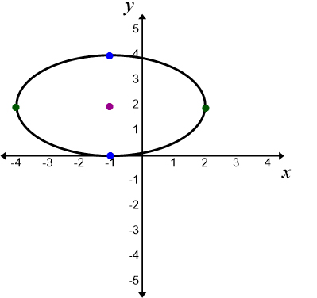
Example: Graphing an Ellipse Centered at (h, k) (4 of 4)
The center is at (−1, 2).
The vertices are (2, 2) and (−4, 2).
The endpoints of the minor axis are (−1, 4) and (−1, 0).

Slide 18
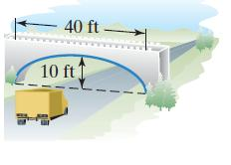
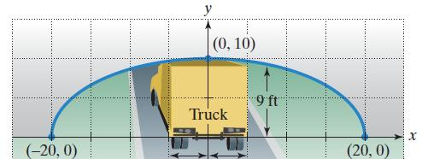
Example: An Application Involving an Ellipse (1 of 3)
A semielliptical archway over a one-way road has a height of 10 feet and a width of 40 feet.
Will a truck that is 12 feet wide and has a height of 9 feet clear the opening of the archway?
Solution:
We construct a coordinate system with the x-axis on the ground and the origin at the center of the archway.

Slide 19
Example: An Application Involving an Ellipse (2 of 3)
The edge of the 12-foot-wide truck corresponds to x = 6. We find the height of the archway 6 feet from the center by substituting 6 for x and solving for y.

Slide 20
Example: An Application Involving an Ellipse (3 of 3)
A semielliptical archway over a one-way road has a height of 10 feet and a width of 40 feet. Will a truck that is 12 feet wide and has a height of 9 feet clear the opening of the archway?
We found that the height of the archway is approximately 9.5 feet. The truck will clear the opening of the archway.

