Slide 1
Precalculus
Sixth Edition
Chapter 9
Conic Sections and Analytic Geometry
Copyright © 2018, 2014, 2010 Pearson Education, Inc. All Rights Reserved
Notes:
If this PowerPoint presentation contains mathematical equations, you may need to check that your computer has the following installed:
1) MathType Plugin
2) Math Player (free versions available)
3) NVDA Reader (free versions available)

Slide 2
9.2 The Hyperbola

Slide 3
Objectives
Locate a hyperbola’s vertices and foci.
Write equations of hyperbolas in standard form.
Graph hyperbolas centered at the origin.
Graph hyperbolas not centered at the origin.
Solve applied problems involving hyperbolas.

Slide 4
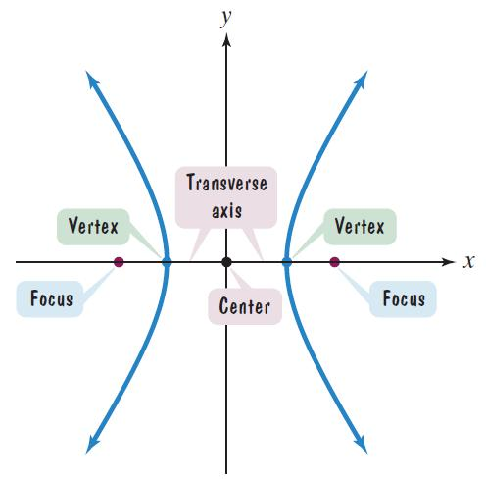
Definition of a Hyperbola
A hyperbola is the set of points in a plane the difference of whose distances from two fixed points, called foci, is constant.

Slide 5
The Two Branches of a Hyperbola
The line through the foci intersects the hyperbola at two points, called the vertices.
The line segment that joins the vertices is the transverse axis.
The midpoint of the transverse axis is the center of the hyperbola.

Slide 6
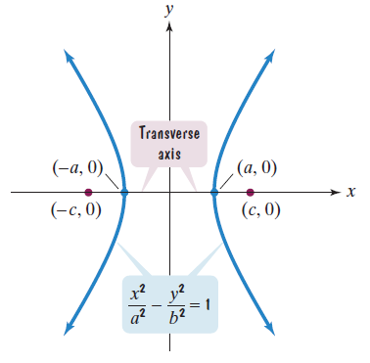
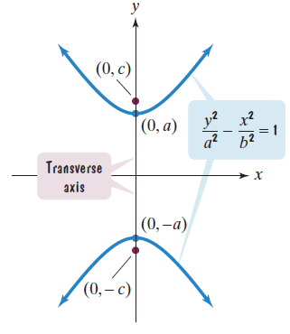
Standard Forms of the Equations of a Hyperbola (1 of 2)

Slide 7
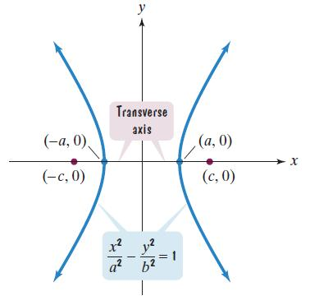
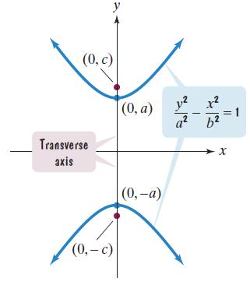
Standard Forms of the Equations of a Hyperbola (2 of 2)
The vertices are a units from the center and the foci are c units from the center.

Slide 8
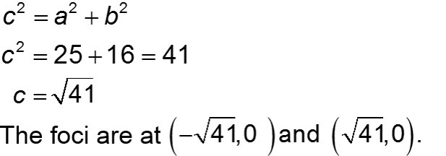
Example 1: Finding Vertices and Foci from a Hyperbola’s Equation (1 of 2)
Find the vertices and locate the foci for the hyperbola with the given equation:
Solution:
The vertices are (−5, 0) and (5, 0).

Slide 9
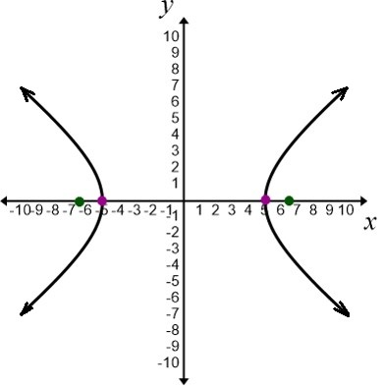
Example 1: Finding Vertices and Foci from a Hyperbola’s Equation (2 of 2)
The vertices are (−5, 0) and (5, 0).

Slide 10
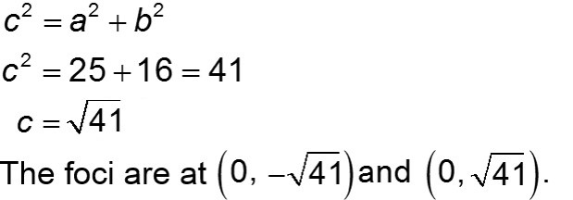
Example 2: Finding Vertices and Foci from a Hyperbola’s Equation (1 of 2)
Find the vertices and locate the foci for the hyperbola with the given equation:
Solution:
The vertices are (0, −5) and (0, 5).

Slide 11
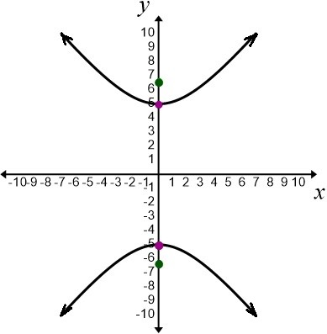
Example 2: Finding Vertices and Foci from a Hyperbola’s Equation (2 of 2)
The vertices are (0, −5) and (0, 5).

Slide 12
Example 3: Finding Vertices and Foci from a Hyperbola’s Equation (1 of 2)
Find the standard form of the equation of a hyperbola with foci at (0, −5) and (0, 5) and vertices (0, −3) and (0, 3).
Solution:
Because the foci are located at (0, −5) and (0, 5), the transverse axis lies on the y-axis. Thus, the form of the equation is
The distance from the center to either vertex is 3, so a = 3.

Slide 13
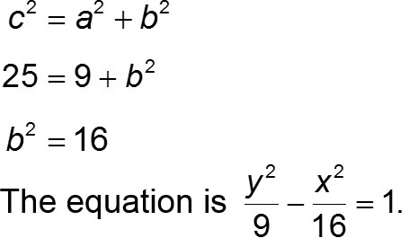
Example 3: Finding Vertices and Foci from a Hyperbola’s Equation (2 of 2)
The distance from the center to either focus is 5. Thus, c = 5.

Slide 14
The Asymptotes of a Hyperbola Centered at the Origin (1 of 2)

Slide 15
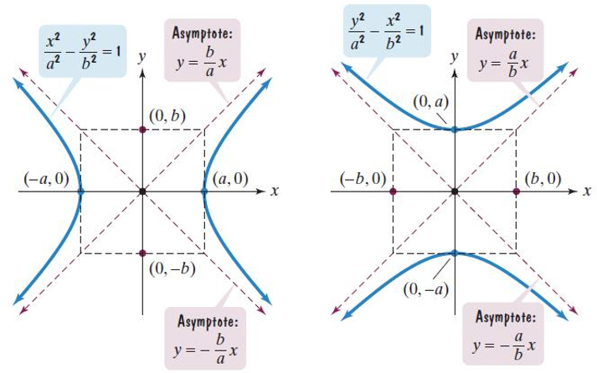
The Asymptotes of a Hyperbola Centered at the Origin (2 of 2)
As x and y get larger, the two branches of the graph of a hyperbola approach a pair of intersecting straight lines, called asymptotes.

Slide 16
Graphing Hyperbolas Centered at the Origin
Graphing Hyperbolas
Locate the vertices.
Use dashed lines to draw the rectangle centered at the origin with sides parallel to the axes, crossing one axis at ±a and the other at ±b.
Use dashed lines to draw the diagonals of this rectangle and extend them to obtain the asymptotes.
Draw the two branches of the hyperbola by starting at each vertex and approaching the asymptotes.

Slide 17
Example: Graphing a Hyperbola (1 of 5)
What are the equations of the asymptotes?
Solution:
Step 1 Locate the vertices.
with
Thus, the vertices are (−6, 0) and (6, 0).

Slide 18
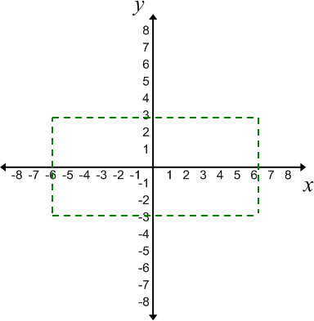
Example: Graphing a Hyperbola (2 of 5)
Step 2 Draw a rectangle.
The rectangle passes through the points (−6, 0) and (6, 0) and (0, −3) and (0, 3).

Slide 19
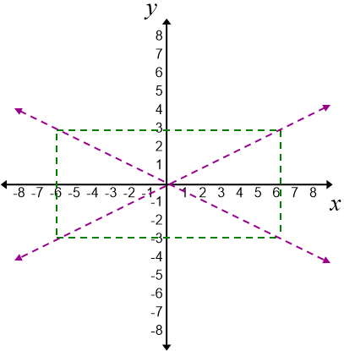
Example: Graphing a Hyperbola (3 of 5)
Step 3 Draw extended diagonals for the rectangle to obtain the asymptotes.

Slide 20
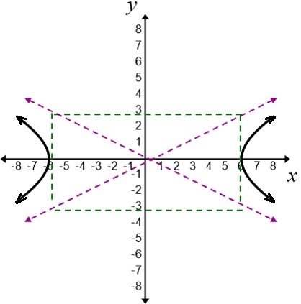
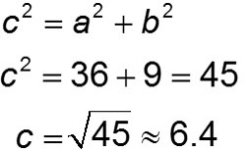
Example: Graphing a Hyperbola (4 of 5)
Step 4 Draw the two branches of the hyperbola starting at each vertex and approaching the asymptotes.

Slide 21
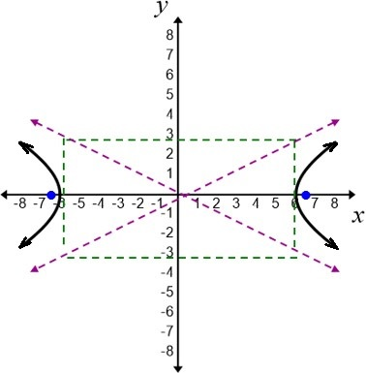
Example: Graphing a Hyperbola (5 of 5)
What are the asymptotes?

Slide 22
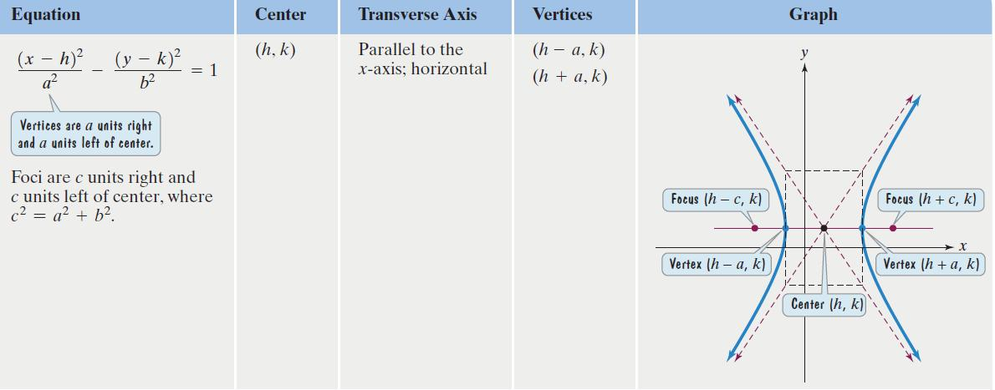
Translations of Hyperbolas − Standard Forms of Equations of Hyperbolas Centered at (h, k) (1 of 2)

Slide 23
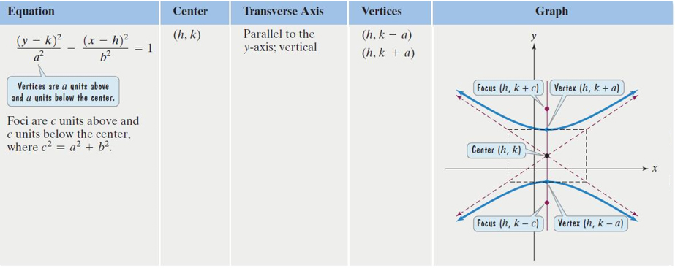
Translations of Hyperbolas − Standard Forms of Equations of Hyperbolas Centered at (h, k) (2 of 2)

Slide 24
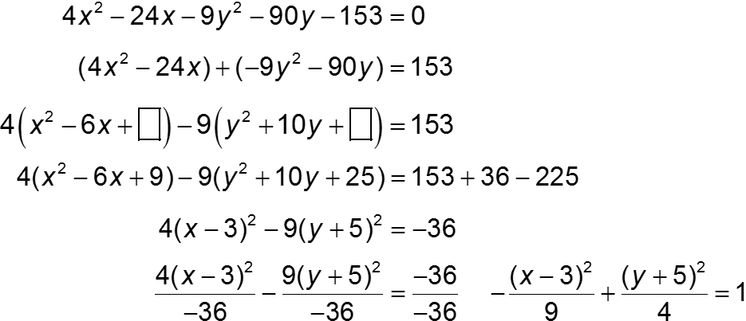
Example: Graphing a Hyperbola Centered at (h, k) (1 of 11)
Solution: We begin by completing the square on x and y.

Slide 25
Example: Graphing a Hyperbola Centered at (h, k) (2 of 11)
The center of the graph is (3, −5).
Step 1 Locate the vertices.
The vertices are a units above and below the center.

Slide 26
Example: Graphing a Hyperbola Centered at (h, k) (3 of 11)
The center is (3, −5). The vertices are 2 units above and 2 units below the center.
2 units above (3, −5 + 2) = (3, −3)
2 units below (3, −5 − 2) = (3, −7)
The vertices are (3, −3) and (3, −7).

Slide 27
Example: Graphing a Hyperbola Centered at (h, k) (4 of 11)
Step 2 Draw a rectangle.
The rectangle passes through points that are 2 units above and below the center - these points are the vertices, (3, −3) and (3, −7). The rectangle passes through points that are 3 units to the right and left of the center.
3 units right (3 + 3, −5) = (6, −5)
3 units left (3 − 3, −5) = (0, −5)

Slide 28
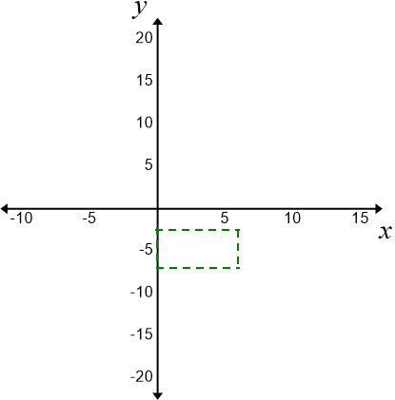
Example: Graphing a Hyperbola Centered at (h, k) (5 of 11)
The rectangle passes through (3, −3), (3, −7), (0, −5), and (6, −5).

Slide 29
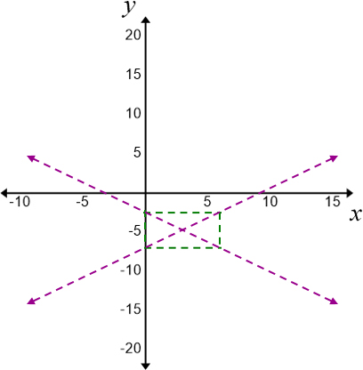
Example: Graphing a Hyperbola Centered at (h, k) (6 of 11)
Step 3 Draw extended diagonals of the rectangle to obtain the asymptotes.

Slide 30
Example: Graphing a Hyperbola Centered at (h, k) (7 of 11)
The asymptotes for the unshifted hyperbola are
The asymptotes for the shifted hyperbola are

Slide 31
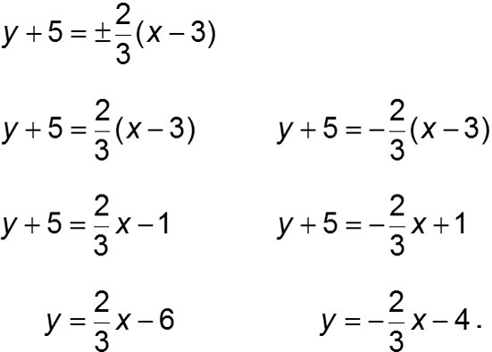
Example: Graphing a Hyperbola Centered at (h, k) (8 of 11)
The asymptotes for the shifted hyperbola are

Slide 32
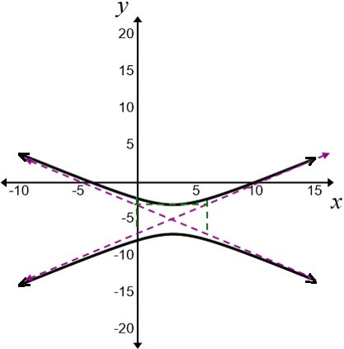
Example: Graphing a Hyperbola Centered at (h, k) (9 of 11)
Step 4 Draw the two branches of the hyperbola by starting at each vertex and approaching the asymptotes.

Slide 33
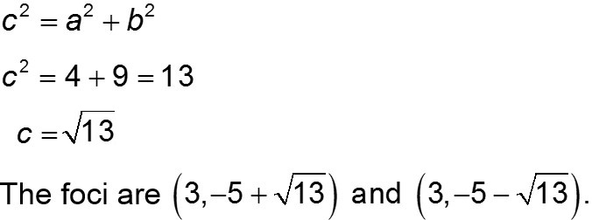
Example: Graphing a Hyperbola Centered at (h, k) (10 of 11)
The foci are at (3, −5 − c) and (3, −5 + c).

Slide 34
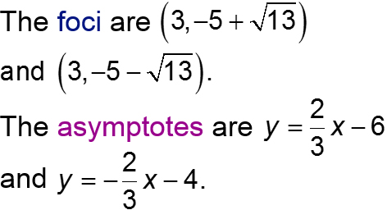
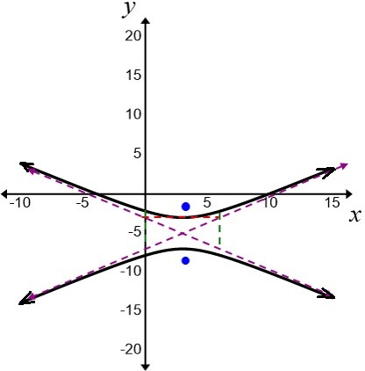
Example: Graphing a Hyperbola Centered at (h, k) (11 of 11)
The vertices are (3, −3) and (3, −7).
The center is (3, −5).

Slide 35
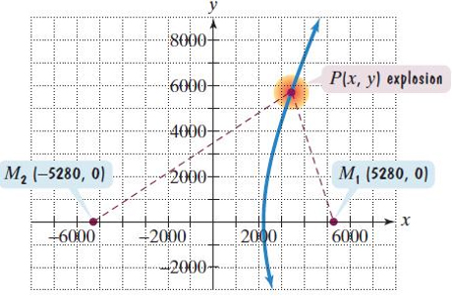
Example: An Application Involving Hyperbolas (1 of 4)
An explosion is recorded by two microphones that are 2 miles apart. Microphone M₁ receives the sound 3 seconds before microphone M₂. Assuming sound travels at 1100 feet per second, determine the possible locations of the explosion relative to the location of the microphones.
Solution:
We begin by putting the microphones in a coordinate system.

Slide 36
Example: An Application Involving Hyperbolas (2 of 4)
We know that M₁ received the sound 3 seconds before M₂. Because sound travels at 1100 feet per second, the difference between the distance from P to M₁ and the distance from P to M₂ is 3300 feet. The set of all points P (or locations of the explosion) satisfying these conditions fits the definition of a hyperbola, with microphones M₁ and M₂ at the foci.

Slide 37
Example: An Application Involving Hyperbolas (3 of 4)
We will use the standard form of the hyperbola’s equation. P(x, y), the explosion point, lies on this hyperbola.
The differences between the distances is 3300 feet. Thus, 2a = 3300 and a = 1650.

Slide 38
Example: An Application Involving Hyperbolas (4 of 4)
The distance from the center, (0, 0), to either focus, (−5280, 0) or (5280, 0), is 5280. Thus, c = 5280.
We can conclude that the explosion occurred somewhere on the right branch (the branch closer to M₁) of the hyperbola given by this equation.

