Slide 1
NAFTrack and Your Future
What’s in it for YOU
Mr. Dave Schmidt

Slide 2
Somebody Once Told Me

Slide 4
Why NAFTrack?
Helps make the connection between high school coursework and your future
Helps you reflect on your own learning in order to set goals for continuous improvement
Helps you gain proficiency in taking online assessments which are more prevalent in higher education
Helps you demonstrate the technical and professional skills you develop while in the academy
Provides connection to top companies that offer preferential hiring practices

Slide 6
This is NOT You…

Slide 7
NAFTrack Certification Benefits
What’s In It For Me?
Projects, exams, and internships will prepare you for college and career
Qualify for NAFTrack Certified Hiring

Slide 8
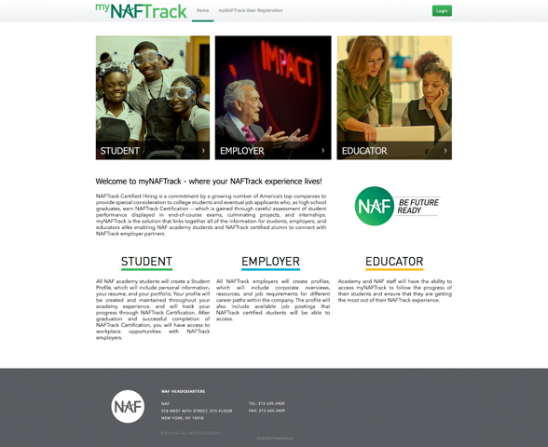

Slide 10
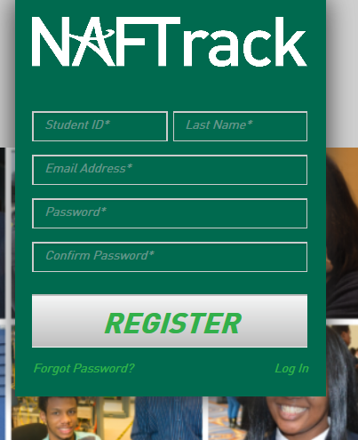
They then need to fill out the registration page using the student ID# from NAFTrack Certification. They only do this once.

Slide 13
NAFTrack Certification Requirements
An online professional network connecting:
NAF students
Alumni
NAFTrack Certified Hiring employers

Slide 14
myNAFTrack Benefits
Student & Alumni
Build a professional online profile and portfolio to easily showcase work to employers
Access to a wide range of potential internship and job opportunities
Access to a library of career resources

Slide 17
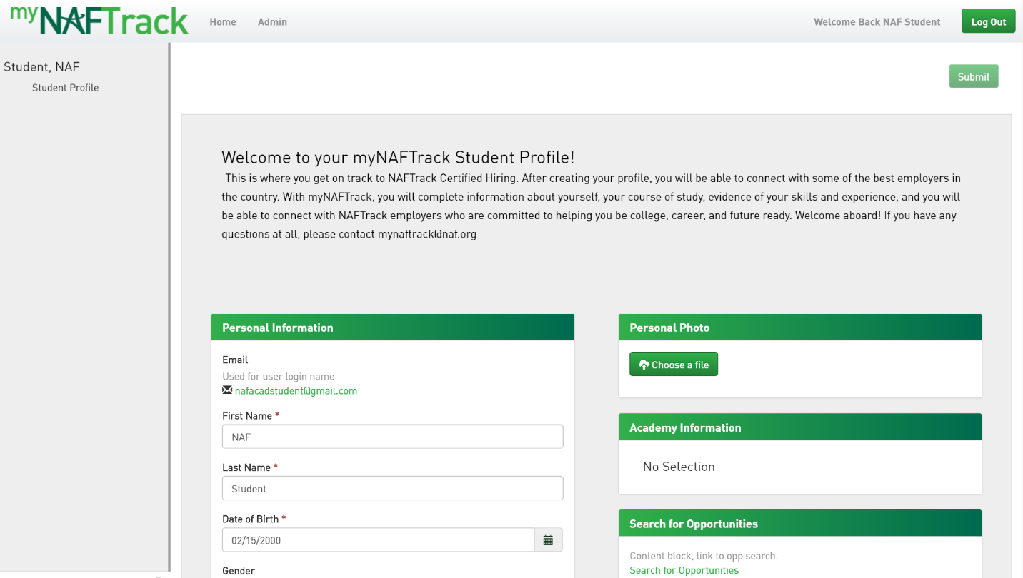
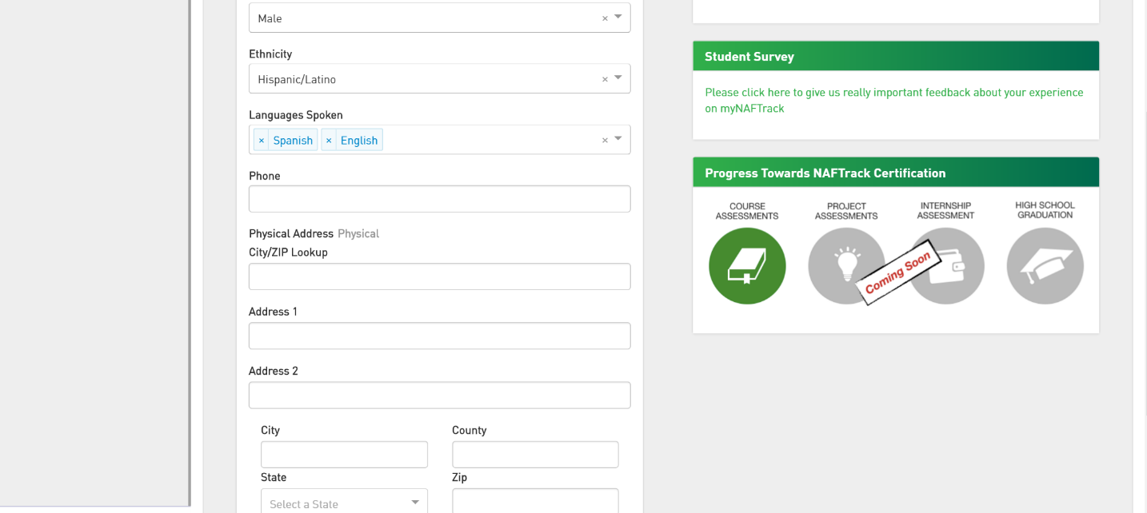

Slide 18
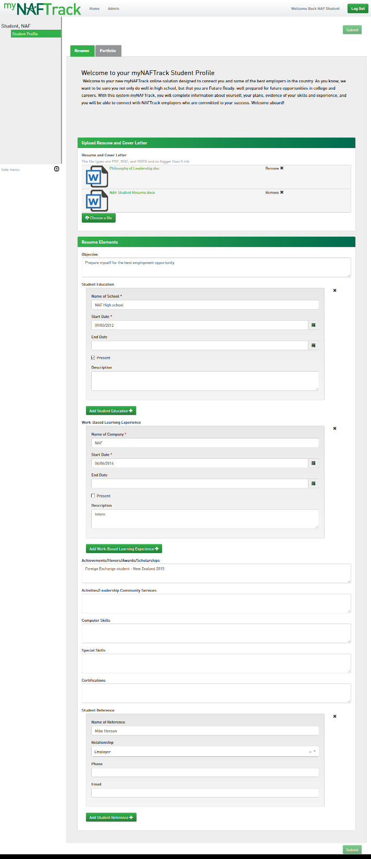

Slide 19
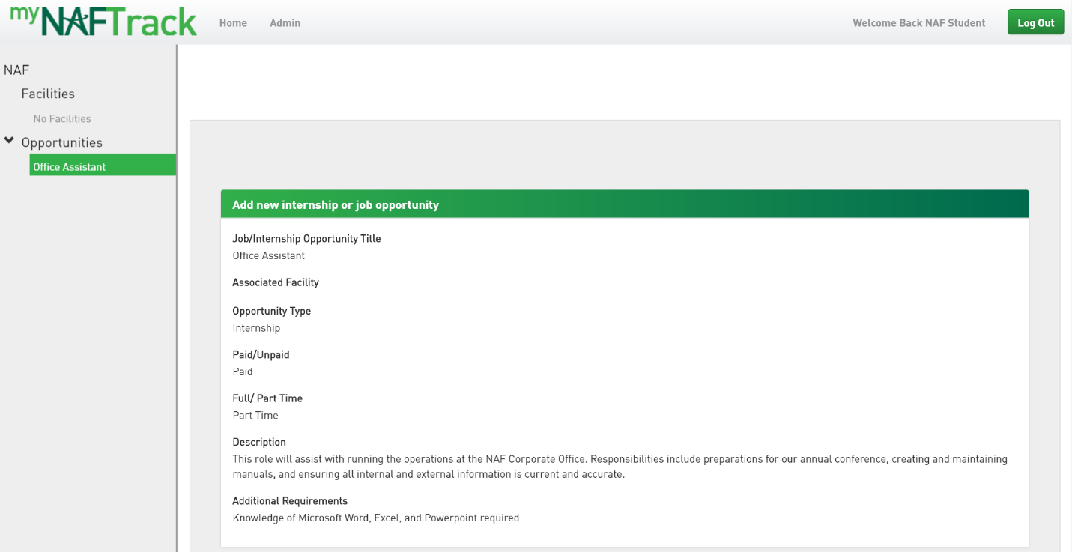

Slide 20
