Slide 1
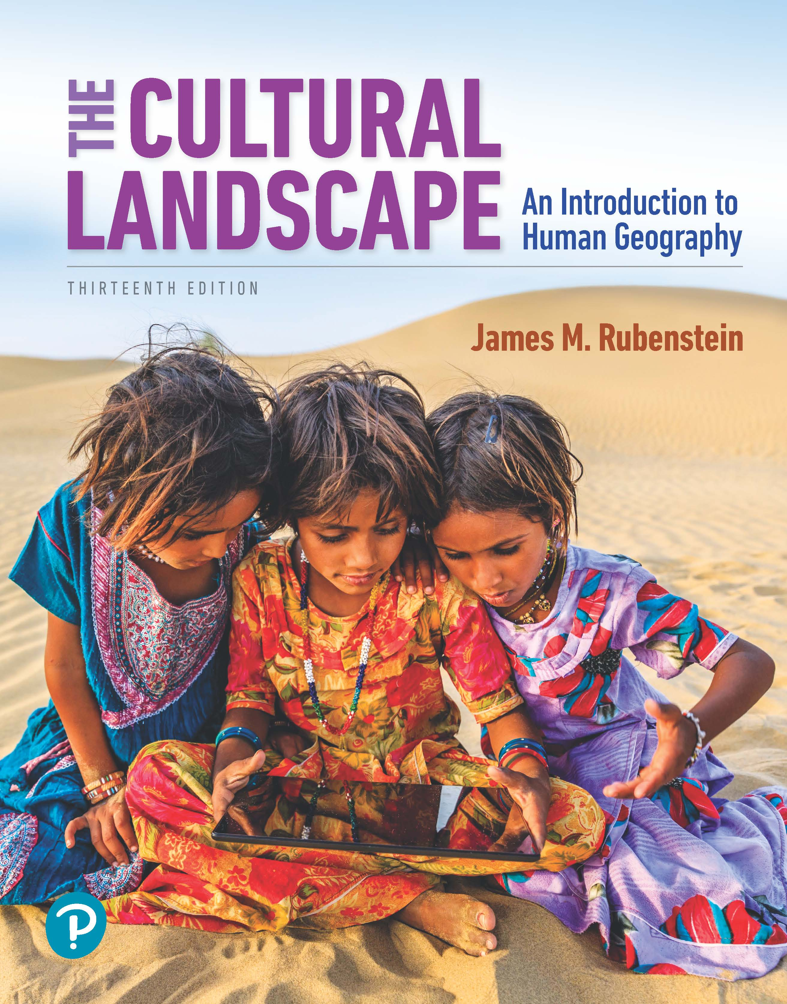
The Cultural Landscape: An Introduction to Human Geography
Thirteenth Edition
Chapter 7 Lecture
Ethnicities
Copyright © 2020 Pearson Education, Inc. All Rights Reserved
Notes:
If this PowerPoint presentation contains mathematical equations, you may need to check that your computer has the following installed:
1) MathType Plugin
2) Math Player (free versions available)
3) NVDA Reader (free versions available)

Slide 2
Ethnicities: Key Issues
7.1 Where Are Ethnicities Distributed?
7.2 Why Do Ethnicities Have Distinctive Distributions?
7.3 Why Might Ethnicities Face Conflicts?
7.4 Why Do Ethnic Cleansing and Genocide Occur?

Slide 3
Key Issue 1: Where Are Ethnicities Distributed?
7.1.1 Ethnicities and Geography
7.1.2 Classifying Race and Ethnicity in the United States
7.1.3 Distribution of U.S. Ethnicities
7.1.4 Ethnically Complex Brazil
7.1.5 Ethnic Enclaves

Slide 4
7.1.1 Ethnicities and Geography (1 of 3)
Ethnicity: identity with group sharing cultural traditions of homeland or hearth
Race: identity with group perceived to share physiological trait like skin color
Nationality: identity with group sharing legal attachment to a particular country

Slide 5
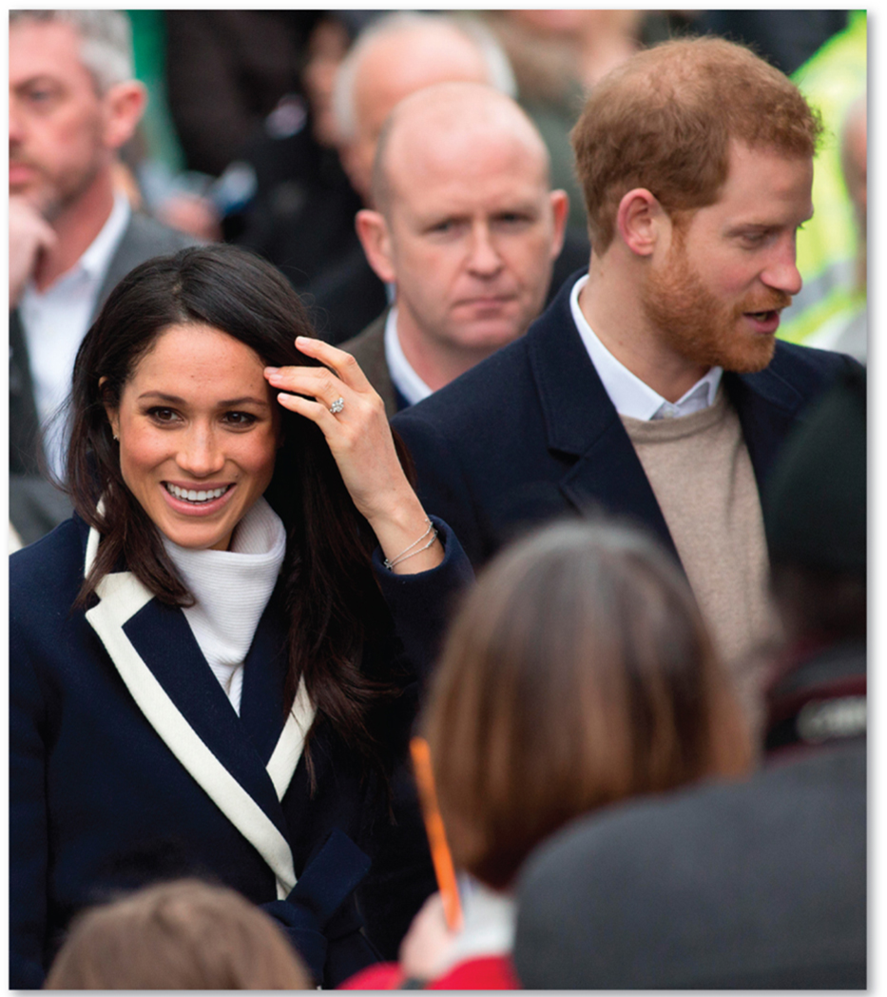
7.1.1 Ethnicities and Geography (2 of 3)
Figure 7-1: The Duchess of Sussex (Meghan Markle) illustrates the complexity of designating ethnicity, race, and nationality.

Slide 6
7.1.1 Ethnicities and Geography (3 of 3)
Figure 7-2: Trevor Noah is the product of a mother of South African nationality, black race, and Xhosa ethnicity and a father of Swiss nationality, white race, and Swiss German ethnicity.

Slide 7
7.1.2 Classifying Race and Ethnicity in the United States (1 of 3)
The U.S. Census reflects the complicated nature of racial and ethnic identity. The census classifies people into the following races:
White
African-American
American Indian or Alaska Native
Asian
Native Hawaiian or Pacific Islander

Slide 8
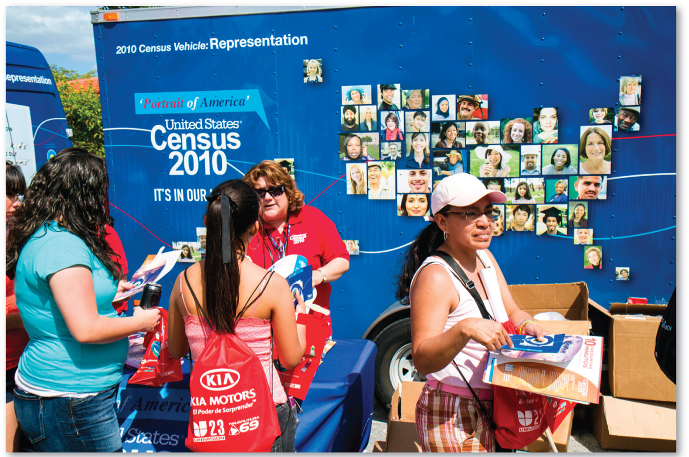
7.1.2 Classifying Race and Ethnicity in the United States (2 of 3)
Figure 7-3: Information outreach on the U.S. Census.

Slide 9
7.1.2 Classifying Race and Ethnicity in the United States (3 of 3)
Table 7-1: The table displays changes over time in the identification of “white” and “black” Americans.

Slide 10
7.1.3 Distribution of U.S. Ethnicities (1 of 6)
The three most numerous U.S. ethnicities are Hispanic American, African American, and Asian American
Hispanic American: 17%
African American: 12%
Asian American: 5%
American Indian, Native Hawaiian, or Alaska Native: 2%

Slide 11
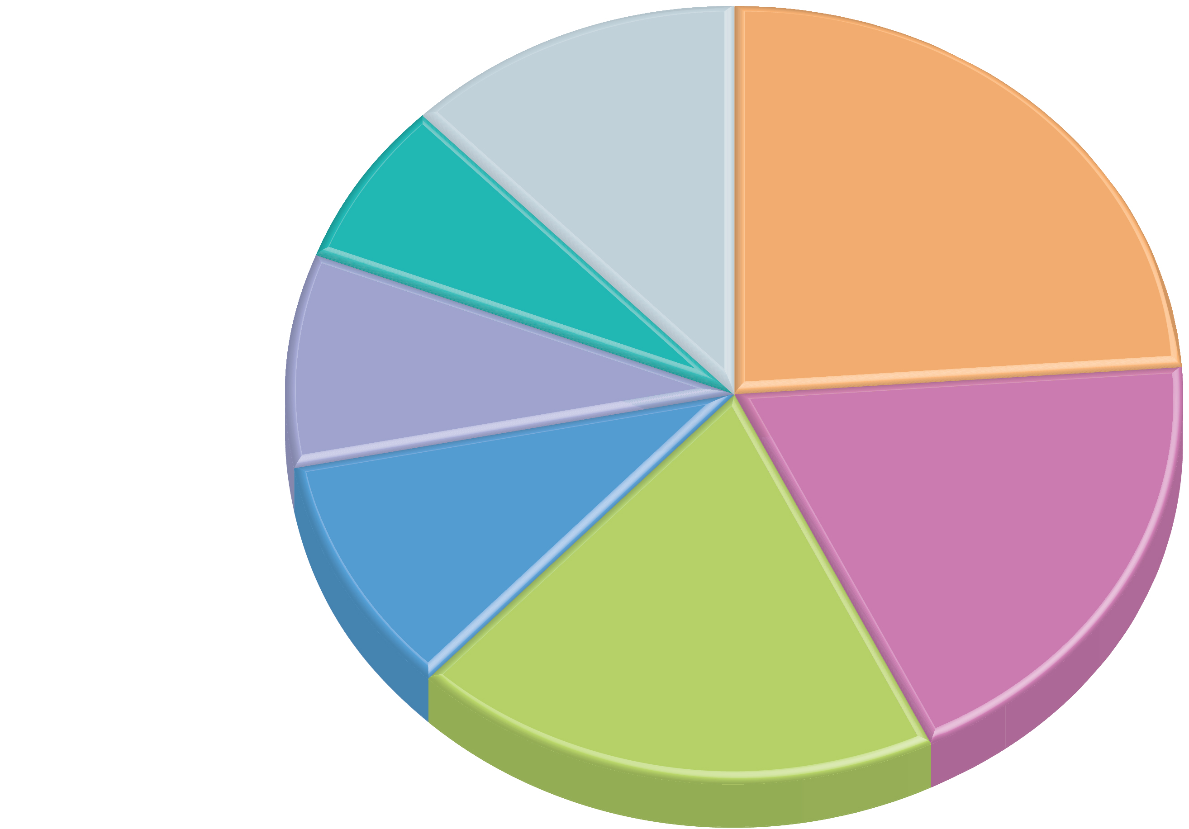
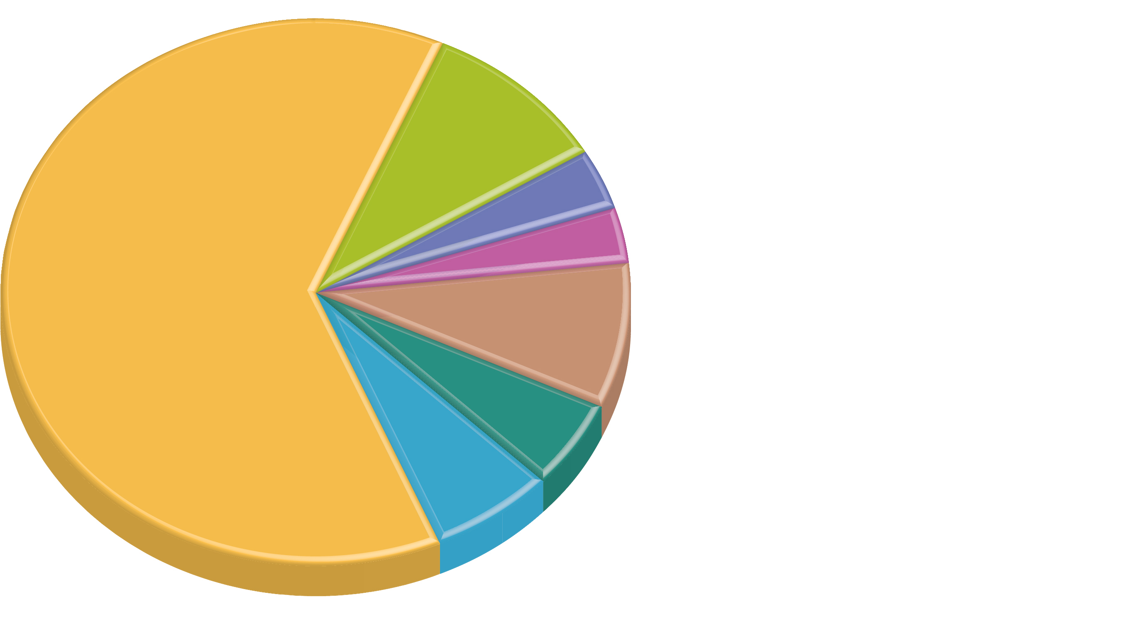
7.1.3 Distribution of U.S. Ethnicities (2 of 6)
Figures 7-5 and 7-7: Country of origin for Hispanic Americans (left) and Asian Americans (right).
Puerto Rico
12%
Japan
24%
9.5%
3.7%
Cuba
7%
other
Dominican
Republic
China
63.3%
3.3%
Korea
9%
Mexico
8.6%
19%
Central America
10%
19%
India
5.4%
South America
Vietnam
Philippines
6.2%
other Caribbean

Slide 12
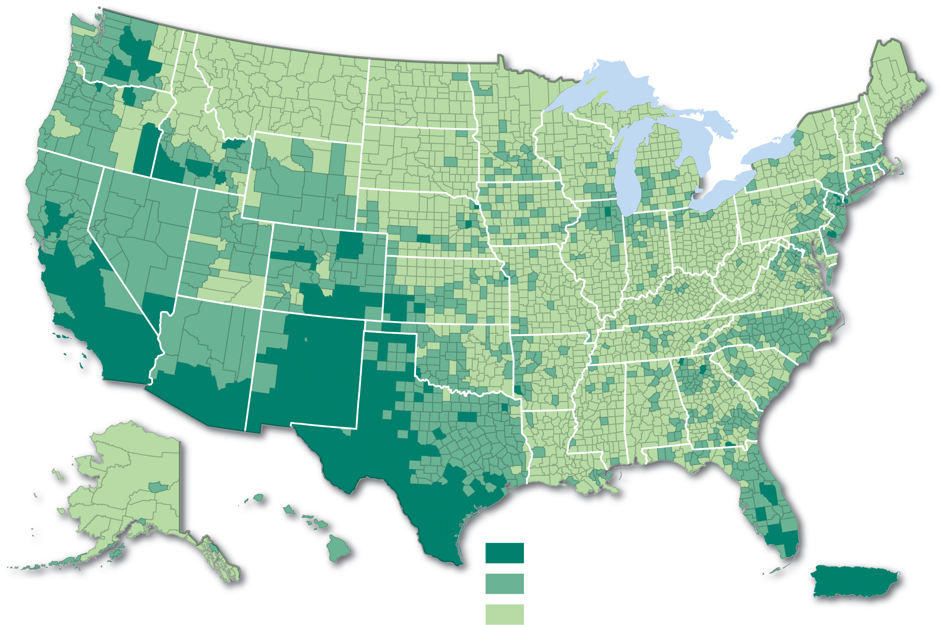
7.1.3 Distribution of U.S. Ethnicities (3 of 6)
Figure 7-6: Hispanics are clustered in the Southwest.
Percent Hispanic or Latino
25.0 and above
5.0–24.9
below 5.0

Slide 13
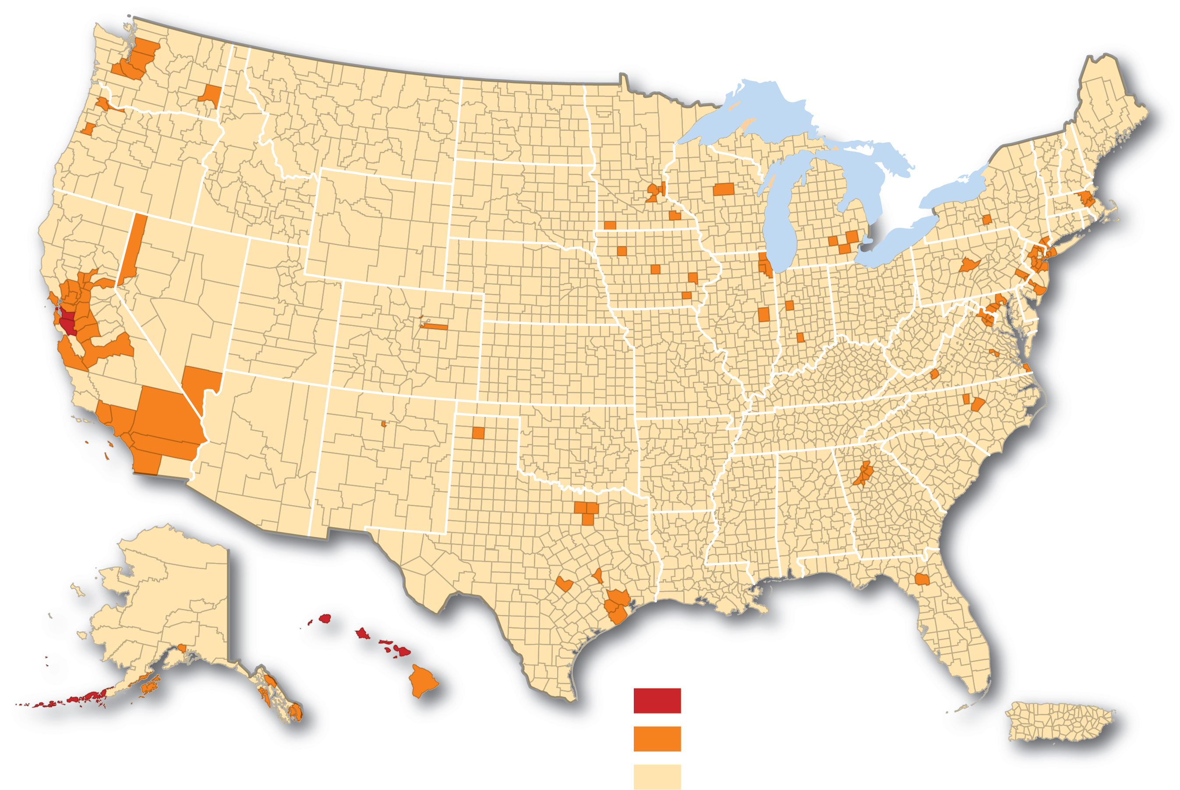
7.1.3 Distribution of U.S. Ethnicities (4 of 6)
Figure 7-8: Asian Americans are clustered in the West.
Percent Asian American
25.0 and above
5.0–24.9
below 5.0

Slide 14
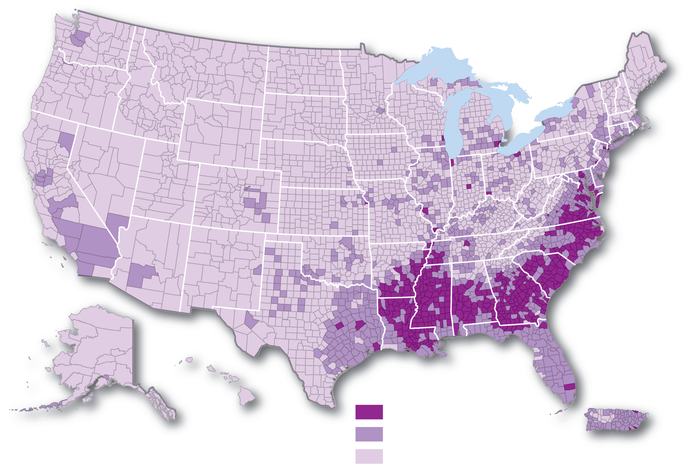
7.1.3 Distribution of U.S. Ethnicities (5 of 6)
Figure 7-9: African Americans are clustered in the Southeast.
Percent African American
25.0 and above
5.0–24.9
below 5.0

Slide 15
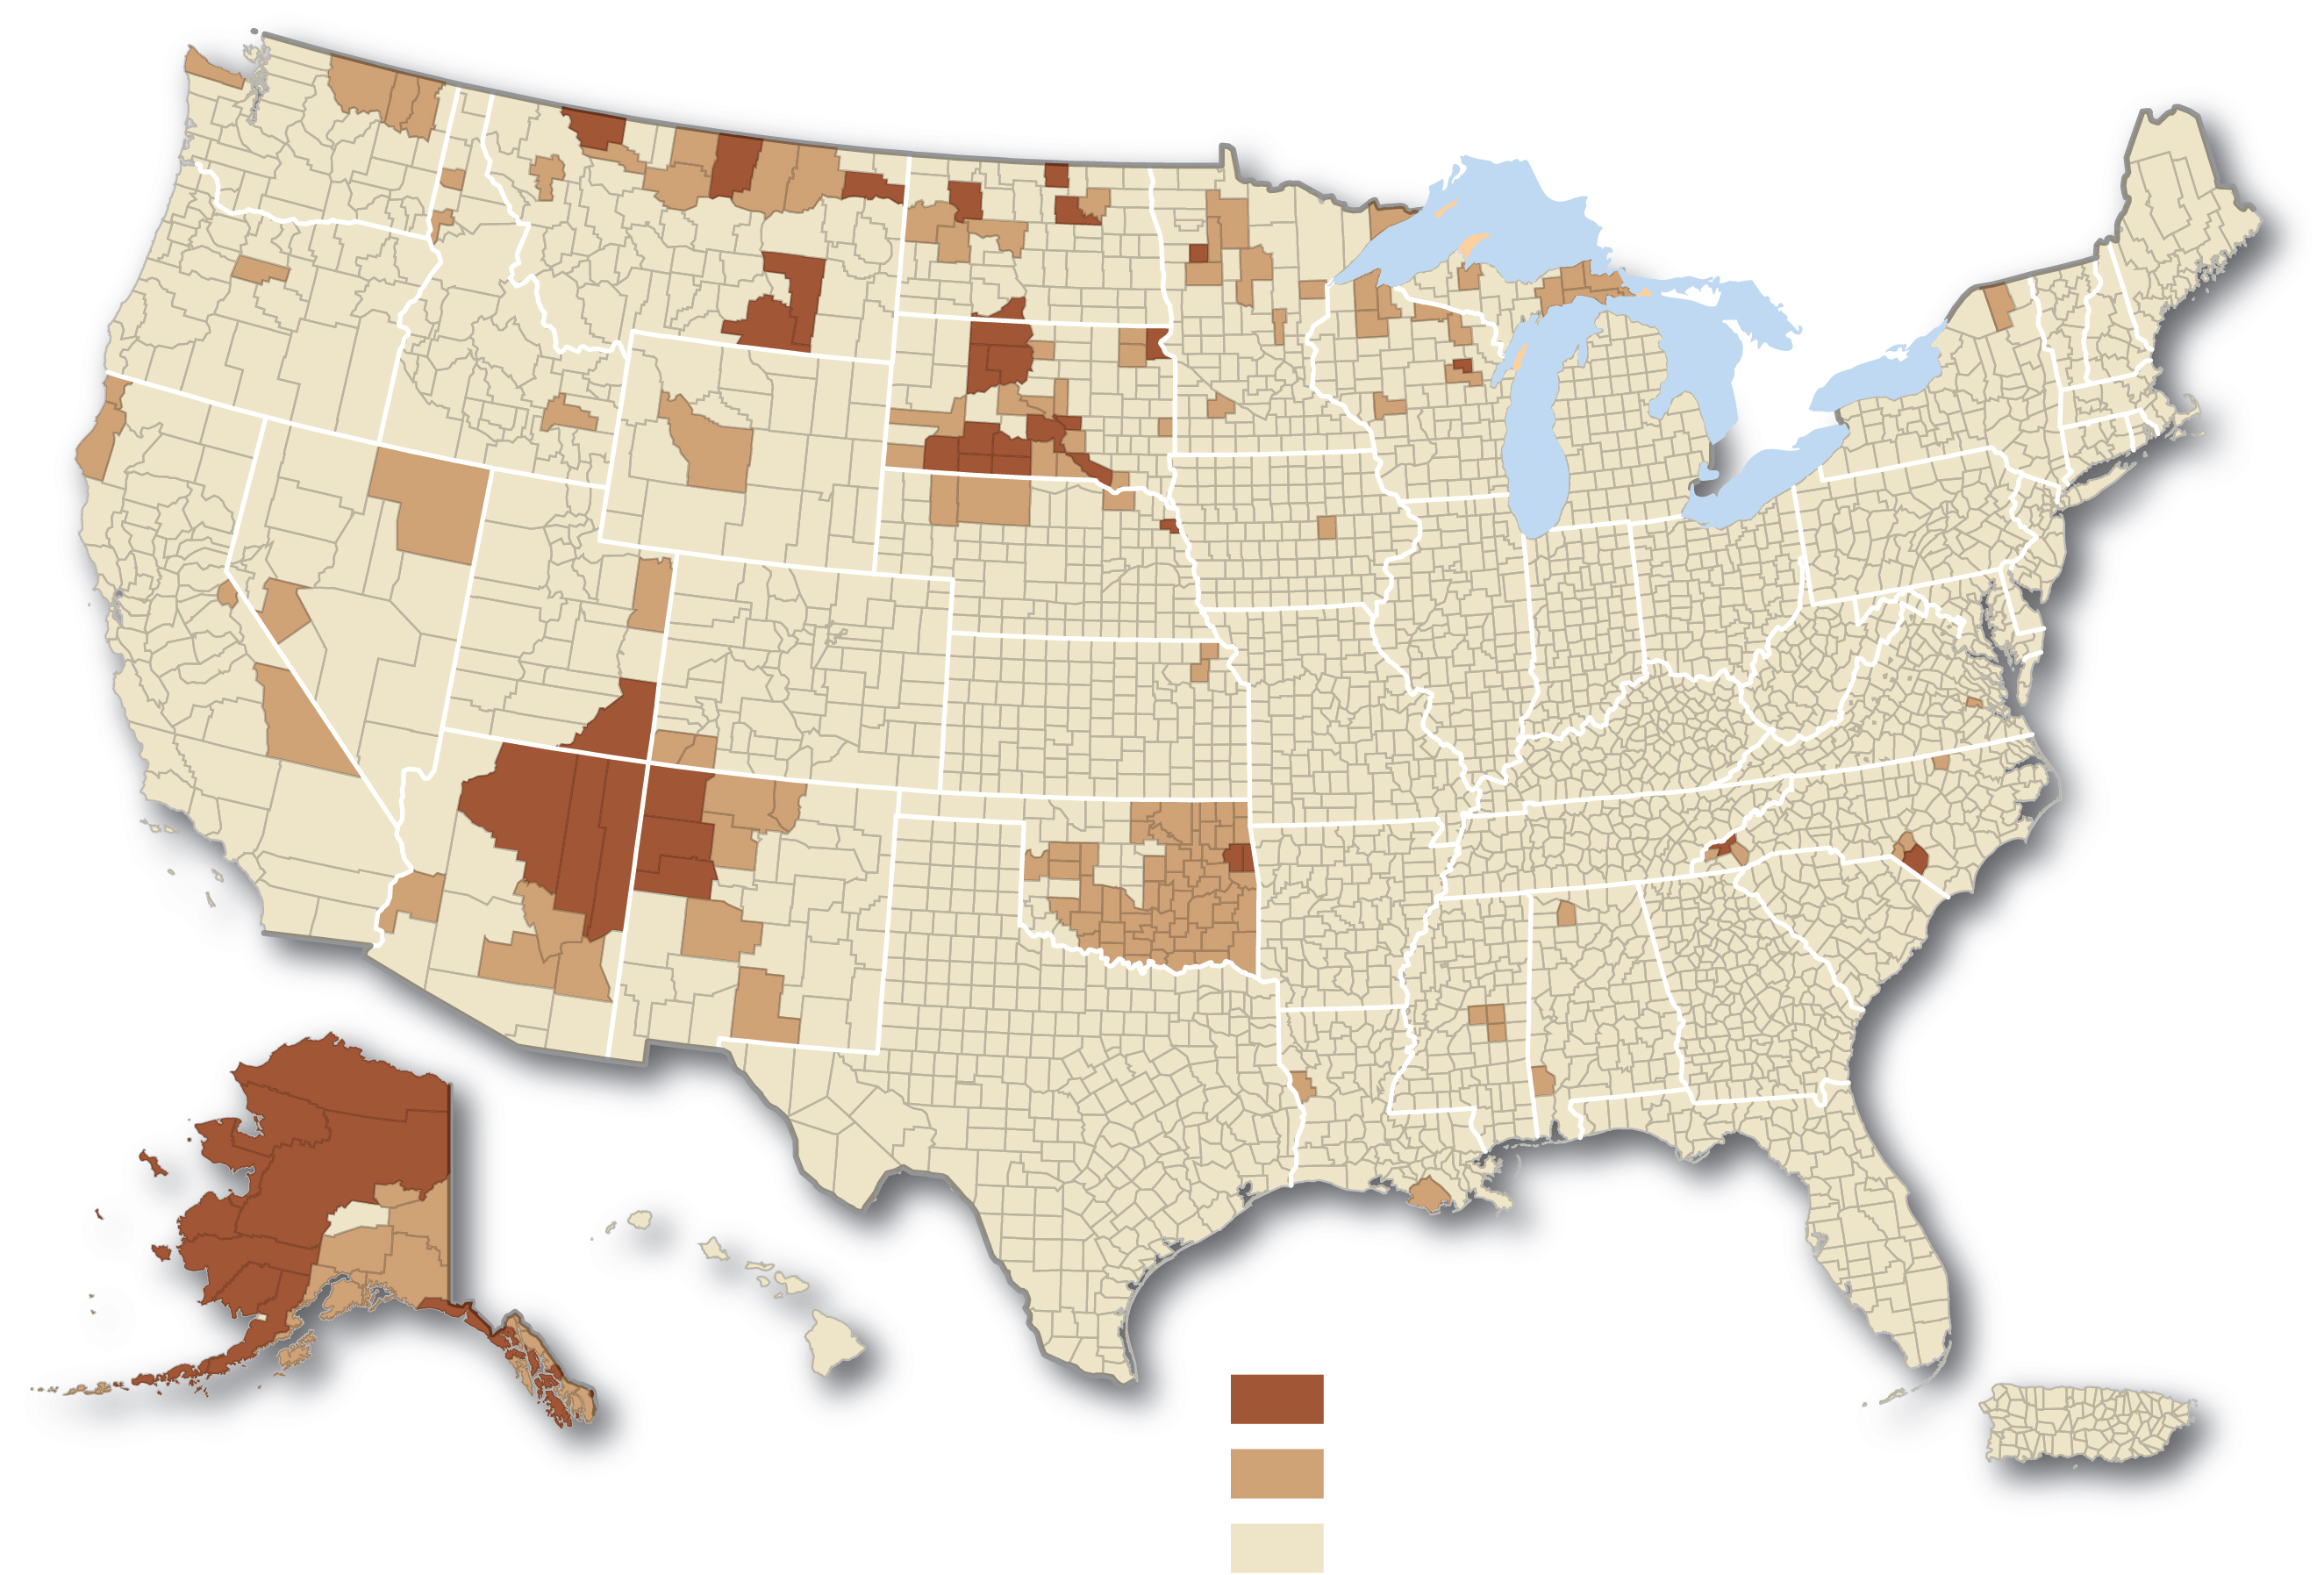
7.1.3 Distribution of U.S. Ethnicities (6 of 6)
Figure 7-10: Native Americans are clustered in the Southwest and north-central states.
Percent American Indian
25.0 and above
5.0–24.9
below 5.0

Slide 16
7.1.4 Ethnically Complex Brazil (1 of 5)
Brazil’s census classifies people according to skin color
branco (white): 47.7%
pardo (brown): 43.1%
preto (black): 7.6%
amarelo (yellow): 1.1%
Southern Brazil has a larger share of the branco population, while northern Brazil is dominated by pardos and pretos

Slide 17
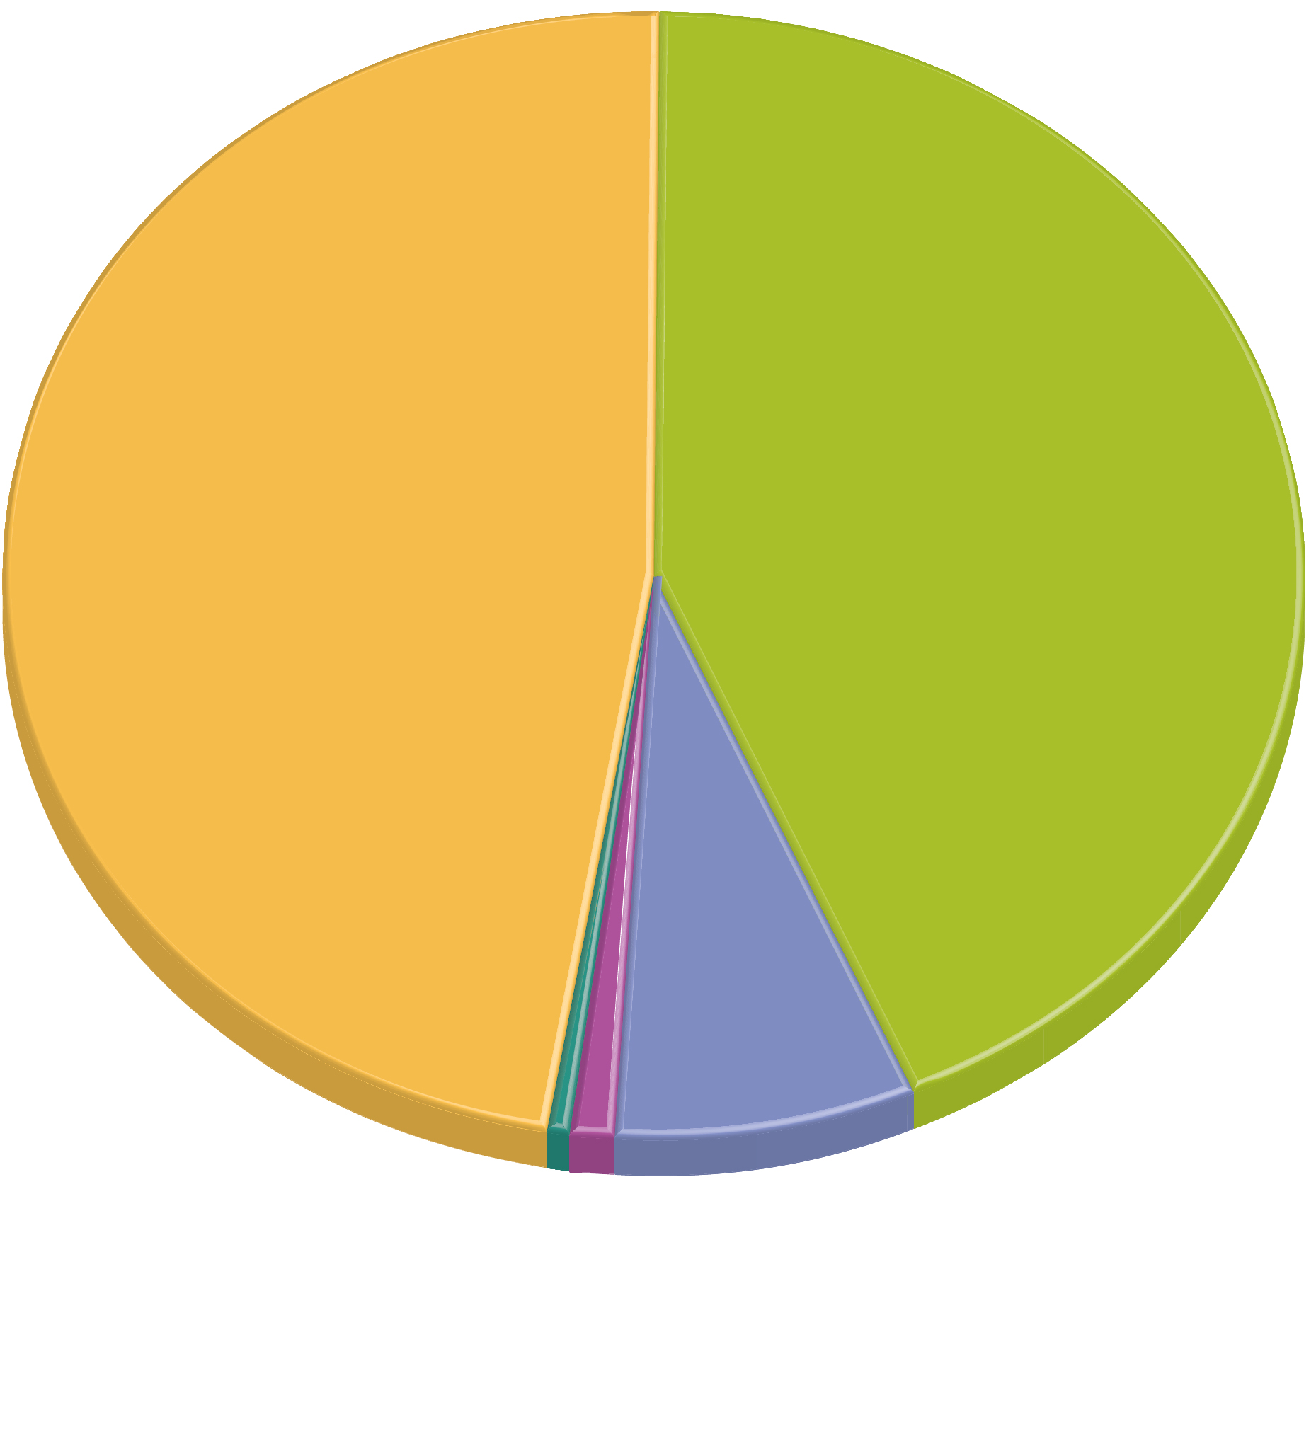
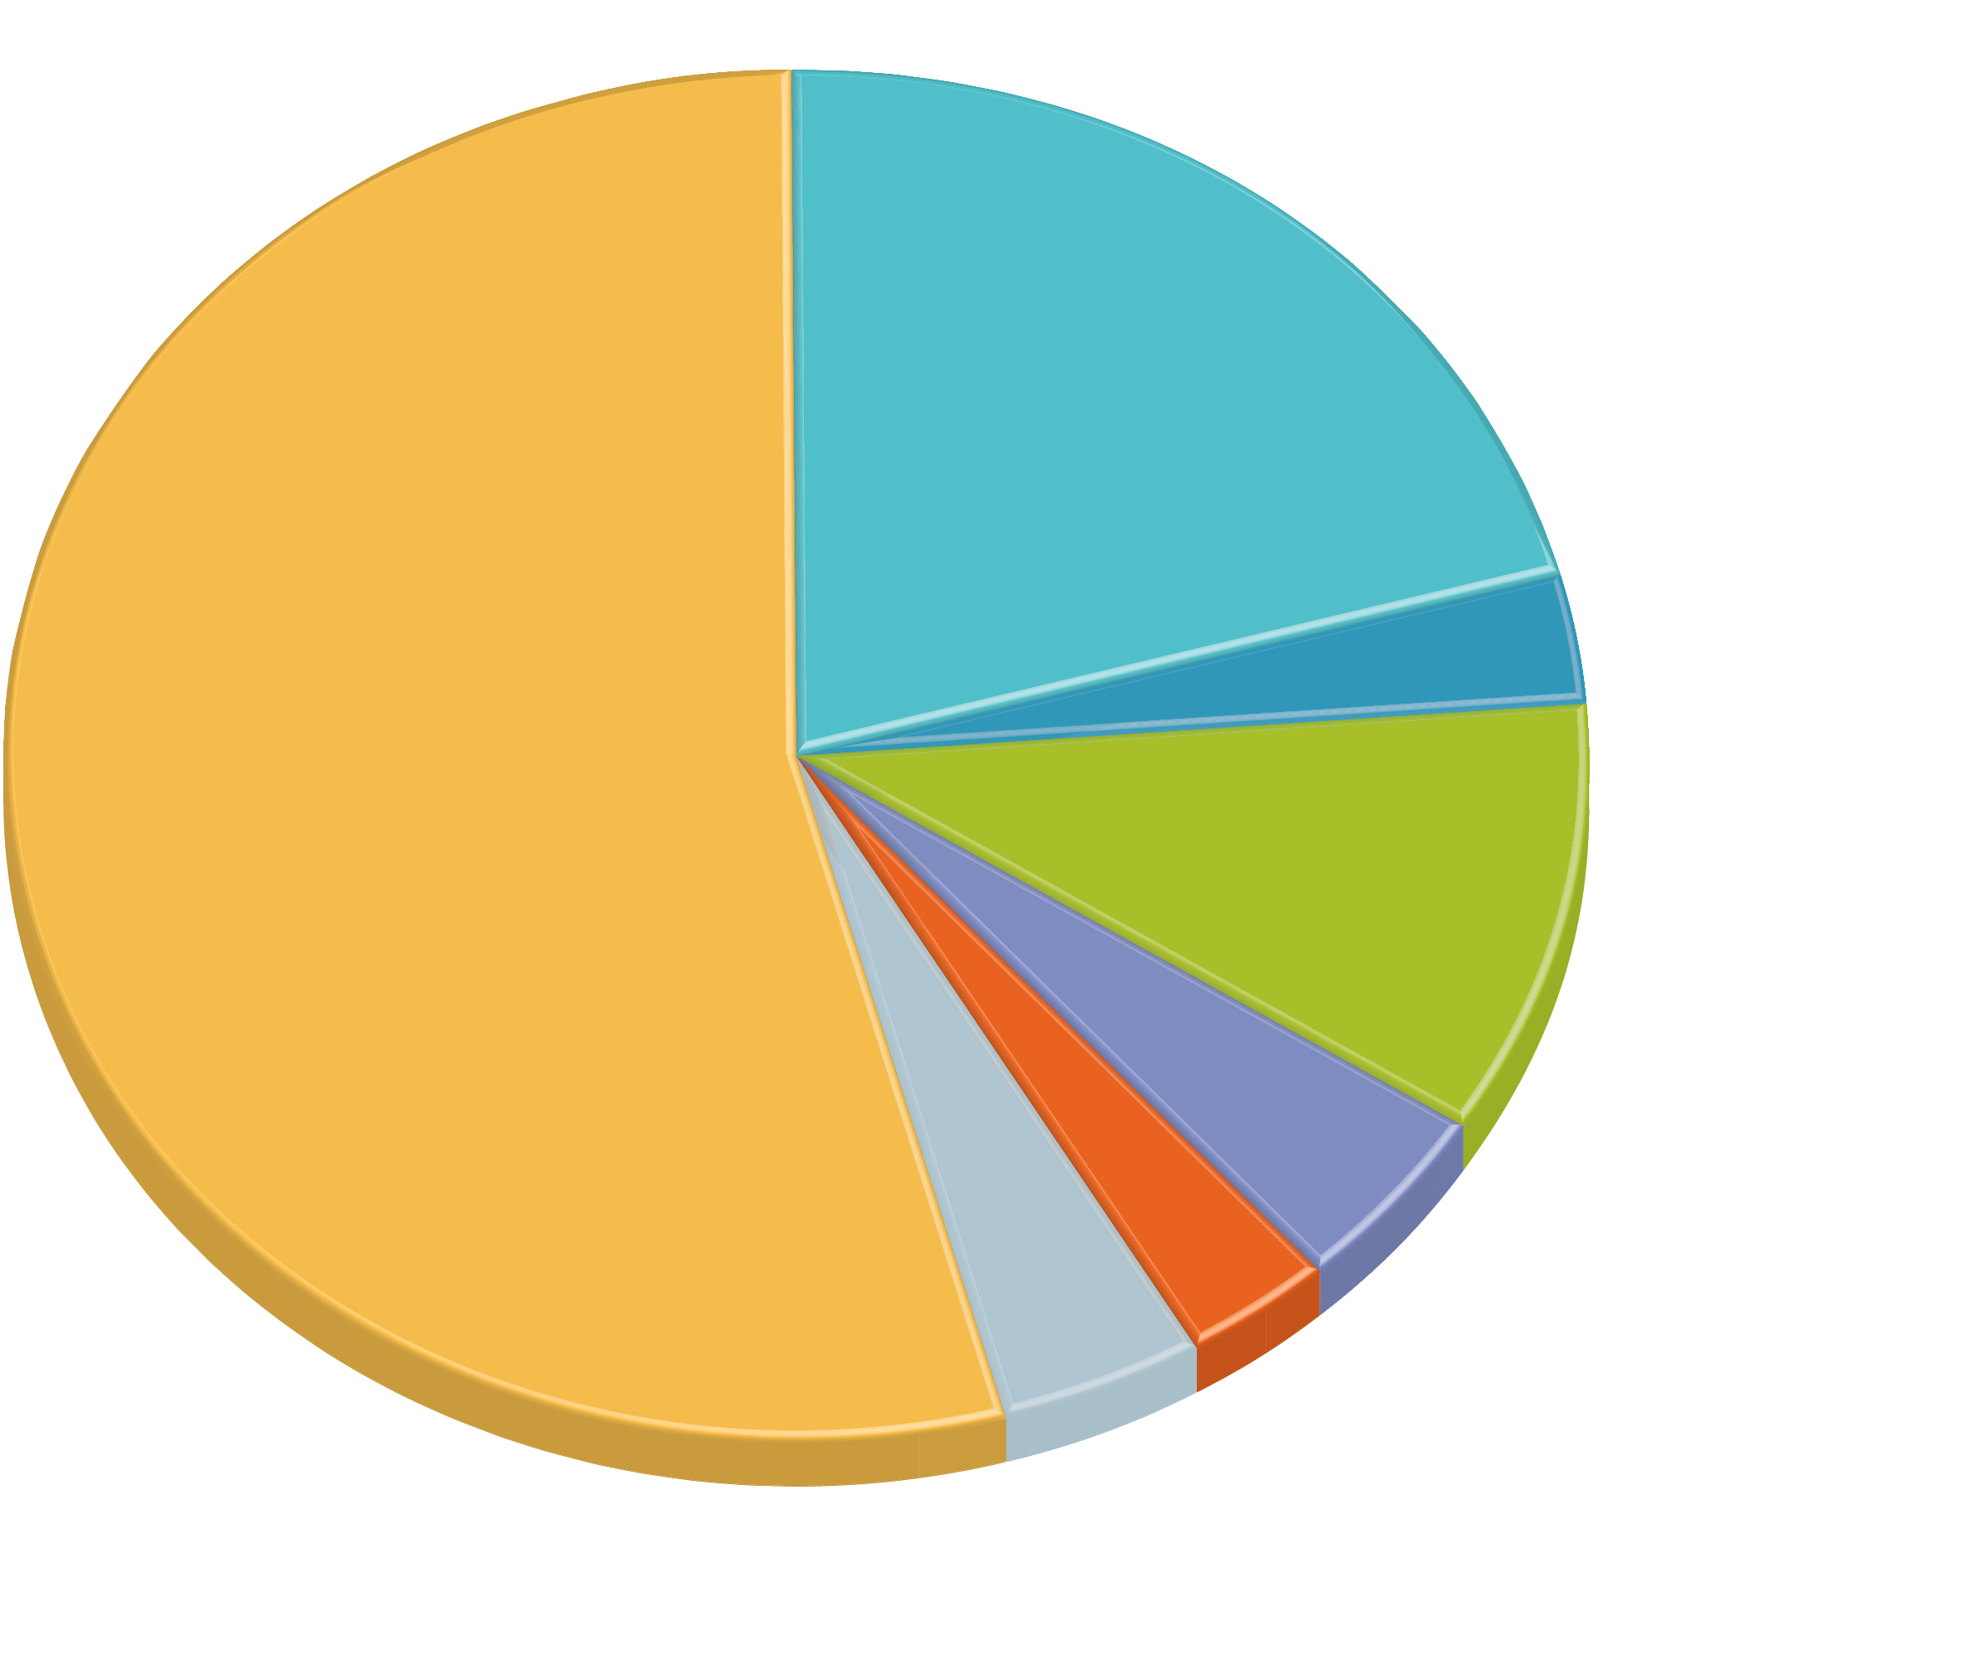
7.1.4 Ethnically Complex Brazil (2 of 5)
Figures 7-12 and 7-13: The Brazilian census, which limits the choice of race categories (left), differs from an independent survey where respondents could write their own race in (right).
2.9%
Moreno claro
(light brunettes)
10.4%
Moreno
(brunettes
or olives)
47.7%
43.1%
Brancos
(whites)
Pardos
(browns)
54.3%
Brancos
(whites)
10.4%
Pardos
(browns)
4.3%
Pretos
(blacks)
7.6%
3.1%
Negros
(blacks)
4.1%
Pretos (blacks)
others combined
1.1%
Amarelos (yellows)
0.4%
Indigenous

Slide 18
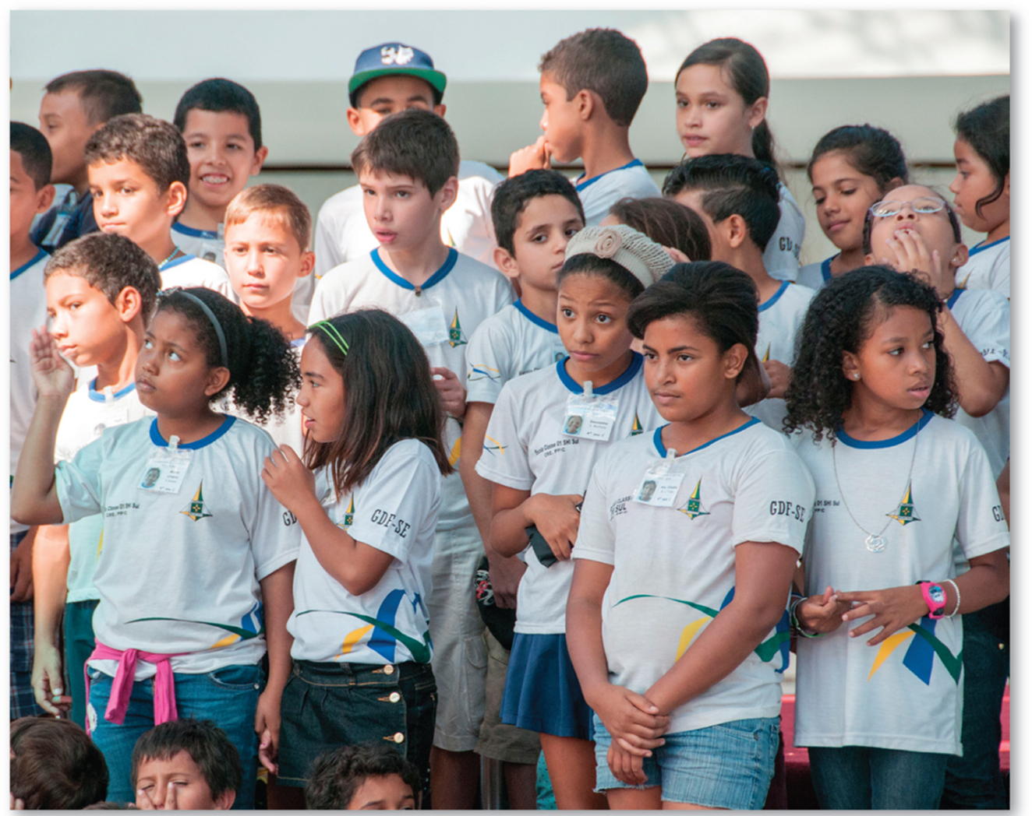
7.1.4 Ethnically Complex Brazil (3 of 5)
Figure 7-14: Brazil is a multiracial and multiethnic society, as seen in this image of schoolchildren in the capital of Brasília.

Slide 19
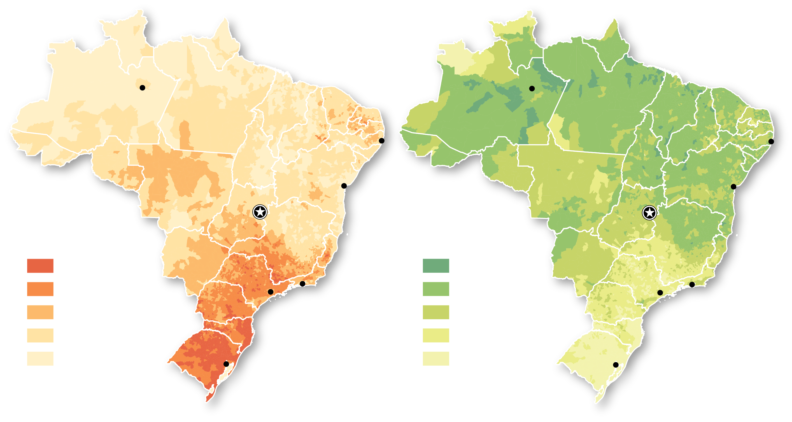
7.1.4 Ethnically Complex Brazil (4 of 5)
Figure 7-15: Northern Brazil is majority brown (pardo); the south is majority white (branco).
Manaus
Manaus
Recife
Recife
Salvador
Salvador
Percent branco
(white)
Brasília
Percent pardo
(brown/mixed)
Brasília
80 and above
Rio de
Janeiro
80 and above
Rio de
Janeiro
60–79.9
São Paulo
60–79.9
São Paulo
40–59.9
40–59.9
20–39.9
20–39.9
below 20
Porto Alegre
below 20
Porto Alegre
(a)
(b)

Slide 20
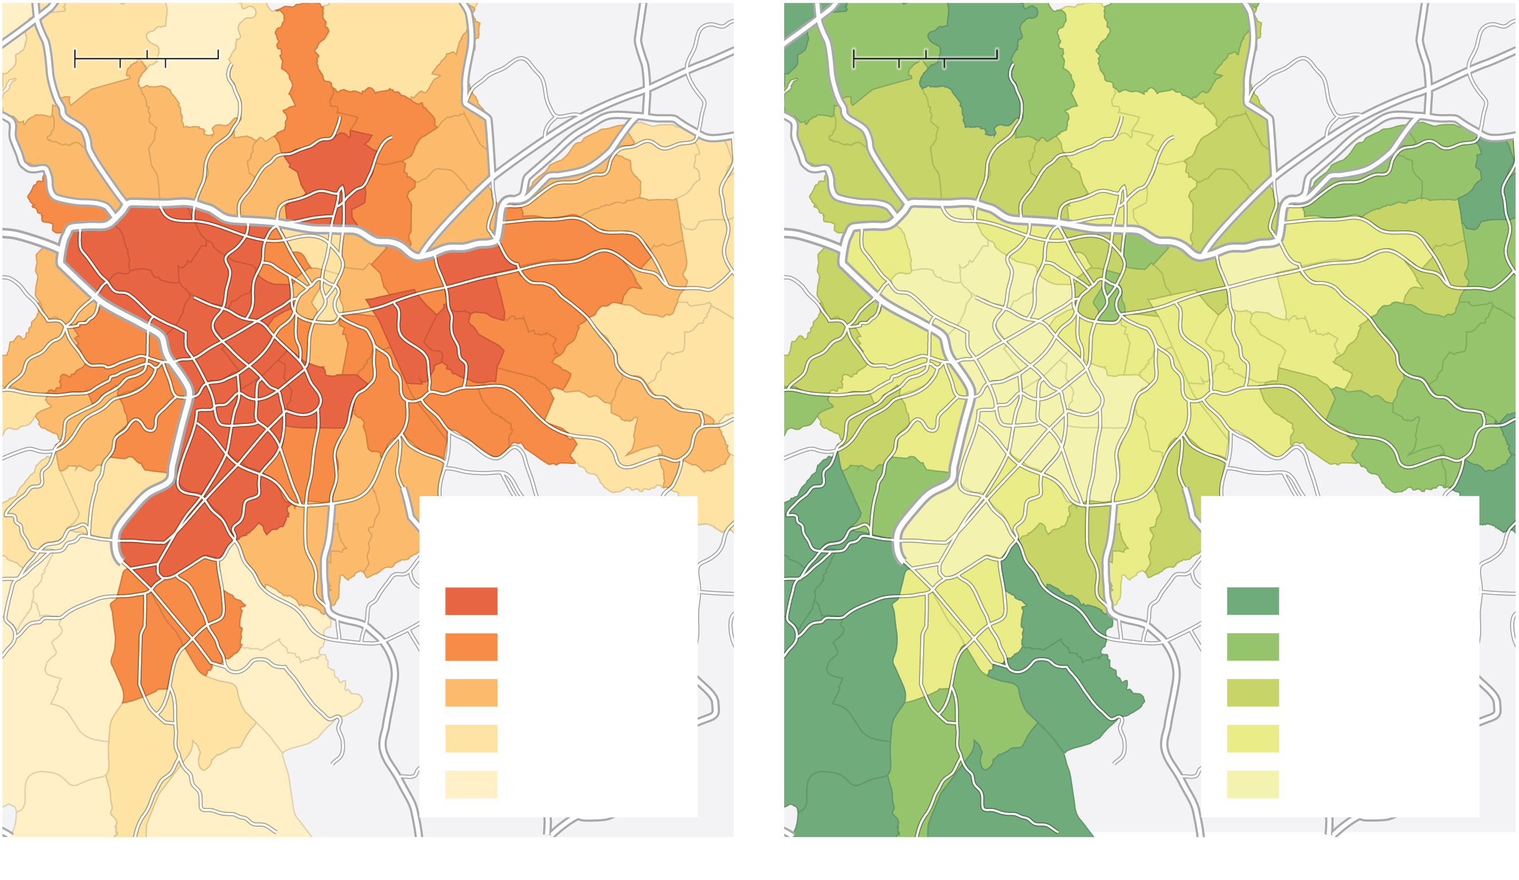
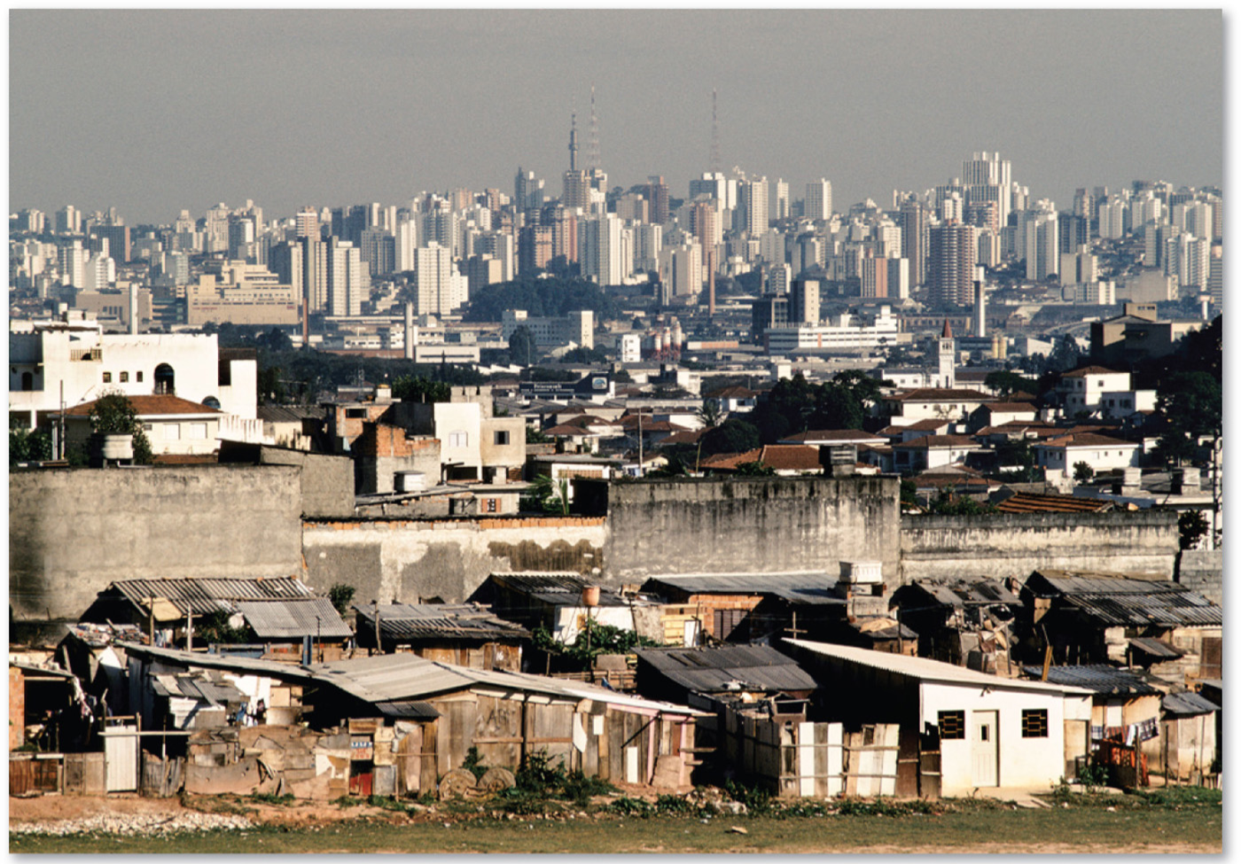
7.1.4 Ethnically Complex Brazil (5 of 5)
Figures 7-16 and 7-17: São Paulo shows a pattern common throughout urban Brazil. Whites (brancos) reside in the wealthier city center, while browns (pardos) reside in the poorer outskirts of the city. Photo (right) shows the juxtaposition of wealthy housing and poor-quality suburban housing.
0
2
4 Miles
0
2
4 Miles
0
2
4 Kilometers
0
2
4 Kilometers
São Paulo
São Paulo
Percent branco
(white)
Percent pardo
(brown/mixed)
80 and above
40 and above
70–79.9
30–39.9
60–69.9
20–29.9
50–59.9
10–19.9
below 50
below 10
(a)
(b)

Slide 21
7.1.5 Ethnic Enclaves (1 of 5)
An ethnic enclave is a place with a high concentration of an ethnic group that is distinct from those in the surrounding area
Ethnic enclaves tend to be found in major cities like New York, Chicago, London, and Paris
An ethnoburb is a suburban area with a cluster of a particular ethnic population

Slide 22
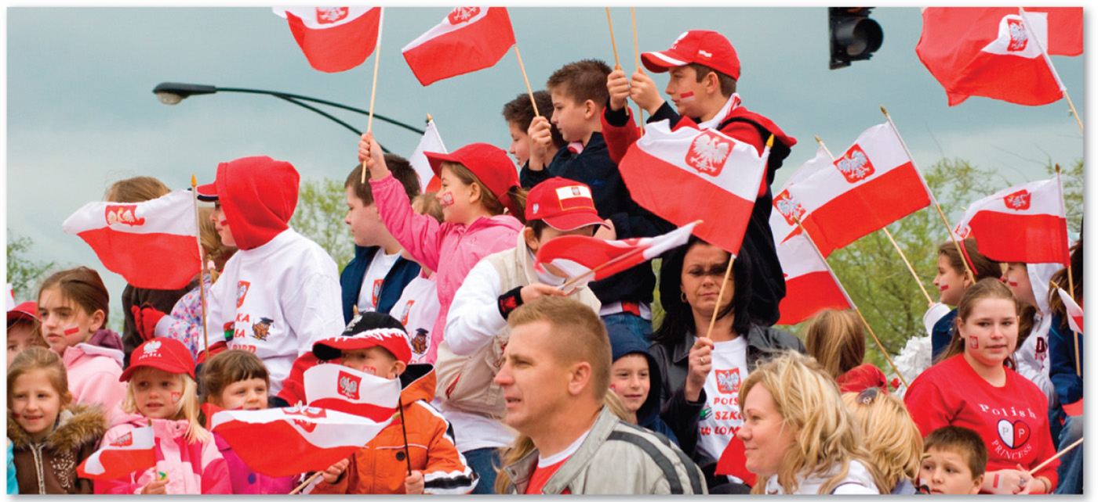
7.1.5 Ethnic Enclaves (2 of 5)
Figure 7-19: Chicago has the largest population of ethnic Poles outside Poland.

Slide 23
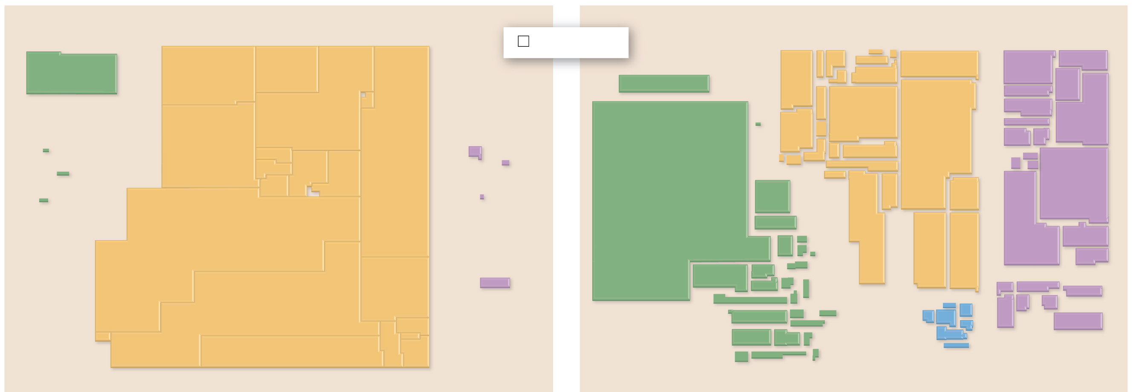
7.1.5 Ethnic Enclaves (3 of 5)
Figure 7-20: Cartograms reveal the changes in Chicago’s ethnic groups from 1910 to 1990.
1910
1,000 people
1990
Nor.
Swe.
Est.
Latvia
Fin.
U.S.S.R.
Japan
Canada
United
Kingdom
Norway
Canada
U.K.
Den.
Lith.
China
Taiwan
Neth.
Hong Kong
Finland
Germany
Vietnam
Korea
Ireland
Sweden
China
Bahamas
Ireland
Belg.
Poland
Laos
Camb.
Mexico
Belgium
Fr.
Sw.
Czech.
Thailand
Malaysia
Cuba
France
Holland
Japan
Por.
Spain
other
Eur.
Austria
Burma
Indonesia
Denmark
Russia
India
Mexico
Cuba
Hun.
Rom.
Philippines
other
Latin
America
Switzerland
Jamaica
Dom.
Rep.
Italy
Germany
Haiti
Trin.
Yugo.
Greece
India
Pakistan
Turkey
Belize
Barb.
Iran
Hungary
Guatemala
Hon.
Nic.
other
Turk.
Israel
El Salvador
Panama
Algeria
Jordan
Austria
Romania
Ven.
Costa Rica
Egypt
Leb.Syria
Spain
Colombia
Brazil
Guyana
Ghana
Eth.
other
Asian
Iraq
Italy
other
European
Bosnia/Serbia/
Montenegro
Ecuador
Peru
Bol.
Nigeria
Greece
Chile
Argentina
other
S. Am.
other Africa
South Africa
(a)
(b)

Slide 24
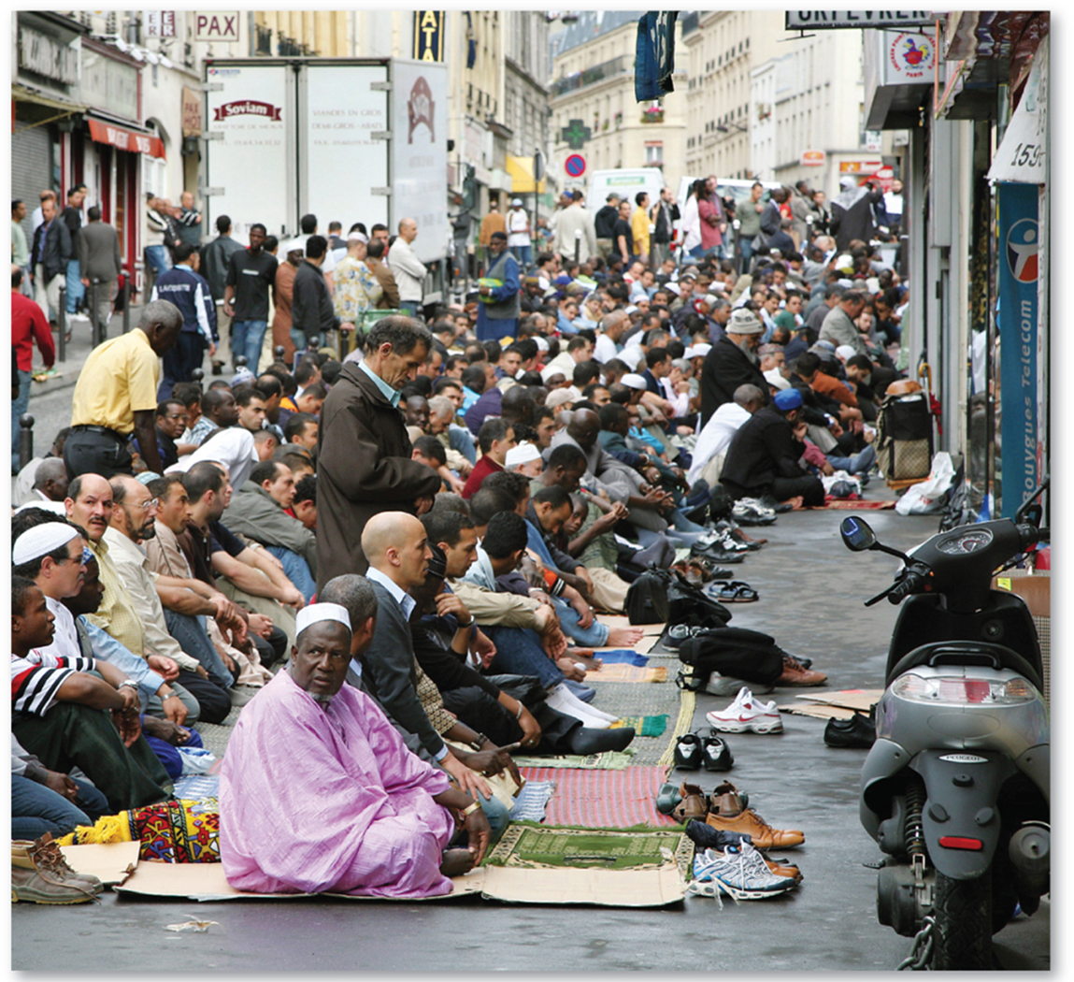
7.1.5 Ethnic Enclaves (4 of 5)
Figure 7-21: Muslim immigrants from Africa pray in the street in the Goutte d’Or neighborhood in Paris.

Slide 25
7.1.5 Ethnic Enclaves (5 of 5)
Figure 7-22: Bangladeshis (a), African (b), Caribbean (c), and Arab (d) ethnic enclaves in London.
London’s borough boundaries
are shown for reference.
Thames R.
Percent
Bangladeshi
70 and above
(a)
45–69.9
20–44.9
10–19.9
0
5
10 MIles
5–9.9
0
10 Kilometers
below 5
5
Thames R.
Percent
African
(b)
45 and above
20–44.9
10–19.9
5–9.9
below 5
Thames R.
(c)
Percent
Caribbean
20 and above
10–19.9
5–9.9
below 5
(d)
Percent
Arab
20 and above
10–19.9
5–9.9
below 5

Slide 26
Key Issue 2: Why Do Ethnicities Have Distinctive Distributions?
7.2.1 Forced Migration of Slaves from Africa
7.2.2 Internal Migration of African Americans
7.2.3 Ethnic and Racial Segregation
7.2.4 Dividing Ethnicities

Slide 27
7.2.1 Forced Migration of Slaves from Africa (1 of 4)
Slavery forced millions from Africa to South America, Caribbean, North America
The triangular slave trade sent slaves from Africa to the Americas, molasses from the Caribbean to North America and Europe, rum from North America to Europe, and cotton from Europe to Africa

Slide 28
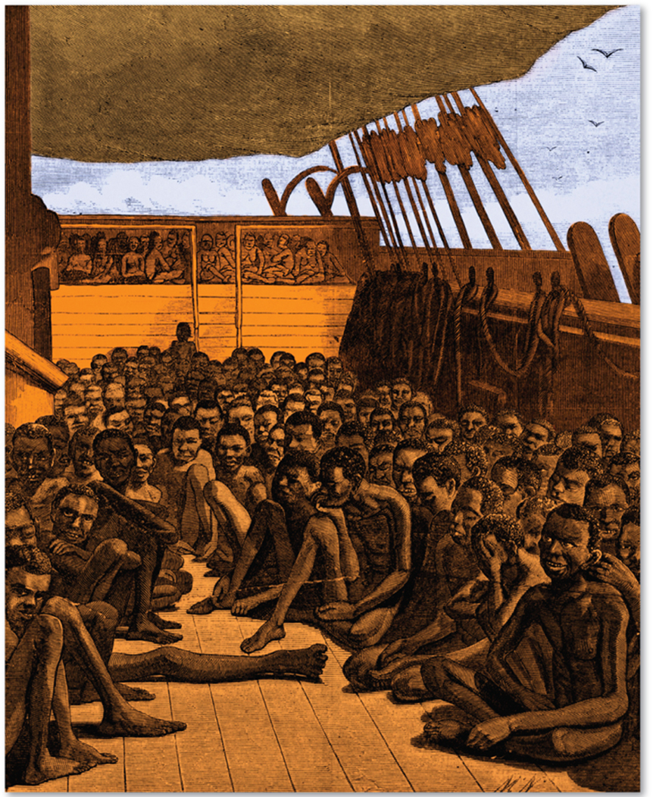
7.2.1 Forced Migration of Slaves from Africa (2 of 4)
Figure 7-23: Africans were enslaved and brought in poor conditions to the Western Hemisphere.

Slide 29
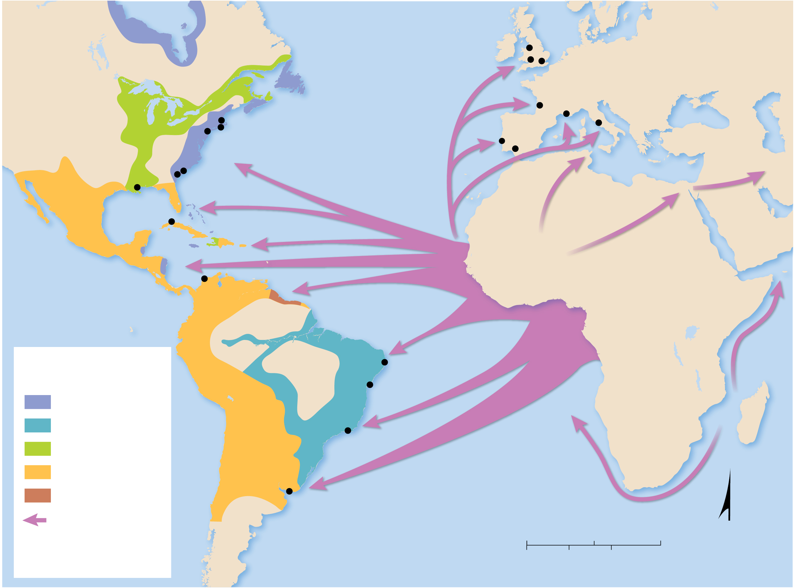
7.2.1 Forced Migration of Slaves from Africa (3 of 4)
Figure 7-24: Ships sailed from Africa to the Western Hemisphere, from the Americas to Europe, and from Europe to Africa. From Africa, slaves and gold were transported to the Western Hemisphere, primarily to the Caribbean islands.
Bristol
Liverpool
Great
Lakes
London
EUROPE
NORTH
AMERICA
Bordeaux
Boston
ATLANTIC
OCEAN
Toulon
Rome
New York
Newport
Lisbon
Seville
BRITISH
NORTH AMERICA
Savannah
New Orleans
Savannah
Charleston
MEXICO
Havana
FLORIDA
SANTO
DOMINGO
CUBA
SENEGAMBIA
AFRICA
HAITI
BARBADOS
Wolof
Mandinka
BENIN
Hausa
Cartagena
Bambara
GOLD
Yoruba
PACIFIC
OCEAN
Mende
COAST
Fon
Ibo
SPANISH MAIN
Akan
SURINAME
SIERRA LEONE
KONGO
Areas of national
domination
SOUTH
AMERICA
Recife
BAKONGO
BRAZIL
Salvador
Ovimbundu
Mbundu
British
ANGOLA
MOZAMBIQUE
MADAGASCAR
Portuguese
Rio de
Janerio
French
Spanish
Dutch
Montevideo
ATLANTIC
OCEAN
Slave trade route
0
1,000
2,000 Miles
N
Ibo
African cultural
group
0
1,000
2,000 Kilometers

Slide 30
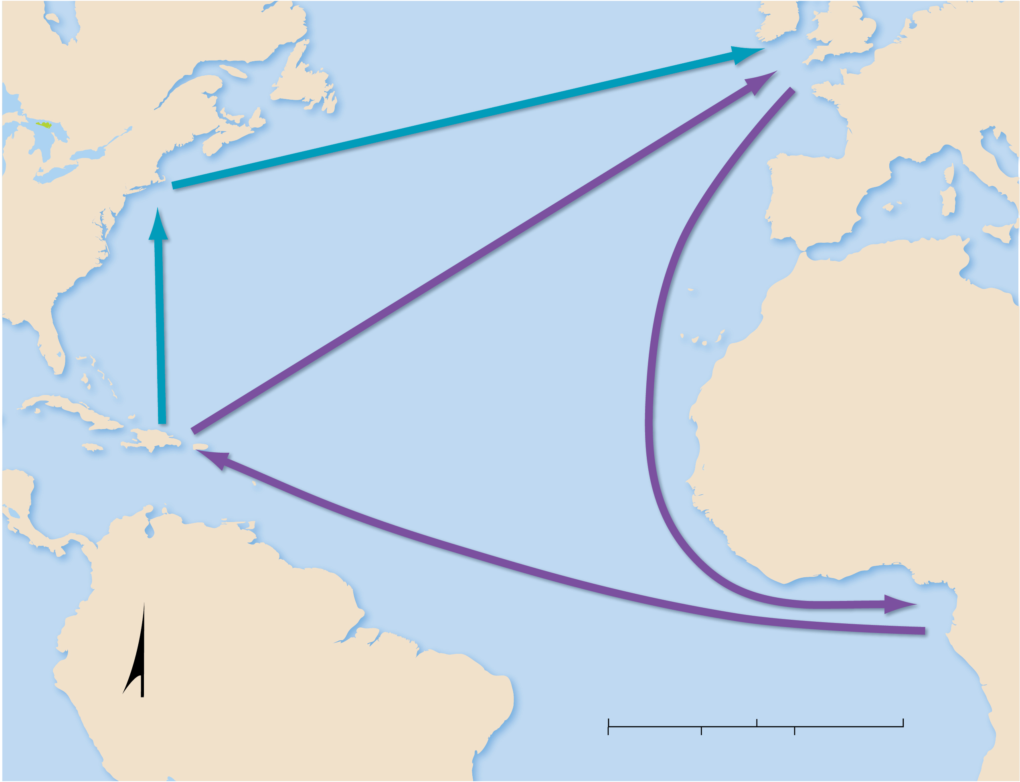
7.2.1 Forced Migration of Slaves from Africa (4 of 4)
Figure 7-25: The three legs in the triangular slave trade were slaves, molasses/rum, and cotton.
NORTH
AMERICA
GREAT
BRITAIN
NEW
ENGLAND
Rum
EUROPE
Molasses
Molasses
Cloth, trinkets
ATLANTIC
OCEAN
AFRICA
WEST
INDIES
Slaves
GOLD
COAST
SOUTH
AMERICA
N
0
1,000
2,000 Miles
0
1,000
2,000 Kilometers

Slide 31
7.2.2 Internal Migration of African Americans (1 of 5)
African Americans displayed two distinctive internal migration patterns within the United States during the 20th century:
Interregional migration from the U.S. South to northern cities during the first half of the 20th century
Intraregional migration from the inner city to outer city and inner suburban neighborhoods during the second half of the 20th century. This coincided with “white flight” to the outer suburbs and was hastened by the practices of blockbusting and redlining

Slide 32
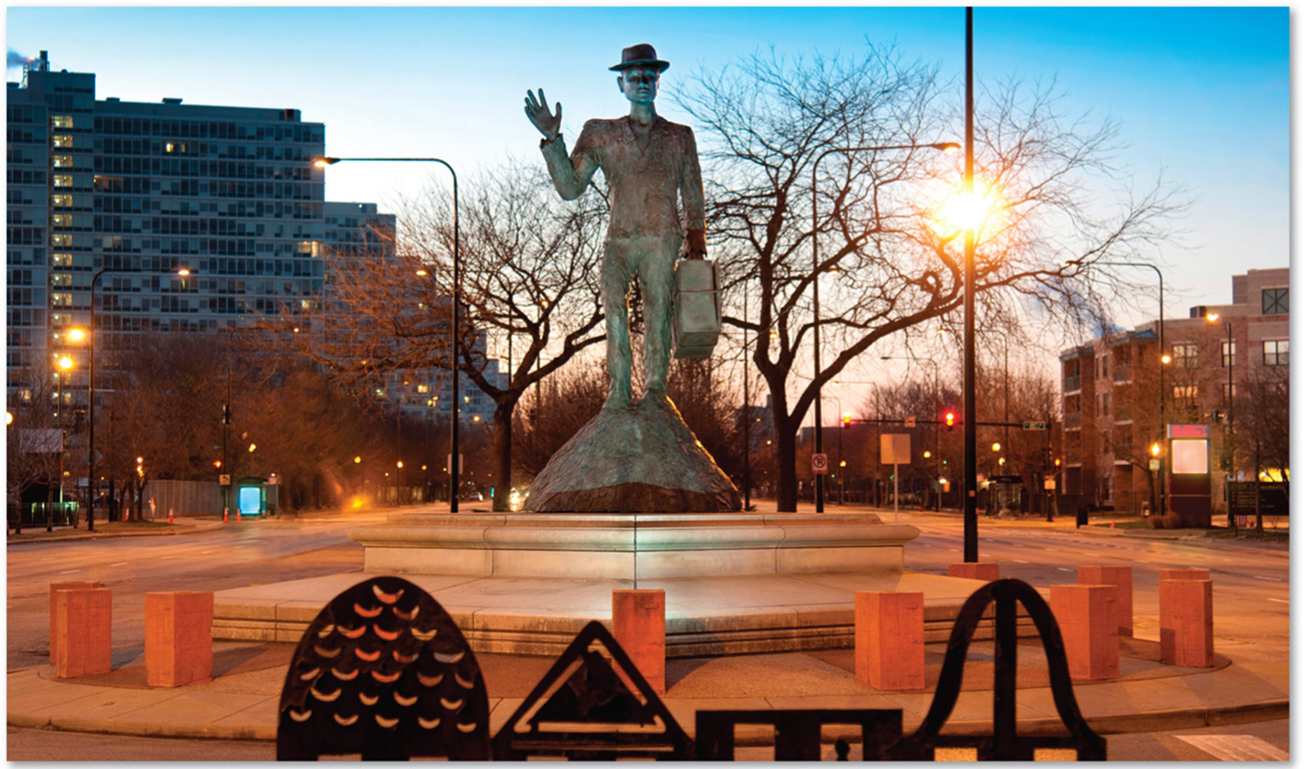
7.2.2 Internal Migration of African Americans (2 of 5)
Figure 7-27: Statue honoring African Americans who migrated to Chicago in the early 20th century. It stands at the entrance to the Bronzeville neighborhood, where most African Americans lived then.

Slide 33
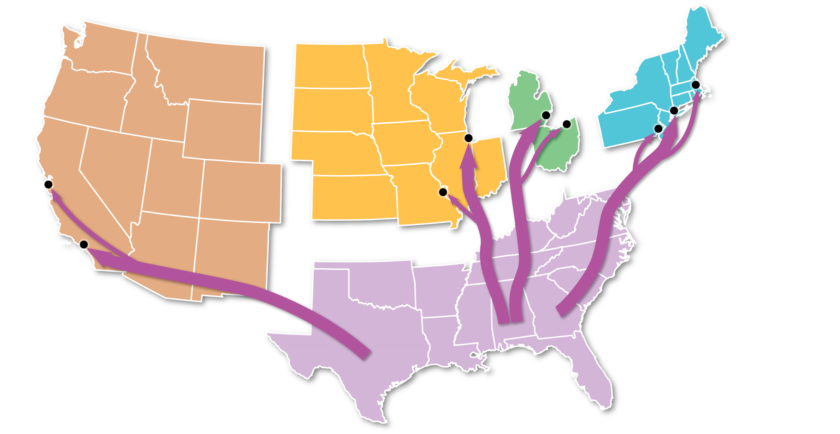
7.2.2 Internal Migration of African Americans (3 of 5)
Figure 7-26: African Americans migrated out of agricultural lands in the South to large cities in the North and West in the 1910s and 1920s and again in the 1940s and 1950s.
NORTHEAST
EAST
CENTRAL
Boston
WEST
CENTRAL
Detroit
Chicago
Cleveland
New York City
San
Francisco
WEST
Philadelphia
St. Louis
Los
Angeles
SOUTH

Slide 34
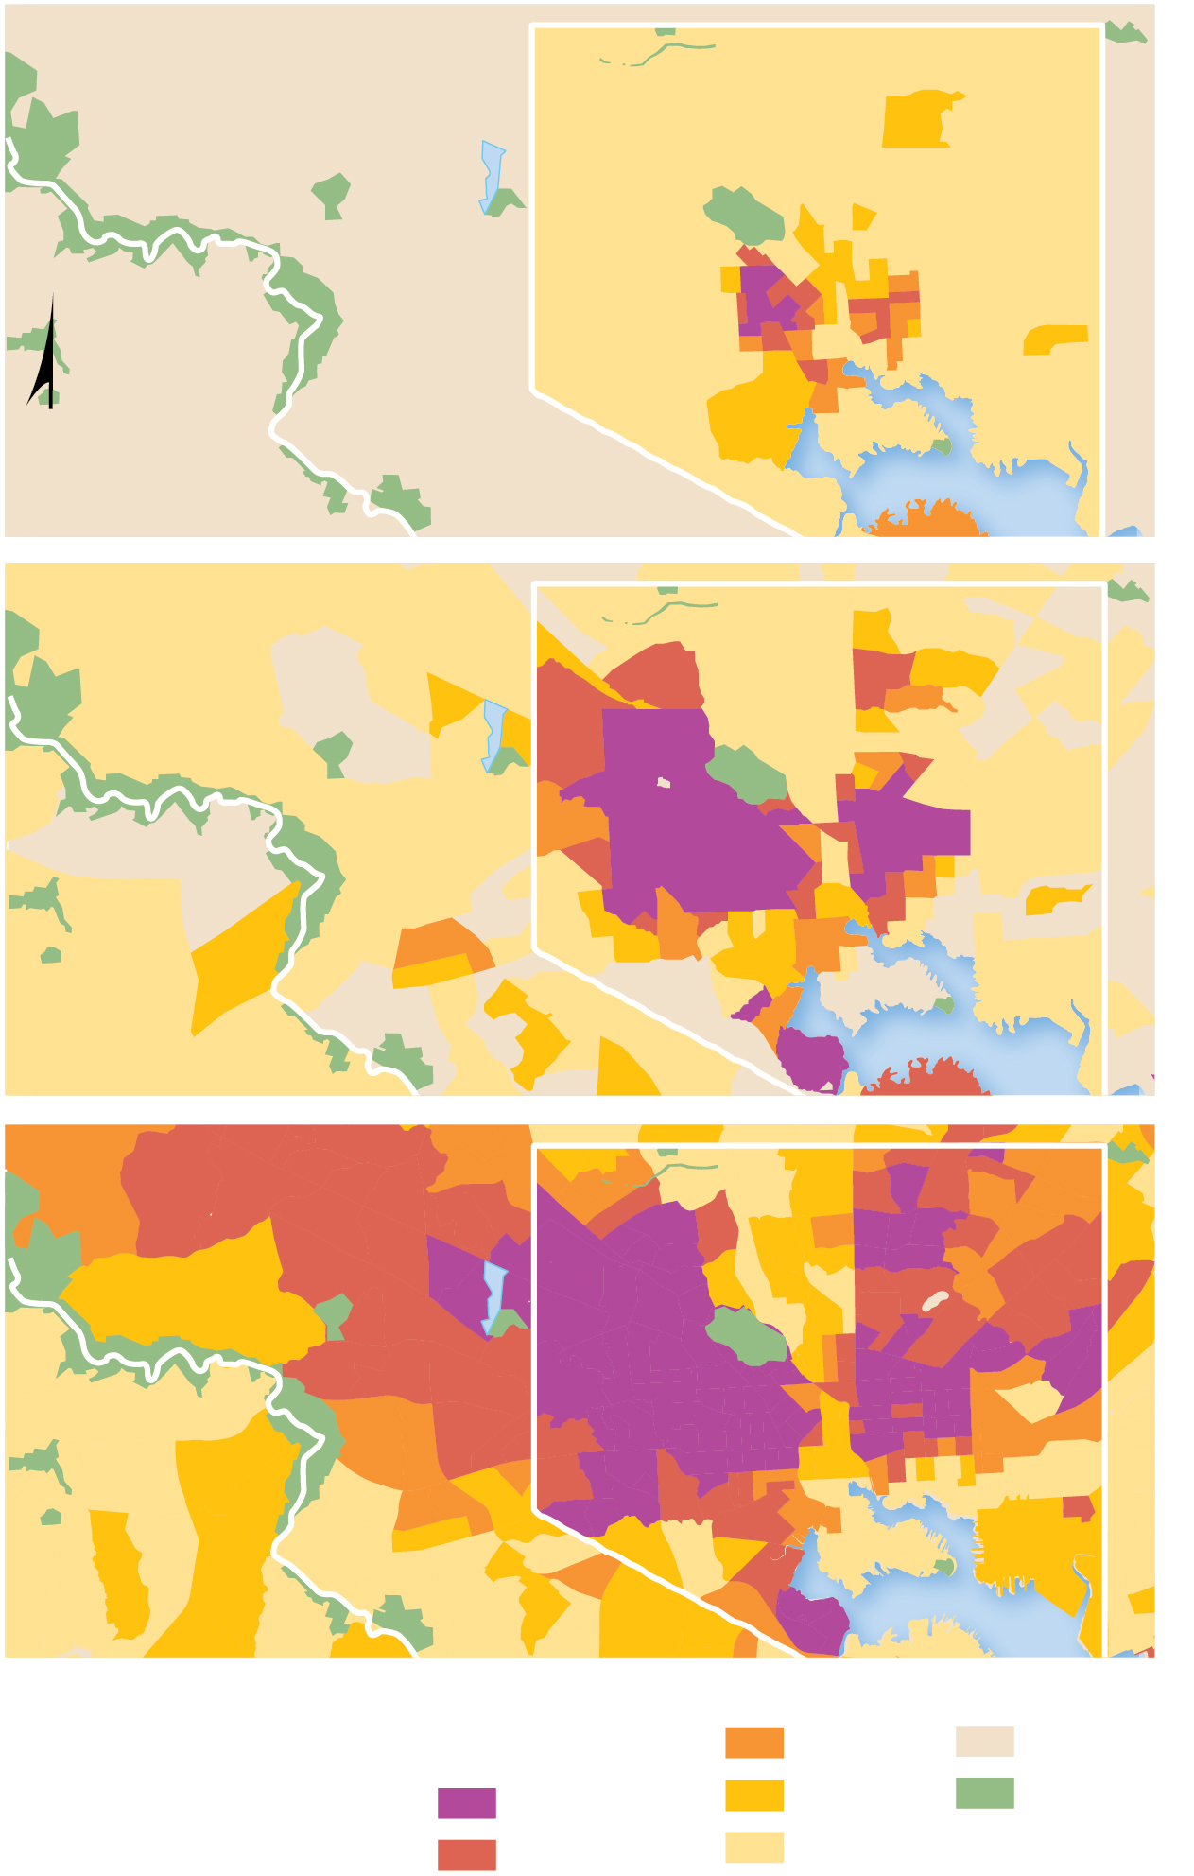
7.2.2 Internal Migration of African Americans (4 of 5)
Figure 7-28: African Americans moved into the center of Baltimore and other northern cities, then expanded outward.
BALTIMORE
COUNTY
Baltimore city
HOWARD
COUNTY
N
1940
BALTIMORE
COUNTY
Baltimore city
HOWARD
COUNTY
1970
BALTIMORE
COUNTY
Baltimore city
HOWARD
COUNTY
2010
Percent African
American
30–59
few or none
90 and above
10–29
Parks
60–89
below 10

Slide 35
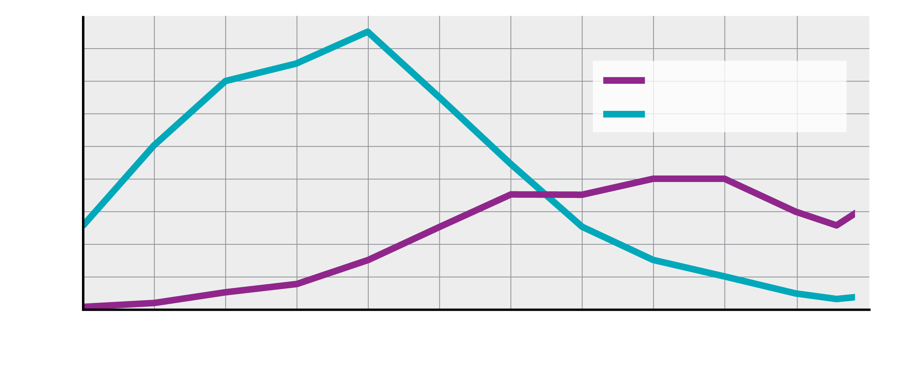
7.2.2 Internal Migration of African Americans (5 of 5)
Figure 7-29: The decrease in racially white residents was much larger than the increase in African American residents, evidence of white flight.
1.8
1.6
1.4
African American
1.2
White
1.0
Population (millions)
0.8
0.6
0.4
0.2
0
1910
1920
1930
1940
1950
1960
1970
1980
1990
2000
2010
2020
Year

Slide 36
7.2.3 Ethnic and Racial Segregation (1 of 5)
South Africa and the United States both had a history of laws enforcing spatial segregation
The United States had a “separate but equal” doctrine supported by law until 1954 with various Jim Crow laws at the state level in the southern states
South Africa was racially segregated until 1991 by apartheid

Slide 37
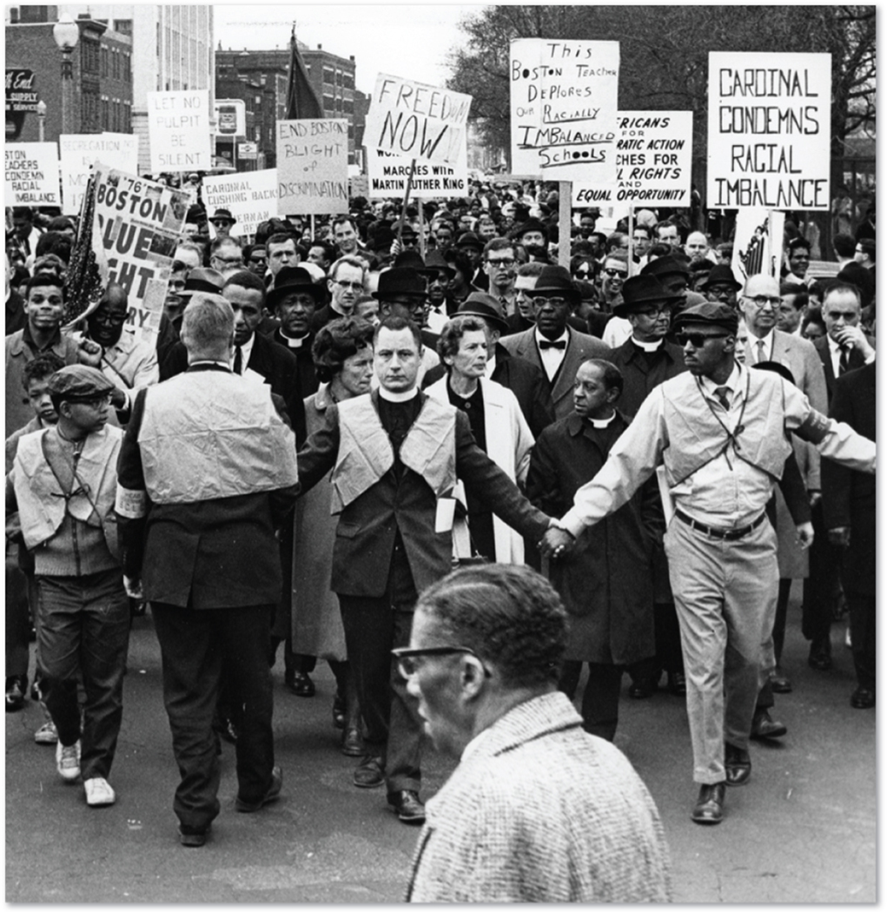
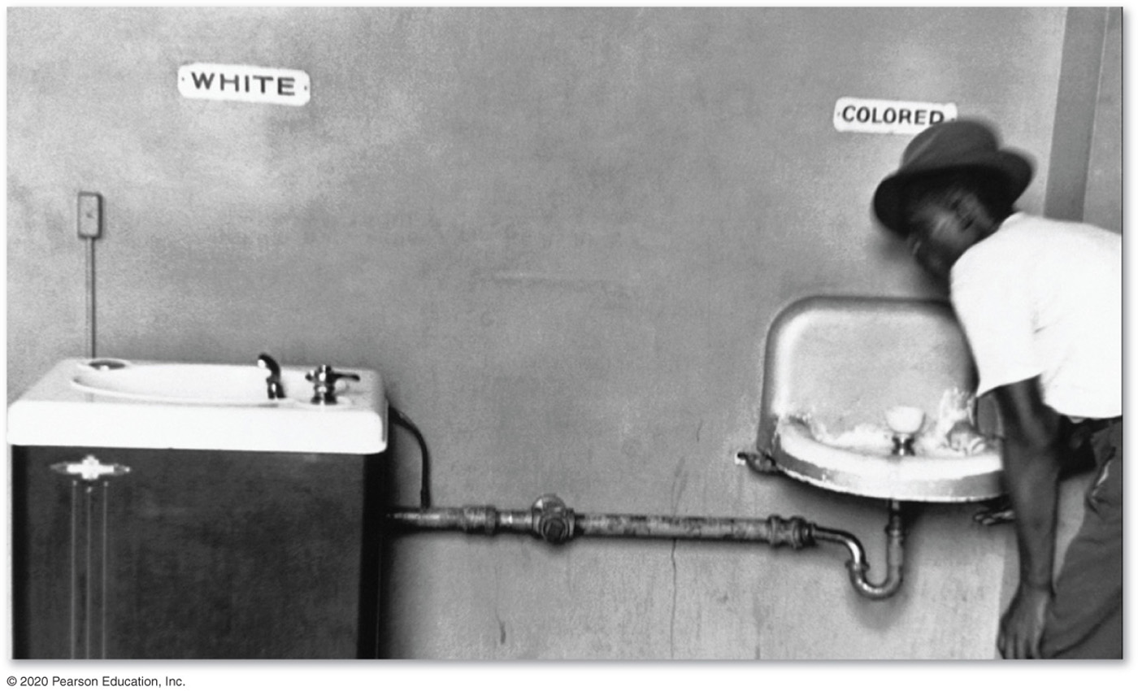
7.2.3 Ethnic and Racial Segregation (2 of 5)
Figures 7-30 and 7-31: Segregation in U.S. drinking fountains (left) and a civil rights march in Boston (right).

Slide 38
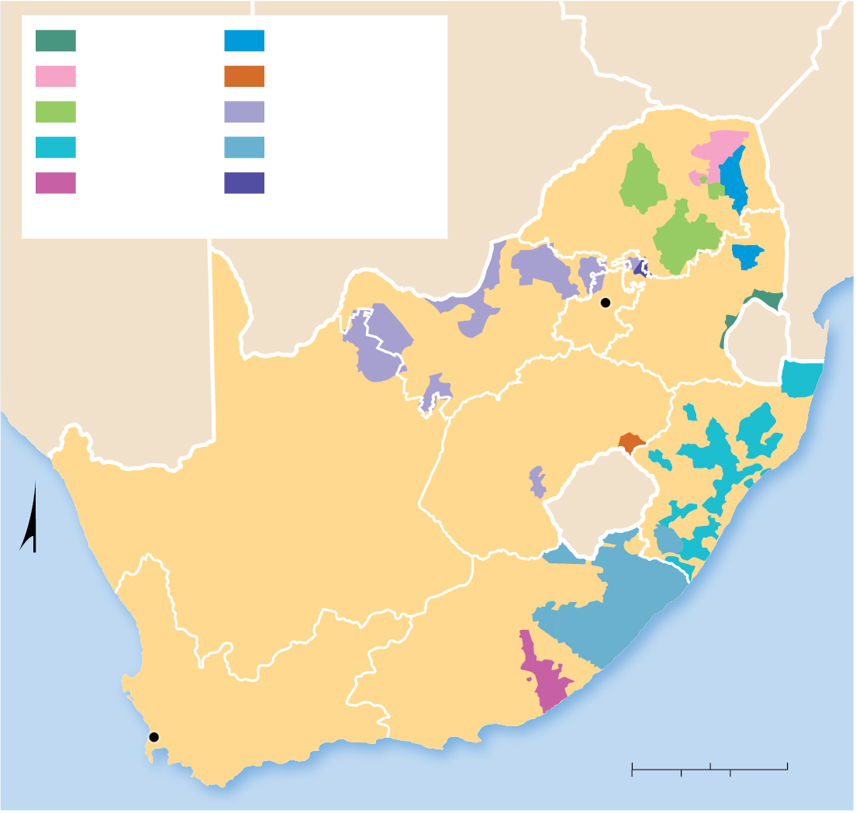
7.2.3 Ethnic and Racial Segregation (3 of 5)
Figure 7-32: South Africa attempted to justify racial segregation (apartheid) by creating “homelands” for its black population.
KaNgwana
Gazankulu
ZIMBABWE
Venda
Qwaqwa
Lebowa
Bophuthatswana
BOTSWANA
Kwazulu
Transkei
MOZAMBIQUE
Ciskei
KwaNdebele
LIMPOPO
Present-day province boundaries are shown.
NAMIBIA
Pretoria
MPUMALANGA
NORTH
WEST
GAUTENG
ESWATINI
FREE STATE
KWAZULU
NATAL
NORTHERN
CAPE
LESOTHO
N
ATLANTIC
OCEAN
EASTERN CAPE
INDIAN
OCEAN
WESTERN CAPE
Cape Town
0
100
200 Miles
0
100
200 Kilometers

Slide 39
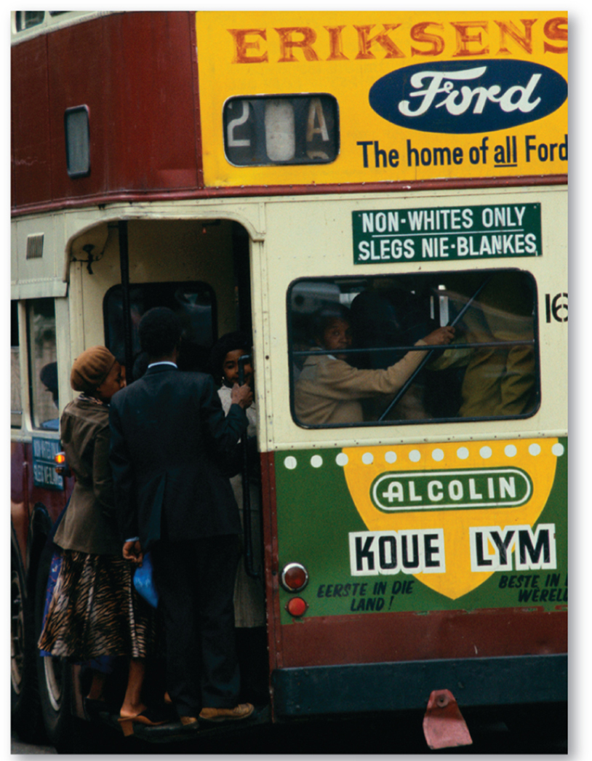
7.2.3 Ethnic and Racial Segregation (4 of 5)
Figure 7-33: Separate buses for black and whites, in South Africa in1975.

Slide 40
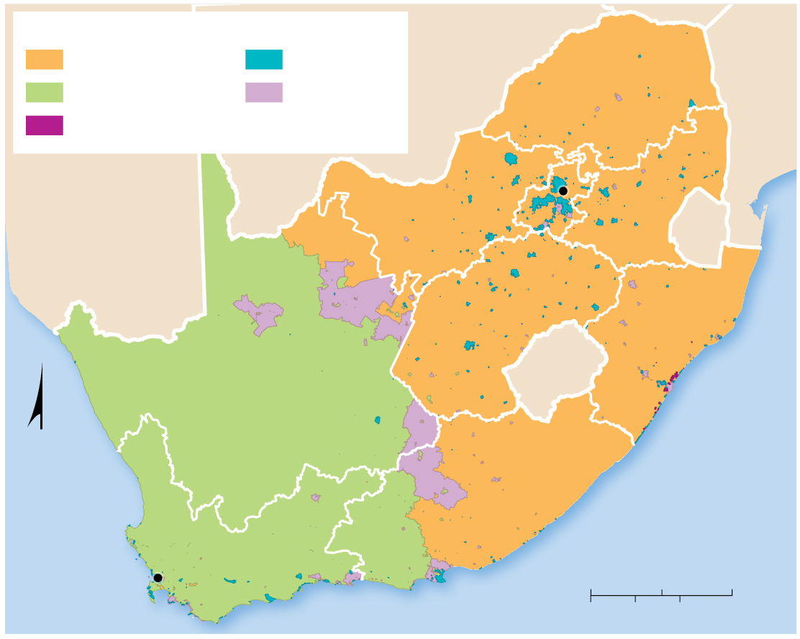
7.2.3 Ethnic and Racial Segregation (5 of 5)
Figure 7-34: Segregation persists in contemporary South Africa. Most blacks live in eastern provinces and most coloreds in western ones.
Dominant Population Group
BOTSWANA
Black African
White
MOZAMBIQUE
Coloured
No group
dominant
LIMPOPO
Indian or Asian
NAMIBIA
Pretoria
MPUMALANGA
NORTH
WEST
GAUTENG
ESWATINI
FREE STATE
KWAZULU
NATAL
NORTHERN
CAPE
LESOTHO
N
ATLANTIC
OCEAN
EASTERN CAPE
INDIAN
OCEAN
Cape Town
WESTERN CAPE
0
100
200 Miles
0
100
200 Kilometers

Slide 41
7.2.4 Dividing Ethnicities (1 of 5)
Ethnicities are sometimes divided among more than one nationality. Two examples are found in South Asia and western Asia
The British partitioned its colony South Asia into a Muslim West/East Pakistan and a Hindu India in 1947, resulting in the relocation of millions and a massive loss of life
The Kurds are an ethnic group spread across multiple nations of southwest Asia—Iran, Iraq, Syria, and Turkey

Slide 42
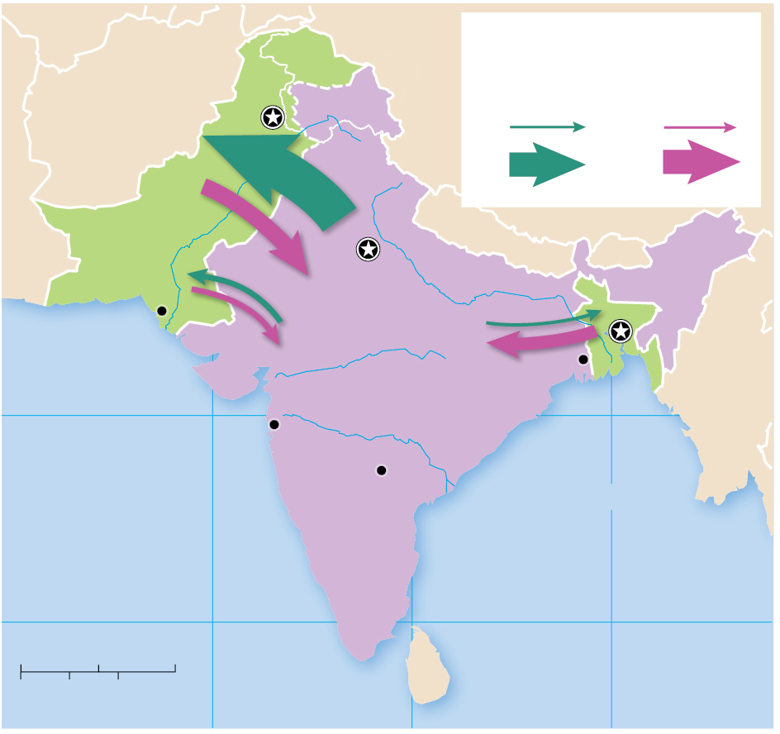
7.2.4 Dividing Ethnicities (2 of 5)
Figure 7-35: The British partition of South Asia into Pakistan and India resulted in the migration of many Hindus to India and Muslims to West Pakistan and East Pakistan (now Bangladesh).
JAMMU
AND
KASHMIR
CHINA
Flow in millions
Primarily
Muslims
Primarily
Hindus
Islamabad
AFGHANISTAN
0.5
0.5
5.3
5.0
5.0
PAKISTAN
3.4
NEPAL
Indus R.
Ganges R.
BHUTAN
1.2
New
Delhi
Karachi
1.2
0.7
Dhaka
Narmada R.
2.6
BANGLADESH
INDIA
Kolkata
20°N
Godavari R.
MYANMAR
Mumbai
Arabian Sea
Hyderabad
Bay of Bengal
10°N
10°N
0
250
500 Miles
0
250
500 Kilometers
70°E
80°E
90°E

Slide 43
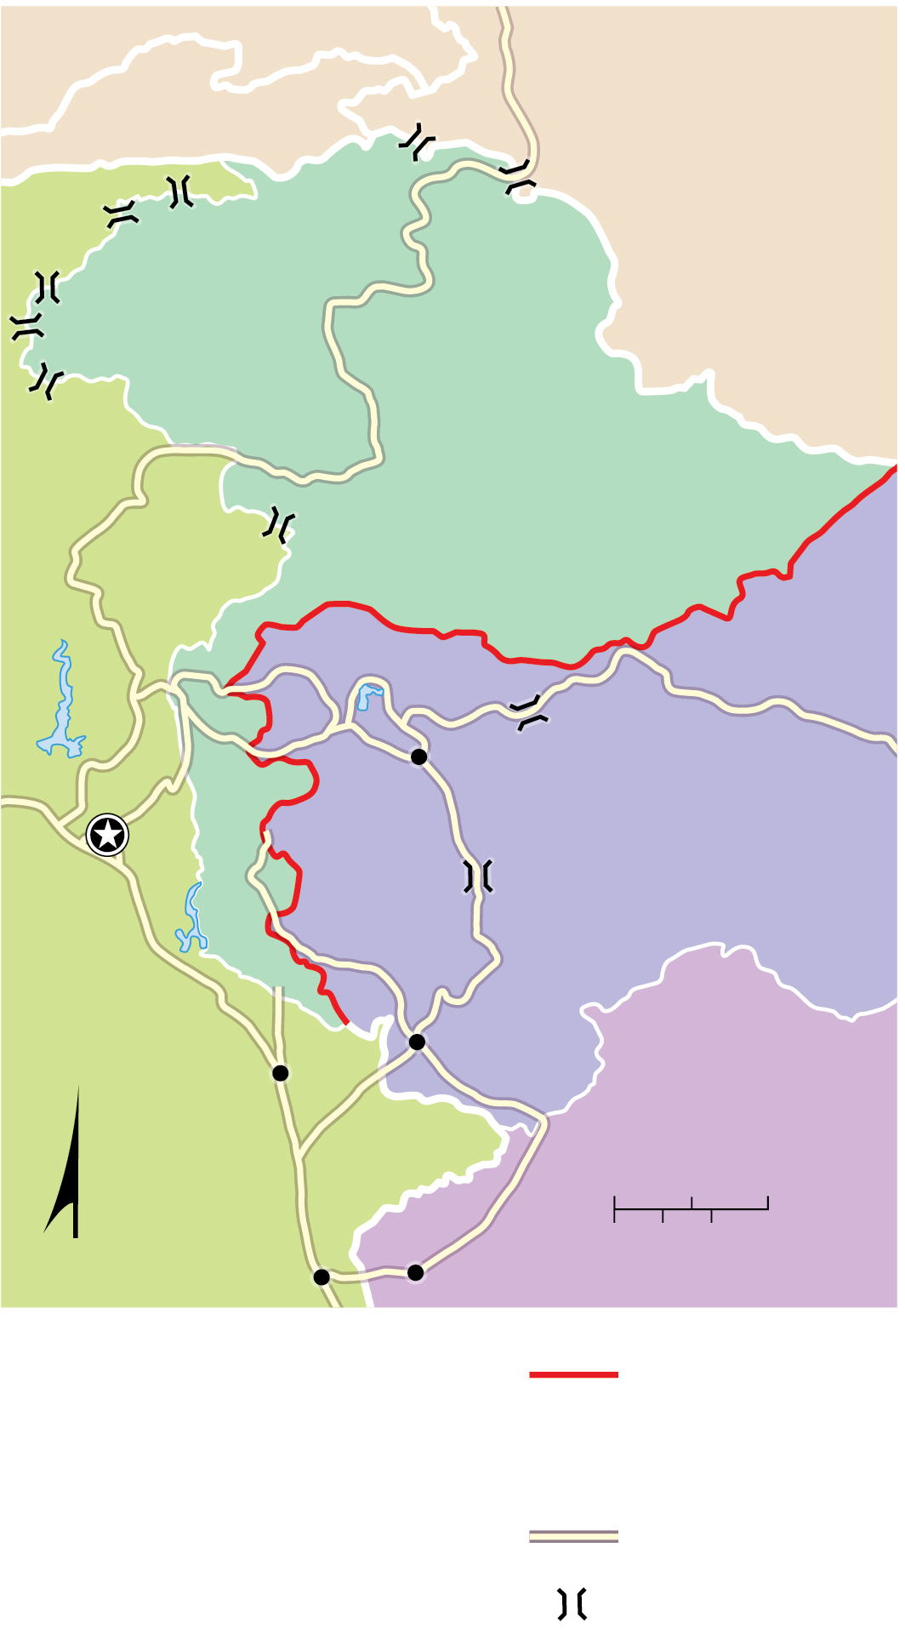
7.2.4 Dividing Ethnicities (3 of 5)
Figure 7-36: India and Pakistan dispute the location of their border in the Kashmir region.
AFGHANISTAN
CHINA
J A M M U A N D K A S H M I R
PAKISTAN
Srinagar
Islamabad
Jammu
INDIA
Gujrat
0
25
50 Miles
N
Lahore
0
25
50 Kilometers
Amritsar
Line of control
between India
and Pakistan
Road
Mountain pass

Slide 44
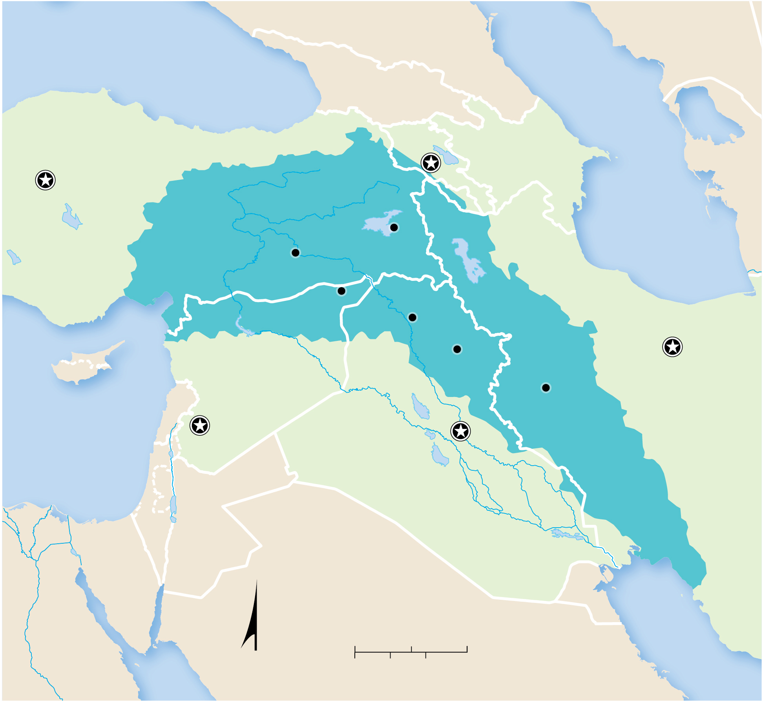
7.2.4 Dividing Ethnicities (4 of 5)
Figure 7-37: Kurds are a stateless people spread across Turkey, Iraq, Iran, and Syria.
Black Sea
RUSSIA
KAZAKHSTAN
GEORGIA
ARMENIA
C a s p i a n S e a
Ankara
Yerevan
AZERBAIJAN
TURKEY
AZER.
Van
Diyarbakir
K U R D I S T A N
Al-Qamishli
Mosul
Tehran
CYPRUS
SYRIA
Tigris
Kirkuk
LEBANON
Euphrates
Kermanshah
Mediterranean
Sea
Damascus
IRAQ
Baghdad
IRAN
ISRAEL
JORDAN
SAUDI
ARABIA
KUWAIT
EGYPT
Persian
Gulf
Red
Sea
N
0
100
200 Miles
0
100
200 Kilometers

Slide 45
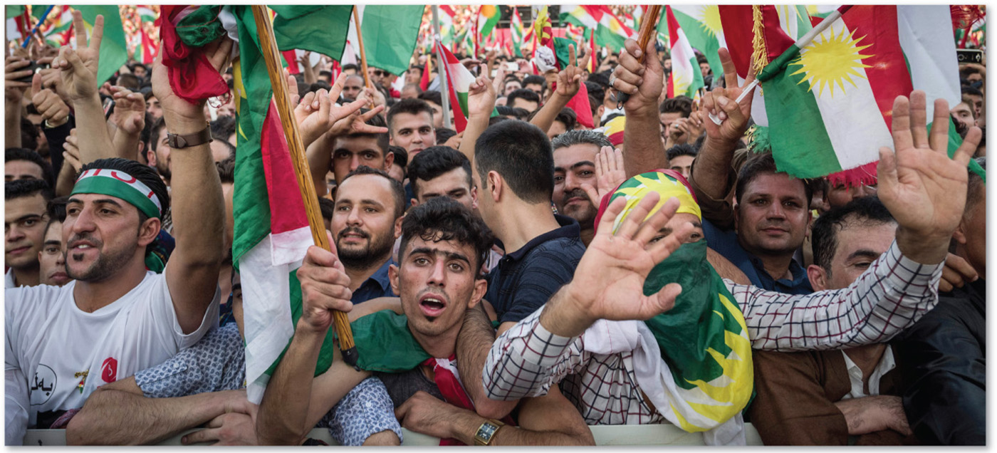
7.2.4 Dividing Ethnicities (5 of 5)
Figure 7-38: Kurdish rally in support of Kurdish independence. Note the Kurdish sundial flag.

Slide 46
Key Issue 3. Why Might Ethnicities Face Conflicts?
7.3.1 Ethnicities and Nationalities
7.3.2 Ethnic Diversity in Western Asia
7.3.3 Ethnic Diversity in West-Central Asia

Slide 47
7.3.1 Ethnicities and Nationalities (1 of 3)
Ethnicity does not always correspond to nationality
Nationalism is loyalty and devotion to a nationality
United States has a shared nationality by many different ethnicities
Canada faces the question whether Québécois are a nationality or ethnicity
United Kingdom—is there one British nationality or several?

Slide 48
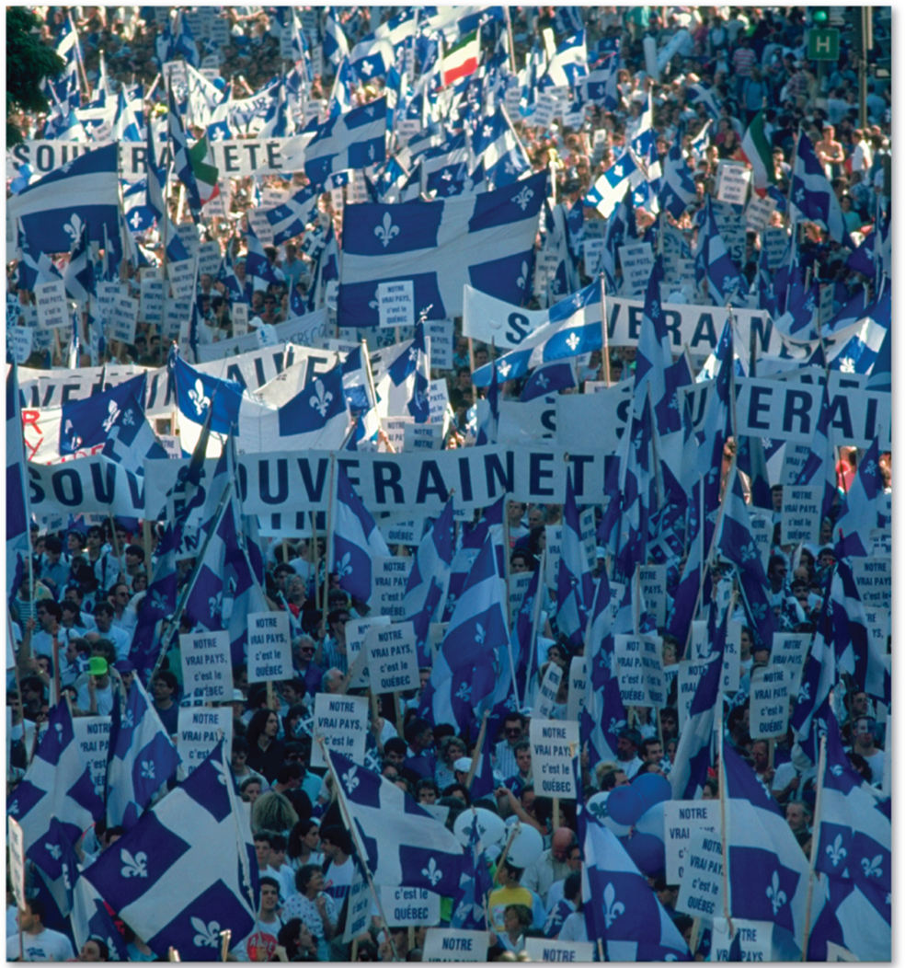
7.3.1 Ethnicities and Nationalities (2 of 3)
Figure 7-40: The Québécois independence movement has waned in the 21st century but remains a latent force.

Slide 49
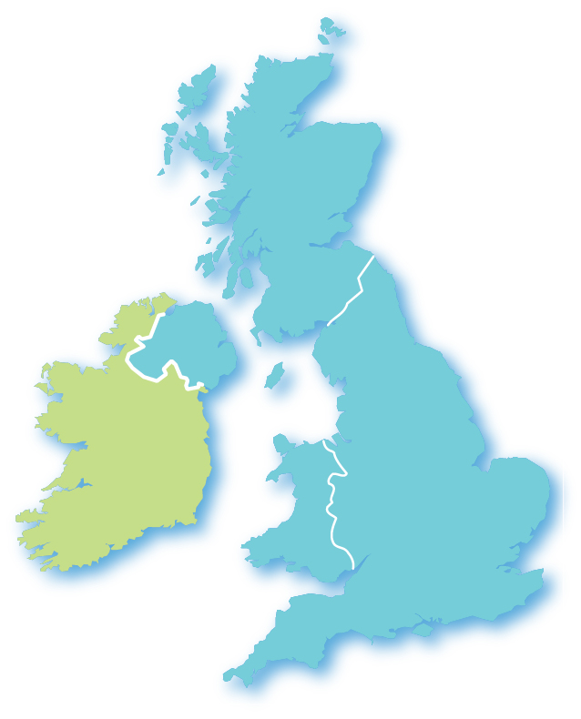
7.3.1 Ethnicities and Nationalities (3 of 3)
Figure 7-41: Most people in Ireland have an Irish ethnicity and nationality. But the labeled ethnicities of the United Kingdom may also identify as their own nationalities instead of British.
SCOTLAND
NORTHERN
IRELAND
UNITED
KINGDOM
IRELAND
WALES
ENGLAND

Slide 50
7.3.2 Ethnic Diversity in Western Asia (1 of 2)
The lack of correspondence between the territories occupied by ethnicities and by nationalities is especially severe in Western Asia and is a driving force for continuous conflicts
Turkey, Syria, Lebanon, and Iraq all face internal conflicts driven by ethnic differences

Slide 51
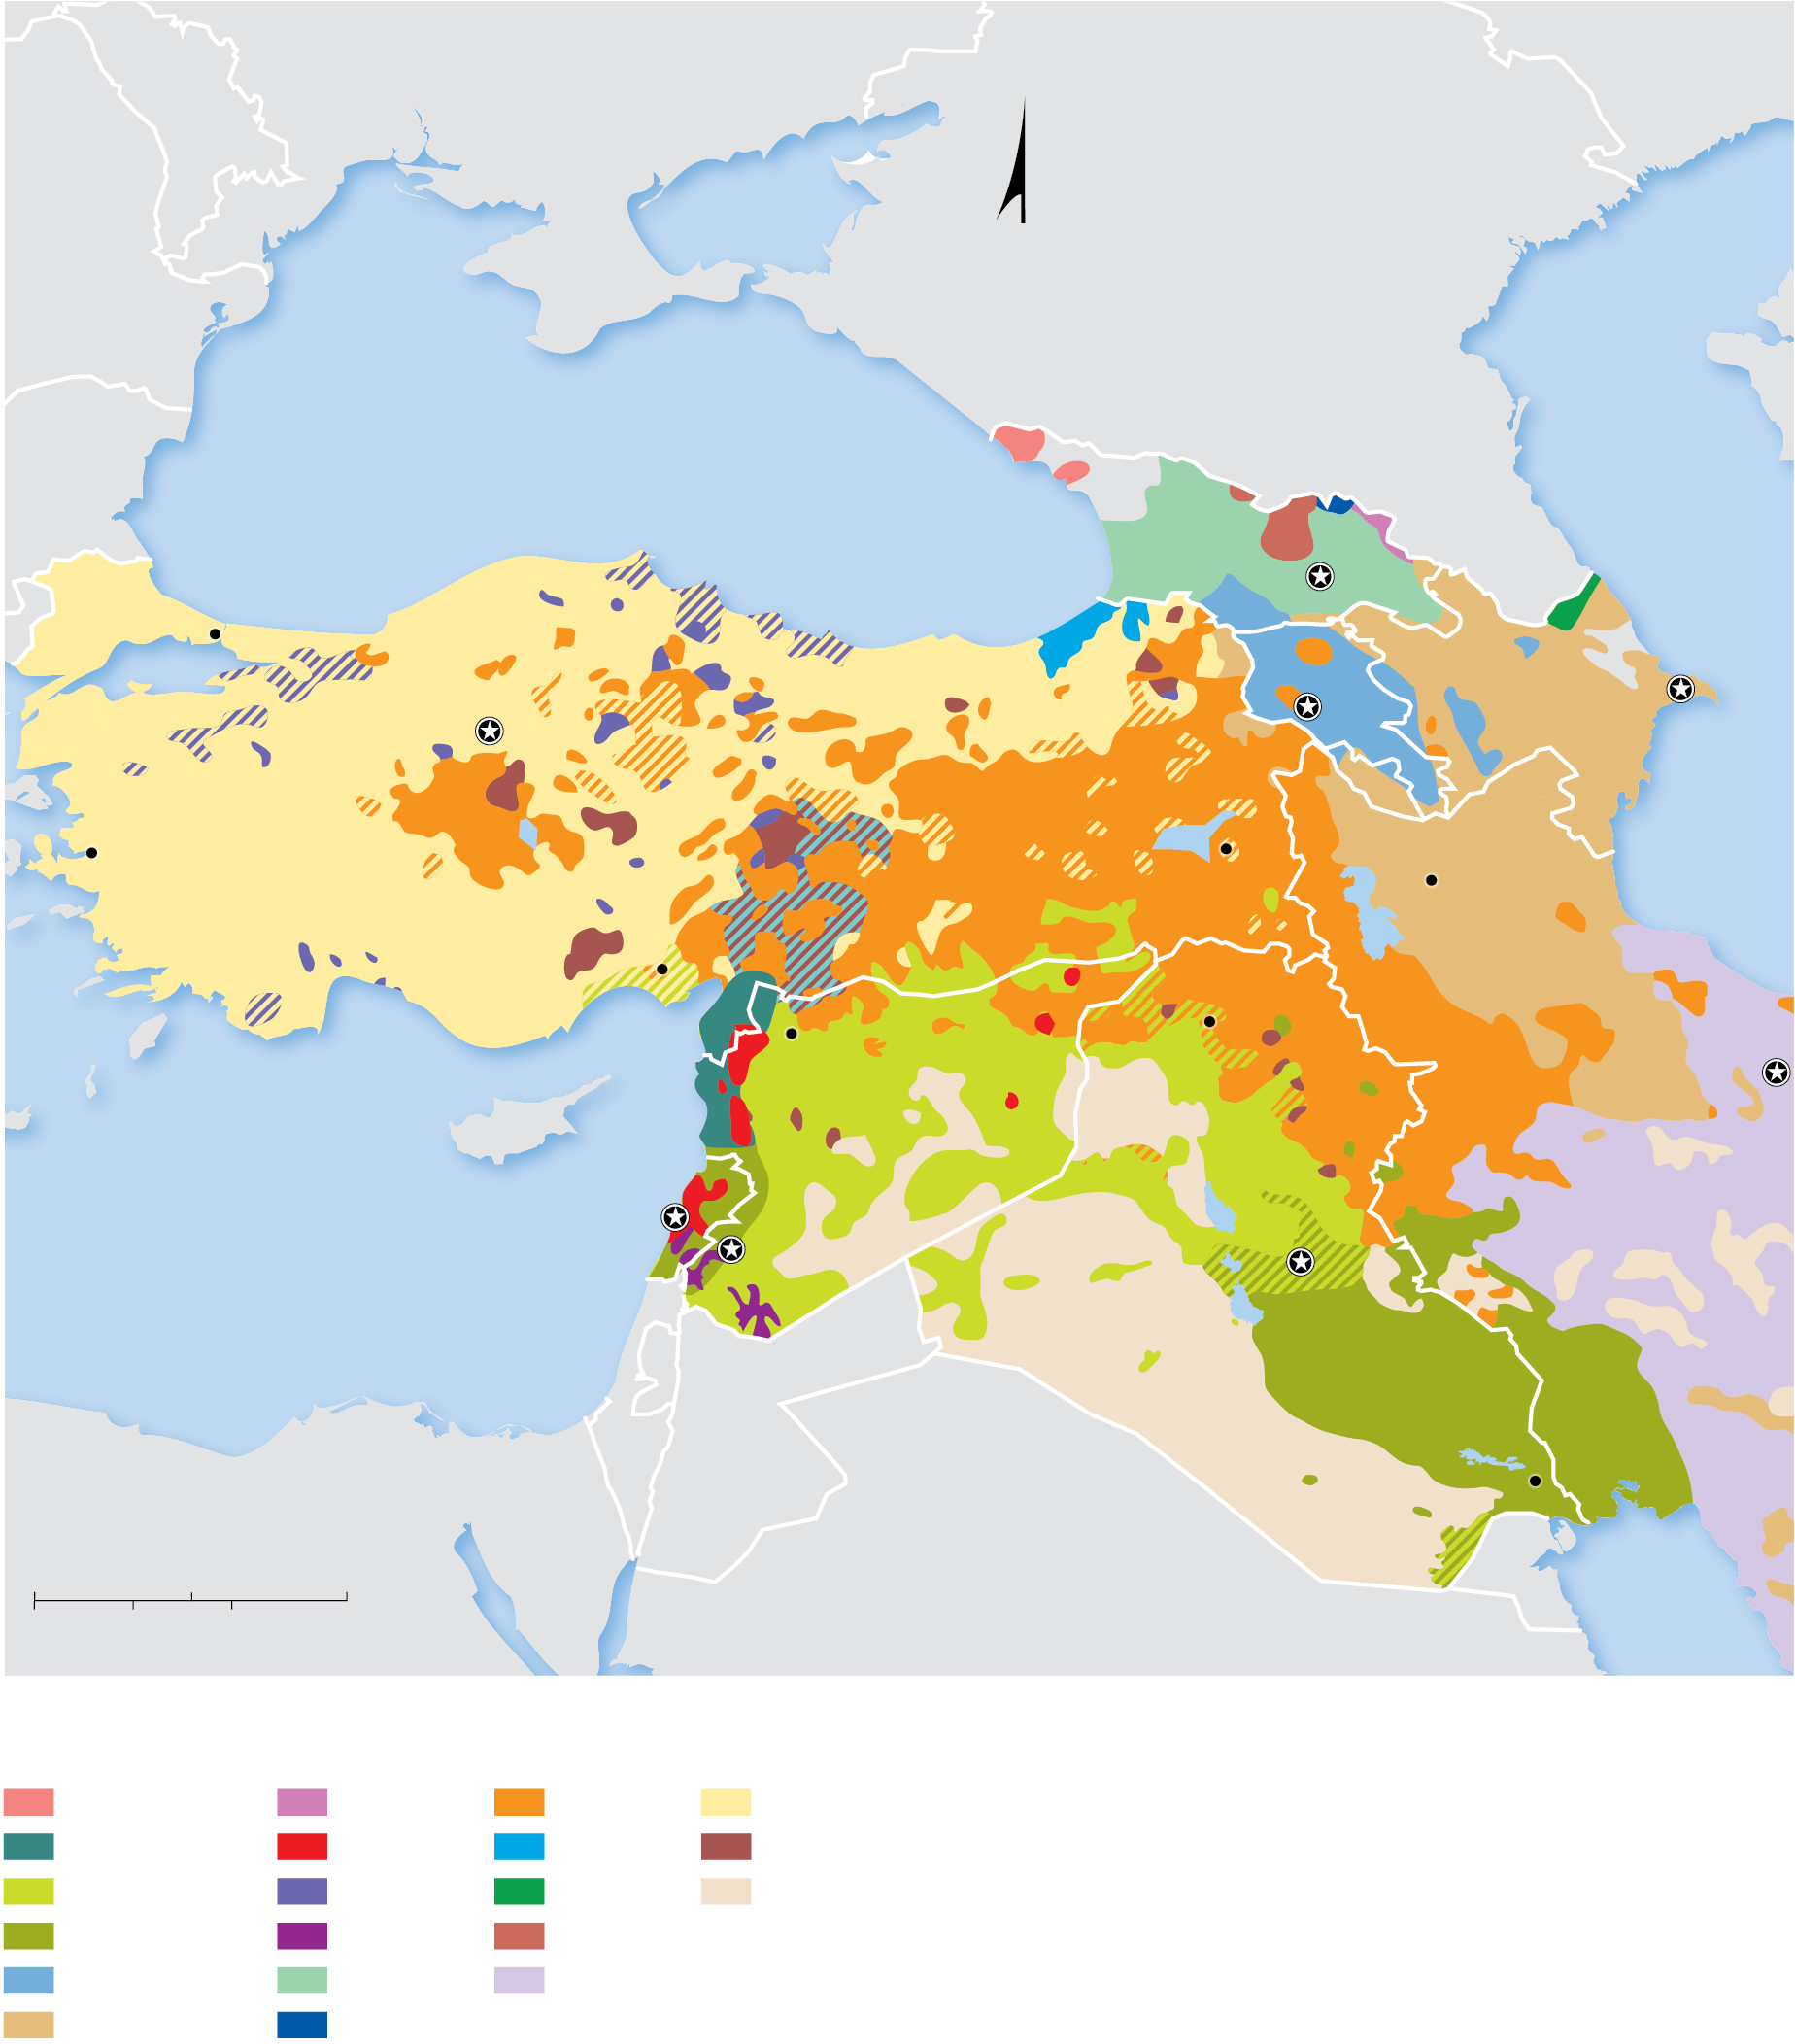
7.3.2 Ethnic Diversity in Western Asia (2 of 2)
Figure 7-43: Western Asia is a complex mosaic of different ethnic groups, sometimes identified by differences in religion as well as other cultural factors.
MOLDOVA
UKRAINE
KAZAKHSTAN
N
RUSSIA
ROMANIA
BULGARIA
B l a c k S e a
GEORGIA
Caspian Sea
Istanbul
Tbilisi
ARMENIA
AZERBAIJAN
Baku
Ankara
TURKEY
Yerevan
Izmir
AZER.
Van
Tabriz
Adana
Aleppo
Mosul
CYPRUS
SYRIA
Tehran
M e d i t e r r a n e a n
S e a
LEBANON
IRAN
Damascus
Baghdad
ISRAEL
IRAQ
EGYPT
JORDAN
SAUDI
ARABIA
Basra
0
150
300 Miles
KUWAIT
Persian
Gulf
0
150
300 Kilometers
Abkhazian
Chechen
Kurdish
Turk
Arab (Alawite)
Christian
Laz
Turkmen
Arab (Sunni)
Circassian
Lezghian
Sparsely
populated
Arab (Shiite)
Druze
Ossetian
Armenian
Georgian
Persian
Azerbaijani
Ingush

Slide 52
7.3.3 Ethnic Diversity in West-Central Asia (1 of 3)
Dozens of ethnicities inhabit the region of West-Central Asia, allocated among eight nationalities. The five most numerous ethnicities are Punjabis, Persians, Pashtuns, Uzbeks, and Azerbaijanis
No nation in the region has suffered from more ethnic conflict than Afghanistan, which is divided by a largely Pashtun south and a north that comprised multiple ethnic groups from Central Asia

Slide 53
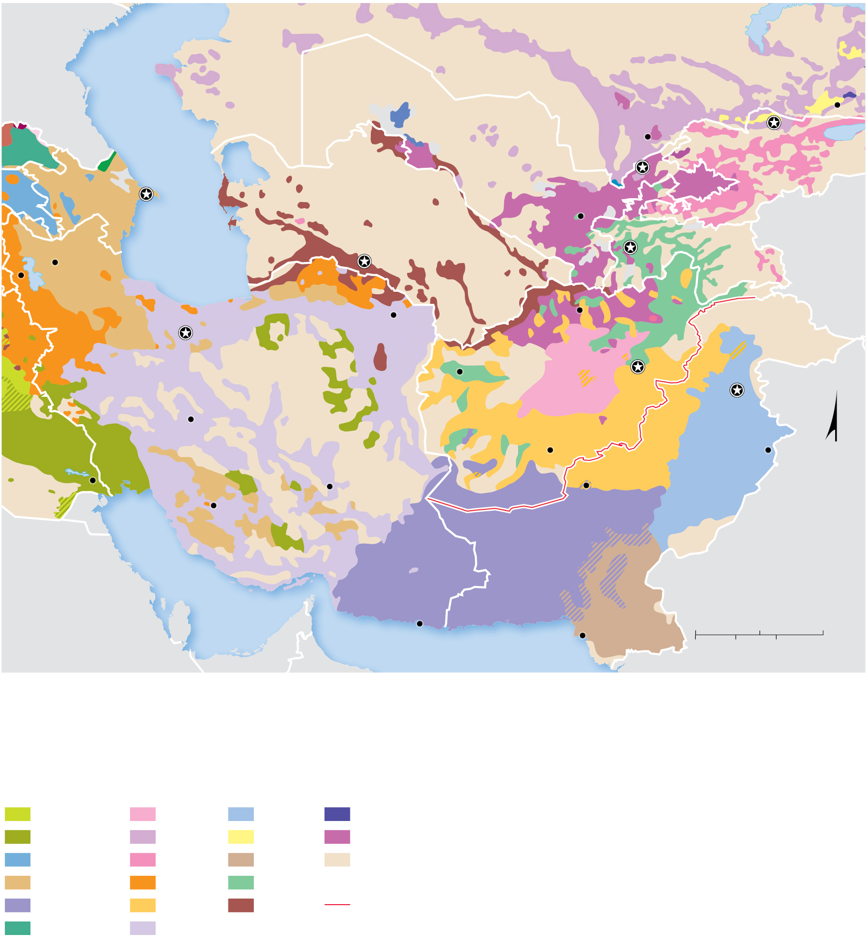
7.3.3 Ethnic Diversity in West-Central Asia (2 of 3)
Figure 7-46: West-Central Asia is a complex mosaic of different ethnic groups. Afghanistan is perhaps the most complex of the region, with a Pashtun south and a north comprised of multiple Central Asian ethnic groups.
KAZAKHSTAN
RUSSIA
Caspian Sea
UZBEKISTAN
Bishkek
Almaty
GEORGIA
Shymkent
KYRGYZSTAN
Tashkent
ARM.
AZERBAIJAN
Baku
TURKMENISTAN
Samarqand
AZER.
TAJIKISTAN
CHINA
Tabriz
Ashgabat
Dushanbe
Orumiyeh
Mazar-e
Sharif
Tehran
Mashhad
IRAN
Herāt
Kabul
Islamabad
Esfahan
AFGHANISTAN
IRAQ
Qandahār
Lahore
N
Basra
Shiraz
Kerman
Quetta
KUWAIT
PAKISTAN
Persian Gulf
INDIA
SAUDI
ARABIA
BAHRAIN
QATAR
OMAN
Bandar
Beheshti
0
150
300 Miles
U.A.E.
OMAN
Arabian Sea
Karachi
0
150
300 Kilometers
Arab (Sunni)
Hazara
Punjabi
Uighur
Arab(Shiite)
Kazakh
Russian
Uzbek
Armenian
Kirghiz
Sindhi
Sparsely
populated
Azerbaijani
Kurdish
Tajik
Baluchi
Pashtun
Turkmen
Durand Line
Georgian
Persian

Slide 54
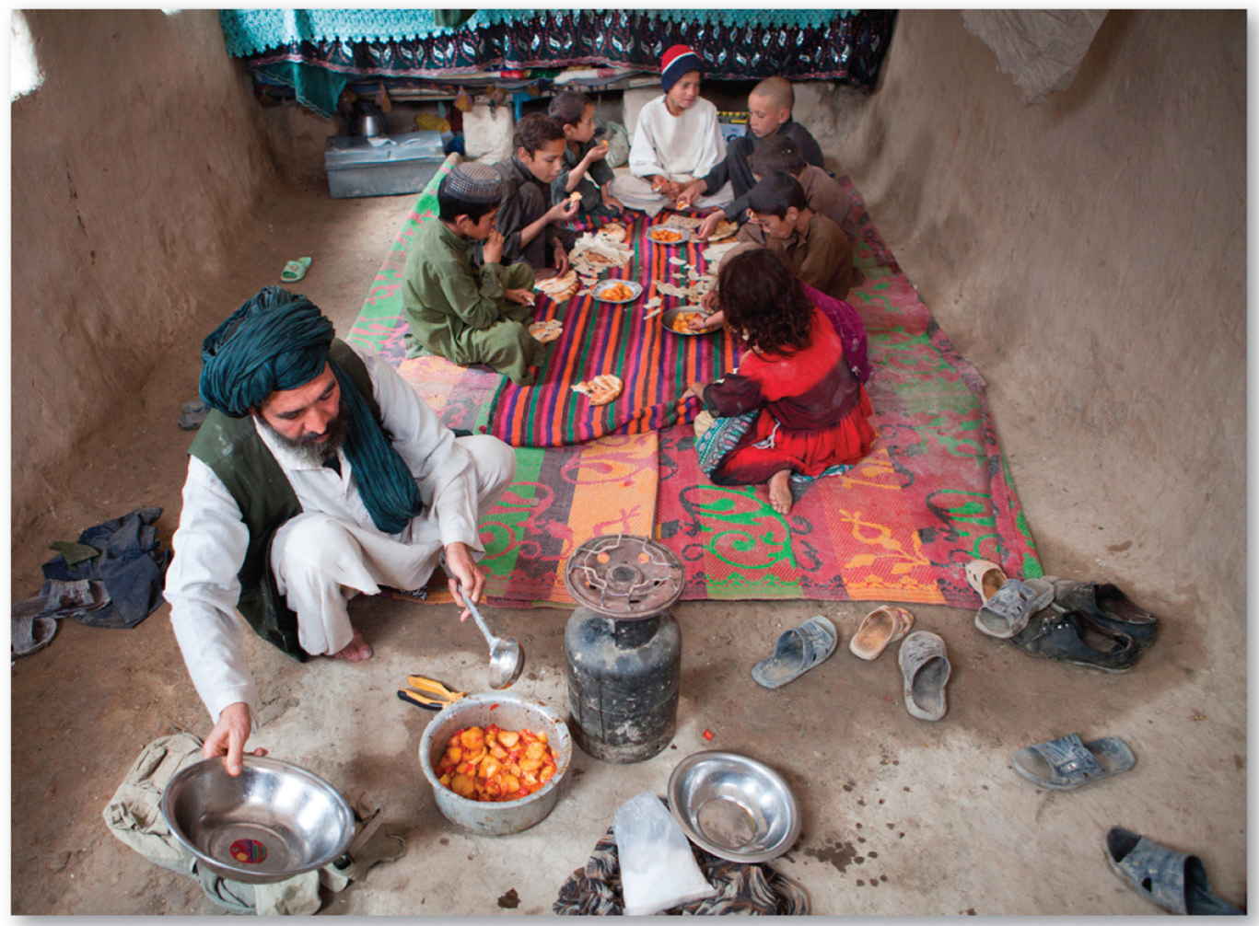
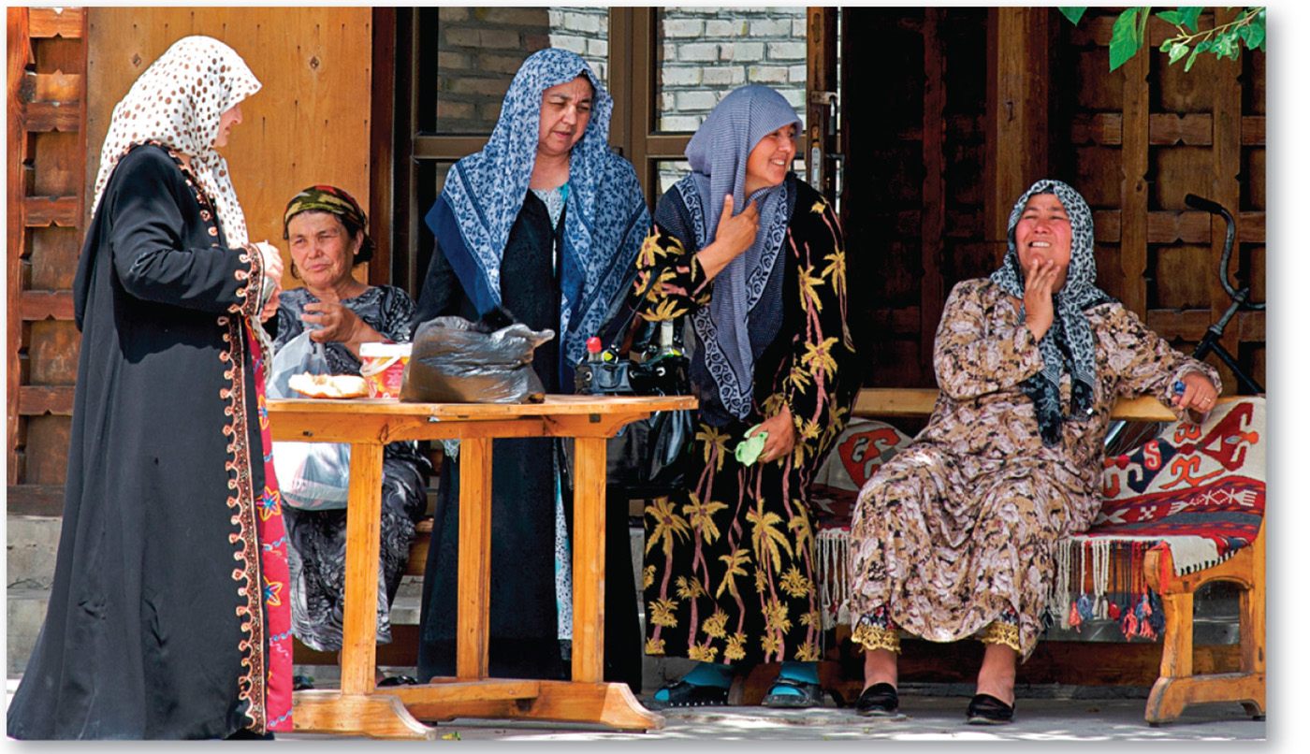
7.3.3 Ethnic Diversity in West-Central Asia (3 of 3)
Figures 7-47 and 7-48: Afghanistan (left) has been beset by civil war which has created four million refugees. Uzbek women (right) in traditional dress.

Slide 55
Key Issue 4: Why Do Ethnic Cleansing and Genocide Occur?
7.4.1 Ethnic Cleansing and Genocide Past and Present
7.4.2 Ethnic Cleansing in Southeast Europe
7.4.3 Ethnic Cleansing in Bosnia and Herzegovina
7.4.4 Ethnic Cleansing and Genocide in Africa
7.4.5 Conflict in Central Africa

Slide 56
7.4.1 Ethnic Cleansing and Genocide Past and Present (1 of 5)
Ethnic cleansing is the policy of one ethnicity or religious group to remove the civilian population of another ethnic or religious group from a certain area
Genocide is the mass killing of a group of people in an attempt to eliminate the entire group from existence
The Holocaust is an example of a past genocide, the eviction of Rohingya Muslims from Myanmar is a recent example of ethnic cleansing

Slide 57
7.4.1 Ethnic Cleansing and Genocide Past and Present (2 of 5)
Ethnophobia is a fear of people of a particular ethnicity
Xenophobia is a fear of people who are from other countries

Slide 58
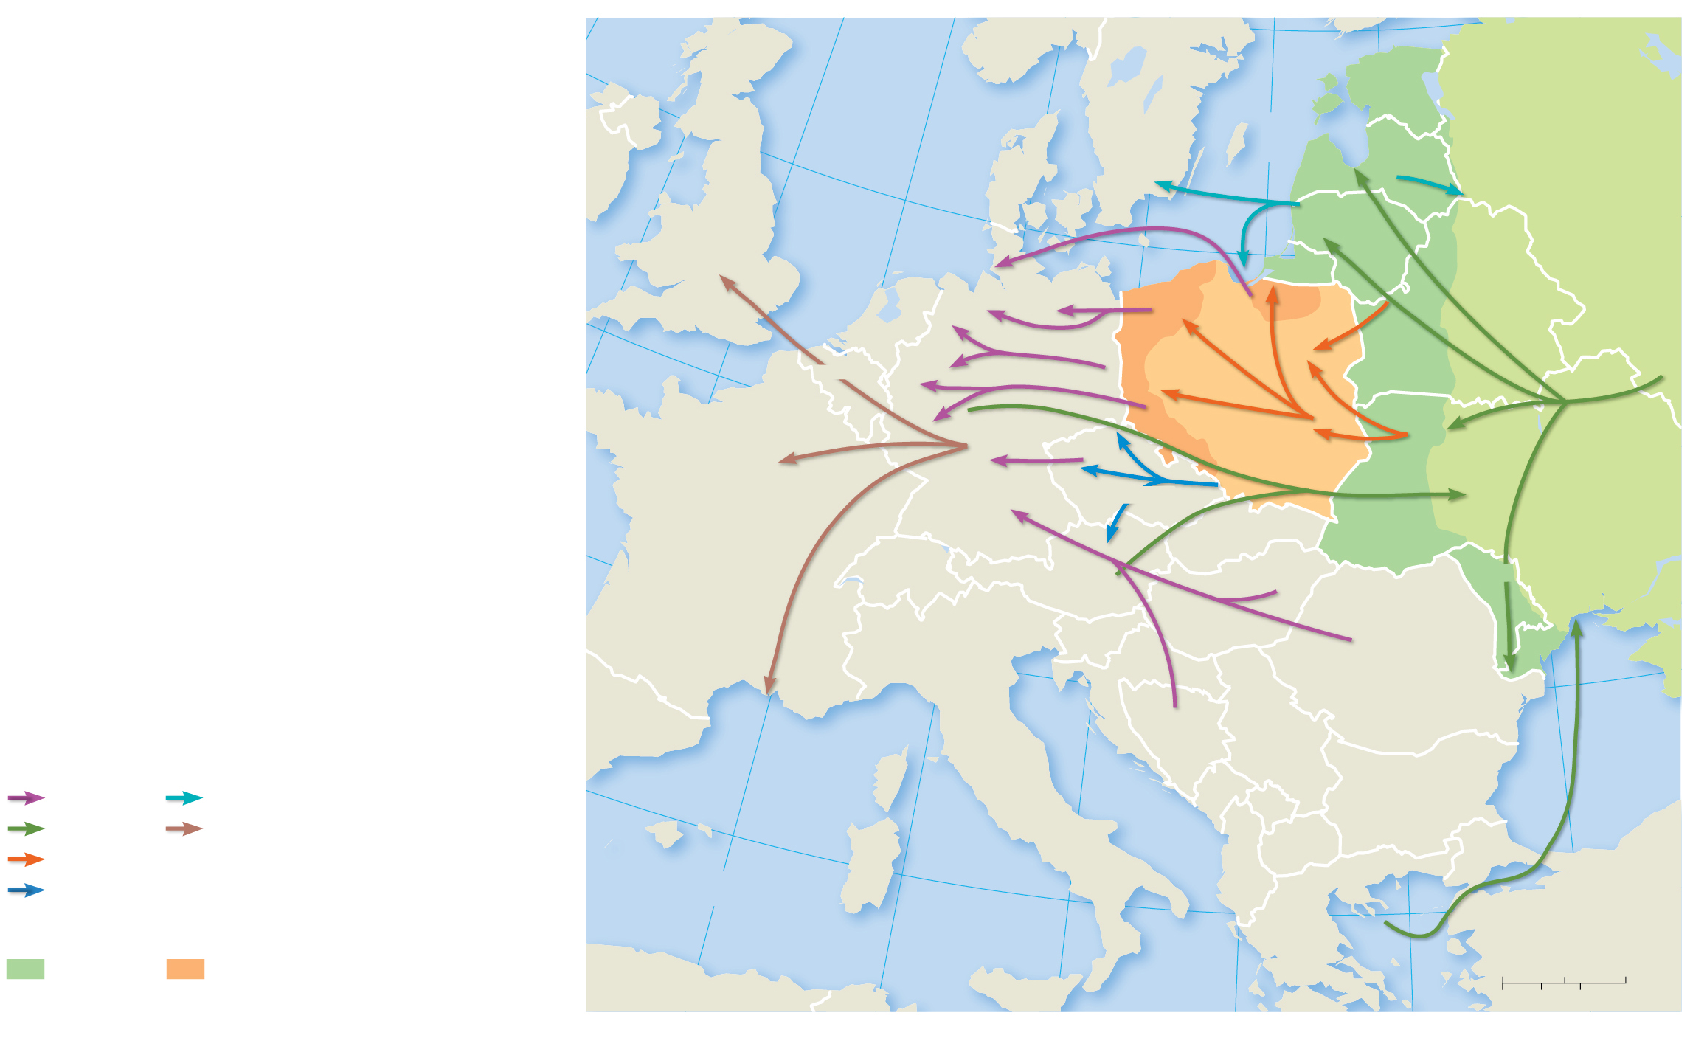
7.4.1 Ethnic Cleansing and Genocide Past and Present (3 of 5)
Figure 7-49: The end of World War
saw boundary changes and
forced migration of many ethnicities.
0°
5°E
NORWAY
60°N
10°E
20°E
ESTONIA
North
Sea
SWEDEN
Baltic Sea
IRELAND
55°N
DENMARK
LATVIA
0.2
RUSSIA
UNITED
2.0
0.2
KINGDOM
LITHUANIA
1.9
RUSSIA
NETHERLANDS
BELARUS
50°N
BELGIUM
GERMANY
1.9
3.3
3.0
2.3
LUX.
1.0
2.9
POLAND
1.5
CZECHIA
2.0
5.5
UKRAINE
FRANCE
SLOVAKIA
SWITZERLAND
AUSTRIA
MOLDOVA
SLOVENIA
HUNGARY
CROATIA
ROMANIA
SPAIN
BOSNIA
& HERZ.
SERBIA
Black
Sea
Forced migrations
ITALY
Germans
Baltic peoples
40°N
MONTENEGRO
KOS.
BULGARIA
Russians
Settled by International
MACEDONIA
Poles
2.9
Refugee Organization
ALBANIA
Czechs
Population movement
(in millions)
Mediterranean
Sea
Land added to
5°E
GREECE
TURKEY
U.S.S.R.
Poland
10°E
15°E
25°E
0
200
400 Miles
Present-day borders are shown.
20°E
0
200
400 Kilometers

Slide 59
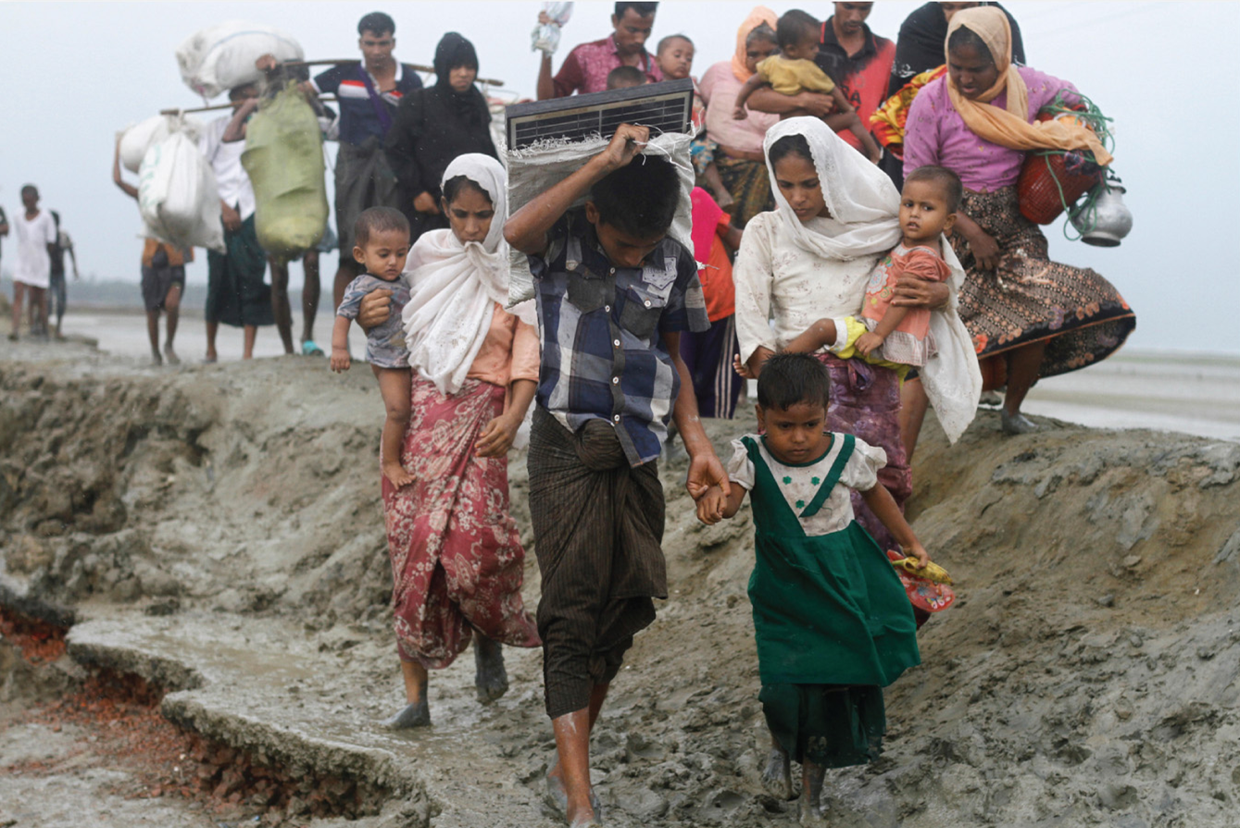
7.4.1 Ethnic Cleansing and Genocide Past and Present (4 of 5)
Figure 7-50: Ethnically cleansed Rohingya are forced to migrate to Bangladesh.

Slide 60
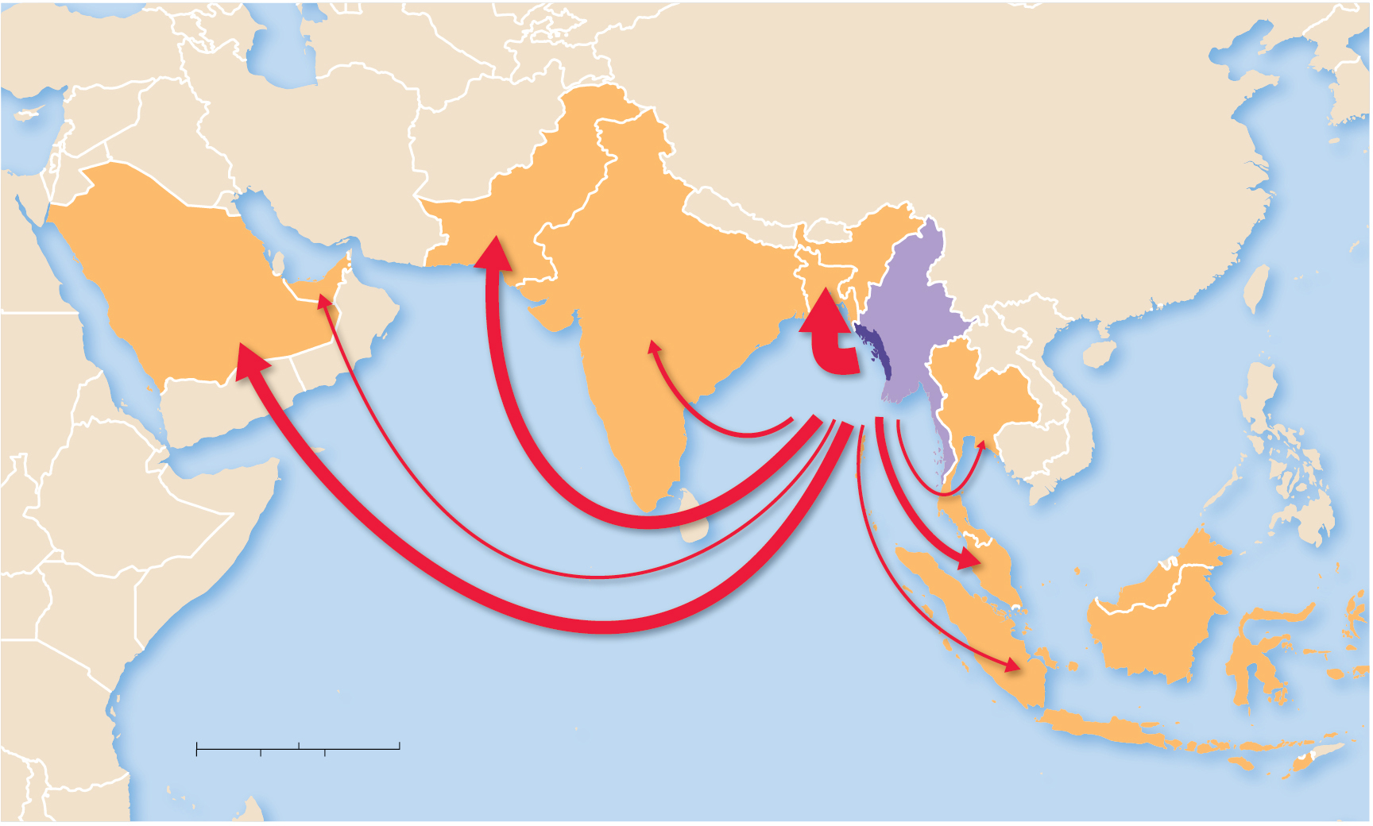
7.4.1 Ethnic Cleansing and Genocide Past and Present (5 of 5)
Figure 7-51: Bangladesh, Pakistan, and Saudi Arabia are the three countries to which ethnically cleansed Rohingya have fled.
IRAN
CHINA
IRAQ
UNITED ARAB
EMIRATES
PAKISTAN
BANGLADESH
350,000
1,000,000
SAUDI
ARABIA
10,000
200,000
INDIA
MYANMAR
40,000
700,000
Arabian
Sea
Rakhine
THAILAND
South
China
Sea
5,000
MALAYSIA
150,000
INDONESIA
INDIAN OCEAN
1,000
0
500
1,000 Miles
0
500
1,000 Kilometers

Slide 61
7.4.2 Ethnic Cleansing in Southeast Europe (1 of 3)
Yugoslavia was a multiethnic state created after
A strong unifying leader, Josef Tito, held the country together until his death, whereupon the country underwent balkanization—the process by which a state breaks down through conflicts among its ethnicities
Ethnic cleansing took place in both Bosnia and Kosovo during the 19 90s

Slide 62
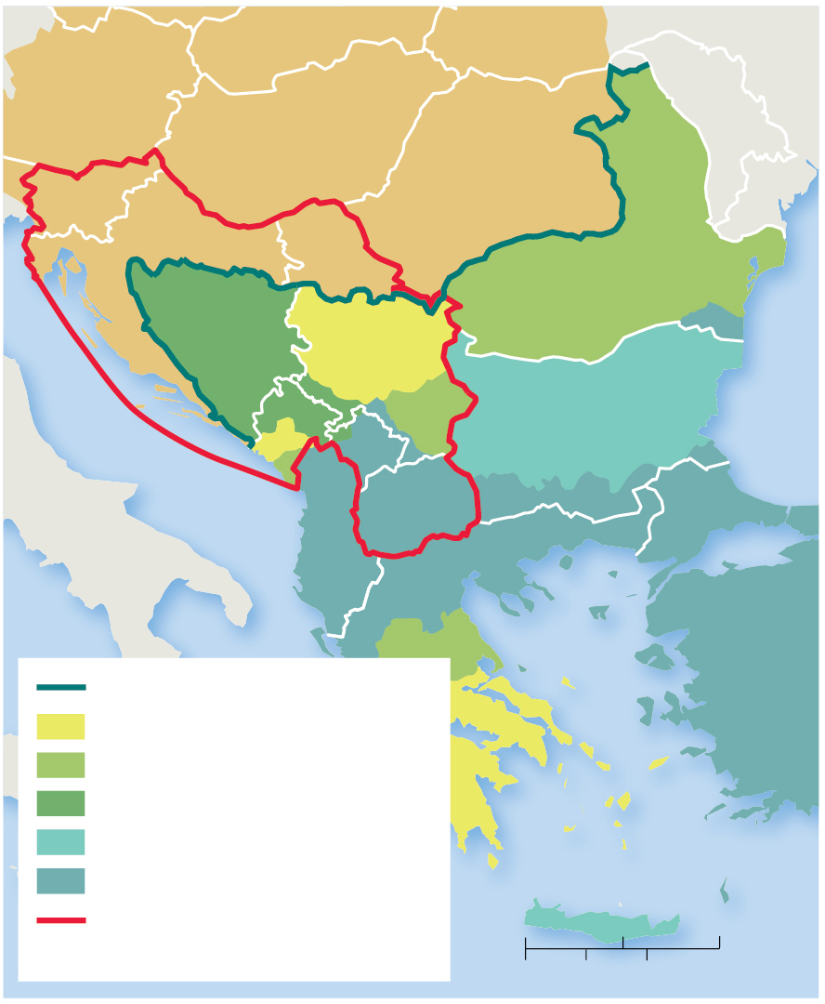
7.4.2 Ethnic Cleansing in Southeast Europe (2 of 3)
Figure 7-52: The Balkans have a varied history of changing borders with complex ethnic and national identities.
AUSTRIA
MOLDOVA
AUSTRIA-HUNGARY EMPIRE
SLOVENIA
HUNGARY
ROMANIA
CROATIA
BOSNIA
& HERZ.
SERBIA
Adriatic Sea
MONT.
OTTOMAN EMPIRE
Black
Sea
KOS.
BULGARIA
ITALY
MACEDONIA
ALBANIA
GREECE
TURKEY
Limits of the Ottoman Empire
Aegean Sea
Independent, 1817–1830
Independent, 1878
Lost to Austria-Hungary, 1878
Independent, 1908
Mediterranean Sea
Ottoman Empire, 1908
Yugoslavia, 1918–1992
0
100
200 Miles
Present-day borders are shown.
0
100
200 Kilometers

Slide 63
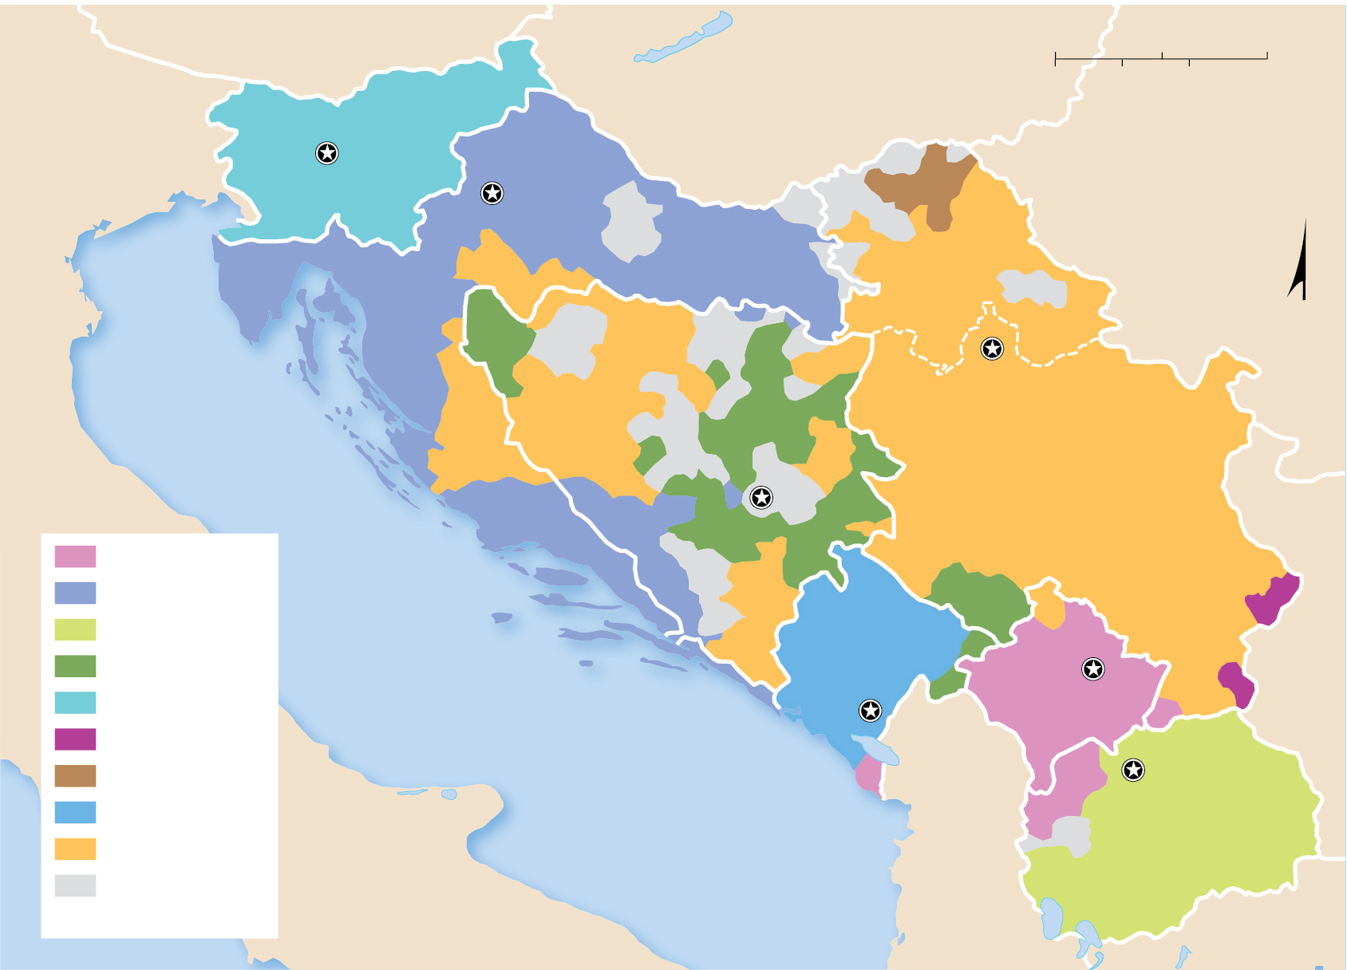
7.4.2 Ethnic Cleansing in Southeast Europe (3 of 3)
Figure 7-53: Yugoslavia was unified until its president’s death, after which it divided, and ethnicities fought for control in several of the territories.
AUSTRIA
0
50
100 Miles
HUNGARY
0
50
100 Kilometers
ITALY
Ljubljana
SLOVENIA
Zagreb
ROMANIA
CROATIA
VOJVODINA
N
BOSNIA &
HERZEGOVINA
Belgrade
SERBIA
BULGARIA
Albanians
Croats
Macedonians
MONTENEGRO
Bosniaks
A d r i a t i c S e a
Pristina
Slovenes
Podgorica
KOSOVO
Bulgarians
Skopje
Hungarians
Montenegrins
MACEDONIA
Serbs
no predominant
majority
ALBANIA
GREECE

Slide 64
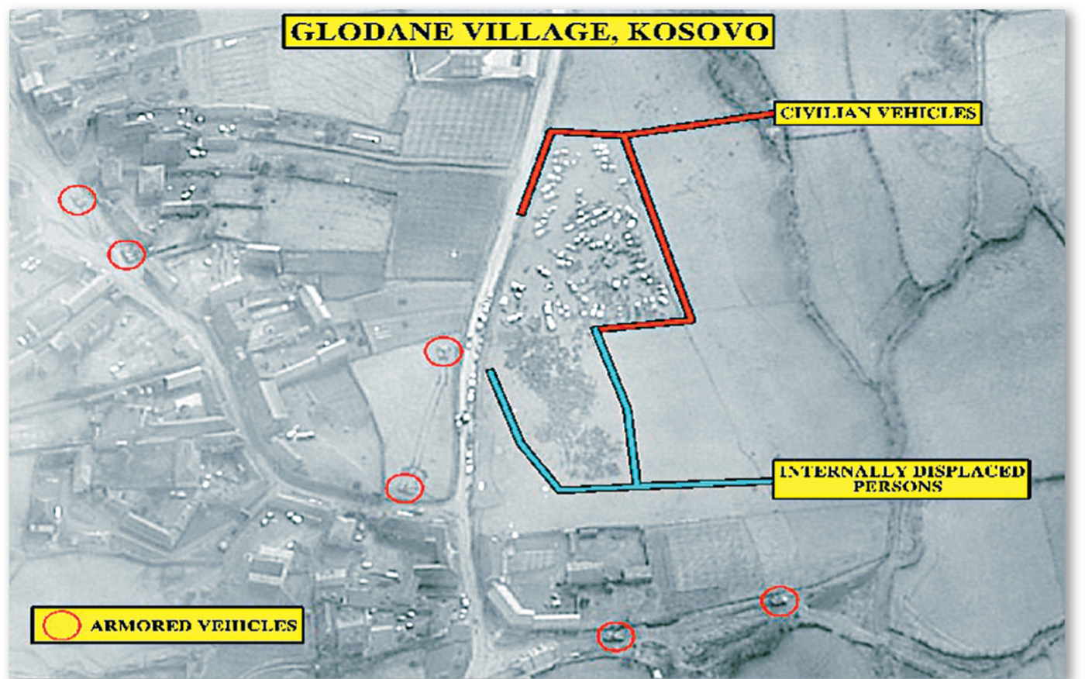
7.4.3 Ethnic Cleansing in Bosnia and Herzegovina (1 of 4)
Figure 7-54: Air photos document the forced removal of Albanian villagers from Kosovo by Serbs.

Slide 65
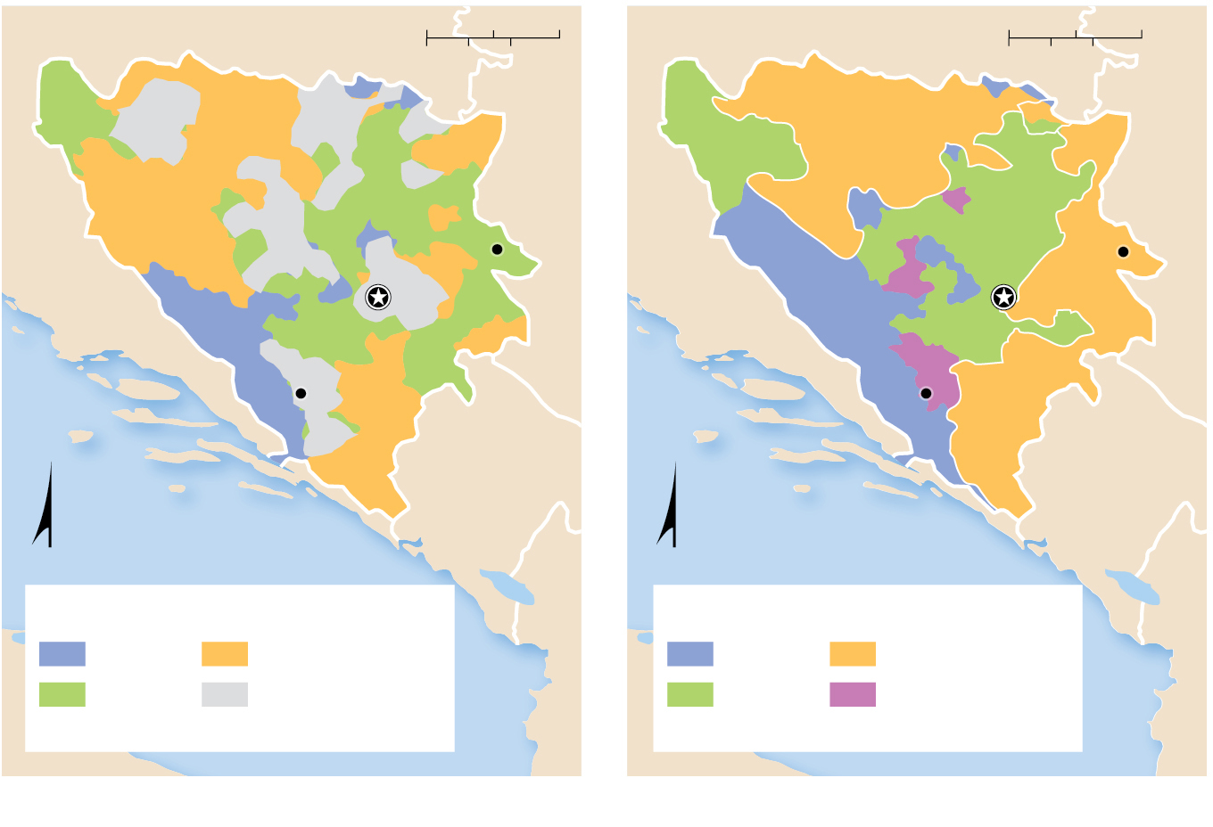
7.4.3 Ethnic Cleansing in Bosnia and Herzegovina (2 of 4)
Figure 7-55: Ethnic cleansing changed the distribution of ethnicities in Bosnia & Herzegovina.
CROATIA
0
25
50 Miles
CROATIA
0
25
50 Miles
0
25
50 Kilometers
0
25
50 Kilometers
BRCKKO
DISTRICT
REPUBLIKA
SRPSKA
SERBIA
SERBIA
Srebrenica
FEDERATION OF
BOSNIA AND
HERZEGOVINA
Srebrenica
Sarajevo
REPUBLIKA
SRPSKA
Sarajevo
Mostar
Mostar
MONTENEGRO
MONTENEGRO
N
Adriatic Sea
N
Adriatic Sea
Before ethnic cleansing, 1991
After ethnic cleansing, 1998
Croat
Serb
Croat
Serb
Bosniak
No predominant
majority
Bosniak
Bosniak-Croat
mix
(a)
(b)

Slide 66
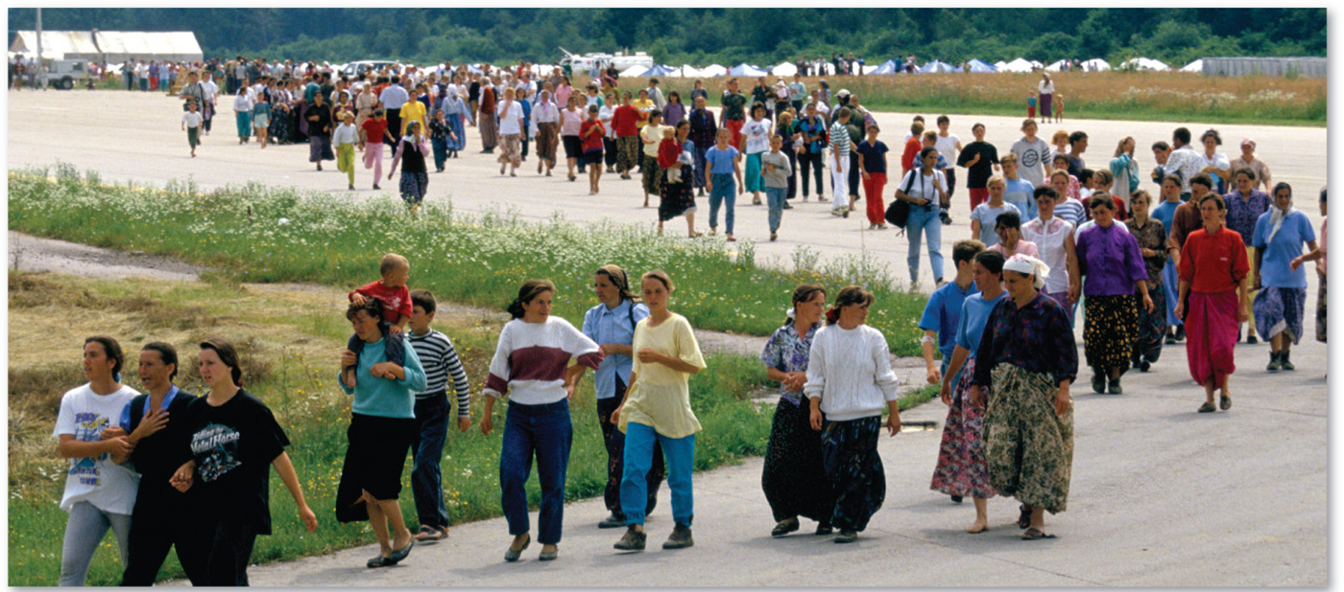
7.4.3 Ethnic Cleansing in Bosnia and Herzegovina (3 of 4)
Figure 7-56: The 1995 Srebrenica massacre is considered the largest single ethnic cleansing and genocide event in Bosnia & Herzegovina.

Slide 67
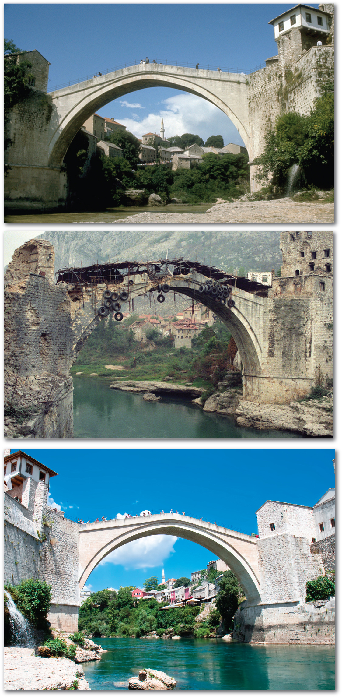
7.4.3 Ethnic Cleansing in Bosnia and Herzegovina (4 of 4)
Figure 7-57: (a) The Stari Most (old bridge), in the city of Mostar, Bosnia & Herzegovina, was built by the Turks in 1566. (b) The bridge was blown up by Croats in 1993 as part of their ethnic cleansing against the Bosniaks. (c) With the end of the war in Bosnia & Herzegovina, the bridge was rebuilt in 2004.
(a)
(b)
(c)
(c)

Slide 68
7.4.4 Ethnic Cleansing and Genocide in Africa (1 of 5)
Africa is extremely ethnically diverse
Colonial boundaries: many ethnicities into single nationalities
Ethnic cleansing and genocide in:
Sudan: Arab majority on peripheral regions
Rwanda and Burundi: Hutus on Tutsis
Democratic Republic of Congo: spillover violence from Rwanda, continued conflict

Slide 69
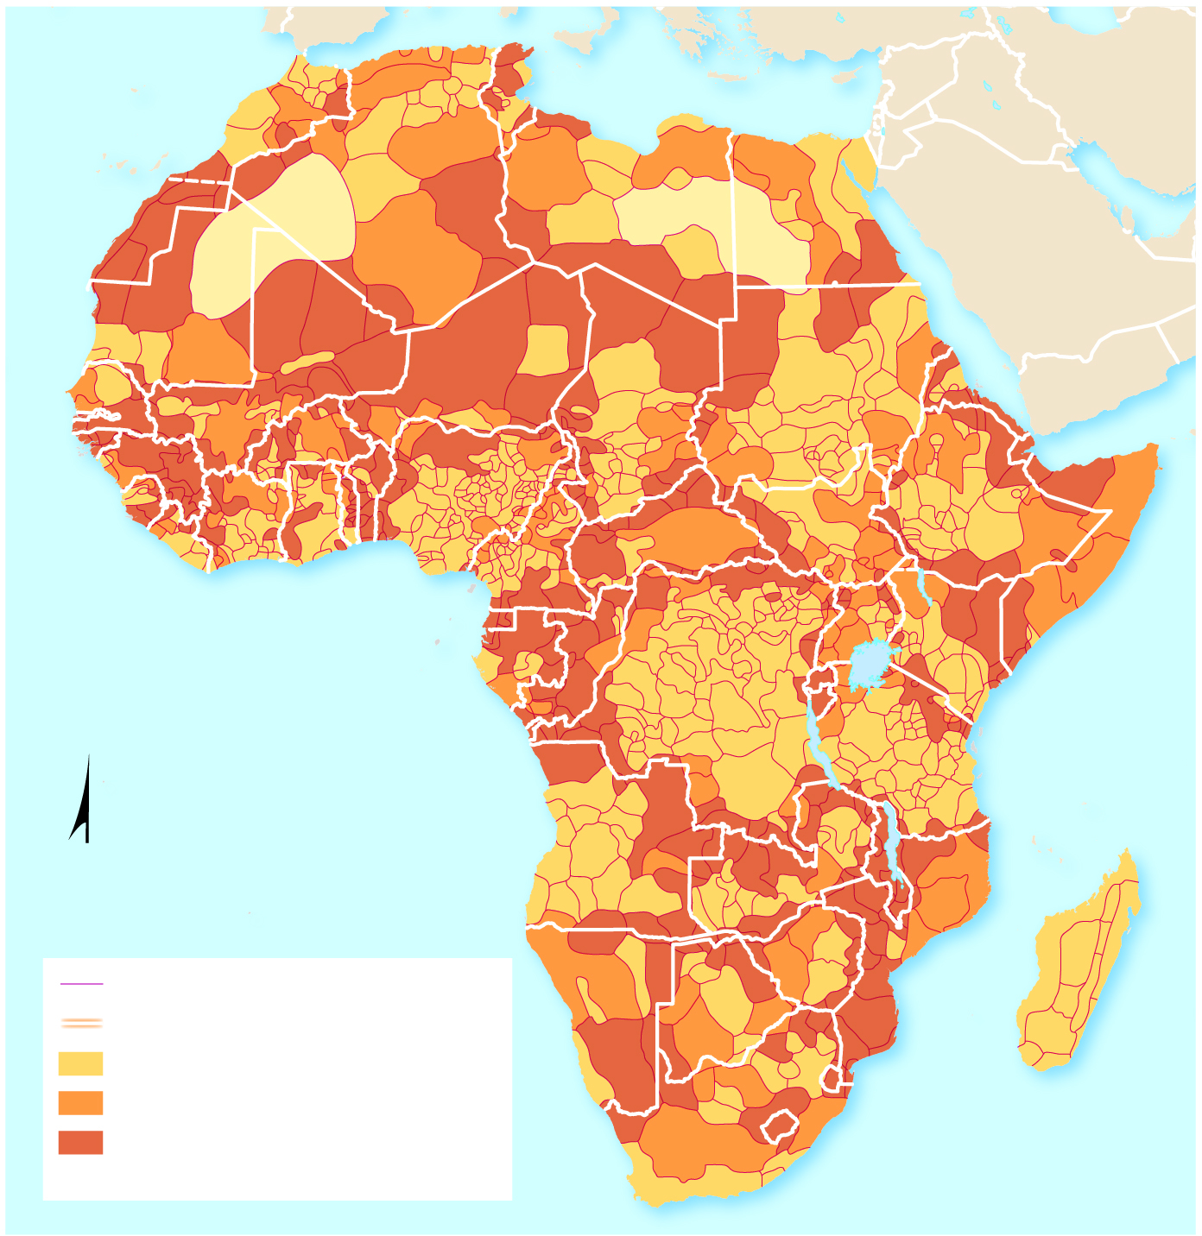
7.4.4 Ethnic Cleansing and Genocide in Africa (2 of 5)
Figure 7-58: National boundaries do not match the distribution of Africa’s many ethnic groups.
MOROCCO
TUNISIA
Mediterranean Sea
WESTERN
SAHARA
ALGERIA
LIBYA
EGYPT
MAURITANIA
MALI
SENEGAL
NIGER
CHAD
SUDAN
ERITREA
GAMBIA
BURKINA
DJIBOUTI
GUINEA-
GUINEA
FASO
BENIN
BISSAU
CÔTE
GHANA
NIGERIA
CENT.
AFRICAN
REP.
SOUTH
ETHIOPIA
SIERRA
LEONE
LIBERIA
D’IVOIRE
CAMEROON
SUDAN
TOGO
SOMALIA
SAO TOME & PRINCIPE
REP.
OF
CONGO
DEM. REP.
OF CONGO
UGANDA
KENYA
EQ. GUINEA
GABON
RWANDA
BURUNDI
TANZANIA
INDIAN
OCEAN
ATLANTIC
OCEAN
N
ANGOLA
ZAMBIA
MALAWI
MOZAMBIQUE
Ethnic boundaries
NAMIBIA
ZIMBABWE
MADAGASCAR
National boundaries
BOTSWANA
Ethnicity 100% in one country
Ethnicity at least 90% in one country
SOUTH
AFRICA
ESWATINI
Ethnicity divided among more than
one country
LESOTHO

Slide 70
7.4.4 Ethnic Cleansing and Genocide in Africa (3 of 5)
Figure 7-59: The Gurage people are one of many ethnicities in southwestern Ethiopia.

Slide 71
7.4.4 Ethnic Cleansing and Genocide in Africa (4 of 5)
Figure 7-60: Ethnic groups in the south, east, and west of the Arab majority of Sudan have been subject to ethnic cleansing and genocide.
EGYPT
SAUDI
ARABIA
LIBYA
EASTERN
FRONT
COALITION
Nile
Red Sea
CHAD
SUDAN
Khartoum
ERITREA
Blue Nile
DARFUR
REGION
SOUTH
KORDOFAN
BLUE
NILE
ABYEI
ETHIOPIA
CENTRAL
AFRICAN
REPUBLIC
SOUTH
SUDAN
N
White Nile
0
125
250 Miles
Juba
0
125
250 Kilometers
DEM. REP. OF
THE CONGO

Slide 72
7.4.4 Ethnic Cleansing and Genocide in Africa (5 of 5)
Figure 7-61: Around two million South Sudanese are internally displaced (I D P s) and living in refugee camps.

Slide 73
7.4.5 Conflict in Central Africa (1 of 3)
Figure 7-62: Genocide in Rwanda resulted in more than a million refugees fleeing Rwanda for neighboring countries.
UGANDA
DEM. REP.
OF CONGO
10,000
850,000
473,000
Byumba
Lake
Kivu
RWANDA
Kigali
Kibuye
Butare
450,000
TANZANIA
255,000
164,000
Bujumbura
BURUNDI
Rwandan genocide
Lake Tanganyika
Massacre sites
(800,000 killed)
Hutu-controlled
government troops
0
20
40 Miles
Refugee flow
0
20
40 Kilometers

Slide 74
7.4.5 Conflict in Central Africa (2 of 3)
Figure 7-63: The Kigali Genocide Memorial Centre contains mass graves of victims of the 1994 genocide.

Slide 75
7.4.5 Conflict in Central Africa (3 of 3)
Figure 7-64: Congo has experienced long-running and deadly civil wars.
CENTRAL AFRICAN
REPUBLIC
SOUTH
SUDAN
Ubangi
Bandia
Yakoma
Zande
Baka
CAMEROON
Ngbaka
Ngbandi
Bongo
Mangbetu
Momvu
Mabale
Ngombe
Congo
Budja
Batete
Mbaka
Ngala
Balolo
Mongo
Doko
Boa
Pere
Lake
Albert
REPUBLIC
OF THE
CONGO
Ngandu
Topoke
Mba
GABON
Loi
Yela
K
omo
Hunde
UGANDA
Ngata
Mbole
Lengola
Lake
Edward
Bakuti
Kundu
Akela
Hamba
Lake Kuvu
Bayanzi
Jonga
Mituku
RWANDA
Baboma
Mfinu
Dengese
Nkutu
Lega
Hungaan
Zimba
BURUNDI
Teke
Pindi
Kasai
Kuba
Binsi
Kusu
Congo
Mbuun
Bangyeen
Bembe
Nsundi
Wumbu
Mbala
Bashilele
Kete
Bushoong
Tetela
Sikasingo
TANZANIA
Woyo
Kongo
Yaka
Dinga
(Lele)
Nsapo
Mputu
Buyu
Kakongo
Nkanu
Suku
Bena-Lulua
Biombo
Songye
Lake
Tanganyika
Pende
Mbagani
Luntu
Kasayi
Hemba
Lunda
Lwalwa
Bindji
Kanyok
Holoholo
Holo
Kete
Kalundwe
Tabwa
Salampasu
Shandaki
Kunda
Rungu
Lunda
Luba
Yeke
Lake
Mweru
ANGOLA
Upenba
Zela
ATLANTIC
OCEAN
Tshokwe
Bemba
Lunda
0
150
300 Miles
ZAMBIA
N
0
150
300 Kilometers

Slide 76
Copyright
This work is protected by United States copyright laws and is provided solely for the use of instructors in teaching their courses and assessing student learning. Dissemination or sale of any part of this work (including on the World Wide Web) will destroy the integrity of the work and is not permitted. The work and materials from it should never be made available to students except by instructors using the accompanying text in their classes. All recipients of this work are expected to abide by these restrictions and to honor the intended pedagogical purposes and the needs of other instructors who rely on these materials.

