Slide 1
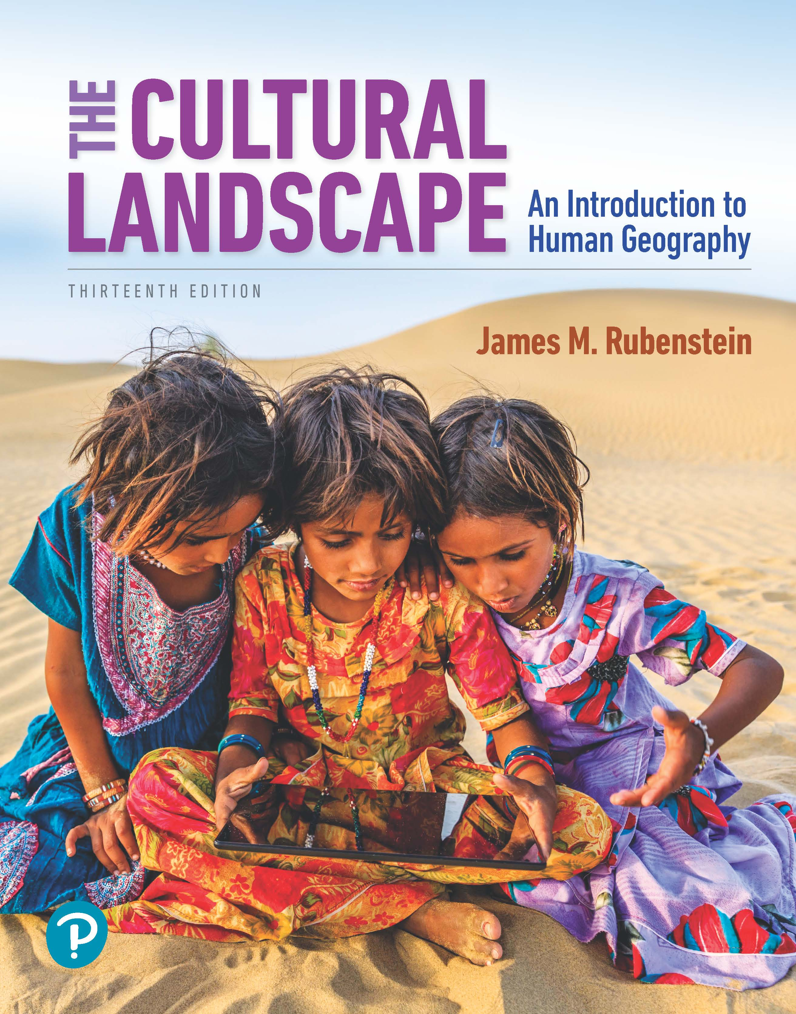
The Cultural Landscape: An Introduction to Human Geography
Thirteenth Edition
Chapter 8 Lecture
Political Geography
Copyright © 2020 Pearson Education, Inc. All Rights Reserved
Notes:
If this PowerPoint presentation contains mathematical equations, you may need to check that your computer has the following installed:
1) MathType Plugin
2) Math Player (free versions available)
3) NVDA Reader (free versions available)

Slide 2
Political Geography: Key Issues
8.1 Where Are States Distributed?
8.2 Why Are States Challenging to Create?
8.3 Why Do States Face Threats?
8.4 Why Do States Have Distinctive Geographic Structure?

Slide 3
Key Issue 1: Where Are States Distributed?
8.1.1 Politics and Geography
8.1.2 Challenges in Defining States

Slide 4
8.1.1 Politics and Geography (1 of 3)
A state is an area organized into a political unit and ruled by an established government that has control over its internal and foreign affairs. It occupies a defined territory on Earth’s surface and contains a permanent population
Country is a synonym for state
A microstate is a state with a very small land area. Monaco (0.8 square miles) and the Vatican (0.17 square miles) are prime examples of microstates

Slide 5
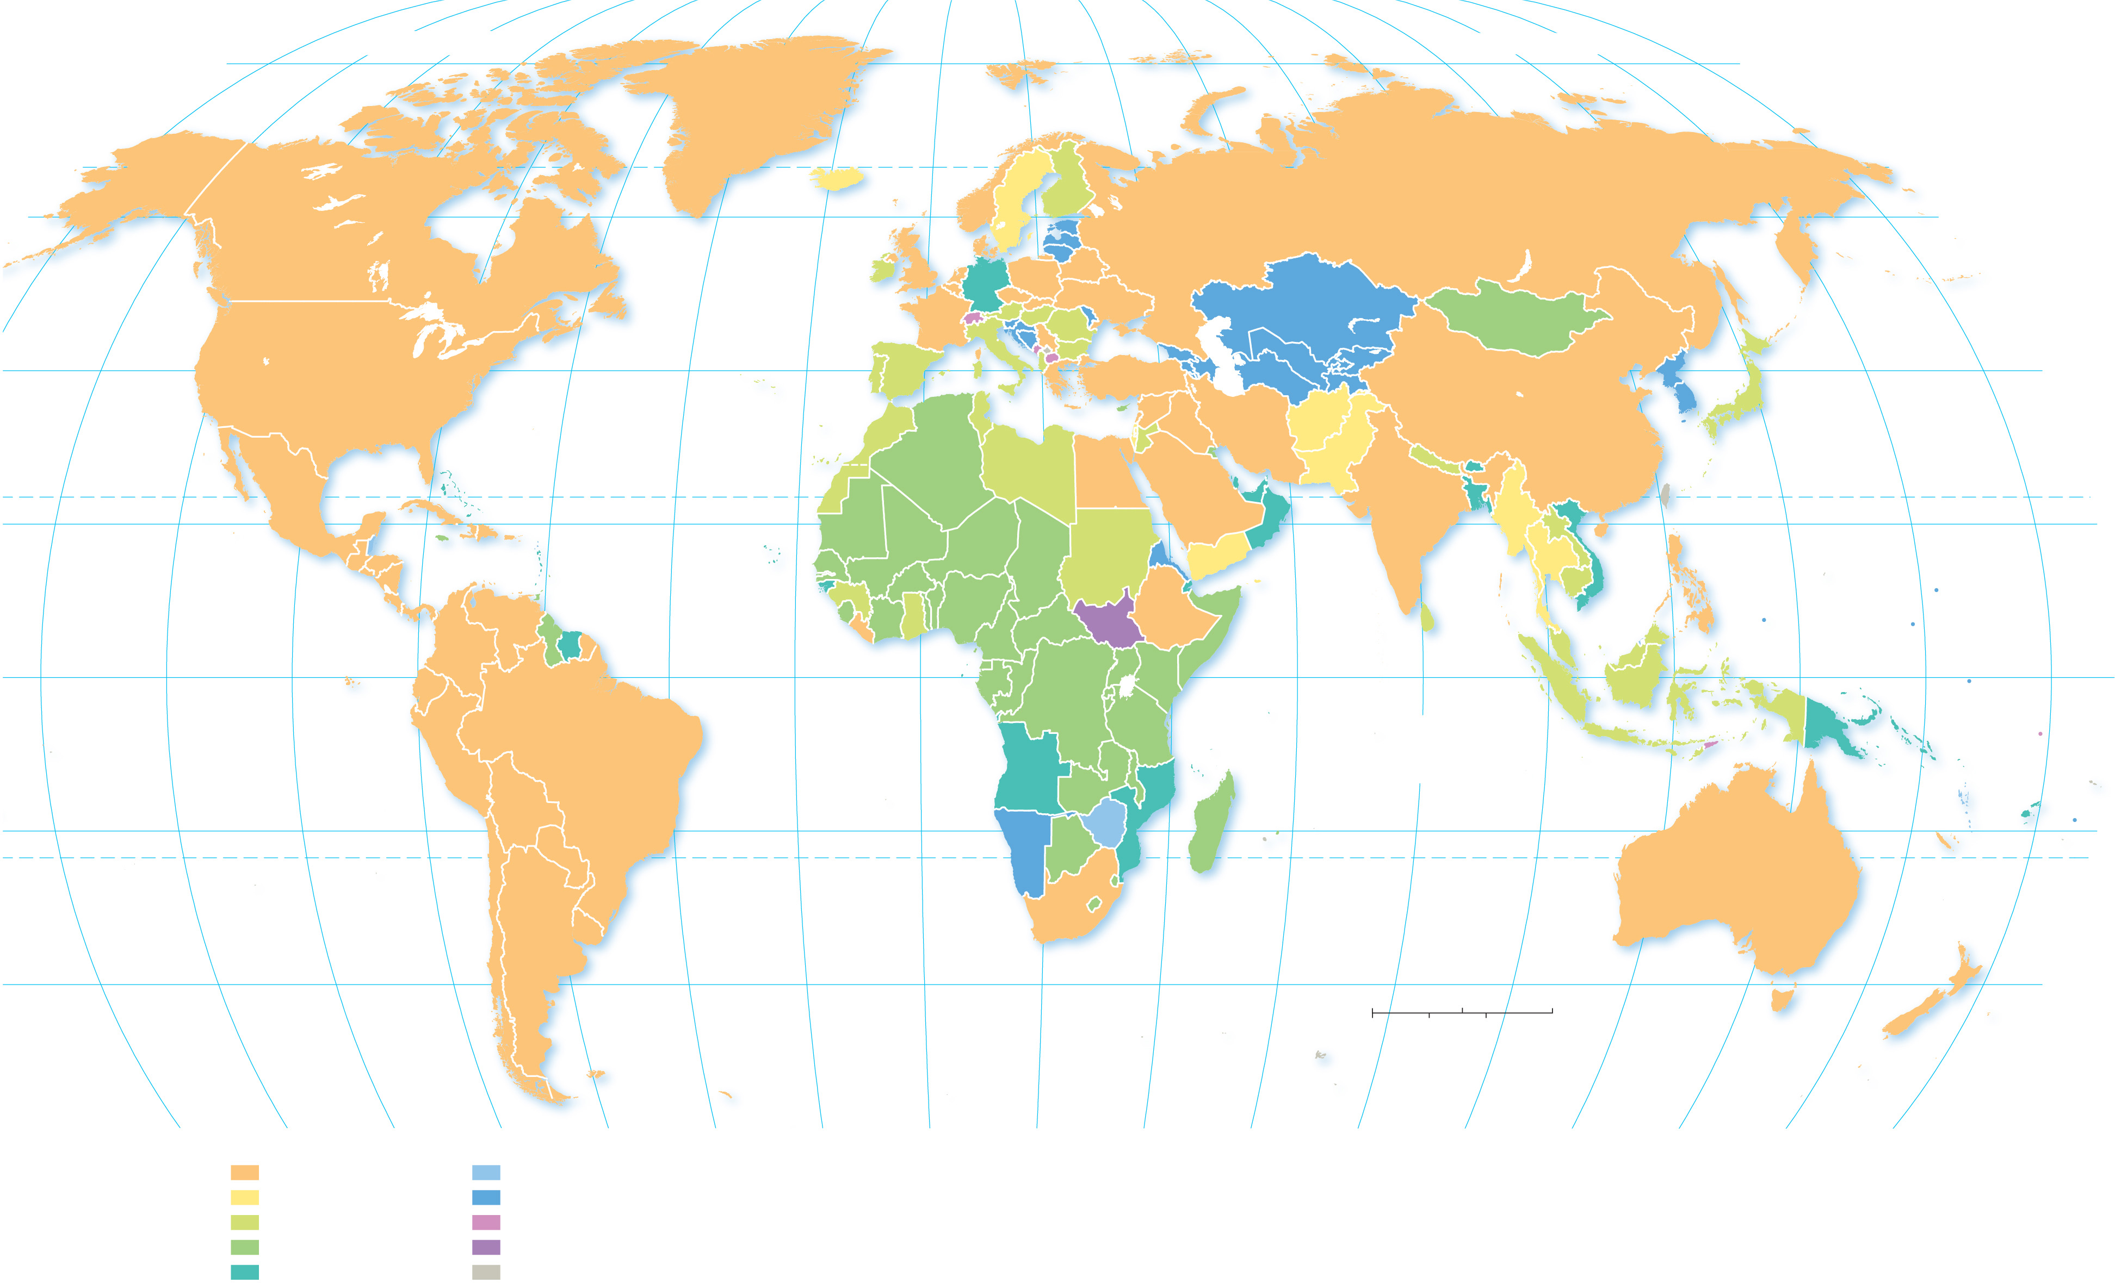
8.1.1 Politics and Geography (2 of 3)
Figure 8-1: Colors indicate date of United Nations membership; nearly every state is a member of the U N.
160°
140°
120°
100°
80°
60°
40°
20°
0°
20°
40°
60°
80°
100°
120°
140°
160°
180°
80°
ARCTIC OCEAN
ARCTIC OCEAN
80°
60°
ICELAND
NORWAY
SWEDEN
FINLAND
RUSSIA
60°
UNITED
KINGDOM
ESTONIA
CANADA
IRELAND
NETH.
DEN.
GER.
POLAND
LATVIA
LITH.
BELARUS
BELG.
LUX.
CZH.
SLVK.
UKRAINE
KAZAKHSTAN
LIECH. (1990)
AUS.
HUN.
ROM.
MOL.
MONGOLIA
ANDORRA
(1993)
SWITZ.
SLOV.
CRO.
FRANCE
ITALY
BOS.-
HER.
SERB.
PORTUGAL
SAN
MAR.
(1992)
MONT.
KOS.
BUL.
GEORGIA
UZBEKISTAN
KYRGYZSTAN
NORTH
KOREA
40°
40°
UNITED STATES
SPAIN
MON.
(1993)
MAC.
TURKEY
ARMENIA
TURKMENISTAN
TAJIKISTAN
ATLANTIC
OCEAN
TUNISIA
ALB.
GREECE
SYRIA
AZERBAIJAN
CHINA
SOUTH
KOREA
JAPAN
MALTA
CYPRUS
IRAQ
IRAN
AFGHANISTAN
MOROCCO
(1964)
LEBANON
THE BAHAMAS
ALGERIA
LIBYA
ISRAEL
JORDAN
KUWAIT
BAHRAIN
(1971)
QATAR
PAKISTAN
NEPAL
BHUTAN
MEXICO
(1973)
DOMINICAN
ST. KITTS & NEVIS (1983)
EGYPT
SAUDI
ARABIA
U.A.E.
BANGLADESH
Taiwan
TROPIC OF CANCER
20°
CUBA
REPUBLIC
ANTIGUA & BARBUDA (1981)
CABO VERDE(
1975)
OMAN
INDIA
MYANMAR
(BURMA)
LAOS
20°
BELIZE
HAITI
DOMINICA (1978)
MAURITANIA
MALI
NIGER
HONDURAS
ST. LUCIA (1979)
ERITREA
YEMEN
THAILAND
PHILIPPINES
PACIFIC
OCEAN
JAMAICA
ST. VINCENT & THE
THE
GAMBIA
SENEGAL
CHAD
SUDAN
PACIFIC
OCEAN
GUATEMALA
NICARAGUA
GRENADINES (1980)
BURKINA
FASO
DJIBOUTI
CAMBODIA
EL SALVADOR
BARBADOS (1966)
GUINEA
BENIN
VIETNAM
MARSHALL IS.
(1991)
VENEZUELA
GRENADA (1974)
GUINEA-
BISSAU
NIGERIA
COSTA RICA
TRINIDAD & TOBAGO (1962)
CÔTE
CENT.
AF. REP.
SOUTH
SUDAN
ETHIOPIA
SRI
PALAU
(1994)
PANAMA
SIERRA
LEONE
D'IVOIRE
CAMEROON
MALDIVES
(1965)
LANKA
BRUNEI
FED. STATES
OF MICRONESIA
(1991)
0°
COLOMBIA
GUYANA
SURINAME
LIBERIA
GHANA
TOGO
GABON
RWANDA
UGANDA
KENYA
SOMALIA
MALAYSIA
EQUATOR
0°
ECUADOR
SAO TOME &
PRINCIPE
(1975)
EQUATORIAL
GUINEA
DEM. REP.
OF CONGO
BURUNDI
SEYCHELLES
(1976)
SINGAPORE
(1965)
INDONESIA
PAPUA
NEW
GUINEA
NAURU
(1999)
KIRIBATI
(1999)
BRAZIL
REP. OF CONGO
TANZANIA
INDIAN
OCEAN
SOLOMON IS.
(1978)
PERU
ATLANTIC
OCEAN
ANGOLA
(CABINDA)
ANGOLA
MALAWI
COMOROS (1975)
TIMOR-
LESTE
TUVALU
(2000)
SAMOA
(1976)
20°
BOLIVIA
ZAMBIA
ZIMBABWE
MADAGASCAR
VANUATU
(1981)
FIJI
(1970)
TONGA
(1999)
NAMIBIA
BOTSWANA
MOZAMBIQUE
MAURITIUS
20°
CHILE
PARAGUAY
(1968)
AUSTRALIA
TROPIC OF CAPRICORN
URUGUAY
SOUTH
AFRICA
LESOTHO
ESWATINI
40°
ARGENTINA
40°
0
1,000
2,000 Miles
NEW ZEALAND
40°
0
1,000
2,000 Kilometers
140°
120°
100°
80°
1980s: added 7
1990s: added 31
2000s: added 4
2010s: added 1
nonmember
60°
40°
20°
0°
20°
40°
60°
80°
100°
120°
140°
160°
180°
Original U.N. members: 51
1940s: added 8
1950s: added 24
1960s: added 42
1970s: added 25

Slide 6
8.1.1 Politics and Geography (3 of 3)
Figure 8-2: Monaco occupies only 2 square kilometers.

Slide 7
8.1.2 Challenges in Defining States (1 of 3)
A state has sovereignty, which means independence from control of its internal affairs by other states
The sovereignty of several states remains in question. Examples:
North and South Korea claim each other
Chinese claims on Taiwan
Claims on the Senkaku/Diaoyu Islands by China and Japan
Sahrawi Republic (Western Sahara)

Slide 8
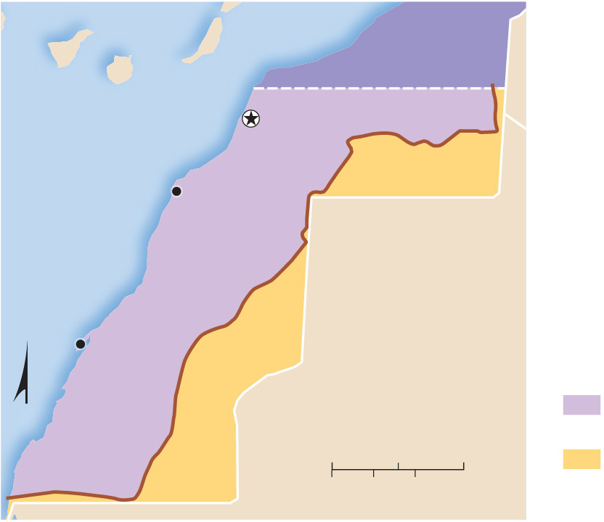
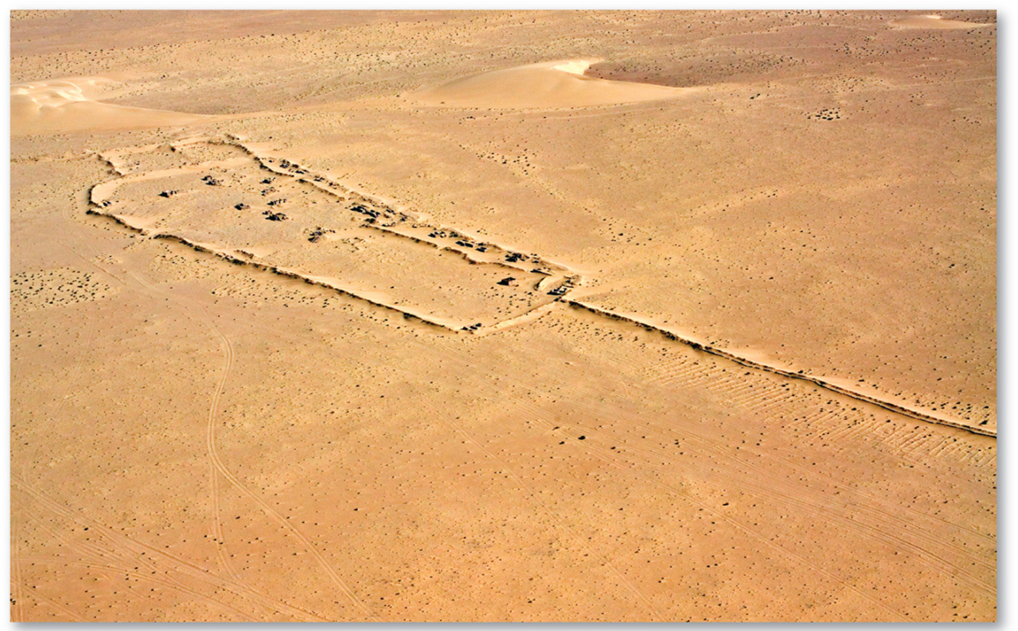
8.1.2 Challenges in Defining States (2 of 3)
Figures 8-4 and 8-5: Western Sahara is claimed by Morocco, which controls most of the territory (left). The Polisario Front controls the far eastern portion, behind a sand berm (right) built by the Moroccan government.
MOROCCO
ATLANTIC
OCEAN
Laayoune
WESTERN SAHARA
Boujdour
MAURITANIA
sand wall
Ad Dakhla
N
Moroccan
control
0
75
150 Miles
Polisario
Front
0
75
150 Kilometers

Slide 9
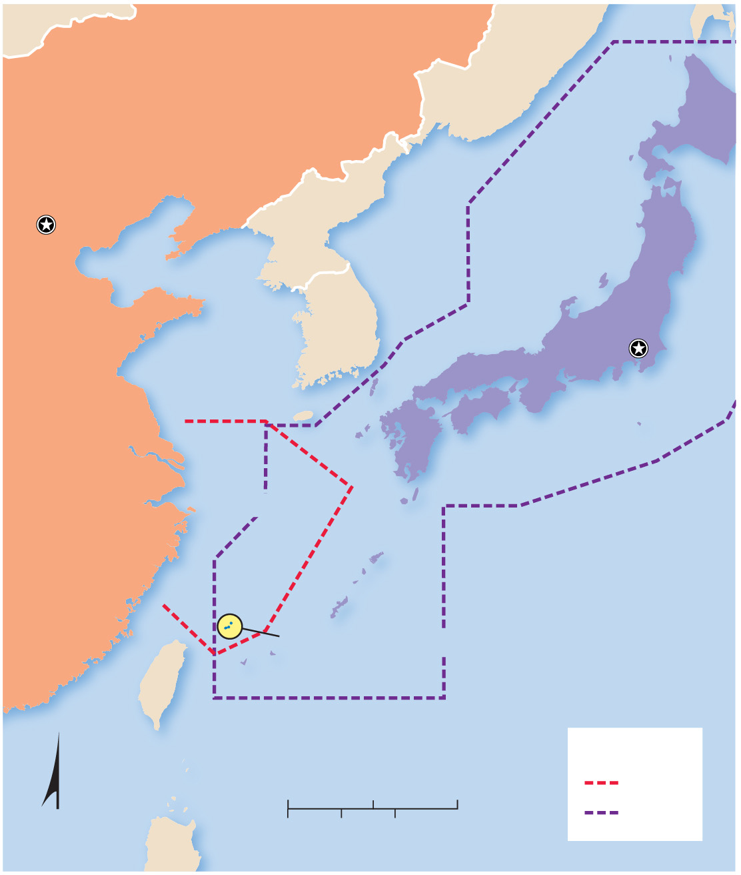
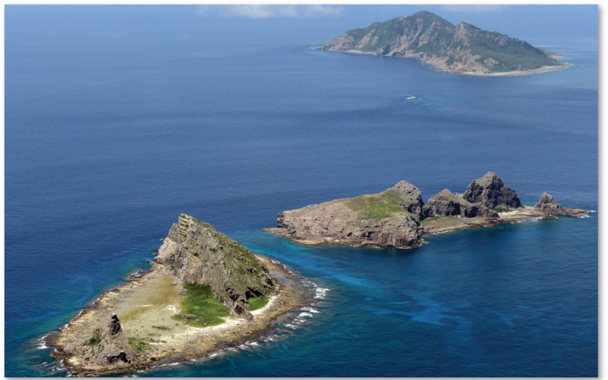
8.1.2 Challenges in Defining States (3 of 3)
Figures 8-6 and 8-7: The Senkaku/Diaoyu Islands are claimed by both China and Japan.
RUSSIA
CHINA
Sea of
Japan
(East Sea)
Beijing
NORTH
KOREA
SOUTH
KOREA
JAPAN
Tokyo
East China
Sea
PACIFIC
OCEAN
Senkaku/Diaoyu
Islands
TAIWAN
Air defense
0
200
400 Miles
China
N
0
200
400 Kilometers
Japan

Slide 10
Key Issue 2: Why Are States Challenging to Create?
8.2.1 Evolution of States
8.2.2 Nation-States
8.2.3 Nation-States in the Former Soviet Union
8.2.4 Multinational States in the Former Soviet Union
8.2.5 Colonies

Slide 11
8.2.1 Evolution of States (1 of 6)
A city-state is a sovereign state that comprises a town and the surrounding countryside
The first city-states emerged in the Fertile Crescent
The Roman Empire at its zenith controlled most of Europe and the Mediterranean Basin
Much of Europe was organized into medieval estates for almost a millennium after the collapse of the Roman Empire

Slide 12
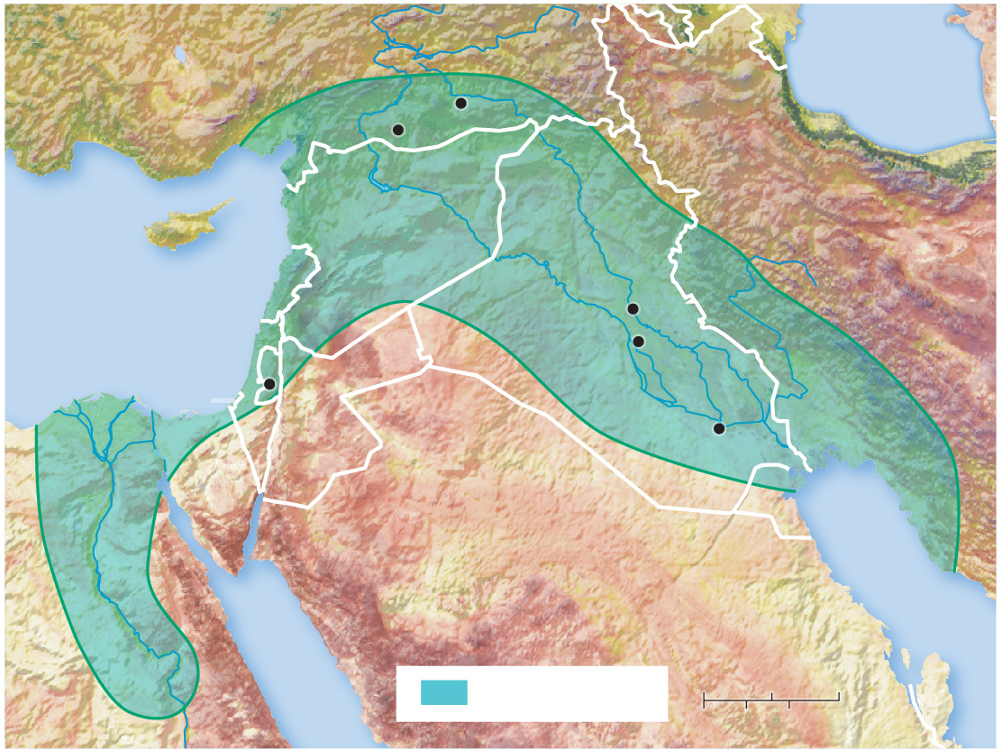
8.2.1 Evolution of States (2 of 6)
Figure 8-8: The Fertile Crescent was home to some of the earliest known city-states.
TURKEY
Black
Sea
Şanlıurfa
Diyarbakir
CYPRUS
SYRIA
IRAN
LEBANON
Mesopotamia
Tigris R.
Mediterranean
Sea
Euphrates R.
Baghdad
ISRAEL
Jerusalem
IRAQ
Babylon
GAZA
Ur
JORDAN
SINAI
SAUDI
ARABIA
KUWAIT
EGYPT
Nile R.
Red
Sea
Persian Gulf
Fertile Crescent
0
100
200 Miles
0
100
200 Kilometers

Slide 13
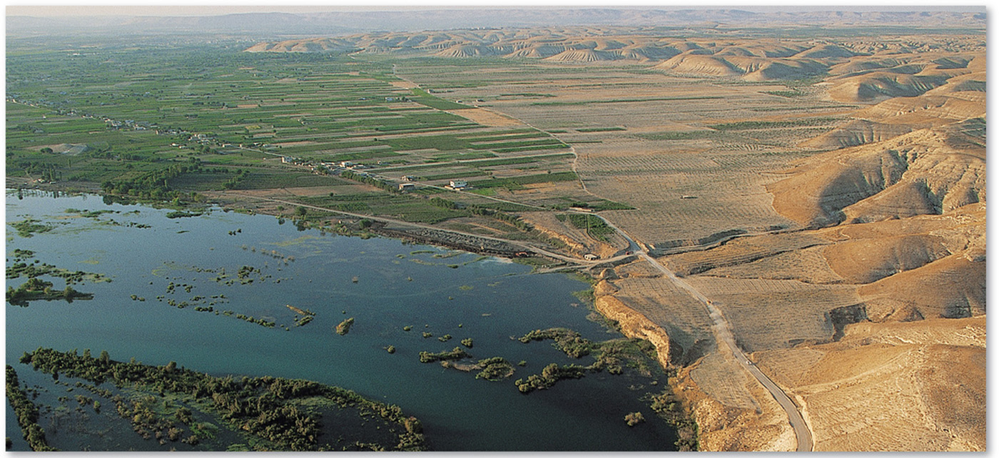
8.2.1 Evolution of States (3 of 6)
Figure 8-9: The Fertile Crescent stretches across much of what is now present-day eastern Turkey and Iraq.

Slide 14
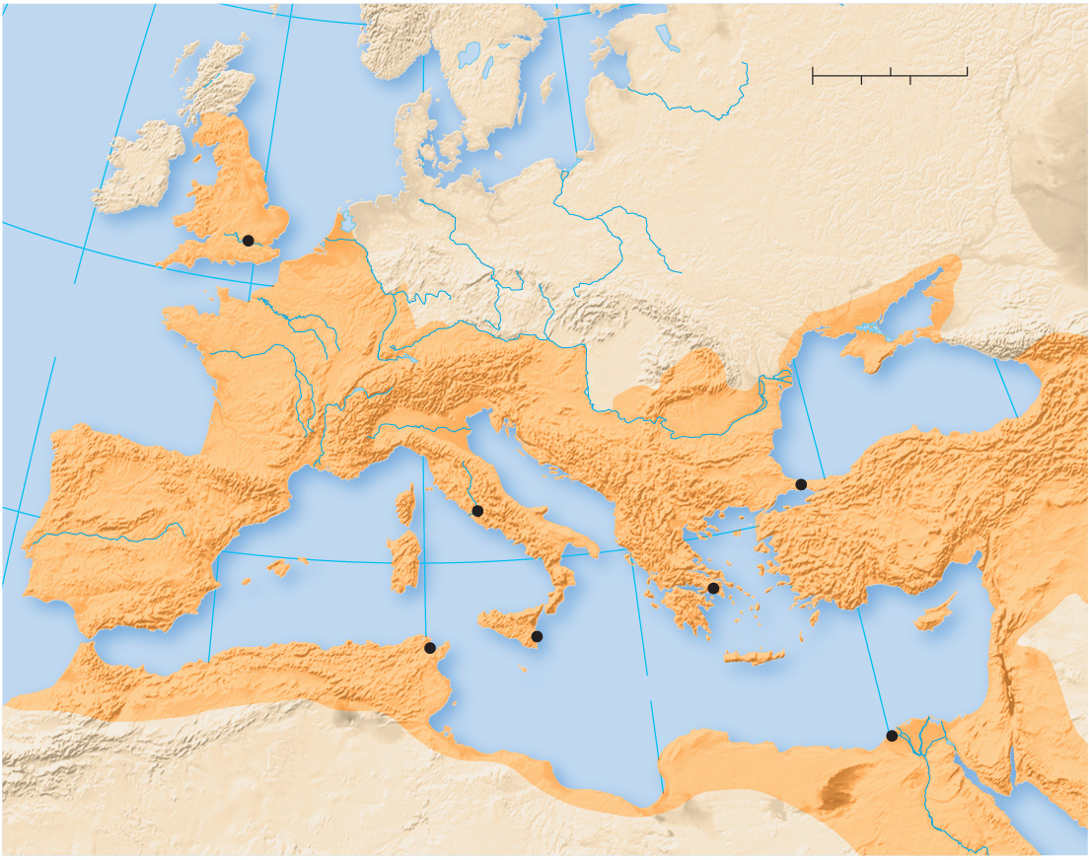
8.2.1 Evolution of States (4 of 6)
Figure 8-10: The Roman Empire represented a unified political body over many disparate ethnicities.
10°W
60°N
20°E
0°
0
200
400 Miles
North
Sea
Baltic
Sea
0
200
400 Kilometers
BRITAIN
50°N
Londinium
GERMANIA
SARMATIA
ATLANTIC
OCEAN
CAUCASUS
GAUL
DACIA
Black Sea
ALPS
Danube
Po
ILLYRICUM
ITALY
THRACE
BITHYNIA
Byzantium
ARMENIA
SPAIN
Corsica
Rome
MACEDONIA
ASIA
40°N
Sardinia
CAPADOCIA
Athens
CILICIA
Carthage
10°E
Sicily
A
CHAIA
S
YRIA
0°
Syracuse
Cyprus
NUMIDIA
Mediterranean Sea
Crete
20°E
Alexandria
30°E
ATLAS MTS.
CYRENAICA
ARABIA
GAETULIA
EGYPT
Red Sea

Slide 15
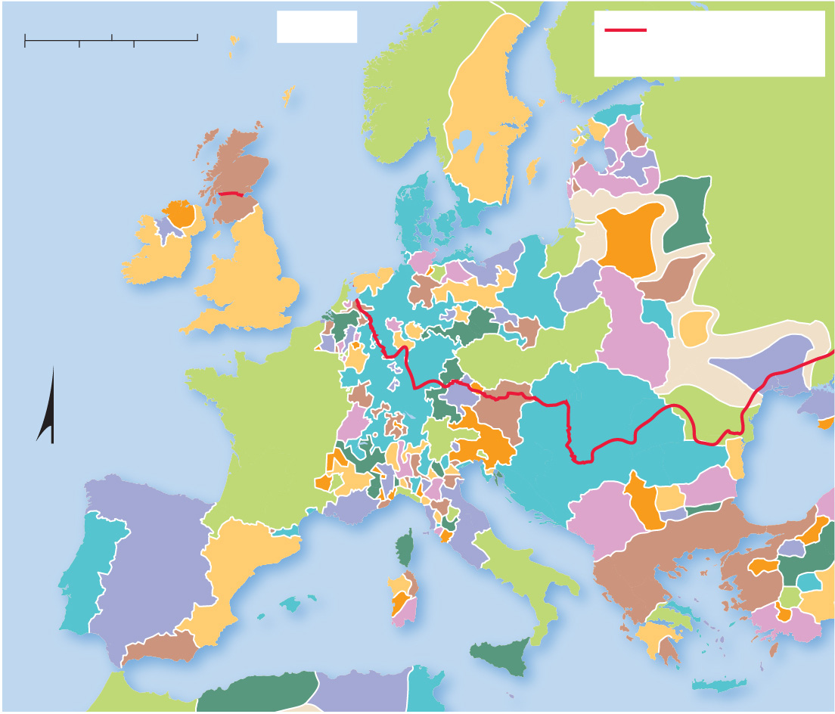
8.2.1 Evolution of States (5 of 6)
Figure 8-12: After the fall of the Roman Empire, Europe had many small political units.
0
250
500 Miles
1300
Extent of Roman
Empire, 100C.E.
0
250
500 Kilometers
ATLANTIC
OCEAN
NORWAY
SCOTLAND
North
Sea
SWEDEN
POLOTSK
DENMARK
WESTERN
KIPCHAK
LITHUANIA
ENGLAND
GREATER
POLAND
PINSK
SMALL
STATES
OF HOLY
ROMAN
EMPIRE
BOHEMIA
GALICIA–
VOLHYNIA
NOGAI
FRANCE
HABSBURG
MOLDAVIA
N
HUNGARY
Black
Sea
SICILY-
NAPLES
PAPAL
STATES
RAŠKA
ARAGON
SICILY-
NAPLES
ROMAN EMPIRE
PORTUGAL
CASTILE
GRANADA
Mediterranean Sea
SICILY-
TRINACRIA
MAGHREB
TIMACEN
BOUGIE
TUNIS

Slide 16
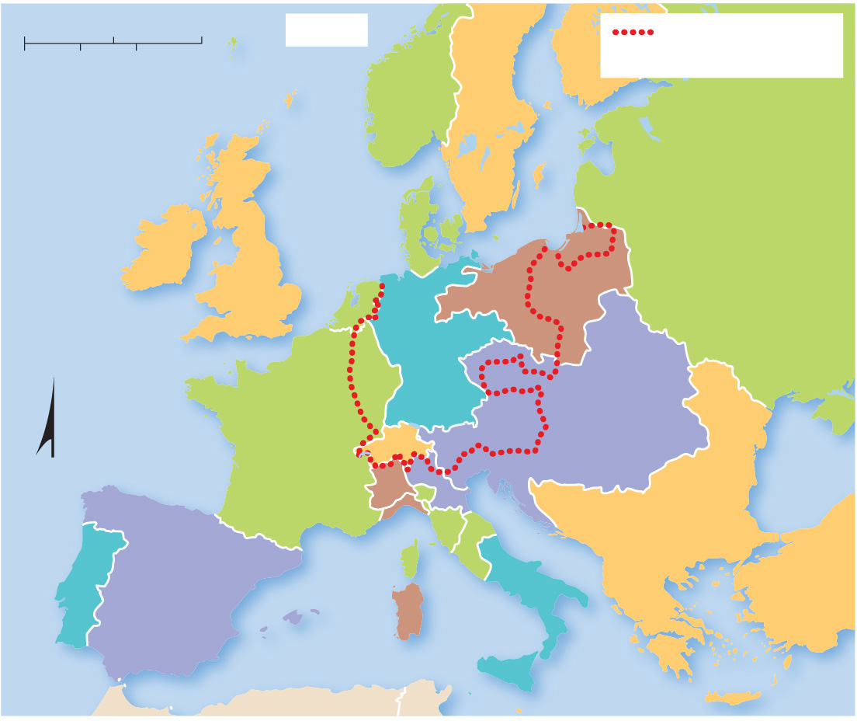
8.2.1 Evolution of States (6 of 6)
Figure 8-13: Smaller political units became part of larger empires by 1800.
0
250
500 Miles
1800
German-speaking
area in 1914
0
250
500 Kilometers
ATLANTIC
OCEAN
DENMARK-NORWAY
North
Sea
SWEDEN
RUSSIAN
EMPIRE
KINGDOM OF
GREAT BRITAIN AND
IRELAND
PRUSSIA
HOLY
ROMAN
EMPIRE
FRENCH
EMPIRE
AUSTRIA
N
HELVETIA
Black
Sea
SPAIN
SARDINIA
NAPLES
OTTOMAN EMPIRE
PORTUGAL
Mediterranean Sea
SICILY

Slide 17
8.2.2 Nation-States (1 of 7)
A nation is a large group of people who are united by common cultural characteristics, such as language and ethnicity, or by shared history
A nation-state is a state whose territory corresponds to that occupied by a particular nation
The concept that nations have the right to govern themselves is known as self-determination

Slide 18
8.2.2 Nation-States (2 of 7)
A multiethnic state has more than one ethnicity, shared nationality—the majority today are in Africa
A multinational state is a state that contains more than one nation
Europe in the 20th century was defined by boundaries matched to ethnicities and/or languages

Slide 19
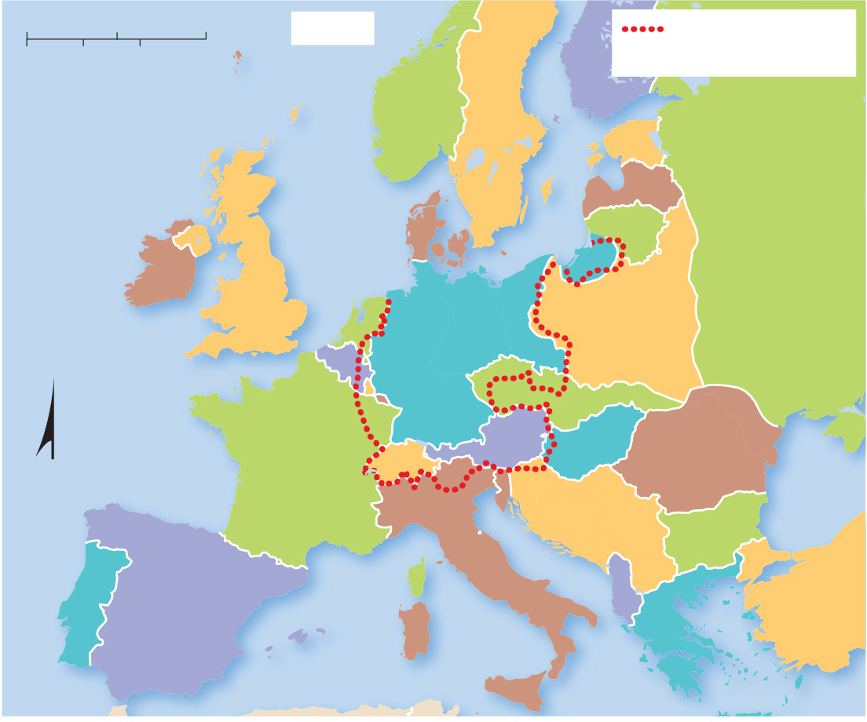
8.2.2 Nation-States (3 of 7)
Figure 8-14: After World War
the victors redrew
boundaries on the basis of language.
0
250
500 Miles
1924
German-speaking
area in 1914
0
250
500 Kilometers
NORWAY
FINLAND
ATLANTIC
OCEAN
SWEDEN
ESTONIA
North
Sea
LATVIA
DENMARK
LITHUANIA
IRELAND
UNITED
KINGDOM
GER.
U.S.S.R.
NETH.
POLAND
GERMANY
BELGIUM
LUX.
SAAR
CZECHOSLOVAKIA
FRANCE
SWITZ.
AUSTRIA
HUNGARY
Black
Sea
N
ROMANIA
AND.
YUGOSLAVIA
BULGARIA
ITALY
SPAIN
ALBANIA
TURKEY
PORTUGAL
Mediterranean Sea
GREECE

Slide 20
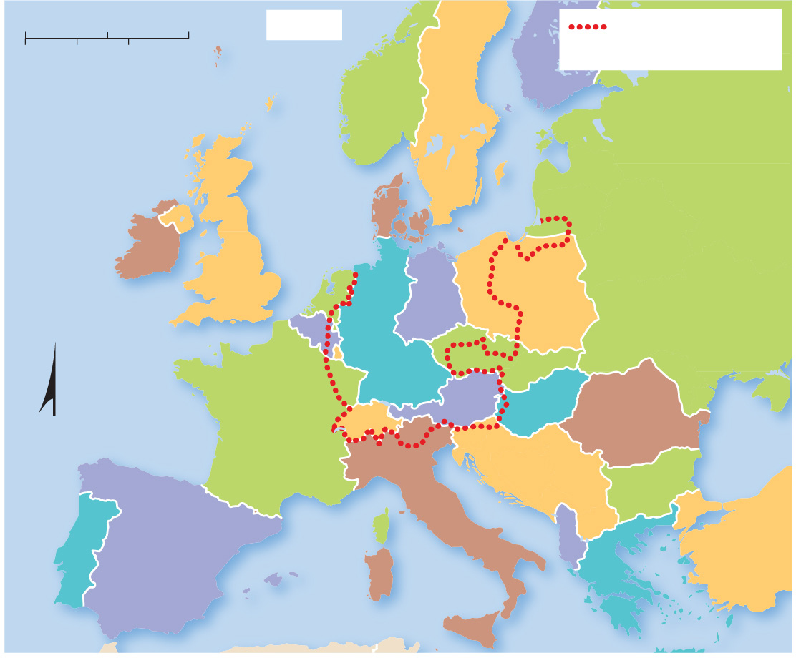
8.2.2 Nation-States (4 of 7)
Figure 8-15: Multinational states like Yugoslavia and Czechoslovakia eventually divided, and a largely German population divided between East and West Germany was reunited.
0
250
500 Miles
1980
German-speaking
area in 1914
0
250
500 Kilometers
NORWAY
FINLAND
ATLANTIC
OCEAN
North
Sea
SWEDEN
UNITED
KINGDOM
DENMARK
U.S.S.R.
IRELAND
NETH.
EAST
POLAND
BELGIUM
WEST
GER.
GER.
LUX.
CZECHOSLOVAKIA
FRANCE
SWITZ.
AUSTRIA
HUNGARY
Black
Sea
N
ROMANIA
AND.
YUGOSLAVIA
BULGARIA
ITALY
SPAIN
ALBANIA
TURKEY
PORTUGAL
Mediterranean Sea
GREECE

Slide 21
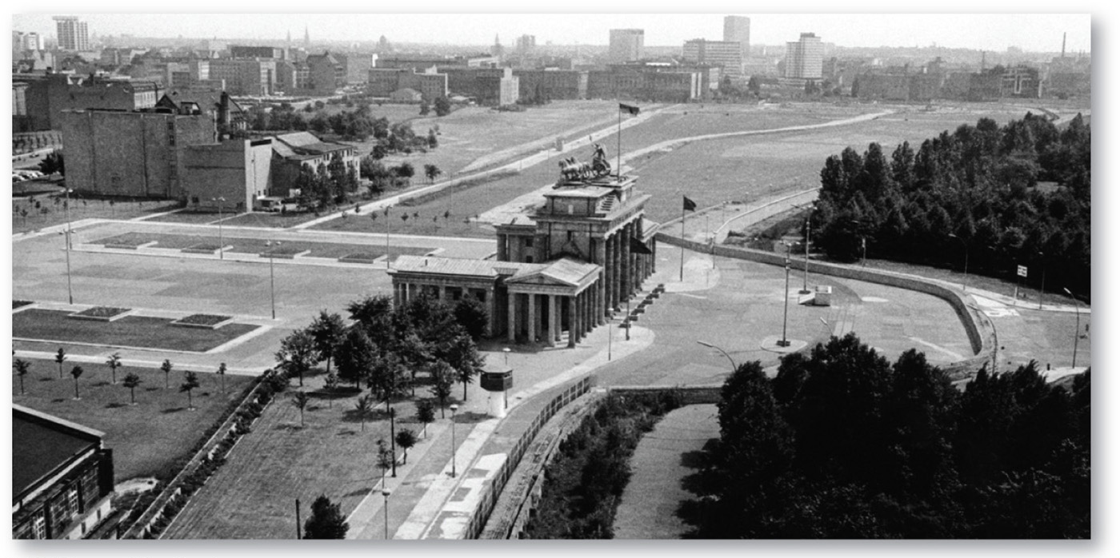
8.2.2 Nation-States (5 of 7)
Figure 8-16: When Germany was divided between East Germany and West Germany, the City of Berlin was also divided. To prevent its citizens from crossing over into the West, East Germany built a wall in 1961. After reunification of Germany in 1990, gates were opened, and the Wall was soon demolished.

Slide 22
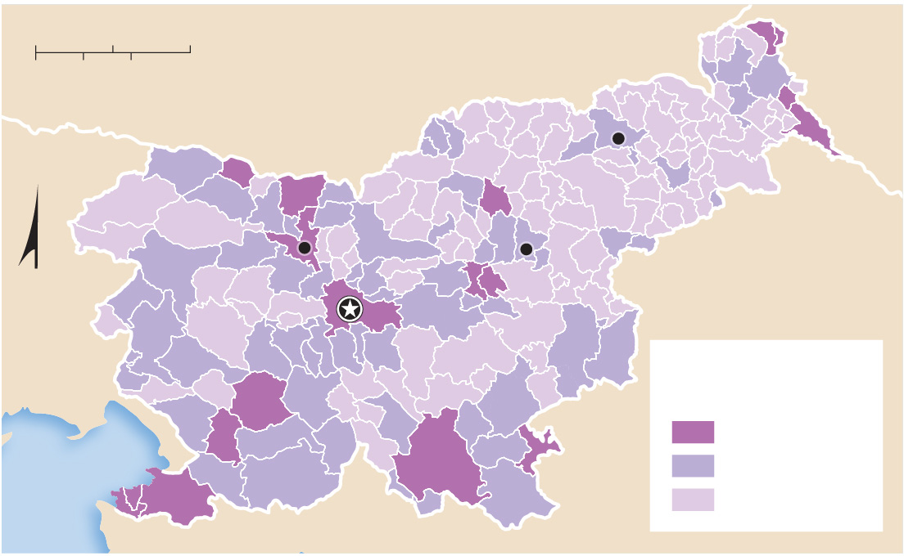
8.2.2 Nation-States (6 of 7)
Figure 8-17: Slovenes make up more than 80% of the country’s population.
0
15
30 Miles
0
15
30 Kilometers
AUSTRIA
HUNGARY
Maribor
Kranj
Celje
N
Ljubljana
CROATIA
ITALY
Percent
non-Slovene
10 and above
Adriatic
Sea
3–9
below 3

Slide 23
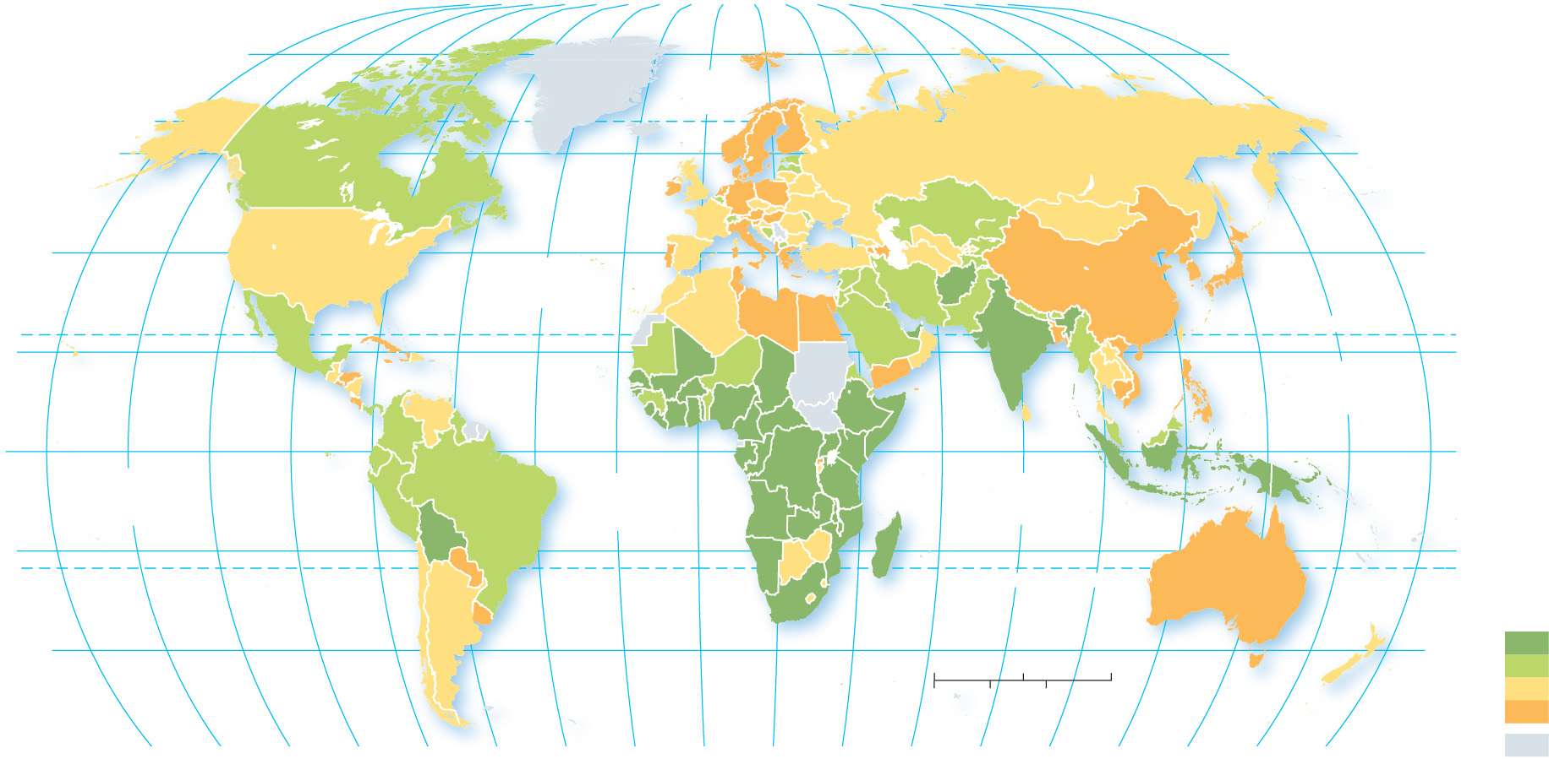
8.2.2 Nation-States (7 of 7)
Figure 8-19: Ethnic diversity by state varies throughout the world, with Africa having the most ethnically diverse states.
80°
160°
140°
120°
100°
80°
60°
40°
20°
0°
20°
40°
60°
80°
100°
120°
140°
160°
180°
80°
ARCTIC
OCEAN
60°
60°
40°
ATLANTIC
OCEAN
40°
TROPIC OF CANCER
20°
PACIFIC
OCEAN
20°
0°
EQUATOR
0°
PACIFIC
OCEAN
ATLANTIC
OCEAN
INDIAN
OCEAN
20°
20°
TROPIC OF CAPRICORN
Ethnic diversity
40°
0
1,500
3,000 Miles
40°
Most diverse
0
1,500
3,000 Kilometers
Least diverse
160°
140°
120°
100°
80°
60°
40°
20°
0°
20°
40°
60°
80°
100°
120°
140°
160°
180°
no data

Slide 24
8.2.3 Nation-States in the Former Soviet Union (1 of 3)
The former Soviet Union consisted of 15 republics based on its 15 largest ethnicities. Russians comprised 51% of the total population of the Soviet Union
The breakup of the Soviet Union in 1991 resulted in the creation of 15 new independent states. Many of these states have faced internal conflict since independence (e.g., Ukraine, Azerbaijan, and Armenia)

Slide 25
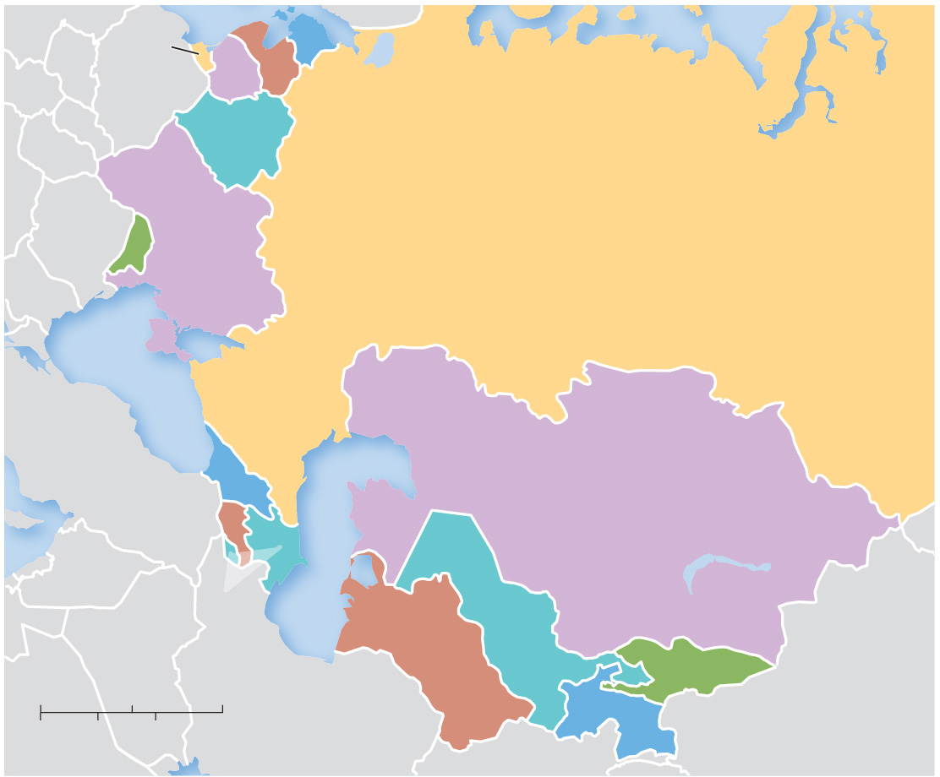
8.2.3 Nation-States in the Former Soviet Union (2 of 3)
Figure 8-20: The former Soviet Union was a multinational state with 15 republics that are now independent states.
RUSSIA
(Kaliningrad)
LATVIA
ESTONIA
LITHUANIA
BELARUS
UKRAINE
RUSSIA
MOLDOVA
Black Sea
GEORGIA
KAZAKHSTAN
ARMENIA
Lake Balkhash
Caspian Sea
AZERBAIJAN
UZBEKISTAN
TURKMENISTAN
KYRGYZSTAN
0
300
600 Miles
TAJIKISTAN
0
300
600 Kilometers

Slide 26
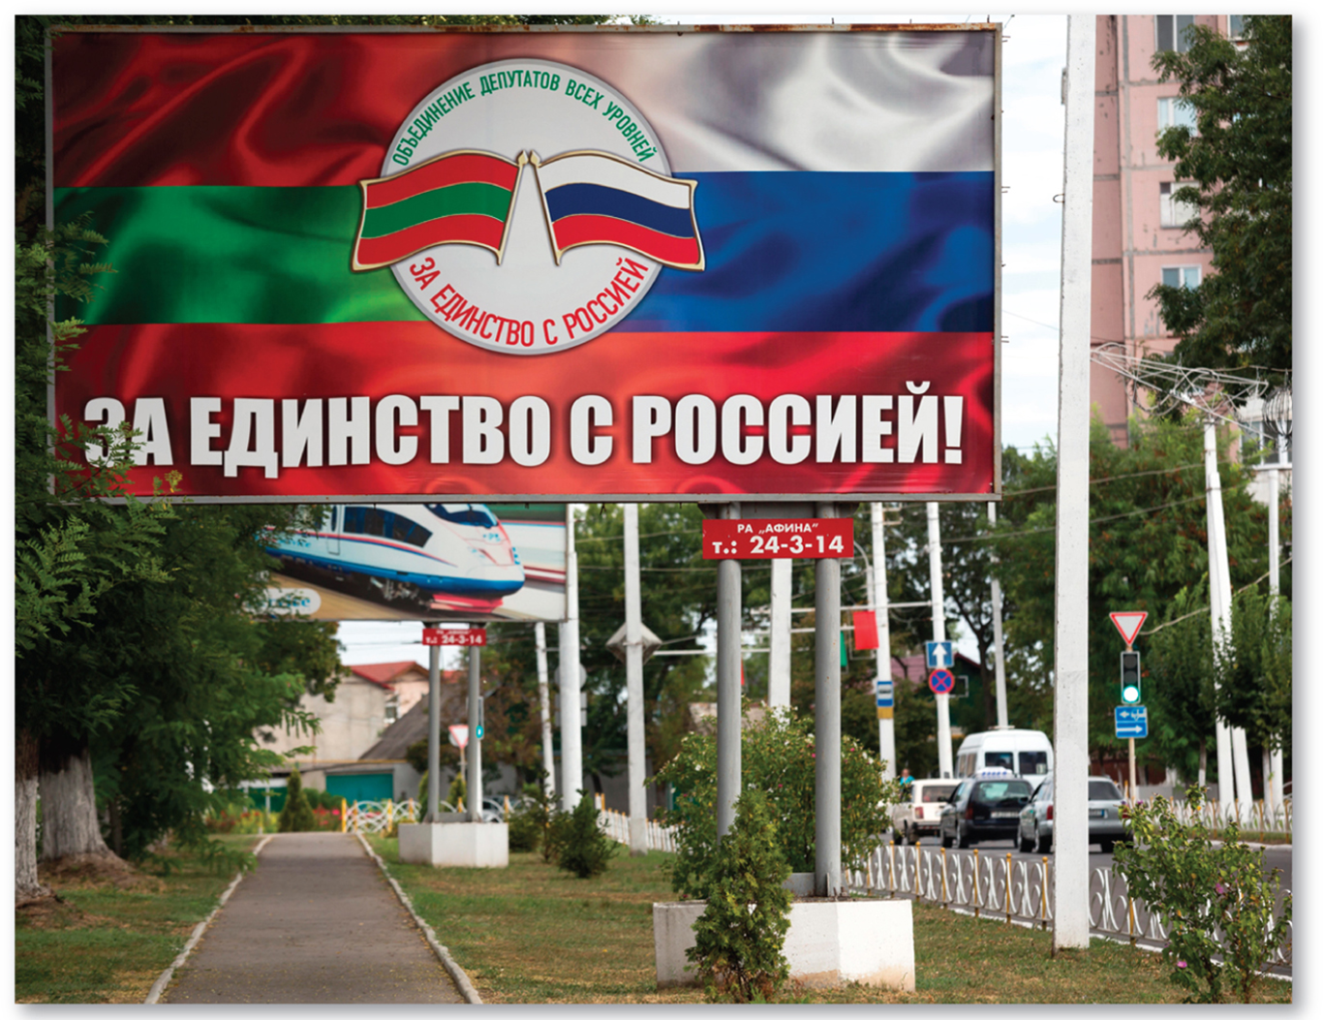
8.2.3 Nation-States in the Former Soviet Union (3 of 3)
Figures 8-21 and 8-22: Belarus and Moldova are two former Soviet republics which are now independent states.

Slide 27
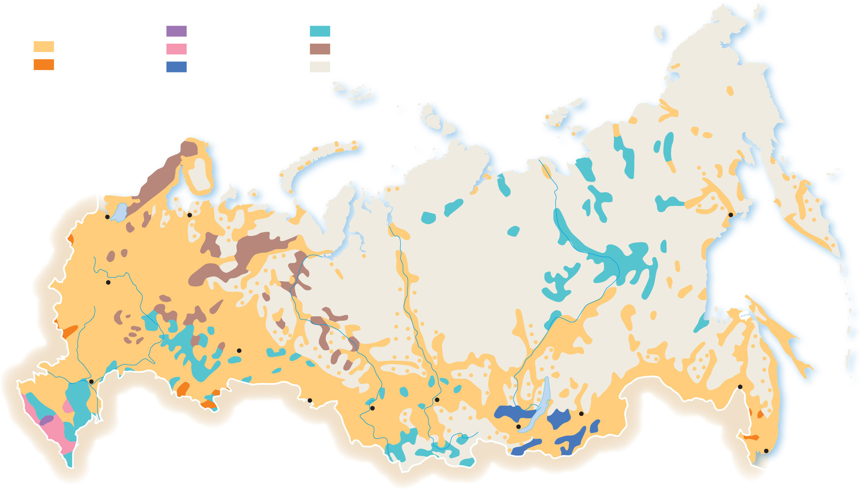
8.2.4 Multinational States in the Former Soviet Union (1 of 3)
Figure 8-23: The majority population is ethnically Russian, but there are diverse groups along Russia’s borders and in its center; some have histories of self-determination.
Indo-European–Slavic
other Indo-European
Turkic
TATAR
1 million and above
Russian
Caucasian
Uralic
Avar
200,000–999,999
other Slavic
Mongolic
other or sparsely settled
Yakut
St Petersburg
Arkhangel’sk
Magadan
Belarusian
Komi
Moscow
Komi
Yakut
RUSSIAN
Mari
UKRAINIAN
CHUVASH
Udmurt
Mordvin
TATAR
Yekaterinburg
Karachay
Volgograd
TATAR
Kumyk
BASHKIR
Omsk
Krasnoyarsk
Khabarovsk
Karabadian
ARMENIAN
Novosibirsk
Buryat
Chita
Ingush
Dargin
Ossetian
Irkutsk
CHECHEN
Lezgian
Kazakh
Tuvan
Buryat
Vladivostok
Avar
Azerbaijani

Slide 28
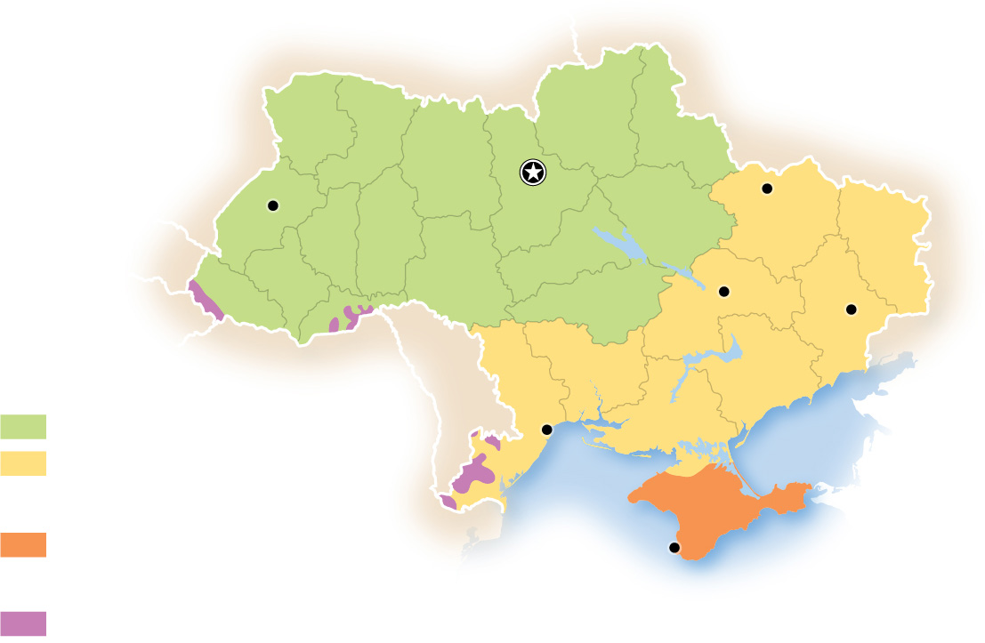
8.2.4 Multinational States in the Former Soviet Union (2 of 3)
Figure 8-24: Ukraine’s eastern region is home to more ethnic Russians. Crimea was occupied by Russian forces in 2014.
BELARUS
POLAND
RUSSIA
Lviv
Kiev
Kharkiv
Dnipro
Donetsk
ROMANIA
Ethnic Ukrainians
Mostly Ukrainian-speaking
MOLDOVA
Odesa
Mostly Russian-speaking
Ethnic Russians
Black
Sea
Crimea
Mostly ethnic Russians
Sevastopol
Other
Romanians, Moldovans,
Hungarians, Bulgarians

Slide 29
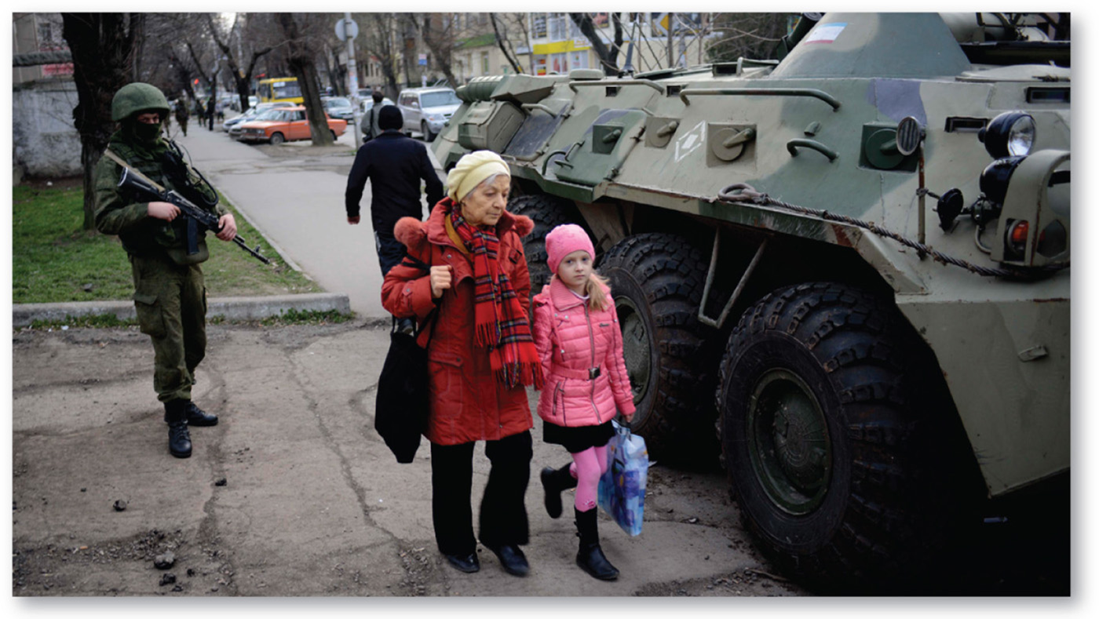
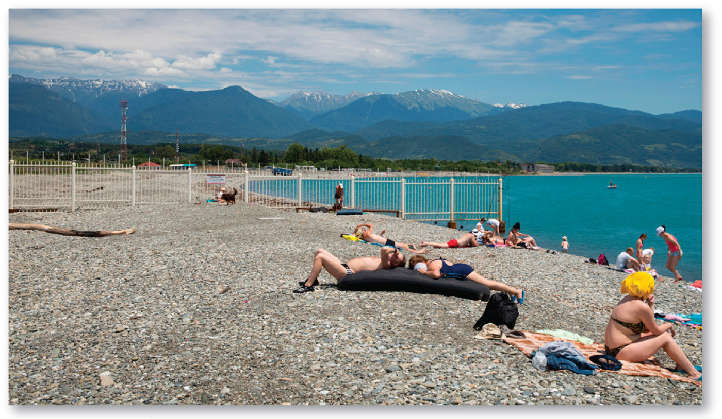
8.2.4 Multinational States in the Former Soviet Union (3 of 3)
Figures 8-25 and 8-26: A Russian soldier stands next to a tank in Crimea (left) and a border fence between Russia and Georgia (right).

Slide 30
8.2.5 Colonies (1 of 3)
A colony is a territory that is legally tied to a sovereign state rather than being completely independent
The remaining colonies in the world are small isolated islands or island groups
Colonialism is an effort by one country to establish settlements in a territory and to impose its political, economic, and cultural principles on that territory
Many European nations maintained a colonial empire (e.g., England, France)

Slide 31
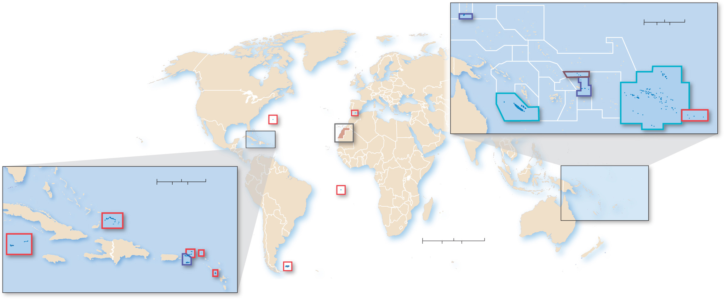
8.2.5 Colonies (2 of 3)
Figure 8-27: Present-day colonies are mostly small, isolated islands or island groups.
Guam
(U.S.)
PACIFIC OCEAN
0
500
1,000 Miles
0
500
1,000 Kilometers
ARCTIC
OCEAN
Tokelau
(New Zealand)
French Polynesia
(France)
ATLANTIC
OCEAN
Pitcairn
Islands
(U.K.)
Bermuda
(U.K.)
Gibraltar
(U.K.)
New
Caledonia
(France)
American
Samoa
(U.S.)
PACIFIC
OCEAN
Area of
inset
Western
Sahara
(disputed)
PACIFIC OCEAN
UNITED
STATES
ATLANTIC
OCEAN
0
150
300 Miles
Area of inset
0
150
300 Kilometers
St. Helena
(U.K.)
INDIAN
OCEAN
Turks and Caicos
(U.K.)
British Virgin Islands (U.K.)
ATLANTIC
OCEAN
0
1,500
3,000 Miles
Anguilla
(U.K.)
0
1,500
3,000 Kilometers
Cayman Islands
(U.K.)
Virgin Islands (U.S.)
Falkland Islands
(U.K.)
Caribbean Sea
Montserrat (U.K.)

Slide 32
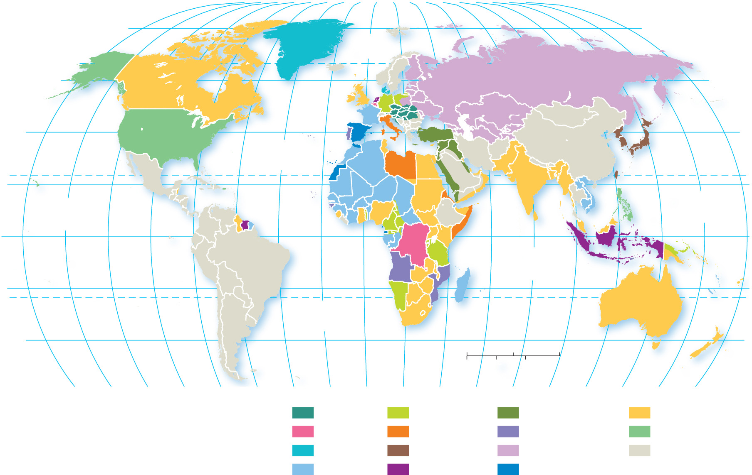
8.2.5 Colonies (3 of 3)
Figure 8-29: Much of the world was in the colonial
possession of European powers at the start of World War
80°
160°
140°
120°
100°
80°
60°
40°
20°
0°
20°
40°
60°
80°
100°
120°
140°
160°
180°
80°
ARCTIC
OCEAN
60°
60°
40°
ATLANTIC
OCEAN
40°
20°
TROPIC OF CANCER
20°
PACIFIC
OCEAN
PACIFIC
OCEAN
0°
EQUATOR
0°
INDIAN
OCEAN
20°
ATLANTIC
OCEAN
20°
TROPIC OF CAPRICORN
40°
0
1,500
3,000 Miles
40°
0
1,500
3,000 Kilometers
160°
140°
120°
100°
80°
60°
40°
20°
0°
20°
40°
60°
80°
100°
120°
140°
160°
180°
Austria
Germany
Ottoman Empire
United Kingdom
Belgium
Italy
Portugal
United States
Denmark
Japan
Russia
independent
France
Netherlands
Spain
Present-day boundaries
are shown.

Slide 33
Key Issue 3: Why Do States Face Threats?
8.3.1 Global Cooperation and Competition
8.3.2 Governing States
8.3.3 Weapons of Mass Destruction
8.3.4 Europe’s Fragile Cooperation
8.3.5 Terrorist Attacks Against the United States
8.3.6 Terrorist Organizations

Slide 34
8.3.1 Global Cooperation and Competition (1 of 4)
The most important global forum for cooperation among states is the United Nations
Membership has grown dramatically since inception after
World War
Forum for United States and Soviet Union to negotiate during Cold War
Major drawback is veto power by the five permanent members of the Security Council

Slide 35
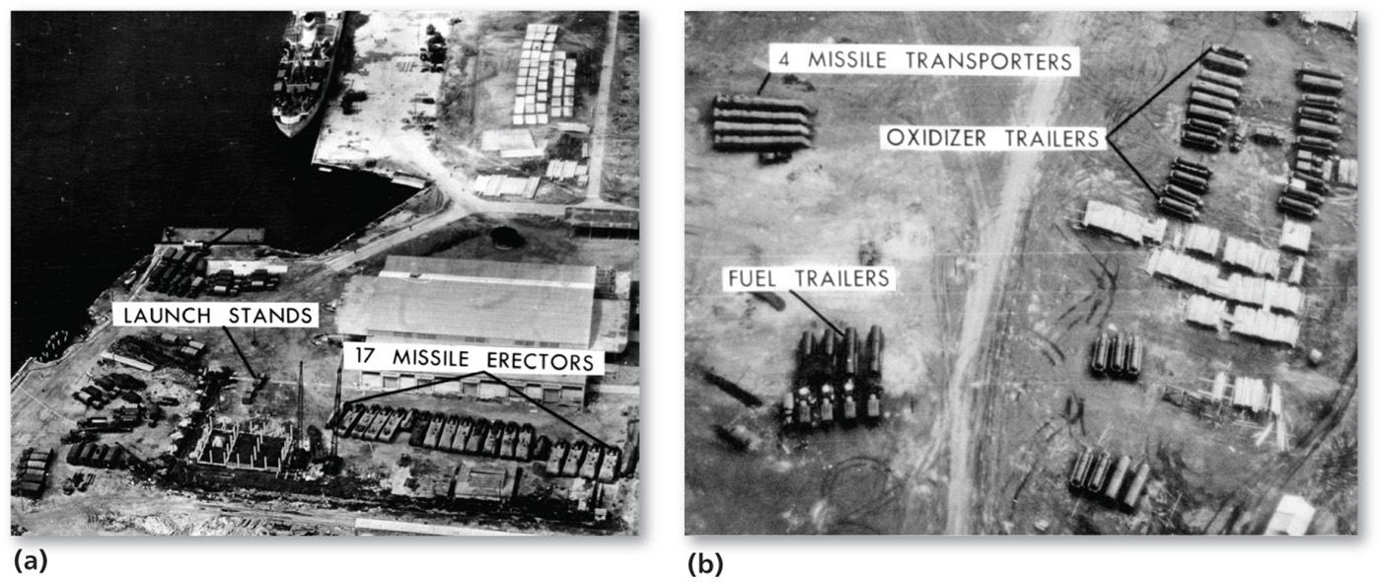
8.3.1 Global Cooperation and Competition (2 of 4)
Figure 8-31: At the United Nations, the United States presented aerial photographic evidence of the Soviet Union threatening the balance of power. (a) Soviet ships unloading and (b) staging missiles in Cuba, threatening the United States.
(a)
(b)

Slide 36
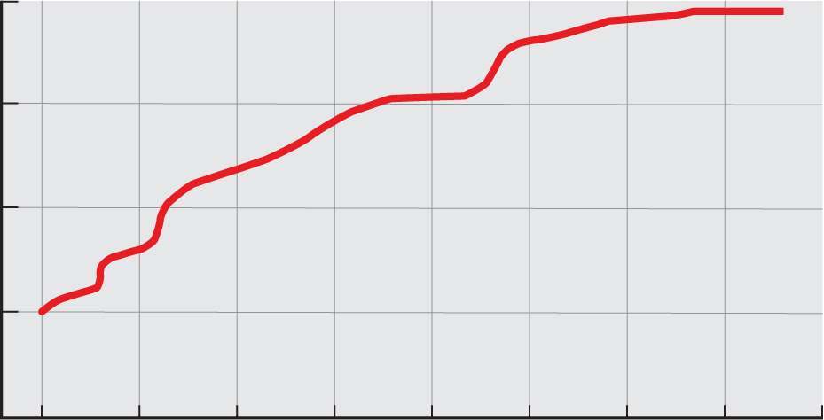
8.3.1 Global Cooperation and Competition (3 of 4)
Figure 8.32: U.N. membership has increased from its original 51 to 193.
200
150
Number of member countries
100
50
0
1945
1955
1965
1975
1985
1995
2005
2015
2020
Year

Slide 37
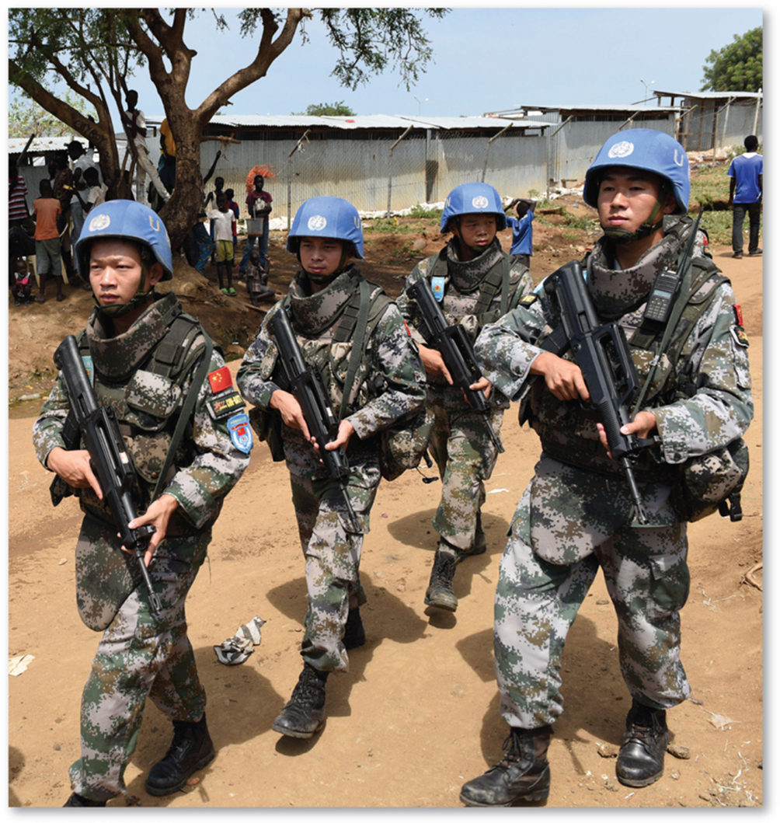
8.3.1 Global Cooperation and Competition (4 of 4)
Figure 8-33: The United Nations regularly engages in peacekeeping missions in crisis zones, such as seen here in South Sudan.

Slide 38
8.3.2 Governing States (1 of 6)
A state has two levels of government: a national government and local governments
A democracy is a country where citizens elect leaders and can run for office
An autocracy is a country that is run according to the interests of the ruler rather than the people
An anocracy is a country that is not fully democratic or fully autocratic, but rather displays a mix of the two types

Slide 39
8.3.2 Governing States (2 of 6)
The internal governments of states are organized according to one of two approaches:
In a unitary state, most power is placed in the hands of central government officials. Most European states are unitary states
In a federal state, strong power is allocated to units of local government. Most of the world’s largest states (e.g., Canada, Russia, and the United States) are federal states

Slide 40
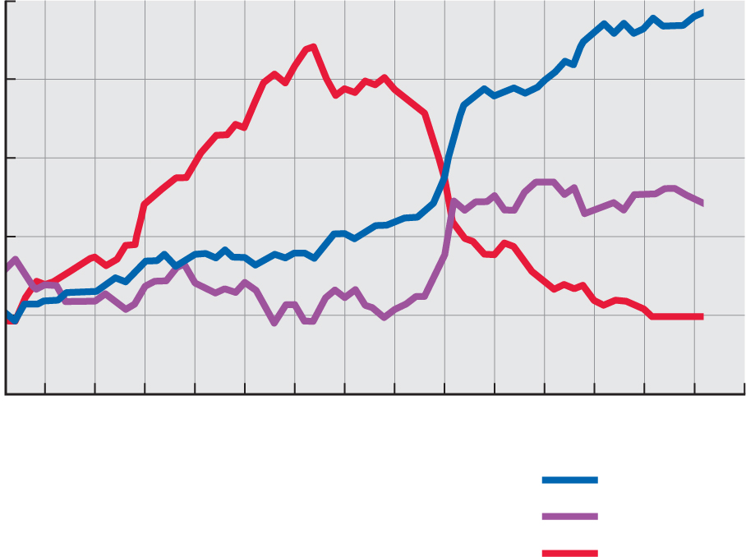
8.3.2 Governing States (3 of 6)
Figure 8-35: Governments have become more democratic and less autocratic, especially since the 1980s.
100
80
60
Number of countries
(population >500,000)
40
20
0
1950
1960
1970
1980
1990
2000
2010
2020
Year
Democracies
Anocracies
Autocracies

Slide 41
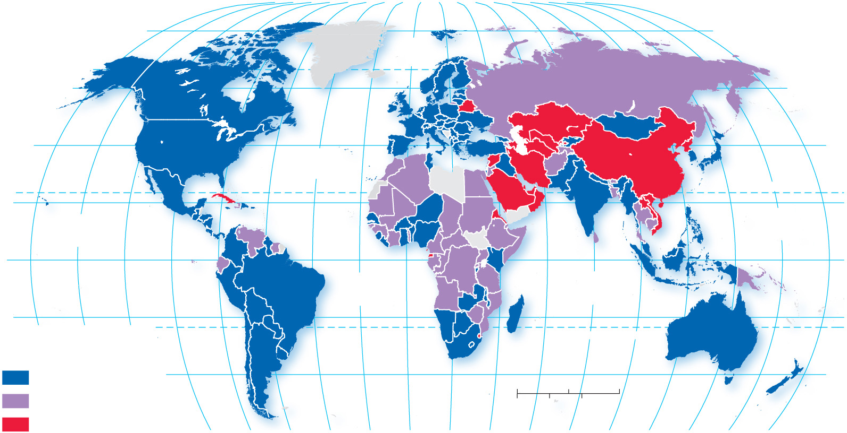
8.3.2 Governing States (4 of 6)
Figure 8-34: Governance regimes vary between full democracies and autocracies. A few countries are considered “failed states” because they effectively have no government.
80°
160°
140°
120°
100°
80°
60°
40°
20°
0°
20°
40°
60°
80°
100°
120°
140°
160°
180°
80°
ARCTIC
OCEAN
60°
60°
40°
ATLANTIC
OCEAN
40°
20°
TROPIC OF CANCER
PACIFIC
OCEAN
PACIFIC
OCEAN
20°
0°
EQUATOR
0°
ATLANTIC
OCEAN
INDIAN
OCEAN
20°
160°
140°
120°
20°
Regime type, 2017
TROPIC OF CAPRICORN
Democracy
40°
0
1,500
3,000 Miles
40°
Anocracy
0
1,500
3,000 Kilometers
Autocracy
100°
80°
60°
40°
20°
0°
20°
40°
60°
80°
100°
120°
140°
160°
180°

Slide 42
8.3.2 Governing States (5 of 6)
Table 8-1: Table comparing and contrasting democratic and autocratic forms of government.
Element | Democracy | Autocracy
Selection of leaders | Institutions and procedures through which citizens can express effective preferences about alternative policies and leaders | Leaders are selected according to clearly defined (often hereditary) rules of succession from within the established political elite
Citizen participation | Institutionalized constraints on the exercise of power by the executive | Citizens’ participation is sharply restricted or suppressed
Checks and balances | Guarantee of civil rights to all citizens in their daily lives and in acts of political participation | Leaders exercise power with no meaningful checks from legislative, judicial, or civil society institutions

Slide 43
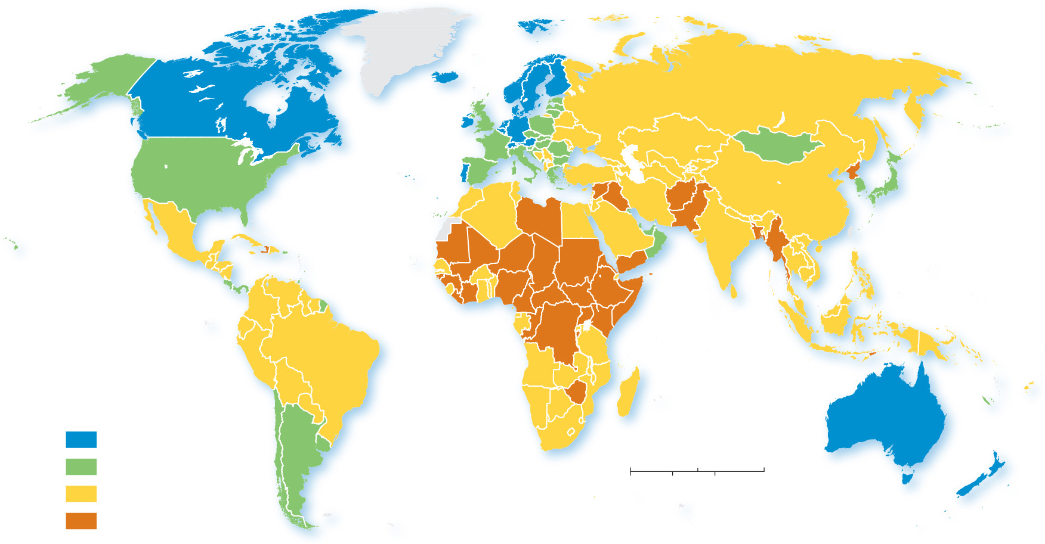
8.3.2 Governing States (6 of 6)
Figure 8-36: The most fragile states are clustered in Africa, especially south of the Sahara.
ARCTIC
OCEAN
ATLANTIC
OCEAN
PACIFIC
OCEAN
PACIFIC
OCEAN
INDIAN
OCEAN
Fragile States Index,
2018
Sustainable
ATLANTIC
OCEAN
Stable
0
1,500
3,000 Miles
Warning
0
1,500
3,000 Kilometers
Alert

Slide 44
8.3.3 Weapons of Mass Destruction (1 of 3)
A weapon of mass destruction is a nuclear, biological, chemical, or other weapon that can kill and bring significant harm to a large number of humans or cause great damage to human-made structures, natural structures, or the biosphere
The vast majority of nuclear weapons belong to the United States and Russia. Nine nations have access to nuclear weapons
Libya, Iraq, Iran, and Syria have long been suspected of developing nuclear weapons

Slide 45
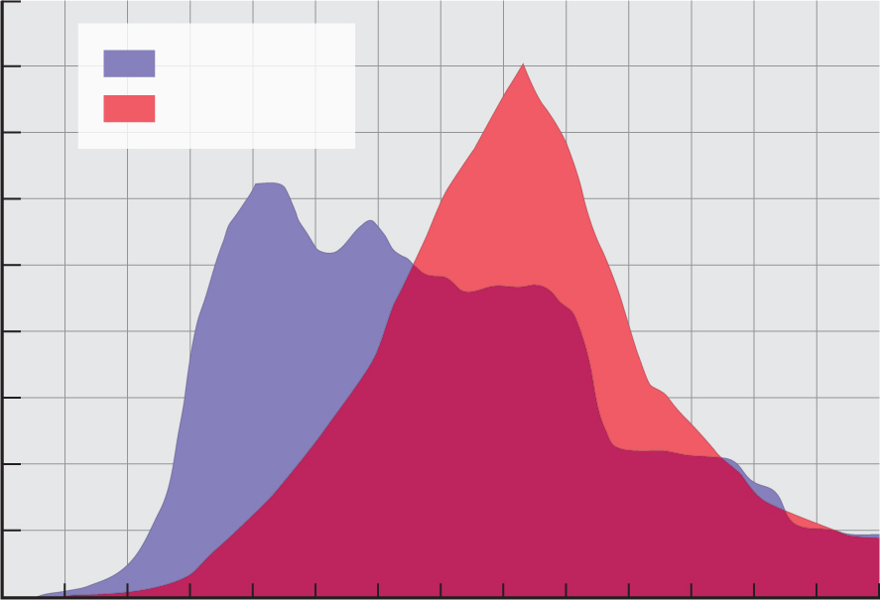
8.3.3 Weapons of Mass Destruction (2 of 3)
Table 8-2 and Figure 8-38: The vast majority of the world’s nuclear weapons are in the possession of the United States and Russia. The number of warheads each nations possesses has dropped significantly since the height of the Cold War in 1980.
Country | Nuclear Warheads
Russia | 7,000
United States | 6,800
United Kingdom | 215
France | 300
China | 270
India | 115
Pakistan | 125
North Korea | 15
Israel | 80
Total | 14,920
45,000
40,000
United States
35,000
USSR/Russia
30,000
25,000
Number of warheads
20,000
15,000
10,000
5,000
0
1950
1960
1970
1980
1990
2000
2010
Year

Slide 46
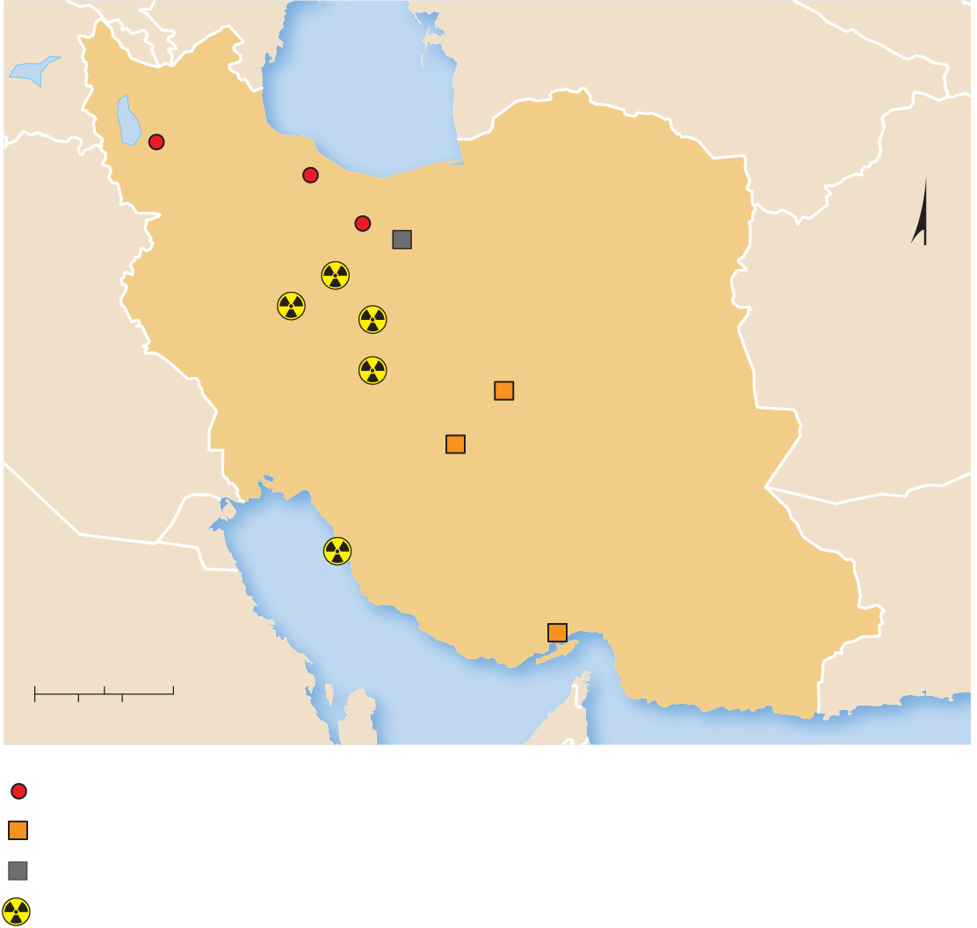
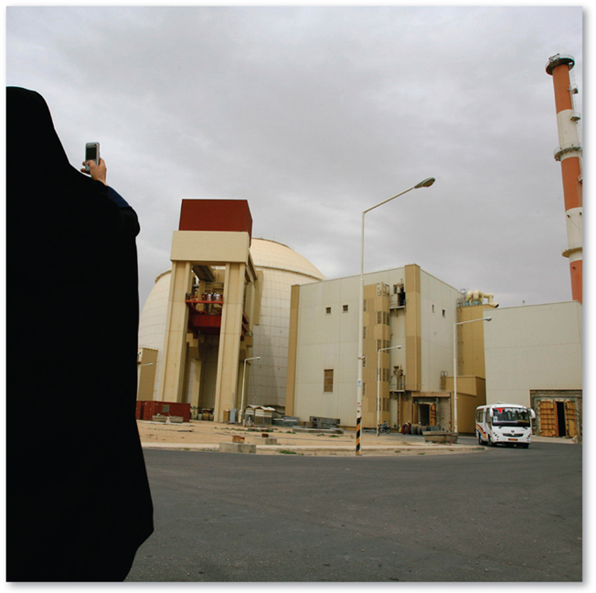
8.3.3 Weapons of Mass Destruction (3 of 3)
Figures 8-40 and 8-41: Iran has insisted on its right to develop nuclear power, but several countries including the United States are concerned the program includes building nuclear weapons. Photo to right is of the Nuclear Production Plant in Arak, Iran.
AZERBAIJAN
TURKMENISTAN
Caspian
Sea
Bonab
Ramsar
Tehran
IRAQ
Fordow Fuel
Enrichment Plant
Parchin
N
Arak Heavy Water
Production Plant
Natanz Fuel
Enrichment Plant
AFGHANISTAN
Isfahan Nuclear Technology
Center and Uranium
Conversion Facility
Saghand
Yazd
IRAN
KUWAIT
Bushehr Nuclear
Power Plant
PAKISTAN
SAUDI
ARABIA
Persian Gulf
Gachin
0
100
200 Miles
0
100
200 Kilometers
Research reactors
Uranium mine
Military site
Nuclear site

Slide 47
8.3.4 Europe’s Fragile Cooperation (1 of 3)
During the Cold War that followed World War
two
military alliances and two economic alliances formed in Europe
Cold War Military Alliances:
North Atlantic Treaty Organization (N A T O)
Warsaw Pact
Cold War Economic Alliances:
European Union (E U)
Council for Mutual Economic Assistance (C O M E C O N)

Slide 48
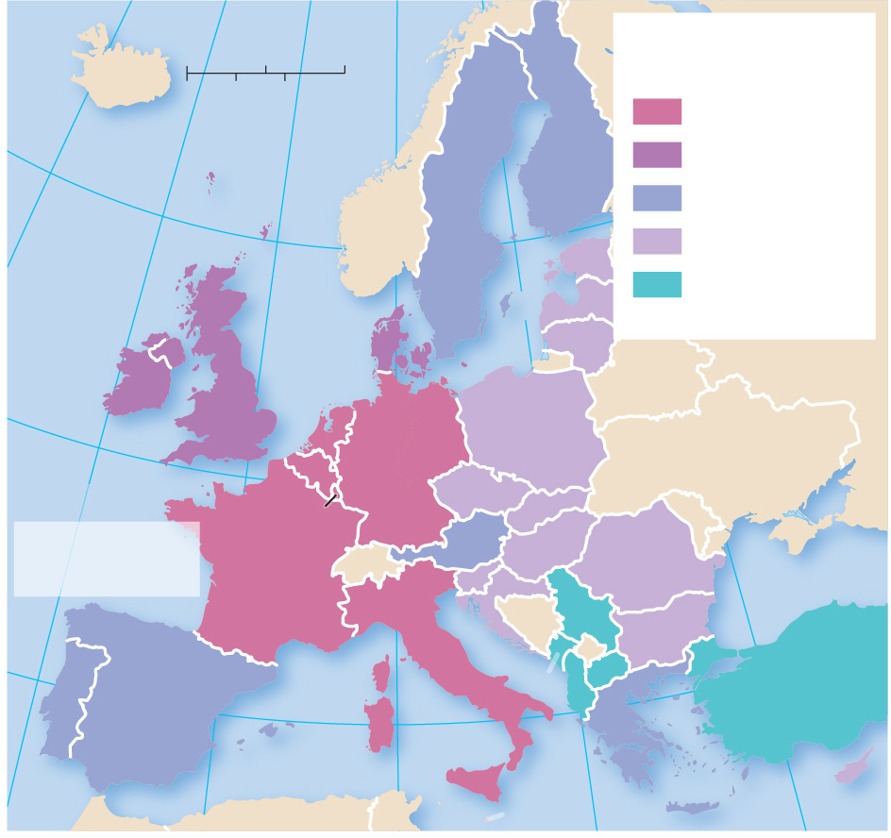
8.3.4 Europe’s Fragile Cooperation (2 of 3)
Figure 8-42: The European Union has most recently expanded to the east.
20°
10°
0°
10°
Expansion of the
European Union
ICELAND
0
250
500 Miles
0
250
500 Kilometers
1958
60°
FINLAND
1959–1979
1980–1999
NORWAY
2000–2018
ATLANTIC
OCEAN
ESTONIA
Possible future
members
North
Sea
SWEDEN
LATVIA
DENMARK
LITHUANIA
IRELAND
UNITED
KINGDOM*
RUSSIA
BELARUS
RUSSIA
50°
NETH.
GERMANY
POLAND
UKRAINE
BELGIUM
CZECHIA
LUX.
SLOVAKIA
MOLDOVA
* The United Kingdom
has voted to exit the
EU, effective 2019
FRANCE
SWITZ.
AUSTRIA
HUNGARY
SLOV.
ROMANIA
Black Sea
CROATIA
SERBIA
BOS. &
HERZ.
BULGARIA
ITALY
KOS.
40°
SPAIN
MONT.
MAC.
TURKEY
ALBANIA
PORTUGAL
GREECE
10°
Mediterranean Sea
MALTA
20°
CYPRUS
30°

Slide 49
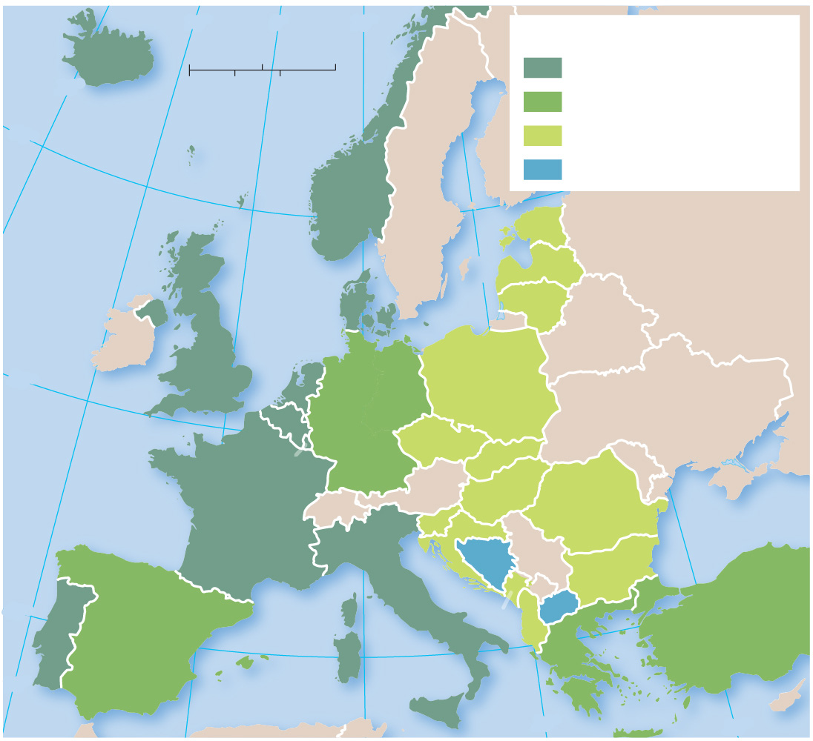
8.3.4 Europe’s Fragile Cooperation (3 of 3)
Figure 8-43: N A T O has expanded to most Warsaw Pact countries.
10°
0°
10°
Expansion of NATO
ICELAND
0
250
500 Miles
Original members, 1949
20°
0
250
500 Kilometers
Joined 1952–1982
60°
Joined 1999–2018
Potential new members
NORWAY
ATLANTIC
OCEAN
SWEDEN
ESTONIA
North
Sea
Baltic Sea
LATVIA
RUSSIA
DENMARK
LITHUANIA
IRELAND
UNITED
KINGDOM
RUSSIA
BELARUS
50°
NETH.
GERMANY
POLAND
BELGIUM
UKRAINE
LUX.
CZECHIA
SLOVAKIA
MOLDOVA
FRANCE
SWITZ.
AUSTRIA
HUNGARY
ROMANIA
SLOV.
Black Sea
CROATIA
SERBIA
BOS. &
HERZ
BULGARIA
.
KOS.
40°
ITALY
MONT.
MAC
.
SPAIN
ALBANIA
TURKEY
PORTUGAL
GREECE
10°
Mediterranean Sea
CYPRUS
20°
30°

Slide 50
8.3.5 Terrorist Attacks Against the United States (1 of 3)
Terrorism is the threatened or actual use of illegal force and violence by a nonstate actor to attain a political, economic, religious, or social goal through fear, coercion, or intimidation. Examples of terrorist organizations include:
Taliban
Boko Haram
A l Qaeda
Islamic State (I S I L or I S I S)

Slide 51
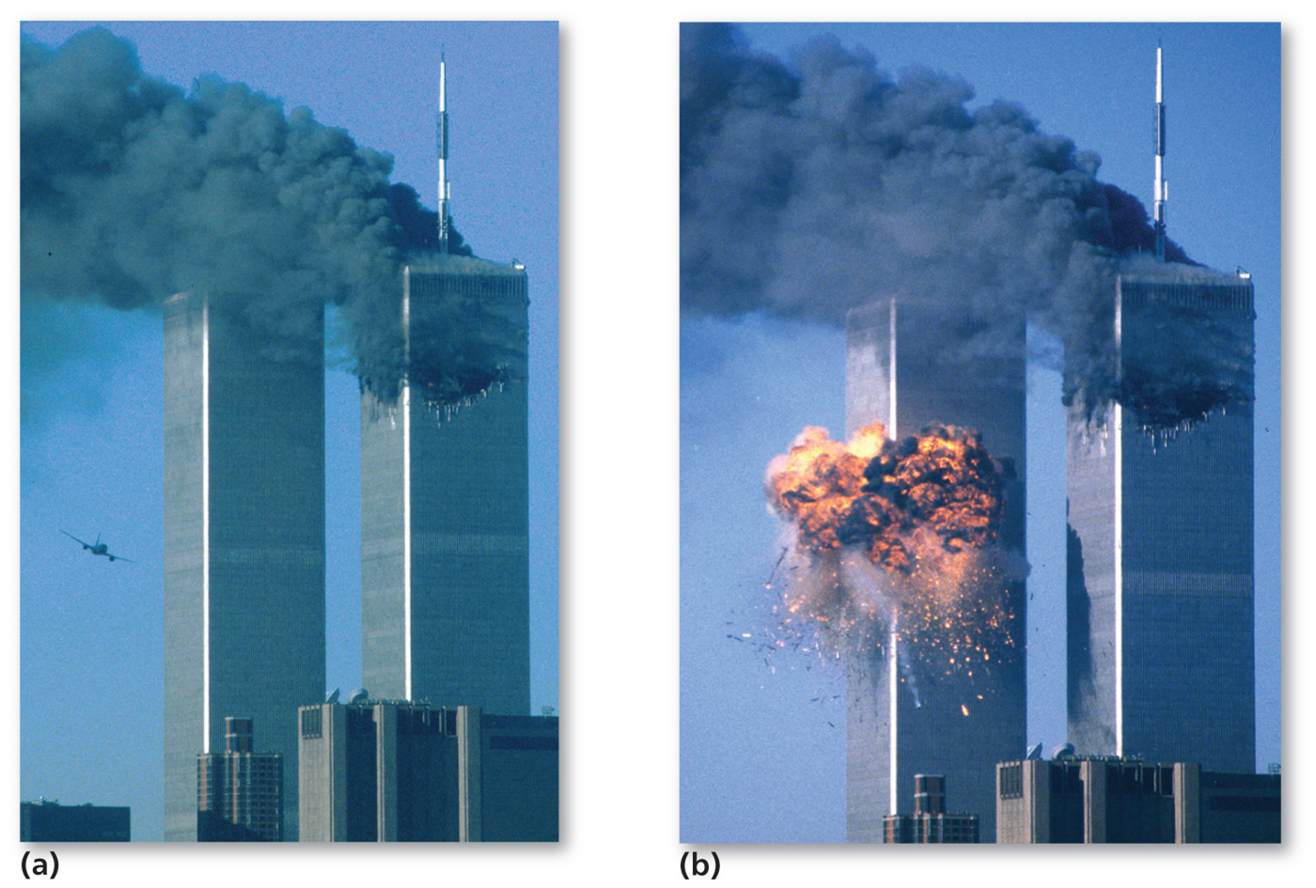
8.3.5 Terrorist Attacks Against the United States (2 of 3)
Figure 8-46: The attacks of September 11, 2001, were the most dramatic and deadly attacks on Americans.
(a)
(b)

Slide 52
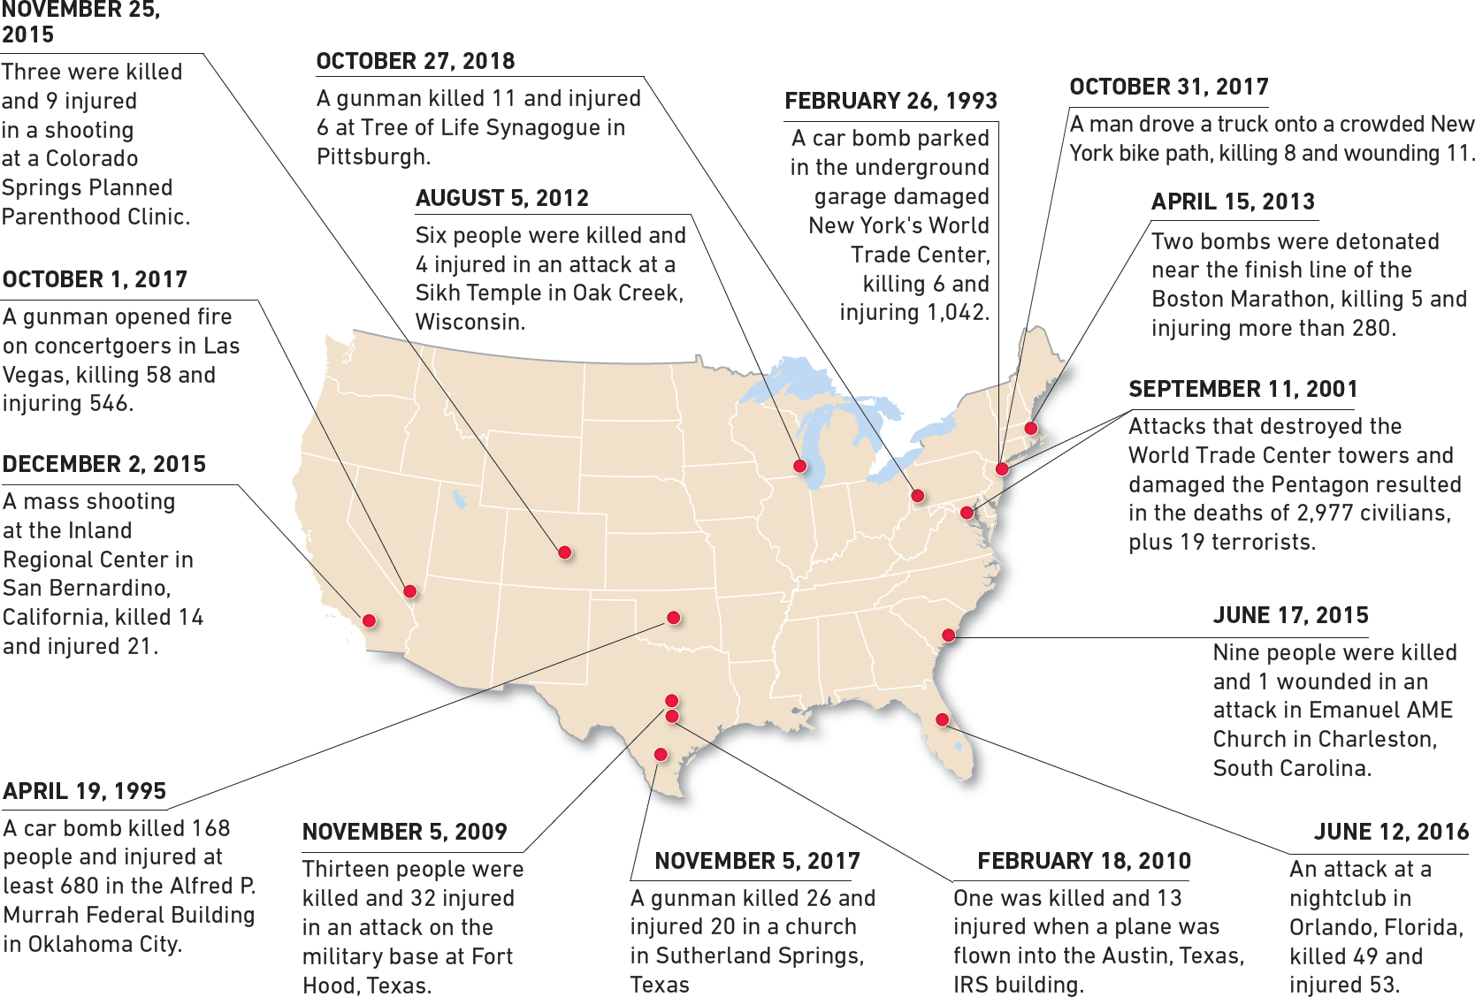
8.3.5 Terrorist Attacks Against the United States (3 of 3)
Figure 8-47: The map shows terrorist attacks between 2009 and 2018 with at least ten fatalities or injuries, plus three earlier attacks with especially high fatalities.

Slide 53
8.3.6 Terrorist Organizations (1 of 4)
Al-Qaeda was founded by Osama bin Laden, responsible for September 11, 2001
Islamic State (I S I S/I S I L) branched from A l-Qaeda and controlled wide swaths of Iraq and Syria between 2014 and 2017
Boko Haram, located in northern Nigeria, wishes to impose sharia law
The Taliban ruled Afghanistan from 1996 to 2001. They gave sanctuary to Osama bin Laden and continue to control parts of Afghanistan and Pakistan

Slide 54
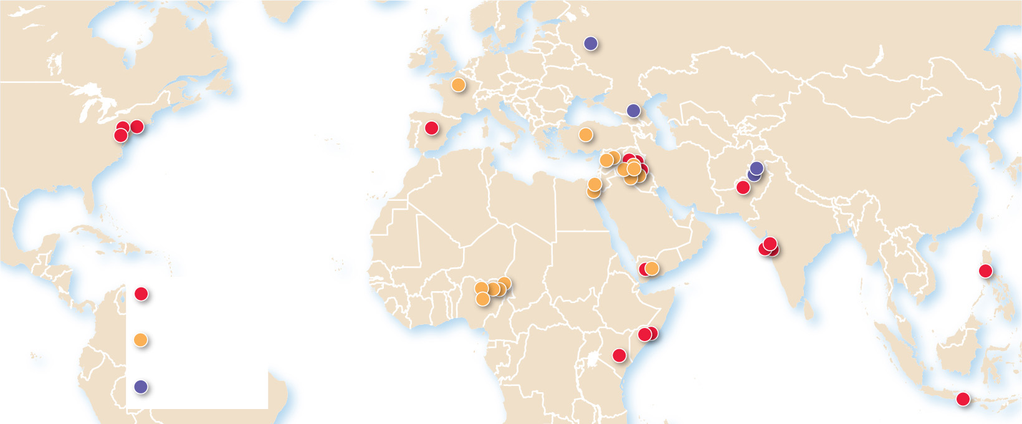
8.3.6 Terrorist Organizations (2 of 4)
Figure 8-48: The majority of deadly terrorist attacks in the 21st century have been concentrated in Southwest Asia and South Asia.
Moscow
Paris
Beslan
New York
Madrid
Ankara
Washington, D.C.
Baghdad
Peshawar
ATLANTIC
OCEAN
Quetta
Mumbai
Kano
Baga
Sana’a
Manila
Bay
Al-Qaeda
and affiliates
Jos
Islamic State
and affiliates
Mogadishu
Garissa
INDIAN
OCEAN
Other
Bali

Slide 55
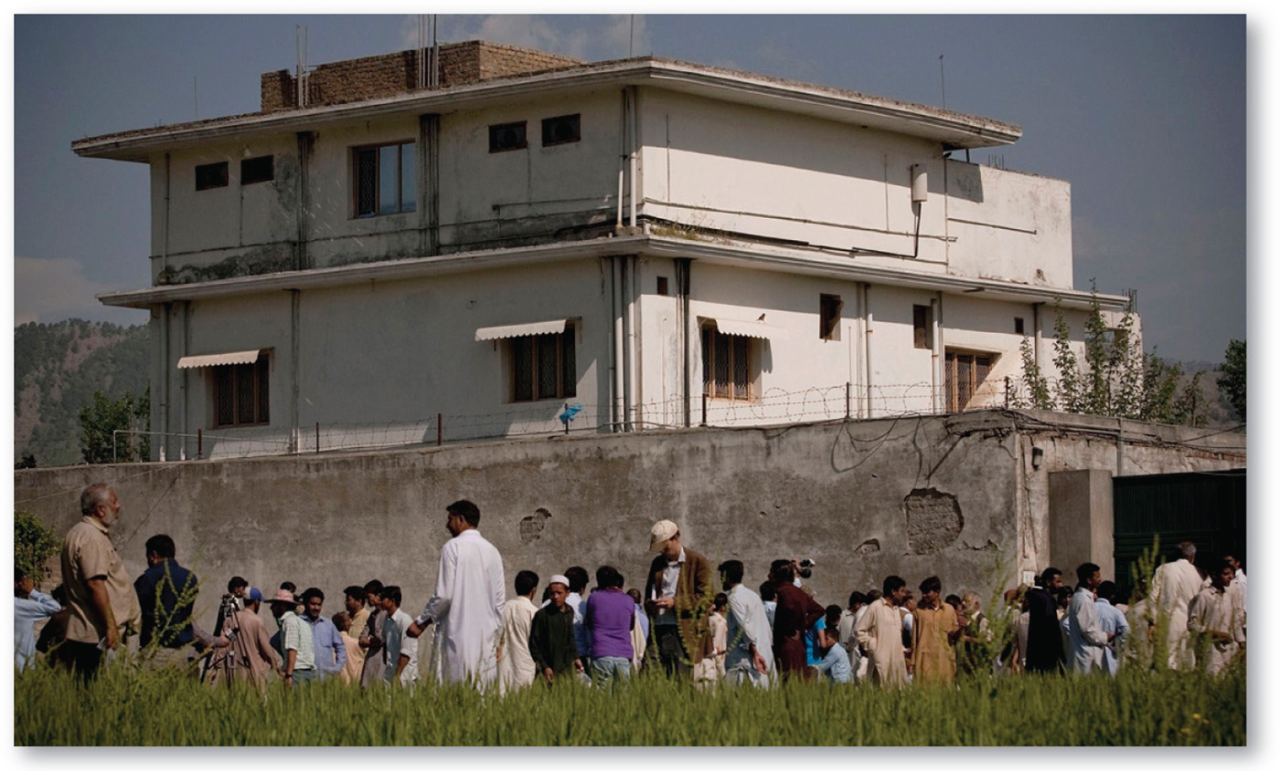
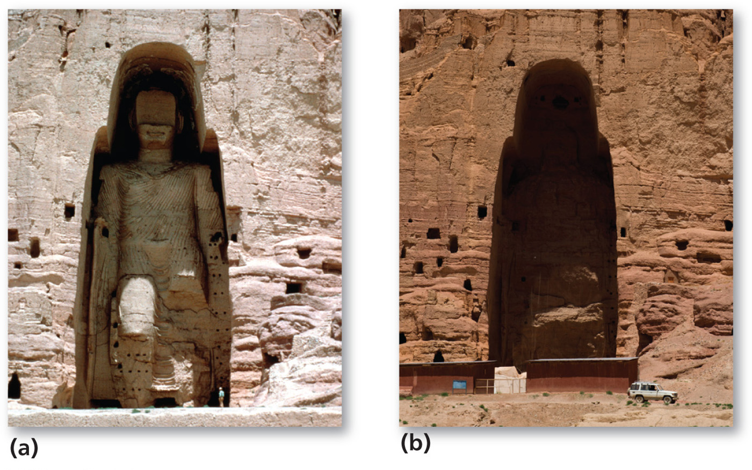
8.3.6 Terrorist Organizations (3 of 4)
Figures 8-49 and 8-50: Osama bin Laden lived in this compound in Abbottabad, Pakistan, for many years, only 6 kilometre (4 mile) from the Pakistan Military Academy (left). The Taliban destroyed the Buddhas of Bamiyan because they claimed it violated Islamic principles (right).
(a)
(b)

Slide 56
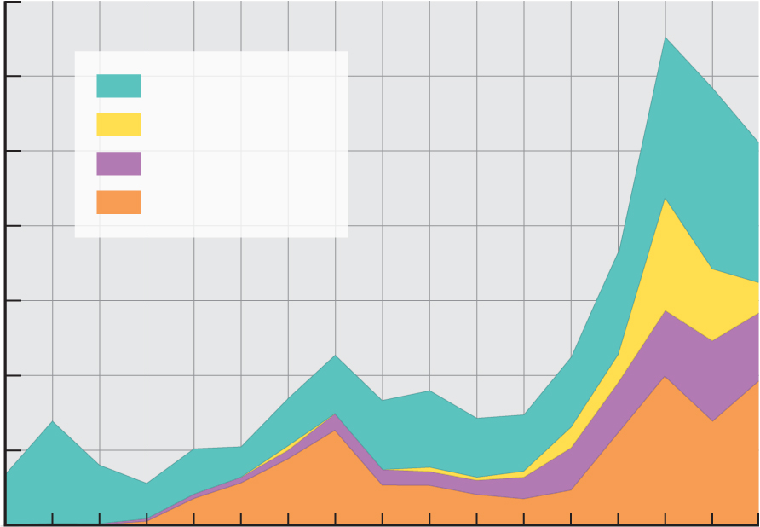
8.3.6 Terrorist Organizations (4 of 4)
Figure 8-51: The number of terrorist attacks has increased in the last decade, especially in Iraq, Afghanistan, and Nigeria.
35,000
30,000
Rest of the world
Nigeria
25,000
Afghanistan
Iraq
20,000
Deaths from terrorism
15,000
10,000
5,000
0
2000
2002
2004
2006
2008
2010
2012
2014
2016
Year

Slide 57
Key Issue 4: Where Do States Have Distinctive Geographic Structure?
8.4.1 Cultural Boundaries
8.4.2 Physical Boundaries
8.4.3 Geometric Boundaries
8.4.4 Shapes of States
8.4.5 Electoral Geography
8.4.6 Redrawing Boundaries

Slide 58
8.4.1 Cultural Boundaries (1 of 4)
A frontier is a zone where no state exercises complete political control
There are three types of boundaries:
Cultural boundaries follow the distribution of cultural features (languages, religions, ethnicities)
Geometric boundaries are based on human constructs such as straight lines and parallels of latitude
Physical boundaries coincide with significant features of the natural landscape (desert, mountains, rivers)

Slide 59
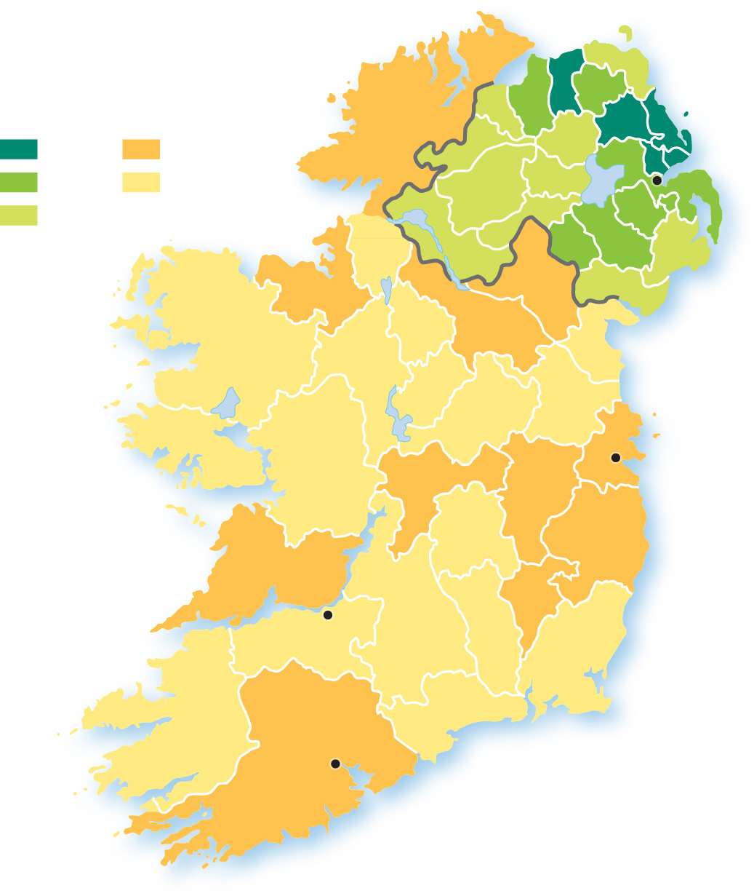
8.4.1 Cultural Boundaries (2 of 4)
Figure 8-52: In 1911, the United Kingdom divided Ireland between the overwhelmingly Irish Catholic Republic of Ireland in the south and (at the time) majority Protestant Northern Ireland, which remained in the United Kingdom.
Percent Protestant, 1911
75–100
10–24
UNITED
KINGDOM
50–74
0–9
Belfast
25–49
REPUBLIC OF
IRELAND (EIRE)
Dublin
Limerick
Cork

Slide 60
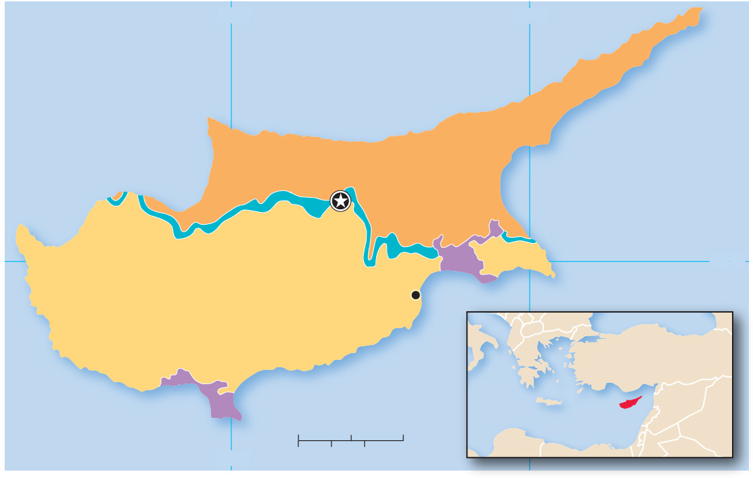
8.4.1 Cultural Boundaries (3 of 4)
Figure 8-53: Cyprus is divided between Greek and Turkish nationalities that face difficulty in creating a unified state.
33°E
34°E
Mediterranean
Sea
TURKISH AREA
Nicosia
U.N. Buffer Zone
British
base
35°N
Larnaca
GREEK AREA
GREECE
TURKEY
British
base
CYPRUS
SYRIA
0
10
20 Miles
Mediterranean Sea
LEB.
IRAQ
EGYPT
ISRAEL
33°E
0
10
20 Kilometers

Slide 61
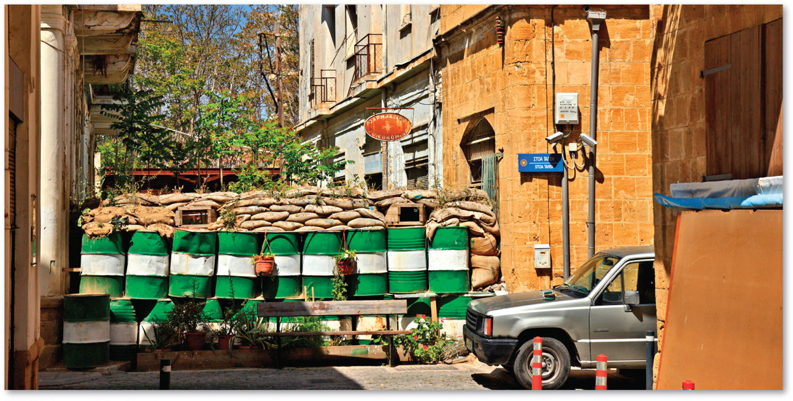
8.4.1 Cultural Boundaries (4 of 4)
Figure 8-54: The city of Nicosia is divided between the Turkish side (foreground) and Greek side (background).

Slide 62
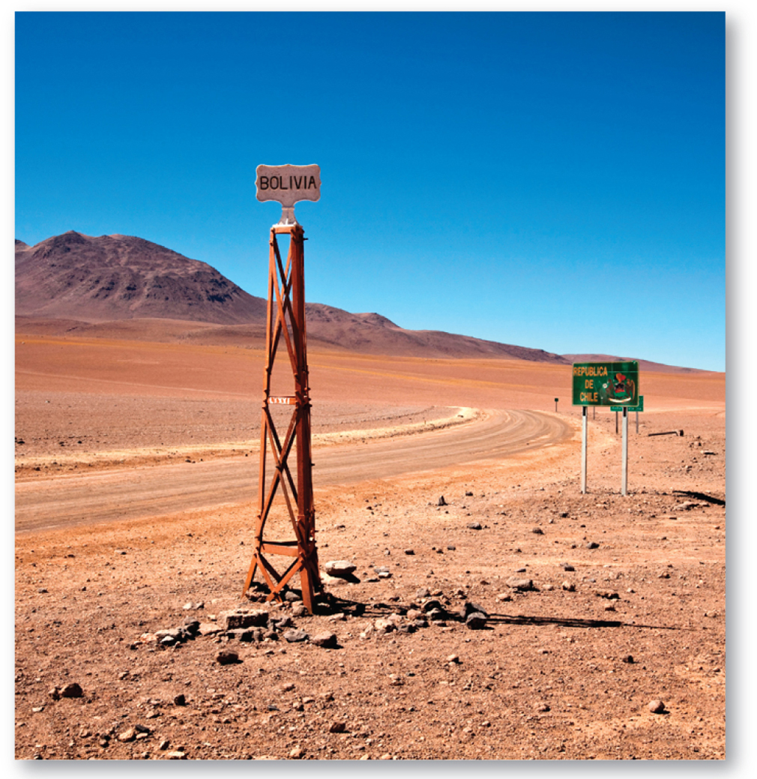
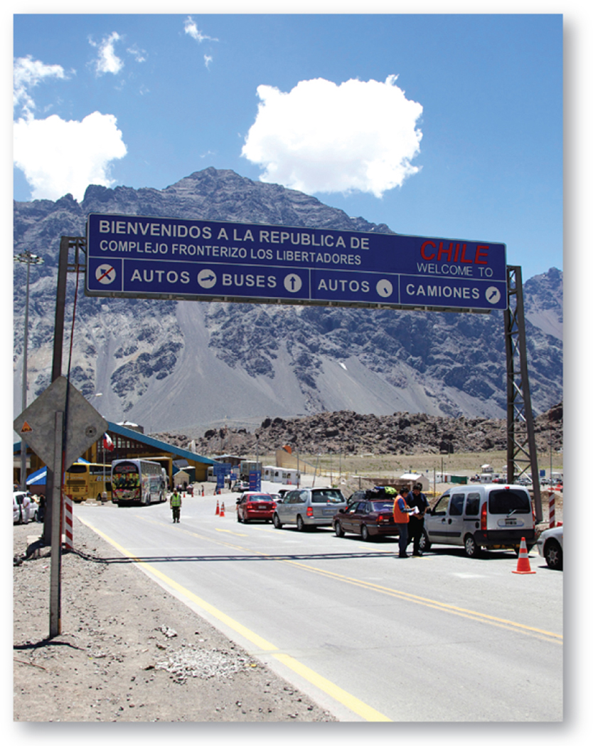
8.4.2 Physical Boundaries (1 of 5)
Figures 8-55 and 8-56: The border between Bolivia and Chile is a largely uninhabited desert (left), while much of the border between Chile and Argentina is formed by the Andes (right).

Slide 63
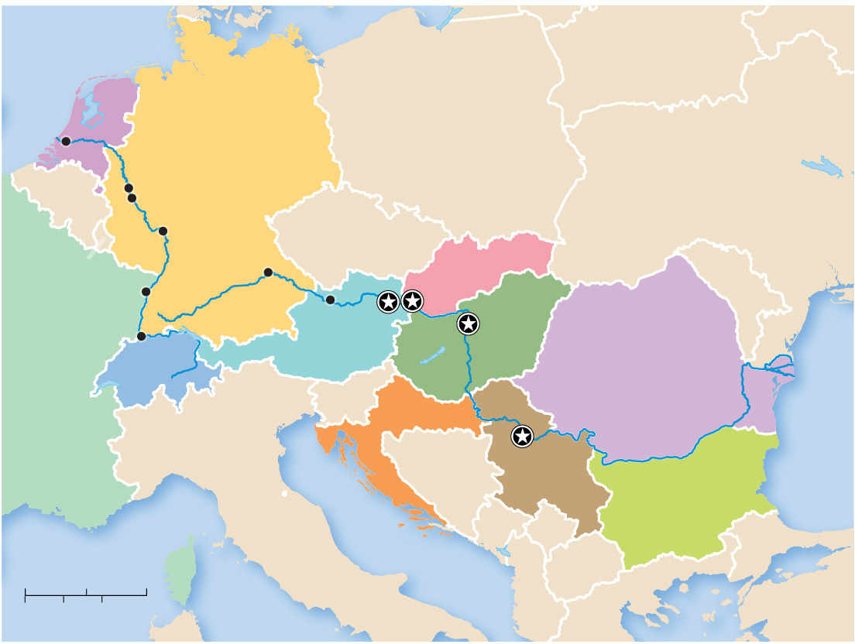
8.4.2 Physical Boundaries (2 of 5)
Figure 8-57: In Europe, the Danube and Rhine rivers serve as boundaries between several countries.
North
Sea
BELARUS
NETHERLANDS
Rotterdam
POLAND
GERMANY
Cologne
UKRAINE
BELGIUM
Bonn
Mainz
CZECHIA
LUX.
Rhine R.
Regensburg
SLOVAKIA
MOLDOVA
Strasbourg
Linz
Bratislava
FRANCE
Vienna
Budapest
Basel
AUSTRIA
HUNGARY
SWITZERLAND
ROMANIA
SLOVENIA
Belgrade
Black
Sea
CROATIA
Danube R.
BOSNIA
& HERZ.
SERBIA
BULGARIA
ITALY
MONT.
KOS.
0
100
200 Miles
MAC.
0
100
200 Kilometers
ALBANIA
TURKEY
GREECE

Slide 64
8.4.2 Physical Boundaries (3 of 5)
The Law of the Sea stipulates:
Territorial waters: Up to 12 nautical miles from shore (about 22 kilometers or 14 land miles), a state may set laws regulating passage by ships registered in other states
Contiguous zone: Between 12 and 24 nautical miles from shore, a state may enforce laws concerning pollution, taxation, customs, and immigration
Exclusive economic zone. Between 24 and 200 nautical miles, a state has the sole right to the fish and other marine life

Slide 65
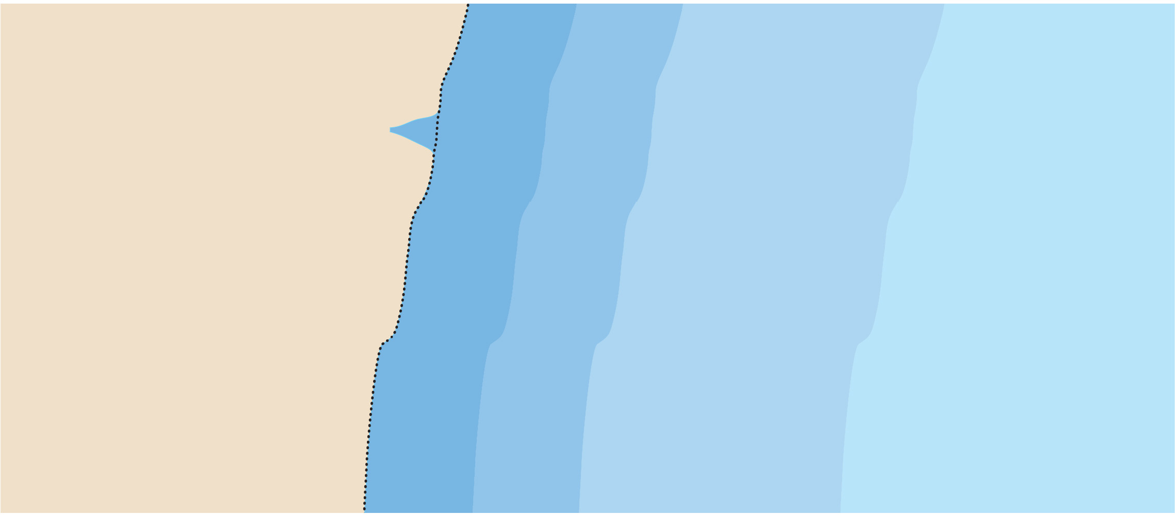
8.4.2 Physical Boundaries (4 of 5)
Figure 8-58: The Law of the Sea guarantees countries different levels of control over the waters near their shores.
INTERNAL WATERS
12
nautical
miles
12
nautical
miles
EXCLUSIVE
ECONOMIC ZONE
INTERNATIONAL
WATERS
All water on the landward side of
the baseline. Foreign vessels have
no right of passage.
No state control.
State has sole right
to exploit natural
resources, such as
fishing.
TERRITORIAL WATERS
States may set laws regulating
passage.
CONTIGUOUS ZONE
States may enforce laws concerning
pollution, taxation, customs, and
immigration.
BASELINE
200
nautical miles
Normally the low water line.

Slide 66
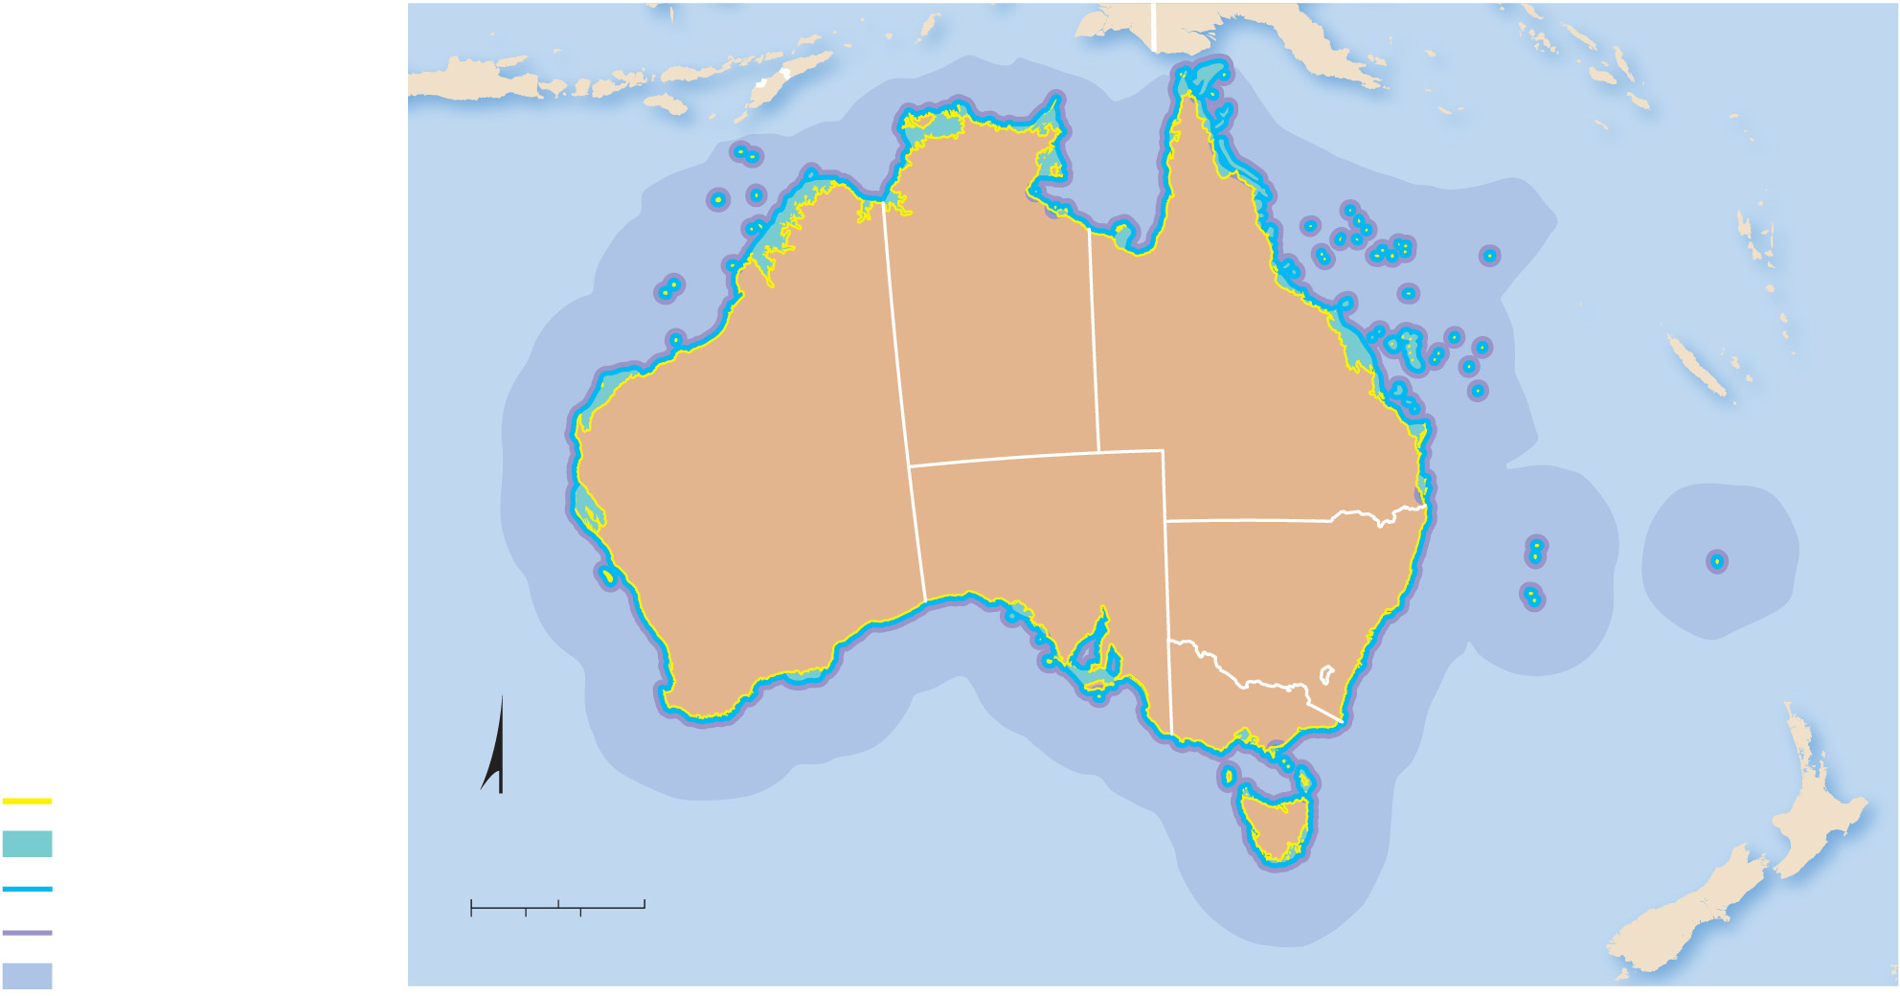
8.4.2 Physical Boundaries (5 of 5)
Figure 8-59: Map displaying the territorial and contiguous waters of Australia and its exclusive economic zones.
INDONESIA
Arafura
Sea
PAPUA NEW GUINEA
SOLOMON ISLANDS
TIMOR-LESTE
Timor
Sea
Coral Sea
INDIAN
OCEAN
NORTHERN
TERRITORY
VANUATU
QUEENSLAND
NEW
CALEDONIA
AUSTRALIA
PACIFIC OCEAN
WESTERN
AUSTRALIA
SOUTH
AUSTRALIA
NEW
SOUTH WALES
Lord
Howe I.
Norfolk I.
VICTORIA
AUSTL. CAP. TERR.
Tasman Sea
Territorial Sea Baseline
N
TASMANIA
NEW ZEALAND
Coastal Waters
INDIAN
OCEAN
Territorial Sea
0
250
500 Miles
Contiguous Zone
0
250
500 Kilometers
Exclusive Economic Zone

Slide 67
8.4.3 Geometric Boundaries (1 of 4)
Figure 8-60: Peace Arch between Blaine, Washington, and Surrey, British Columbia.

Slide 68
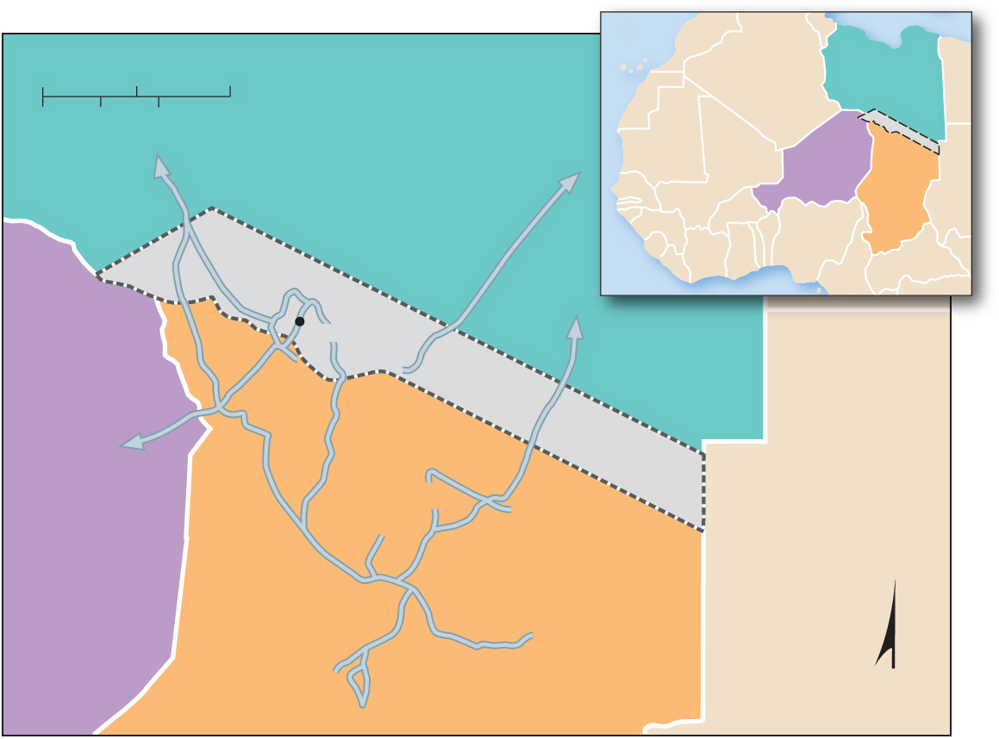
8.4.3 Geometric Boundaries (2 of 4)
Figure 8-61: The Aouzou Strip is a once-disputed geometric boundary between Libya and Chad.
AOUZOU
STRIP
0
100
200 Miles
LIBYA
0
100
200 Kilometers
NIGER
CHAD
LIBYA
Aouzou
AOUZOU STRIP
NIGER
SUDAN
CHAD
N

Slide 69
8.4.3 Geometric Boundaries (3 of 4)
Figure 8.62: Portions of Antarctica are claimed by Argentina, Australia, Chile, France, New Zealand, Norway, and the United Kingdom; claims by Argentina, Chile, and the United Kingdom are conflicting.
PACIFIC
OCEAN
120°W
90°W
60°W
South
America
ANTARCTIC CIRCLE
ATLANTIC
OCEAN
150°W
70°S
30°W
Unclaimed
ARGENTINA
CHILE
UNITED
KINGDOM
180°
NEW ZEALAND
South Pole
0°
New
Zealand
NORWAY
AUSTRALIA
Africa
FRANCE
AUSTRALIA
150°E
30°E
INDIAN
OCEAN
Australia
0
500
1,000 Miles
120°E
90°E
0
500
1,000 Kilometers

Slide 70
8.4.3 Geometric Boundaries (4 of 4)
Figure 8.63: Under the Law of the Sea Treaty of 1982, countries have submitted claims to territory inside the Arctic Circle. Some of these claims overlap.
0
500
1,000 Miles
0
500
1,000 Kilometers
RUSSIA
ARCTIC CIRCLE
150°E
200-nautical-
mile limit
FINLAND
SWEDEN
Lomonosov
Ridge
NORWAY
180°
North Pole
0°
ARCTIC OCEAN
GREENLAND
(DENMARK)
ICELAND
Territorial
claims
UNITED STATES
(ALASKA)
Denmark
30°W
Canada
CANADA
Russia
150°W
Norway
PACIFIC
OCEAN
ARCTIC CIRCLE
ATLANTIC
OCEAN
United States
60°W

Slide 71
8.4.4 Shapes of States (1 of 7)
Countries have one of the five basic shapes. The latter four shapes can be problematic. Landlocked states face the lack of access to the sea
compact (e.g., Uganda, Kenya)
elongated (e.g., Malawi, the Gambia)
prorupted (e.g., Namibia, Democratic Republic of Congo)
perforated (e.g., South Africa)
fragmented (e.g., Angola)

Slide 72
8.4.4 Shapes of States (2 of 7)
Figure 8-64: Kenya, Uganda, Rwanda, and Burundi are all examples of compact states.
ETHIOPIA
0
125
250 Miles
SOUTH SUDAN
0
125
250 Kilometers
DEM.
REP.
CONGO
SOMALIA
UGANDA
KENYA
Lake
Victoria
RWANDA
INDIAN OCEAN
BURUNDI
TANZANIA

Slide 73
8.4.4 Shapes of States (3 of 7)
Figure 8-65: The Democratic Republic of Congo and Namibia are examples of prorupted states.
C.A.R.
Congo R.
GABON
DEM. REP.
CONGO
ANGOLA
ZAMBIA
Caprivi Strip
Zambezi R.
NAMIBIA
ZIMBABWE
BOTSWANA
SOUTH
AFRICA
ATLANTIC
OCEAN
0
250
500 Miles
0
250
500 Kilometers

Slide 74
8.4.4 Shapes of States (4 of 7)
Figure 8-66: South Africa is perforated by Lesotho.
BOTSWANA
NAMIBIA
ESWATINI
LESOTHO
SOUTH
AFRICA
INDIAN
OCEAN
0
125
250 Miles
0
125
250 Kilometers

Slide 75
8.4.4 Shapes of States (5 of 7)
Figure 8-67: The Gambia is an elongated state.
SENEGAL
0
25
50 Miles
0
25
50 Kilometers
ATLANTIC OCEAN
THE GAMBIA
Gambia R.
SENEGAL

Slide 76
8.4.4 Shapes of States (6 of 7)
Figure 8-68: Angola is divided into two fragments by the Democratic Republic of Congo.
Cabinda
DEM. REP. CONGO
ANGOLA
ZAMBIA
NAMIBIA
0
125
250 Miles
BOTSWANA
0
125
250 Kilometers

Slide 77
8.4.4 Shapes of States (7 of 7)
Figure 8-69: Rail is the most cost-effective way to transport goods to and from landlocked states, but not all states have good access to oceanic trade.
Mediterranean Sea
Red Sea
MALI
NIGER
CHAD
BURKINA
FASO
CENTRAL
AFRICAN
REP.
SOUTH
SUDAN
ETHIOPIA
UGANDA
RWANDA
BURUNDI
ATLANTIC
OCEAN
ZAMBIA
MALAWI
0
500
1,000 Miles
ZIMBABWE
0
500
1,000 Kilometers
BOTSWANA
Landlocked country
ESWATINI
INDIAN
OCEAN
Railroad
LESOTHO

Slide 78
8.4.5 Electoral Geography (1 of 5)
Redrawing legislative boundaries to benefit the party in power is called gerrymandering
Gerrymandering takes two forms:
cracking—like-minded voters are spread across several districts to prevent them from reaching a majority in any of them
packing—like-minded voters are stacked in one district to prevent them from affecting elections in other districts

Slide 79
8.4.5 Electoral Geography (2 of 5)
Figure 8-70: A political cartoon lampooned the odd shape of an electoral district in Massachusetts after Governor Elbridge Gerry approved oddly shaped districts in a stacked vote strategy.

Slide 80
8.4.5 Electoral Geography (3 of 5)
Figure 8-71: Like-minded voters are spread across many districts as a minority.

Slide 81
8.4.5 Electoral Geography (4 of 5)
Figure 8-72: Like-minded voters are stacked into a few districts.

Slide 82
8.4.5 Electoral Geography (5 of 5)
Figure 8-73: Map highlights the most gerrymandered districts in the United States and ranks states on how gerrymandered their districts are.
PENNSYLVANIA 7
ILLINOIS 4
ILLINOIS 7
This oddly-shaped
district was known as
Goofy kicking Donald
Duck.
Two predominantly Chicago
Hispanic neighborhoods
(Puerto Rican to the
north and Mexican to the
south).
Predominantly African
American Chicago neigh-
borhoods are packed
into the district.
MASSACHUSETTS 7
OHIO 11
African Americans
are divided among
several districts.
African Americans are
packed into a district
combining parts of Cleveland
and Akron.
MARYLAND 3
Created a safe Demo-
cratic seat
Gerrymander score, 2018
Boston
Most gerrymandered
Intermediate
Chicago
Cleveland
Least gerrymandered
Salt
Lake
City
Akron
Philadelphia
None
Baltimore
UTAH 4
Fort Worth
Dallas
More liberal-voting Salt
Lake City is cracked
into several suburban- dominated districts.
San Antonio
Tallahassee
Jacksonville
FLORIDA 5
Houston
New
Orleans
Predominantly African American por-
tions of Jacksonville and Tallahassee
are packed into the district.
TEXAS 33
People of color
and liberal Dallas
city voters are cracked into more than one suburban- dominated district.
TEXAS 2
TEXAS 35
People of color and
liberal Houston city
voters are cracked into
more than one suburban- dominated district.
Democratic-voting
Hispanics are packed
into a single district.
LOUISIANA 2
African Americans are packed into a single district.

Slide 83
8.4.6 Redrawing Boundaries
Figure 8-74: Ohio’s Congressional map between 2012 and 2020 was gerrymandered to pack Democrats into a handful of districts.
CANADA
MICHIGAN
Lake Erie
Lake
Ashtabula
Williams
Fulton
Lucas
Ottawa
9
11
Geauga
14
Wood
Sandusky
Erie
Cuyahoga
Trumbull
Defiance
Henry
Lorain
13
Paulding
5
Seneca
Huron
Medina
Summit
Portage
PENNSYLVANIA
Putnam
Hancock
16
Mahoning
Van Wert
Allen
Wyandot
Crawford
Richland
Ashland
Wayne
Stark
Columbiana
Auglaize
Hardin
Marion
Morrow
Holmes
Carroll
Mercer
4
Knox
7
Tuscarawas
Jefferson
INDIANA
Shelby
Logan
Union
Delaware
Coshocton
Harrison
Darke
Champaign
12
Guernsey
8
Miami
3
Licking
Muskingum
6
Belmont
Clark
Madison
Franklin
Preble
Montgomery
Fairfield
Perry
Noble
Monroe
10
Greene
Pickaway
Morgan
Warren
Fayette
15
Hocking
Washington
Butler
1
Clinton
Ross
Athens
Hamilton
Highland
Vinton
WEST
VIRGINIA
Clermont
2
Pike
Jackson
Meigs
Brown
Adams
Scioto
Gallia
at least 60% Democratic
KENTUCKY
Lawrence
at least 60% Republican
50–59% Republican

Slide 84
Copyright
This work is protected by United States copyright laws and is provided solely for the use of instructors in teaching their courses and assessing student learning. Dissemination or sale of any part of this work (including on the World Wide Web) will destroy the integrity of the work and is not permitted. The work and materials from it should never be made available to students except by instructors using the accompanying text in their classes. All recipients of this work are expected to abide by these restrictions and to honor the intended pedagogical purposes and the needs of other instructors who rely on these materials.

