Slide 1
Chapter 12 LECTURE OUTLINE Environment & conservation
Human Geography by Malinowski & Kaplan

Slide 2
Chapter 12 Modules
12A How Geographers See the Environment
12B Natural Hazards
12C Natural Disasters
12D Human Geography and Water
12E Human Geography and Air Pollution
12F Solid Waste
12G Hazardous Waste
12H Geography of Fossil Fuels
12I Population Growth and the Environment
12J Environmental Justice

Slide 3
12A: How Geographers See the Environment
Environment
In common usage, the physical or natural conditions of an area
Geographers use the term physical or natural environment
Sauer’s Morphology of Landscape
Believed that the physical landscape is modified by culture to create a cultural landscape
Cultural Ecology
The study of how human societies adapt to local habitats and how traditional societies engage in farming or other primary activities.

Slide 4
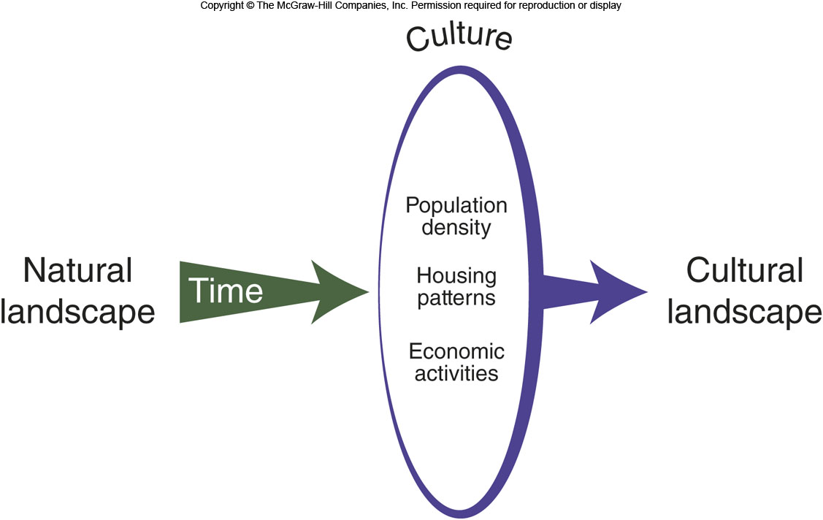
Sauer’s Morphology of Landscape
Figure 12A.1

Slide 5
12B: Natural Hazards 1
Environmental events such as floods, hurricanes, earthquakes, tornados, tsunami, mudslides, volcanic eruptions, and droughts
Environmental perception
How people perceive, feel about, and interact with the environment

Slide 6
12B: Natural Hazards 2
According to Gilbert White, human responses to flooding are either
Structural responses, such as building levees, walls, or engineering systems
Nonstructural responses, namely actions taken by a society, political body, or individuals to reduce risk
Other theorists have looked at:
Cognitive factors, such as a person’s personality or attitudes
Situation factors, such as where people live, their age, their financial resources, etc.

Slide 7
12C: Natural Disasters
Earthquakes
Measured using moment magnitude scale
Can generate tsunami
Hurricanes/Typhoons/Cyclones
Damage from high winds, storm surges, rainfall
Tornados
The United States has the most in the world

Slide 8
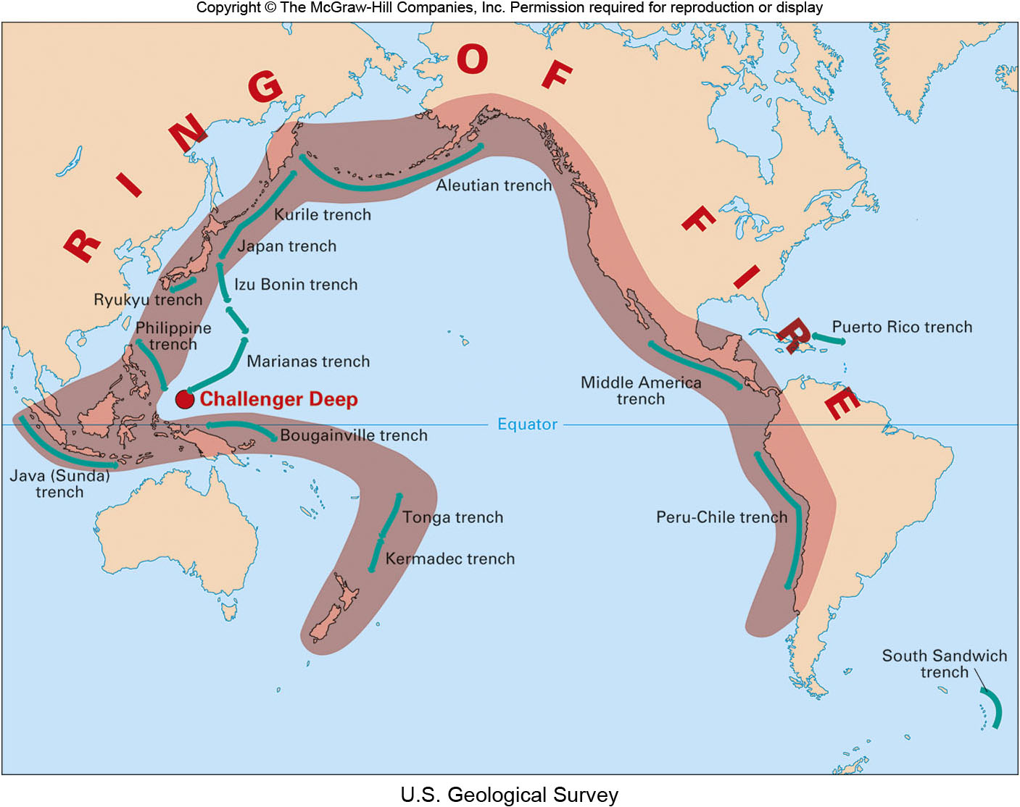
Ring of Fire
Figure 12C.1

Slide 9
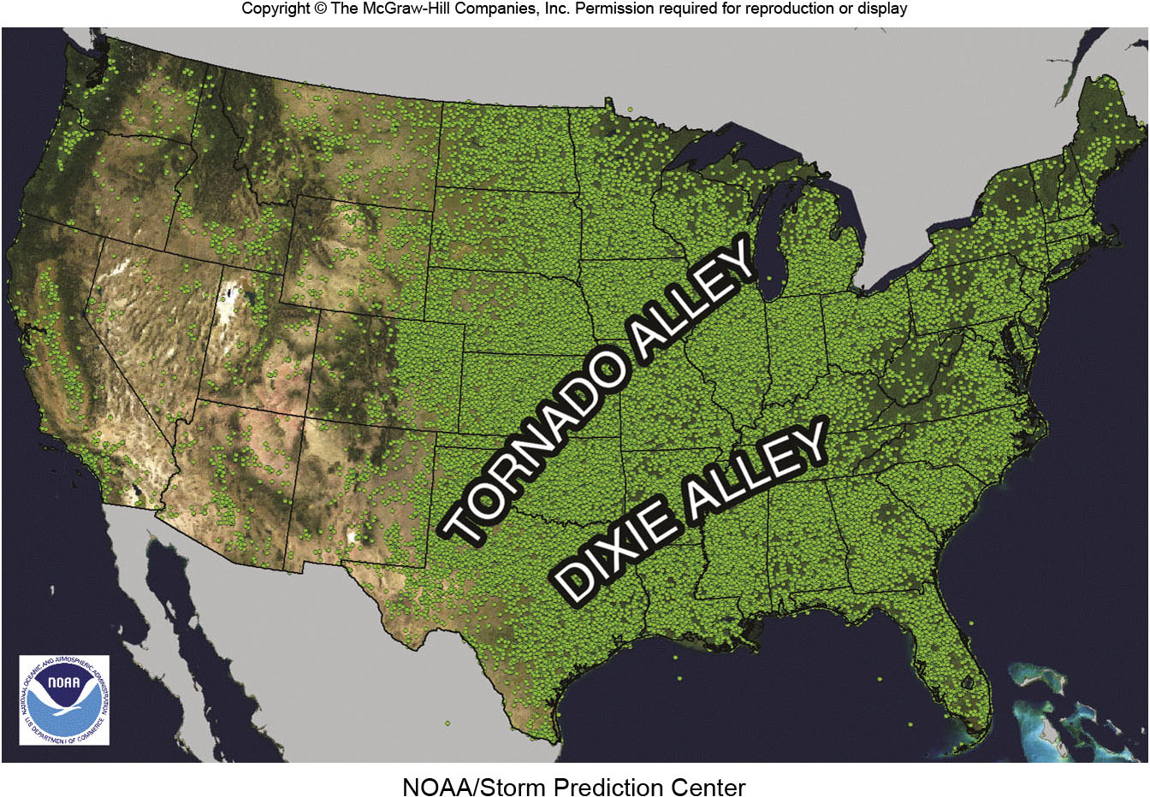
Tornado Alley
Figure 12C.3

Slide 10
12D: Human Geography & Water
40% of the world’s population lives within 100km of a coast
Water diversion by human cultures has changed the environment in many ways
Can be minor or major, like the Three Gorges Dam
Water pollution is a major global problem

Slide 11
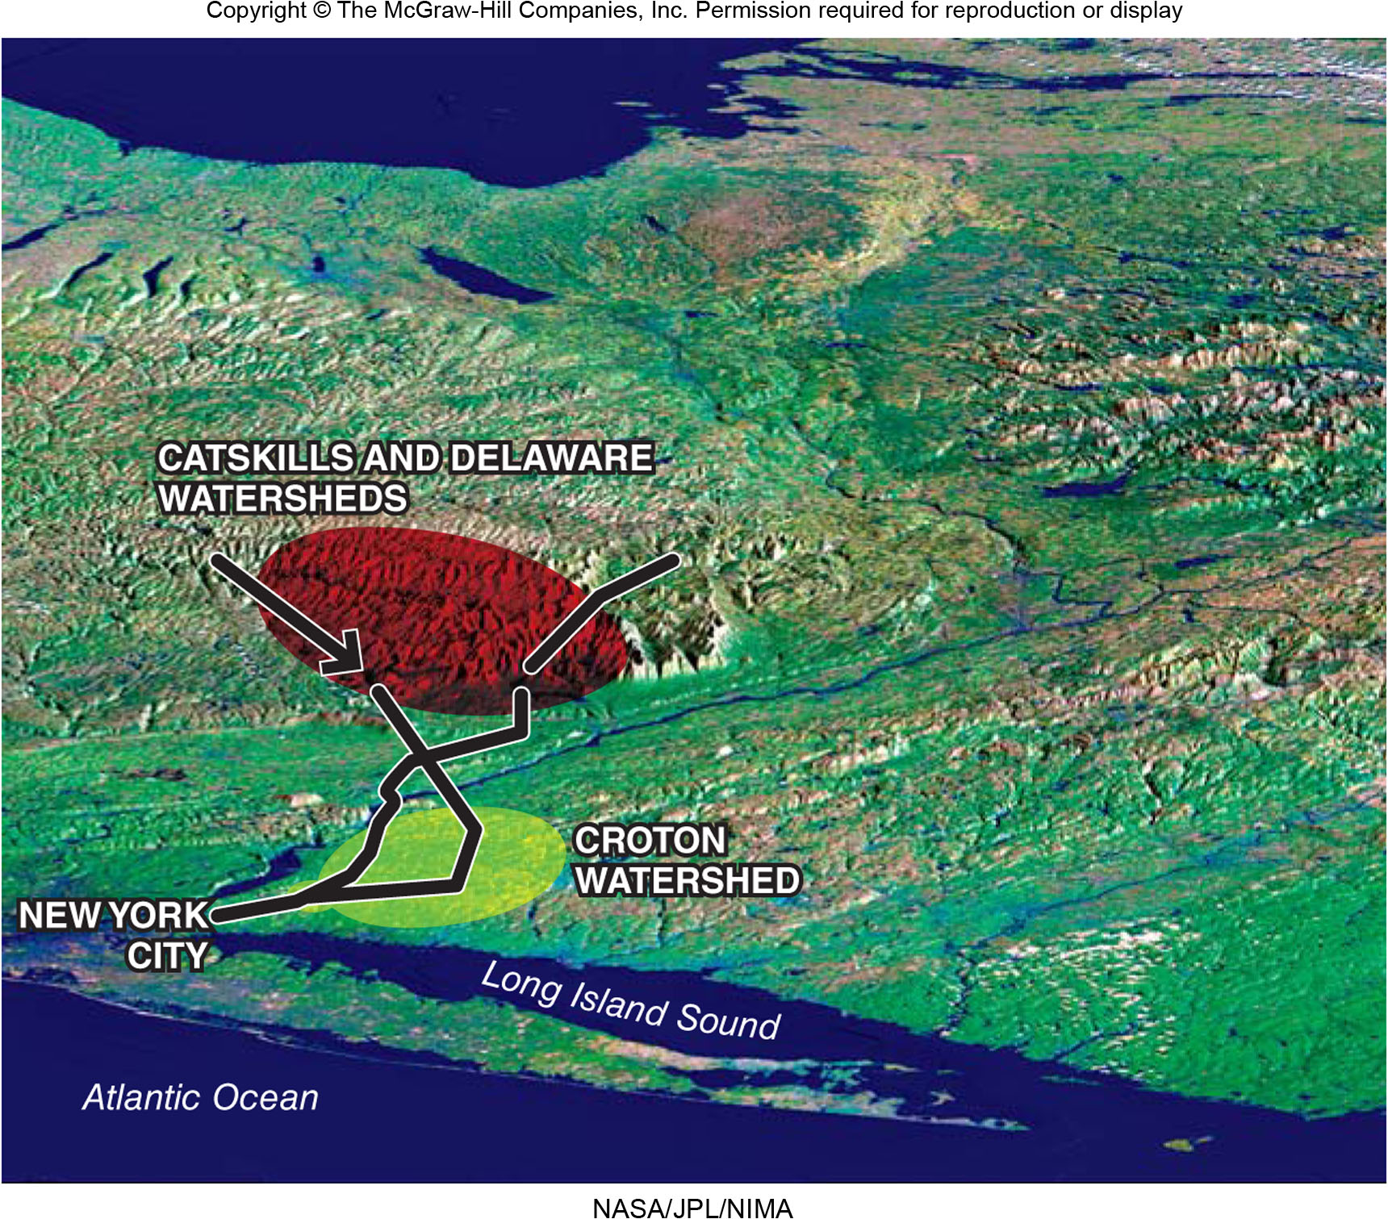
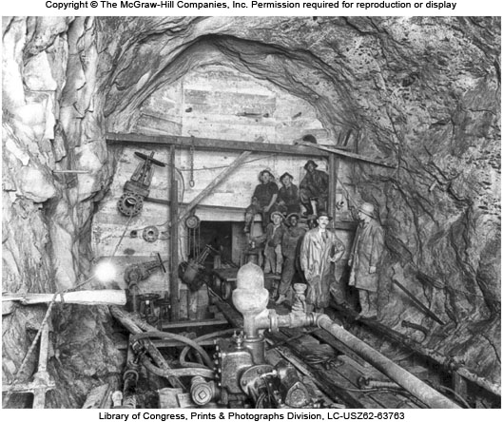
New York City Water System
Figure 12D.1

Slide 12
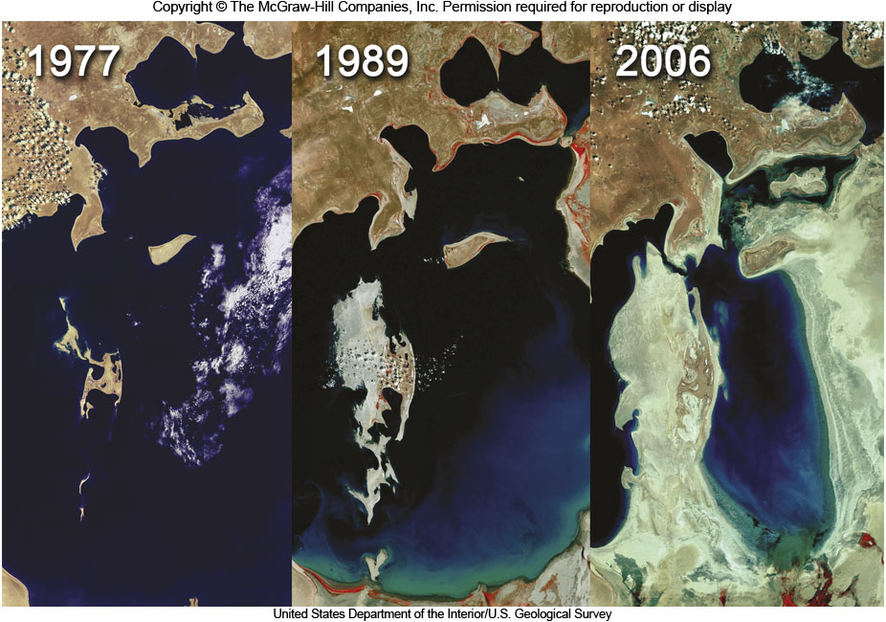
Aral Sea
Figure 12D.2

Slide 13
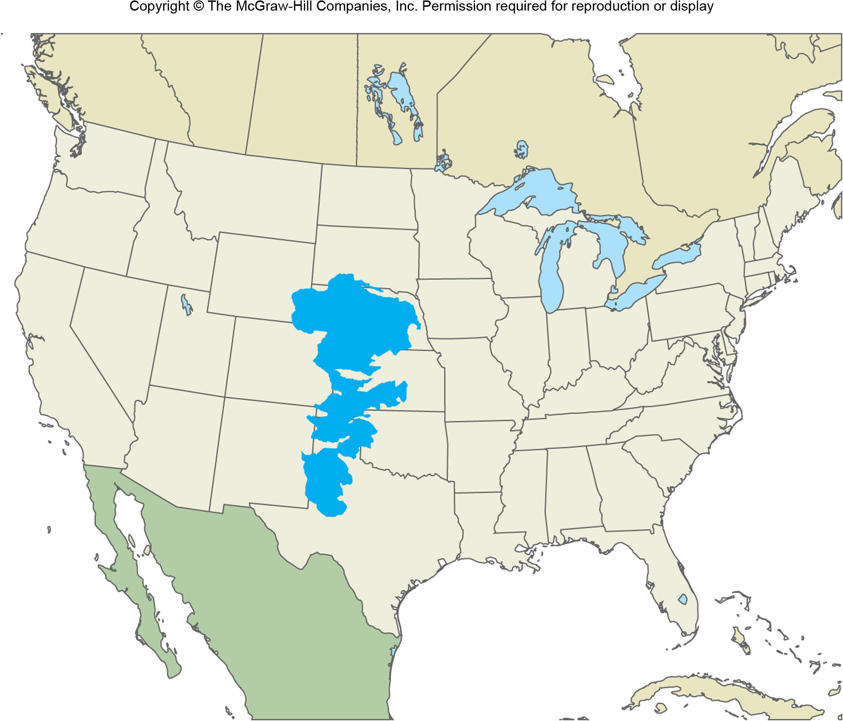
Ogallala Aquifer
Figure 12D.4

Slide 14
12E: Human Geography & Pollution
Air pollution is the introduction of chemicals, biological matter, or particulates into the atmosphere
Urban areas and regions downwind of manufacturing are the main affected areas
Reduction in daylight, chronic lung problems, and acid rain are key problems

Slide 15
12F: Solid Waste
Solid waste is commonly known as garbage
In 2009, Americans generated over 243 tons of municipal solid waste
Recycling has reduced solid waste in landfills
NIMBY
“Not In My Back Yard”
Increased recycling and use of incinerators could reduce solid waste bound for landfills

Slide 16
12G: Hazardous Waste
Also known as toxic waste
Waste that poses a risk to either the environment or to people
A major local problem
US government’s Superfund Program became law in 1980
1,300 sites
Hazardous waste is dangerous because it can move, either in the environment or by humans
Work by geographers has helped identify cancer clusters

Slide 17
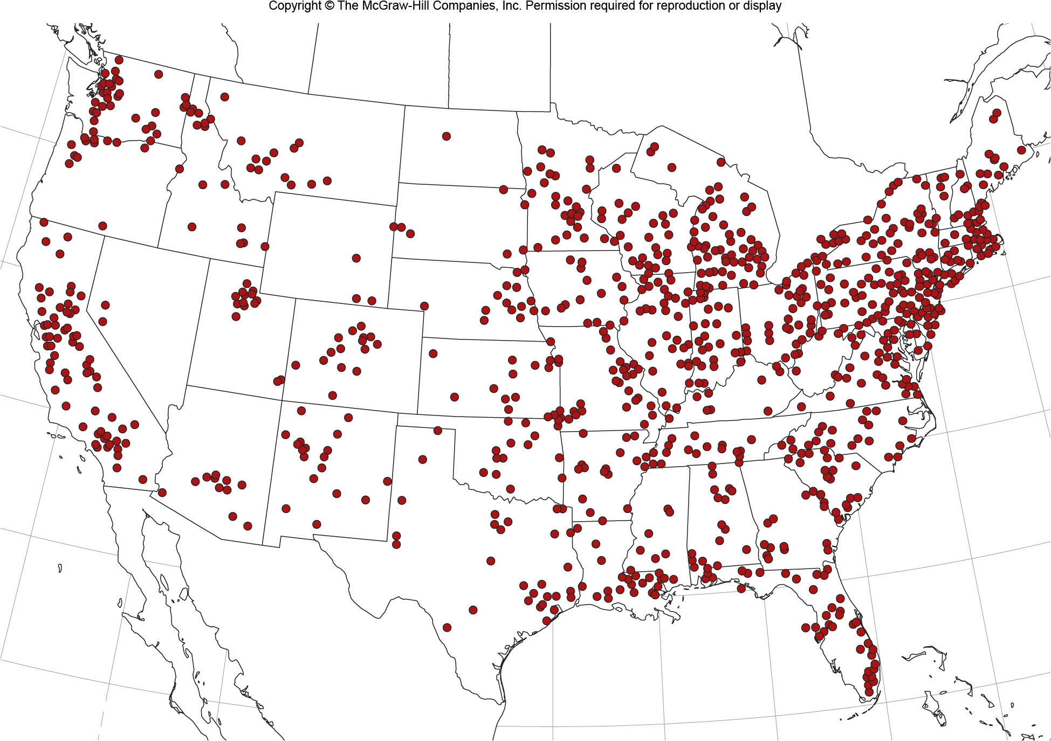
Superfund Sites
Figure 12G.1

Slide 18
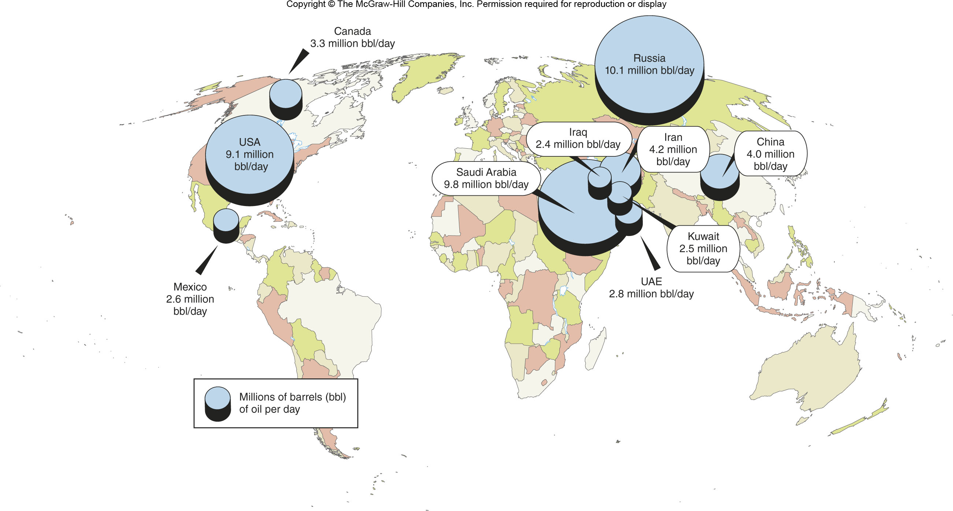
Crude Oil Production
Figure 12H.1

Slide 19
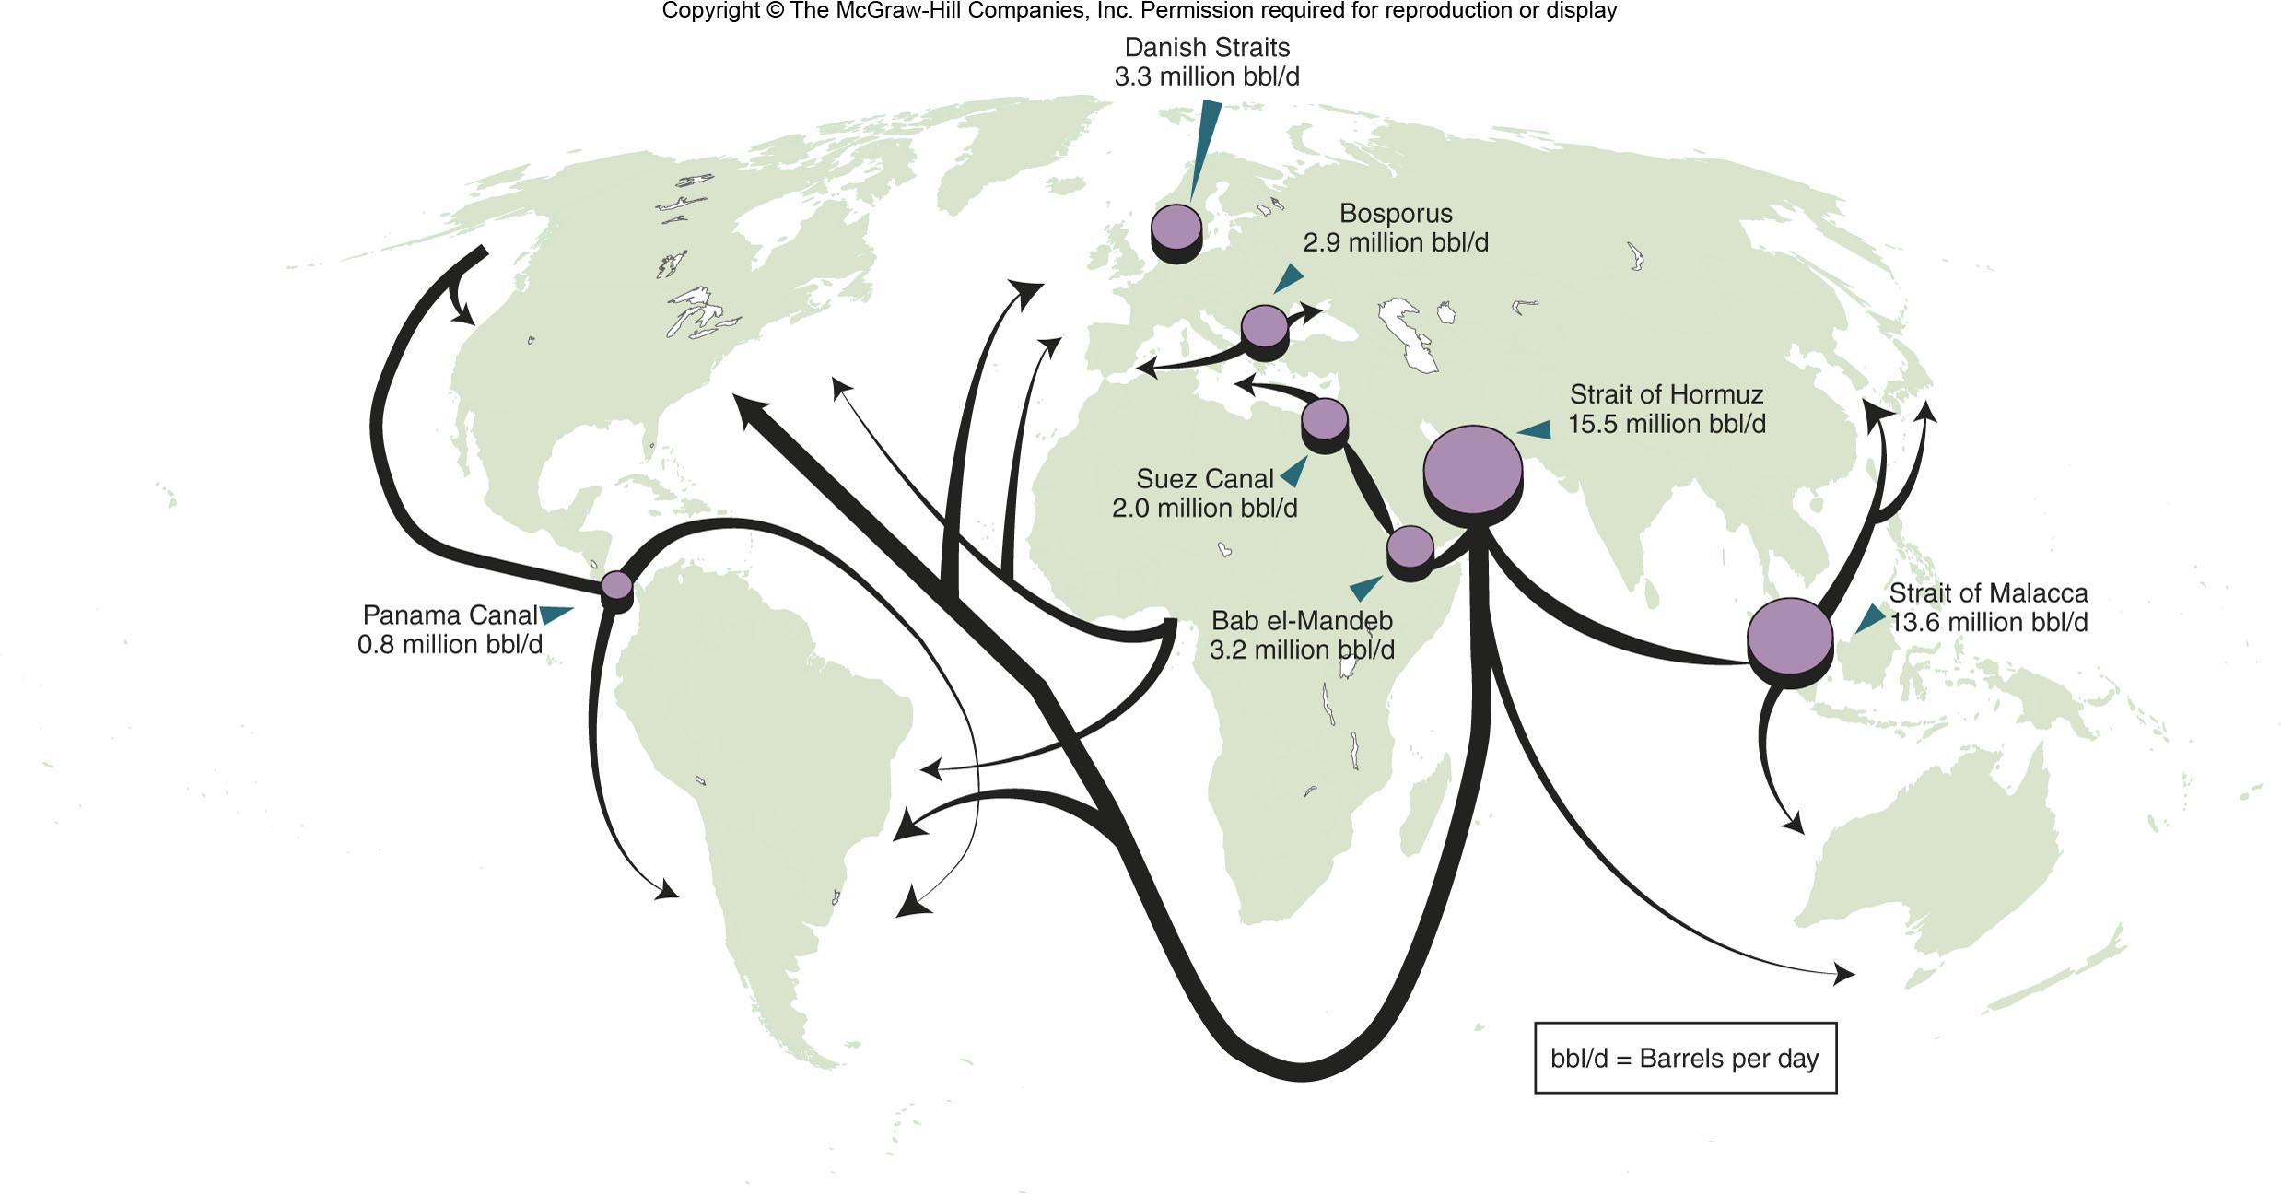
Oil Shipping Rates & Chokepoints
Figure 12H.2

Slide 20
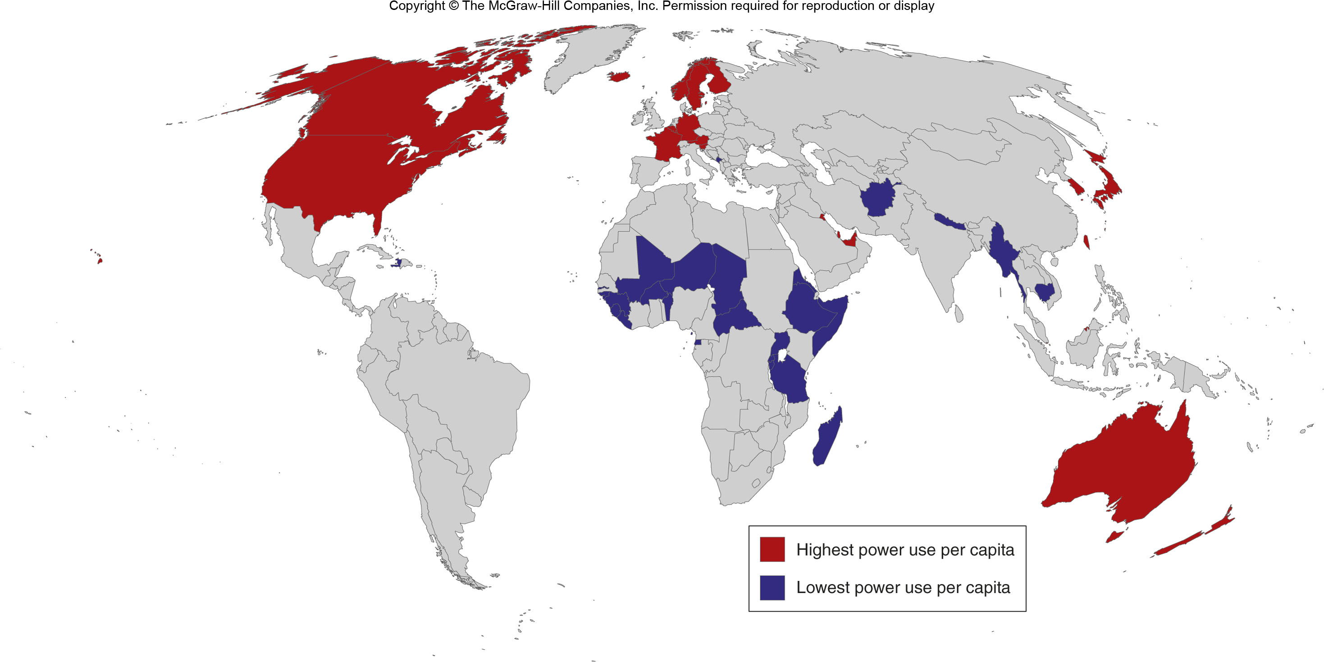
Power Use per Capita
Figure 12H.3

Slide 21
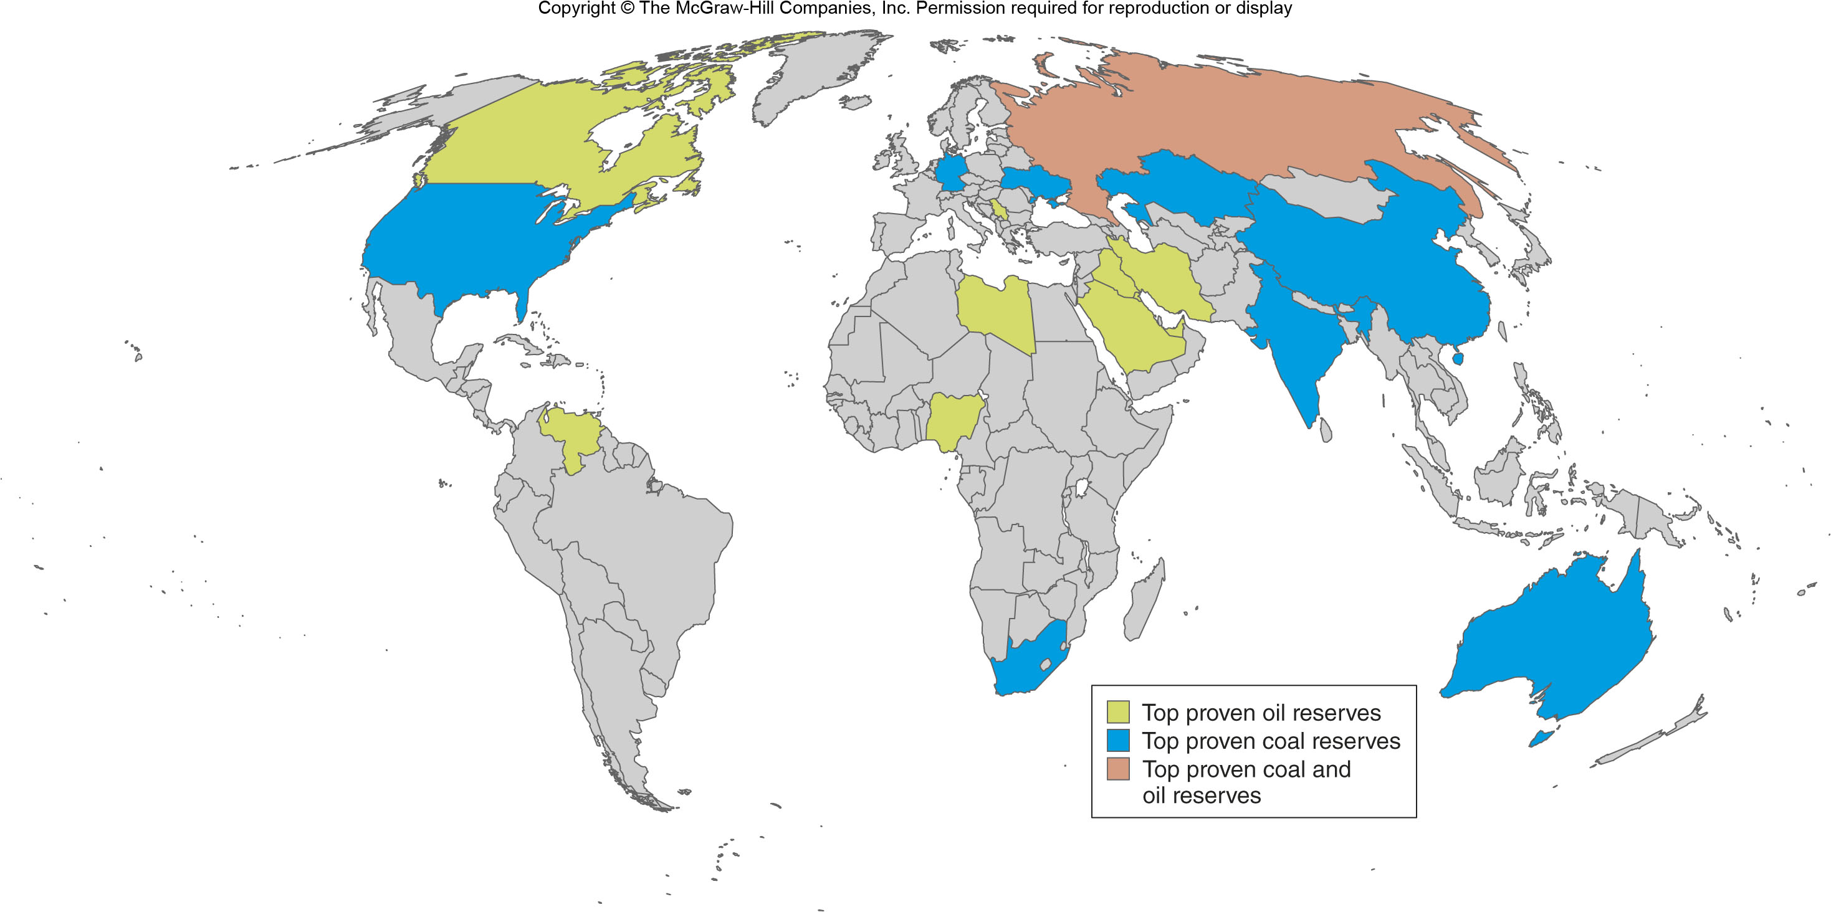
Oil & Coal Reserves
Figure 12H.4

Slide 22
12I: Population Growth & the Environment
Rapid population growth can strain the environment
How population affects the environment is debated
Typical environmental problems that stem from population increase include:
Deforestation
Coastal pollution

Slide 23
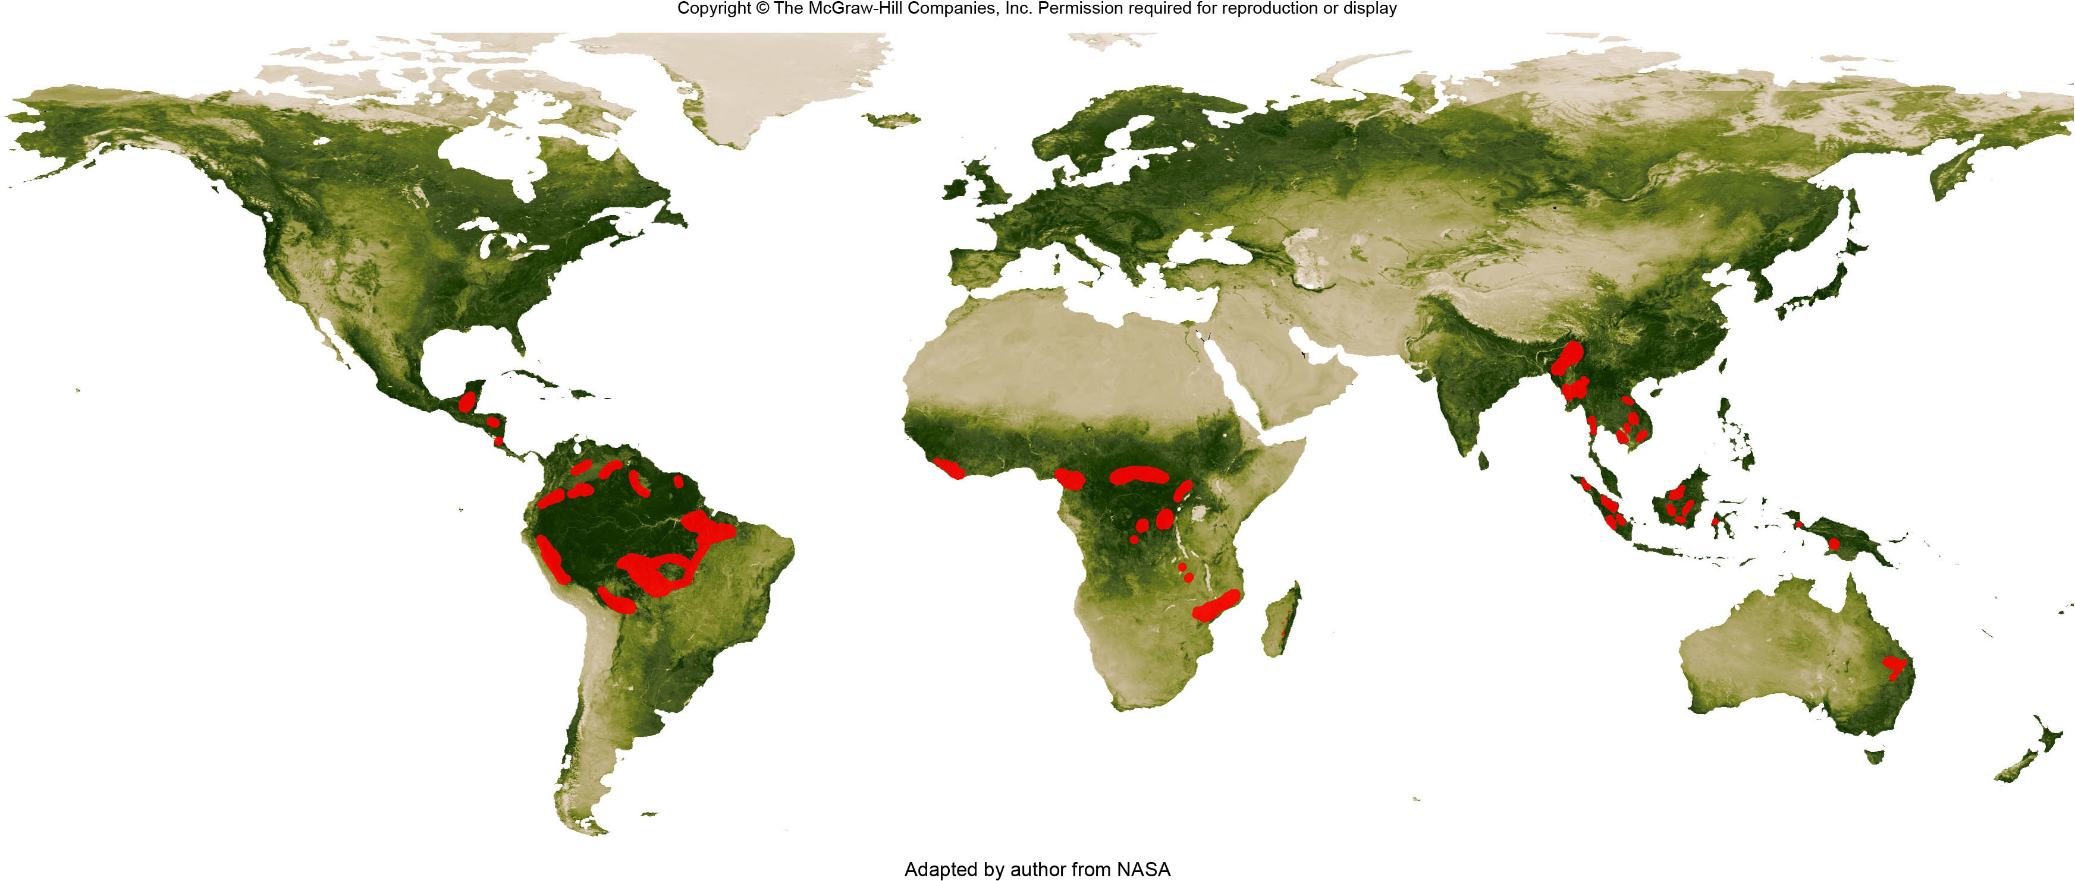
Deforestation Worldwide
Figure 12I.2

Slide 24
12J: Environmental Justice
The concept that environmental laws and regulations should apply to all areas, regardless of the racial or ethnic composition of a location.
Environmental racism
The situation in which polluters intentionally or unintentionally take advantage of a minority community because the community is less likely to oppose any hazards

