Slide 1
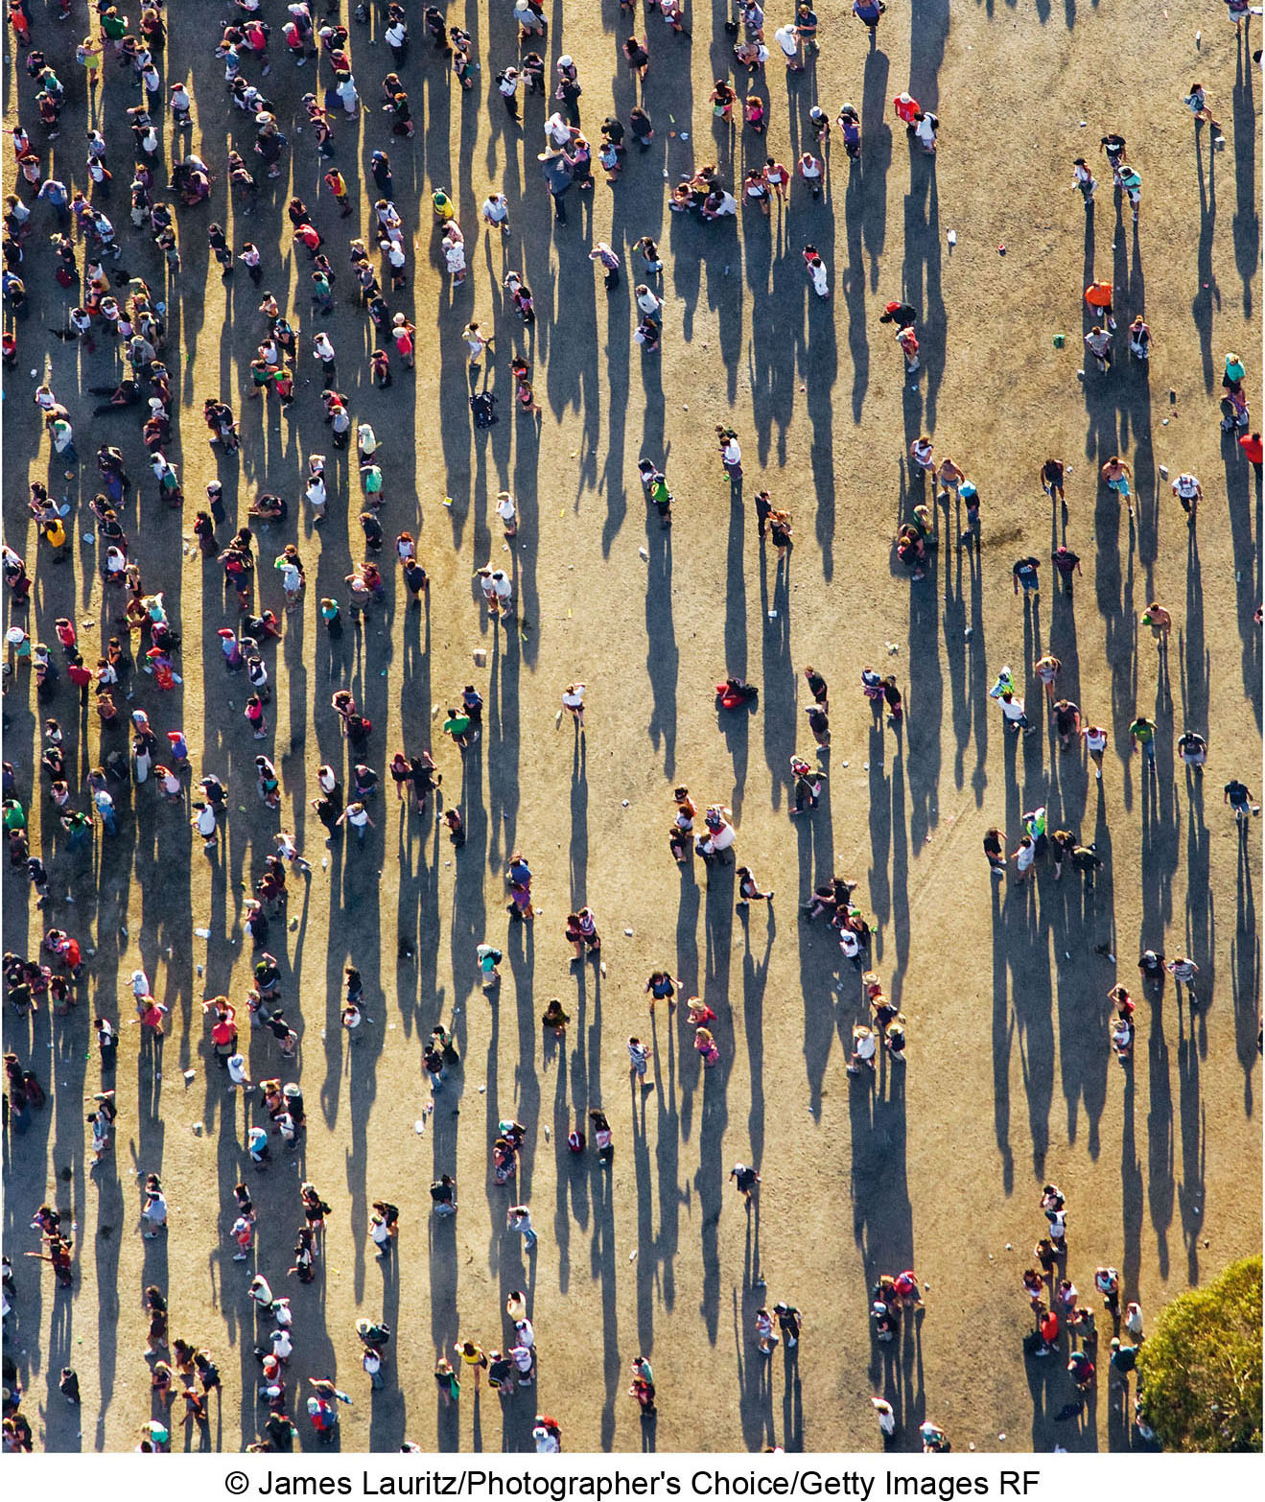
CHAPTER 3 LECTURE OUTLINE Population
Human Geography by Malinowski & Kaplan

Slide 2
Chapter 3 Modules
3A Population Growth in the Past
3B World Population Today: The Americas
3C World Population Today: Europe and Africa
3D World Population Today: Asia and Oceania
3E The Basic Demographic Equation and Fertility
3F Mortality and Population Change
3G The Demographic Transition Model
3H Population Profiles
3I Population Change in the Future
3J Population Planning

Slide 3
3A: Population Growth in the Past
Neolithic Revolution
Domestication of livestock and agriculture
Began about 12,000 years ago
Slow but steady growth from 10,000 BCE until 1750
Decline during plagues of the 1300s
Industrial Revolution
Mid-18th century

Slide 4
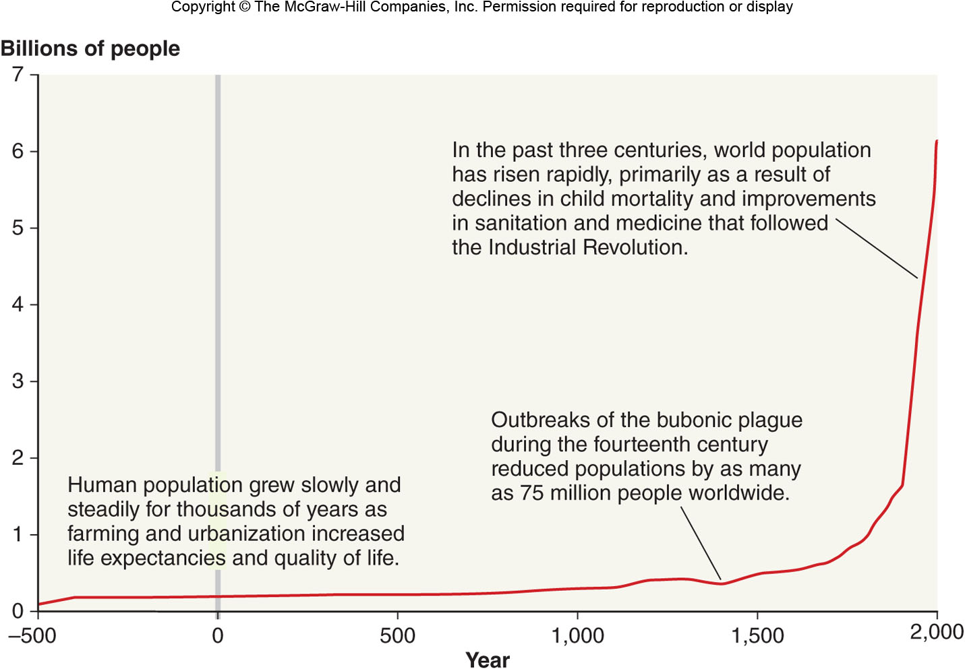
World Population Growth
Figure 3A.1

Slide 5
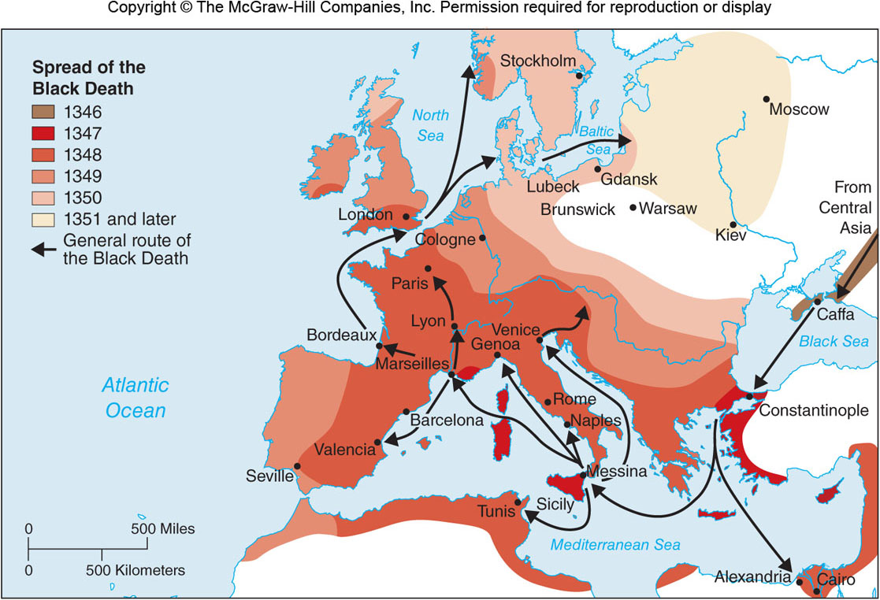
The Black Death in Europe
Figure 3A.2

Slide 6
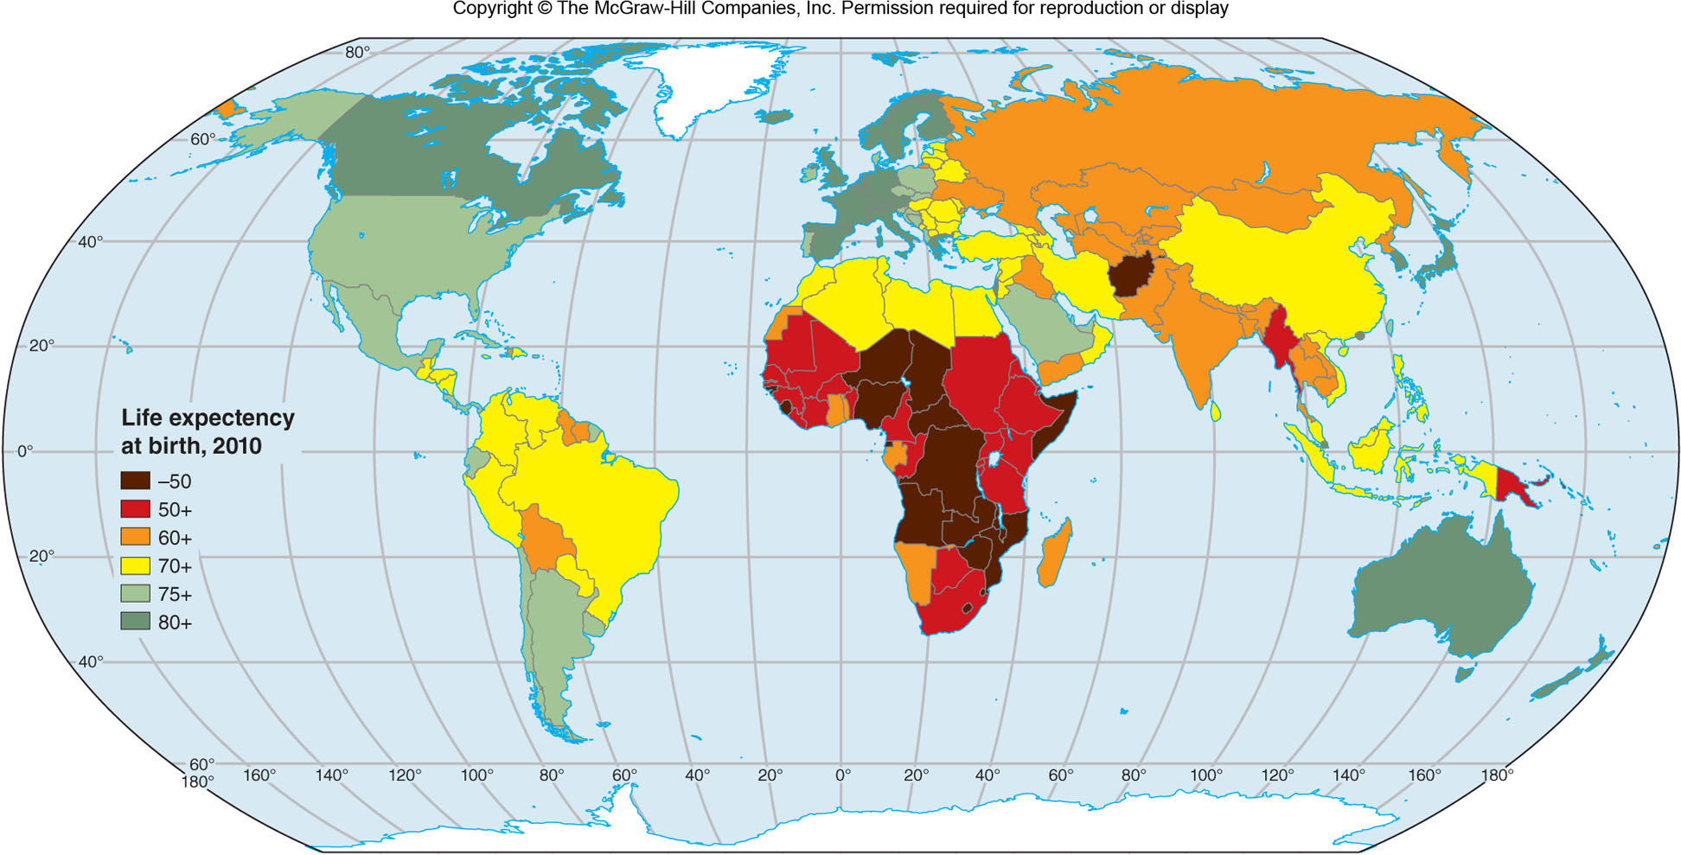
Life Expectancies, 2010
Figure 3A.3

Slide 7
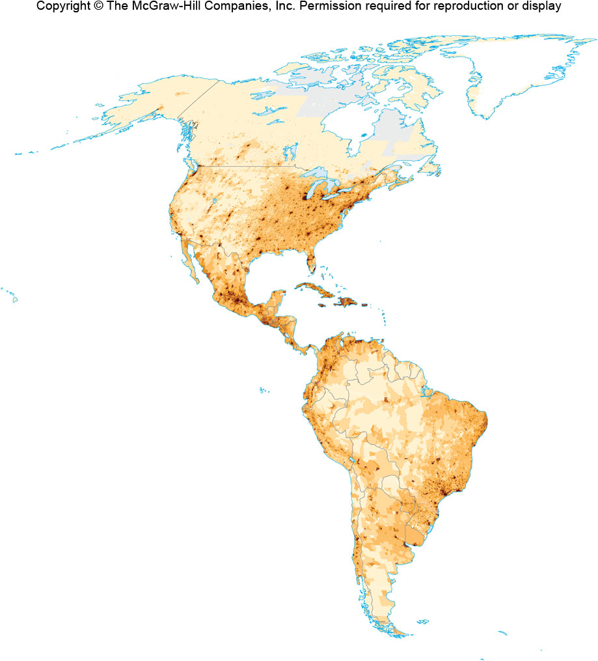
Population in the Americas
Figure 3B.1

Slide 8
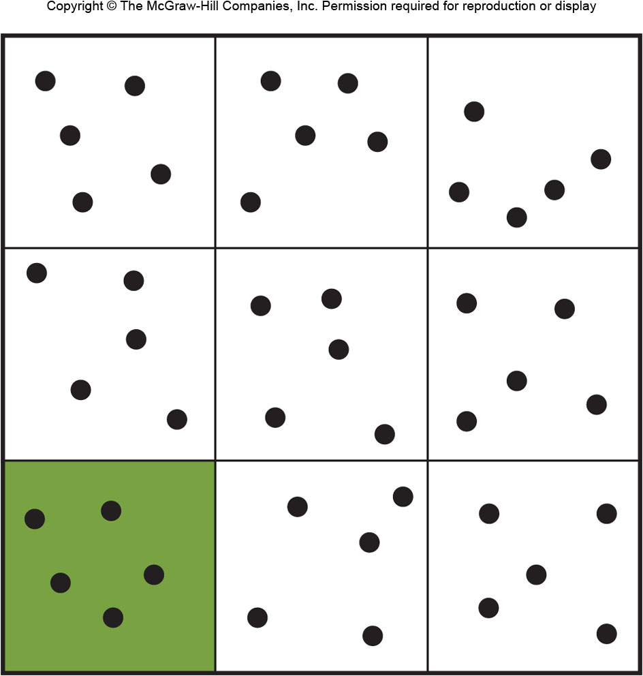
Density
Arithmetic Density
Calculated by dividing a country’s population by its total land area.
Such as people/km²
Physiologic Density
Calculated by dividing a country’s population by its area of arable land.
people/km² of farmland

Slide 9
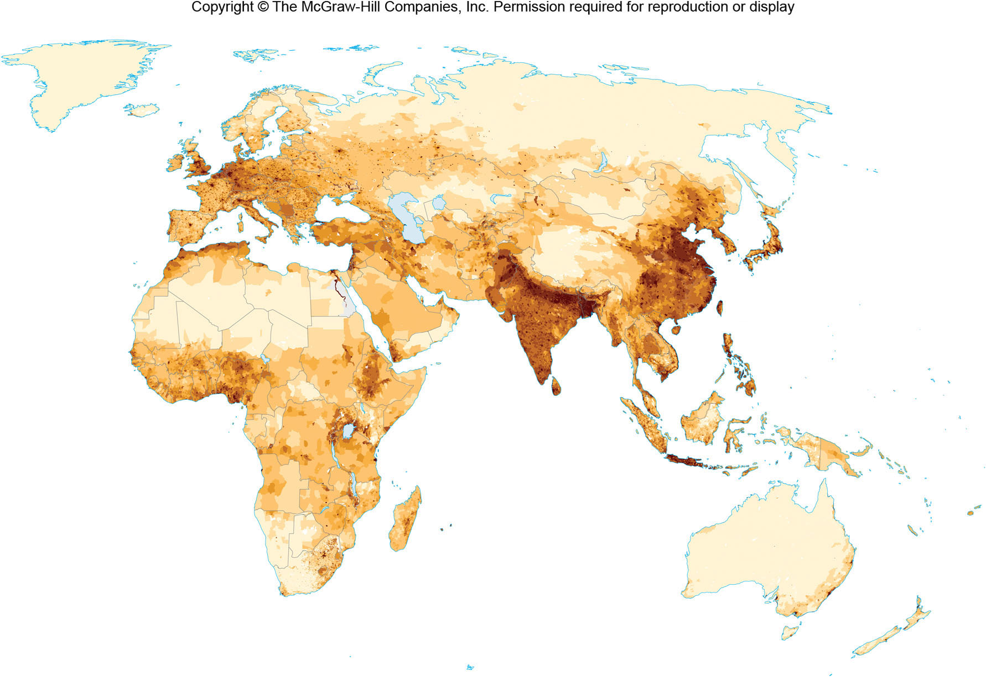
Population in Eurasia & Africa
Figure 3C.1

Slide 10
3E: The Demographic Equation
Future population = current population
+ births – deaths
+ immigrants – emigrants

Slide 11
3E: Fertility
Crude Birth Rate (CBR)
# of children born per year per 1000 people in a population
Total Fertility Rate (TFR)
The # of children a woman can expect to have in her lifetime given current fertility rates
Replacement Level of Fertility
A TFR of 2.1-2.3
Also called “zero population growth”

Slide 12
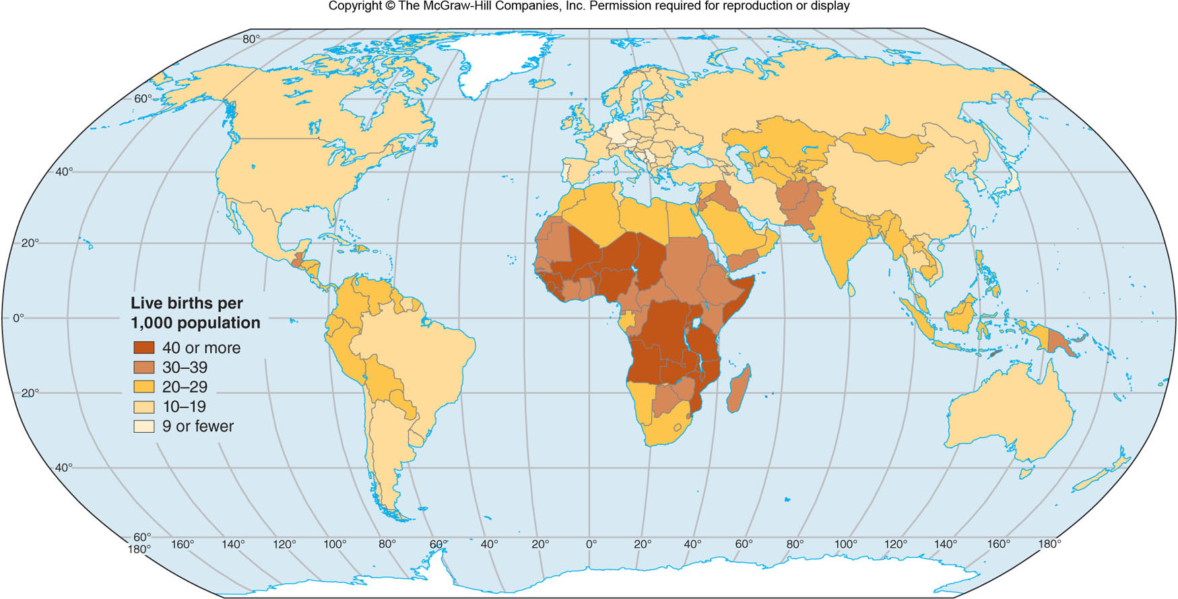
Crude Birth Rates
Figure 3E.1

Slide 13
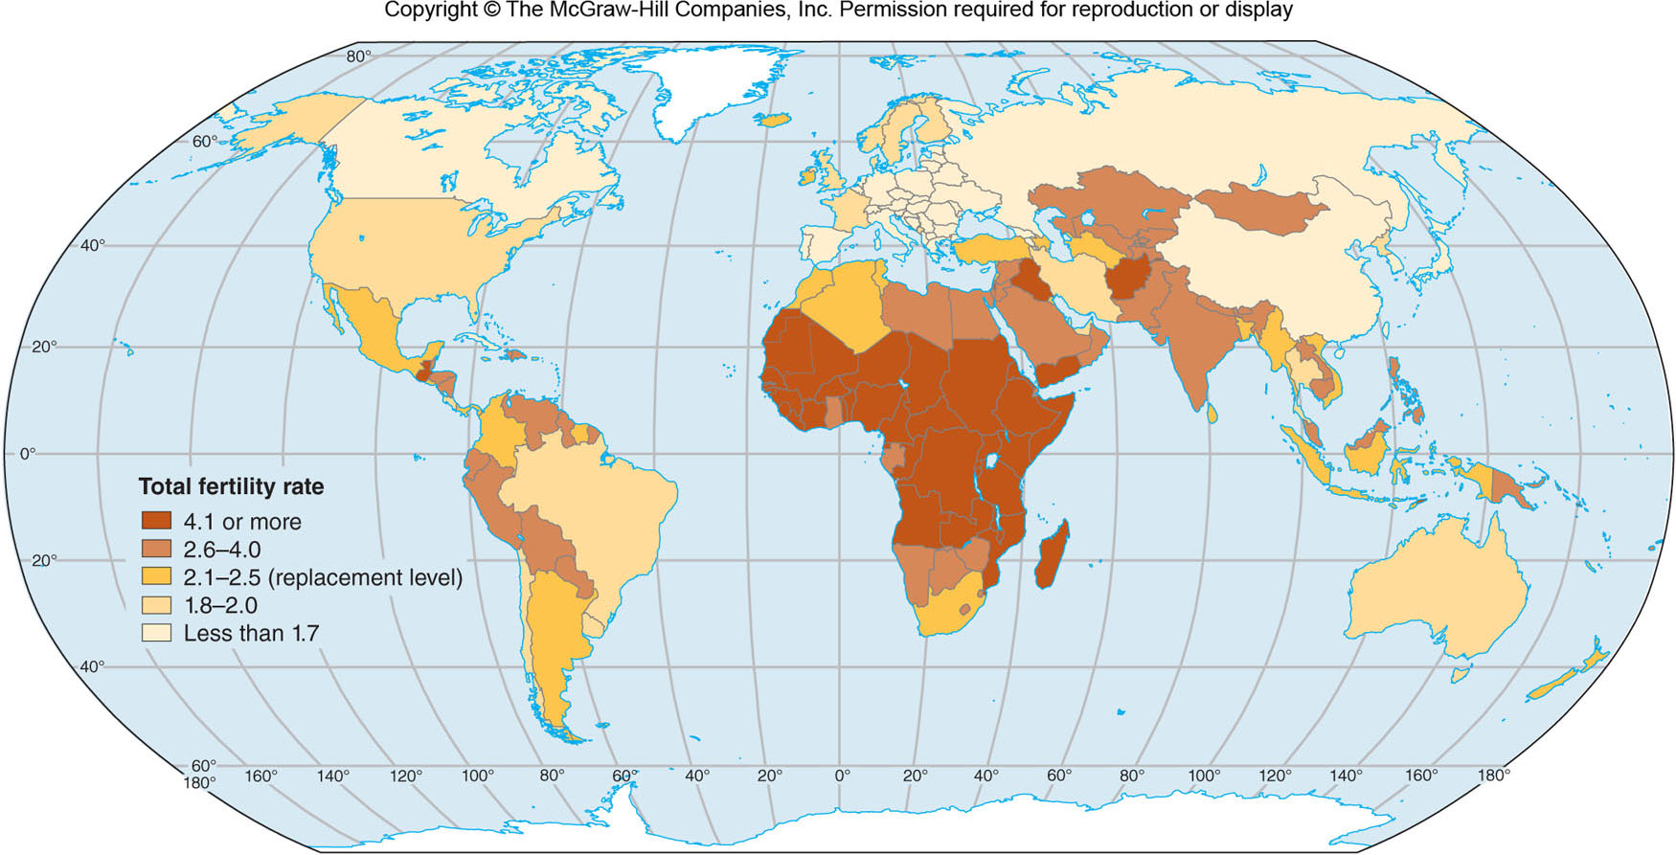
Total Fertility Rates
Figure 3E.2

Slide 14
3F: Mortality
Crude Death Rate (CDR)
# of deaths per year in a population per 1,000 people
Infant Mortality Rate (IMR)
(The # of infants who die before age 1 /by all births) x 1000

Slide 15
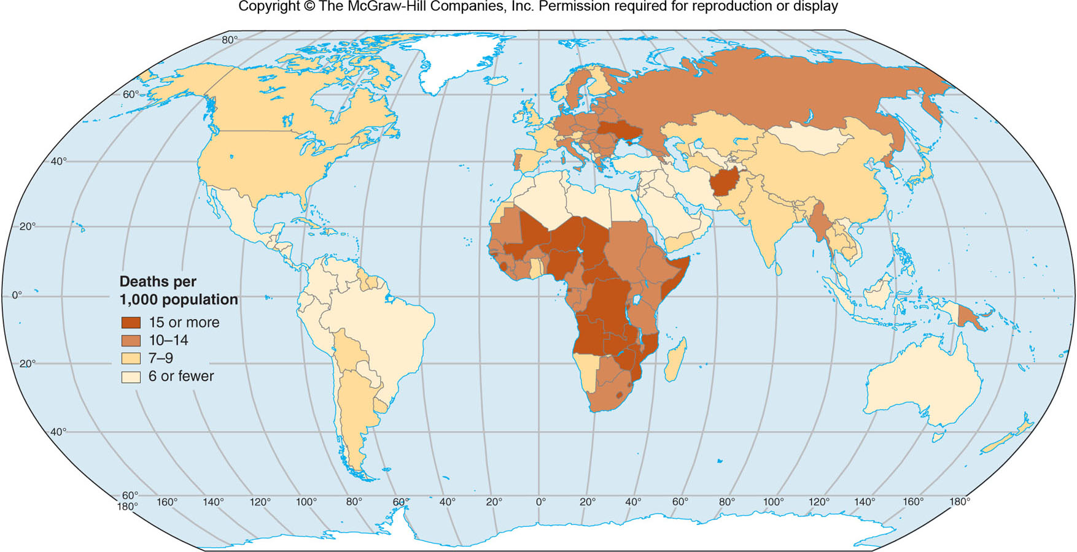
Crude Mortality Rates
Figure 3F.1

Slide 16
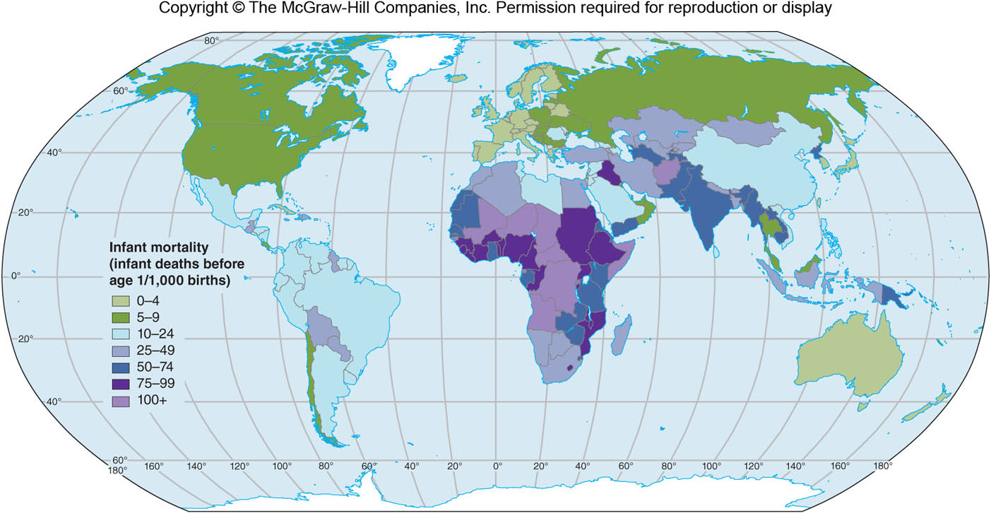
Infant Mortality Rates
Figure 3F.3

Slide 17
3F: Natural Population Change
Rate of Natural Increase as a % (RNI%)
RNI = (crude birth rate – crude death rate) / 10
Does NOT account for migration
Rate of Population Growth
Factors in migration
Doubling Time
Doubling Time = 70 years / RNI%

Slide 18
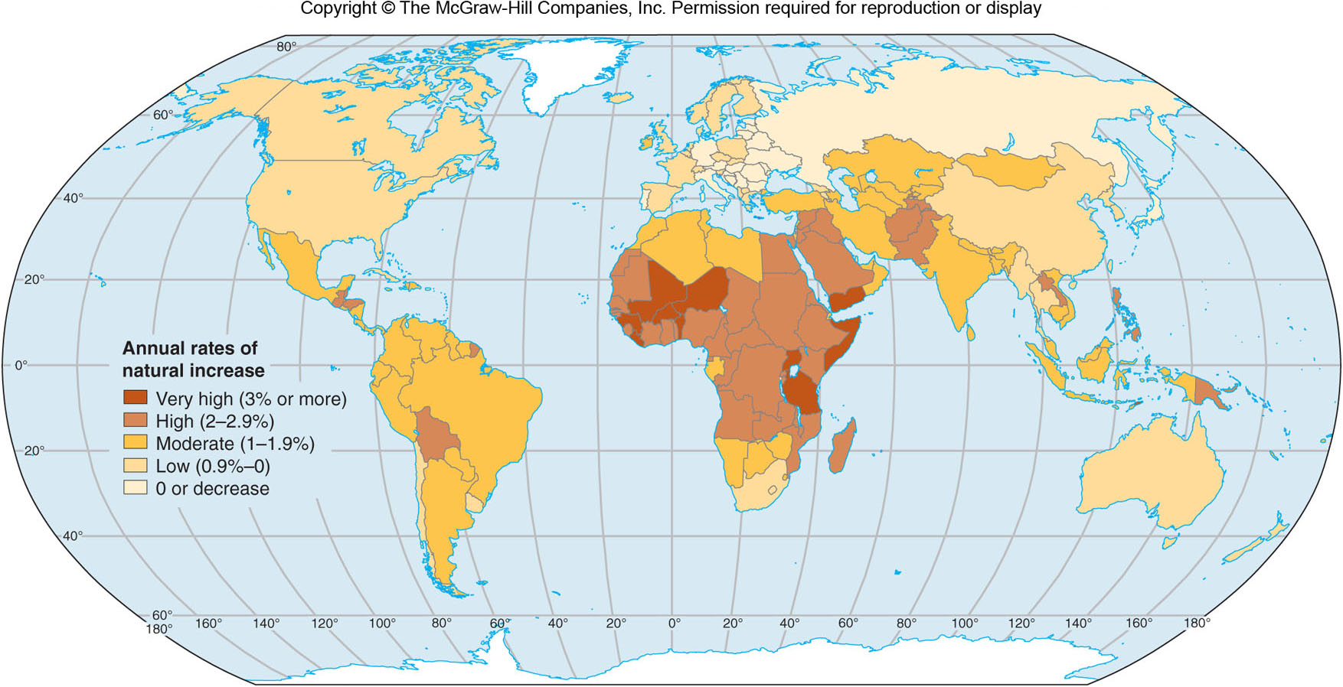
Rates of Natural Increase
Figure 3F.5

Slide 19
3G: Demographic Transition Model
A model of demographic change based on Europe’s population in the 18th-20th centuries.
Argues that, as a country modernizes, its fertility and mortality rates drop, but not at the same time. Because death rates drop before birth rates, population increase will occur.

Slide 20
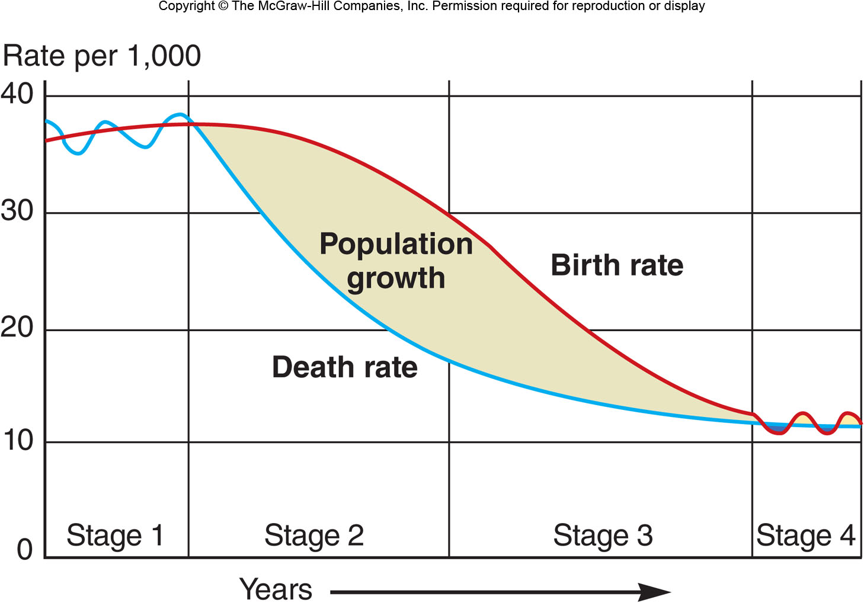
Demographic Transition Model
Figure 3G.1

Slide 21
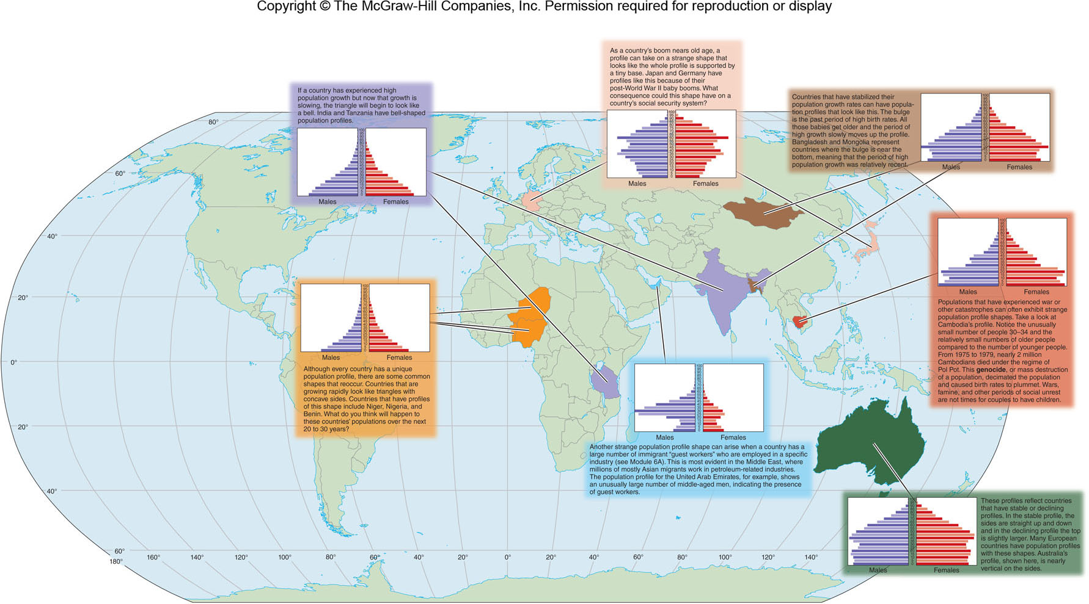
Population Profiles: Shows the # or % of a population that is a particular age (or age range)
Figure 3H.1

Slide 22
3I: Population Change in the Future 1
Thomas Malthus
1798, An Essay on the Principle of Population
Believed that food production would not keep up with population growth
Neo-Malthusians
Modern theorists who believe in Malthus’ notion that population growth will lead to global crisis

Slide 23
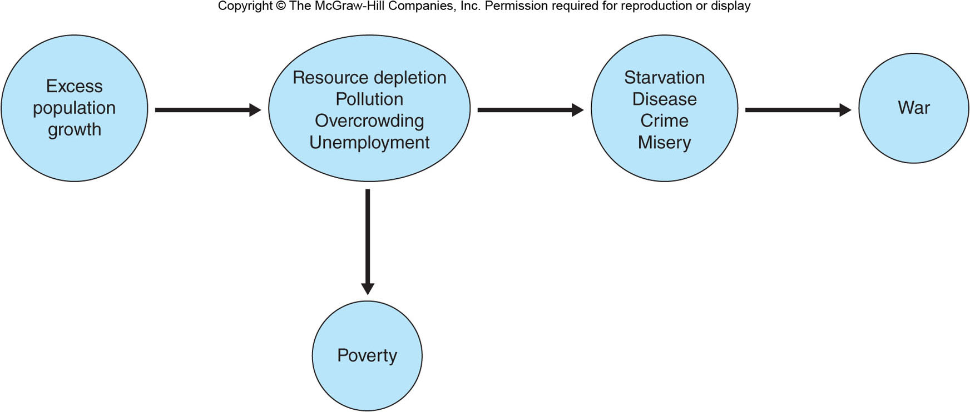
Malthus’ View of Population Growth
Figure 3I.1

Slide 24
3I: Population Change in the Future 2
Ester Boserup
Argued that population growth stimulates societies to innovate and produce more food.
Marxists
Argue that food is poorly distributed
Implosionists vs. Explosionists
Implosionists believe lack of population will be a problem because jobs will be unfilled
Explosionists are more Malthusian

Slide 25
3J: Population Planning
Can be controversial
“Comstock Law”, 1873
Resistance from some religious groups
Modern focus is on cultural attitudes, contraceptives, better recordkeeping & technology, and improving the status of women

Slide 26
China’s One-Child Policy
Began in late 1970s
Restricts # of births for most couples
Strictest in urban areas
Weakest in rural, minority regions

Slide 27
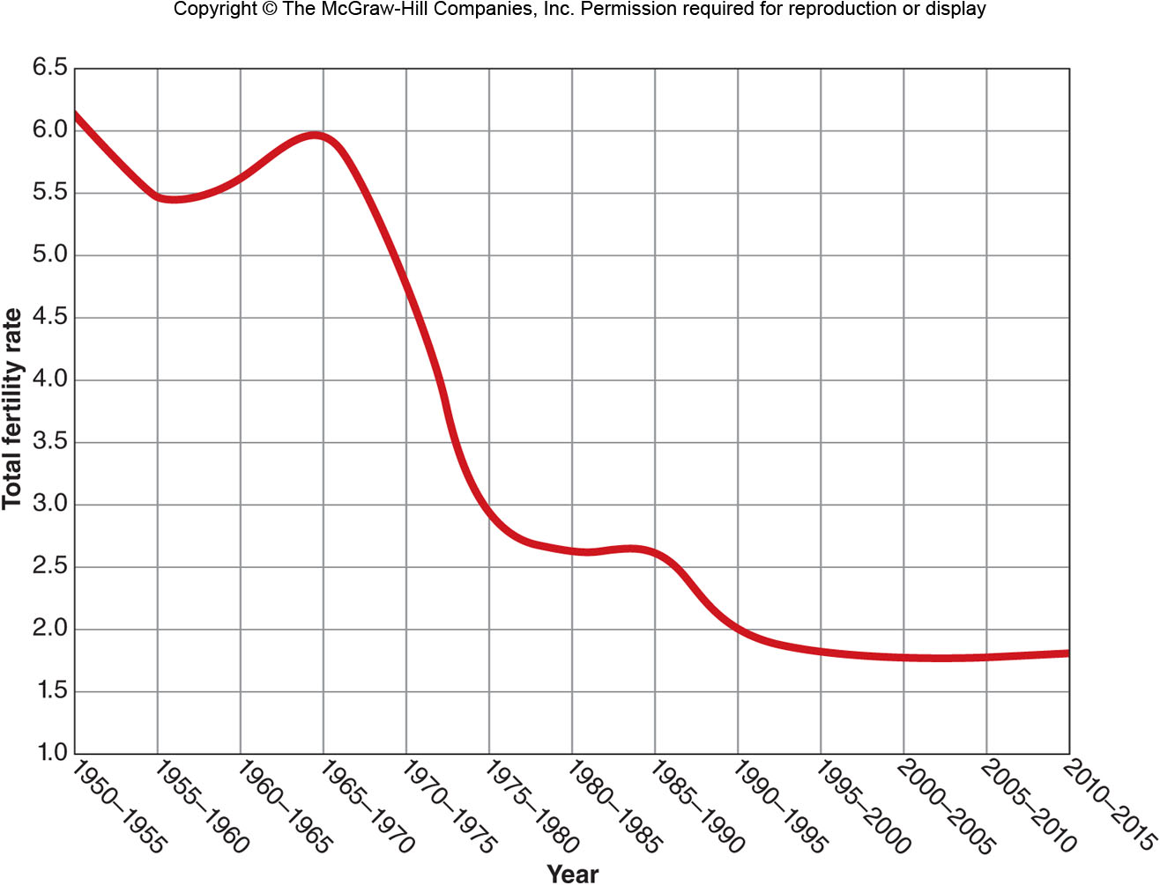
Total Fertility Rate in China
Figure 3J.2

