Slide 1
Chapter 7 LECTURE OUTLINE The Geography of language
Photo © Jon Malinowski.
All rights reserved. Used with permission.
Human Geography by Malinowski & Kaplan

Slide 2
Chapter 7 Modules
7A Basic Components of Language
7B Dialects, Accent, Linguae Francae, Pidgins, & Creoles
7C Language Families
7D Geography of English
7E Language Isolation and Language Extinction
7F Toponymy
7G Language Conflict

Slide 3
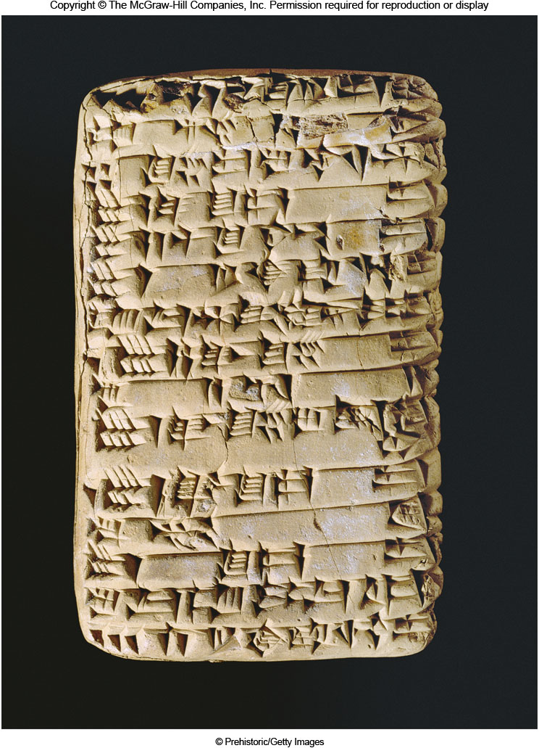
7A: Basic Components of Language
Language
A system of communication using sounds, gestures, marks, and signs
Phonemes
The sounds in a language
Early writing was often pictographic
Such as cuneiform

Slide 4
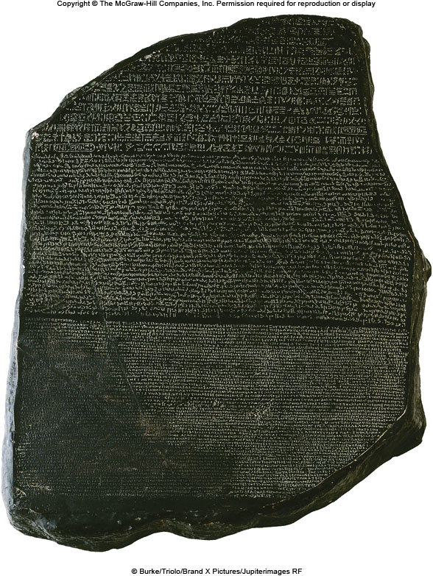
The Rosetta Stone
Figure 7A.2

Slide 5
7B: Dialects, etc.
Dialect
Variations of sounds & vocabulary in a language
Accent
Differences in how a language sounds or is spoken
Idiom
A language peculiar to a certain group or region
Patois
Generally refers to rural or provincial speech
Vernacular
Also refers to a local form of a language

Slide 6
7B: Lingua Franca
Lingua Franca
A common language used for cross-cultural communication or for trade
Examples include Kiswalhili, Russian, French,
Pidgin
A simplified language used by people who don’t speak the same language
Different from a lingua franca because it generally refers to a language that is nobody’s native language
Usually has a simplified vocabulary
Creole
A pidgin that is adopted by a group as its primary language

Slide 7
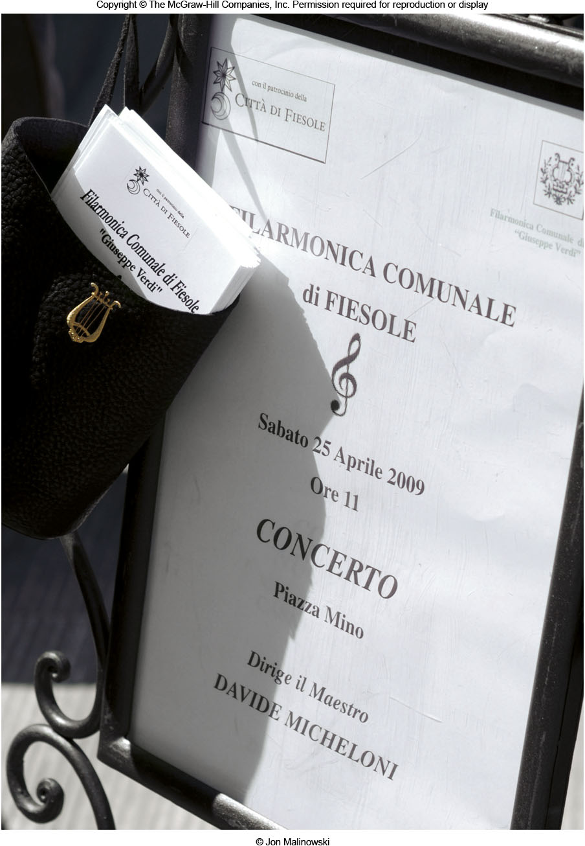
7C: Language Families
Language Family
Collection of languages with a common ancestor
Today, 6,800 languages grouped into about 120 language families

Slide 8
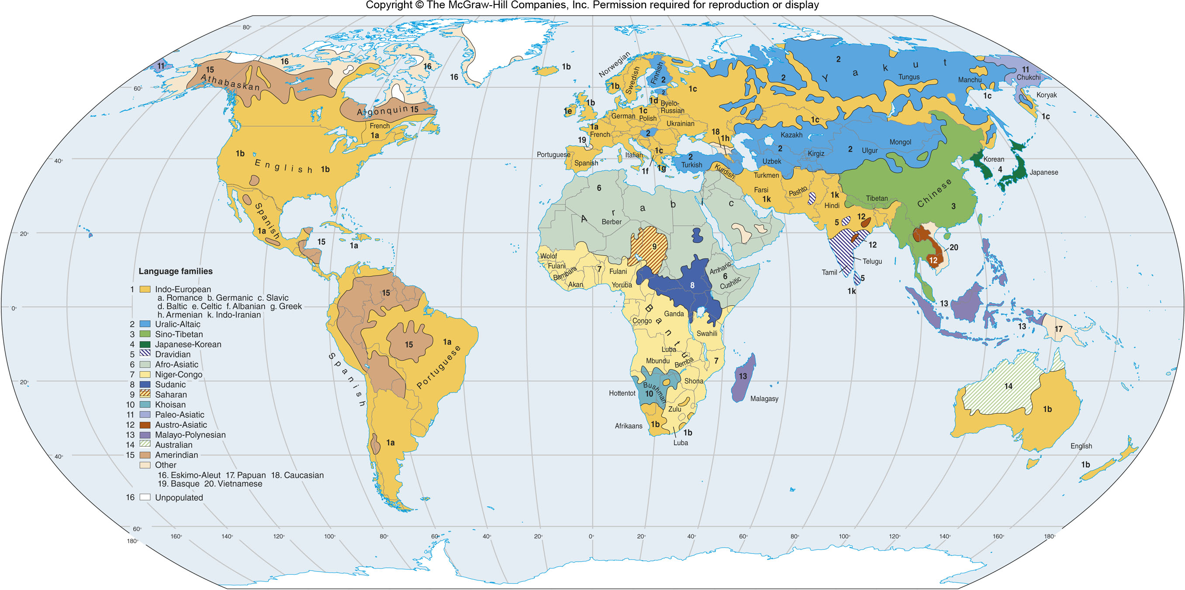
Major Language Families
Figure 7C.3

Slide 9
7D: Geography of English
“Standard” English is known as Received Pronunciation (RP)
The English of educated British speakers in London
American English starts splitting 500 years ago
Regional dialects and pidgins such as Gullah
Distinct varieties in Australia, New Zealand, South Africa, India, etc.

Slide 10
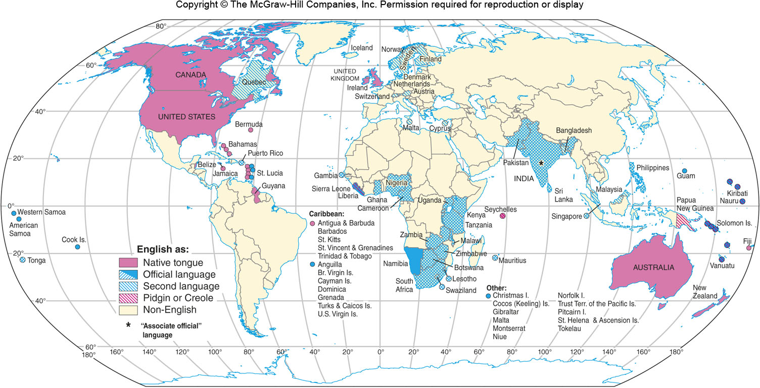
English Today
Figure 7D.1

Slide 11
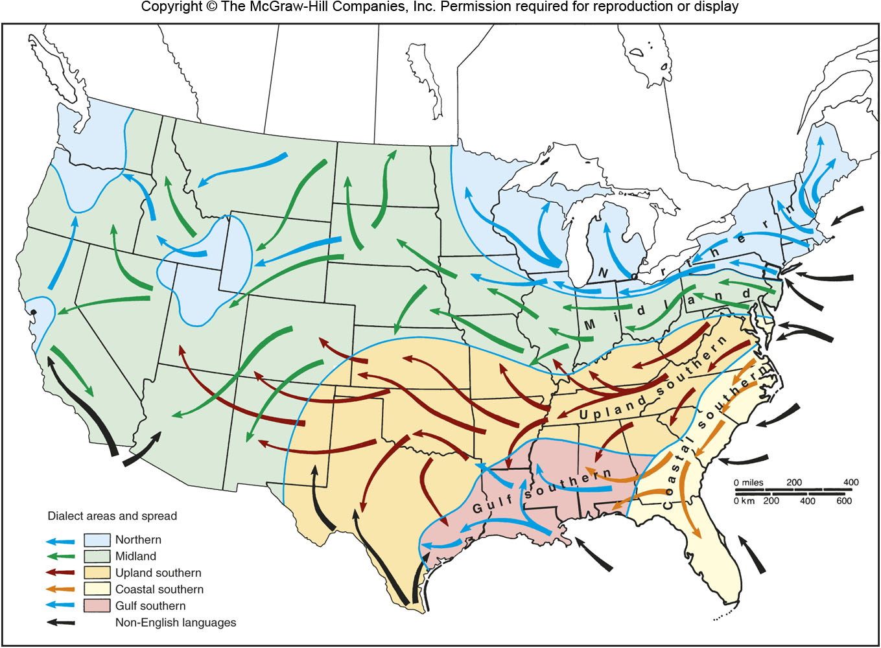
Dialect Areas in the U.S.
Figure 7D.2

Slide 12
7E: Language Isolation & Extinction
Languages change over space & time
Language Divergence
When a language splits into two new languages
Latin became French, Spanish, Romanian, etc.
Language Convergence
When two languages merge into one
Language Isolate
A language that belongs to no language family
Language Extinction
The death of a language
300 languages have died since the year 1500

Slide 13
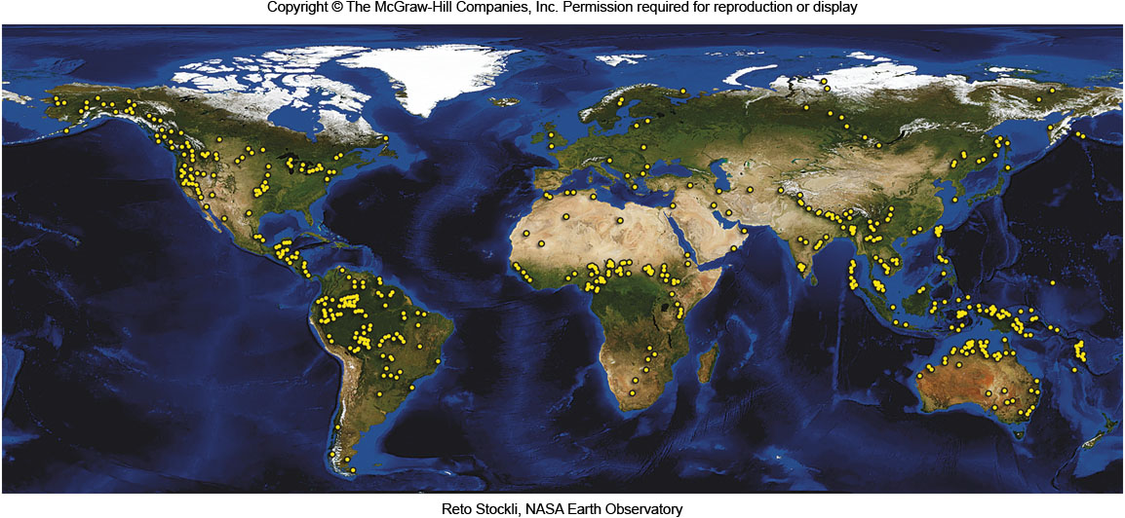
Nearly Extinct Languages
Figure 7E.2

Slide 14
7F: Toponymy
The study of place names
A place name can reflect:
Physical features
Stony Point
A function that happened at a place
Minersville, PA
Current or past cultures in the area
Ideas such as Patriotism
Independence, MO

Slide 15
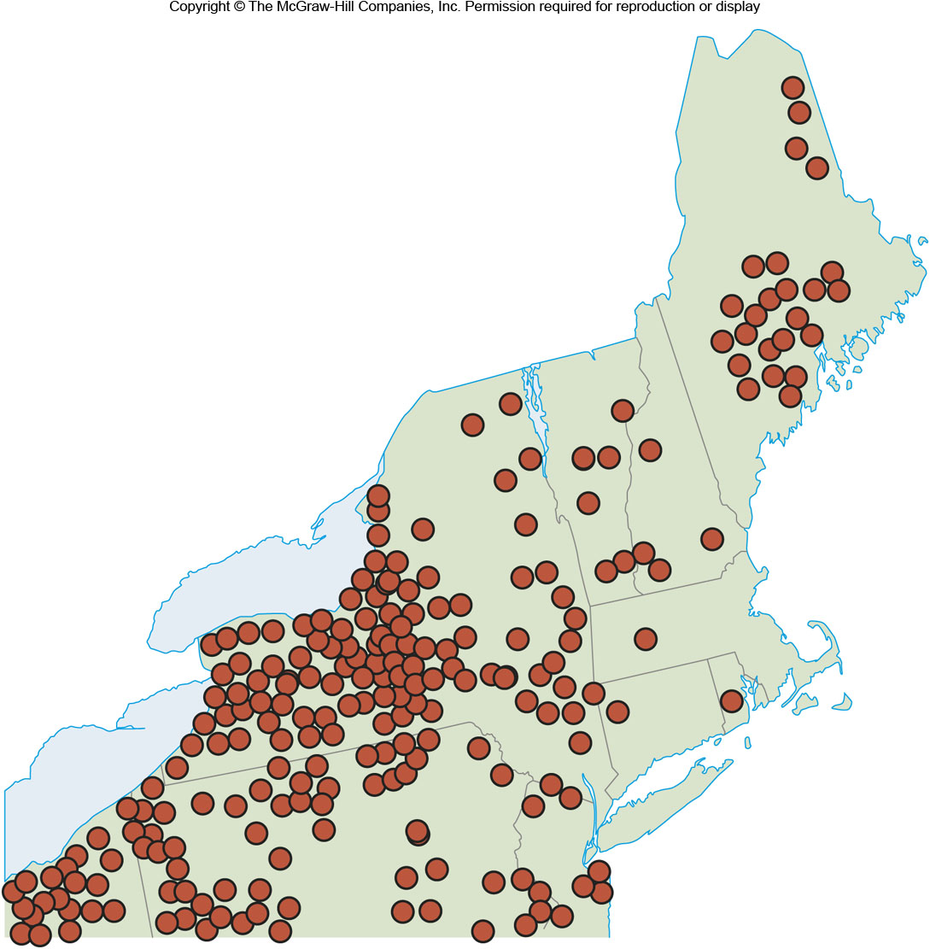
Classical Town Names
After Zelinsky
Figure 7F.2

Slide 16
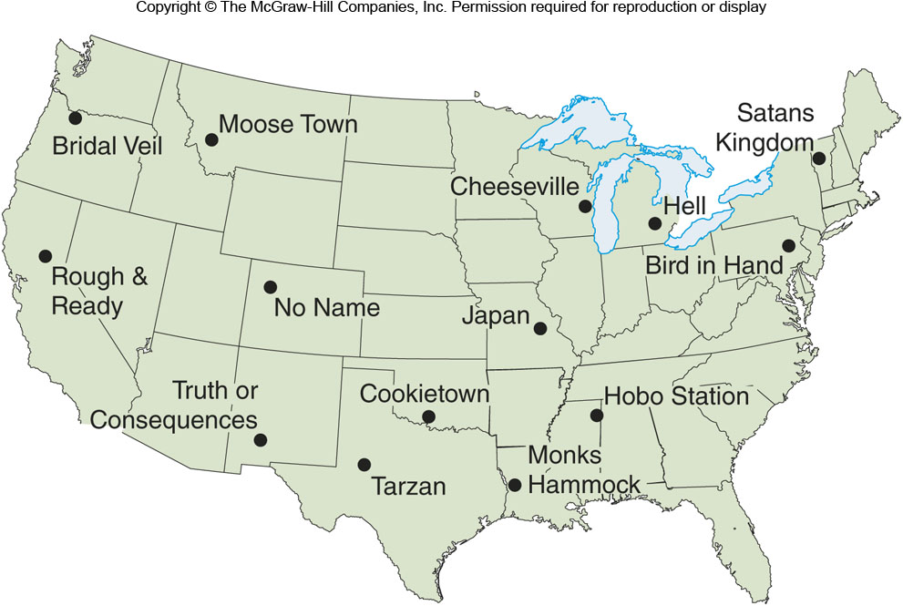
Unusual Place Names
Figure 7F.3

Slide 17
7G: Language Conflict
Conflict over language and place names is common
Macedonia’s name angered Greece
Israelis and Palestinians have changed names to indicated control of a space
Arabian Gulf or Persian Gulf?
Official language debates in the U.S.
Quebec nationalist movements
The French battle against loan words

