Slide 1
Chapter 17
Nomadic Empires and Eurasian Integration

Slide 2
Nomadic Economy and Society
Rainfall in central Asia too little to support large-scale agriculture
Animal herding
Food
Clothing
Shelter (yurts)
Migratory patterns to follow pastureland
Small-scale farming, rudimentary artisanry

Slide 3
Nomads in Turkmenistan

Slide 4
Nomadic Economy
Trade links between nomadic and settled peoples
Nomads engage in long-distance travel
Caravan routes

Slide 5
Nomadic Society
Governance basically clan-based
Charismatic individuals become nobles, occasionally assert authority
Unusually fluid status for nobility
Hereditary, but could be lost through incompetence
Advancement for meritorious non-nobles

Slide 6
Gender Relations
Women wielded considerable influence
Advisors
Occasionally regents or rulers

Slide 7
Nomadic Religion
Shamans center of pagan worship
Appeal of Buddhism, Nestorian Christianity, Islam, Manichaeism from sixth century C.E.
Turkish script developed, partially to record religious teachings
Conversion to Islam in tenth century due to Abbasid influence

Slide 8
Military Organization
Large confederations under a khan
Authority extended through tribal elders
Exceptionally strong cavalries
Mobility
Speed

Slide 9
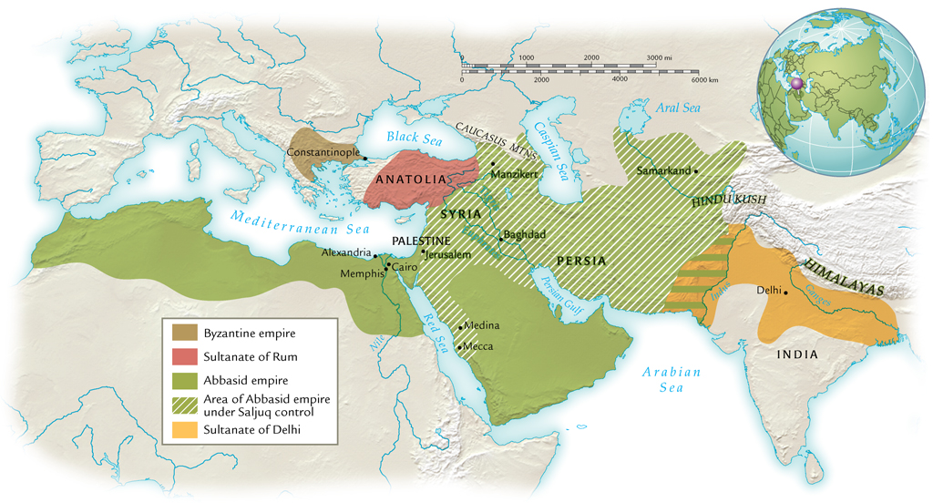
Turkish Empires and Their Neighbors, ca. 1210 C.E.

Slide 10
Saljuq Turks and the Abbasid Empire
Eighth to tenth centuries, Turkish peoples on border of Abbasid empire
Service in Abbasid armies
Eventually came to dominate Abbasid caliphs
1055, Saljuq leader Tughril Beg recognized as sultan
Tughril consolidated his hold on Baghdad, then extended rule to other parts of the empire
Abbasid caliphs served as figureheads of authority

Slide 11
Saljuq Turks and the Byzantine Empire
1071, Saljuq Turks defeat Byzantine army at Manzikert, take emperor captive
Large-scale invasion of Anatolia
Many conversions to Islam
Ottoman Turks conquer Constantinople in 1453

Slide 12
Ghaznavid Turks and the Sultanate of Delhi
Mahmud of Ghazni, Afghanistan, invades northern India
At first for plunder, later to rule
Northern India completely dominated by thirteenth century
Persecution of Buddhists, Hindus

Slide 13
Chinggis Khan (1167-1227) and the Making of the Mongol Empire
Temüjin, b. 1167
Father prominent warrior, poisoned ca. 1177, forced into poverty
Mastered steppe diplomacy, elimination of enemies
Brought all Mongol tribes into one confederation
1206, proclaimed Chinggis Khan (“universal ruler”)

Slide 14
Mongol Political Organization
Broke up tribal organization
Formed military units from men of different tribes
Promoted officials on basis of merit and loyalty
Established capital at Karakorum

Slide 15
Mongol Arms
Mongol population only one million (less than 1% of Chinese population)
Army numbered 100,000-125,000
Strengths:
Cavalry
Short bows
Rewarded enemies who surrendered, cruel to enemies who fought

Slide 16
Mongol Conquests
Conquest of China by 1220
Conquest of Afghanistan, Persia
Emissaries murdered; following year, Chinggis Khan destroys ruler
Ravaged lands to prevent future rebellions
Large-scale, long-term devastation

Slide 17
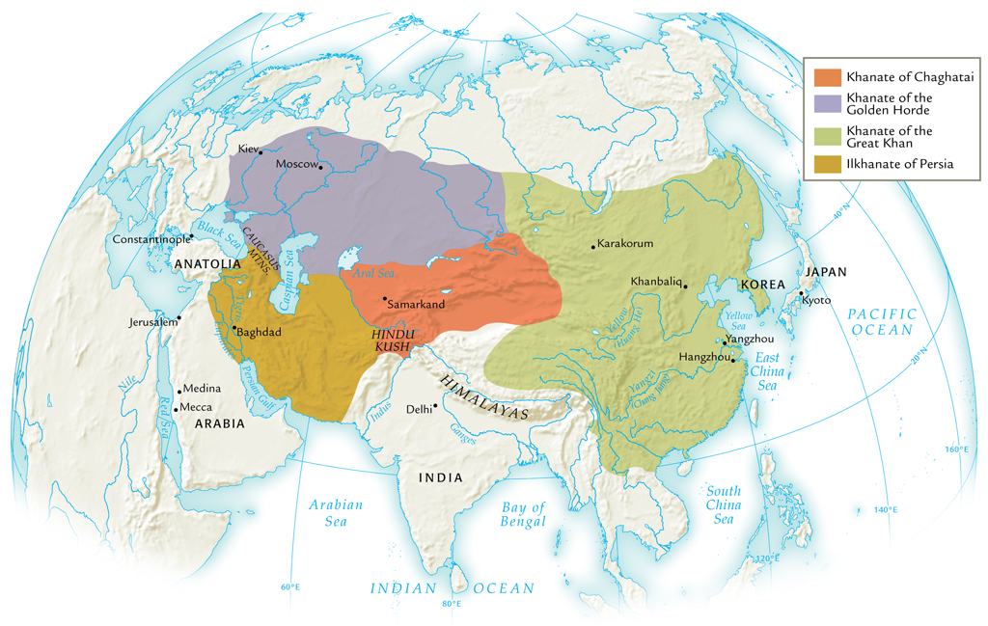
The Mongol Empires, ca. 1300 C.E.

Slide 18
Khubilai Khan (r. 1264-1294)
Grandson of Chinggis Khan
Rule of China
Ruthless warrior, but religiously tolerant
Hosted Marco Polo
Established Yuan dynasty (to 1368)
Unsuccessful forays into Vietnam, Cambodia, Burma, Java
Two attempted invasions of Japan (1274, 1281) turned back by typhoons (kamikaze: “divine winds”)

Slide 19
The Golden Horde
Conquest of Russia, 1237-1241
Established tributary relationship to fifteenth century
Rule over Crimea to late eighteenth century
Raids into Poland, Hungary, Germany

Slide 20
The Ilkhanate of Persia
Abbasid empire toppled
Baghdad sacked, 1258
200,000 massacred
Expansion into Syria checked by Egyptian forces

Slide 21
Mongol Rule in Persia
Nomadic conquerors had to learn to rule sedentary societies
Inexperienced, lost control of most lands within a century
Persia: dependence on existing administration to deliver tax revenues
Left matters of governance to bureaucracy
Eventually assimilated into Islamic lifestyle

Slide 22
Mongol Rule in China
Strove to maintain strict separation from Chinese
Intermarriage forbidden
Chinese forbidden to study Mongol language
Imported administrators from other areas (especially Arabs, Persians)
Yet tolerated religious freedoms

Slide 23
The Mongols and Buddhism
Shamanism remains popular
Lamaist school of Buddhism (Tibet) gains strength among Mongols
Large element of magic, similar to shamanism
Ingratiating attitude to Mongols: khans as incarnations of Buddha

Slide 24
The Mongols and Western Integration
Experience with long-distance trade
Protection of traveling merchants
Volume of trade across central Asia increases
Diplomatic missions protected
Missionary activity increases
Mongol resettlement policies

Slide 25
Decline of the Mongol Empire in Persia
Overspending, poor tax returns from overburdened peasantry
Ilkhan attempts to replace precious metal currency with paper in 1290s
Failure, forced to rescind
Factional fighting
Last ilkhan dies without heir in 1335, Mongol rule collapses

Slide 26
Decline of the Yuan Dynasty in China
Mongols spend bullion that supported paper currency
Public loses confidence in paper money, prices rise
From 1320s, major power struggles
Bubonic plague spreads 1330-1340s
1368, Mongols flee peasant rebellion

Slide 27
Surviving Mongol Khanates
Khanate of Chaghatai in central Asia
Continued threat to China
Golden Horde in Caucasus and steppes to mid-sixteenth century
Continued threat to Russia

Slide 28
Tamerlane the Conqueror (ca. 1336-1405)
Turkish conqueror Timur
Timur the Lame: Tamerlane
United Turkish nomads in khanate of Chaghatai
Major military campaigns
Built capital in Samarkand

Slide 29
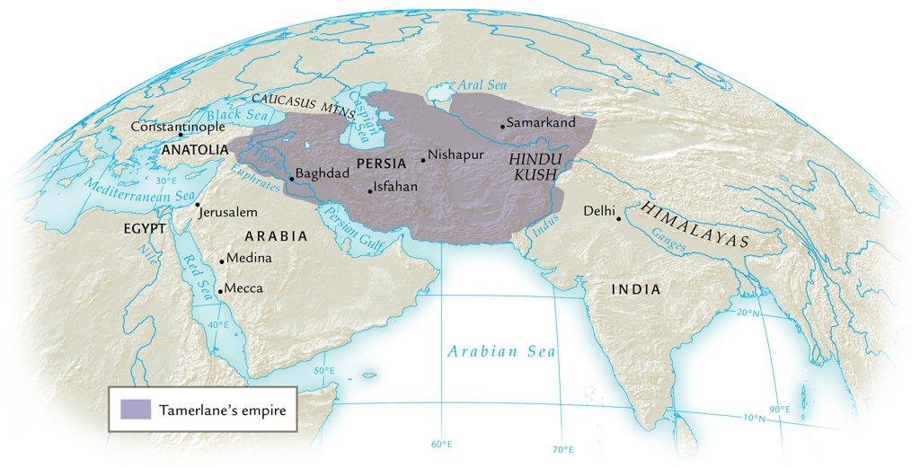
Tamerlane’s Empire, ca. 1405 C.E.

Slide 30
Tamerlane’s Heirs
Poor organization of governing structure
Power struggles divide empire into four
Yet heavily influenced several empires:
Mughal
Safavid
Ottoman

Slide 31
The Ottoman Empire
Osman, charismatic leader who dominates part of Anatolia
Declares independence from Saljuq sultan, 1299
Attacks Byzantine empire
Followers known as Osmanlis (Ottomans)

Slide 32
Ottoman Conquests
1350s conquests in the Balkans
Local support for Ottoman invasion
Peasants unhappy with fragmented, ineffective Byzantine rule
Tamerlane defeats Ottoman forces in 1402, but Ottomans recover by 1440s

Slide 33
The Capture of Constantinople, 1453
Sultan Mehmed II (“Mehmed the Conqueror”)
Renamed city Istanbul, capital of Ottoman empire

