Slide 1
Chapter 25
Africa and the Atlantic World

Slide 2
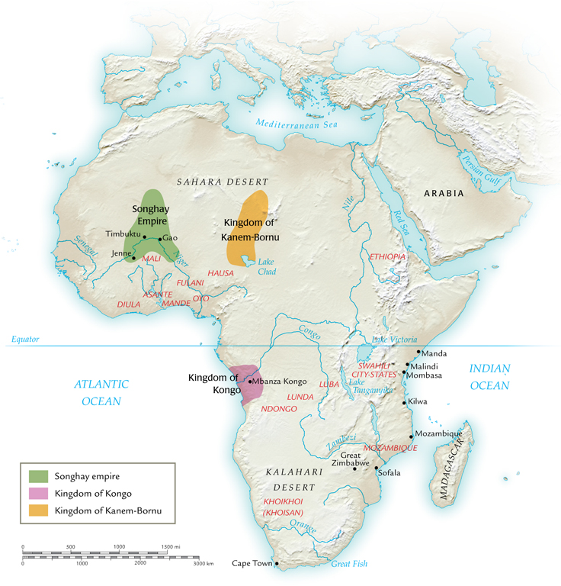
African States, 1500-1650

Slide 3
The States of West Africa and East Africa
Developed over eighth to sixteenth centuries
Kingdom of Ghana
Not related to modern State of Ghana
Major gold trader
Mali empire, thirteenth century
Songhay empire, fifteenth century
Sunni Ali (r. 1464-1493) created effective army, navy
Musket-bearing Moroccan army destroys Songhay forces; regional city-states exert local control

Slide 4
Swahili Decline in East Africa
Portuguese Vasco da Gama skirmishes with Africans on eastern coast, 1497-1498
1502 returns, forces Kilwa to pay tribute
1505 Portuguese gun ships dominate Swahili ports

Slide 5
The Kingdom of Kongo
Relations with Portuguese beginning 1483
King Nzinga Mbemba (Afonso I, r. 1506-1542) converts to Roman Catholicism
Useful connection with Portuguese interests
But zealous convert, attempts to convert population at large

Slide 6
The King of Kongo and European Ambassadors

Slide 7
Slave Raiding in Kongo
Initial Portuguese attempts at slave raiding
Soon discovered it is easier to trade weapons for slaves provided by African traders
Dealt with several authorities besides Kongo
Kongo kings appeal without success to slow, but not eliminate, slave trade
Relations deteriorate, Portuguese attack Kongo and decapitate king in 1665
Improved slave market develops in the south

Slide 8
The Kingdom of Ndongo (Angola)
Ndongo gains wealth and independence from Kongo by means of Portuguese slave trade
But Portuguese influence resisted by Queen Nzinga (r. 1623-1663)
Posed as male king, with male concubines in female dress attending her
Nzinga establishes temporary alliance with Dutch in unsuccessful attempt to expel Portuguese
Decline of Ndongo power after her death

Slide 9
Regional Kingdoms in South Africa
Chieftains develop trade with Swahili city-states
1300: Great Zimbabwe
Dutch build Cape Town in 1652, increased involvement with southern African politics
Encounter Khoikhoi people (“Hottentots”)
British colonies also develop

Slide 10
Islam in Sub-Saharan Africa
Pre-Islamic paganism, ancestor worship
Islam develops in commercial centers
Timbuktu becomes major center of Islamic scholarship by sixteenth century
African traditions and beliefs blended into Islam
Gender relations, standards of female modesty

Slide 11
The Fulani
Movement to impose strict adherence to Islamic norms in Africa
1680 begins military campaigns to enforce sharia in west Africa
Considerable influence extends to south as well

Slide 12
Christianity in Sub-Saharan Africa
Like African Islam, syncretic with African beliefs
Antonian movement flourishes early eighteenth century
Founded by Dona Beatriz, claiming possession by St. Anthony of Padua (thirteenth-century Franciscan preacher, patron saint of Portugal)
Promotes distinctly African Christianity
Jesus a black man, Kongo the holy land, heaven for Africans
Christian missionaries persuade King Pedro IV of Kongo to burn Dona Beatriz at the stake

Slide 13
Social Change in Early Modern Africa
Trade with Europeans brings new goods to Africa
New crops from Americas
Manioc becomes staple bread flour
Increased food supply boosts population growth despite slave trade

Slide 14
Population Growth in Africa

Slide 15
Foundations of the Slave Trade
African slavery dates to antiquity
War captives, criminals, people expelled from clans
Distinct from Asian, European slavery
No private property, therefore wealth defined by human labor potential, not land
Slaves often assimilated into owner’s clan

Slide 16
The Islamic Slave Trade
Dramatic expansion of slave trade with Arab traders
New slaves acquired by raiding villages, selling on Swahili coast
Arab traders depend on African infrastructure to maintain supply
European demand on west coast causes demand to rise again

Slide 17
Arab Slave Trader

Slide 18
The Early Slave Trade
Portuguese raid west African coast in 1441, take twelve men
Meet with stiff resistance
African dealers ready to provide slaves
1460: 500 slaves per year sold to work as miners, porters, domestic servants in Spain and Portugal
1520: 2,000 per year to work in sugarcane plantations in the Americas

Slide 19
Slaves at Work in a Mine

Slide 20
The Triangular Trade
European manufactured goods (especially firearms) sent to Africa
African slaves purchased and sent to Americas
Cash crops purchased in Americas and returned to Europe

Slide 21
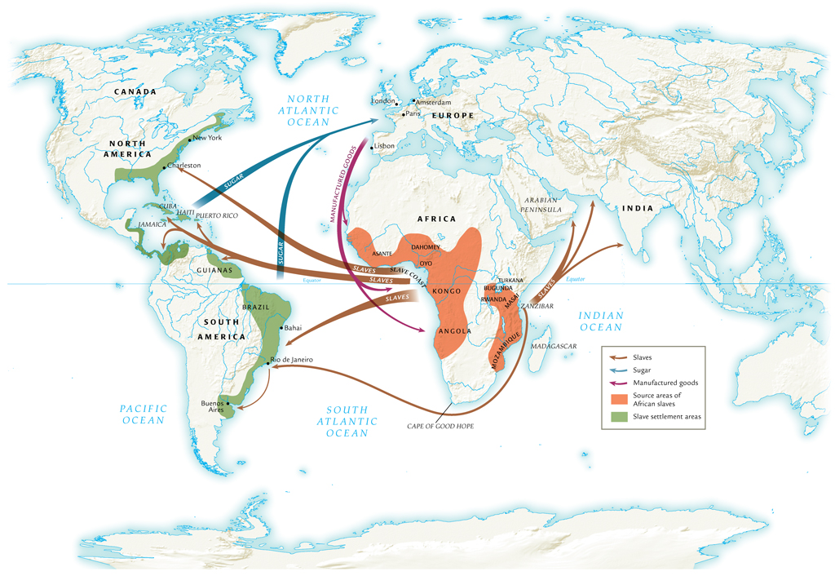
The Atlantic Slave Trade, 1500-1800

Slide 22
The Middle Passage (Africa to Americas)
African slaves captured by raiding parties, force-marched to holding pens at coast
Middle passage under horrific conditions
4-6 weeks
Mortality initially high, often over 50%, eventually declined to 5%
Total slave traffic, fifteenth to eighteenth century: 12 million
Approximately 4 million die before arrival

Slide 23
African Slave Export per Year

Slide 24
Impact on African Regions
Rwanda, Bugunda, Masai, Turkana resist slave trade
Benefit from distance from slave ports on western coast
Other societies benefit from slave trade profit
Asante, Dahomey, Oyo peoples

Slide 25
Social Effects of Slave Trade
Total African population expands due to importation of American crops
Yet millions of captured Africans removed from society, deplete regional populations
Distorted sex ratios result
Two-thirds of slaves male, 14-35 years of age
Encouraged polygamy, women acting in traditionally male roles

Slide 26
Political Effects of Slave Trade
Introduction of firearms increases violence of pre-existing conflicts
More weapons, more slaves; more slaves, more weapons
Dahomey people create army dedicated to slave trade

Slide 27
African Slaves in Plantation Societies
Most slaves in tropical and subtropical regions
First plantation established in Hispaniola (Haiti and Dominican Republic) 1516
Later Mexico, Brazil, Caribbean, and Americas
Sugar major cash crop
Later: tobacco, rice, indigo, cotton, coffee
Plantations heavily dependent on slave labor
Racial divisions of labor

Slide 28
Destinations of African Slaves

Slide 29
Regional Differences
Caribbean, South America: African population unable to maintain numbers through natural means
Malaria, yellow fever
Brutal working conditions, sanitation, nutrition
Gender imbalance
Constant importation of slaves
North America: less disease, more normal sex ratio
Slave families encouraged as prices rise in eighteenth century

Slide 30
Resistance to Slavery
Half-hearted work effort
Sabotage
Flight (Maroon populations)
Revolts

Slide 31
Slave Revolts
Only one successful revolt
French-controlled Saint-Domingue (1793)
Renamed Haiti
Elsewhere, revolts outgunned by Euro-American firepower

Slide 32
African-American Culture
Diversity of African cultures concentrated in slave population
Blend of cultures
African languages when numbers permit, otherwise European language adapted with African influences
Creole languages
Christianity adapted to incorporate African traditions

Slide 33
The Abolition of Slavery
Olaudah Equiano (1745-1797), former slave author’s best-selling autobiography
Eloquent attacks on institution of slavery
Economic costs of slavery increase
Military expenses to prevent rebellions
Eighteenth century: price of sugar falls, price of slaves rises
Wage labor becomes more efficient
Wage-earners can spend income on manufactured goods

Slide 34
End of the Slave Trade
Denmark abolishes slave trade in 1803, followed by Great Britain (1807), United States (1808), France (1814), Netherlands (1817), Spain (1845)
Possession of slaves remains legal
Clandestine trade continues to 1867
Emancipation of slaves begins with British colonies (1833), then French (1848), U.S. (1865), Brazil (1888)
Saudi Arabia and Angola continue to the 1960s

