Slide 1
Chapter 26
Tradition and Change in East Asia

Slide 2
The Ming Dynasty (1368-1644)
Ming (“Brilliant”) dynasty comes to power after Mongol Yuan dynasty driven out
Founded by Emperor Hongwu (r. 1368-1398)
Used traveling officials called mandarins and large number of eunuchs to maintain control
Emperor Yongle (r. 1403-1424) experiments with sea expeditions, moves capital north to Beijing to deter Mongol attacks

Slide 3
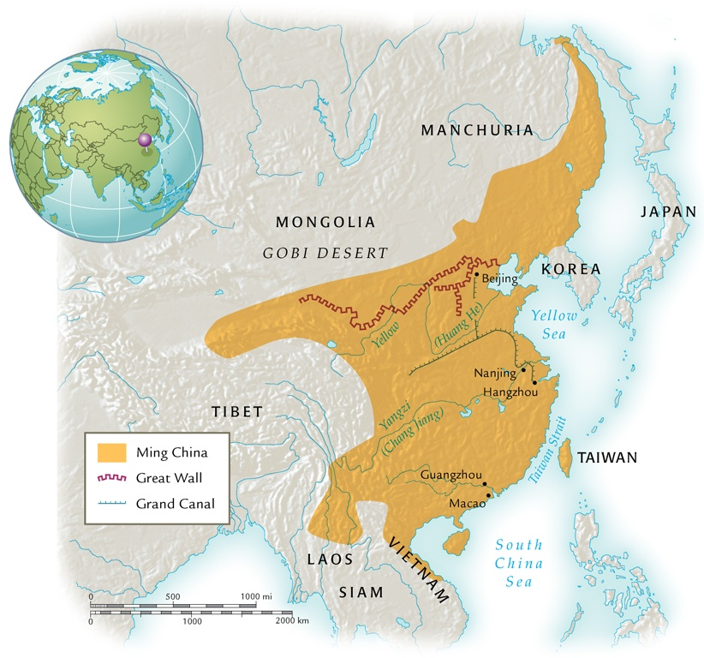
Ming China, 1368-1644

Slide 4
The Great Wall
Origins before fourth century B.C.E., ruins from Qin dynasty in third century B.C.E.
Rebuilt under Ming rule, fifteenth to sixteenth century
1,550 miles, 33-49 feet high
Guard towers
Room for housing soldiers

Slide 5
The Great Wall of China

Slide 6
Eradicating the Mongol Past
Ming emperors encourage abandonment of Mongol names, dress
Support study of Confucian classics
Civil service examinations renewed

Slide 7
Ming Decline
Sixteenth century, maritime pirates harm coastal trade
Navy, government unable to respond effectively
Emperors secluded in Forbidden City, palace compound in Beijing
Hedonists
Emperor Wanli (r. 1572-1620) abandons imperial activity to eunuchs

Slide 8
Ming Collapse
Famine, peasant rebellions in early seventeenth century
Rebels take Beijing in 1644
Manchu fighters enter from the north and retake city
Manchus refuse to allow reestablishment of Ming dynasty
Establish Qing (“Pure”) Dynasty

Slide 9
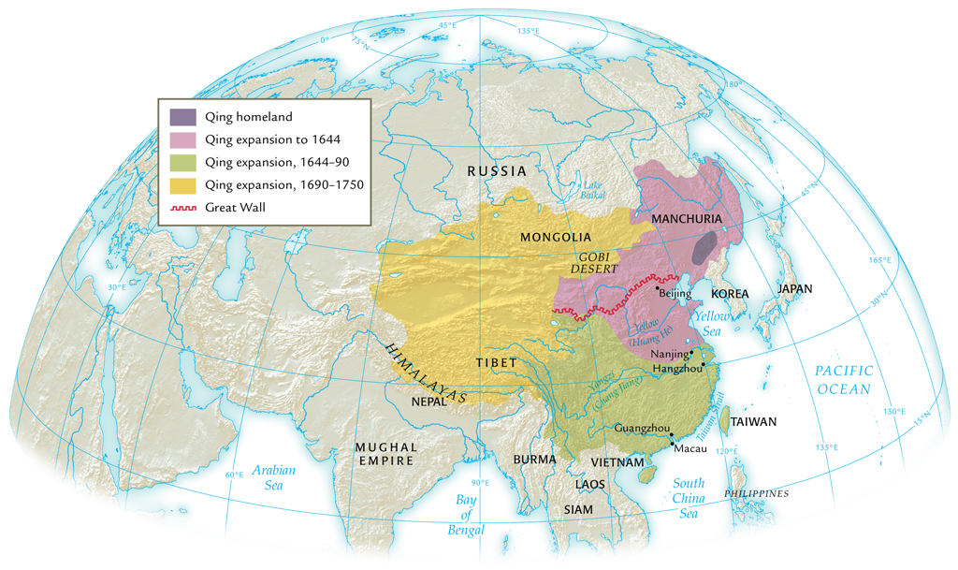
The Qing Empire, 1644-1911

Slide 10
The Qing Dynasty (1644-1911)
Manchus originally pastoral nomads, north of Great Wall
Chieftain Nurhaci (r. 1616-1626) unifies tribes into state, develops laws, military
Establishes control over Korea, Mongolia, China
War with Ming loyalists to 1680
Support from many Chinese, fed up with Ming corruption
Manchus forbid intermarriage, study of Manchu language by Chinese; force Manchu hairstyles as sign of loyalty

Slide 11
Emperor Kangxi (r. 1661-1722)
Confucian scholar, poet
Military conquests: island of Taiwan, Tibet, central Asia
Grandson Emperor Qianlong (r. 1736-1795) expands territory
Height of Qing dynasty
Great prosperity, tax collection cancelled on several occasions

Slide 12
The “Son of Heaven”
Ming, Qing emperors considered quasi-divine
Hundreds of concubines, thousands of eunuch servants
Clothing designs and name characters forbidden to rest of population
The kowtow: three bows, nine head-knocks

Slide 13
The Scholar-Bureaucrats
Ran government on a day-to-day basis
Graduates from intense civil service examinations
Open only to men
Curriculum: Confucian classics, calligraphy, poetry, essay writing
Also: history, literature

Slide 14
The Civil Service Examinations
District, provincial, and metropolitan levels
Only 300 allowed to pass at highest level
Multiple attempts common
Students expected to bring bedding, chamber pots for three-day uninterrupted examinations
Students searched for printed materials before entering private cells

Slide 15
Examination System and Society
Ferocious competition
Qing dynasty: One million degree holders compete for 20,000 government positions
Remainder turn to teaching, tutoring positions
Some corruption, cheating
Advantage for wealthy classes: hiring private tutors, etc.
But open to all, tremendous opportunity for social mobility

Slide 16
The Patriarchal Family
Filial piety understood as duty of child to parent; individual to emperor
Eldest son favored
Clan-based authority groups augment government services

Slide 17
Gender Relations
Males receive preferential status
Economic factor: girls join husband’s family
Infanticide common
Widows strongly encouraged not to remarry
Chaste widows honored with ceremonial arches
Men control divorce
Grounds: from infidelity to talking too much

Slide 18
Foot Binding
Origins in Song dynasty (960-1279 CE)
Linen strips bind and deform female child’s feet
Perceived aesthetic value
Statement of social status and/or expectations
Commoners might bind feet of especially pretty girls to enhance marriage prospects

Slide 19
Woman with Bound Feet

Slide 20
Population Growth and Economic Development
Only 11% of China arable
Intense, garden-style agriculture necessary
American food crops introduced in seventeenth century
Maize, sweet potatoes, peanuts
Rebellion and war reduce population in seventeenth century
Offset by increase due to American crops

Slide 21
Chinese Population Growth

Slide 22
Foreign Trade
Silk, porcelain, tea, lacquerware
Chinese in turn import relatively little
Spices, animal skins, woolen textiles
Pay for exports with silver bullion from Americas
After Emperor Yongle’s early maritime expeditions (1405-1433), Ming dynasty abandons large-scale maritime trade plans
In part to appease southern populations

Slide 23
Trade in Southeast Asia
Chinese merchants continue to be active in southeast Asia, especially Manila
Extensive dealings with Dutch VOC

Slide 24
Government and Technology
During Tang and Song dynasties (seventh to thirteenth century), China a world leader in technology
Stagnates during Ming and Qing dynasties
European cannons purchased, based on early Chinese invention of gunpowder
Government suppressed technological advancement, fearing social instability would result
Mass labor over productivity

Slide 25
Classes in Chinese Society
Privileged classes
Scholar-bureaucrats, gentry
Distinctive clothing with ranks
Immunity from some legal proceedings, taxes, labor service
Working classes
Peasants, artisans/workers, merchants
Confucian doctrine gives greatest status to peasants
Merchant activity not actively supported
Lower classes
Military, beggars, slaves

Slide 26
Neo-Confucianism
Version of Confucian thought promoted by Zhu Xi (1130-1200 C.E.)
Confucian morality with Buddhist logic
Education at various levels promoted
Hanlin Academy, Beijing
Provincial schools
Compilation of massive Yongle Encyclopedia
Development of popular novels as well

Slide 27
Christianity in China
Nestorian and Roman Catholic Christians had presence in China
Disappeared with plague and social chaos of fourteenth century
Jesuits return under Matteo Ricci (1552-1610), attempt to convert Ming Emperor Wanli
Mastered Chinese before first visit in 1601
Brought western mechanical technology
Prisms, harpsichords, clocks

Slide 28
Confucianism and Christianity
Argued that Christianity was consistent with Confucianism
Differences due to neo-Confucian distortions
Yet few converts in China
Approximately 200,000 mid-eighteenth century, about 0.08 percent of population
Christian absolutism difficult for Chinese to accept
Franciscans and Dominicans convince pope that Jesuits compromising Christianity with Chinese traditions (e.g. ancestor worship)
Emperor Kangxi bans Christian preaching in China

Slide 29
The Unification of Japan
Shoguns rule Japan, twelfth to sixteenth century
Large landholders with private armies
Emperor merely a figurehead
Constant civil war: sixteenth century sengoku, “country at war”
Tokugawa Ieyasu (r. 1600-1616) establishes military government
Bakufu: “tent government”
Establishes Tokugawa dynasty (1600-1867)

Slide 30
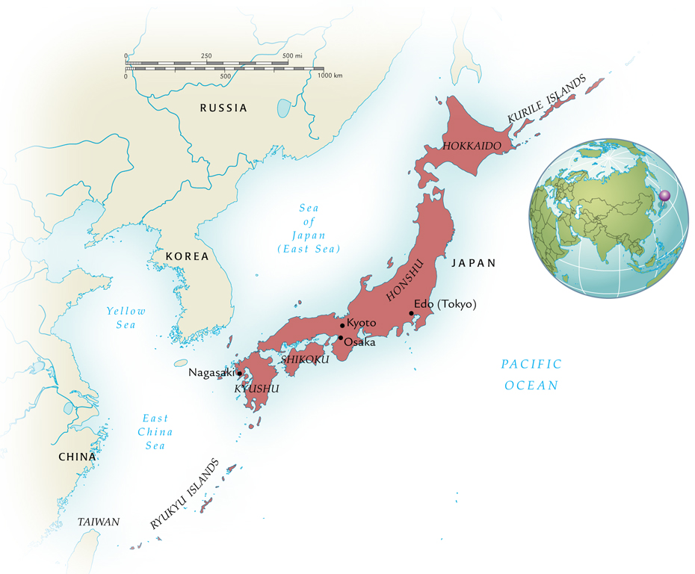
Tokugawa Japan, 1600-1867

Slide 31
Control of Daimyo (“Great Names”)
Approximately 260 powerful territorial lords
Independent militaries, judiciaries, schools, foreign relations, etc.
From capital Edo (Tokyo), shogun requires “alternate attendance”: daimyo forced to spend every other year at court
Controlled marriage, socializing of daimyo families
Beginning 1630s, shoguns restrict foreign relations
Travel, import of books forbidden
Policy strictly maintained for 200 years

Slide 32
Economic Growth in Japan
End of civil conflict contributes to prosperity
New crop strains and irrigation systems improve agricultural production
Yet population growth moderate
Contraception, late marriage, abortion
Infanticide: “thinning out the rice shoots”

Slide 33
Population Growth

Slide 34
Social Change
End of civil disturbances create massive unemployment of daimyo, samurai warriors
Encouraged to join bureaucracy, scholarship
Many declined to poverty
Urban wealthy classes develop from trade activity

Slide 35
Neo-Confucianism in Japan
Chinese cultural influence extends through Tokugawa period
Chinese language essential to curriculum
Zhu Xi and neo-Confucianism remains popular
“Native learning” also popular in eighteenth century
Folk traditions, Shinto

Slide 36
Floating Worlds (ukiyo)
Urban culture expressed in entertainment, pleasure industries
Marked contrast to solemn bakufu proceedings
Ihara Saikaku (1642-1693), The Life of a Man Who Lived for Love
Kabuki theatre, men playing women’s roles
Bunraku puppet theatre

Slide 37
Christianity in Japan
Jesuit Francis Xavier in Japan, 1549
Remarkable success among daimyo
Daimyo also hoping to establish trade relations with Europeans
Government backlash
Fear of foreign intrusion
Confucians, Buddhists resent Christian absolutism
Anti-Christian campaign 1587-1639 restricts Christianity, executes staunch Christians
Sometimes by crucifixion

Slide 38
Persecution of Catholics

Slide 39
Dutch Learning
Dutch presence at Nagasaki principal route for Japanese understanding of the world
Before ban on foreign books lifted (1720), Japanese scholars study Dutch to approach European science, medicine, and art

