Slide 1
Chapter 29
The Making of Industrial Society

Slide 2
Overview: The Industrial Revolution
Energy: coal and steam replace wind, water, human and animal labor
Organization: factories over cottage industries
Rural agriculture declines, urban manufacturing increases
Transportation: trains, automobiles replace animals, watercraft

Slide 3
Overview: Creation of New Classes
The industrial middle class
Urban proletariat
Shift in political power
Inspiration for new political systems, especially Marxism

Slide 4
Overview: Unexpected Costs of the Industrial Revolution
Genesis of an environmental catastrophe
Intellectual origins of human domination over natural resources
Unforeseen toxins, occupational hazards
Social ills
Landless proletariat
Migrating work forces

Slide 5
Genesis of the Industrial Revolution
Great Britain, 1780s
Followed agricultural revolution
Food surplus
Disposable income
Population increase
Market
Labor supply

Slide 6
British Advantages
Natural resources
Coal, iron ore
Ease of transportation
Size of country
River and canal system
Exports to imperial colonies
Especially machine textiles

Slide 7
Cotton-Producing Technology
Flying shuttle (1733), John Kay
Sped up weaving output; stimulated demand for thread
The “mule” (1779), Samuel Compton
Could produce 100 times more thread than a manual wheel
Power loom (1785), Edmund Cartwright
Supplanted hand weavers in cotton industry by 1820s

Slide 8
Steam Power
Steam engine
James Watt (1736-1819)
Coal-fired
Applied to rotary engine, multiple applications
Horsepower
Especially prominent in textile industry

Slide 9
Iron and Steel
1709, British smelters begin to use coke
Iron production skyrockets
Bessemer converter (1856), Henry Bessemer
Refined blast furnace makes production of steel faster and cheaper

Slide 10
Transportation
Railroads
1815, first steam-powered locomotive
The Rocket (1829), 28 mph
Steamships
Dense transportation networks developed
13,000 miles of railroads laid between 1830 and 1870
Rapid and inexpensive transportation encouraged industrialization

Slide 11
The Growth of Factories
Massive machinery
Supply of labor
Transport of raw materials, finished product to markets
Concentration in newly built factory towns on rivers

Slide 12
The Factory System
Early modern Europe adopts “putting-out” system
Individuals work at home, employers avoid wage restrictions of medieval guilds
Rising prices cause factories to replace both guilds and putting-out system
Machines too large, expensive for home use
Large buildings could house specialized laborers
Urbanization guarantees supply of cheap unskilled labor

Slide 13
Working Conditions
Dramatic shift from rural work rhythms
Six days a week, fourteen hours a day
Immediate supervision, punishments
“Luddite” protest against machines 1811-1816
Name from legend about boy named Ludlam who broke a knitting frame
Leader called “King Lud”
Masked Luddites destroy machinery, enjoyed popular support
14 Luddites hung in 1813, movement dies out

Slide 14
Spread of Industrialization
Western Europe
Spread to Germany, Belgium, France
French revolution and Napoleonic wars set stage for industrialization
Abolish internal trade barriers
Dismantle guilds
After 1871, Bismarck sponsors rapid industrialization in Germany

Slide 15
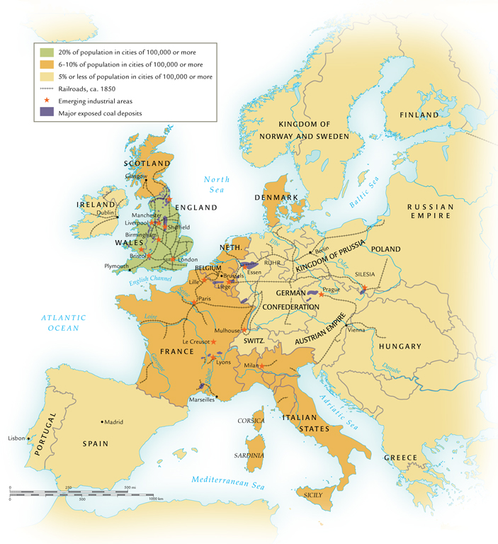
Industrial Europe ca. 1850

Slide 16
Industrialization in North America
Began in 1820s in New England with cotton textile industry
1870s, heavy iron and steel industries emerged in Pennsylvania, Alabama
By 1900, U.S. an economic powerhouse, industrialization spilling over into Canada
Railroad construction stimulates industry

Slide 17
Mass Production
Eli Whitney (U.S., 1765-1825) invents cotton gin (1793), also technique of using machine tools to make interchangeable parts for firearms
Mass production becoming hallmark of industrial societies
Henry Ford, 1913, develops assembly line approach
Complete automobile chassis every 93 minutes
Previously: 728 minutes

Slide 18
Big Business
Large factories require start-up capital
Corporations formed to share risk, maximize profits
Britain and France lay foundations for modern corporation, 1850-1860s

Slide 19
Monopolies, Trusts, and Cartels
Large corporations form blocs to drive out competition, keep prices high
John D. Rockefeller controls almost all oil drilling, processing, refining, marketing in U.S.
German firm IG Farben controls 90% of chemical production
Governments often slow to control monopolies

Slide 20
Industrial Demographics
Technological innovation
Improved agricultural tools
Cheap manufactured goods
Especially textiles
Travel and transportation

Slide 21
Population Growth (millions)

Slide 22
The Demographic Transition
Industrialization results in marked decline of both fertility and mortality
Better diets
Improved disease control
Smallpox vaccine (1797)
Declining fertility

Slide 23
Contraception
Ancient and medieval methods
Thomas Malthus (1766-1834) predicts overpopulation crisis, advocates “moral restraint”
Condom first efficient means of contraception without negative side effects
Made from animal intestines in seventeenth century, latex in nineteenth century

Slide 24
The Urban Environment
Urbanization proceeds dramatically
1800: only 20% of Britons live in towns with population over 10,000
1900: 75% of Britons live in urban environments
Intensified industrial pollution
City centers become overcrowded, unsanitary

Slide 25
Transcontinental Migrations
Nineteenth to early twentieth century, rapid population growth drives Europeans to Americas
50 million cross Atlantic
Britons to avoid urban slums, Irish to avoid potato famines of 1840s, Jews to abandon tsarist persecution
United States is favored destination

Slide 26
New Social Classes
Economic factors result in decline of slavery
Capitalist wealth brings new status to non-aristocratic families
New urban classes of professionals
Blue-collar factory workers
Urban environment also creates new types of diversions
Sporting events

Slide 27
Women at Home and Work
Agricultural, cottage industry work involved women: natural transition
But development of men as prime breadwinners, women in private sphere, working cheap labor
Double burden: women expected to maintain home as well as work in industry
Working class women expected to work until marriage
Domestic service
Related to child labor: lack of day care facilities

Slide 28
Child Labor
Easily exploited, abused
1840s British Parliament began to pass child labor laws
Moral concerns remove children from labor pool
Also, need for educated workforce

Slide 29
The Socialist Challenge
Socialism first used in context of utopian socialists Charles Fourier (1772-1837) and Robert Owen (1771-1858)
Opposed competition of market system
Attempted to create small model communities
Inspirational for larger social units

Slide 30
Karl Marx (1818-1883) and Friedrich Engels (1820-1895)
Two major classes:
Capitalists, who control means of production
Proletariat, wageworkers who sell labor
Exploitative nature of capitalist system
Religion: “opiate of the masses”
Argued for an overthrow of capitalists in favor of a “dictatorship of the proletariat”

Slide 31
Social Reform and Trade Unions
Socialism had major impact on nineteenth-century reformers
Addressed issues of medical insurance, unemployment compensation, retirement benefits
Trade unions form for collective bargaining
Strikes to address workers’ concerns

Slide 32
Global Effects
Global division of labor
Rural societies that produce raw materials
Urban societies that produce manufactured goods
Uneven economic development
Developing export dependencies of Latin America, sub-Saharan Africa, south and southeast Asia
Low wages, small domestic markets

