Slide 1
Chapter 30
The Americas in the Age of Independence

Slide 2
Westward Expansion of the United States
Britain cedes territories between Appalachian Mountains and Mississippi River
Napoleon Bonaparte sells Louisiana Territory, 1803
Meriwether Lewis and William Clark map the territory, 1804-1806
Settlers move west
“Manifest destiny” to occupy all lands between Atlantic and Pacific

Slide 3
Conflict with Indigenous Peoples
Native peoples resist incursions onto ancestral lands and traditional hunting grounds
Formed alliances, also sought British support in Canada
U.S. Indian Removal Act of 1830 drives natives into “Indian Territory” (Oklahoma)
Seminoles forced to march, some escape to Florida
Cherokees migrate 800 miles: the Trail of Tears (1838-1839); thousands die en route

Slide 4
Armed Conflict
Sioux, Comanche, Pawnee, and Apache peoples resist
1876, Lakota Sioux destroy army of Colonel George Armstrong Custer, battle of Little Big Horn (Montana)
U.S. forces have superior firepower, including cannons and Gatling (machine) gun
1890 massacre at Wounded Knee Creek
Nervous U.S. cavalry slaughters men, women, and children

Slide 5
The Mexican-American War (1845-1848)
Mexico then included Texas, California, New Mexico
Texas, influenced by many U.S. settlers, declares independence from Mexico in 1836
Accepted into Union in 1845 despite Mexican protest
Conflict ensues, Mexico forced to cede territory in Treaty of Guadalupe Hidalgo (1848) in exchange for 15 million dollars

Slide 6
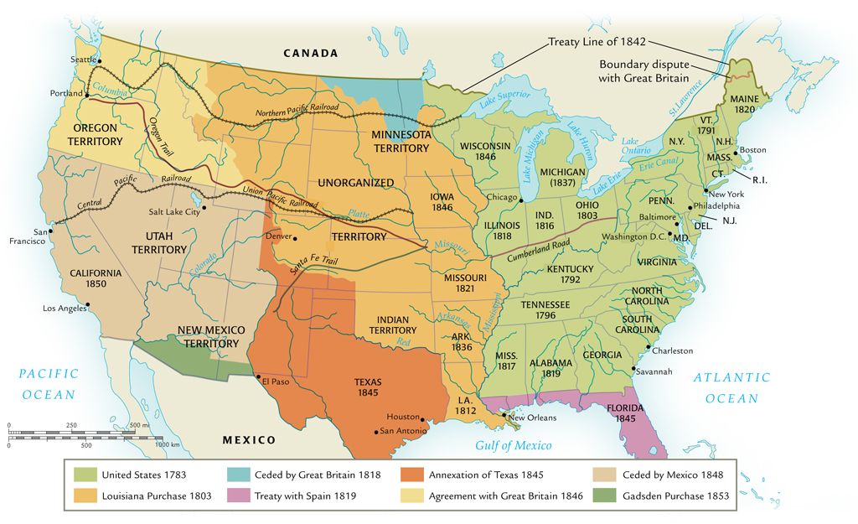
Westward Expansion of the United States during the Nineteenth Century

Slide 7
Sectional Conflict
Major issue: slavery to be allowed in new territories?
Tobacco cultivation on decline, but cotton industry spurs new demand for slaves
U.S. slave population rises from 500,000 in 1770 to 2 million in 1820
Missouri Compromise (1820) attempts to strike balance between slave and free states

Slide 8
Roots of the U.S. Civil War (1861-1865)
Abraham Lincoln elected president, 1860
Committed to antislavery position
Issue of slavery highlighted principle of states’ rights, scope of federal authority
Eleven southern states withdraw from Union, 1860-1861
Southern economy dependent on cotton as cash crop
Northern economy developing industrialization, wage earners

Slide 9
The Emancipation Proclamation
First two years of war inconclusive
1863, Lincoln signs Emancipation Proclamation, makes abolition of slavery explicit goal of the war
Battle of Gettysburg (1863) turns tide against south
North wins after four years of bloody conflict

Slide 10
Canada: Independence without War
Regional divisions in Canadian society, but independence achieved without war
British and French Canadians
French territories ceded after Seven Years’ War (1756-1763)
Concessions made to large French population
Recognition of Roman Catholic church, French law code
After 1781, British population in Ontario joined by loyalists fleeing U.S. War of Independence

Slide 11
The War of 1812
U.S. declares war on Britain over encroachments during Napoleonic wars
British forces in Canada repel U.S. attacks
Social tensions between French and English populations remain
British wish to avoid repeat of U.S. War of Independence, gradually extend home rule between 1840 and 1867
Durham Report (1839) by John George Lambton (1782-1840)

Slide 12
British North America Act (1867)
Joins Quebec, Ontario, Nova Scotia, and New Brunswick as Dominion of Canada
Other provinces join later
Provincial and federal governments with governor-general as British representative
Dominion controls all domestic affairs
Foreign affairs after 1931
First Prime Minister John A. Macdonald (1815-1891) purchases territory, builds trans-Canada railroad

Slide 13
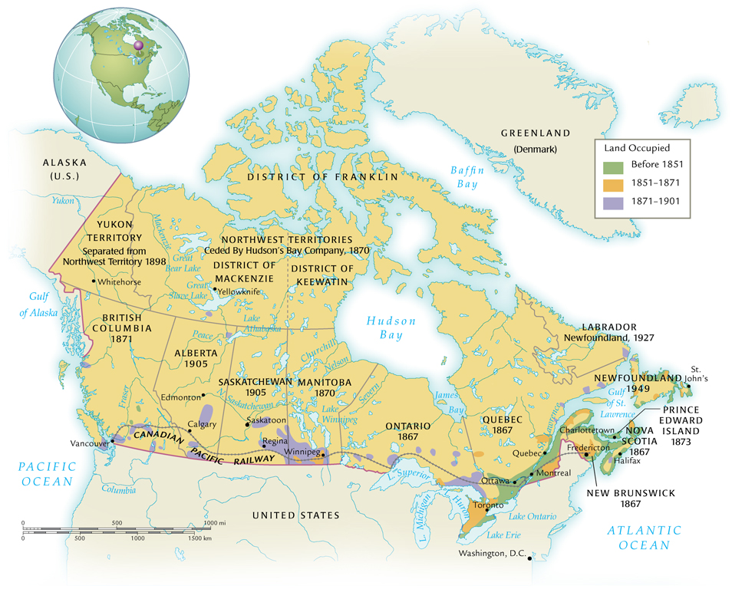
The Dominion of Canada in the Nineteenth Century

Slide 14
Latin America
Creole elites produce republics with constitutions
But less experience with self-rule
Spanish, Portuguese more autocratic than British
Creoles also limit wide participation in politics
Significant political differences divide creoles
Conflict with indigenous peoples
Especially in Argentina and Chile
Caudillos (regional military leaders) come to power
Juan Manuel de Rosas, Argentina, brutally maintained order

Slide 15
Mexican Reform Attempts
After U.S.-Mexico war, reform government of Benito Juárez (1806-1872) comes to power
Attempts to limit power of military, church
Juárez meets powerful conservative opposition, forced out of Mexico City
Suspends loan payments to foreign powers; Europeans intervene to collect investments
French, Mexican forces clash in 1862

Slide 16
The Mexican Revolution (1910-1920)
Middle-class Mexicans, peasants and workers join to overthrow dictator Porfirio Díaz (1830-1915)
Revolutionary leaders Emiliano Zapata (1879-1919) and Francisco (Pancho) Villa (1878-1923) lead masses of landless peasants
Popular, but unable to take major cities
Mexican Constitution of 1917 addresses many of the major concerns of land redistribution

Slide 17
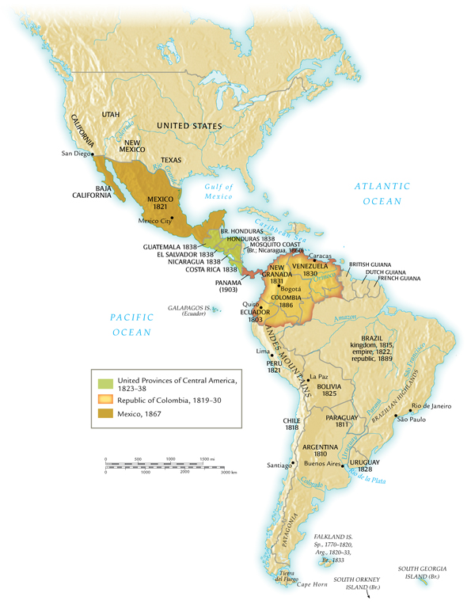
Latin America in the Nineteenth Century

Slide 18
American Economic Development
California gold rush of 1845, also Canadian gold rushes, attract migrants
Others migrate to factories, railroad construction sites, plantations, support services
Some, especially Italians, migrate and return several times

Slide 19
Economic Expansion
British capital spurs vast expansion of U.S. industry
Massive expansion of rail system:
31,000 miles before 1861, almost all in eastern U.S.
200,000 miles by 1900, coast to coast
Necessitates division of U.S. into four time zones
Massive expansion of economy, 1870-1900
Electrification
Trade unions

Slide 20
Canadian Prosperity
British investments in Canada
Policy of economic development: the National Policy
Attract migrants, promote start-up industries, build transportation infrastructure
U.S. also invests in Canada, owning 30% of Canadian industry by 1918

Slide 21
Latin American Dependence
Limited foreign investment
Small size of Latin American markets
Interest in exploiting raw materials
Argentina: beef
Limited industrializing initiatives foiled by government corruption
Yet significant export-driven rise in economy

Slide 22
Societies in the United States
U.S. population most culturally diverse in the hemisphere
Indigenous peoples subject to formal policy of forced assimilation
Destruction of Buffalo-based economies
Dawes Severalty Act of 1887 shifts policies away from collective tribal reservations
Native children taken from families, enrolled in white-controlled boarding schools

Slide 23
Freed Slaves
Slavery ended, but social discrimination remains
Northern armies occupy southern states, forced social program of Reconstruction (1867-1877)
Violent backlash follows their departure
Land-poor freed slaves forced to work as sharecroppers
Violence and intimidation continue

Slide 24
Canadian Cultural Contrasts
British and French each view selves as principal founding peoples of Canada; principal social tensions between them
Also small populations of slaves (before abolished in 1833), freed slaves, runaways, Chinese migrants
Louis Riel (1844-1885) leads natives and métis (mixed-race) in rebellion in western Canada
Defeated, Riel sent into exile; attempts another rebellion in 1885, executed

Slide 25
Diversity in Latin America
Complex social structure, based on racial background
Europeans, natives, African slaves, and combinations thereof
Increasing migration in nineteenth century from Asia
Some conflicts between cosmopolitan cities and rural areas
Symbol of rural culture: the gaucho cowboy

