Slide 1
Chapter 33
The Great War: The World in Upheaval

Slide 2
Immediate Origins of World War I
June 28, 1914, assassination of Archduke Francis Ferdinand (1863-1914)
Sarajevo, Bosnia-Herzegovina
Occupied by Austro-Hungarian empire 1878, annexed 1908
Ferdinand in favor of greater Serbian autonomy
Not enough for Serbian extremists

Slide 3
Gavrilo Princip
Bosnian Serb (1894-1918)
One of seven assassins
First balked, second bungled, attempted suicide
Princip shot Ferdinand and expectant wife Sophie as couple went to hospital to visit victims
Princip swallows ineffective cyanide; captured by mob and tortured
Too young to be executed, sentenced to 20 years in prison, dies of tuberculosis

Slide 4
Outcome of Princip’s Bullet
First conflict of global proportions
Conservative estimates of 15 million dead (5 million non-combatants), 20 million injured
End of four empires, rise of nine new countries
Massive global economic dislocations
End of Europe’s domination of globe

Slide 5
Larger Causes of World War I
Culmination of competing nationalisms
Especially in south, eastern Europe
Rivalry among empires
Especially between Britain and Germany
Inflexible diplomatic alliances
Germany, France, England, Russia

Slide 6
Competing Nationalisms
Inevitable outcome of French revolution
Self-determination and independence movements
Belgium, 1830
Unification of Italy, 1861
Unification of Germany, 1871

Slide 7
Nationalism in Multi-National Empires
Austro-Hungarian empire
South Slavs
Russian empire
Poles, Ukrainians, Baltic states
Ottoman empire
Greeks, Serbians, Romanians, and Bulgarians

Slide 8
Rivalry Among Empires
Dominance of British empire declining
1870, 32% of world industrial output (Germany 13%)
Drops to 14% by 1914
Imperial competition
Germany latecomer, but aggressive
Small-scale disputes around the globe, especially in Balkans

Slide 9
Naval Competition
Arms race between United Kingdom and Germany to control seas
Decisive for control of trade routes in case of war
Construction of dreadnoughts

Slide 10
Role of Public Opinion
Beginning of media age
Availability of cheap newspapers
Little accountability
Awkward pressure on politicians
Sacrifice diplomatic expediency for public support

Slide 11
Inflexible Diplomatic Alliances
Agreements of mutual defense
Chain reaction for global war
Triple Alliance
Germany and Austro-Hungarians (1879), joined by Italians 1882
Triple Entente
Russia, France, and the United Kingdom

Slide 12
Concerns of the Entente
Cultural similarities of Germany, Austro-Hungary
Worries over two-front war
Worries over English domination of the sea
Worries over possibility of French attack, Russian interference over Austrian Balkan policies

Slide 13
Concerns of the Alliance
Russia worried about strong German-Austro-Hungarian alliance
United Kingdom concerned with maintaining balance of power
France worried about hostilities with Germany
Military pact signed, summer 1914
Reciprocal treaty obligations

Slide 14
Mutually Threatening War Plans
French “Plan XVII”
Heavy emphasis on rapid offensives
German Schlieffen plan
Fear of encirclement
France to be defeated swiftly, then attention turned to Russia
Conditional on mobilization of enemy forces

Slide 15
The Chain Reaction
23 July, Austrians issue ultimatum to Serbs
28 July, Austrians declare war
29 July, Russia mobilizes to defend Serbia
31 July, Germany issues ultimatums to Russia, France
1 August, Germany declares war on Russia; France mobilizes
3 August, Germans declare war on France, invade Belgium
4 August, Britain comes to defense of Belgium

Slide 16
War of Attrition
West: three years of stalemate
Trenches from English channel to Switzerland
East: more movement, treaty of Brest-Litovsk in March 1918 places much in Entente control

Slide 17
New Military Technology
Barbed wire, machine gun
Gas
First used by German troops, 1915
Mustard gas: 800,000 casualties
Tanks
Initially effective, but ground quickly lost to counterattacks
Airplanes
Limited bombing, strafing, used primarily for reconnaissance
Dirigibles
Submarines

Slide 18
Brutality of New Warfare
Unprecedented casualties
Verdun, 1916
315,000 French killed
280,000 German casualties
Less than 160,000 bodies recovered
The Somme, British gain few thousand yards
420,000 casualties
No significant strategic advantage

Slide 19
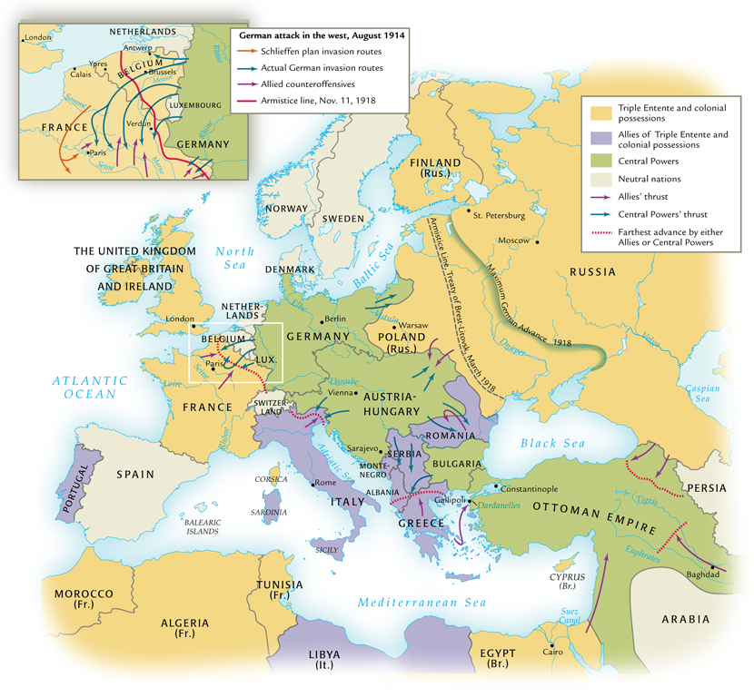
The Great War in Europe and Southwest Asia, 1914-1918

Slide 20
Total War: The Home Front
Implications of modern industrial war: concept of a “home front”
Government takes command of economies
Women in the workforce
TNT poisoning: yellow skin, orange hair
Bombing of civilian areas by zeppelins

Slide 21
War Propaganda
Maintenance of public support for war
Untruths
Irony: Disbelief of WWI propaganda makes belief in WWII atrocities more difficult

Slide 22
Global Involvement
Importation of troops from colonies
United Kingdom: Australia, New Zealand, Canada
Gallipoli
Japanese designs on China with distraction of European powers
Twenty-one secret demands

Slide 23
Collapse of the Russian Empire
Russia: March Revolution, 1917
Germany smuggles Lenin into provisional government in Russia
November Revolution, creation of the USSR
Treaty of Brest-Litovsk cedes Poland, Baltic countries, Ukraine to Central Powers

Slide 24
U.S. Enters the War
U.S. and the war economy
Sale of goods to the Allies
Debts to American banks
U.S. neutrality a mirage
German blockade of British overseas trade
Submarine patrols
Sinking of Lusitania, May 7, 1915
1,198 lives lost (128 U.S.)
Carried munitions
U.S. declares war April 1917

Slide 25
Defeat of the Central Powers
Fall of 1918, exhaustion of Central Powers troops
Bulgaria, Ottomans, Austro-Hungarians, Germans surrender
Armistice: November 11, 1918

Slide 26
The Paris Peace Conference
Dominated by France, Great Britain, and the United States
No Central Powers representation
A dictated peace
Woodrow Wilson’s Fourteen Points
Peace treaties harsh on Central Powers

Slide 27
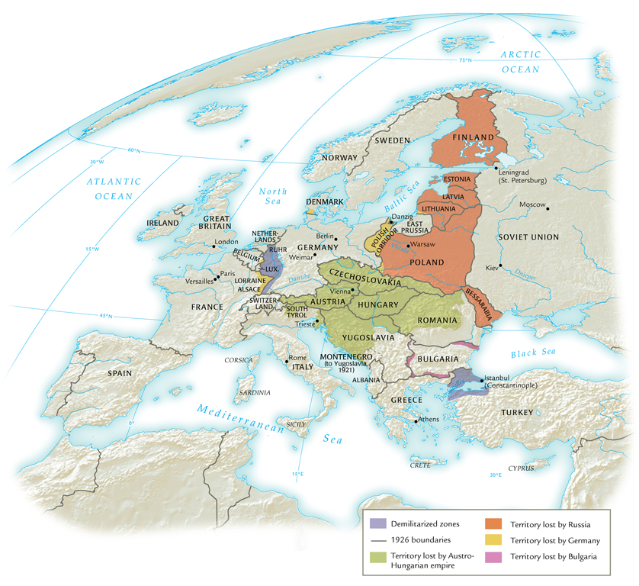
Territorial Changes in Europe after the Great War

Slide 28
The End of the Ottoman Empire
Treaty of Sèvres (1920) removes Balkan and Arab provinces, allows for European occupation of south and east Anatolia
Mustafa Kemal (Atatürk) leads uprising against sultanate, creates Republic of Turkey
Allies recognize republic in Treaty of Lausanne (1923)
Intensely secular government, women’s rights

Slide 29
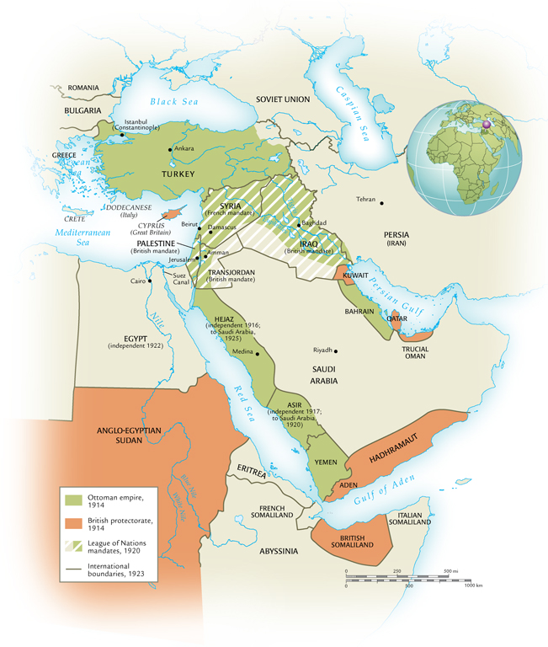
Territorial Changes in Southwest Asia after the Great War

Slide 30
The League of Nations
League of Nations created by diplomats in Paris
42 original member-states, 26 non-European
Application of Wilson’s concept of “self-determination”
Mandate system created to control formerly colonized areas

