Slide 1
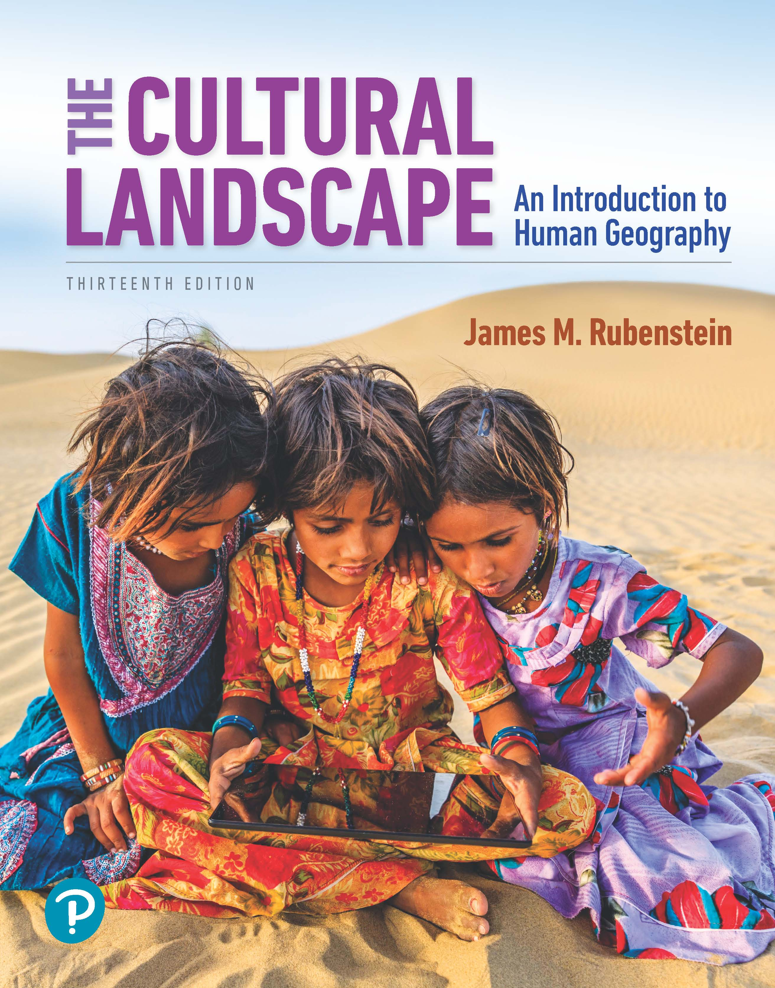
The Cultural Landscape: An Introduction to Human Geography
Thirteenth Edition
Chapter 5 Lecture
Languages
Copyright © 2020 Pearson Education, Inc. All Rights Reserved
Notes:
If this PowerPoint presentation contains mathematical equations, you may need to check that your computer has the following installed:
1) MathType Plugin
2) Math Player (free versions available)
3) NVDA Reader (free versions available)

Slide 2
Languages: Key Issues
5.1 Where Are Languages Distributed?
5.2 Why Do Languages Diffuse?
5.3 Why Do Languages Vary Among Places?
5.4 Why Do Languages Survive or Perish?

Slide 3
Key Issue 1: Where Are Languages Distributed?
5.1.1 Languages and Geography
5.1.2 Distribution of Language
5.1.3 Language Families
5.1.4 Distribution of Indo-European Languages
5.1.5 Distribution of Other Language Families

Slide 4
5.1.1 Languages and Geography (1 of 6)
Language is a system of communication through speech, movement, sounds, or symbols that a group of people understands to have the same meaning
Languages are organized into families, branches, and groups
Languages are classified as institutional, developing, vigorous, threatened, or dying depending on number of speakers and their usage

Slide 5
5.1.1 Languages and Geography (2 of 6)
An institutional language is used in work, education, mass media, and government
A developing language is in daily use by people of all ages
A vigorous language is in daily use by people of all ages, but it lacks a literary tradition
A threatened language is used for face-to-face communication, but is losing users
A dying language is used by older people, but is not being transmitted to children

Slide 6
5.1.1 Languages and Geography (3 of 6)
A language family is a collection of languages related through a common ancestral language that existed long before recorded history
A language branch is a collection of languages within a family related through a common ancestral language
A language group is a collection of languages within a branch that share a common origin in the relatively recent past

Slide 7
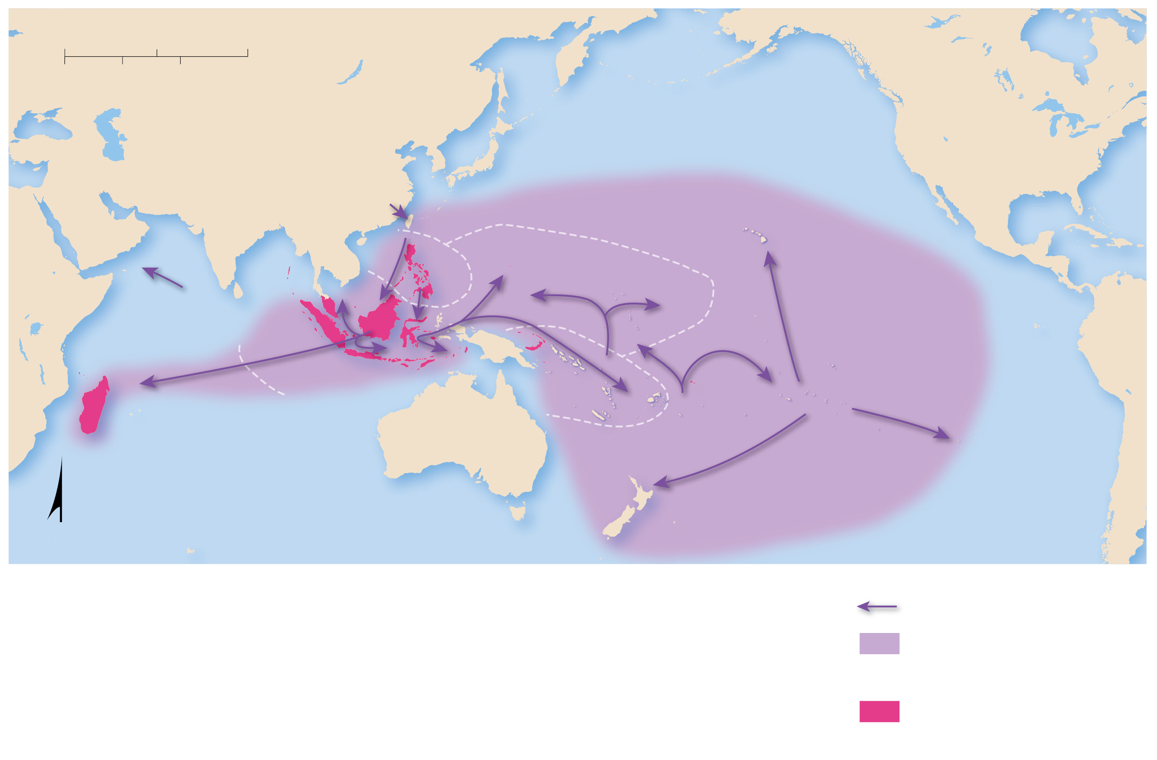
5.1.1 Languages and Geography (4 of 6)
Figure 5-1: Austronesian languages are related to one another but have diverged with the isolation of groups after migration.
0
1,500
3,000 Miles
0
1,500
3,000 Kilometers
PACIFIC
OCEAN
TAIWAN
PHILIPPINES
HAWAII
MICRONESIA
INDONESIA
POLYNESIA
MELANESIA
Society
Islands
Easter
Island
MADAGASCAR
INDIAN
OCEAN
FIJI
N
NEW ZEALAND
Migration routes
Spread of Austronesian
languages
Current Austronesian
language areas

Slide 8
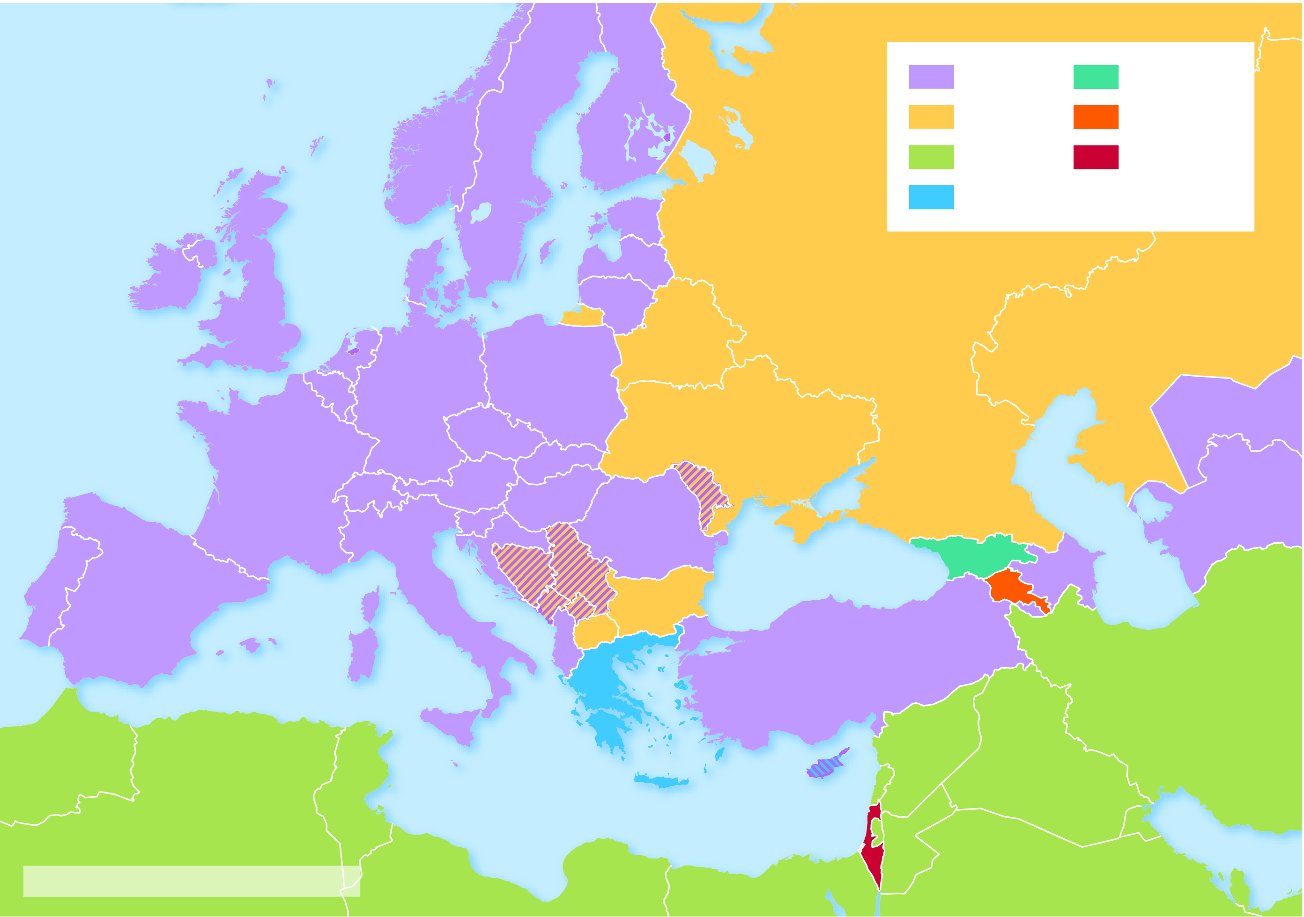
5.1.1 Languages and Geography (5 of 6)
Figure 5-2: There are multiple writing scripts in Europe and Southwest Asia, including Latin, Cyrillic, Greek, Hebrew, and Arabic.
ATLANTIC
OCEAN
Latin
Georgian
FINLAND
Cyrillic
Armenian
NORWAY
Arabic
Hebrew
North
Sea
SWEDEN
ESTONIA
Greek
IRELAND
UNITED
KINGDOM
DENMARK
Baltic Sea
LATVIA
R U S S I A
LITHUANIA
KAZAKHSTAN
NETH.
POLAND
BELARUS
BELGIUM
GERMANY
UZBEKISTAN
CZECHIA
SLOVAKIA
UKRAINE
FRANCE
SWITZ.
AUSTRIA
HUNGARY
MOLDOVA*
SLOVENIA
ROMANIA
Caspian Sea
TURKMENISTAN
PORTUGAL
CROATIA
Black Sea
GEORGIA
SPAIN
ITALY
BOS. &
HERZ.*
SERBIA*
BULGARIA
ARMENIA
AZERBAIJAN
MON.
KOS.
ALBANIA
MAC.
TURKEY
GREECE
IRAN
MOROCCO
MALTA
CYPRUS
SYRIA
IRAQ
ALGERIA
TUNISIA
M e d i t e r r a n e a n S e a
LEBANON
JORDAN
KUWAIT
ISRAEL
JORDAN
Persian Gulf
*Latin and Cyrillic are both used.
LIBYA
EGYPT
SAUDI ARABIA
QATAR

Slide 9
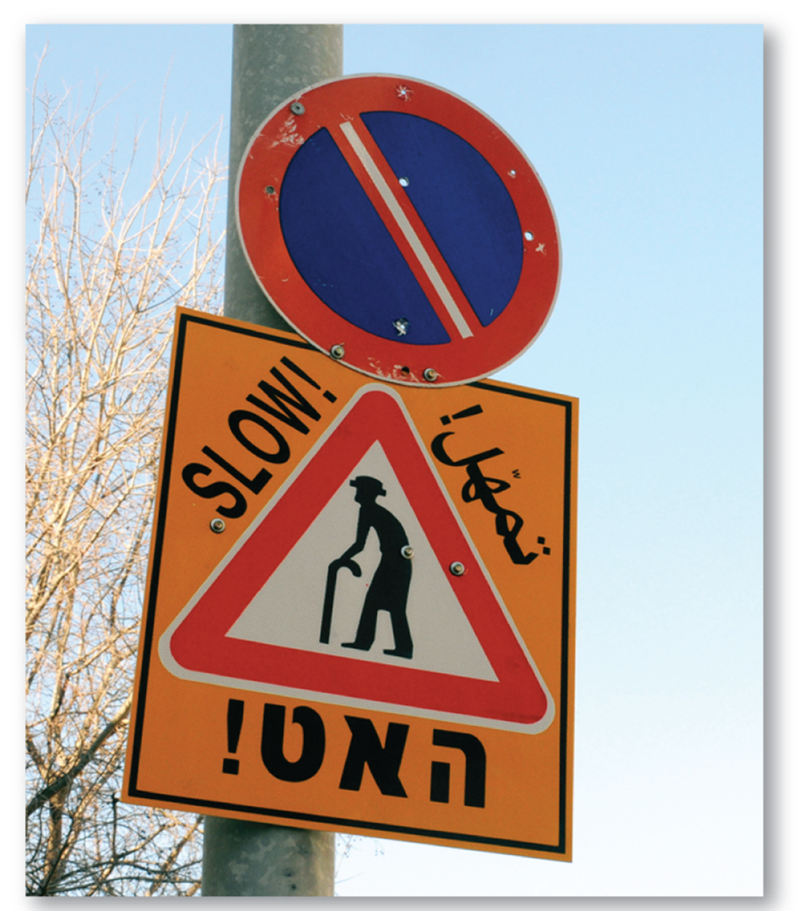
5.1.1 Languages and Geography (6 of 6)
Figure 5-3: Sign in Hebrew (bottom), Arabic (upper right), and English (Latin writing system)

Slide 10
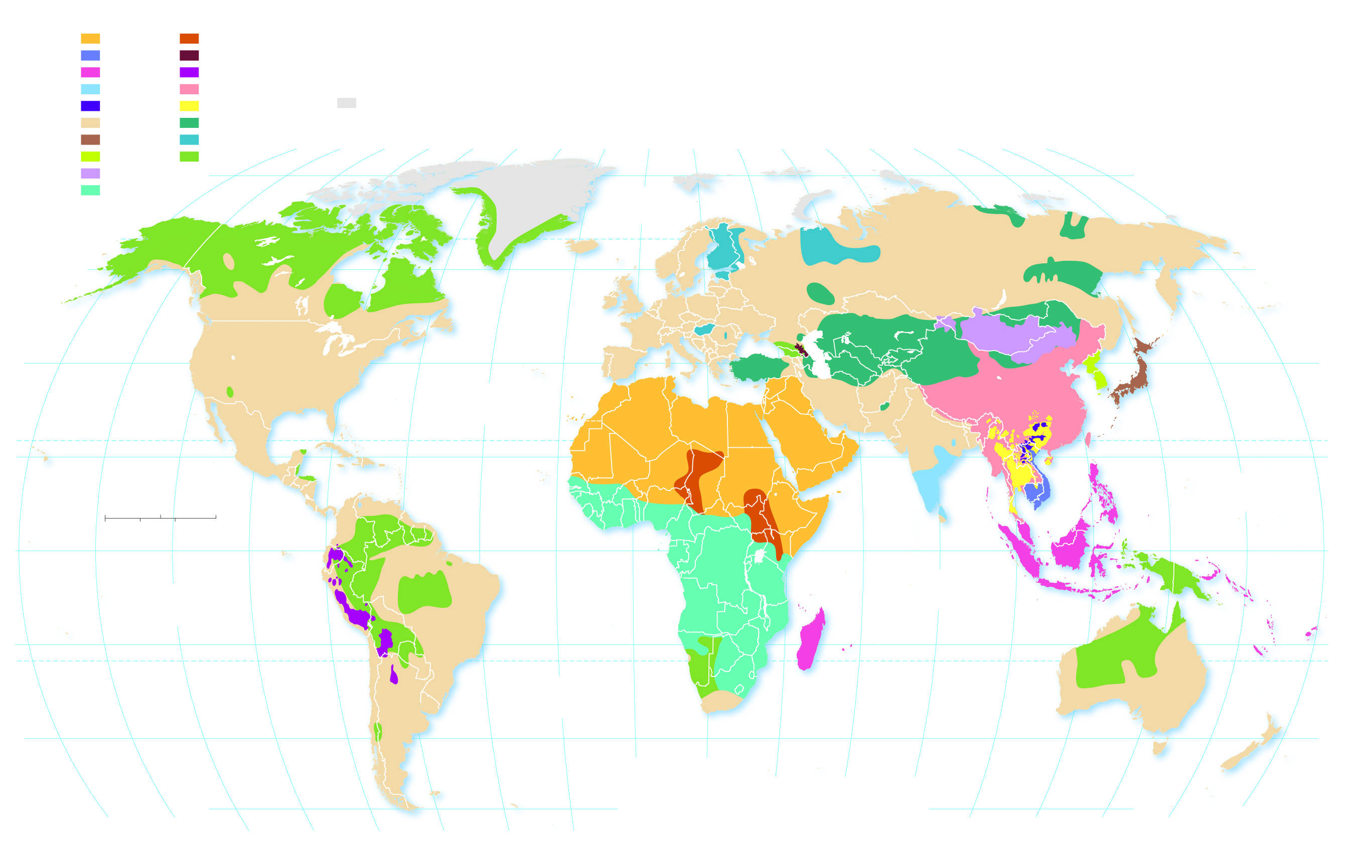
5.1.2 Distribution of Languages (1 of 2)
Figure 5-4: Global map featuring distribution of all language families with >7 million speakers.
Language families with at least
7 million native users
Afro-Asiatic
Nilo-Saharan
SPANISH
Languages with more than
100 million users
Austro-Asiatic
Northern Caucasian
French
Languages with 50-100
million users
Austronesian
Quechuan
Dravidian
Sino-Tibetan
Sparsely inhabited
Hmong-Mien
Tai-Kadai
Indo-European
Turkic
Japanese
Uralic
160°
140°
120°
100°
80°
60°
40°
20°
0°
20°
40°
60°
80°
100°
120°
140°
160°
180°
Korean
Other
Mongolic
80°
80°
Niger-Congo
ARCTIC
OCEAN
60°
ENGLISH
RUSSIAN
60°
French
German
French
40°
ENGLISH
PORTUGUESE
SPANISH
Italian
Turkish
MANDARIN
Korean
40°
ATLANTIC
OCEAN
Farsi
LAHNDA
Wu
JAPANESE
SPANISH
ARABIC
ARABIC
Urdu
HINDI
Yue
TROPIC OF CANCER
20°
Marathi
BENGALI
20°
Telugu
Vietnamese
PACIFIC
OCEAN
0
1,000
2,000 Miles
Tamil
0°
0
1,000
2,000 Kilometers
Malay
EQUATOR
0°
PACIFIC
OCEAN
INDIAN
OCEAN
Javanse
20°
PORTUGUESE
TROPIC OF CAPRICORN
20°
ATLANTIC
OCEAN
ENGLISH
40°
SPANISH
20°
40°
40°
60°
80°
180°
160°
140°
120°
100°
80°
60°
40°
20°
0°
100°
120°
140°
160°

Slide 11
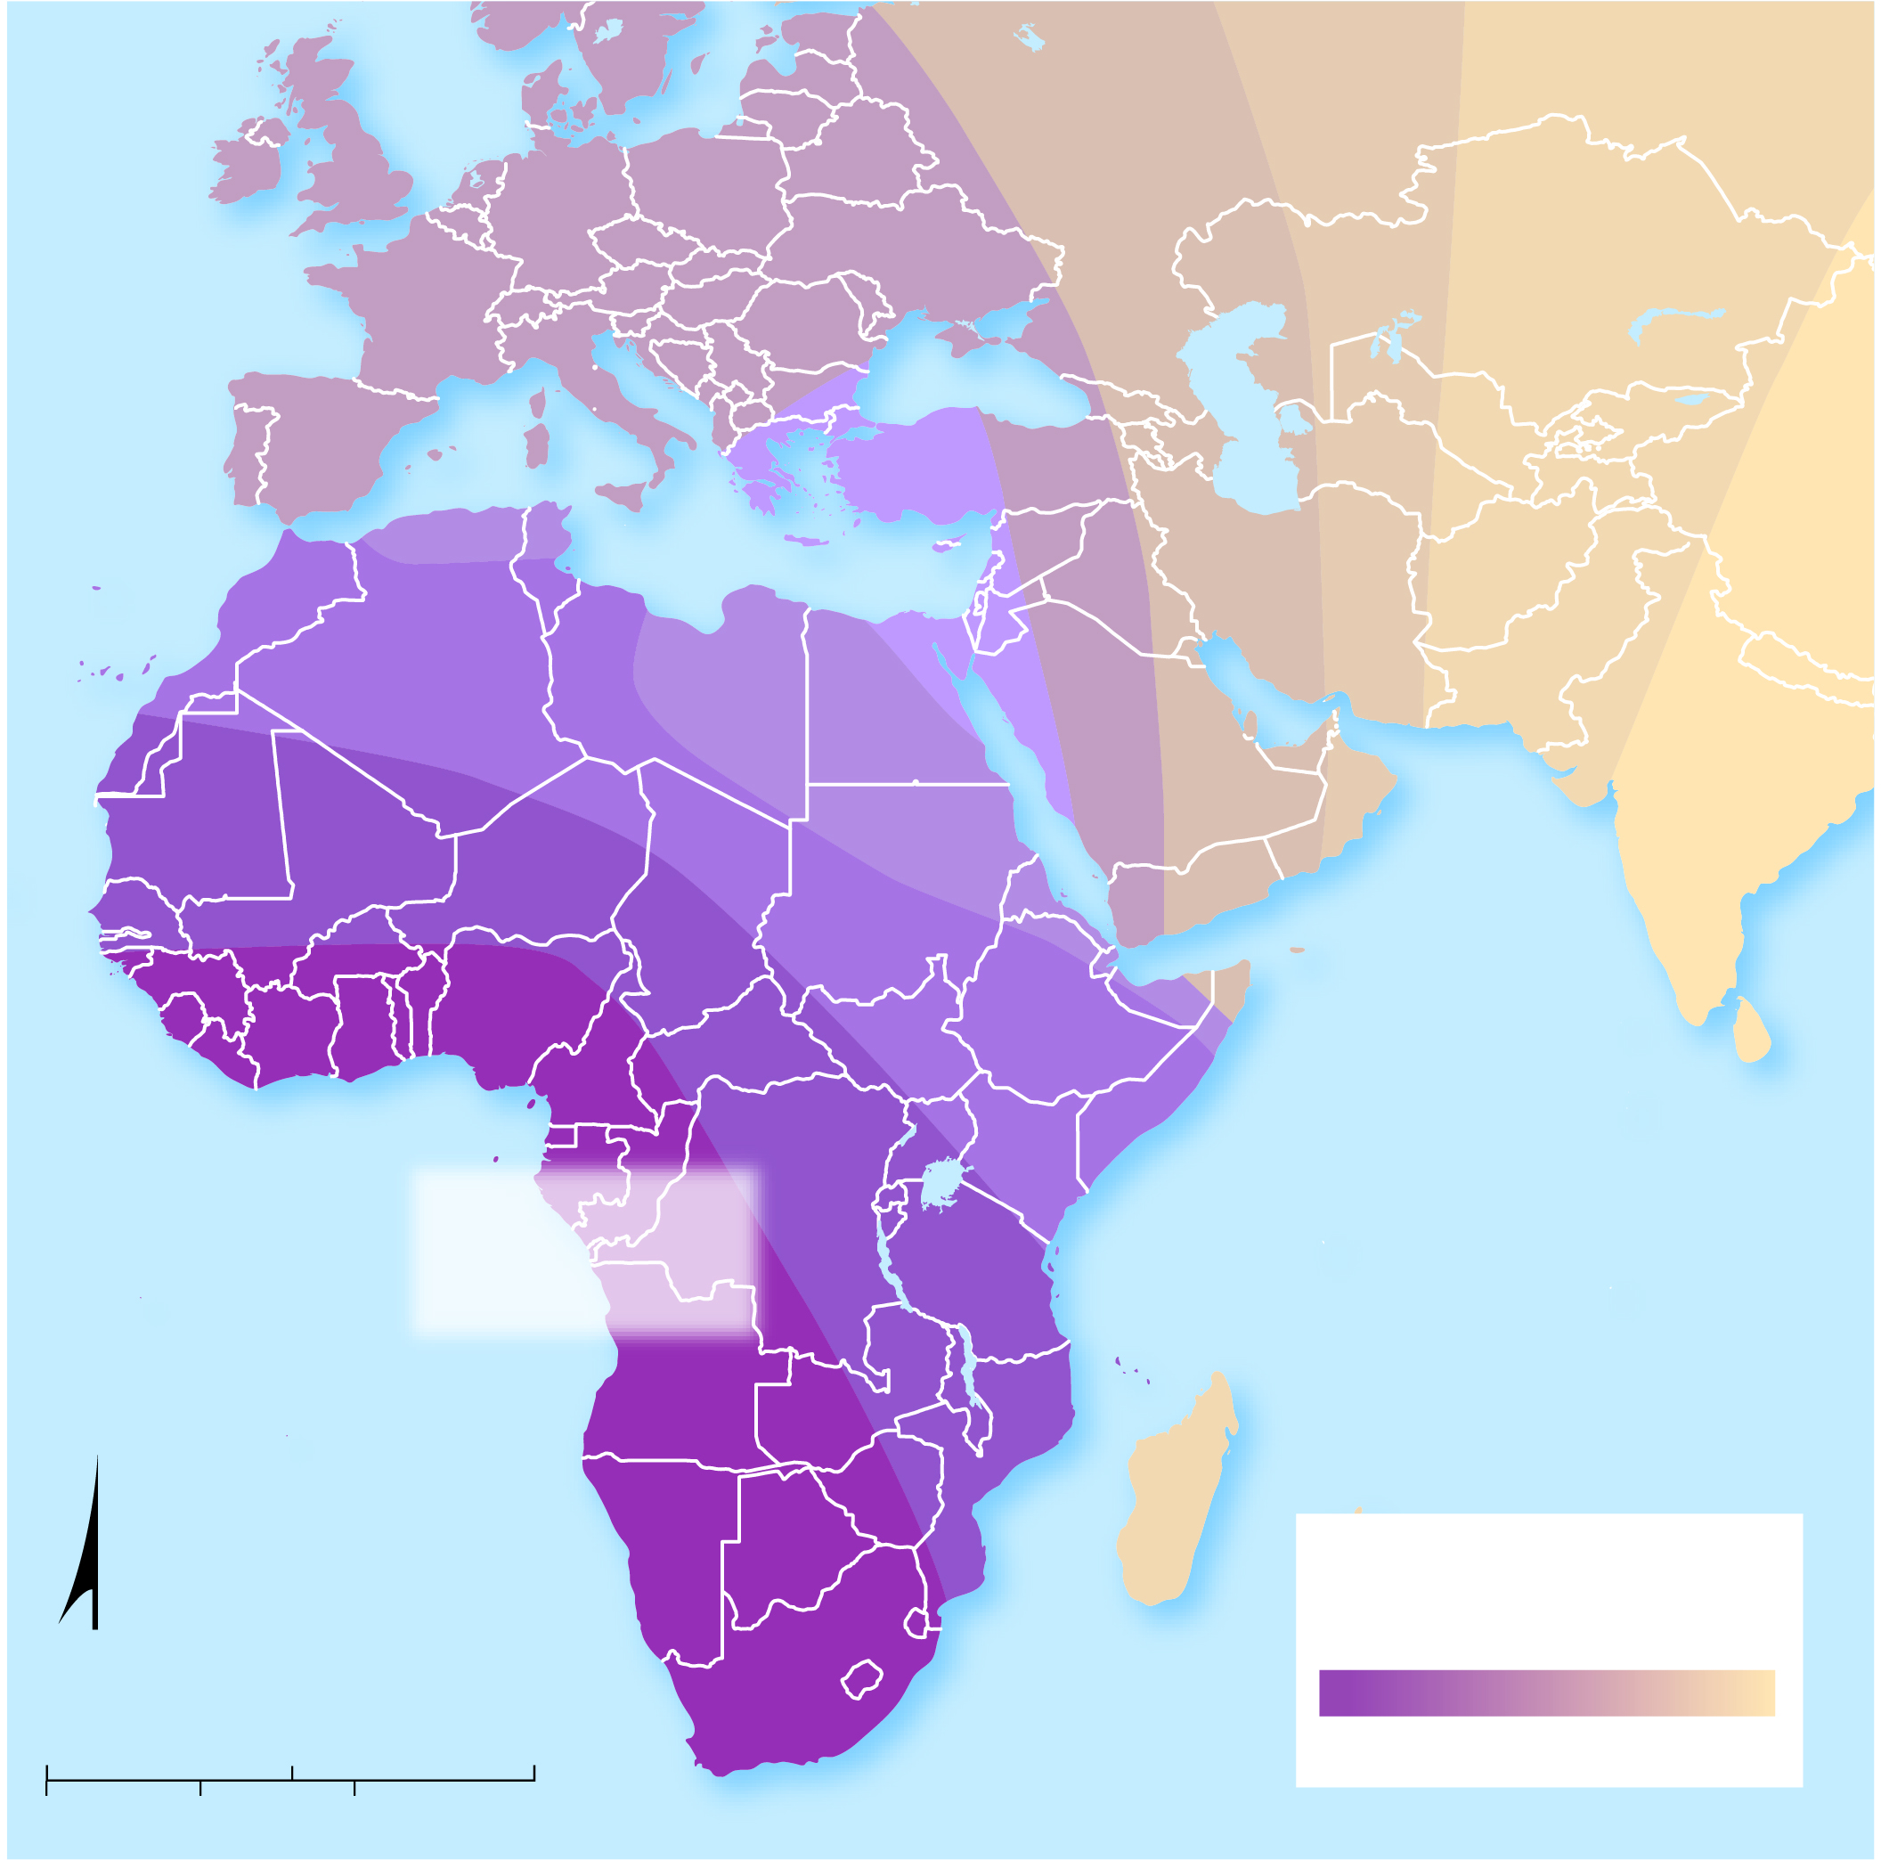
5.1.2 Distribution of Languages (2 of 2)
Figure 5-5: The most diverse sounds in languages are found in western Africa, implying language originated there and became less diverse with diffusion.
Likely origin
of language
INDIAN
OCEAN
ATLANTIC
OCEAN
Diversity of sounds
in local languages
N
0
1,000
2,000 Miles
more
less
0
1,000
2,000 Kilometers

Slide 12
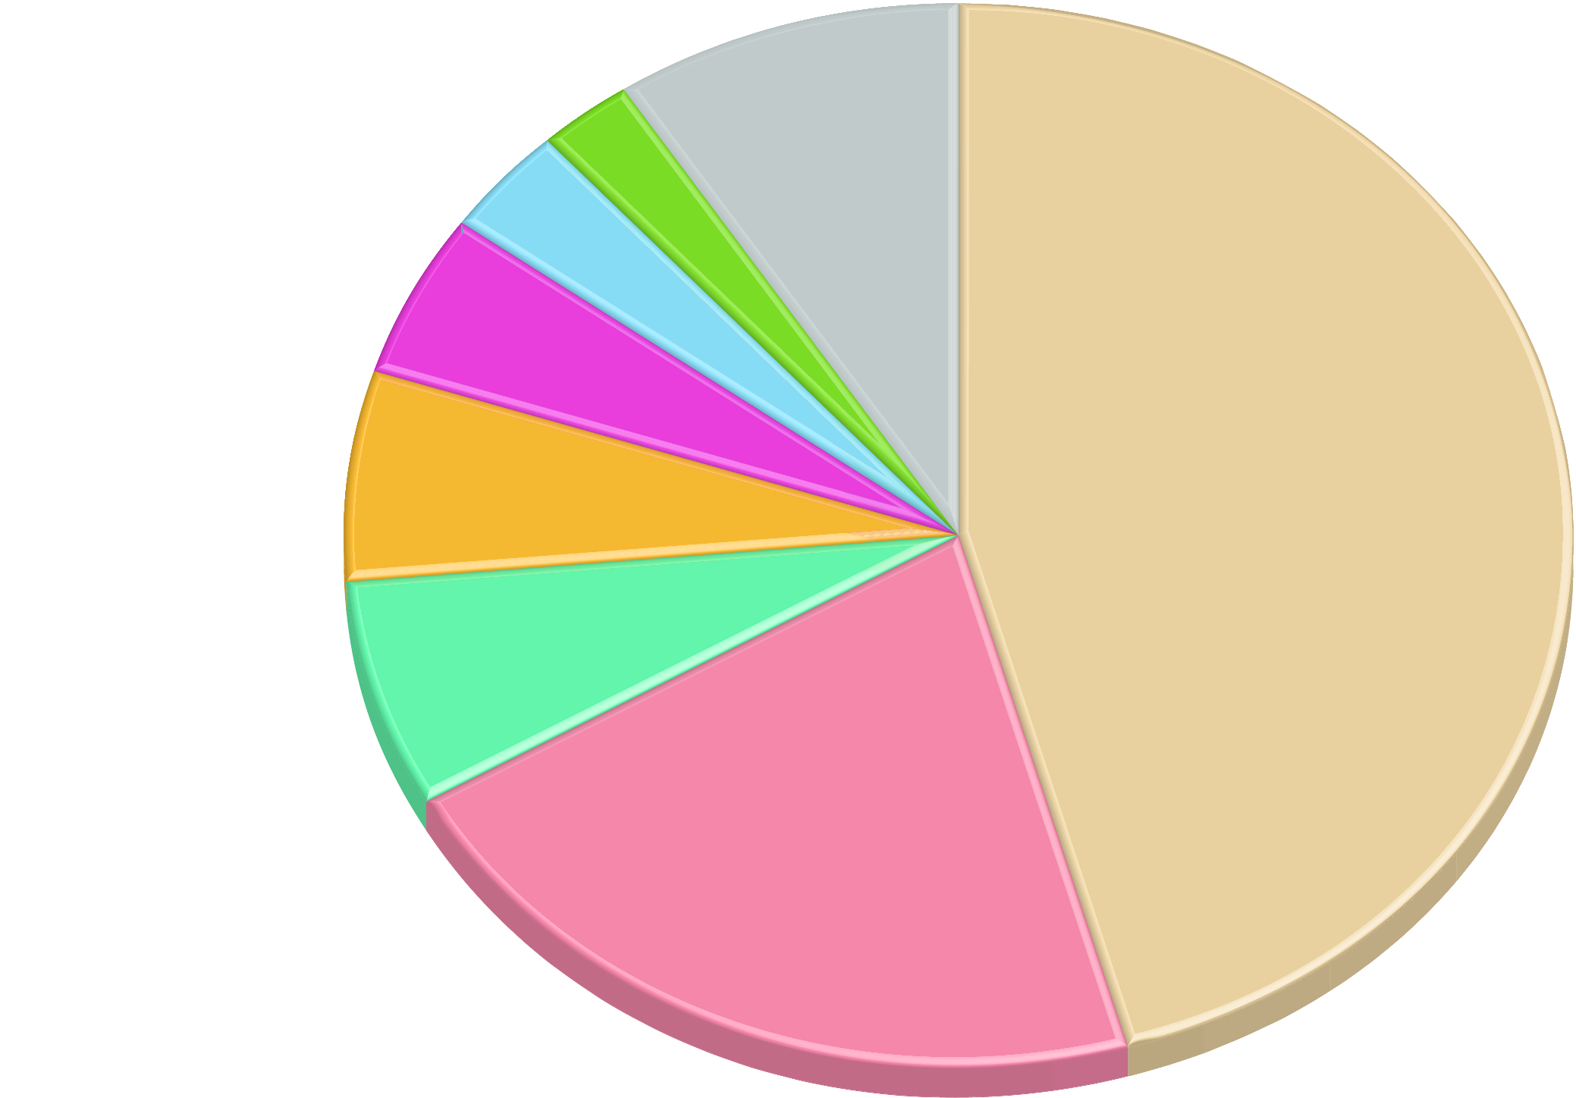
5.1.3 Language Families (1 of 2)
More than 90% of the people in the world use a language that belongs to one of seven language families
Figure 5-7: The chart shows the percentage of people who use a language from each major family.
Turkic
2.6
Dravidian
3.5
Others
Austronesian
5.0
8.9
Afro-Asiatic
Indo-European
6.3
45.7
Niger-Congo
6.9
Sino-Tibetan
21.1

Slide 13
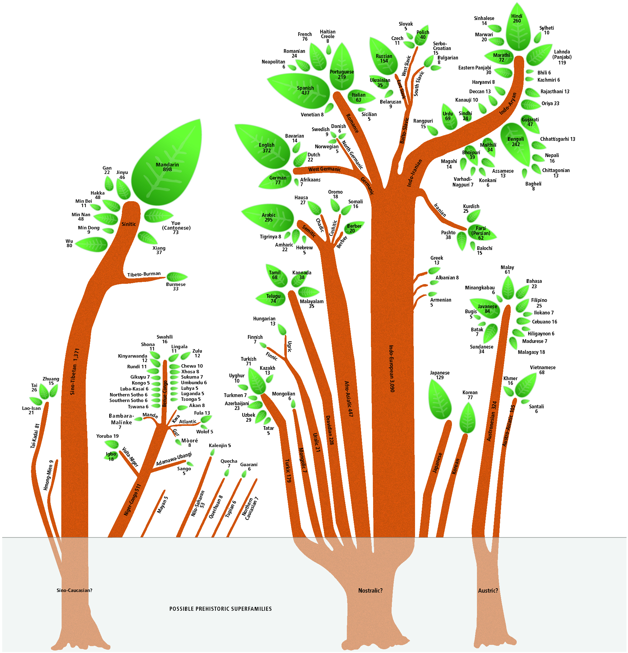
5.1.3 Language Families (2 of 2)
Figure 5-9: If language families are visualized as tree trunks, the branches are branches, the sub-branches are groups, and the leaves are individual languages.

Slide 14
5.1.4 Distribution of Indo-European Languages (1 of 5)
Indo-European languages are the most widespread language branch in the world. They are broken into several branches:
Indo-Iranian (e.g., Persian, Hindi, Urdu)
Germanic (e.g., German, English)
Romance (e.g., Spanish, French, Italian)
Balto-Slavic (e.g., Russian, Polish, Serbian)

Slide 15
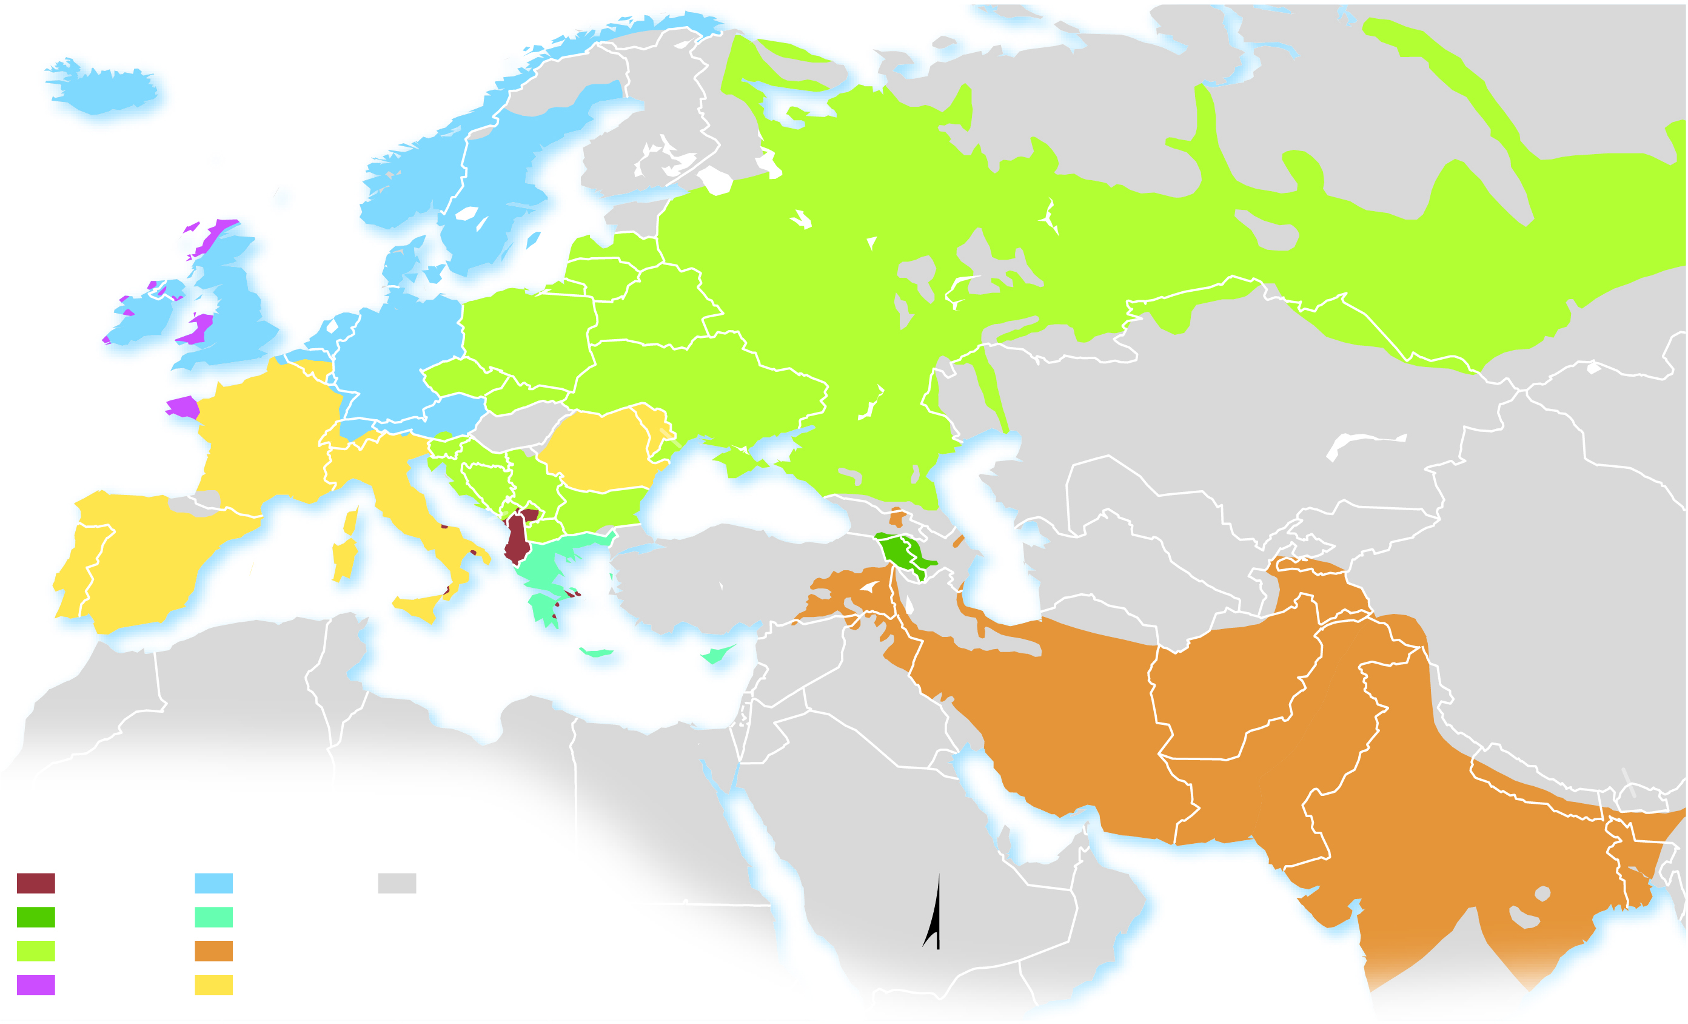
5.1.4 Distribution of Indo-European Languages (2 of 5)
Figure 5-10: The largest language groups in Indo-European are Germanic, Balto-Slavic, Indo-Iranian, and Romance.
ICELAND
Norwegian Sea
NORWAY
ATLANTIC
OCEAN
NORWAY
SWEDEN
FINLAND
North
Sea
ESTONIA
R U S S I A
UNITED
KINGDOM
DENMARK
Baltic Sea
LATVIA
LITHUANIA
IRELAND
NETH.
GERMANY
POLAND
BELARUS
BELGIUM
CZECHIA
UKRAINE
AUSTRIA
SLOVAKIA
KAZAKHSTAN
Bay of
Biscay
FRANCE
SWITZ.
SLO.
HUNGARY
ROMANIA
MOLDOVA
CROATIA
SERBIA
ITALY
BOS &
HERZ.
KOS.
BULGARIA
Black Sea
UZBEKISTAN
MONT.
MAC.
GEORGIA
KYRGYZSTAN
PORTUGAL
ALBANIA
Caspian Sea
SPAIN
GREECE
TURKEY
ARMENIA
AZER.
TURKMENISTAN
TAJIKISTAN
C H I N A
Mediterranean Sea
SYRIA
TUNISIA
CYPRUS
I R A N
AFGHANISTAN
MOROCCO
ALGERIA
IRAQ
LIBYA
EGYPT
PAKISTAN
BHUTAN
SAUDI
ARABIA
NEPAL
Albanian
Germanic
Non-Indo-European
languages
U.A.E.
OMAN
I N D I A
BANGLADESH
Armenian
Greek
Balto-Slavic
Indo-Iranian
N
Arabian
Sea
Bay of
Bengal
Celtic
Romance

Slide 16
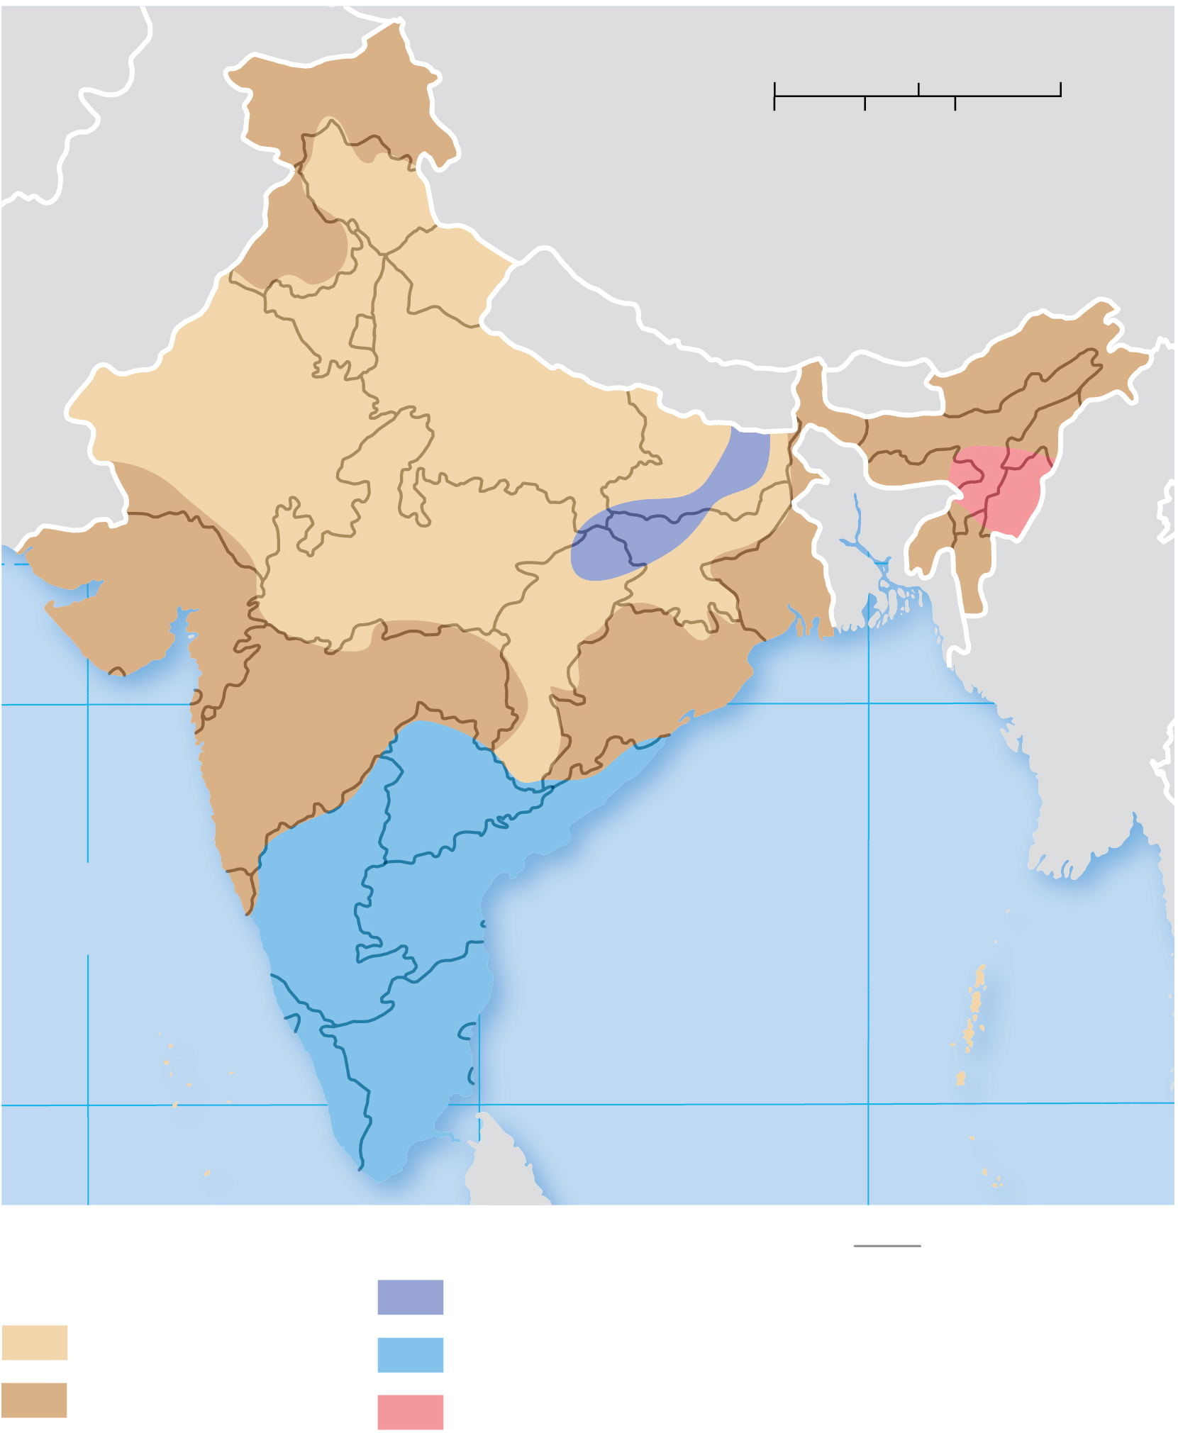
5.1.4 Distribution of Indo-European Languages (3 of 5)
Figure 5-11: India’s principal language is Hindi, but there are 22 other scheduled languages.
Kashmiri
0
250
500 Miles
Urdu
Dogri
0
250
500 Kilometers
PAKISTAN
Panjabi
CHINA
NEPAL
BHUTAN
H I N D I
Nepali
Assamese
Maithili
Bodo
Sindhi
Urdu
Manipuri
Santali
BENGALI
Gujarati
Marathi
Oriya
MYANMAR
20°
BANGLADESH
Konkani
Telugu
Arabian
Sea
Kannada
Bay of
Bengal
Sanskrit
HINDI
Malayalam
Tamil
10°
70°
SRI LANKA
90°
Indo-European
language family
Other language families
State boundary
Hindi
Austro-Asiatic
BENGALI
Scheduled
language
Dravidian
Bodo
Other
Sino-Tibetan

Slide 17
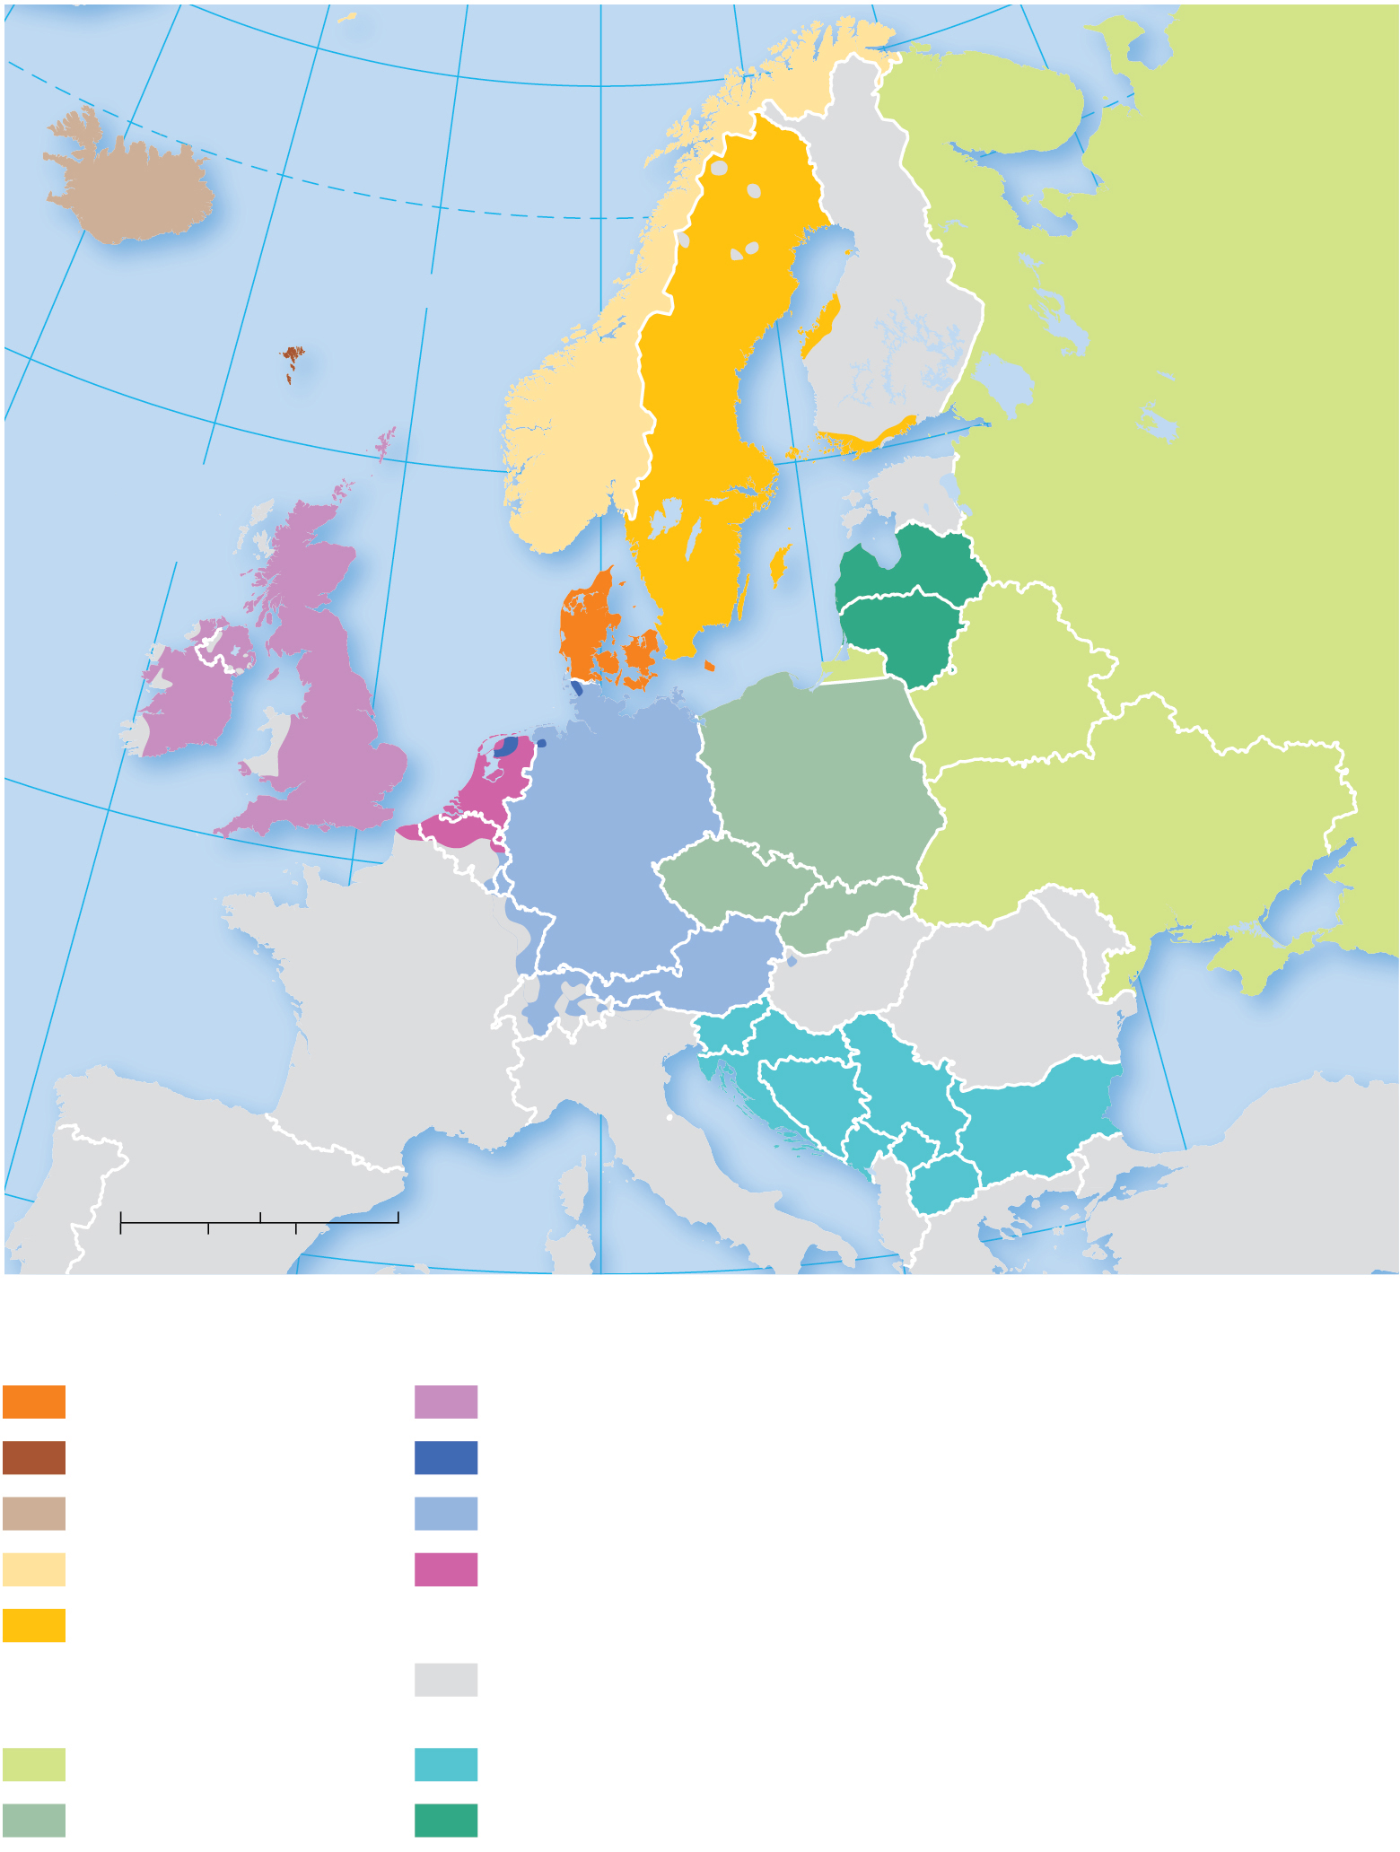
5.1.4 Distribution of Indo-European Languages (4 of 5)
Figure 5-12: The Germanic branch is subdivided into North and West Germanic language groups. English is part of the West Germanic group. Slavic is divided into several groups, including a Baltic group.
20°
10°
0°
10°
20°
40°
70°
ARCTIC CIRCLE
ICELAND
Faeroe Is.
Norwegian
Sea
FINLAND
60°
Shetland Is.
NORWAY
ATLANTIC
OCEAN
SWEDEN
ESTONIA
R U S S I A
N. IRELAND
SCOTLAND
North
Sea
Baltic Sea
LATVIA
IRELAND
UNITED
KINGDOM
DENMARK
LITH.
ENGLAND
Frisian Is.
POLAND
BELARUS
50°
WALES
NETH.
GERMANY
UKRAINE
BELGIUM
CZECHIA
LUX.
AUSTRIA
SLOVKIA
MOLD.
Bay of
Biscay
FRANCE
SWITZ.
SLO.
HUNG.
ROMANIA
Black Sea
ITALY
CROATIA
SERBIA
10°
SPAIN
BOS. &
HERZ.
KOS.
BULGARIA
PORT.
250
500 Miles
MONT.
MAC.
0
500 Kilometers
ALBANIA
GREECE
TURKEY
0
250
Germanic branch
North Germanic group
West Germanic group
Danish
English
Faeroese
Frisian
Icelandic
German
Norwegian
Netherlandish
(Dutch)
Swedish
Other
Balto-Slavic branch
Eastern Slavic group
Southern Slavic group
Western Slavic group
Eastern Baltic group

Slide 18
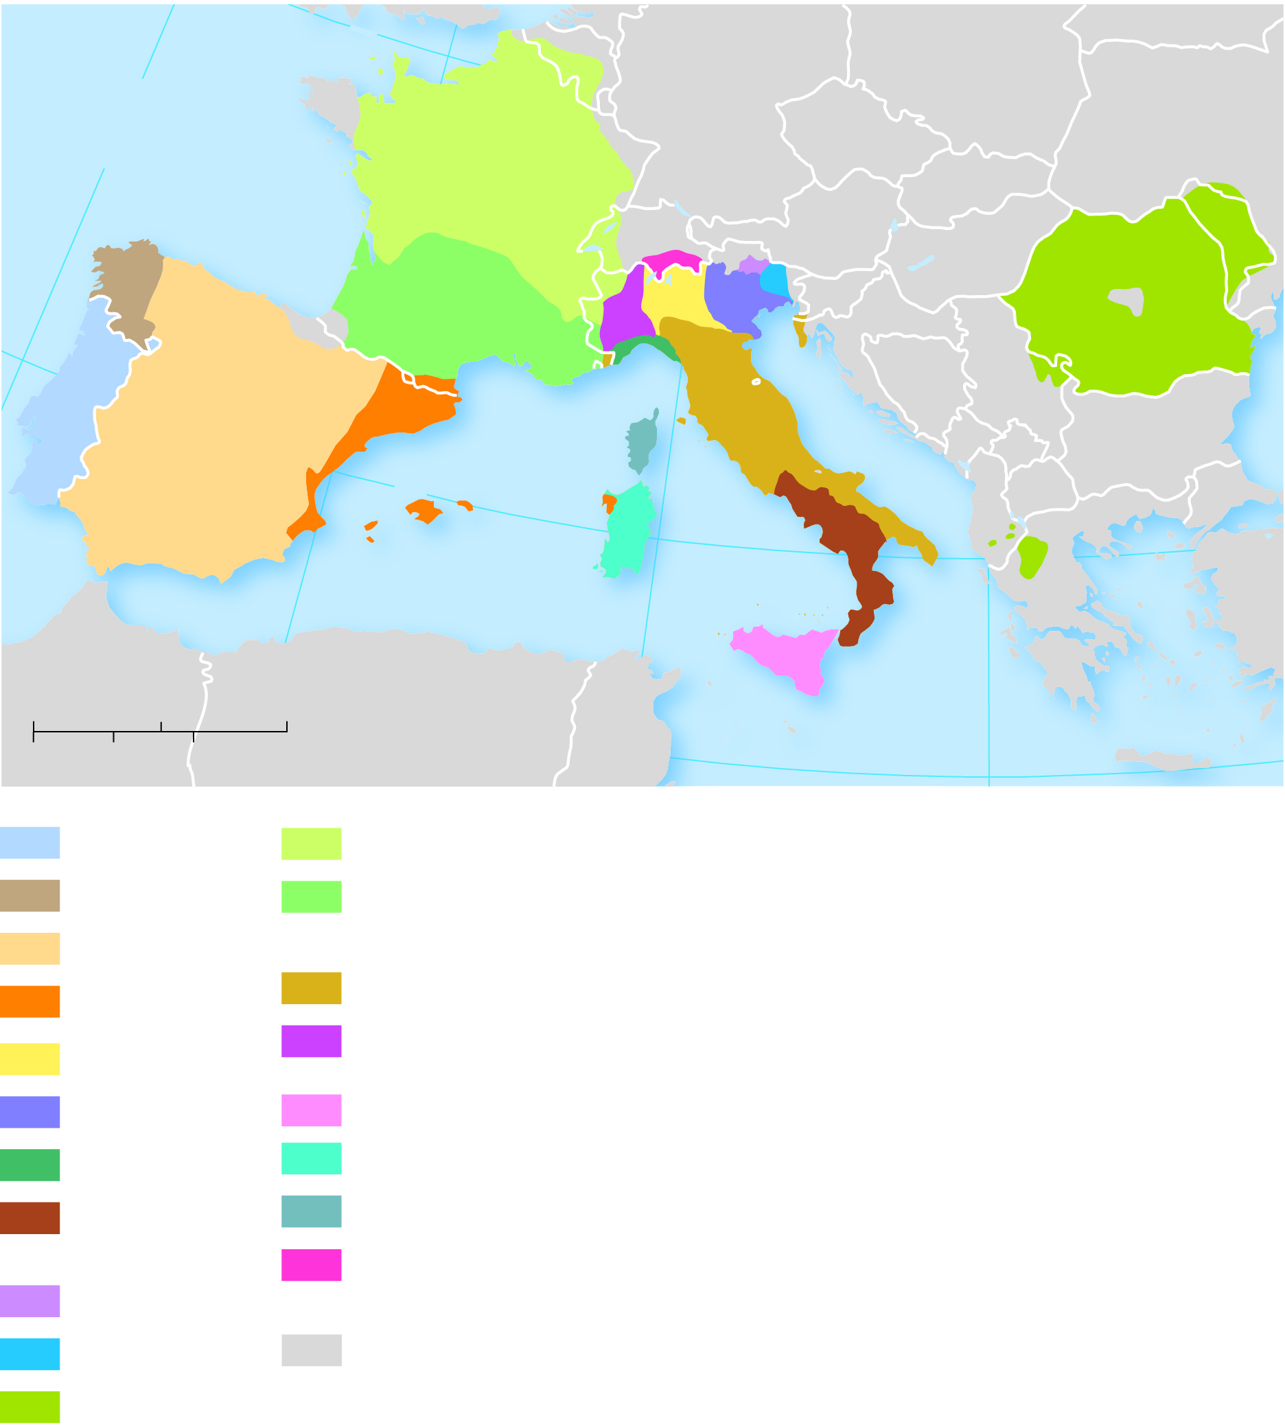
5.1.4 Distribution of Indo-European Languages (5 of 5)
Figure 5-13: Romance languages developed from Latin, the language of the Roman empire. The most widely used are Spanish, Portuguese, French, and Italian.
10°
50°
BELG.
GERMANY
POLAND
BELARUS
ATLANTIC
OCEAN
LUX.
CZECHIA
UKRAINE
Bay of
Biscay
FRANCE
LIECH.
SLOVAKIA
SWITZ.
AUSTRIA
HUNGARY
MOLDOVA
SLOVENIA
ROMANIA
ANDORRA
CROATIA
40°
SAN
MARINO
BOS. &
HERZ.
SERBIA
PORTUGAL
MONACO
MONT.
BULGARIA
SPAIN
Corsica
ITALY
KOS.
MAC.
Balearic Is.
Sardinia
ALBANIA
Mediterranean Sea
GREECE
TURKEY
MOROCCO
0°
10°
Sicily
0
200
400 Miles
ALGERIA
TUNISIA
MALTA
20°
0
200
400 Kilometers
30°
Portuguese
French/Langue d'oïl
Galician
French/Langue
d'òc (Occitan)
Spanish
Italian
Catalán
Piemontese
Lombard
Venetian
Sicilian
Ligurian
Sardinian
Napoletano-
Calabrese
Corsican
Ladin
Romansh
Friulian
Non-Romance
languages
Romanian

Slide 19
5.1.5 Distribution of Other Language Families (1 of 5)
Major language families in East Asia include:
Sino-Tibetan is the second-largest language family and includes Mandarin Chinese
Japanese
Korean
Austronesian (e.g., spoken in Indonesia)
Austro-Asiatic (e.g., Khmer, Vietnamese)
Tai-Kadai (e.g., Thai, Lao)

Slide 20
5.1.5 Distribution of Other Language Families (2 of 5)
Other major language families in South Asia, Southwest Asia, and Central Asia include:
Dravidian (spoken in southern India, e.g., Tamil)
Turkic (spoken in a wide arc across Southwest and Central Asia, e.g., Turkish, Kazakh, Kyrgyz)

Slide 21
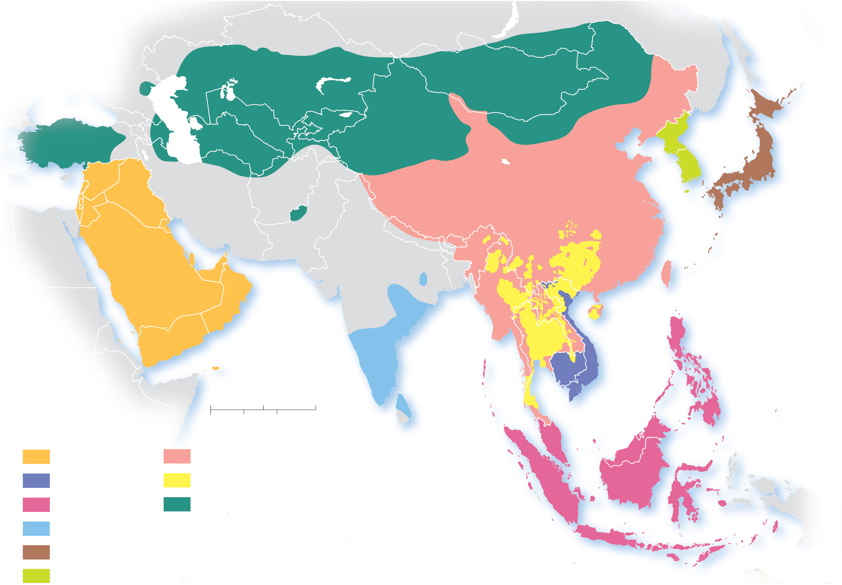
5.1.5 Distribution of Other Language Families (3 of 5)
Figure 5-14: Asia features languages from the Sino-Tibetan, Turkic, and Dravidian families.
Bay of
Biscay
Sea of
Japan
(East Sea)
TURKISH
KOREAN
MANDARIN
JAPANESE
WU
East
China
Sea
YUE
PACIFIC
OCEAN
TELUGU
Bay
of
Bengal
VIETNAMESE
Arabian
Sea
South
China
Sea
0
200
1,000 Miles
TAMIL
Language families
0
200
1,000 Kilometers
Afro-Asiatic
Sino-Tibetan
INDIAN OCEAN
MALAY
Austro-Asiatic
Tai-Kadai
Austronesian
Turkic
Dravidian
YUE
Languages with more
than 50 million speakers
Japanese
JAVANESE
Korean

Slide 22
5.1.5 Distribution of Other Language Families (4 of 5)
Three major language families dominate Africa:
Afro-Asiatic (dominates much of northern Africa, e.g., Arabic, Amharic, Somali)
Niger-Congo (more than 95% of people in Sub-Saharan Africa belong to this family, e.g., Swahili, Igbo, Yoruba)
Nilo-Saharan (spoken in north-central Africa, no one language of this family contains a large number of speakers)

Slide 23
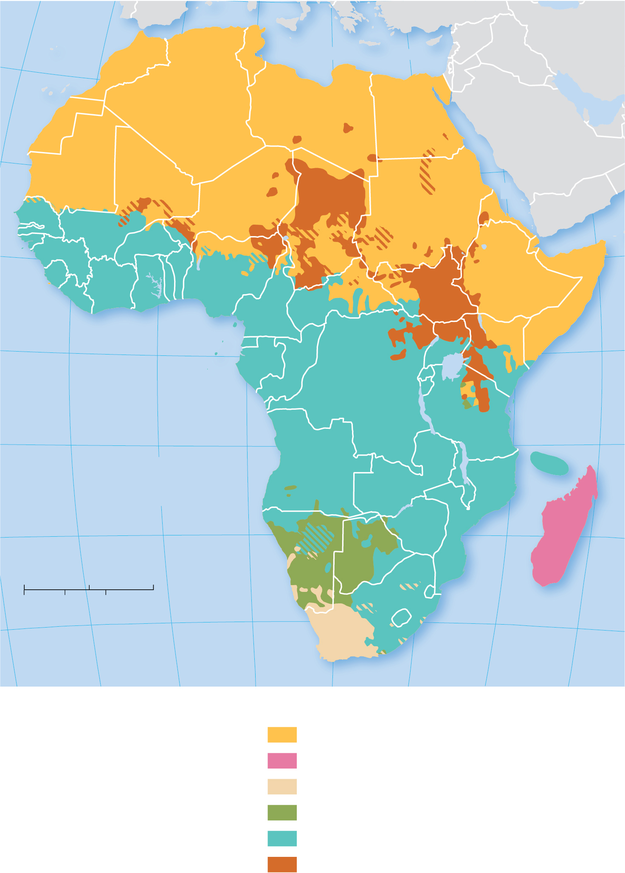
5.1.5 Distribution of Other Language Families (5 of 5)
Figure 5-15: Africa displays a great diversity of languages. This map displays language families, which can be subdivided into language groups and then individual languages.
20°
10°
0°
10°
20°
30°
BERBER
Mediterranean Sea
A R A B I C
20°
Red
FRENCH
Sea
10°
FULA
HAUSA
TIGRIGNA
AKAN
IGBO
AMHARIC
YORUBA
OROMO
SOMALI
EQUATOR
0°
FRENCH
RWANDA
GIKUYU
KONGO
RUNDI
INDIAN
OCEAN
10°
SWAHILI
10°
ATLANTIC
OCEAN
PORTUGUESE
NYANJA
20°
SHONA
MALAGASY
20°
TSWANA
20°
0
200
1,000 Miles
PORTUGUESE
0
200
1,000 Kilometers
ZULU
30°
AFRIKAANS
SESOTHO
30°
ENGLISH
XHOSA
20°
10°
0°
10°
20°
30°
40°
50°
Language families
Labeled languages
are spoken by more
than 5 million
Afro-Asiatic
ZULU
Austronesian
Indo-European
Khoisan
Niger-Congo
Nilo-Saharan

Slide 24
Key Issue 2: Why Do Languages Diffuse?
5.2.1 Origin and Distribution of Indo-European Languages
5.2.2 Origin and Diffusion of English
5.2.3 Sharing Languages

Slide 25
5.2.1 Origin and Diffusion of Indo-European Languages (1 of 3)
Linguists suspect the earliest speakers lived inland near the Europe/Asia boundary
Two theories:
Nomadic Warrior—Kurgan peoples from what is present-day southern Russia established military superiority with horses and spread their languages into Europe and South Asia
Sedentary Farmer—Peoples from Anatolia, via their agricultural innovations, spread their languages into Europe and South Asia

Slide 26
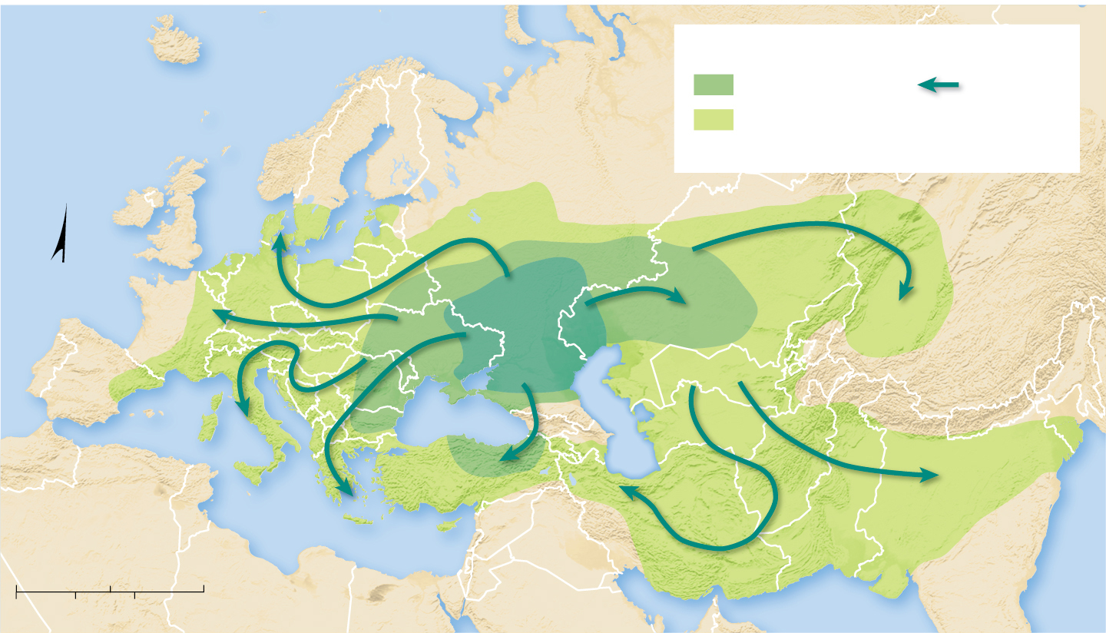
5.2.1 Origin and Diffusion of Indo-European Languages (2 of 3)
Figure 5-16: The nomadic warrior theory proposes a group known as the Kurgans were the original speakers of an Indo-European language.
Area infiltrated
ATLANTIC
OCEAN
before 1000 B.C.E
Migration
route
after 1000 B.C.E
Present-day boundaries shown for reference.
N
Kurgan
hearth
Black Sea
Caspian Sea
Mediterranean Sea
0
500
1,000 Miles
0
500
1,000 Kilometers
Arabian Sea

Slide 27
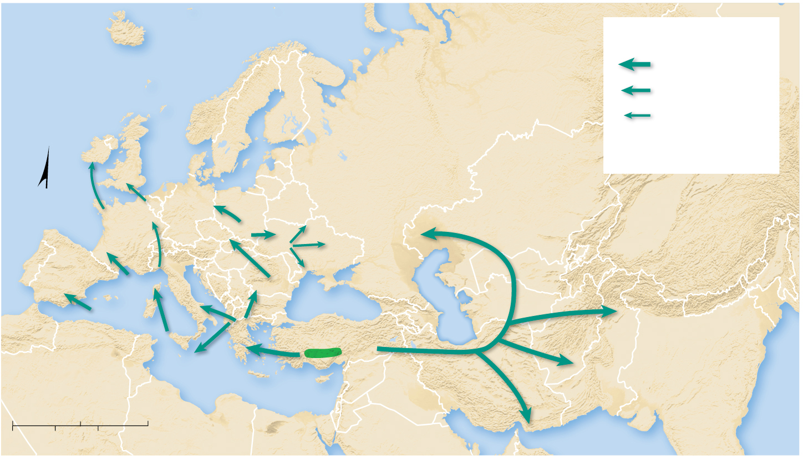
5.2.1 Origin and Diffusion of Indo-European Languages (3 of 3)
Figure 5-17: The sedentary farmer theory proposes original speakers of an Indo-European language were farmers from present-day Turkey.
Anatolian migration
ATLANTIC
OCEAN
6000–5000 B.C.E.
5000–4000 B.C.E.
4000–3000 B.C.E.
Present-day boundaries
shown for reference.
N
Black Sea
Caspian Sea
Anatolian
hearth
Mediterranean Sea
0
500
1,000 Miles
0
500
1,000 Kilometers
Arabian Sea

Slide 28
5.2.2 Origin and Diffusion of English (1 of 4)
The origins of English stem from successive Germanic invasions of the British Isles followed by the Norman invasion from France. English has adopted words from both Germanic languages and Latin languages

Slide 29
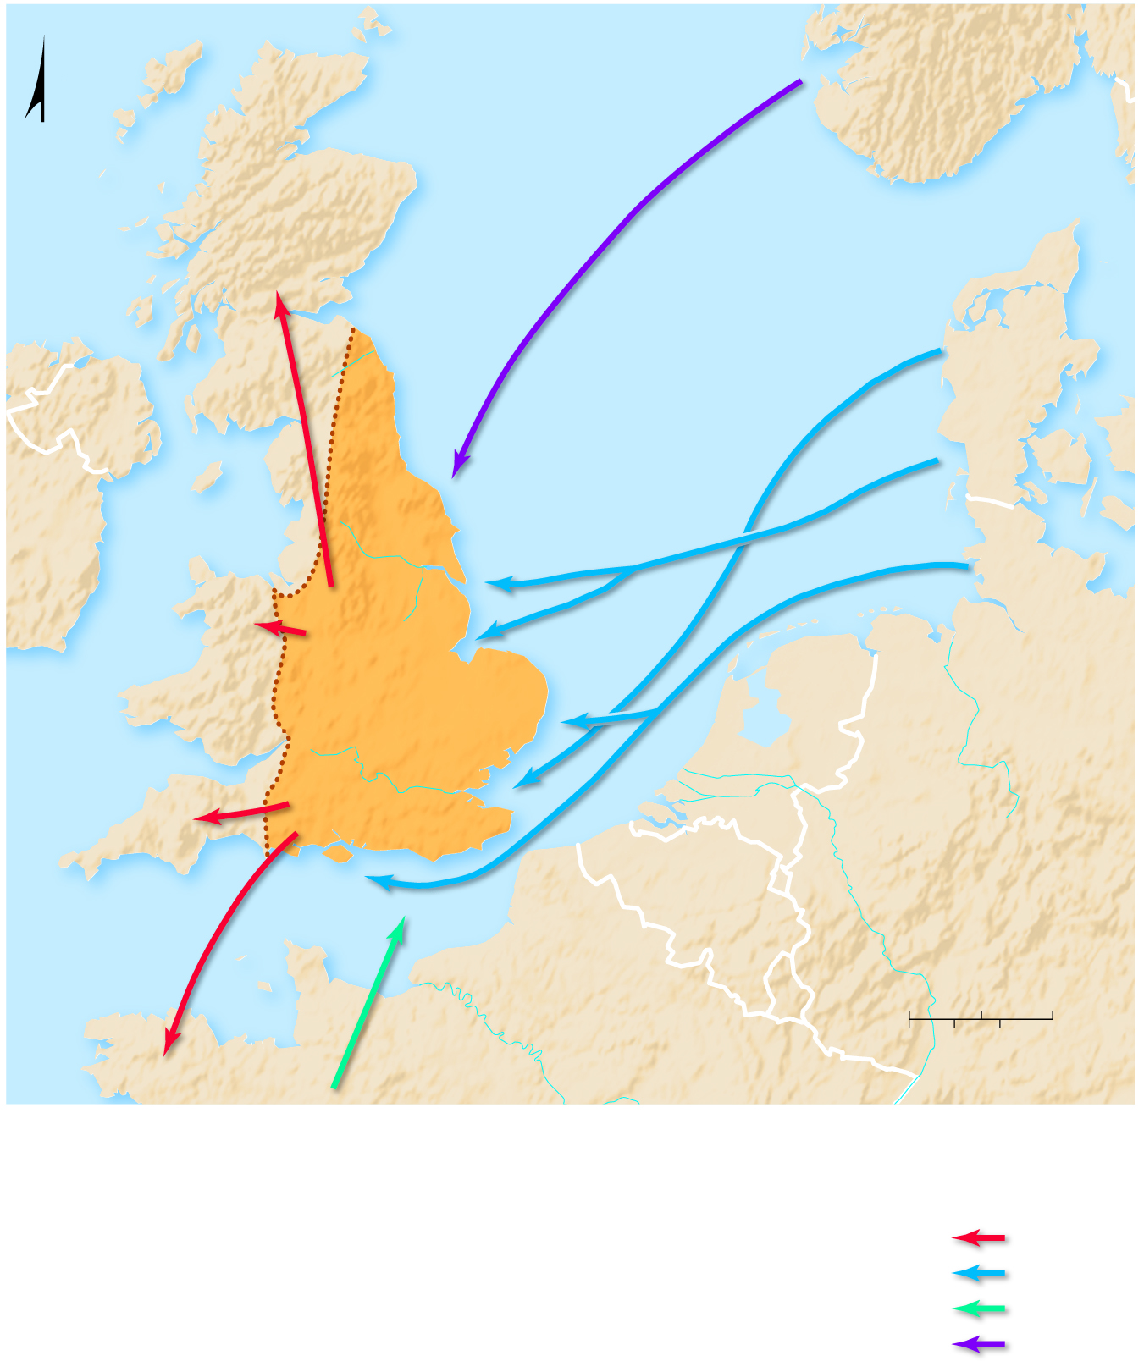
5.2.2 Origin and Diffusion of English (2 of 4)
Figure 5-18: English has developed from a mix of different language influences from earlier languages already present and those spoken by repeated invasions of different groups.
NORWAY
N
SCOTLAND
9th Century
N o r t h
S e a
Jutes
DENMARK
Irish
Sea
Angles
Angles
Limit of
Anglo-Saxon
Settlement
to A.D. 626
Humber
Saxons
R.
The
Wash
5th Century
WALES
Middle
Angles
East
Angles
West
Saxons
East
Saxons
Thames
South
Saxons
R.
CORNWALL
Isle of
Wight
Jutes
GERMANY
English
Channel
1066
NORMANDY
0
50
100 Miles
0
100 Kilometers
BRITTANY
50
Invasion and
migration routes
Celts
Germans
Normans
Vikings

Slide 30
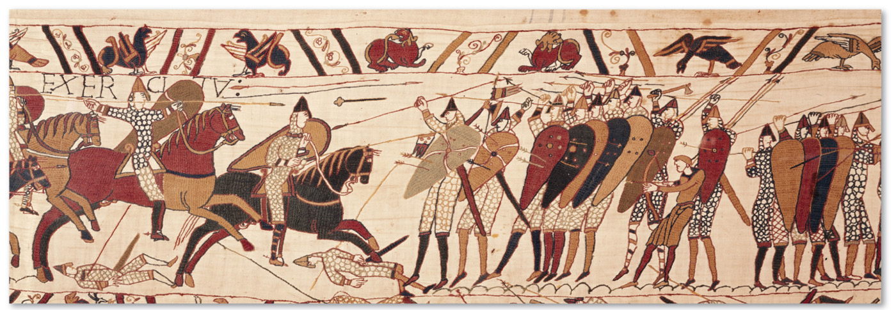
5.2.2 Origin and Diffusion of English (3 of 4)
Figure 5-20: The Bayeux Tapestry depicts the Norman invasion. It was woven a few years after the invasion. It normally is displayed at a museum in Bayeux, France.

Slide 31
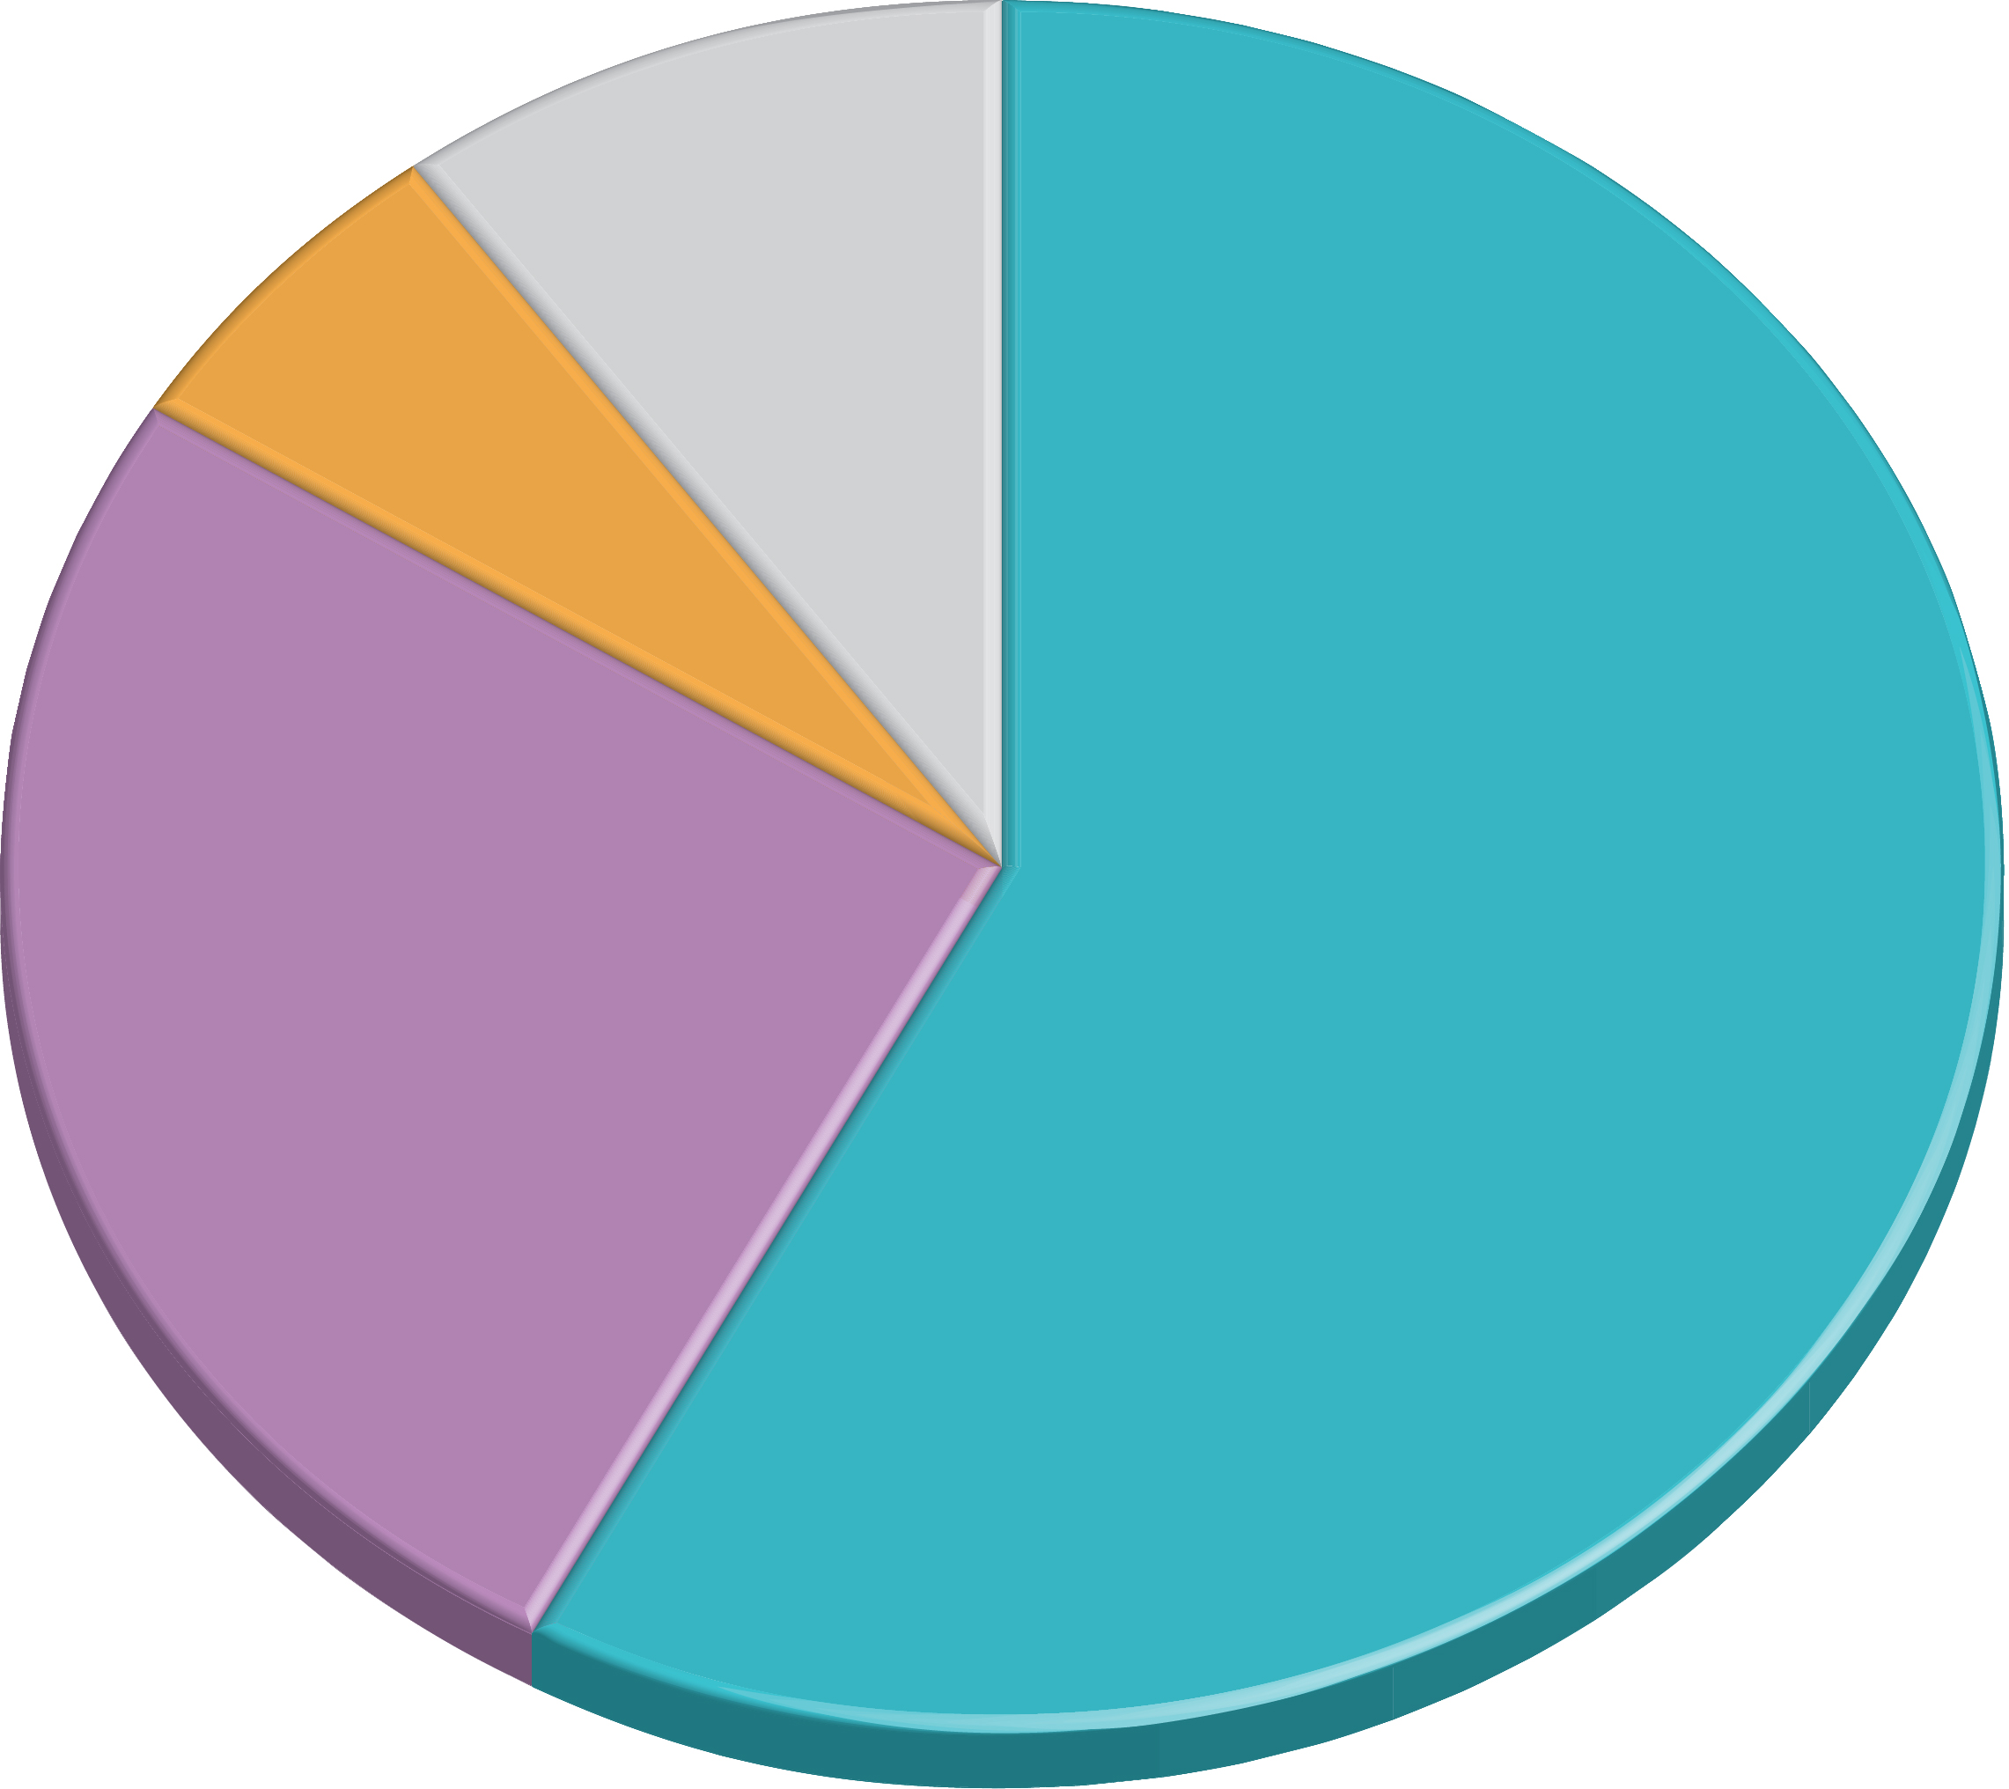
5.2.2 Origin and Diffusion of English (4 of 4)
Figure 5-21: Even though it is classified as a member of the Germanic branch, most English words are from Romance languages.
Other
languages
Greek
10%
6%
Romance
languages
Germanic
languages
26%
58%

Slide 32
5.2.3 Sharing Languages (1 of 3)
A lingua franca is a language of international communication. English is a well-known lingua franca
Other examples of a lingua franca are Swahili in East Africa, Russian in the former Soviet Union, and Hindi in South Asia

Slide 33
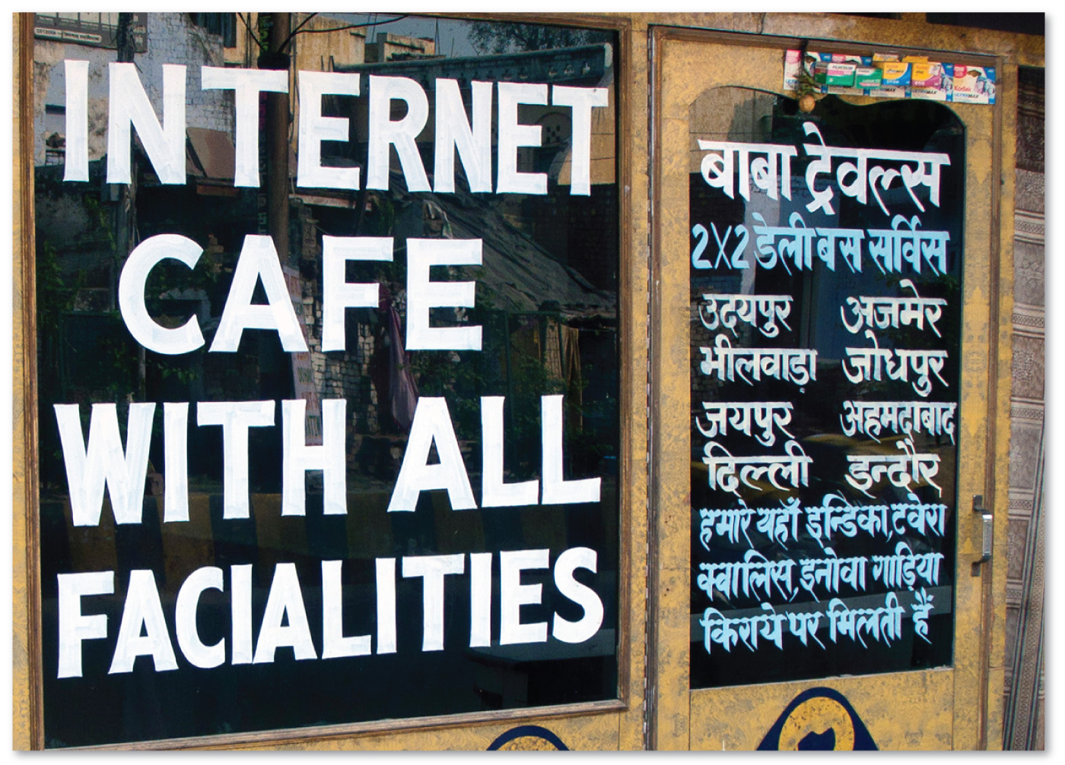
5.2.3 Sharing Languages (2 of 3)
Figure 5-22: A lingua franca allows speakers to communicate in a common language. Students learning English in China and a sign for an Internet café in India.
Figure 5-23: A lingua franca allows speakers to communicate in a common language. Students learning English in China and a sign for an Internet café in India.

Slide 34
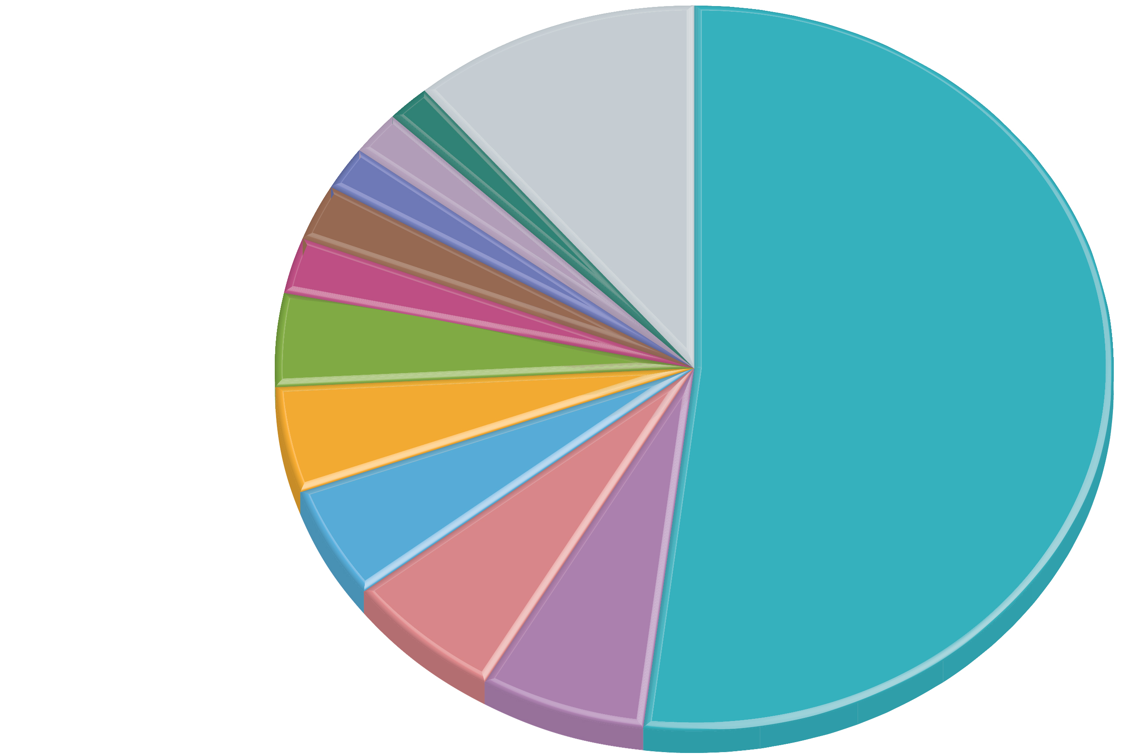
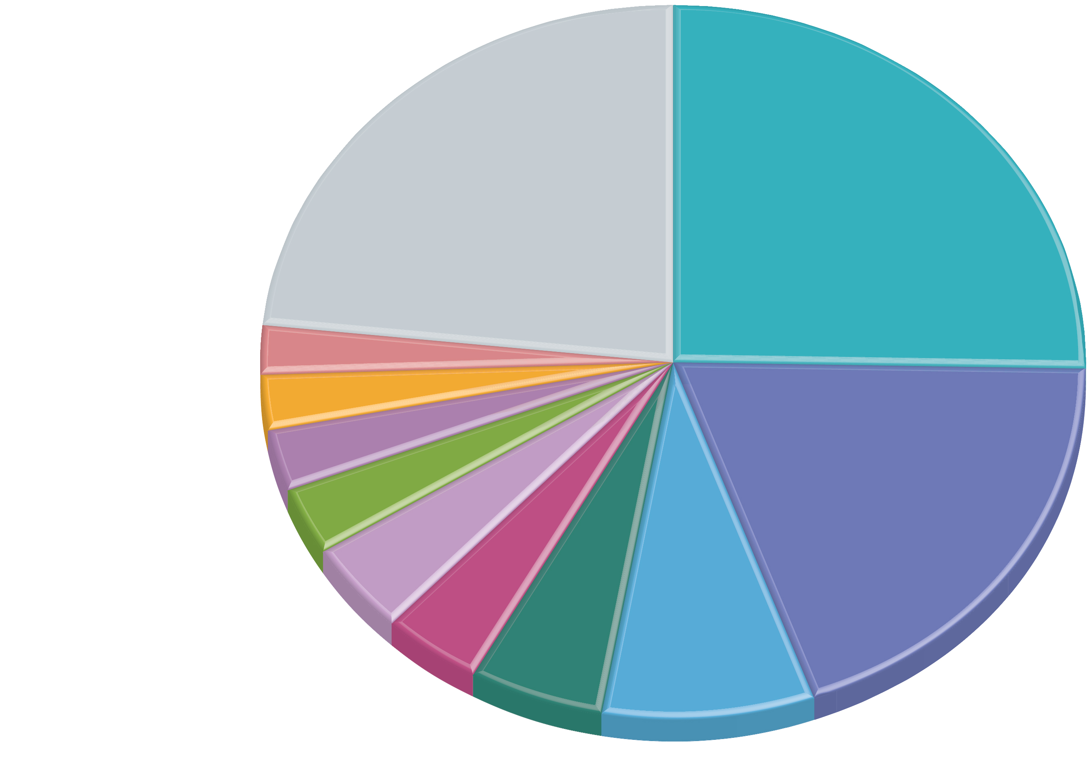
5.2.3 Sharing Languages (3 of 3)
Figure 5-24: More than one-half of websites are written in English (left), but English speakers make up only about a quarter of Internet users (right).
Figure 5-25: More than one-half of websites are written in English (left), but English speakers make up only about a quarter of Internet users (right).
Polish
1.8
Other
Persian
1.8
10.9
Chinese
1.9
Other
English
Italian
2.5
23.1
25.3
Portuguese
2.7
French
4.1
English
German
2.2
52.0
Japanese
2.7
Japanese
4.7
Russian
2.8
Chinese
5.1
French
2.9
4.1
19.4
Spanish
6.0
4.1
German
6.5
Malay
5.3
Spanish
Russian
Portuguese
8.1
Arabic

Slide 35
Key Issue 3: Why Do Languages Vary Among Places?
5.3.1 Official Languages
5.3.2 English Dialects
5.3.3 U.S. Dialects
5.3.4 Dialect or Language?
5.3.5 Multilingual Places

Slide 36
5.3.1 Official Languages (1 of 5)
An official language is used by the government to enact legislation, publish documents, and conduct other public business
A working language is designated by an international organization or corporation as its primary means of communication for daily correspondence and conversation

Slide 37
5.3.1 Official Languages (2 of 5)
The United Nations has six official and working languages:
English
French
Arabic
Spanish
Russian
Chinese

Slide 38
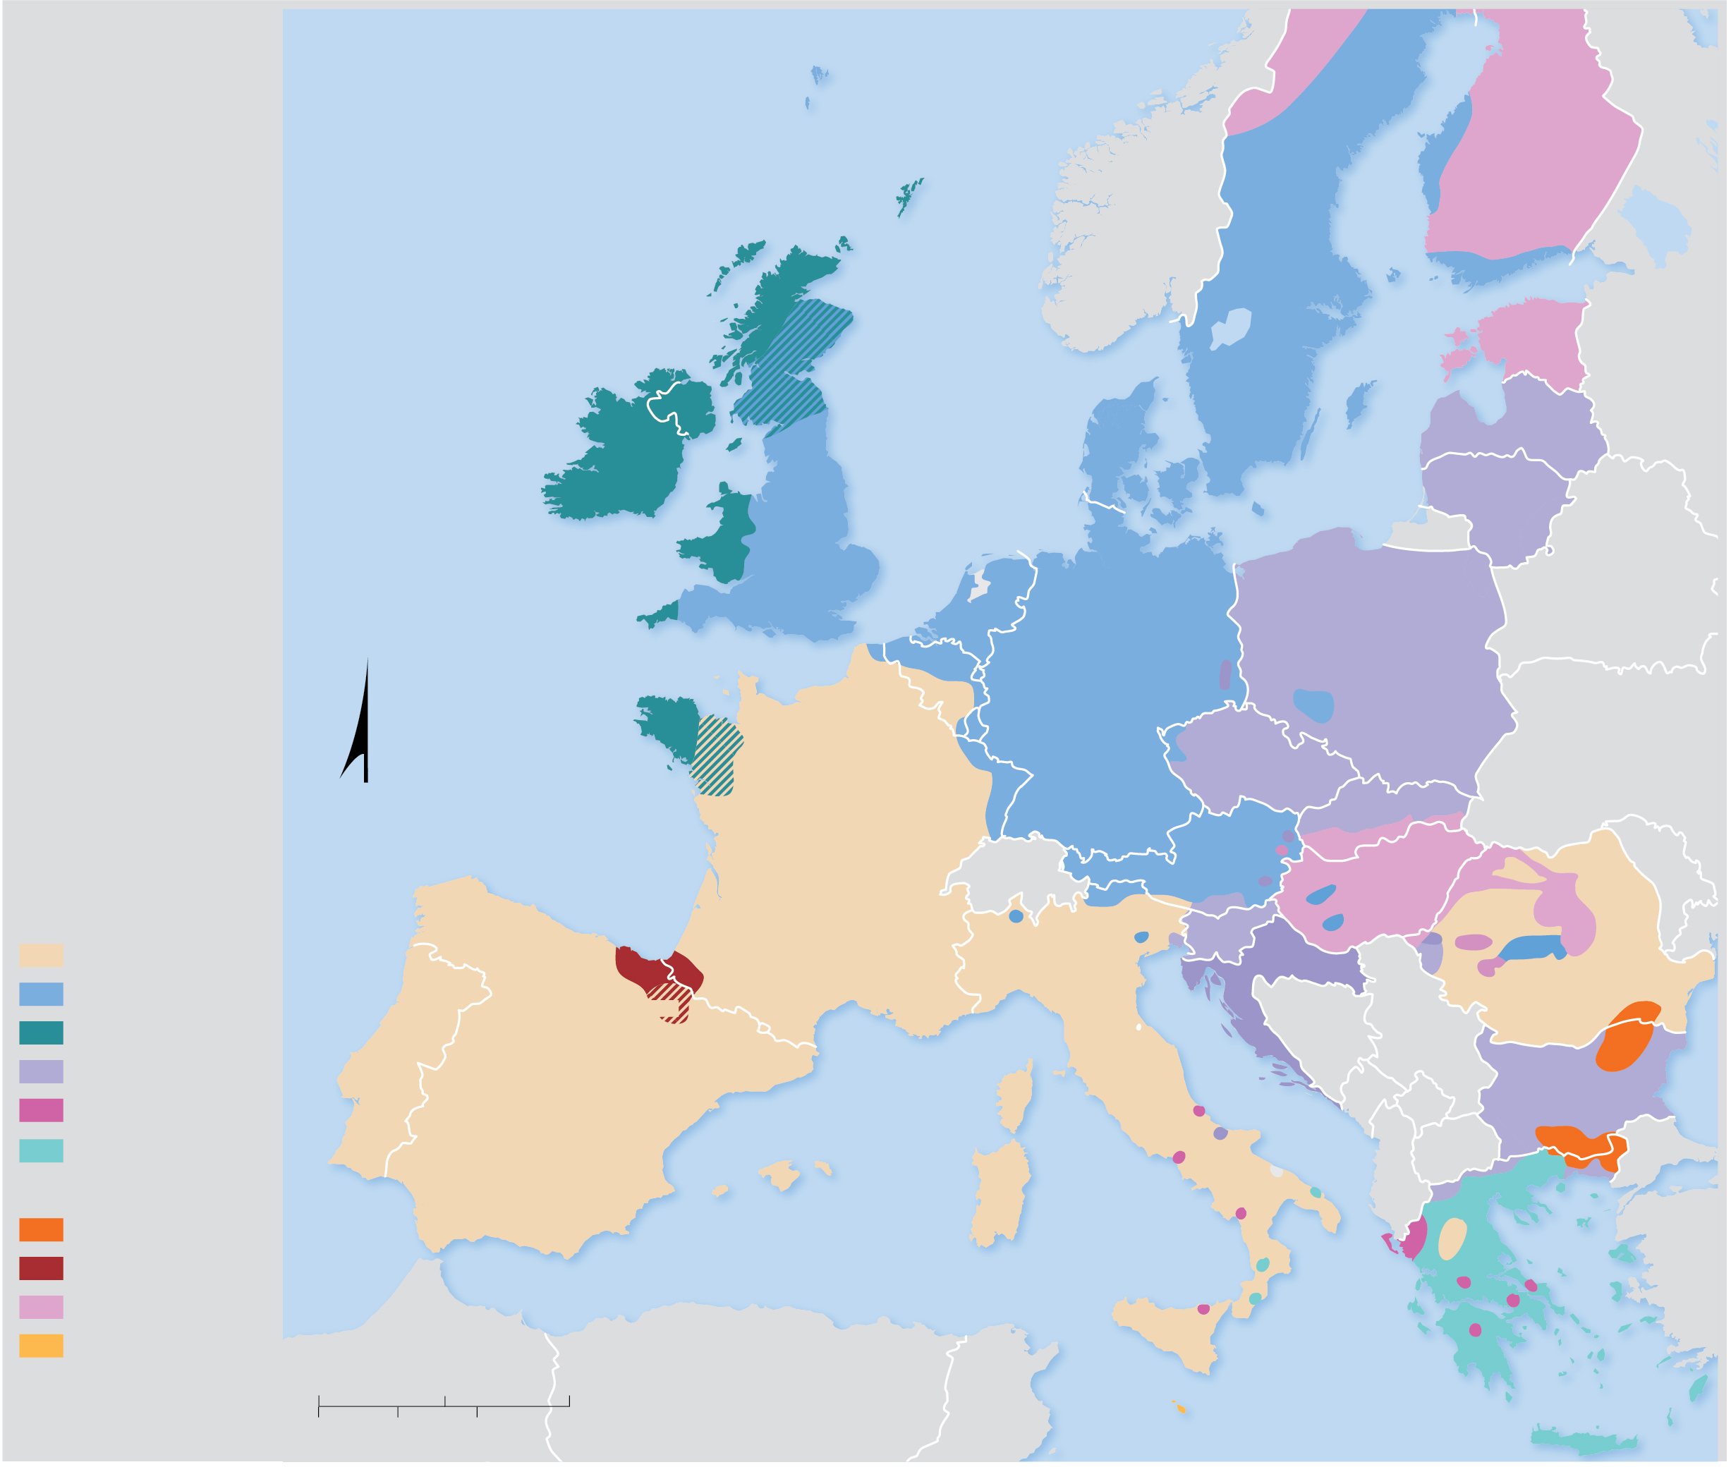
5.3.1 Official Languages (3 of 5)
Figure 5-26: Official EU languages are written in black, bolder font. Purple lettering denotes protected minority languages.
Faroese
Norwegian
Sea
Tornedalian
Finnish
FINLAND
ATLANTIC
OCEAN
Finnish
SWEDEN
Swedish
Scottish Gaelic
Finnish
ESTONIA
Scots
North
Sea
Swedish
Estonian
Ulster Scots
Manx
DENMARK
Baltic Sea
Livian
LATVIA
IRELAND
UNITED
Danish
Latvian
Irish Gaelic
KINGDOM
Northern
LITHUANIA
Welsh
English
Frisian
Cashubian
Lithuanian
Polish
Frisian
Eastern
Cornish
NETH.
Low
Saxon
Frisian
Dutch
Sorabian
POLAND
Bielorussian
BELGIUM
GERMANY
Polish
Breton
Luxembourgish
German
German
Ukrainian
Oil
LUX.
CZECHIA
Ruthenian
N
Czech
SLOVAKIA
Languages of the
European Union
Bay of
Biscay
FRANCE
AUSTRIA
Slovak
French
Franco-
provençal
Ladino
HUNGARY
Indo-European family
Galician
Asturian
Basque
German
Friulan
SLOV.
Hungarian
ROMANIA
Romance
Occitan
German
Slovene
Serbian
Romanian
Germanic
PORTUGAL
CROATIA
Celtic
Portuguese
Aragonese
ITALY
Croatian
Turkish
Balto-Slavic
SPAIN
Catalan
Coriscan
Italian
BULGARIA
Albanian
Castilian
Albanian
Croatian
Bulgarian
Greek
Catalan
Slav-
Turkish
Other Families
Catalan
Sard
Greek
Macedonian
GREECE
Pomak
Turkic
Albanian
Albanian
Aroumanian
Basque
Albanian
Greek
Albanian
Uralic
Greek
Afro-Asiatic
0
200
400 Miles
Greek
Majority language
0
200
400 Kilometers
MALTA
Scots
Minority language
Mediterranean Sea

Slide 39
5.3.1 Official Languages (4 of 5)
Informal languages include:
Franglais (mix of French and English)
Spanglish (mix of Spanish and English)
Denglish (mix of German and English)
A pidgin language is created by learning a few of the grammar rules and words of a lingua franca and mixing in some elements of a different languages. A pidgin language has no native speakers

Slide 40
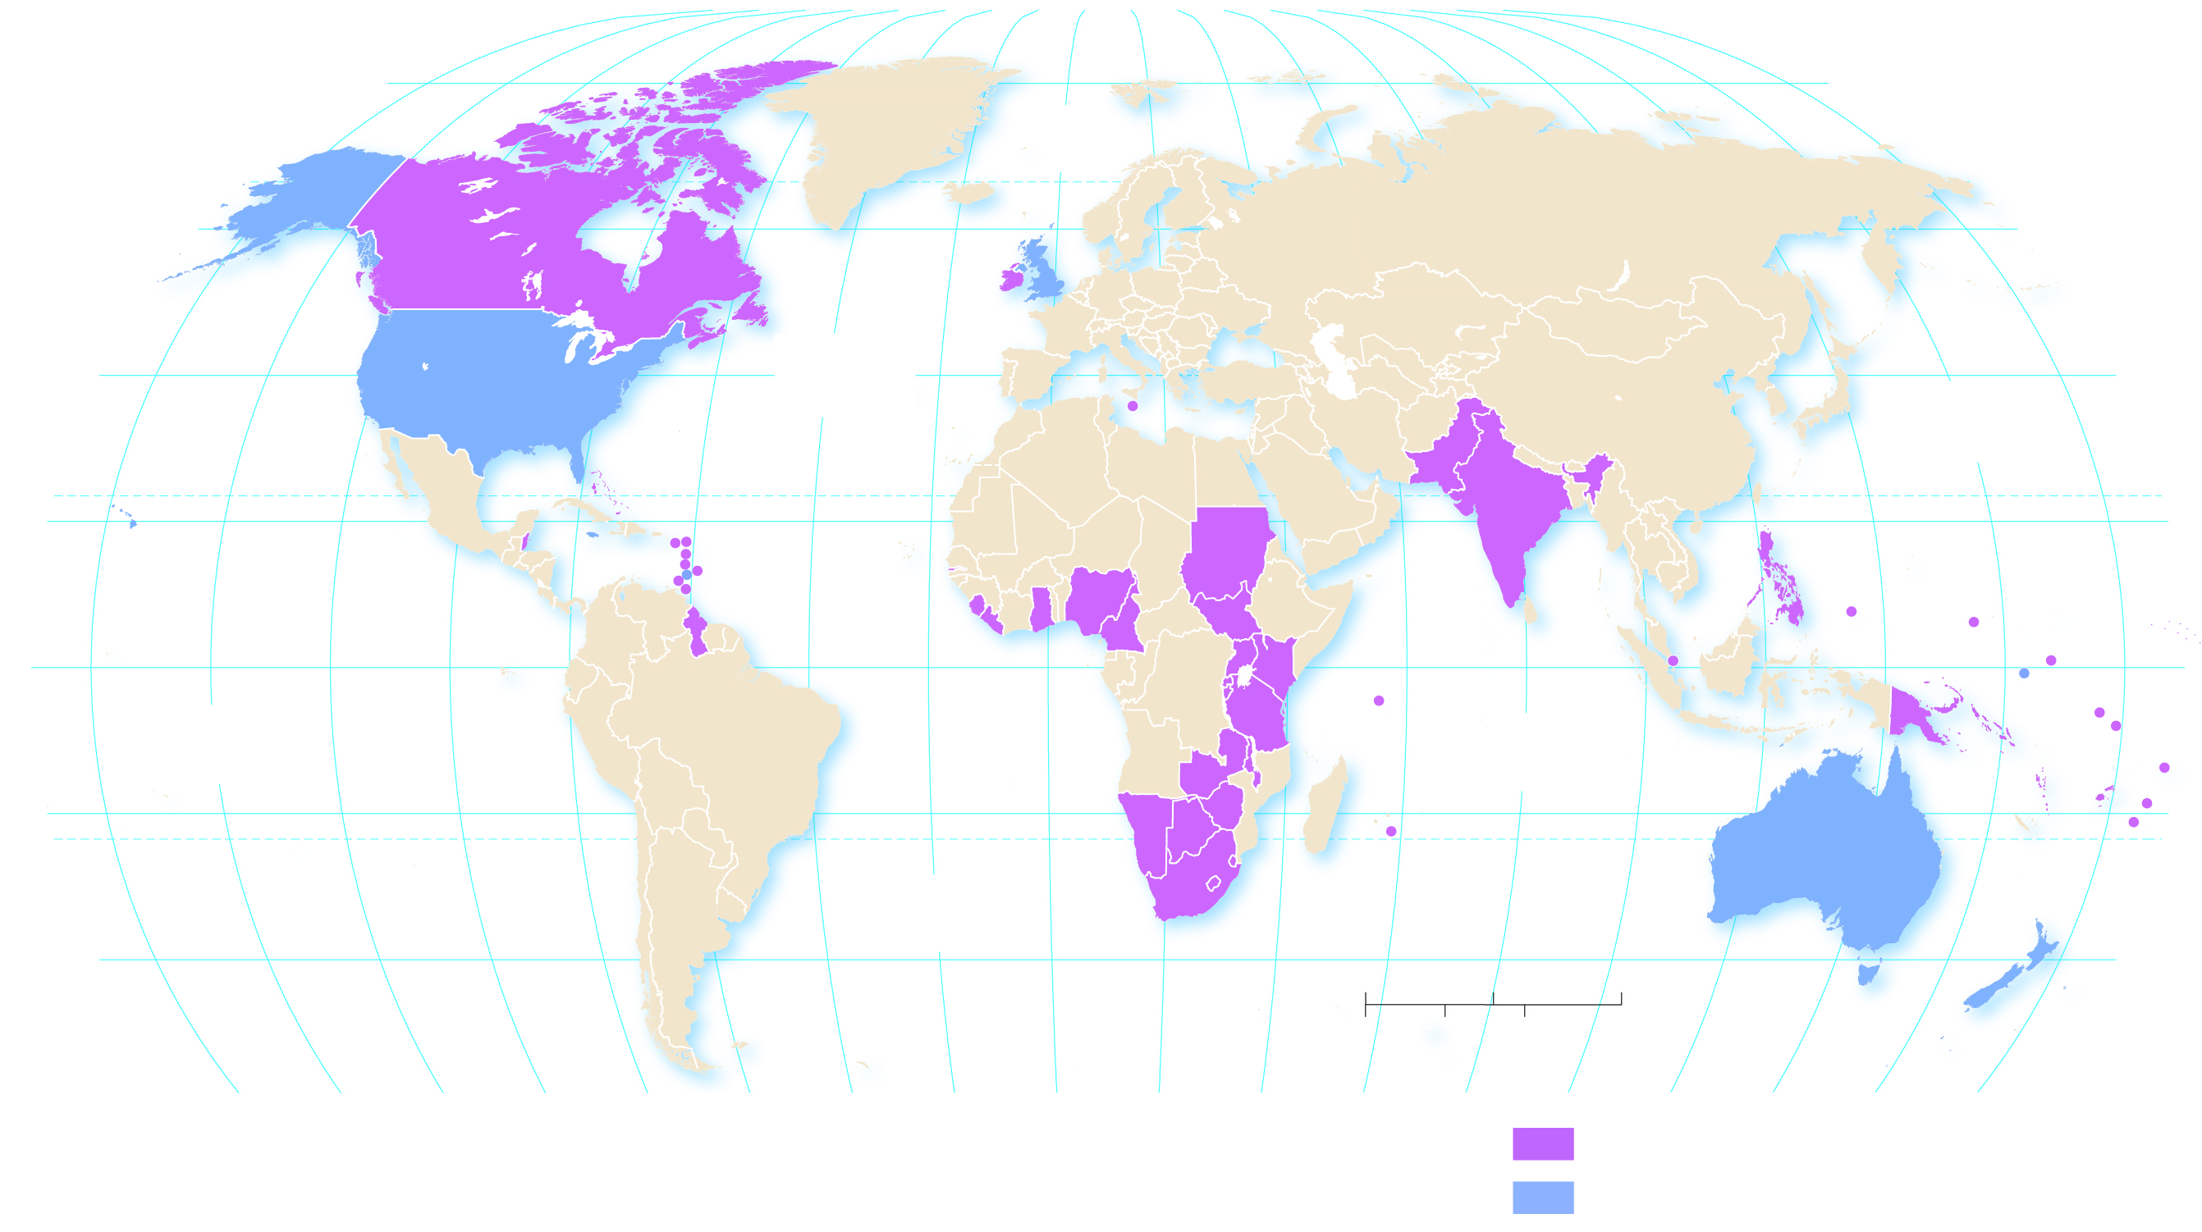
5.3.1 Official Languages (5 of 5)
Figure 5-27: English is an official language in 56 countries and widely spoken in several others.
160°
140°
120°
100°
80°
60°
40°
20°
0°
20°
40°
60°
80°
100°
120°
140°
160°
180°
80°
ARCTIC
OCEAN
80°
60°
UNITED
KINGDOM
60°
CANADA
IRELAND
40°
UNITED STATES
ATLANTIC
OCEAN
40°
MALTA
PAKISTAN
PACIFIC
OCEAN
THE BAHAMAS
ST KITTS AND NEVIS
INDIA
TROPIC OF CANCER
20°
JAMAICA
ANTIGUA AND BARBUDA
20°
BELIZE
DOMINICA
GAMBIA
SUDAN
PHILIPPINES
ST LUCIA
BARBADOS
FED. STATES OF
MICRONESIA
GRENADA
ST VINCENT
AND THE
GRENADINES
SIERRA
LEONE
NIGERIA
SOUTH SUDAN
MARSHALL
ISLANDS
0°
EQUATOR
TRINIDAD
AND TOBAGO
GHANA
UGANDA
KENYA
SINGAPORE
PALAU
NAURU
0°
GUYANA
LIBERIA
RWANDA
SEYCHELLES
PAPUA
NEW GUINEA
KIRIBATI
PACIFIC
OCEAN
CAMEROON
BURUNDI
TANZANIA
INDIAN
OCEAN
TUVALU
ZAMBIA
MALAWI
SOLOMON IS.
SAMOA
20°
NAMIBIA
ZIMBABWE
MAURITIUS
VANUATU
FIJI
NIUE
BOTSWANA
SWAZILAND
TROPIC OF CAPRICORN
AUSTRALIA
TONGA
ATLANTIC
OCEAN
SOUTH
AFRICA
LESOTHO
40°
0
1,500
3,000 Miles
40°
NEW
ZEALAND
0
1,500
3,000 Kilometers
160°
140°
120°
100°
80°
60°
40°
20°
0°
20°
40°
60°
80°
100°
120°
140°
160°
180°
English is an official national language
English is de facto national language

Slide 41
5.3.2 English Dialects (1 of 3)
A dialect is a regional variation of a language distinguished by distinctive vocabulary, spelling, and pronunciation
English in the United States differs from the English in England in three significant ways—vocabulary, spelling, and pronunciation. This difference is due to a historical lack of spatial interaction
In a language with multiple dialects, one dialect may be considered the standard language which is the dialect considered the most acceptable

Slide 42
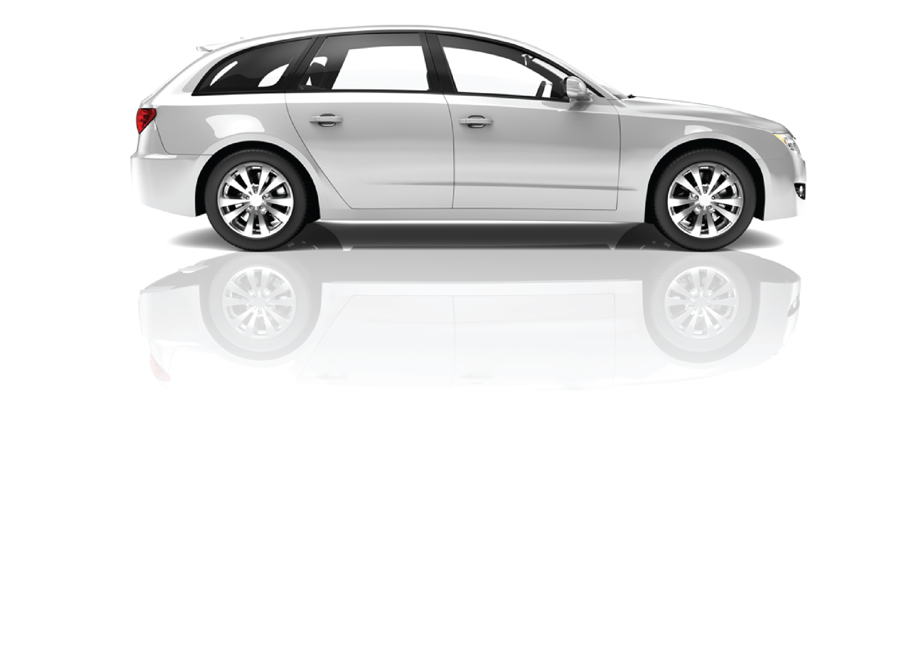
5.3.2 English Dialects (2 of 3)
Figure 5-29: Car and driving-related terms indicate dialectical differences between English spoken in the United States and United Kingdom.
Lorry
Truck
Sleeping policeman
Speed bump
Petrol
Gas
Car park
Parking Lot
Number plate
License plate
Zebra crossing
Crosswalk
Multipurpose vehicle
Minivan
Motorway
Freeway
Flyover
Overpass
Saloon
Sedan
Multistorey car park
Parking garage
Petrol station
Gas station
Cat's eye
Raised pavement marker
Bonnet
Hood
Caravan/campervan
RV
Windscreen
Windshield
Estate car
Station wagon
Boot
Trunk
Indicators
Turn signal
Reversing lights
Back-up lights
Amber traffic light
Yellow light
Dual carriageway
Divided highway
Gear Box
Transmission

Slide 43
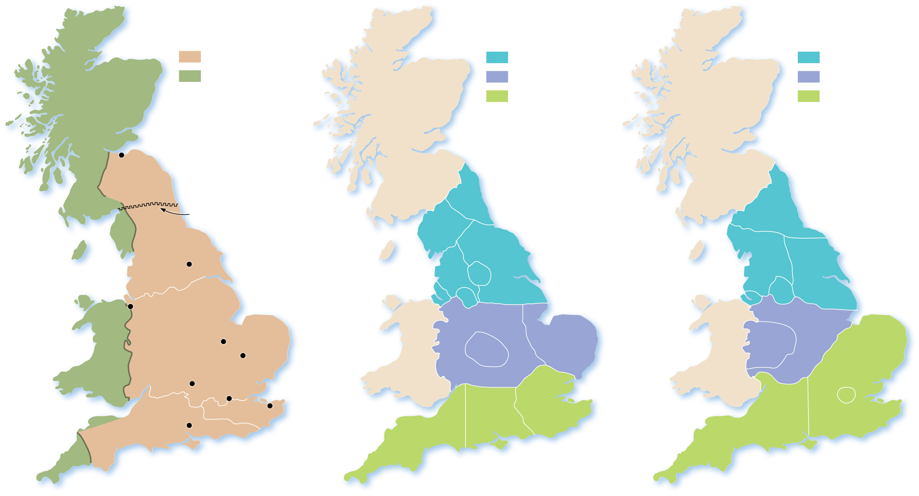
5.3.2 English Dialects (3 of 3)
Figure 5-30: The Southeast dialect based in London is forecast to expand because of migration of Londoners.
Medieval
languages
Contemporary
dialects
Projected
future dialects
Old English
Northern
Northern
Celtic
Midlands
Midlands
Southern
Southern
Edinburgh
STRATHCLYDE
Hadrian’s Wall
Northeast
Cumbria
Northeast
Northumbrian
Yorkshire
South Cumbria
andLancashire
York
Lancashir
e
West Yorkshire
Yorkshire
Liverpool
Manchester
Liverpool
Manchester
Chester
Midlands
Midlands
NORTH
WALES
Mercian
Peterborough
West
Midlands
East
Anglia
West
Midlands
Cambridge
Southeast
Oxford
London
Kentish
Canterbury
South
central
Southeast
London
(inner city)
West
Saxon
Winchester
Southwest
Southwest
WEST
WALES
(a)
(b)
(c)

Slide 44
5.3.3 U.S. Dialects (1 of 5)
An isogloss is a word-use boundary with a degree of geographic extent
There are three primary dialects in the United States:
North—dialect originates in East Anglia and developed in New England
South—dialect originates in southeastern England and represented a diversity of social class backgrounds
Midland—dialect originates in northern England and developed in Pennsylvania

Slide 45
5.3.3 U.S. Dialects (2 of 5)
A creole, or creolized language, is a language that results from the mixing of a colonizer’s language with the indigenous language of the people being dominated. French Creole in Haiti is a prime example of a creolized language

Slide 46
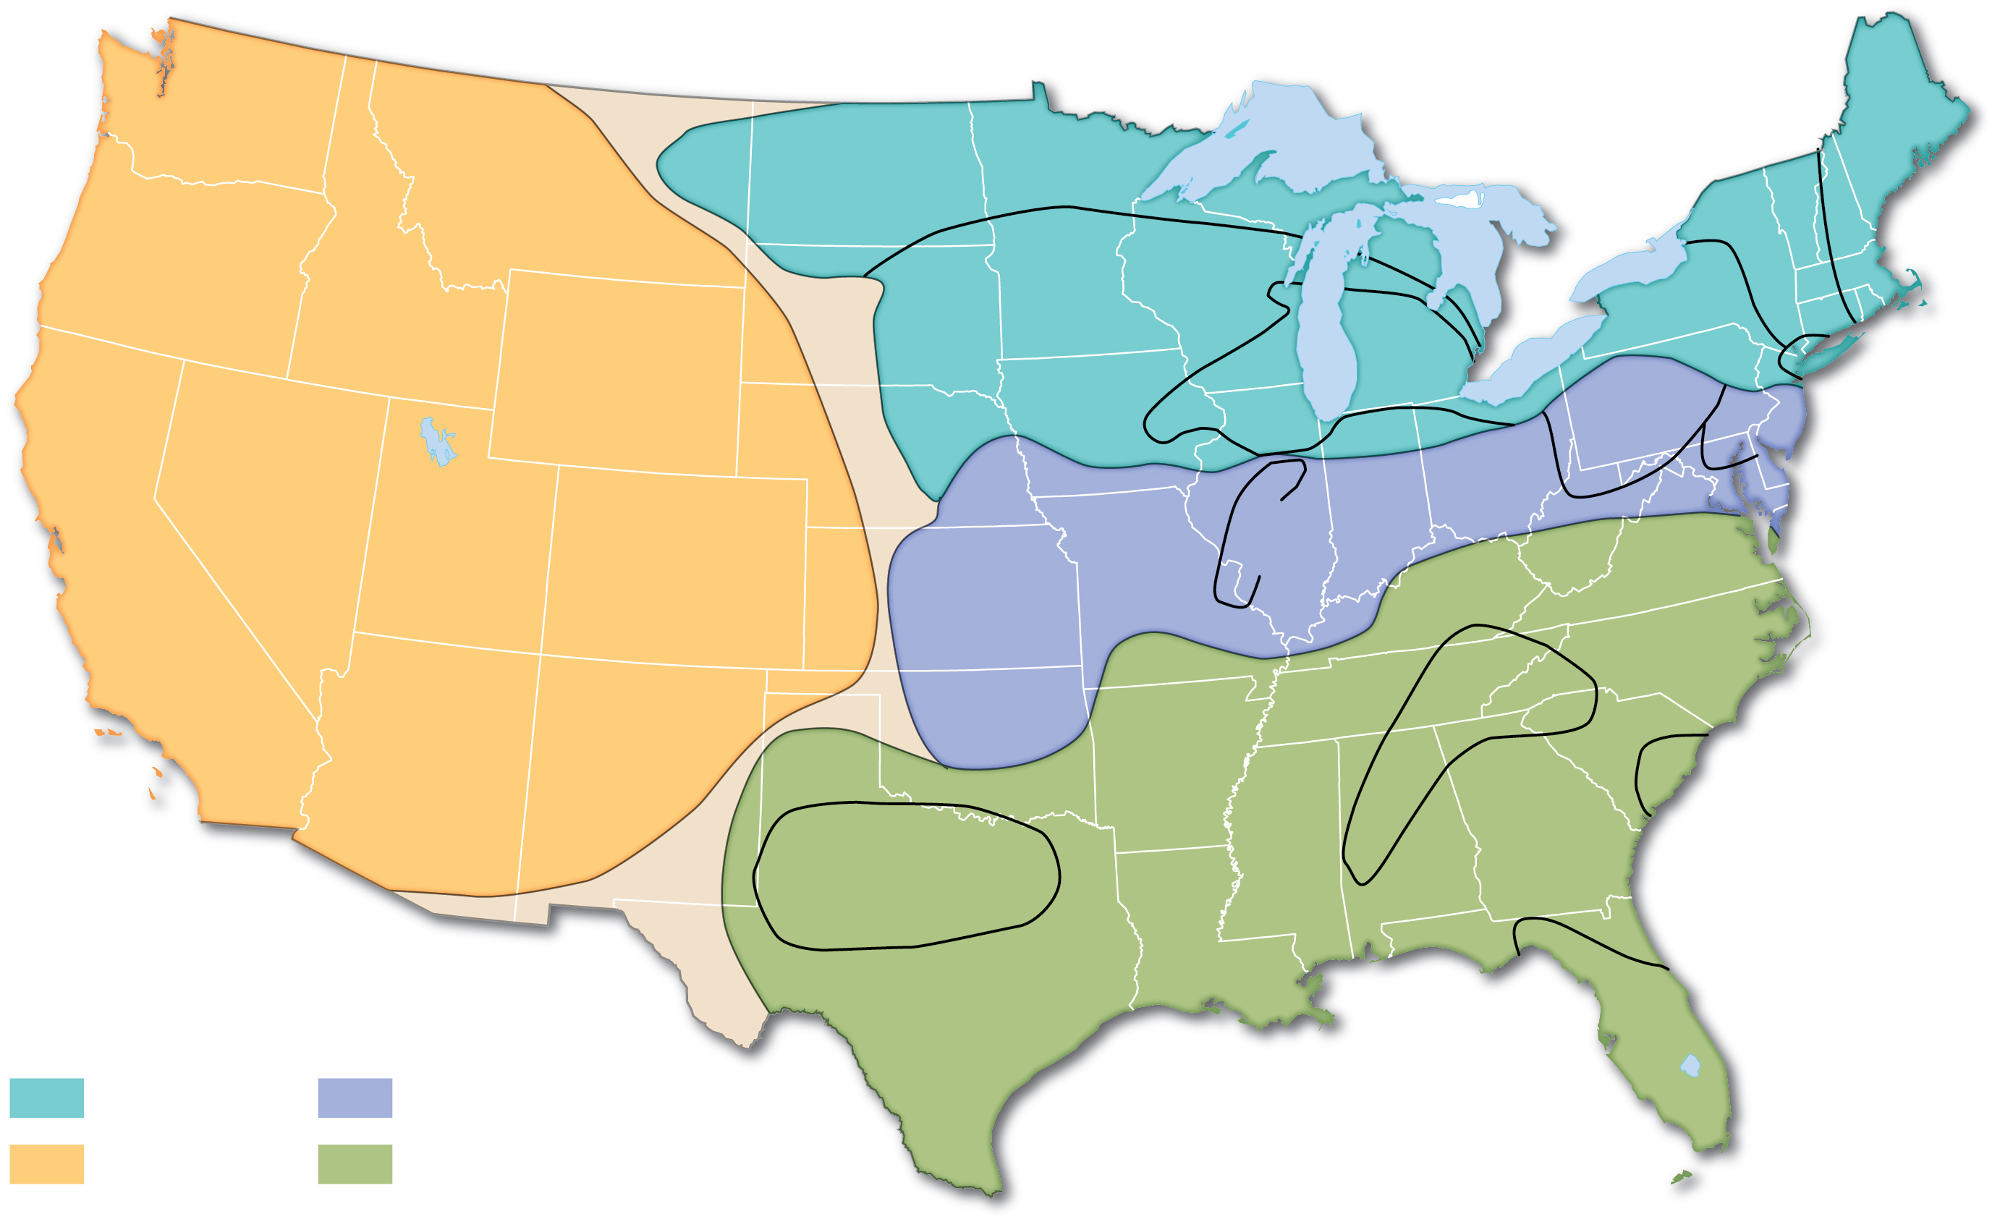
5.3.3 U.S. Dialects (3 of 5)
Figure 5-31: The United States has four major dialect regions and several subdialects.
North Central
W. New
England
E. New
England
The North
Inland
North
Inland North
W. Pa.
New York
City
St. Louis
Corridor
Mid-
Atlantic
The West
The Midland
Inland
South
The South
Charleston
Texas South
United States dialects
Florida
Northern
Midlands
Western
Southeastern

Slide 47
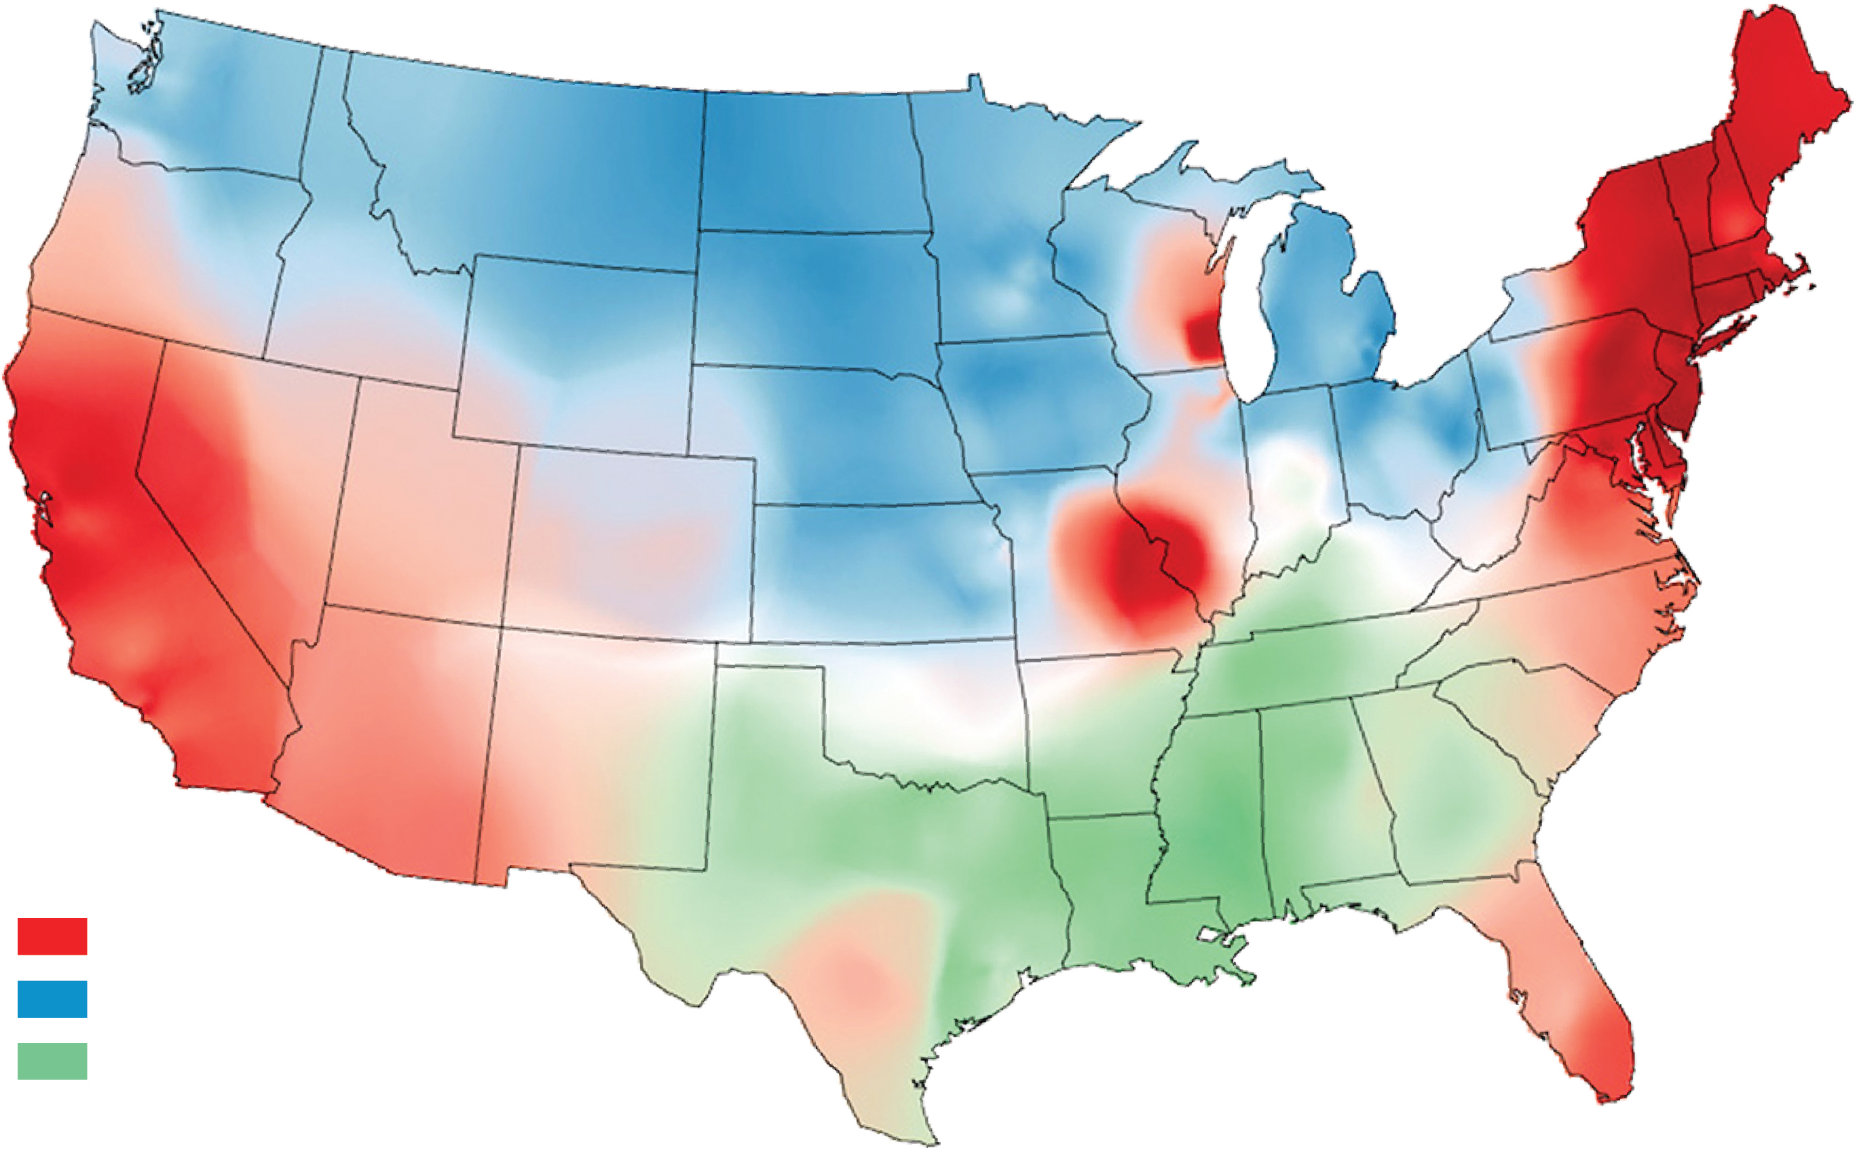
5.3.3 U.S. Dialects (4 of 5)
Figure 5-32: The names used for soft drinks represent regional dialectical differences in the United States.
Soda
Pop
Coke

Slide 48
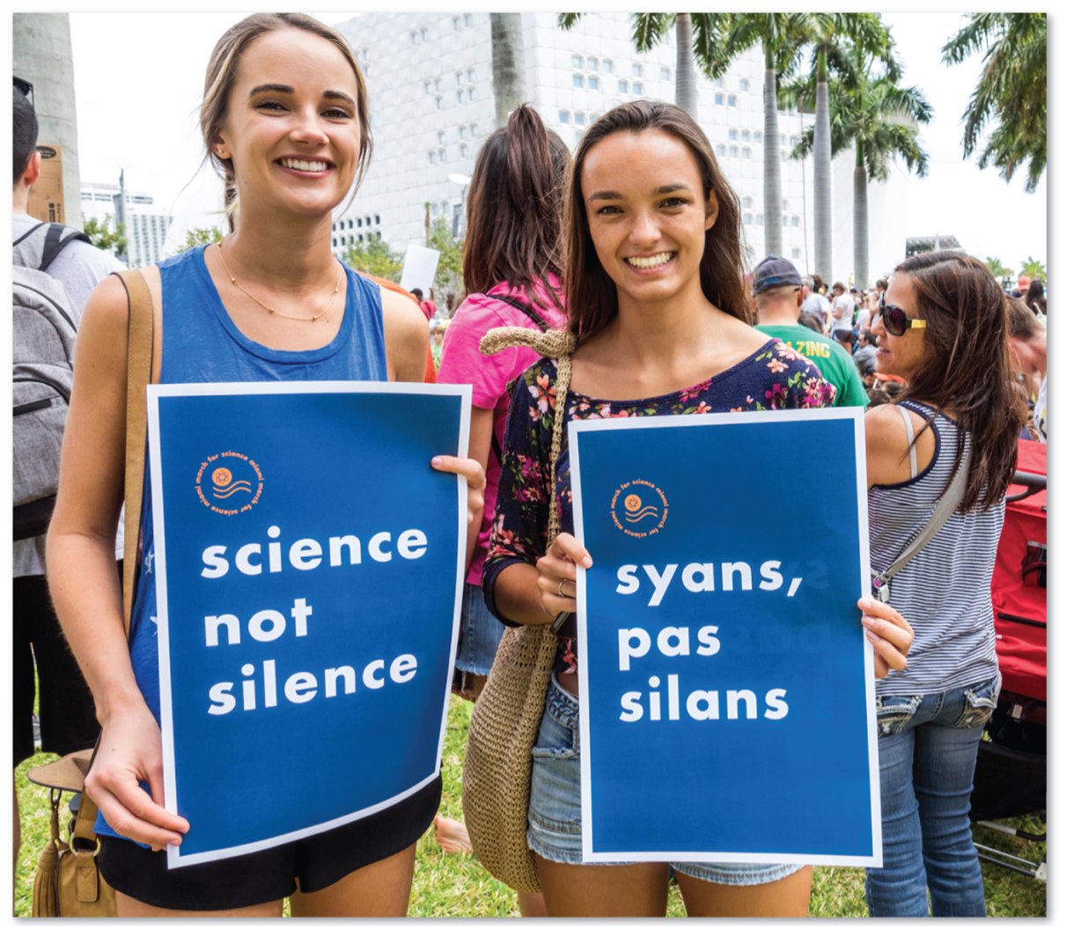
5.3.3 U.S. Dialects (5 of 5)
Figure 5-33: Sign on the right, displayed at a march in Miami, Florida, is in Haitian French Creole.

Slide 49
5.3.4 Dialect or Language? (1 of 2)
It is sometimes difficult to distinguish between a language and a dialect
Dialects may become distinct languages over time (e.g., Catalan, Galician, Sicilian)
Cultural identity plays a role
Some governments standardize language for unity

Slide 50
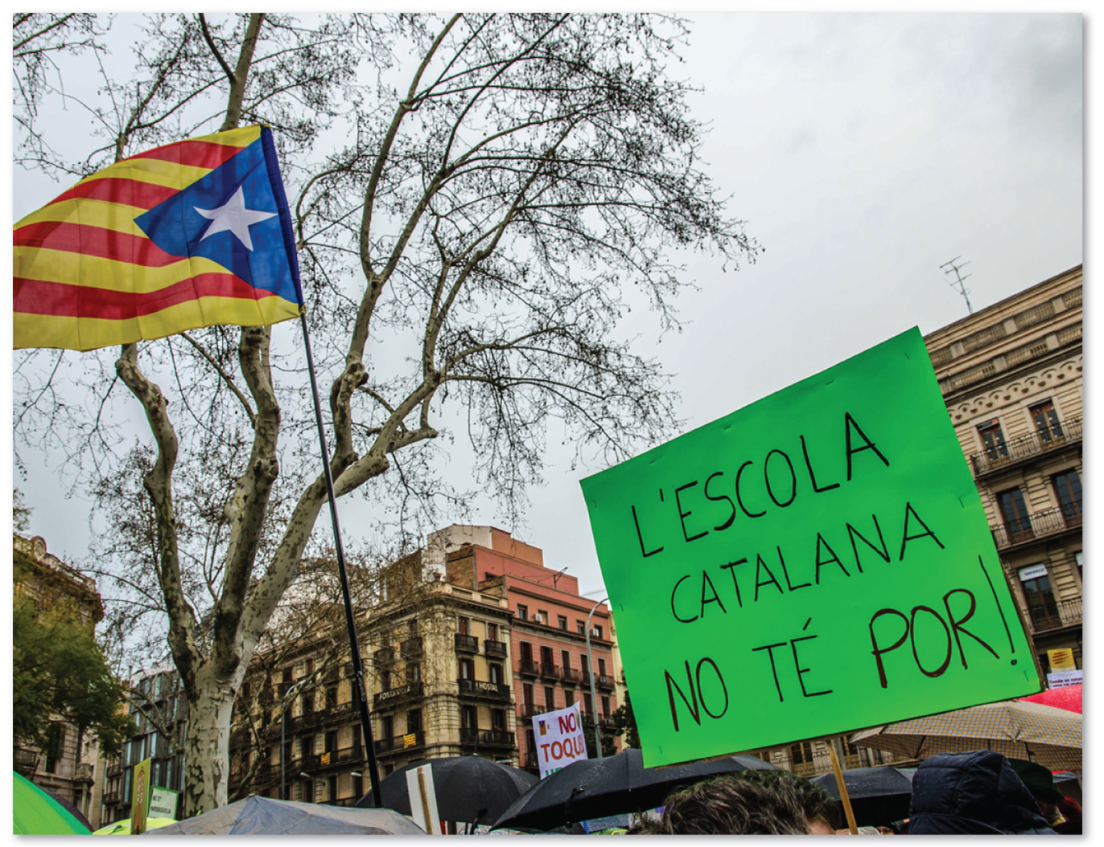
5.3.4 Dialect or Language? (2 of 2)
Figure 5-34: Protest sign in Catalonian and flag of Catalonia.

Slide 51
5.3.5 Multilingual Places (1 of 5)
Switzerland peacefully co-exists with multiple languages found in distinctive geographic regions
Belgium has a sharp linguistic divide between its two regions
Nigeria moved its capital to the center of the country where none of the three major languages dominates
Canada has recently forged more unity between its English majority and French minority

Slide 52
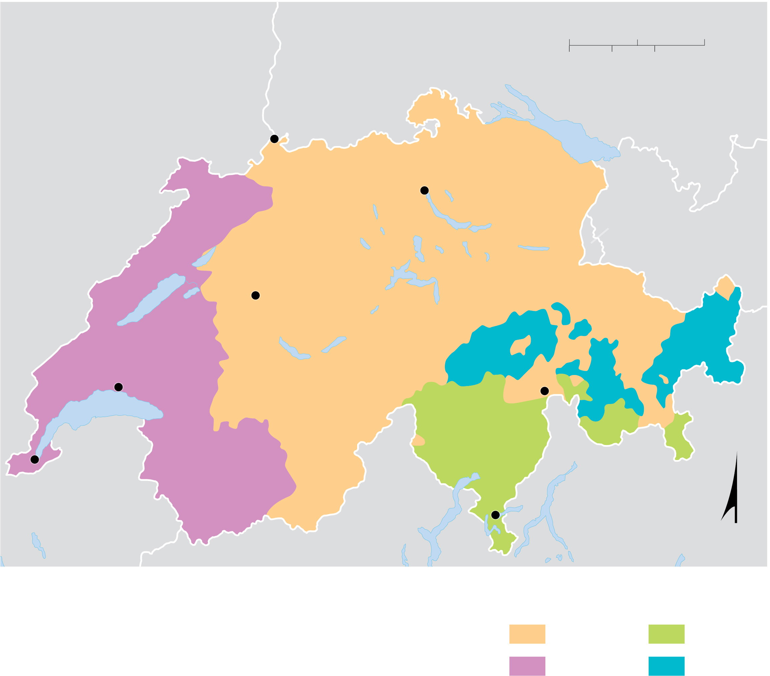
5.3.5 Multilingual Places (2 of 5)
Figure 5-36: Switzerland has four official languages.
0
20
40 Miles
GERMANY
0
20
40 Kilometers
FRANCE
Bodensee
Basel
Zürich
LIECHTENSTEIN
GERMAN
AUSTRIA
Bern
R O M A NS H
Lausanne
St. Moritz
Lake
Geneva
ITALIAN
Geneva
FRENCH
Lugano
ITALY
N
Predominant languages
German
Italian
French
Romansh

Slide 53
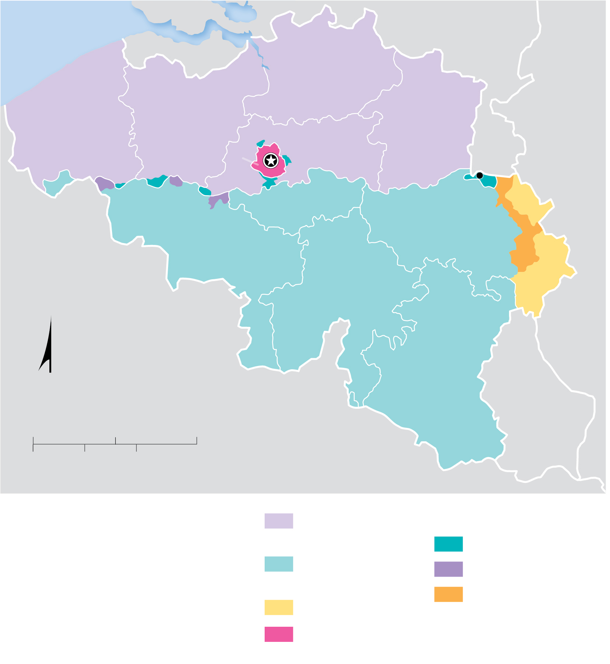
5.3.5 Multilingual Places (3 of 5)
Figure 5-37: Belgium is divided regionally between the Flemish north and French south, with protected minorities in border areas and a bilingual capital.
North Sea
NETHERLANDS
ANTWERP
FLANDERS
GERMANY
WEST
EAST
FLEMISH
LIMBURG
FLANDERS
FLANDERS
BRABANT
Fourons/
Voeren
BRUXELLES
Brussels
WALLOON
HÄINAUT
BRABANT
LIÈGE
WALLONIA
NAMUR
FRANCE
LUXEMBOURG
N
0
25
50 Miles
LUXEM-
BOURG
0
25
50 Kilometers
Flemings
(speaking Flemish)
Protected minorities
Walloons
(speaking French)
Walloons in Flanders
Flemings in Wallonia
Germans
Germans in Wallonia
Flemings and Walloons
(legally bilingual)

Slide 54
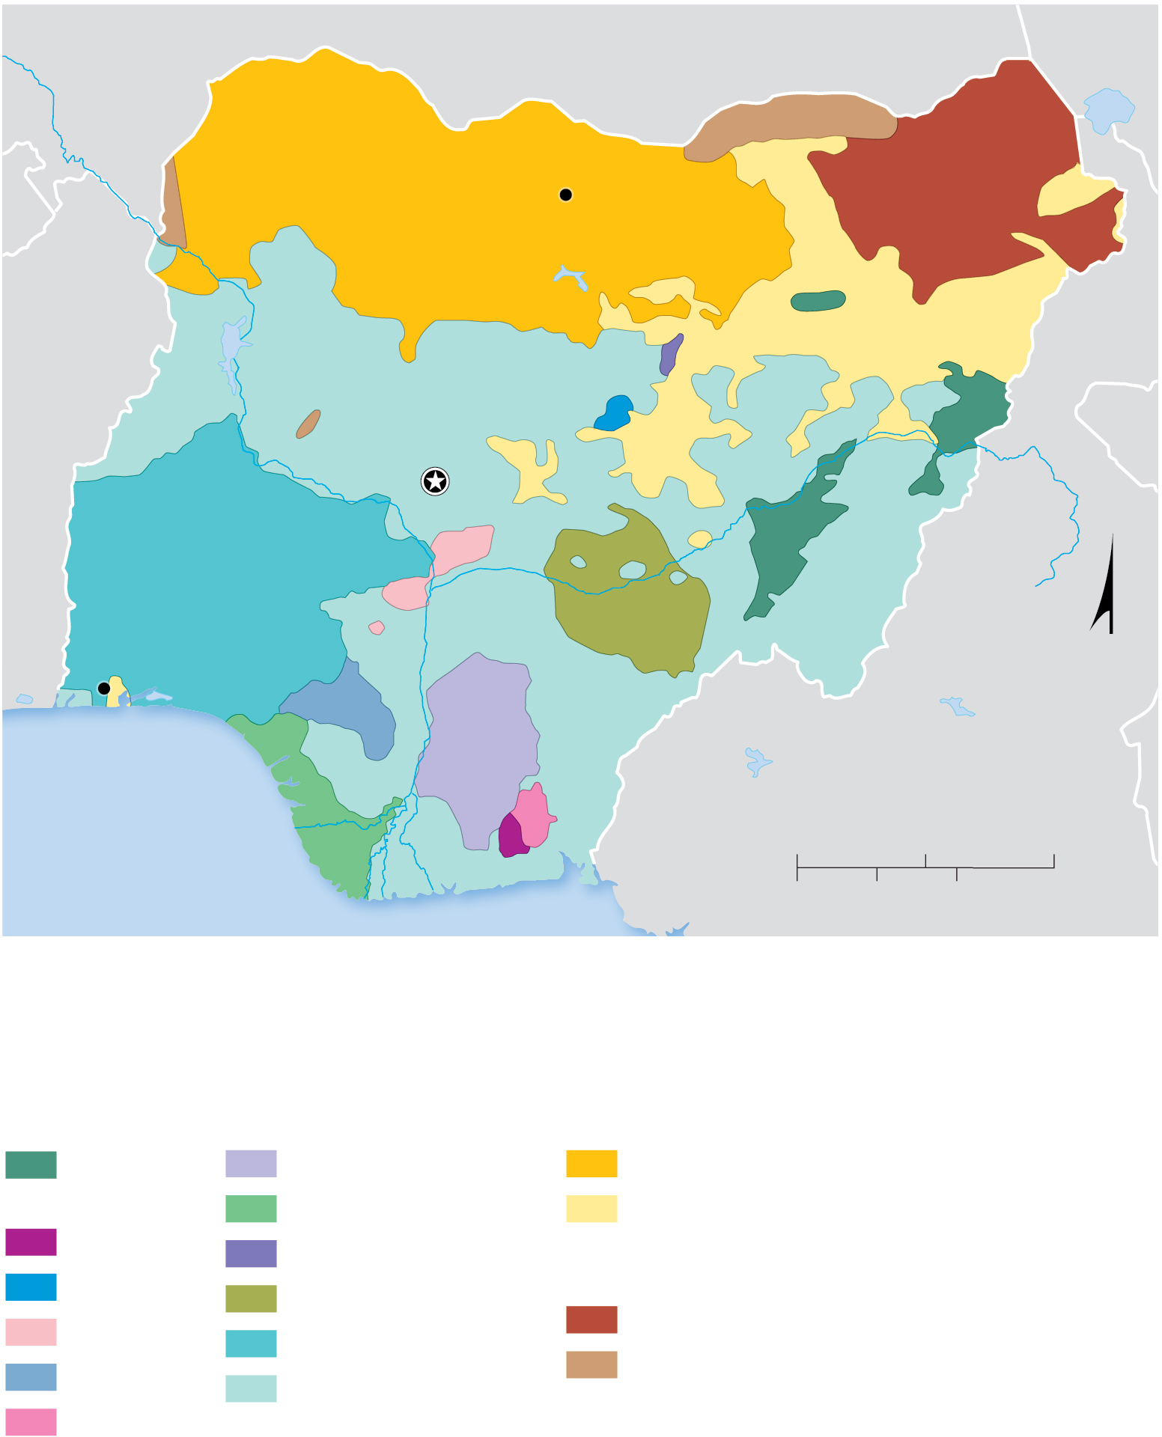
5.3.5 Multilingual Places (4 of 5)
Figure 5-38: Nigeria has 529 languages among several families. Hausa, Igbo, and Yoruba are the most common.
NIGER
Niger R.
Kano
BENIN
N I G E R I A
Abuja
Benue R.
Lagos
N
Niger R.
CAMEROON
ATLANTIC
OCEAN
0
100
200 Miles
0
100
200 Kilometers
Languages with more than 1 million speakers
Niger-Congo family
Afro-Asiatic family
Adamawa-
Fulfulde
Igbo
Hausa
Anaang
Izon
Other peoples
Berom
Nigerian Fulfulde
Nilo-Saharan family
Ebira
Tiv
Kanuri
Edo
Yoruba
Other peoples
Ibibio
Other peoples

Slide 55
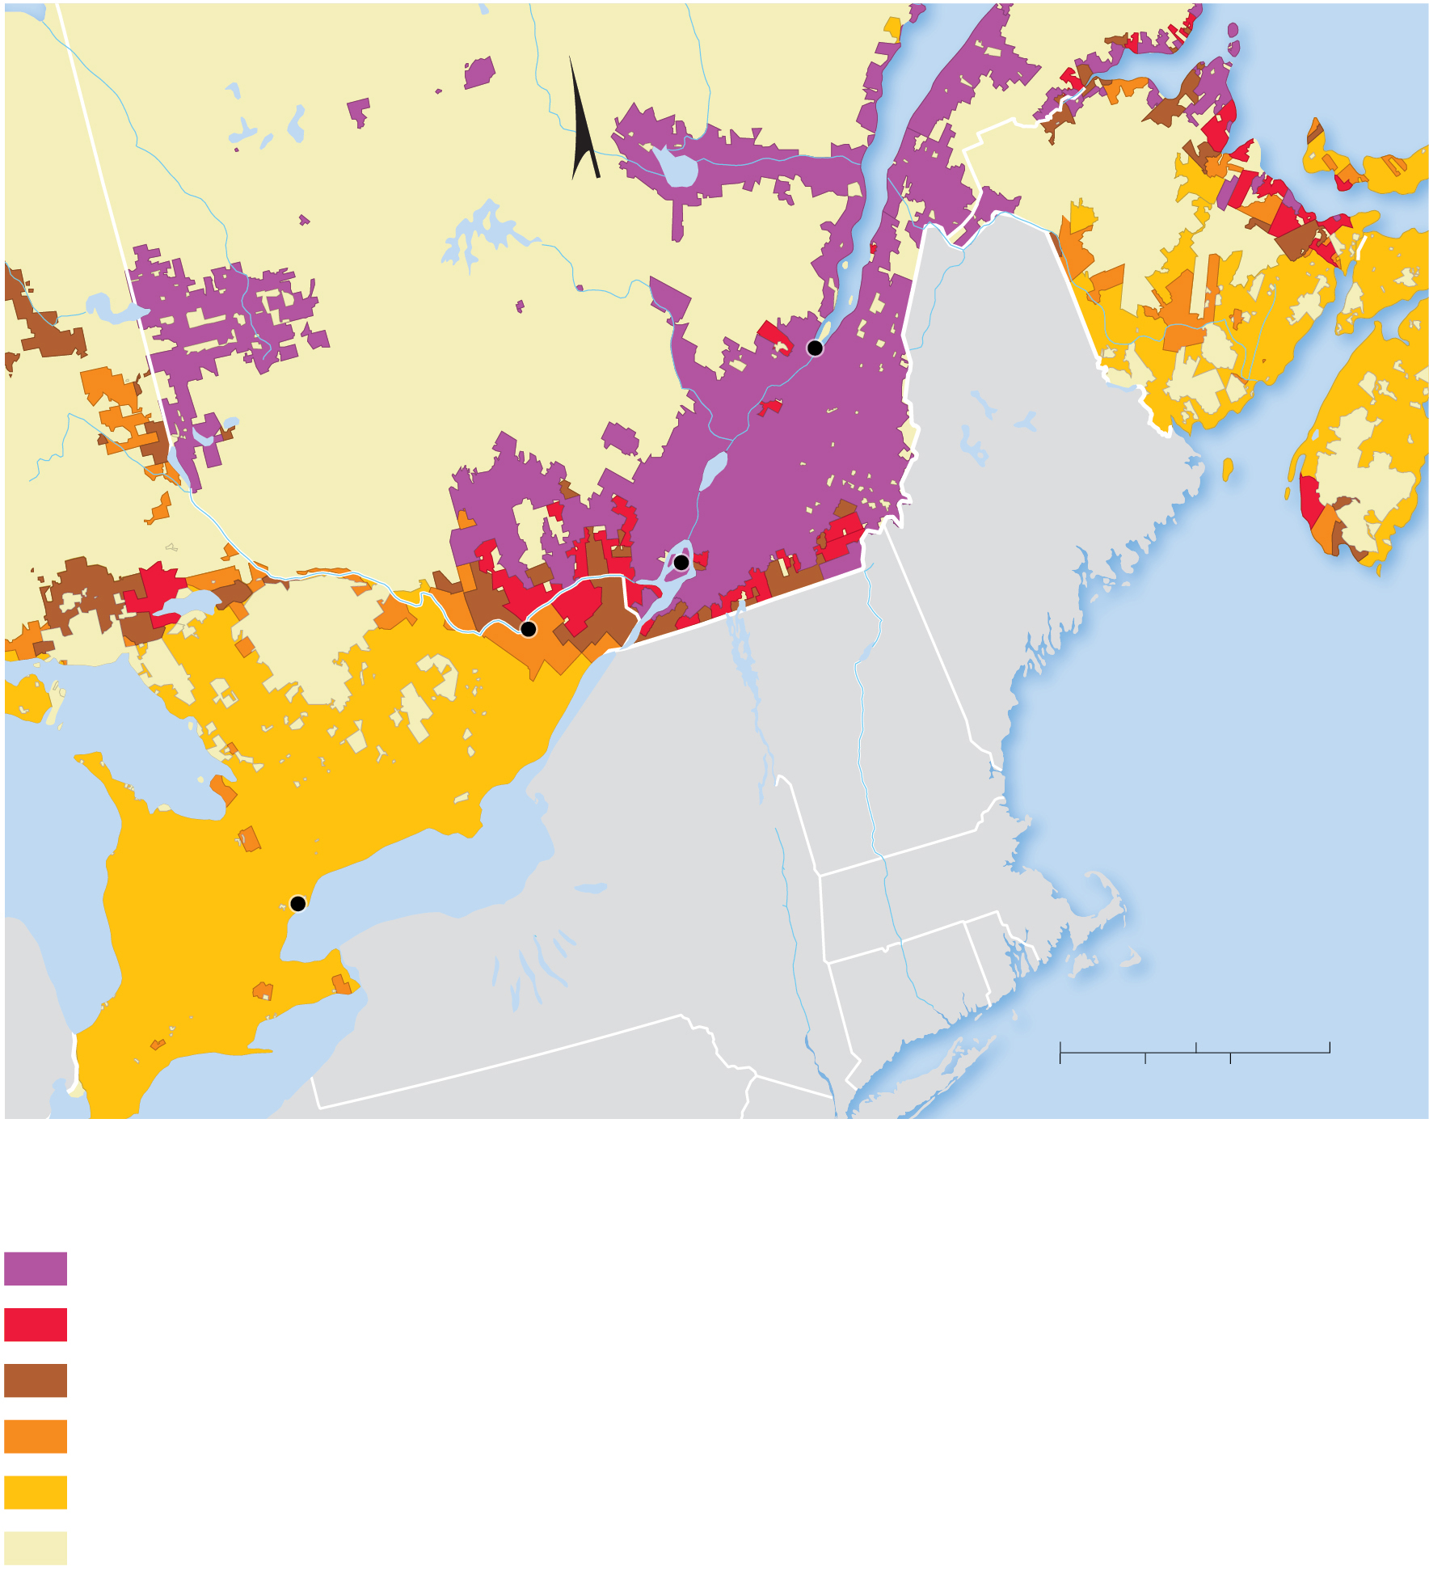
5.3.5 Multilingual Places (5 of 5)
Figure 5-39: Canada’s French speakers are concentrated along the St. Lawrence and Great Lakes.
P.E.I.
N
NEW
BRUNSWICK
Q U É B E C
Québec
NOVA
SCOTIA
Montréal
ME
ONTARIO
Ottawa
Georgian
Bay
VT
ATLANTIC
OCEAN
NH
Lake Huron
MA
Toronto
Lake Ontario
NY
CT
RI
0
100
200 Miles
Lake Erie
PA
0
100
200 Kilometers
Percent
French speakers
89–100
64–88
26–63
5–25
below 5
Sparsely
inhabited

Slide 56
Key Issue 4: Why Do Languages Survive or Perish?
5.4.1 Endangered Languages
5.4.2 Isolated and Extinct Languages
5.4.3 Preserving Languages
5.4.4 New and Growing Languages

Slide 57
5.4.1 Endangered Languages (1 of 4)
The United Nations defines an endangered language as one that children are no longer learning, and its remaining speakers use it less frequently. The U N has listed:
592 vulnerable languages
640 definitely endangered languages
537 severely endangered
577 critically endangered languages

Slide 58
5.4.1 Endangered Languages (2 of 4)
Table 5-1: More than 2400 languages are endangered.
Blank | In Trouble | Dying
North America | 84 | 154
Europe | 50 | 51
Latin America | 225 | 185
Sub-Saharan Africa | 209 | 117
Southwest Asia & North Africa | 67 | 27
South Asia | 129 | 29
Central Asia | 4 | 1
East Asia | 112 | 33
Southeast Asia | 417 | 111
South Pacific | 234 | 208
Total | 1,531 | 916

Slide 59
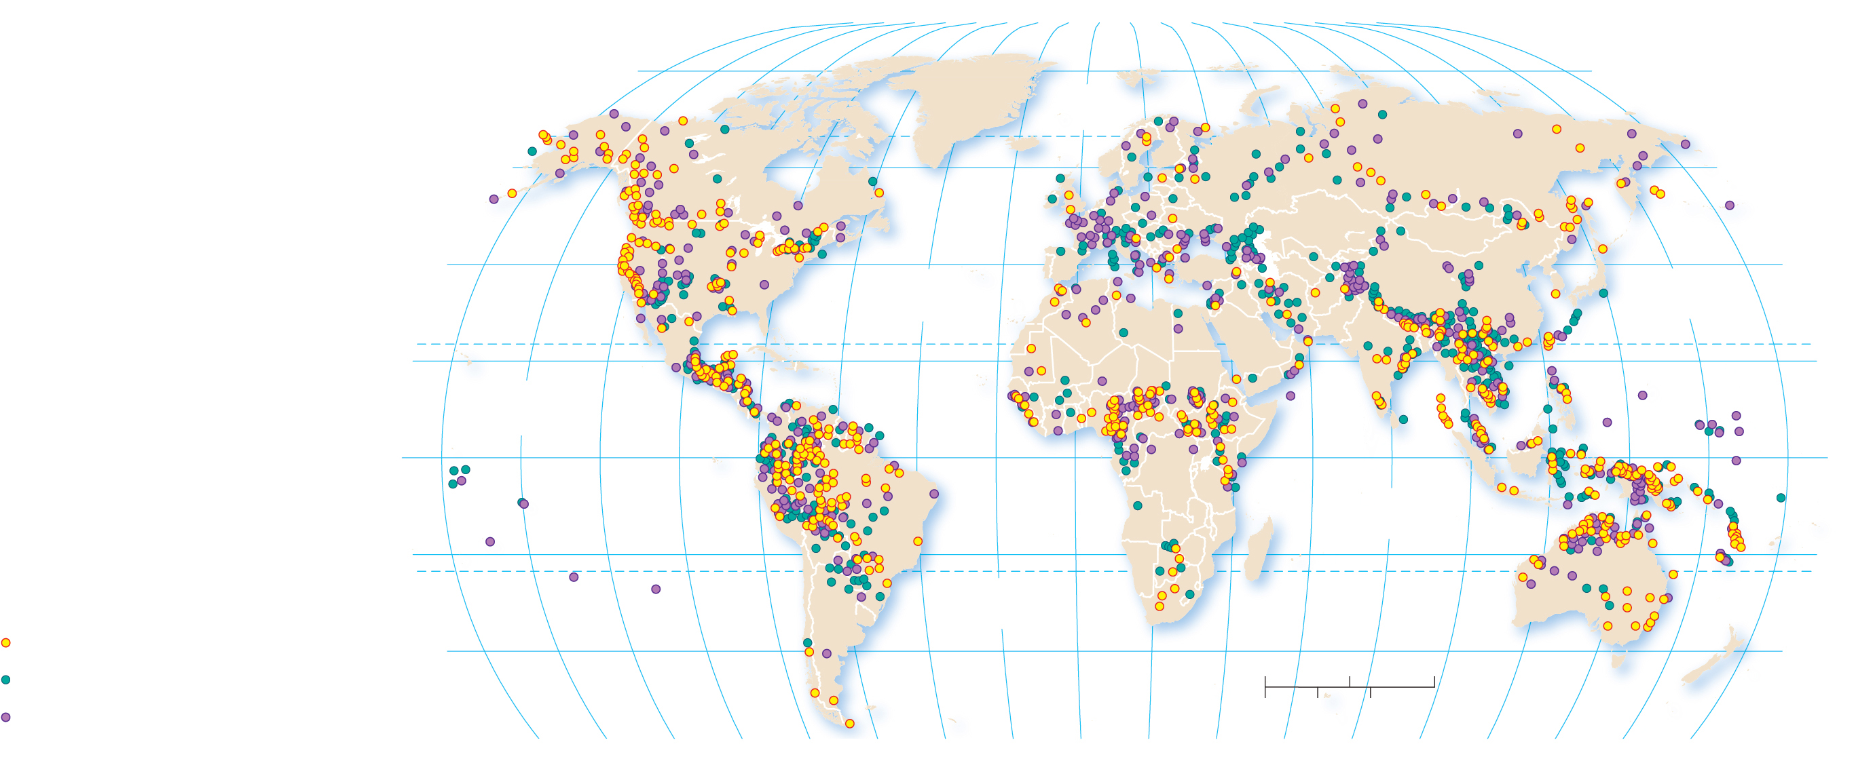
5.4.1 Endangered Languages (3 of 4)
Figure 5-40: Endangered languages are found on every continent and correspond with indigenous peoples.
80°
160°
140°
120°
100°
80°
60°
40°
20°
0°
20°
40°
60°
80°
100°
120°
140°
160°
180°
80°
ARCTIC
OCEAN
60°
60°
40°
ATLANTIC
OCEAN
PACIFIC
OCEAN
40°
20°
TROPIC OF CANCER
20°
PACIFIC
OCEAN
0°
EQUATOR
0°
INDIAN
OCEAN
20°
ATLANTIC
OCEAN
TROPIC OF CAPRICORN
Critically endangered
40°
0
1,500
3,000 Miles
40°
Definitely endangered
Severely endangered
160°
140°
120°
100°
80°
60°
40°
20°
0°
20°
40°
0
1,500
3,000 Kilometers
180°
60°
80°
100°
120°
140°
160°

Slide 60
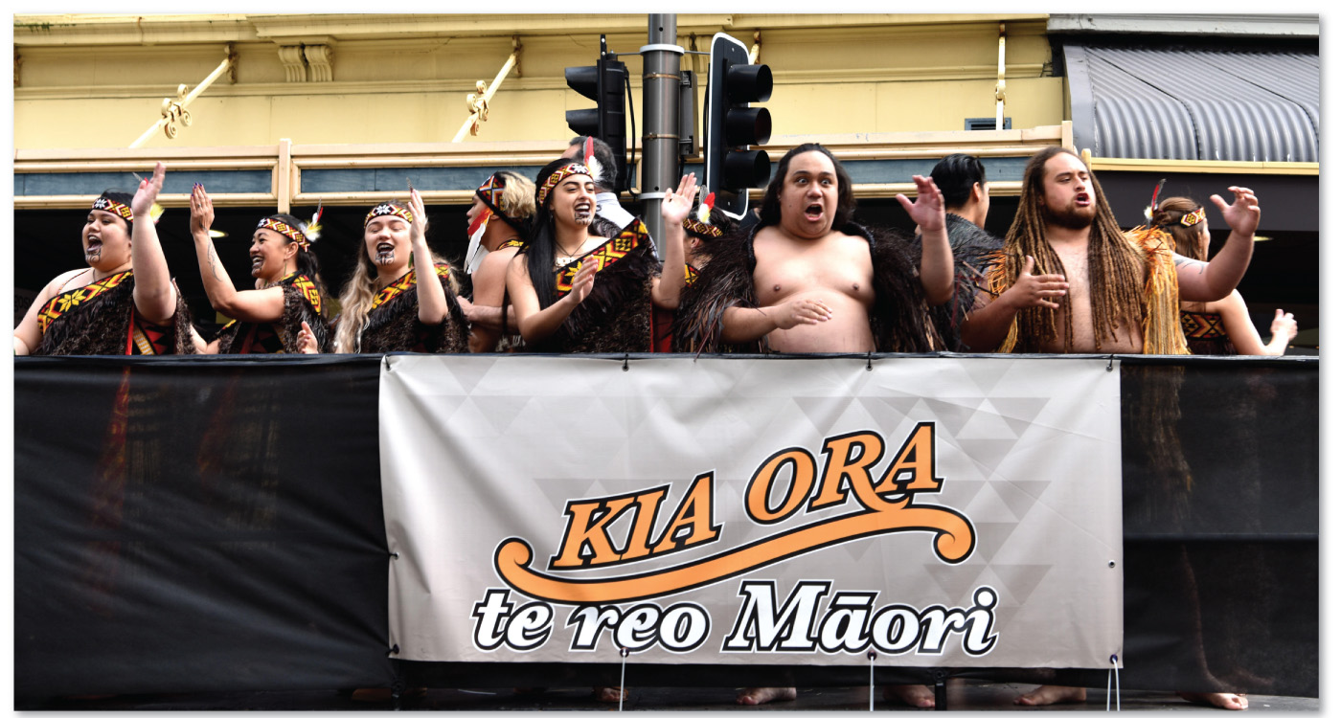
5.4.1 Endangered Languages (4 of 4)
Figure 5-41: Maoris participate in a parade in Wellington, New Zealand, to celebrate their language. The sign says “To keep the Maori voice alive.”

Slide 61
5.4.2 Isolated and Extinct Languages (1 of 5)
An isolated language is a language that is unrelated to any other and therefore not attached to any language family. Basque is a classic example of an isolated language within Europe
An extinct language is a language that was once used by people in daily activities but is no longer in use. Liv and Clallam are examples of languages that have recently gone extinct

Slide 62
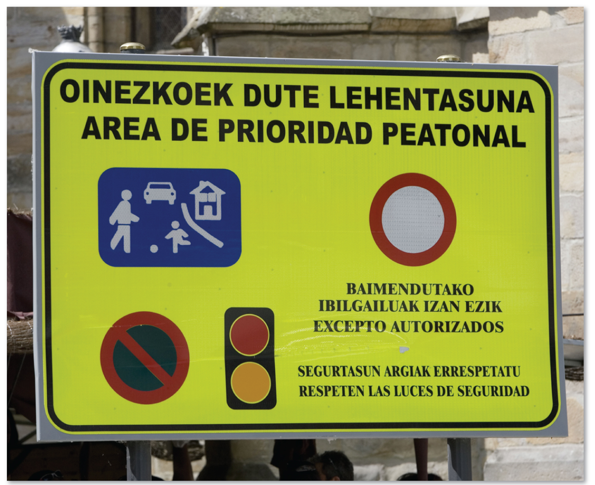
5.4.2 Isolated and Extinct Languages (2 of 5)
Figure 5-42: Street sign in the Basque language.

Slide 63
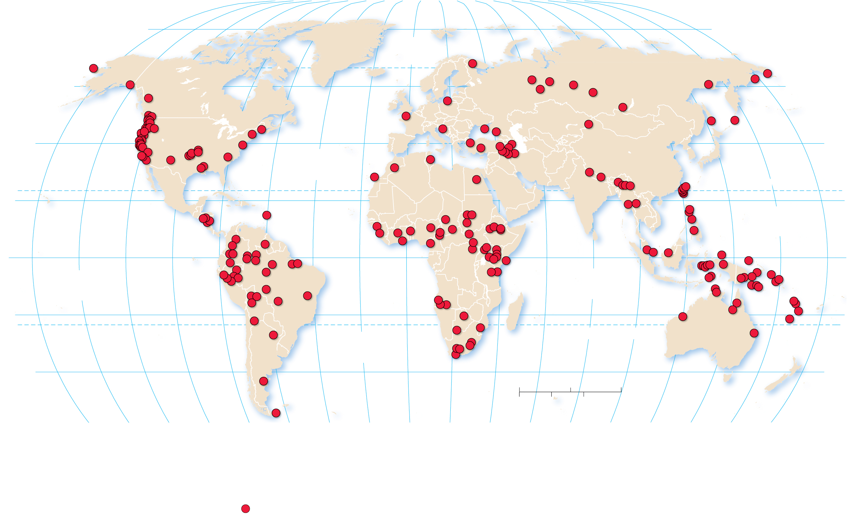
5.4.2 Isolated and Extinct Languages (3 of 5)
Figure 5-43: Dots are located approximately where recently extinct languages were last spoken.
80°
160°
140°
120°
100°
80°
60°
40°
20°
0°
20°
40°
60°
80°
100°
120°
140°
160°
180°
80°
ARCTIC
OCEAN
60°
60°
40°
ATLANTIC
OCEAN
40°
20°
TROPIC OF CANCER
20°
PACIFIC
OCEAN
0°
EQUATOR
0°
PACIFIC
OCEAN
INDIAN
OCEAN
20°
20°
ATLANTIC
OCEAN
TROPIC OF CAPRICORN
40°
0
1,500
3,000 Miles
40°
0
1,500
3,000 Kilometers
160°
140°
120°
100°
80°
60°
40°
20°
0°
20°
40°
60°
80°
100°
120°
140°
160°
180°
Extinct language

Slide 64
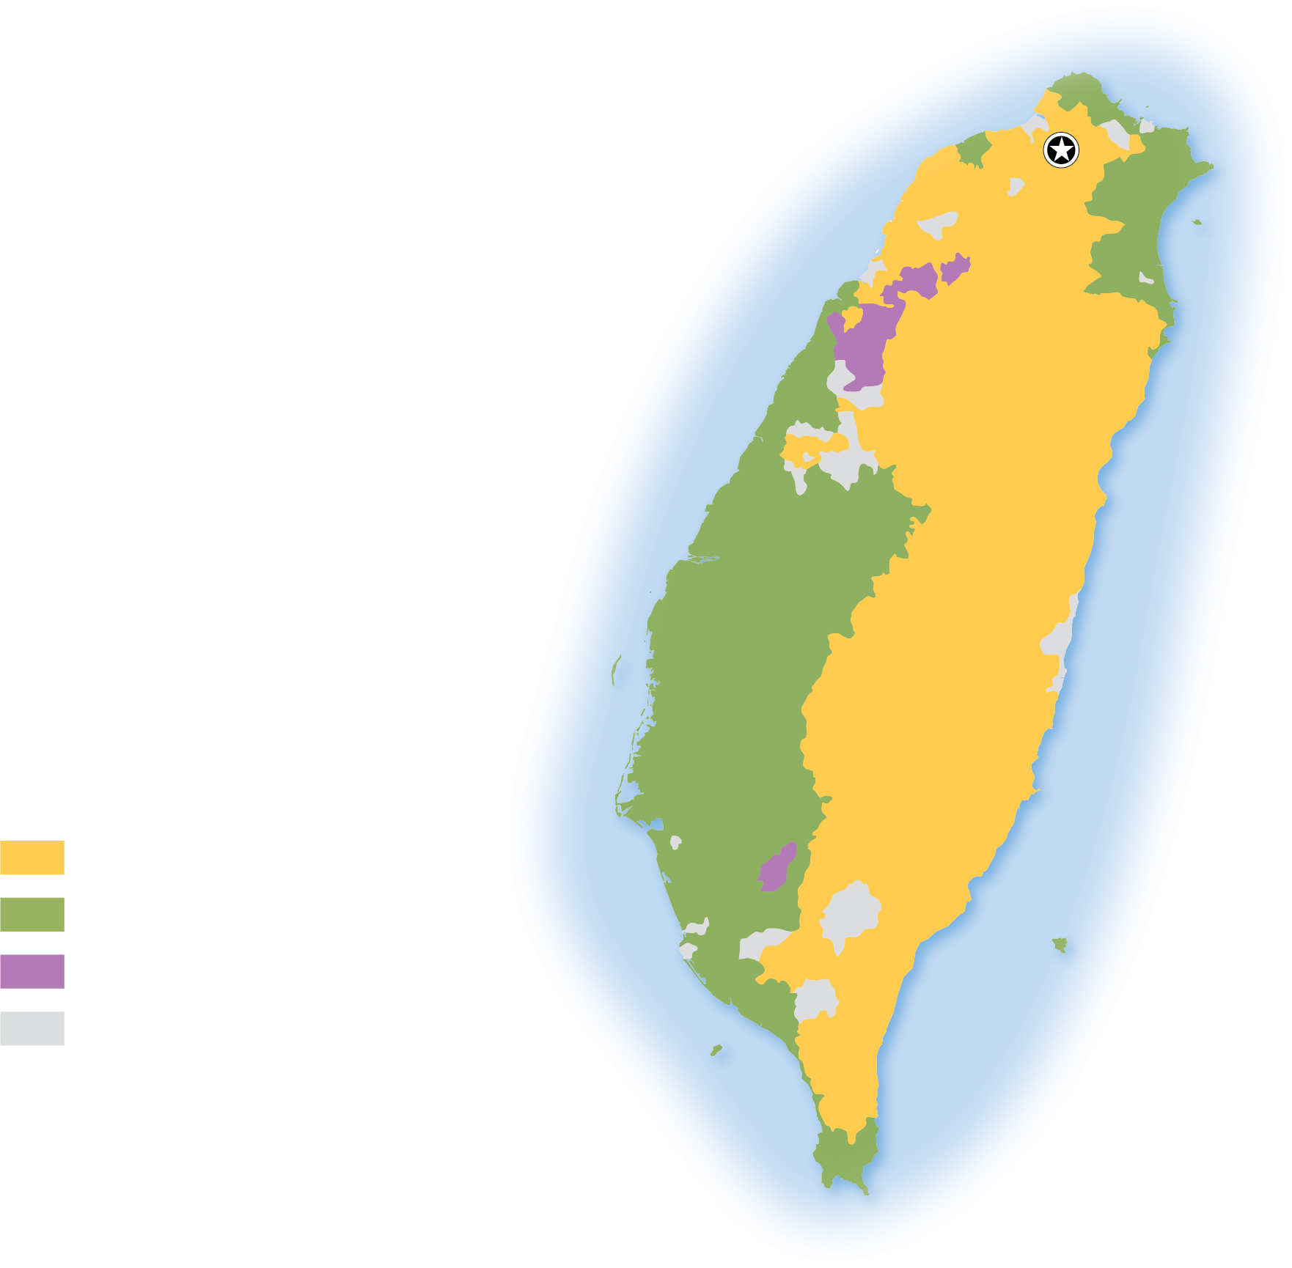
5.4.2 Isolated and Extinct Languages (4 of 5)
Figure 5-44: The languages named in red have gone extinct.
Kulun
Basay
Ketangalan
Taipei
Taokas
Papora
Pazeh
Babuza
T a i w a n
Hoanya
Predominant
language
Philippine
Sea
Siraiya
Mandarin
Min Nan
Hakka
Other or none
predominant
South
China
Sea

Slide 65
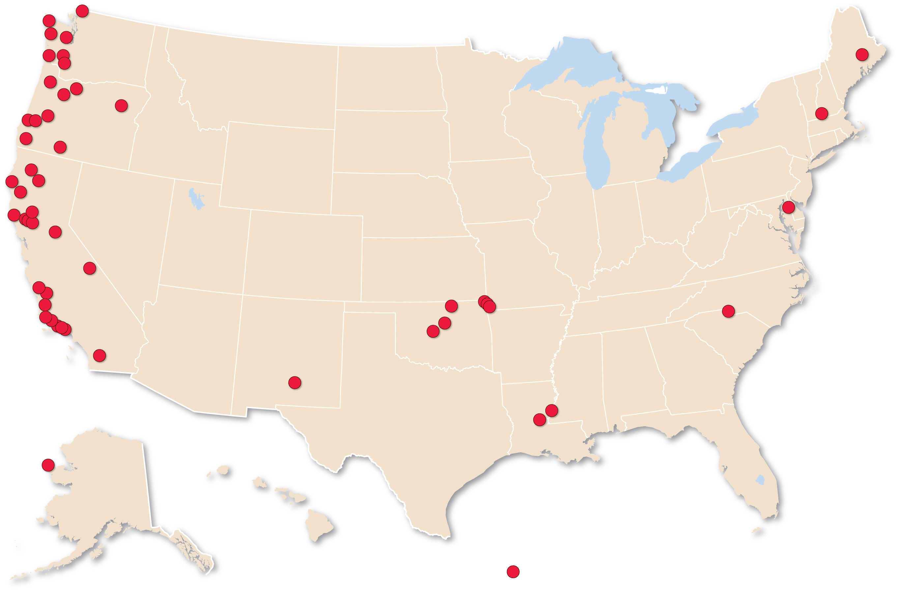
5.4.2 Isolated and Extinct Languages (5 of 5)
Figure 5-45: Dots are located approximately where recently extinct languages were last spoken.
Extinct language

Slide 66
5.4.3 Preserving Languages (1 of 3)
There is a growing movement in many countries to preserve endangered languages. The Celtics languages (e.g., Irish, Welsh, Breton) are a prime example of this movement as the United Kingdom, Ireland, and France have, in tandem with the United Nations and the European Union, encouraged the use of these languages

Slide 67
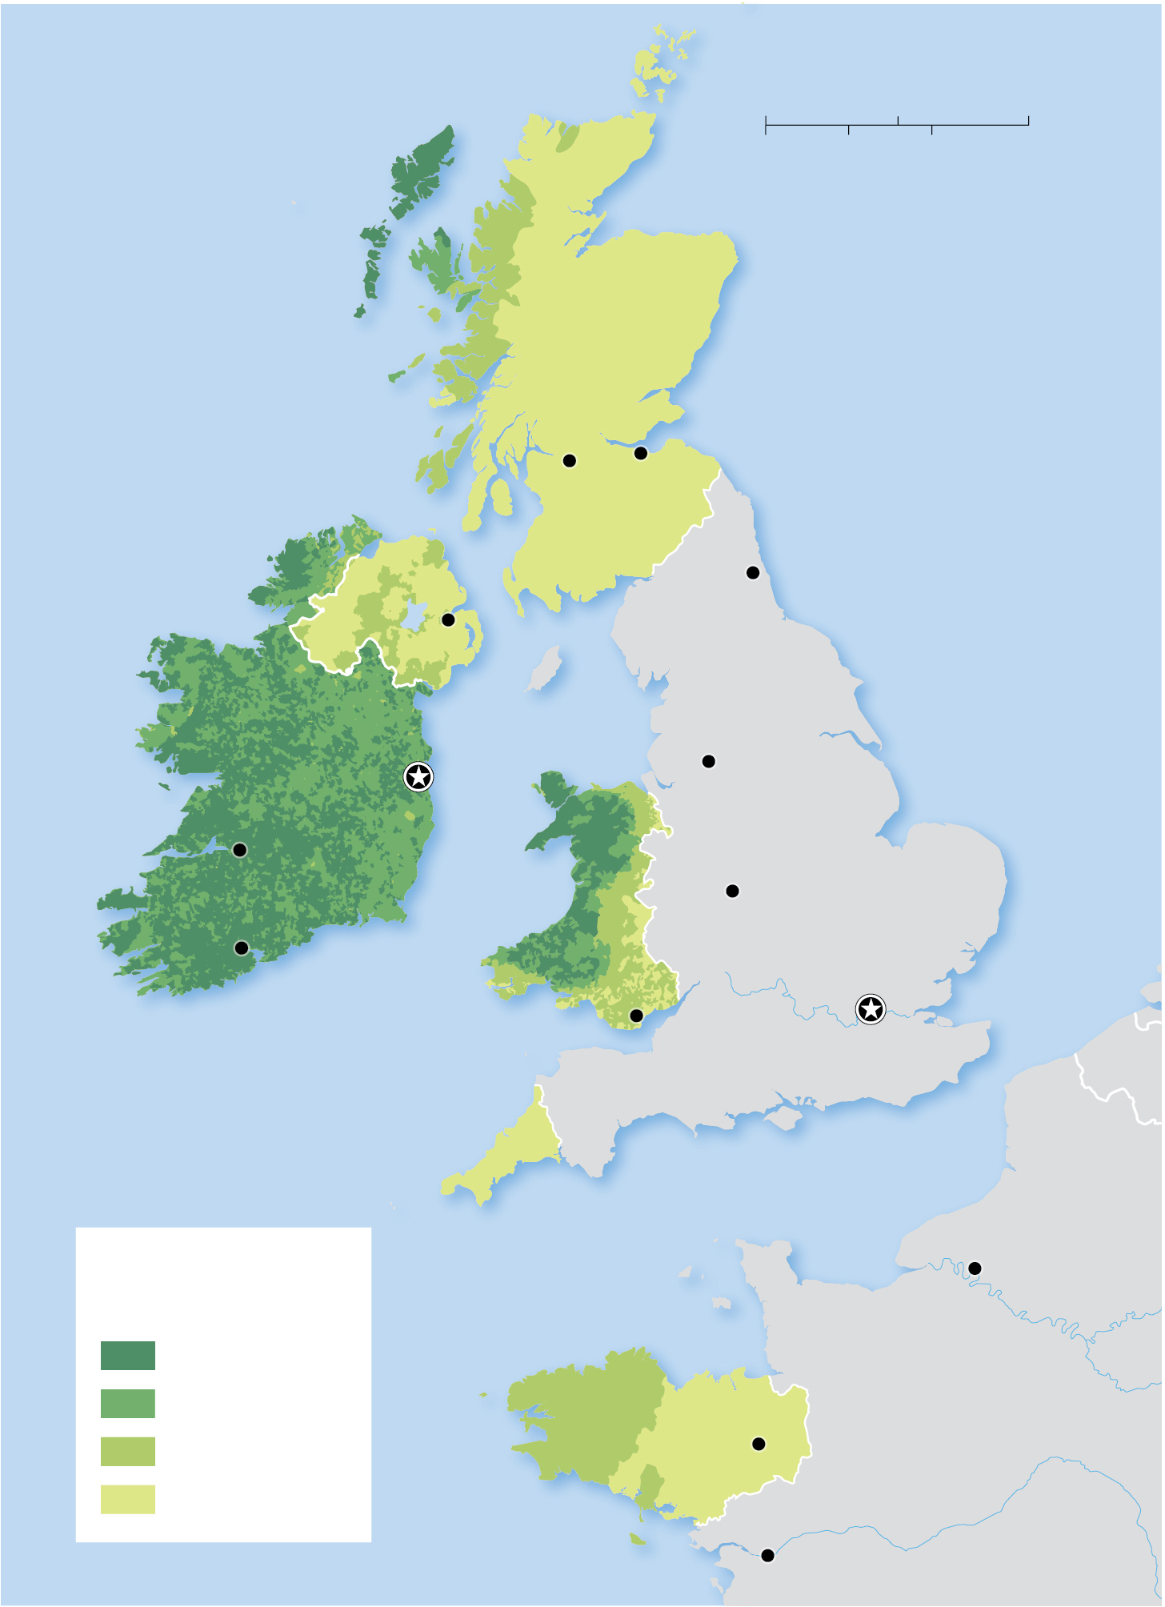
5.4.3 Preserving Languages (2 of 3)
Figure 5-46: Welsh becomes less spoken closer to the English-Wales border.
Orkney Is.
0
75
150 Miles
0
75
150 Kilometers
Hebrides
ATLANTIC
OCEAN
SCOTLAND
Edinburgh
North
Sea
Glasgow
NORTHERN
IRELAND
Newcastle
Belfast
UNITED
KINGDOM
Dublin
Irish
Sea
Manchester
Limerick
IRELAND
WALES
ENGLAND
Cork
Birmingham
Celtic
Sea
Cardiff
London
CORNWALL
English Channel
Percent speaking
a Celtic language
Rouen
50 and above
30–49
BRITTANY
Rennes
FRANCE
10–29
below 10
Nantes

Slide 68
5.4.3 Preserving Languages (3 of 3)
Figure 5-46: Irish, Welsh, Cornish, and Breton are all Celtic languages where local governments have actively promoted their revival.
Orkney Is.
0
75
150 Miles
0
75
150 Kilometers
Hebrides
ATLANTIC
OCEAN
SCOTLAND
Edinburgh
North
Sea
Glasgow
NORTHERN
IRELAND
Newcastle
Belfast
UNITED
KINGDOM
Dublin
Irish
Sea
Manchester
Limerick
IRELAND
WALES
ENGLAND
Cork
Birmingham
Celtic
Sea
Cardiff
London
CORNWALL
English Channel
Percent speaking
a Celtic language
Rouen
50 and above
30–49
BRITTANY
Rennes
FRANCE
10–29
below 10
Nantes

Slide 69
5.4.4 New and Growing Languages (1 of 4)
While the number of languages in the world is declining, a handful of languages are being invented or revived
Hebrew has been growing with the establishment of Israel in 1948, reflecting the unique Jewish heritage of that nation
There has been an effort to revive the Native American language of Myaamia (spoken by the Miami people found in Oklahoma)

Slide 70
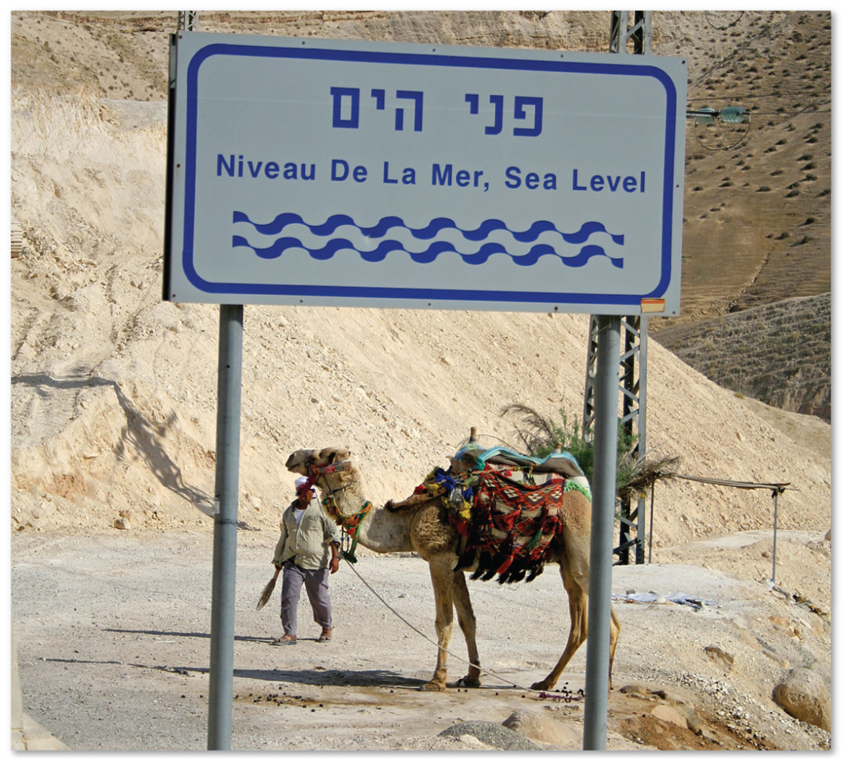
5.4.4 New and Growing Languages (2 of 4)
Figure 5-49: Hebrew became more widely spoken after 1948 with the creation of Israel. Sign in Hebrew, English, and French.

Slide 71
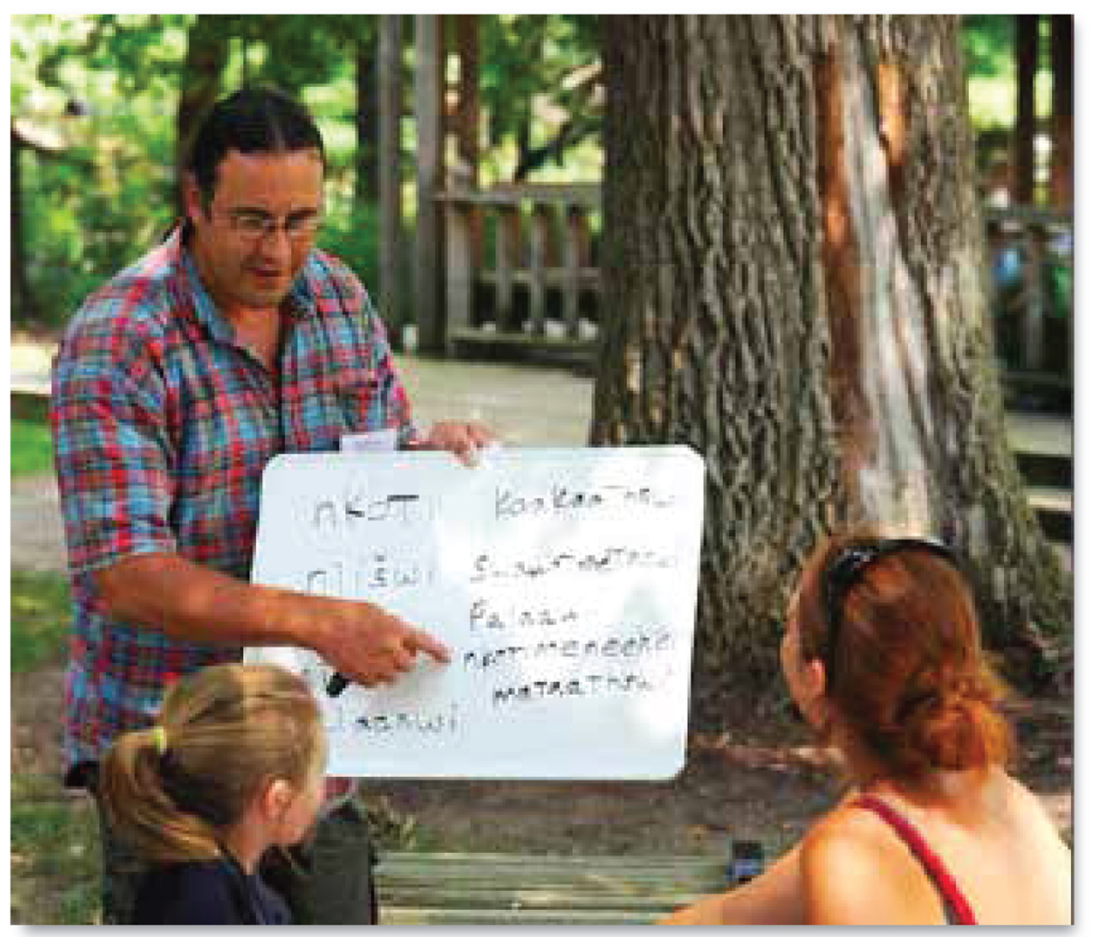
5.4.4 New and Growing Languages (3 of 4)
Figure 5-50: Myaamia is a language spoken by the Miami people of Oklahoma.

Slide 72
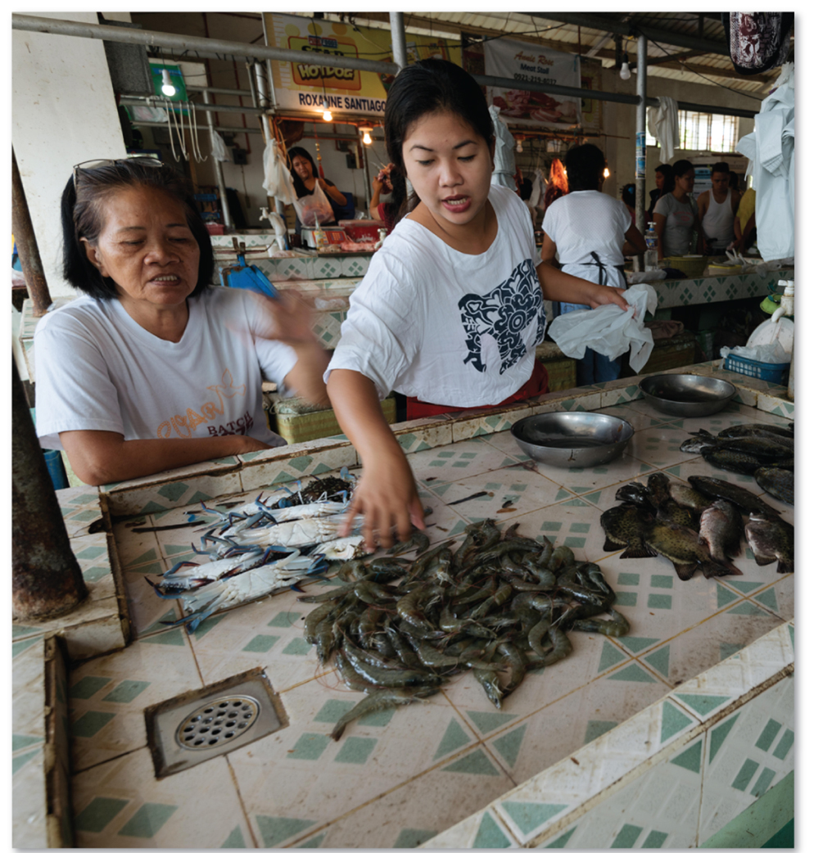
5.4.4 New and Growing Languages (4 of 4)
Figure 5-51: Bolinao is a threatened language in the Philippines.

Slide 73
Copyright
This work is protected by United States copyright laws and is provided solely for the use of instructors in teaching their courses and assessing student learning. Dissemination or sale of any part of this work (including on the World Wide Web) will destroy the integrity of the work and is not permitted. The work and materials from it should never be made available to students except by instructors using the accompanying text in their classes. All recipients of this work are expected to abide by these restrictions and to honor the intended pedagogical purposes and the needs of other instructors who rely on these materials.

