Slide 1
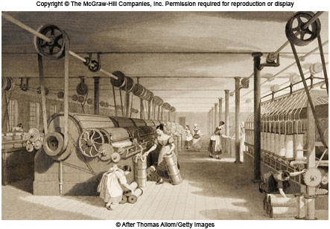
Chapter 16 LECTURE OUTLINE Geographies of Production and Consumption
Human Geography by Malinowski & Kaplan

Slide 2
Chapter 16 Modules
16A Growth of Mass Production and an Industrial World
16B Factors of Production and Changing Geographies of Industrial Location
16C Industrialization and the Early Development of the US Space Economy
16D Modern Shifts in US Manufacturing
16E The Geography of High Technology
16F Globalized Manufacturing and the Rise of Transnational Corporations
16G Geographies of Consumption
16H Consuming Places: Geographies of Tourism

Slide 3
16A: Growth of Mass Production
Production adds value greater than the sum of the raw materials used, hence value added
Mass production was the key outcome of industrialization
As the quantity of goods rose, prices dropped
The factory system emerged because large, expensive machines required a great deal of money to buy and operate
Factories led to a division of labor where workers specialized in single, repeated tasks

Slide 4
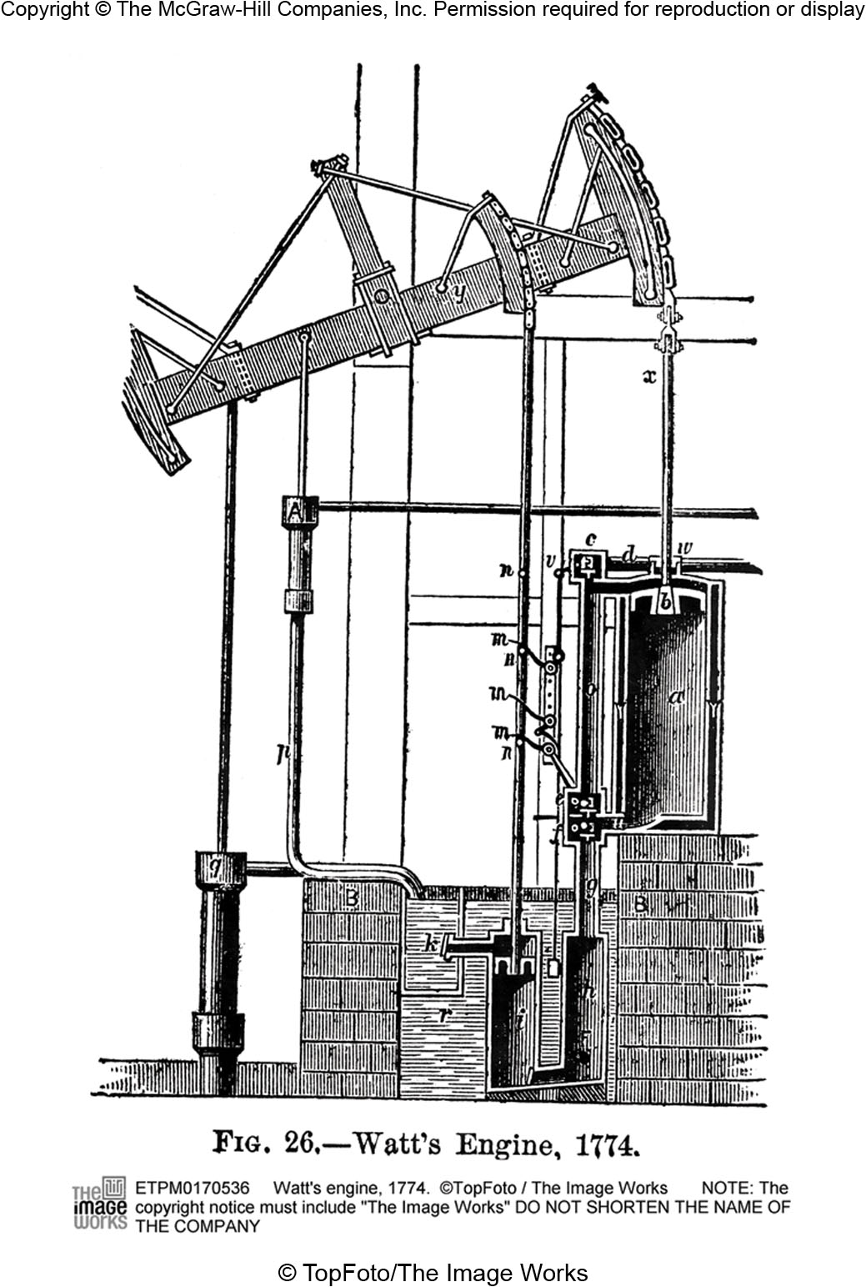
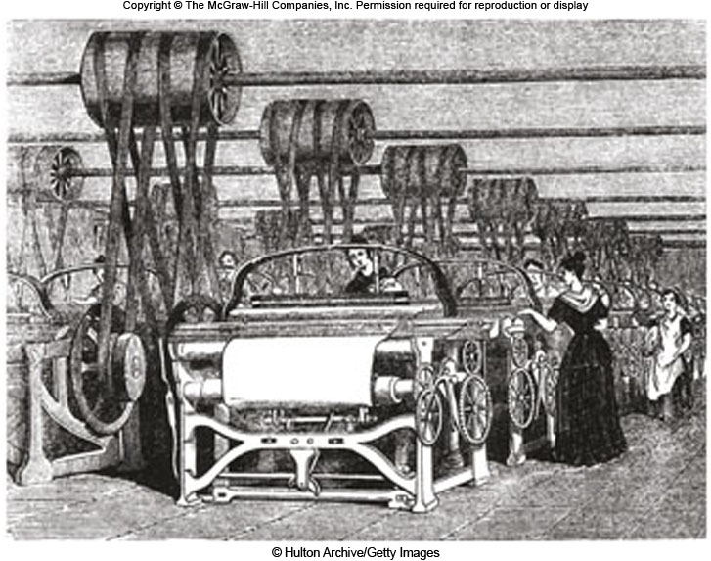
19th Century Factory
Figure 16A.1

Slide 5
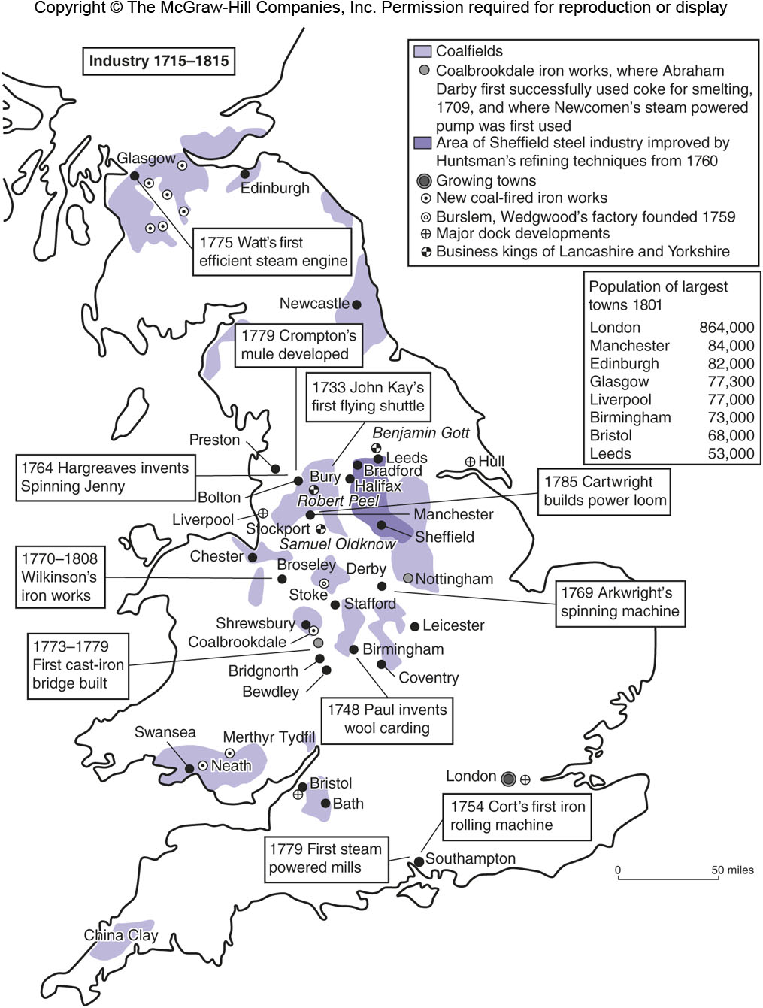
Industry in Great Britain 1715-1815
Figure 16A.2

Slide 6
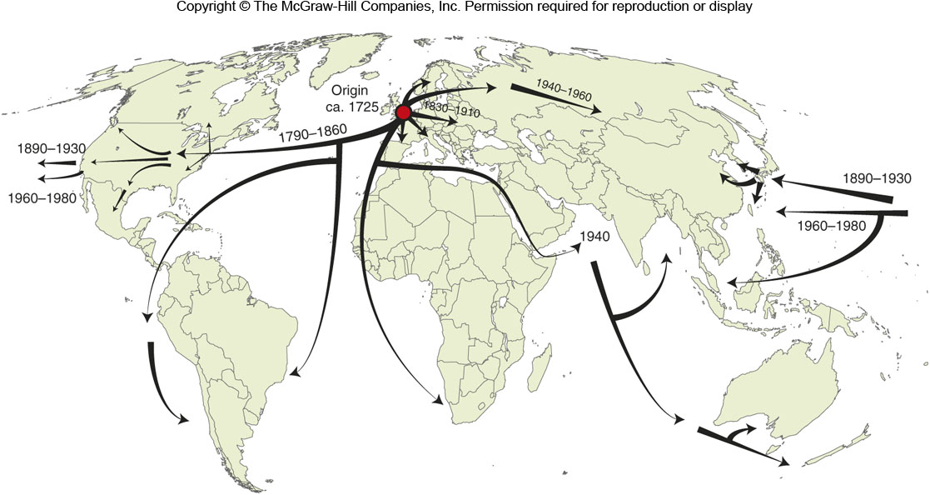
The Spread of Industrialization
Figure 16A.3

Slide 7
16B: Factors of Production and Changing Geographies of Industrial Location 1
A production chain transforms raw materials into a finished product
The process incorporates a number of direct and indirect factors of production

Slide 8
16B: Direct & Indirect Factors of Production
DIRECT FACTORS
INDIRECT FACTORS
Raw materials
Labor
Financial capital
Markets
Technology
Infrastructure
Financial system
Government role
Education / training
Entrepreneurial climate

Slide 9
16B: Factors of Production and Changing Geographies of Industrial Location 2
Alfred Weber’s model of industrial location
The optimum location of a manufacturing plant is a balance between the locations of raw materials, the labor force, and the markets where the products are sold
Products that lose weight in production are better situated near the raw materials
Products that gain weight in production, such as the adding of water, are better situated near the market

Slide 10
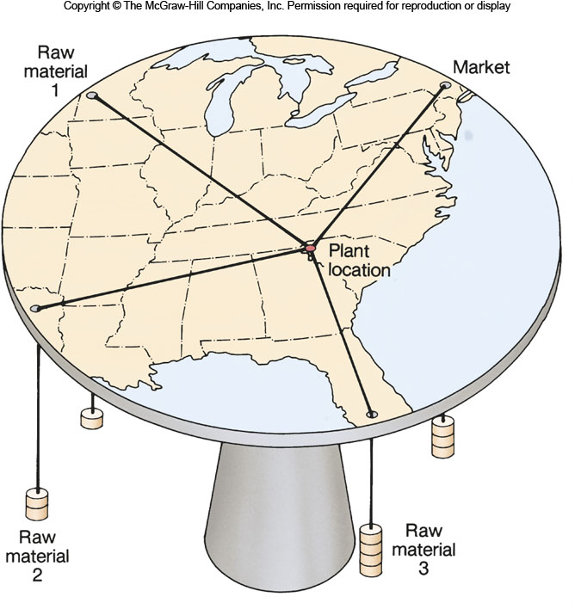
Weber’s Model
Figure 16B.1

Slide 11
16B: Factors of Production and Changing Geographies of Industrial Location 3
Changes in recent decades have affected industrial location:
Transportation costs have declined
Labor costs and specialization of labor have increased
A lot of production is now conducted overseas
Government plays a bigger role in trying to lure businesses to certain areas
Production processes are more flexible and nimble because of computers, robots, fast shipping of raw materials, etc..

Slide 12
16C: Industrialization and the Early Development of the US Space Economy
The U.S. started industrializing later than some places in Europe
By 1790 textile mills were in Rhode Island and then across southern New England by the 1830s
By 1860, 72% of all manufacturing was in the Northeast
Diversification through forward linkages and backward linkages

Slide 13
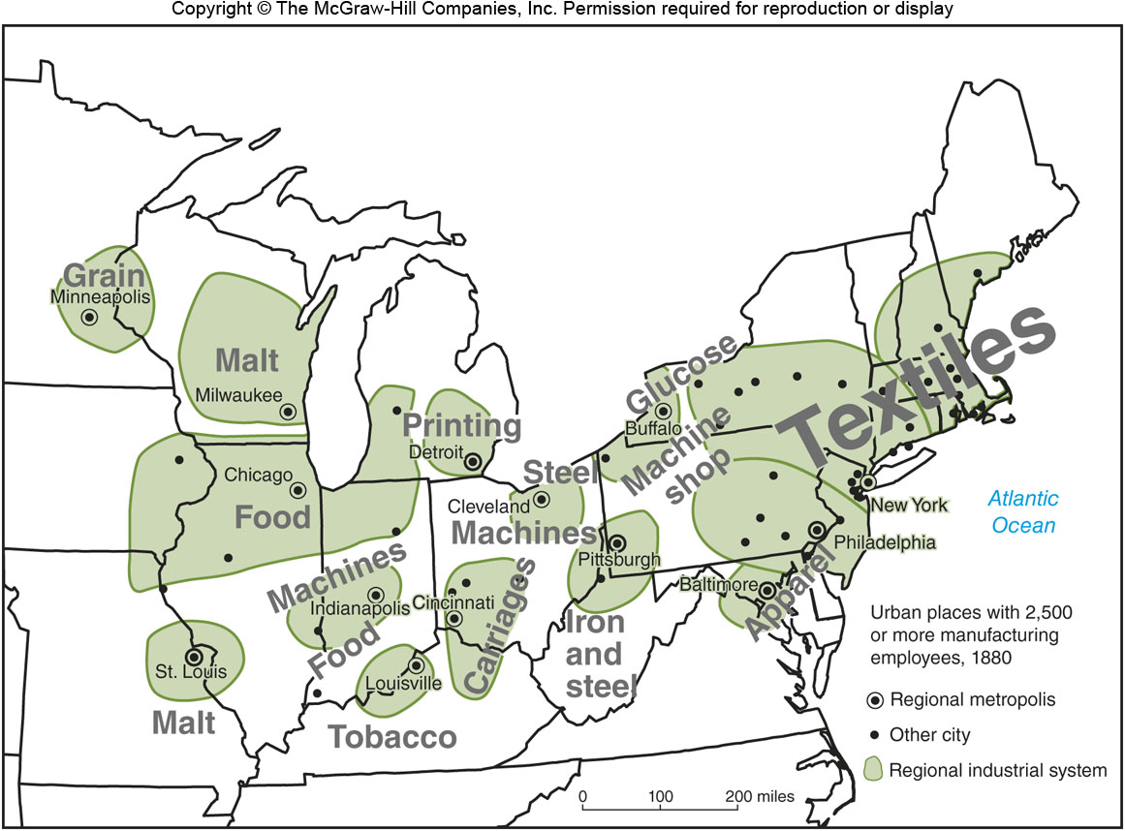
Late 19th Century Industry
Figure 16C.3

Slide 14
Geographic Advantages of the Anglo-American Manufacturing Belt
Good railroad network to tie the region together
Close proximity between places
Close to main banks
Good ports, good farmland, abundant coal
The region attracted skilled and unskilled labor

Slide 15
16D: Modern Shifts in US Manufacturing 1
After the middle of the 20th century, a shift to the South and West
A move from inner cities to outer suburbs
The move of high-paying jobs hurt losing areas
Base employment supports numerous service sector jobs [multiplier effect]

Slide 16
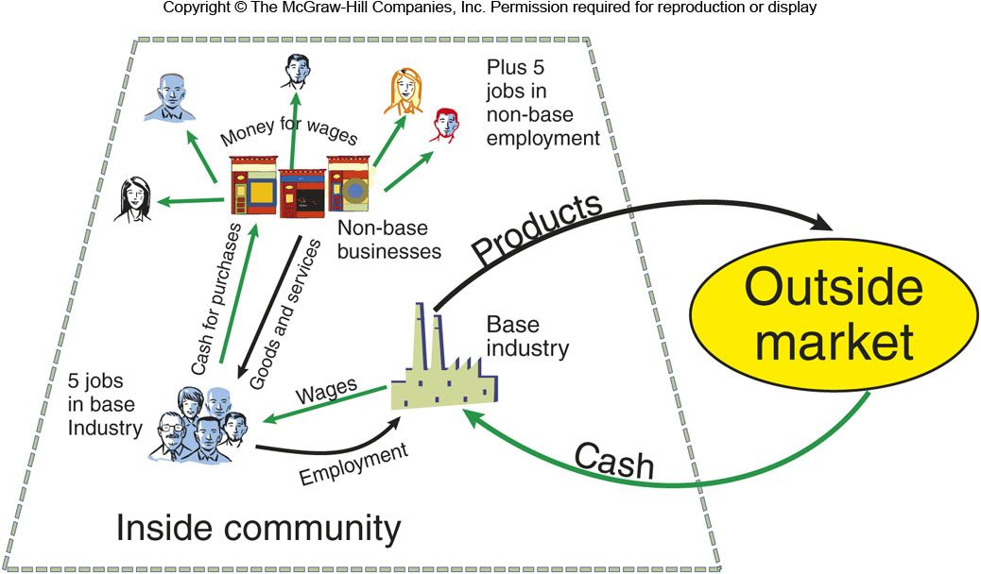
Base Employment
Figure 16D.2

Slide 17
16D: Modern Shifts in US Manufacturing 2
Causes for the shift to the South and West:
Cheaper labor costs in the South
Increased car use and trucking, & better highways, made the railroads of the Northeast less important
Increased need for oil and gas made places like Texas more important for businesses
New, high-tech sectors sprung up in areas outside of the Northeast, or moved there
Government programs helped develop non-Northeast areas

Slide 18
16E: The Geography of High Technology 1
High-technology firms have emerged recently and have made certain areas more important
Geographic factors for high-tech firms include:
Proximity to major universities
An entrepreneurial climate with venture capitalists
Environmental amenities to attract skilled labor
Good transportation and communication networks

Slide 19
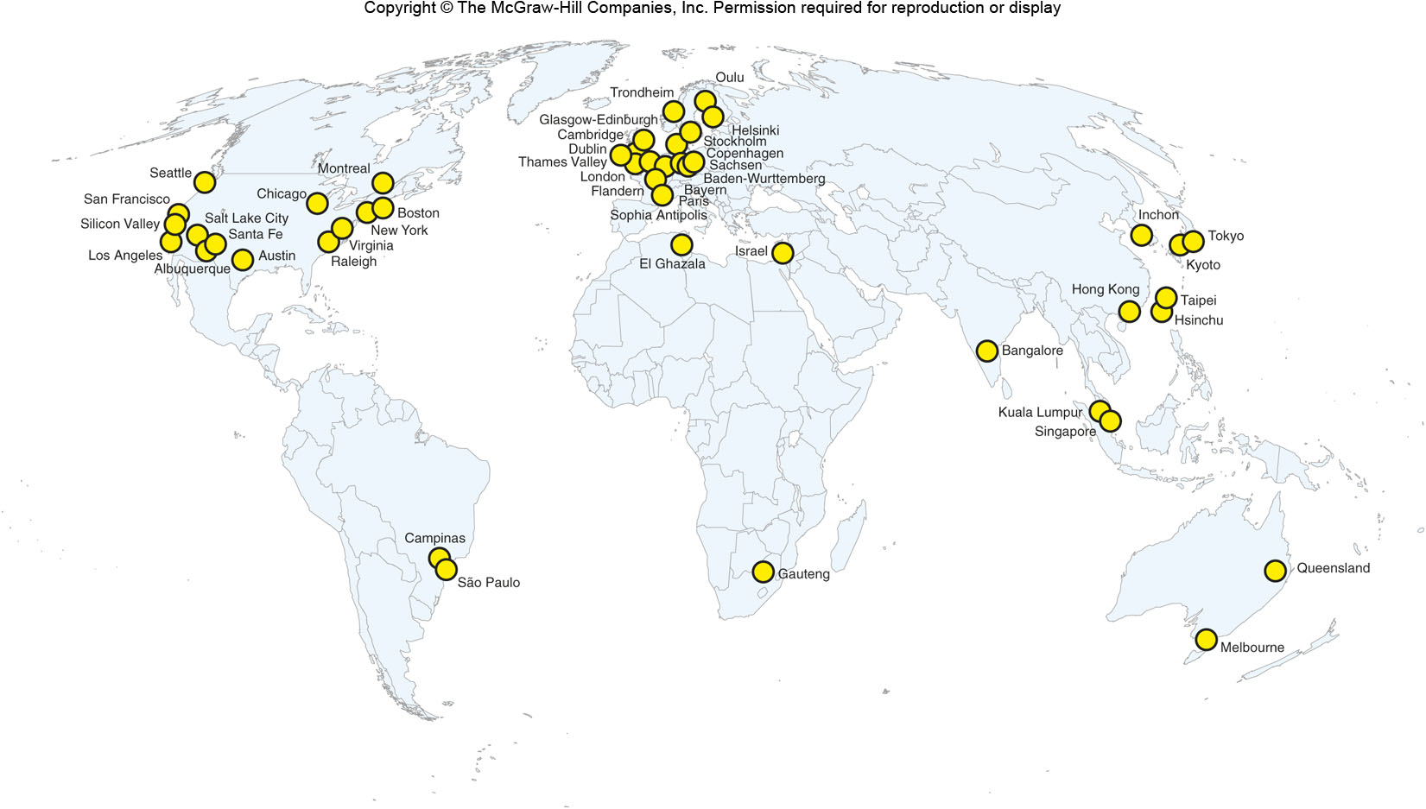
Global High-Tech Centers, 2000
Figure 16E.1

Slide 20
16E: The Geography of High Technology 2
High-technology clusters share:
Specialized labor
Specialized inputs: specific technologies, specialized equipment, etc.
Knowledge spillovers from formal and informal channels, and from universities
Accessibility to markets or users

Slide 21
16F: Globalized Manufacturing and the Rise of Transnational Corporations 1
Globalization
The elimination of national boundaries through ever greater integration of people, companies, and governments across the world
Characteristics of globalization include:
Deterritorialization
More social and economic interconnectedness
Faster communications
A multipronged process including political, social, cultural, and economic movements

Slide 22
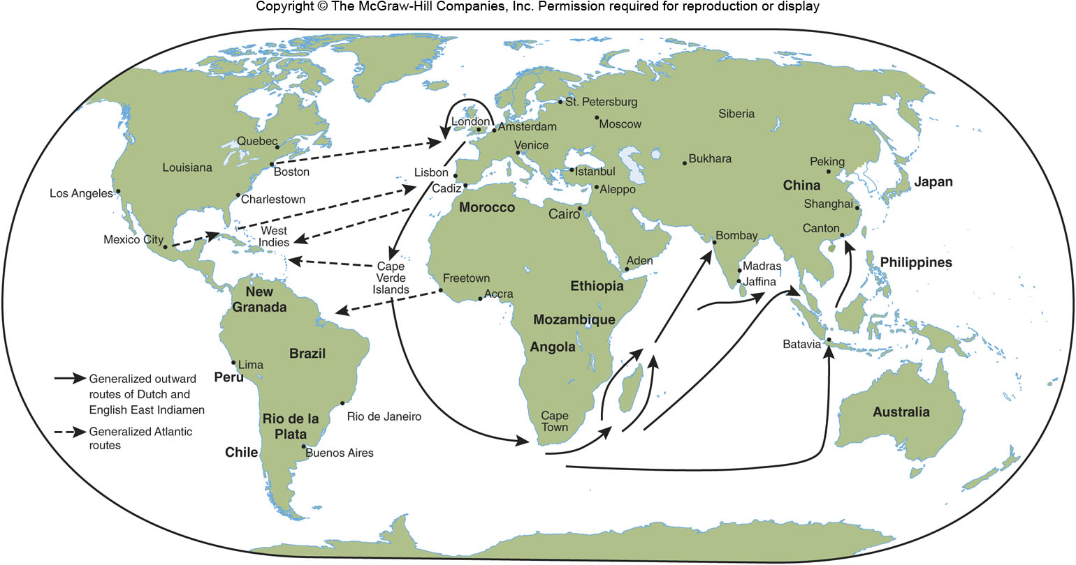
Global Colonial & Trade Activity 1500-1800
Figure 16F.1

Slide 23
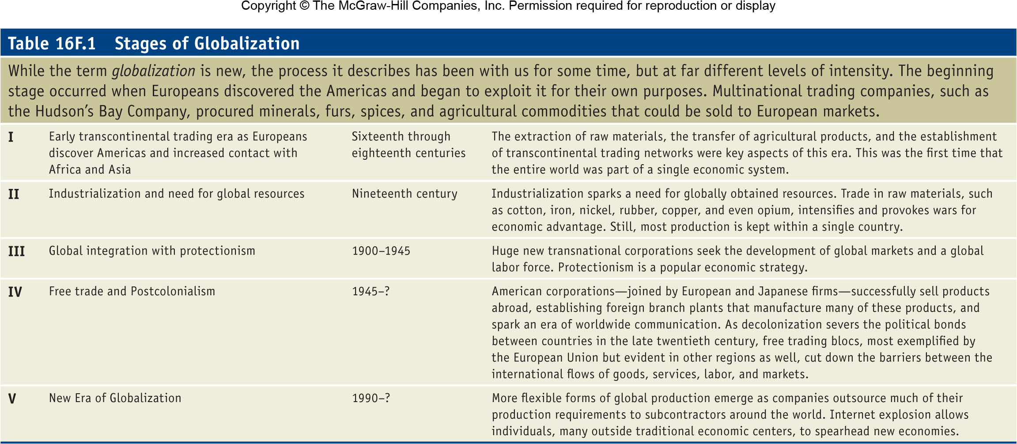
Stages of Globalization
Table 16F.1

Slide 24
16F: Globalized Manufacturing and the Rise of Transnational Corporations 2
A multidivisional corporation is a company with many division based on product lines
A transnational corporation (TNC) is a multidivisional corporation that has overseas divisions

Slide 25
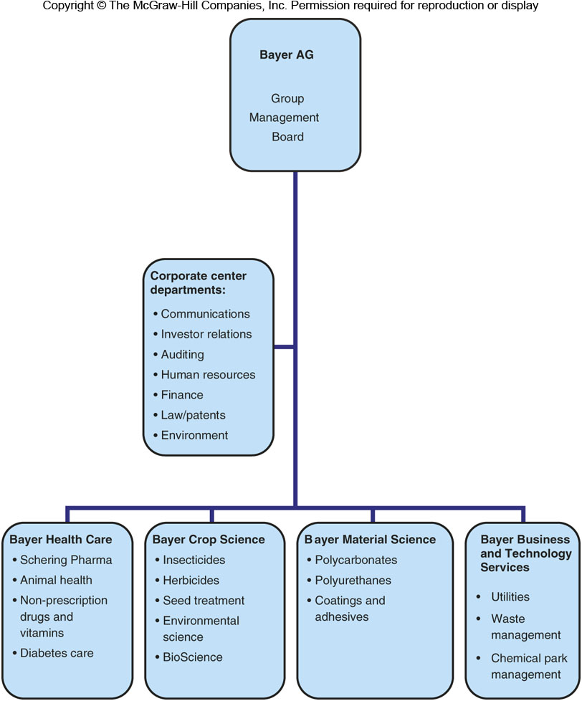
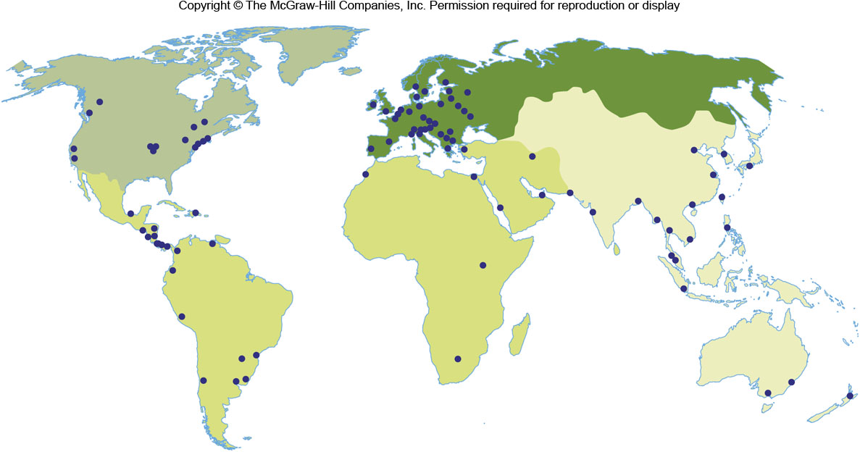
Location of Bayer’s Branch Plants
Figure 16F.3

Slide 26
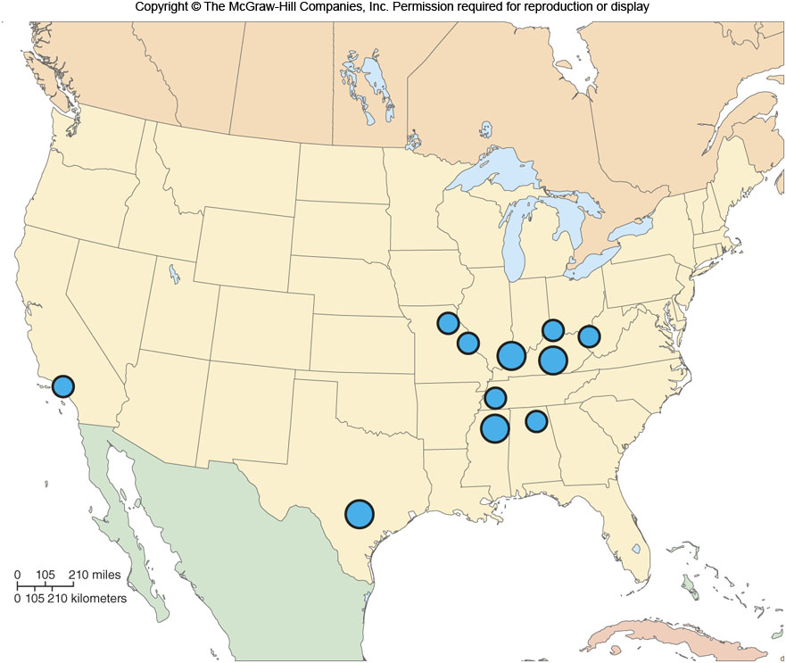
Toyota Plants in the US
Figure 16F.4

Slide 27
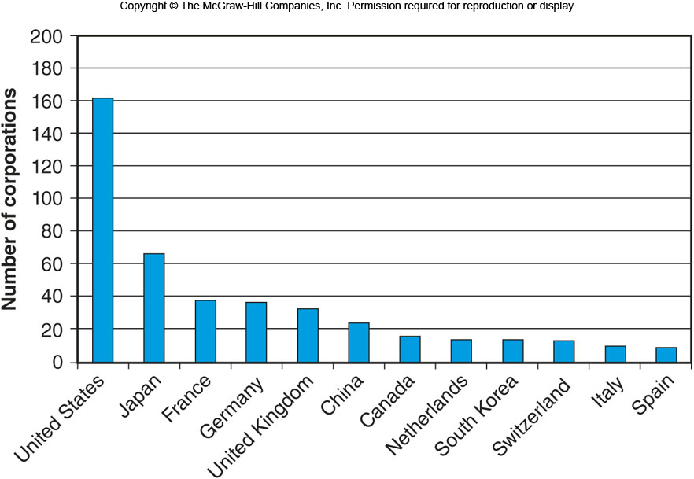
Corporations by Country
Figure 16F.5

Slide 28
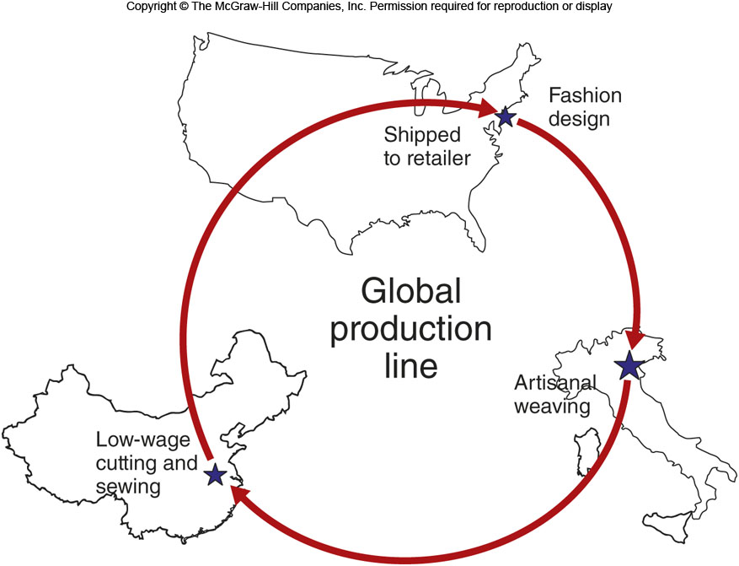
Global Production Lines
Figure 16F.7

Slide 29
16G: Geographies of Consumption
Consumption is interlinked with production
Mass consumption means more and more people are consuming “luxuries”
Conspicuous consumption
people feel a need to display their status by ostentatiously consuming goods and services
Commodity chains:
Design, Production, Marketing, Retail

Slide 30
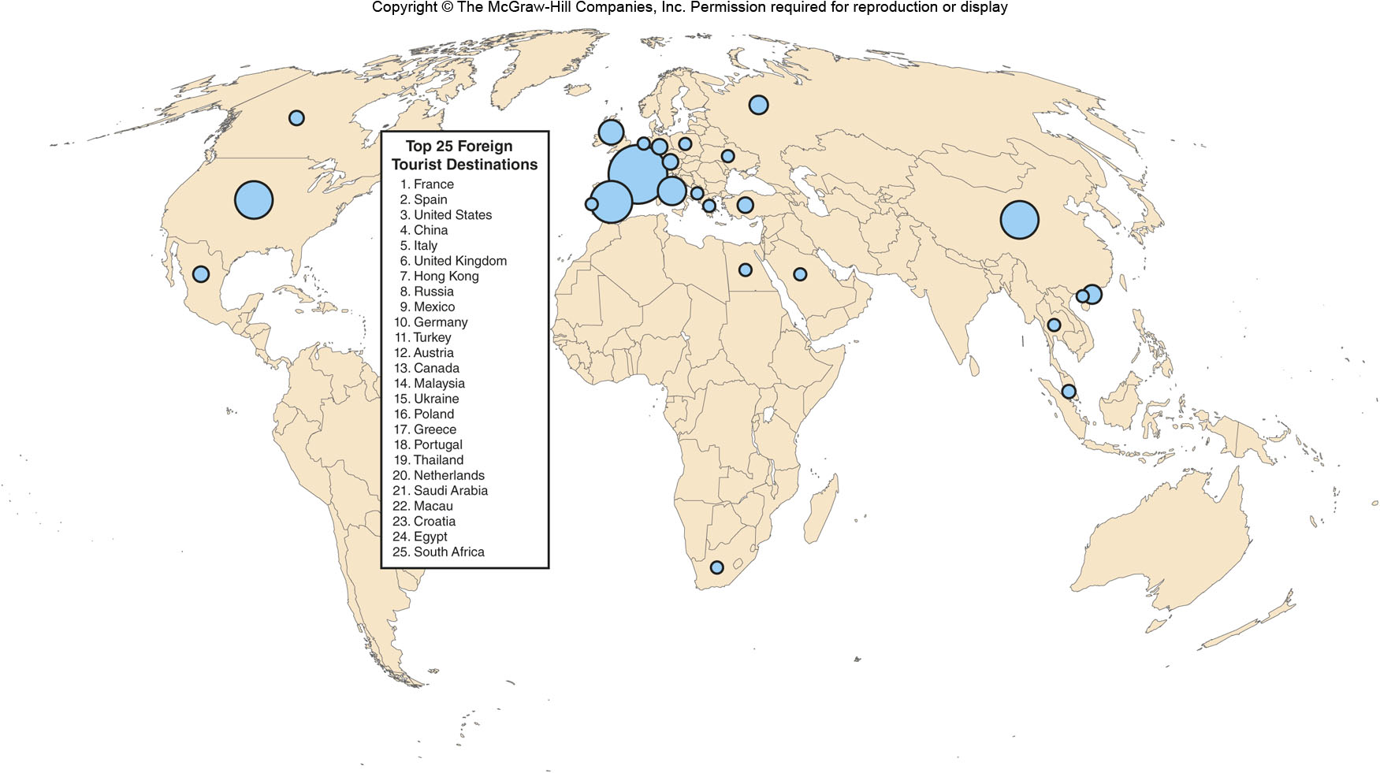
16H: Consuming Places: Geographies of Tourism
Figure 16H.2

