Slide 1
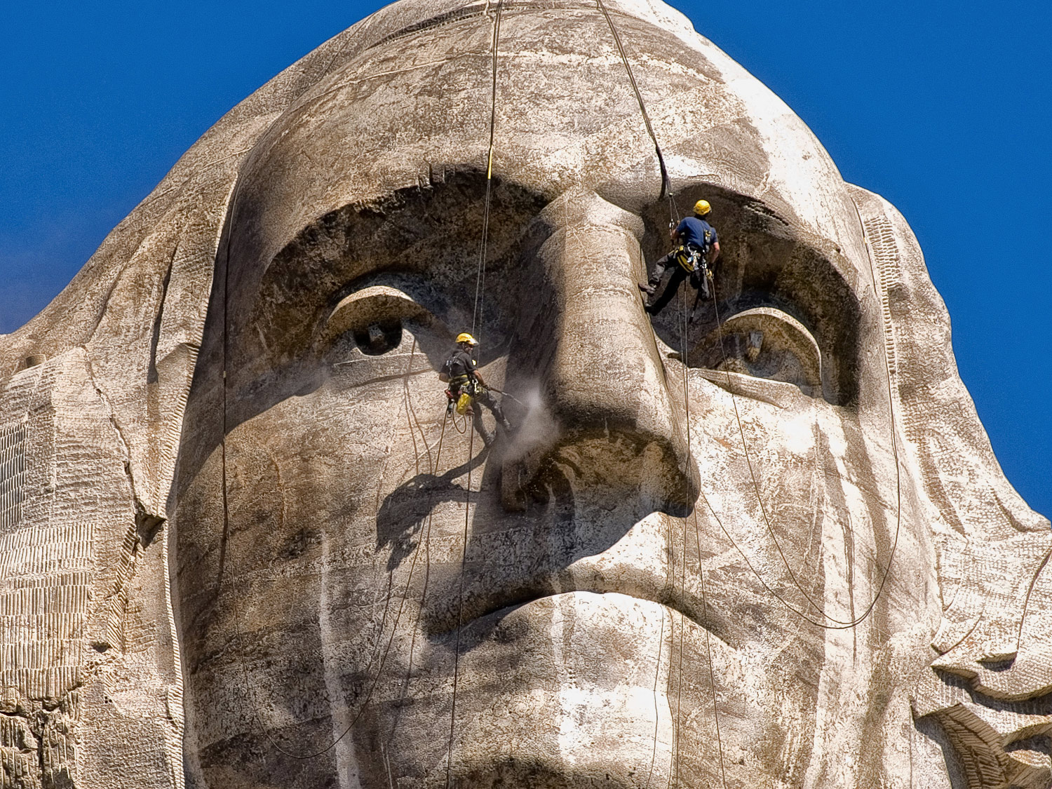
CHAPTER 6 LECTURE OUTLINE CULTURE & CULTURAL LANDSCAPES
Photo © Jon Malinowski.
All rights reserved. Used with permission.
Human Geography by Malinowski & Kaplan

Slide 2
Chapter 6 Modules
6A Culture and Cultural Geography
6B Culture Complexes
6C The Components of Culture
6D Cultural Diffusion
6E Culture Hearths
6F Cultural Landscapes
6G Folk Culture and American Foodways
6H Popular Culture: House Types
6I A Cultural Geography of Sports

Slide 3
6A: Culture Definitions
Culture
shared patterns of learned behavior, attitudes, and knowledge
Culture Trait
a single component of a culture
Culture Region
an area that shares a large # of culture traits
Culture Realm
Groupings of culture regions based on broad culture similarities

Slide 4
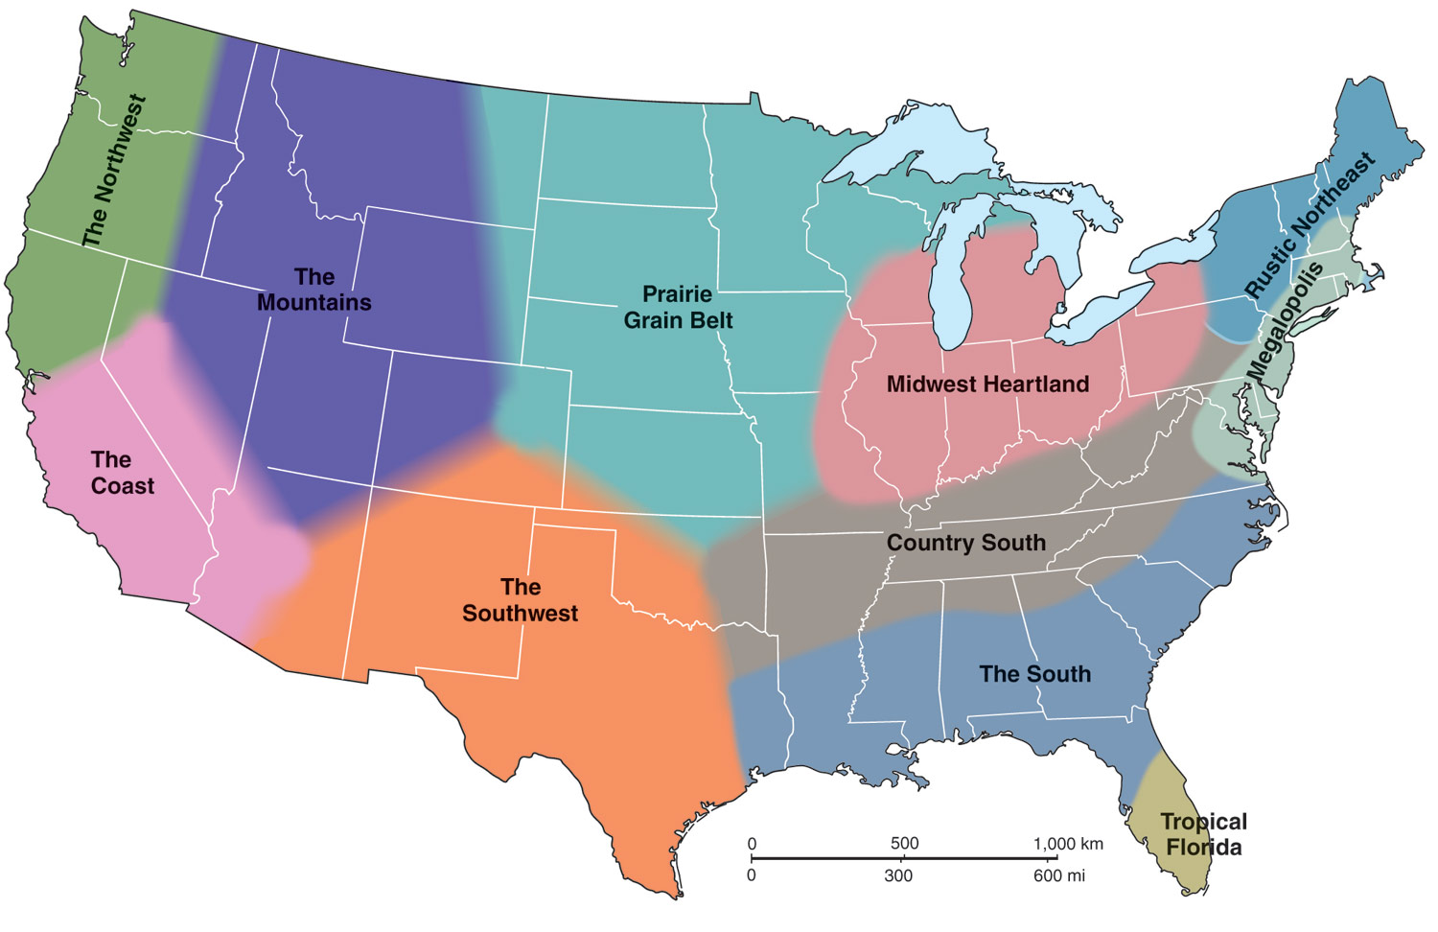
Figure 6A.2
What culture traits define each culture region?
Do you agree with the regionalization?

Slide 5
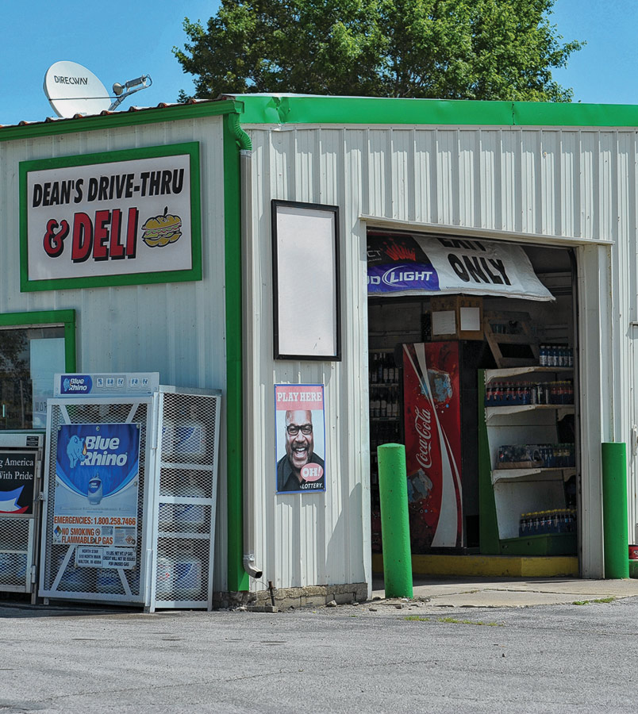
6B: Culture Complexes
Interrelated culture traits
Examples:
Cattle in Masai society
Cars in U.S. society
How are cars connected to numerous aspects of modern American culture?
Photo © Jon Malinowski.
All rights reserved. Used with permission.

Slide 6
6C: The Components of Culture
Technological Subsystem
the material objects that a culture produces, as well as the procedures for using those objects
artifacts
Sociological Subsystem
how people in a culture are expected to interact with each other and how their social institutions are structured
sociofacts
Ideological Subsystem
the ideas, beliefs, values, and knowledge of a culture
mentifacts

Slide 7
IDEOLOGICAL
SOCIOLOGICAL
TECHNOLOGICAL
The Components
of Culture

Slide 8
6D: Cultural Diffusion
Diffusion: the movement of people, ideas, or things from a point of origin to another location over time
Types of Diffusion:
Relocation: the diffusion of a particular phenomenon that results from the migration of people who practice that phenomenon
Contagious: the spread of phenomenon to nearby places
Hierarchical: movement of phenomenon from one place to other places that have some similarities
Often from large cities to small cities

Slide 9
6D: Cultural Diffusion
Gladwell’s Model
1st- idea/item alike are diffused through the efforts of a select group of people: “the law of the fews”
2nd- refers to people’s need to see a good reason for the idea/item and how it fits into their lives: “stickiness factor”
3rd- diffusion relies on prevailing conditions: the place and time have to be right to accept the new thing/item

Slide 10
6D: Cultural Diffusion
Hagerstrand’s Model
thing/idea – transfer – using any or simultaneous means:
communication
observation
marketing
physical

Slide 11
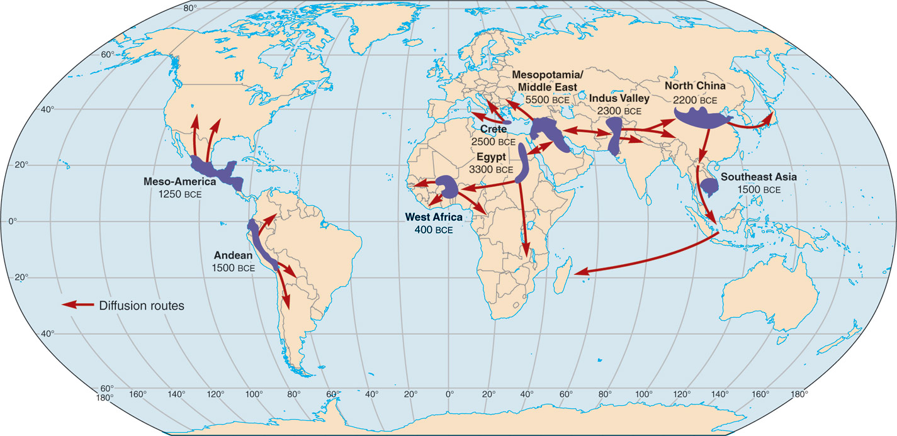
Figure 6E.1
MAJOR CULTURE HEARTHS
areas from which important culture traits, including ideas, technology, and social
structures, originated

Slide 12
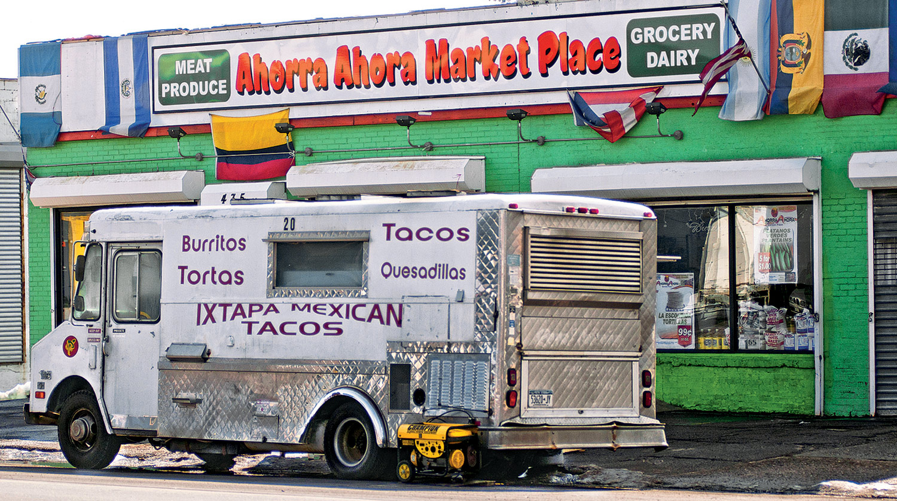
6F: Cultural Landscapes
The cultural impact on an area, including buildings, agricultural patterns, roads, signs, and nearly everything else that humans have created
Photo © Jon Malinowski.
All rights reserved. Used with permission.

Slide 13
Folk vs. Popular Culture
Folk Culture:
culture traits that are traditional, no longer widely practiced by a large amount of people, and generally isolated in small, often rural, areas
Popular Culture:
aspects of a culture that are widespread, fast-changing, and transmitted by the mass media

Slide 14
American Foodways
New England
Seafood, native vegetables, wheat & corn, items from trade
The South
African influence, heavy use of pork, corn products, rice
The Southwest
Mexican, Spanish, & Native American influences, beans, chili peppers
The Midwest
Strong European influence, local produce, cheese & cream, grains

Slide 15
6H: House Types
An example of how popular culture, in this case a house style, can become imprinted on the landscape and remain long after a style ceases to be popular

Slide 16
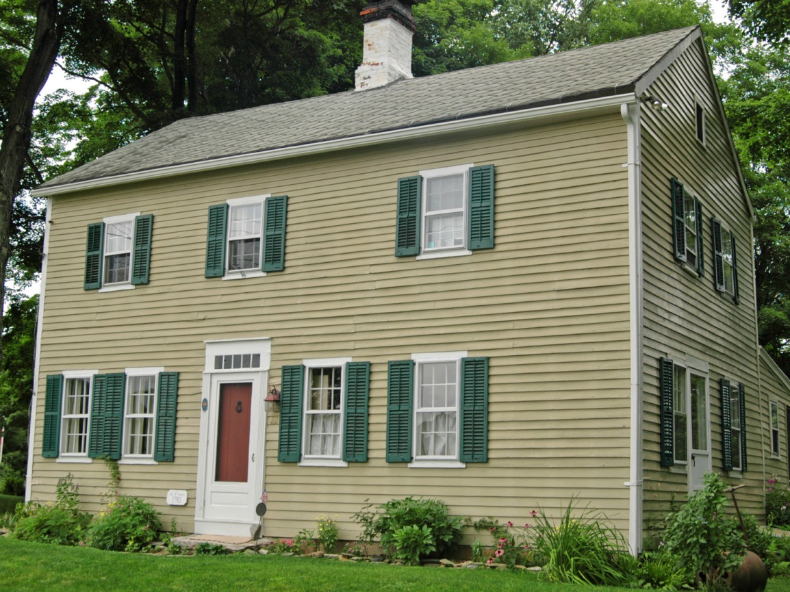
Photo © Jon Malinowski.
All rights reserved. Used with permission.
Georgian Style
Colonial Period

Slide 17
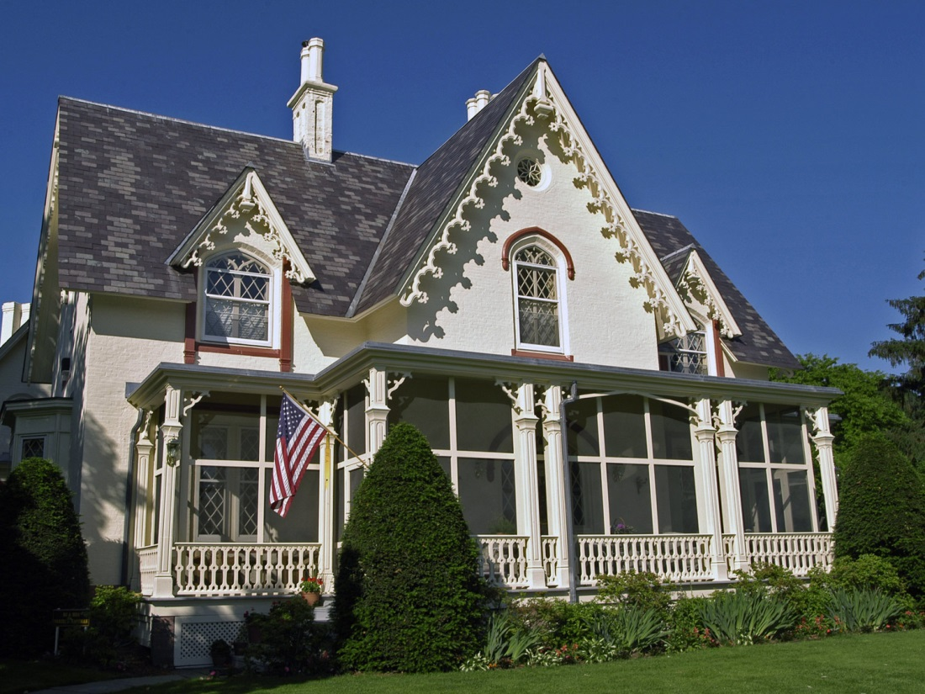
Photo © Jon Malinowski.
All rights reserved. Used with permission.
Gothic Revival Style
Mid-19th Century

Slide 18
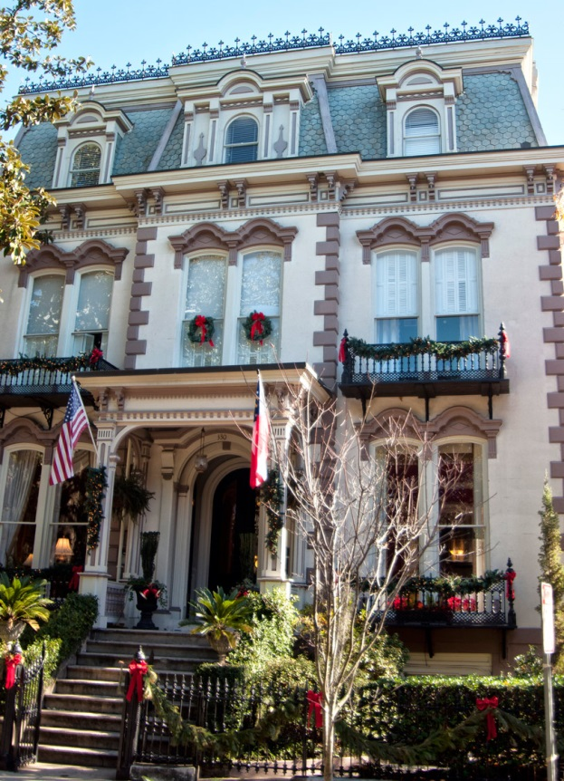
Second Empire Style
~1855-1875
Photo © Jon Malinowski.
All rights reserved. Used with permission.

Slide 19
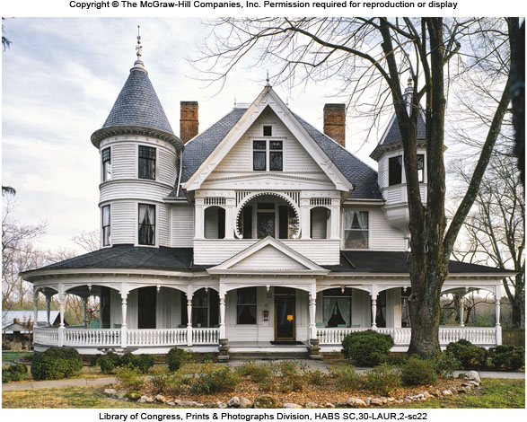
Victorian Homes
Late 19th Century

Slide 20
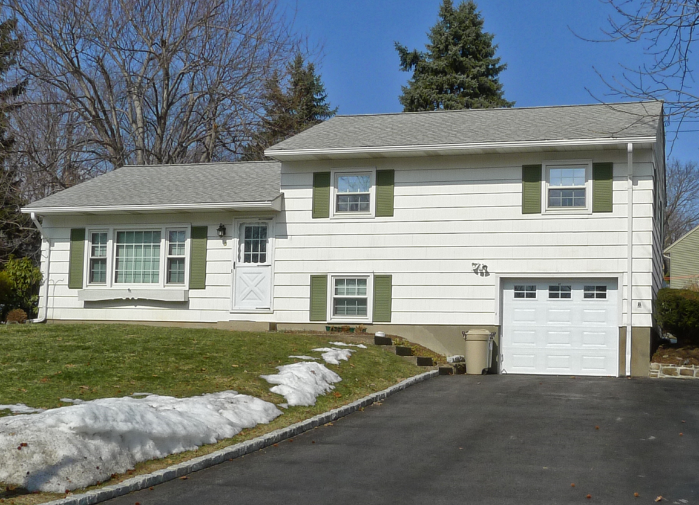
Photo © Jon Malinowski.
All rights reserved. Used with permission.
Modern Homes
1945-

Slide 21
6I: Cultural Geography of Sports
What do sports say about what our culture values?
How is the landscape modified to accommodate the cultural value on sports?

Slide 22
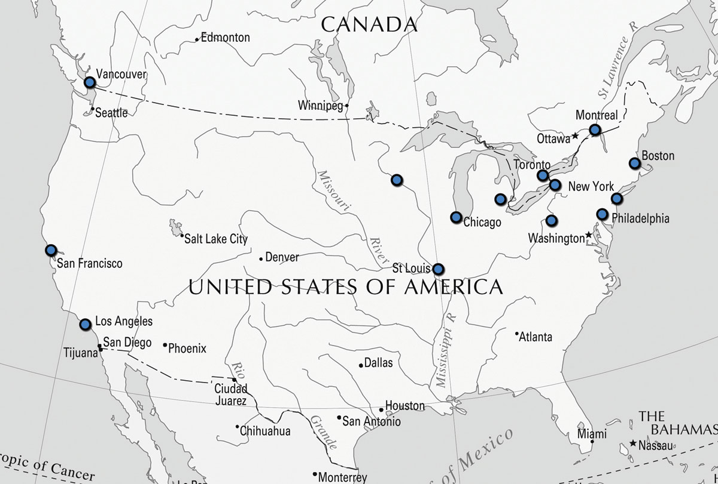
Figure 6I.1a
Pro Hockey Teams 1971

Slide 23
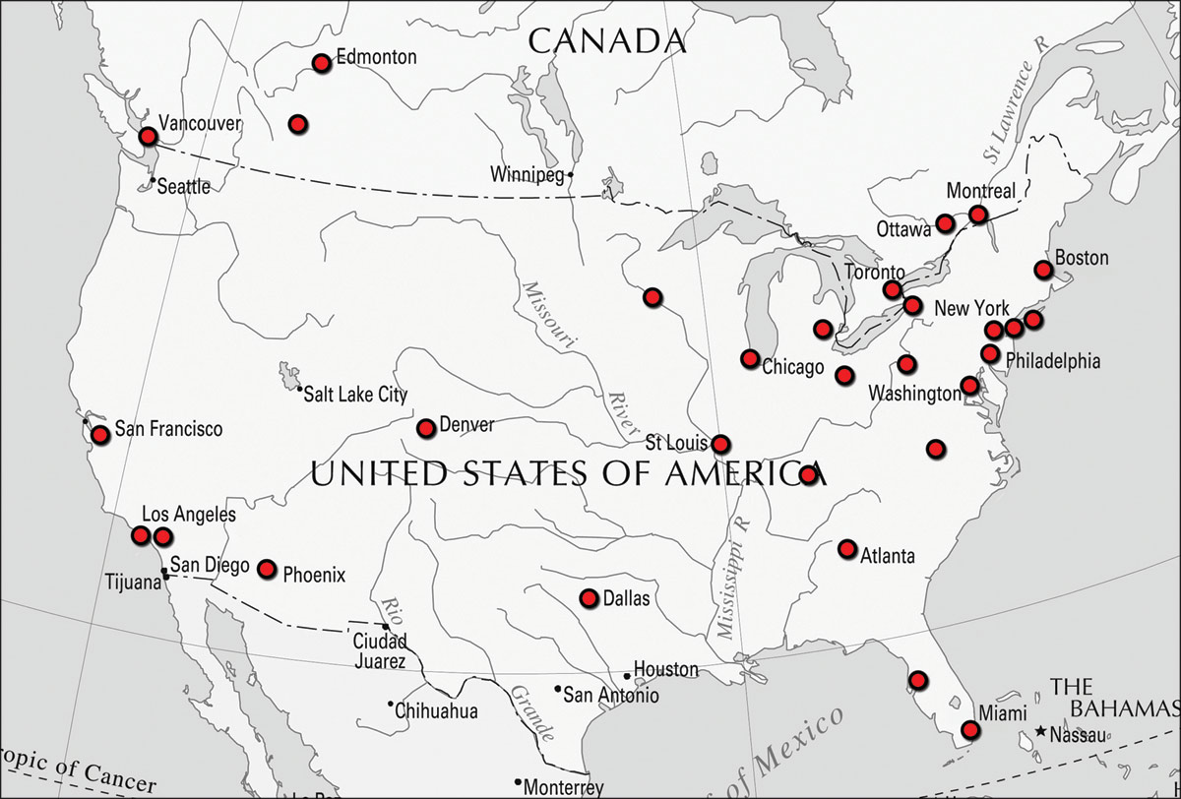
Figure 6I.1b
Pro Hockey Teams 2010

