Slide 1
Chapter 21
Reaching Out: Expanding Horizons of Cross-Cultural Interaction

Slide 2
Patterns of Long-Distance Trade
Silk roads
Sea lanes of Indian Ocean basin
Trans-Saharan caravan routes
Development of trading cities, emporia
Nomadic invasions cause local devastation but expand trade network
Example: Mongols in China, thirteenth century

Slide 3
Marco Polo (1253-1324)
Example of long-distance travel
Traveled to China with merchant father, uncle
Enters service of Mongol Khubilai Khan
Returns to Venice after 17-year absence
Experiences recorded by fellow prisoner in Venice-Genoa conflict
Great influence on European engagement with far east

Slide 4
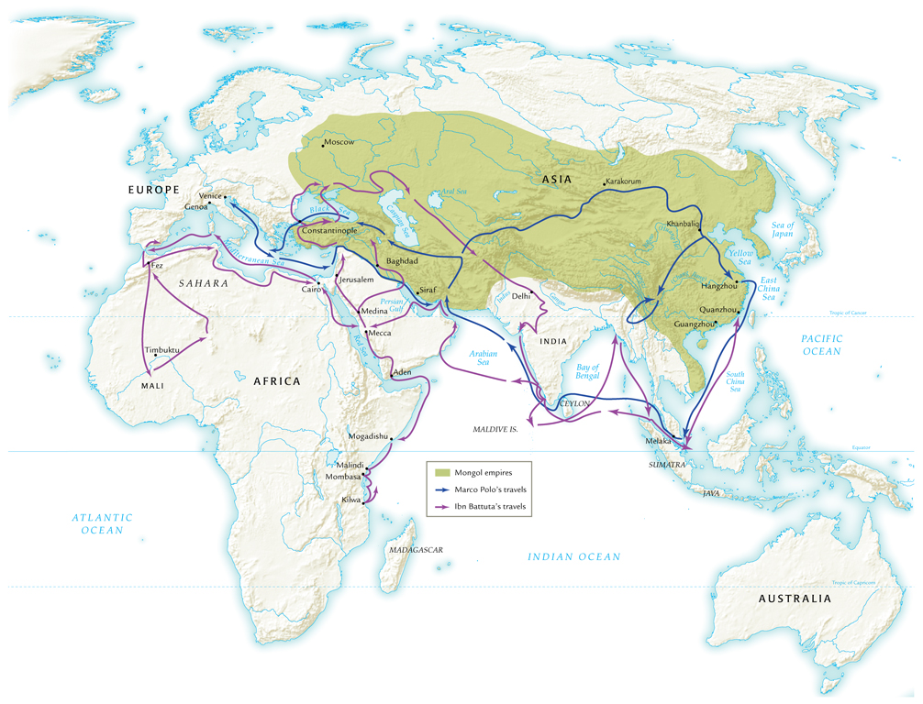
Travels of Marco Polo and Ibn Battuta

Slide 5
Political and Diplomatic Travel
Trade requires diplomatic relations after 1000 C.E.
Mongols, Christians recognize Muslims as common enemy, thirteenth century
Pope Innocent IV invites Mongols to convert to Christianity
Mongols counter-offer: Christians accept Mongol rule or face destruction

Slide 6
Diplomatic Travelers
Rabban Sauma
Nestorian Christian priest sent to pope by Mongols in Persia, 1287, regarding proposed attack on Jerusalem
Did not win European support
1295, new leader of Persia accepts Islam

Slide 7
Diplomatic Travelers
Ibn Battuta (1304-1369)
Islamic scholar, worked in governments on extensive travel
Strict punishment meted out according to sharia
Lashes for drinking alcohol, hand amputations for theft
Unable to convince women of Maldive Islands to cover breasts

Slide 8
Missionary Travelers
Sufi missionaries travel throughout new Muslim territories, 1000-1500 C.E.
Christian missionaries accompany, follow crusaders
Roman Catholic priests travel east to serve expatriate communities
John of Montecorvino travels to China in 1291
Translates Biblical texts, builds churches

Slide 9
Cultural Exchanges
Songs and stories – troubadours
European scientists consulted with Muslim and Jewish counterparts on understanding of natural world
Magnetic compass from China

Slide 10
Spread of Crops
Citrus fruits, Asian rice, cotton
Sugarcane
Muslims introduce crystallized sugar to Europeans
Demand increases rapidly
Europeans use Muslim precedent of having large populations of slaves work on sugarcane plantations

Slide 11
Gunpowder Technologies
Muslims, Mongols spread gunpowder
Technology reaches Europe by mid-thirteenth century

Slide 12
Crisis and Recovery
“Little ice age,” ca. 1300 C.E.
Decline of agricultural output leads to widespread famine
Bubonic plague spreads from southwest China
Carried by fleas on rodents
Mongol campaigns spread disease to Chinese interior

Slide 13
Spread of Plague
Mongols, merchants, travelers spread disease west
1346 Black Sea ports
1347 Mediterranean ports
1348 western Europe

Slide 14
Symptoms of the Black Plague
Inflamed and discolored lymph nodes in neck, armpits, groin area
Buboes, hence bubonic
60-70% mortality rate, within days of onset of symptoms
Extreme northern climates less affected
Winter hard on flea population
India, sub-Saharan areas unaffected
Reasons unknown

Slide 15
Population Decline (millions)

Slide 16
Social and Economic Effects
Massive labor shortage
Demand for higher wages
Population movements
Governments attempt to freeze wages, stop serf movements
Riots result

Slide 17
Recovery in China: The Ming Dynasty
Yuan dynasty collapses 1368, Mongols depart
Impoverished orphan raised by Buddhist monks, works through military ranks, becomes Emperor Hongwu
Proclaims new Ming (“brilliant”) dynasty, 1368-1644

Slide 18
Ming Centralization
Reestablishment of Confucian educational system
Execution of minister suspected of treason, begins tradition of direct rule by emperor
Reliance on emissaries called mandarins
Heavy reliance on eunuchs
Sterile, could not build hereditary power base
Centralized structure lasts through Qing dynasty to 1911

Slide 19
Economic Recovery
Conscripted labor to repair, rebuild irrigation systems
Promoted manufacturing of porcelain, silk
Cultural revival
Attempt to eradicate Mongol legacy by promoting traditional Chinese culture
Emperor Yongle commissions 23,000-roll Encyclopedia

Slide 20
Recovery in Western Europe: State Building
China: centralized empire
Europe: regional states
Europe develops new taxes
Italian states: bonds
France: salt tax, sales tax
England: hearth tax, head tax, plow tax
Establish large standing armies
French Louis XI (1461-1483) had army of 15,000

Slide 21
Spain
Fernando of Aragon marries Isabel of Castile, 1469
Major political and economic alliance
Completes reconquista, expanded beyond Iberian peninsula to Italy
Funded Columbus’s quest for China

Slide 22
The Renaissance, Fourteenth to Sixteenth Century
“Rebirth” of classical culture
Italian artists use perspective
Work with real human anatomy and musculature
Leonardo da Vinci (1452-1519)
Architecture: domed cathedrals
Imitation of Roman domes

Slide 23
The Humanists
Humanities: literature, history, moral philosophy
Renaissance humanists deeply devoted to Christianity
Desiderius Erasmus (1466-1536) publishes critical Greek-Latin edition of New Testament
Also devoted to rediscovering classical Latin texts, often ignored in monastic libraries

Slide 24
Humanist Moral Thought
Rejection of monastic lifestyle in favor of morally virtuous life while engaged in the world
Marriage, business
Reconciliation of Christianity with rapidly changing European society and economy

Slide 25
Renaissance Europe and the Larger World
Artists express interest in Byzantine, Asian worlds
Giovanni Pico della Mirandola (1463-1494) tries to reconcile Plato, Aristotle, Judaism, Christianity, Islam, Zoroastrianism
Illustrative failure

Slide 26
Exploration and Colonization
Ming dynasty hesitant to have large foreign populations
Mongol experience
Allowed small populations in port cities
Yongle engaged Admiral Zheng He to mount seven massive naval expeditions, 1405-1433
Placed trade under imperial control
Demonstrated strength of Ming dynasty
Successful, but aborted as Mongols presented new threat in the north

Slide 27
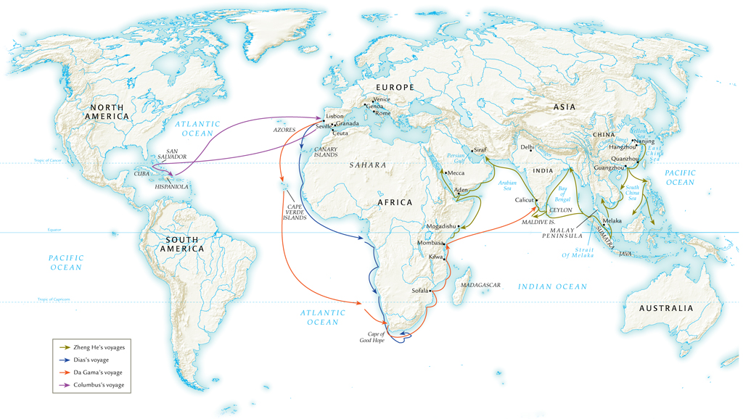
Chinese and European Voyages of Exploration, 1405-1498

Slide 28
European Exploration in the Atlantic and Indian Oceans
Motives: profit, missionary activity
Portuguese early leaders in Atlantic exploration
Search for sea route to Indian Ocean basin
Prince Henrique (Henry the Navigator) seizes Strait of Gibraltar, 1415
Begins encouragement of major Atlantic voyages

Slide 29
Colonization of the Atlantic Islands
Madeiras, Azores Islands, etc.
Investments in sugarcane plantations
Exploration of west African coast
Dramatically increases volume of slave trade
Ultimately, some 12 million Africans deported to Americas for slave labor

Slide 30
Indian Ocean Trade
Attempt to avoid using Muslim middlemen in trade with east
1488, Bartolomeu Dias sails around Cape of Good Hope
1497-1499, Vasco da Gama sails this route to India and back
Portuguese gun ships attempt to maintain trade monopoly
Beginnings of European imperialism in Asia

Slide 31
Christopher Columbus
Search for western sea route to Indian Ocean
Portuguese consider his proposal impractical, reject it
Fernando and Isabel of Spain underwrite voyage; departs in 1492
Makes landfall in San Salvador
Believed he had reached islands off coast of Asia

