Slide 1
Chapter 22
Transoceanic Encounters and Global Connections

Slide 2
Portuguese Exploration
Originally for fishing
Land hunger
Discovery of Azores, Madeiras Islands
Acquisition of land to plant sugarcane

Slide 3
The Lure of Trade
Maritime routes to Asia
Spices, silk, porcelain
Silk roads more dangerous since spread of bubonic plague
Prices, profits increase
Indian pepper, Chinese ginger increasingly essential to diet of European wealthy classes
African gold, ivory, slaves

Slide 4
Missionary Efforts
Franciscan, Dominican missionaries to India, central Asia and China
Violent efforts with crusades, reconquista

Slide 5
The Technology of Exploration
Chinese rudder introduced in twelfth century
Square sails replaced by triangular lateen sales
Work better with cross winds
Navigational instruments
Knowledge of winds, currents
The volta do mar
“Return through the sea”

Slide 6
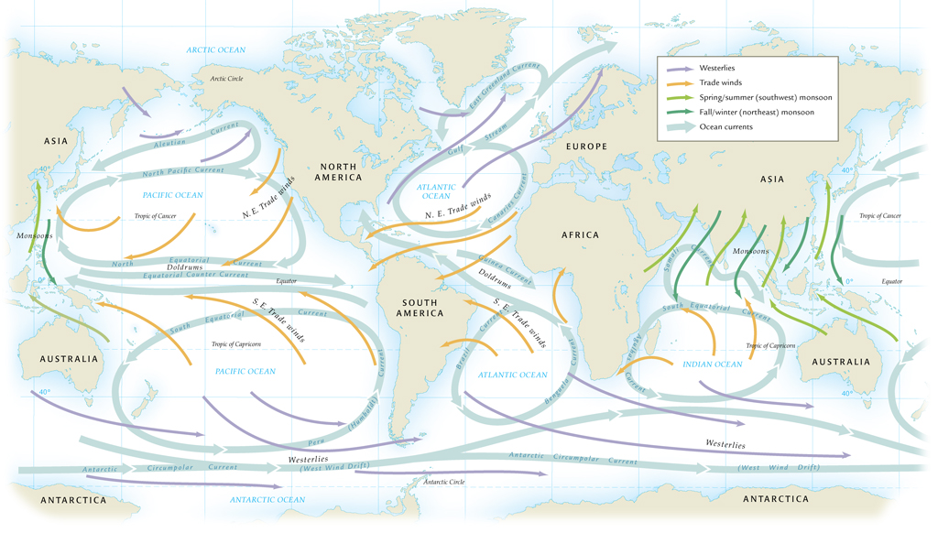
Wind and Current Patterns in the World’s Oceans

Slide 7
Portuguese Breakthroughs
Prince Henry of Portugal (1394-1460)
Promoted exploration of west African coast
Established fortified trading posts
1488, Bartolomeu Dias rounds Cape of Good Hope, enters Indian Ocean basin
Storms and restless crew force return
Vasco da Gama reaches India by this route, 1497
By 1500, a trading post at Calicut

Slide 8
Christopher Columbus (1451-1506)
Believed Earth was smaller
Estimated Japan approximately 2,500 miles west of Canaries (actually 10,000 miles)
Portuguese kings do not fund proposed westward trip
Fernando and Isabel of Spain, Italian bankers underwrite voyage
Discovers Bahamas, Cuba

Slide 9
Hemispheric Links
Columbus tries three times, never reaches Asia
But by early sixteenth century, several powers follow
English, Spanish, French, Dutch
Realization of value of newly discovered Americas

Slide 10
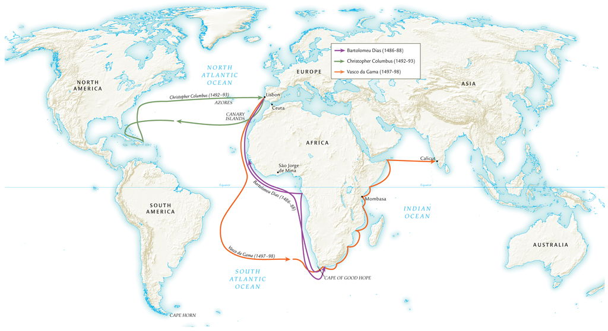
European Exploration in the Atlantic Ocean, 1486-1498

Slide 11
Circumnavigation of the Globe
Vasco Nuñez de Balboa finds Pacific Ocean while searching for gold in Panama, 1513
Distance to Asia unknown
Ferdinand Magellan (1480-1521) not supported by Portuguese, sails in service of Spain
Sails through Strait of Magellan at southern tip of South America
Crew assailed by scurvy, only 18 of 250 sailors return to Spain from journey
Magellan killed in local political dispute in Philippines

Slide 12
Exploration of the Pacific
Spanish build Philippines-Mexico trade route
English, Russians look for northwest passage to Asia
Most of route clogged by ice in Arctic circle
Norwegian Roald Amundsen completes route only in twentieth century
Sir Frances Drake (England) explores west coast of North America
Vitus Bering (Russia) sails through Bering Strait
James Cook (England) explores southern Pacific

Slide 13
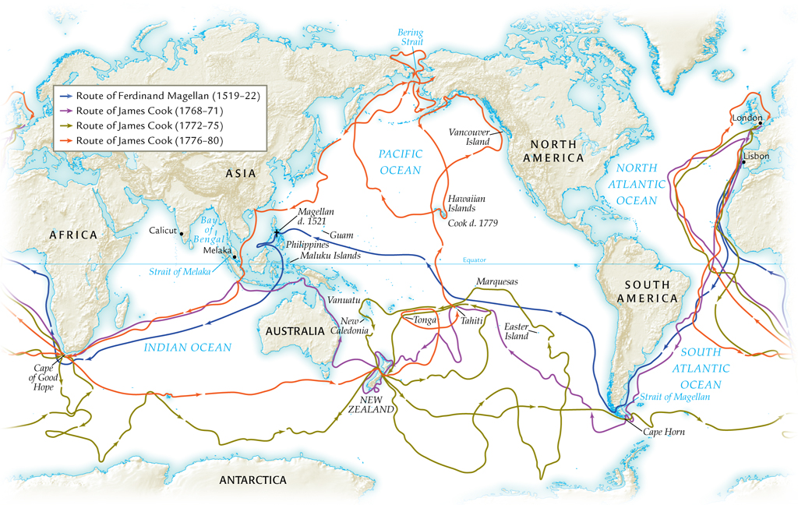
European Exploration, Cook’s Voyages in the Pacific Ocean, 1519-1780, and Magellan’s Voyages

Slide 14
Establishment of Trading-Post Empires
Portuguese first to set up trading posts
Fifty by mid-sixteenth century
Not to establish trade monopolies, rather to charge duties
Afonso d’Alboquerque major naval commander
Architect of trade duties policy; violators would have hands amputated
Yet Arab traders continue to operate
Portuguese control declines by end of 16th century

Slide 15
English and Dutch Trading Posts
Rival, parallel trading networks
English concentrate on Indian trade
Dutch in Cape Town, Colombo, southern Pacific

Slide 16
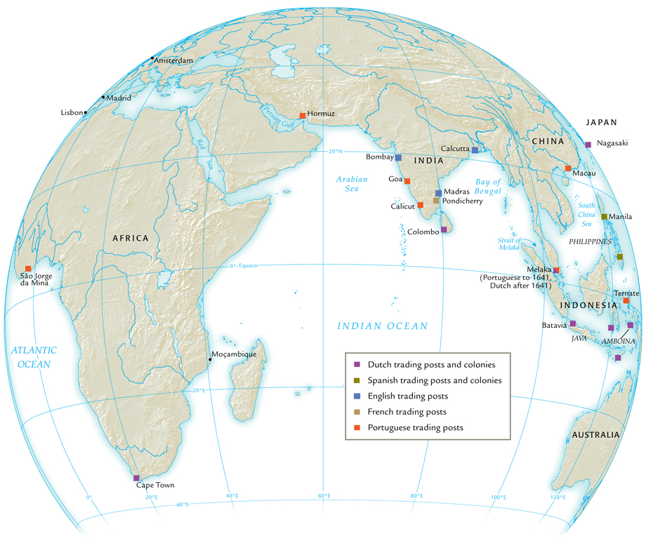
European Trading Posts in Africa and Asia, about 1700

Slide 17
The Trading Companies
Advantage of Dutch and English over Portuguese
English East India Company, established 1600
Dutch United East India Company (VOC), established 1602
Privately owned ships, government support
Empowered with right to engage in trade, build posts, even make war
Exceptionally profitable

Slide 18
European Conquests in Southeast Asia
Spanish conquer Philippines, name them after King Philip II
Manila becomes major port city
Influx of Chinese traders, highly resented by Spanish, Filipinos
Frequent massacres throughout seventeenth, up to nineteenth century
Significant missionary activity
Dutch concentrate on spice trade in Indonesia
Establish Batavia, trading post in Java
Less missionary activity

Slide 19
Russian Expansion in Asia
Russians take over Mongol khanates, sixteenth century
Astrakhan becomes major trading city
Caucasus absorbed in eighteenth century
Siberian expansions in sixteenth to seventeenth century
Trade with indigenous Siberian peoples
Little success with missionary efforts
Some local rebellions

Slide 20
Russian Occupation of Siberia
Criminals, prisoners of war exiled to Siberia
Disgruntled peasants migrate east
Trading posts develop
Russian population expands dramatically
In 1763: 420,000 Russians in Siberia, outnumber indigenous peoples 2:1

Slide 21
Russian Convict Village in Siberia

Slide 22
The Seven Years’ War (1756-1763)
Commercial rivalries between empires at sea
Global conflict erupts: multiple theatres in Europe, India, Caribbean, North America
North America: merges with French and Indian War, 1754-1763
British emerge victorious, establish primacy in India, Canada

Slide 23
The Columbian Exchange
Named for Christopher Columbus
Global diffusion:
Plants and crops
Animals
Human populations
Disease pathogens
Links between previously independent biological zones
Permanently alters human geography, natural environment

Slide 24
Epidemic Diseases and Population Decline
Smallpox
Also measles, diphtheria, whooping cough, influenza
No prior exposure to these diseases in western hemisphere or Oceania
No inherited, acquired immunities
1519 smallpox in Aztec empire
Population declines 90% within 100 years (17 million to 1.3 million)

Slide 25
Food Crops and Animals
Columbian exchange also increases overall food supply
Introduction of European animals to Americas
Horses, cattle, pigs, chickens, etc.
Introduction of American foods to Europe, Asia, Africa
Maize, potatoes, beans, etc.

Slide 26
World Population Growth, 1500-1800 C.E.

Slide 27
Migration
Enslaved Africans
To South America, North America, Caribbean
European pioneers

Slide 28
Origins of Global Trade
Transoceanic trade in Atlantic Ocean basin
Manufactured goods from Europe
Raw goods from Americas
The Manila galleons
1565-1815, Spanish galleons dominate Pacific Ocean trade
Chinese luxury goods for American raw materials, especially silver

Slide 29
Environmental Effects of Global Trade
Fur-bearing animals hunted to extinction or near-extinction
Also whales, codfish, other animals with industrial uses
Relentless human exploitation of the natural environment

