Slide 1
Chapter 24
New Worlds: The Americas and Oceania

Slide 2
The Spanish Caribbean
Spanish mariners meet indigenous Taíno (Arawaks)
Originally from Orinoco River valley in South America; settled in Caribbean in late centuries B.C.E. through 900 C.E.
Columbus uses Hispaniola (Haiti and Dominican Republic) as base for trading with Taíno
Disappointed that Taíno had no spices, silks
Recruit locals to mine gold instead
Encomienda: forced labor

Slide 3
From Mining to Plantation Agriculture
Taíno occasionally rebel, but outgunned by Spanish military technology
Smallpox epidemics begin 1518
Spaniards launch raids to kidnap and replace workers, spread disease further
Taíno society disappears by middle of sixteenth century
Limited gold production causes new interest in exploiting Caribbean for sugarcane production
Requires massive importation of slaves

Slide 4
Conquest of Mexico and Peru
Spanish conquerors (conquistadores) explore other territories
Hernán Cortés and 450 men bring down Aztec empire in Mexico (1519-1521)
Smallpox destroys besieged Tenochtitlan
Francisco Pizarro and 600 men bring down Inca empire in Peru (1532-1533)
Calls conference of warring Inca rulers, massacres them all

Slide 5
Spanish Colonial Administration
Spanish administration based in New Spain (Mexico) and New Castile (Peru), extended to Florida and Buenos Aires
Mexico city built atop Tenochtitlan, founded Lima in Peru
Viceroys rule, but supervised by local courts called audiencias designed to prevent buildup of local power bases
Considerable dispute with Spanish homeland

Slide 6
Portuguese Brazil
1494 Treaty of Tordesillas divides entire (non-Christian) world between Spain and Portugal
Portugal claims Brazil
Little interest at first, but increases as other imperial powers take notice
Exploited for sugarcane production

Slide 7
Settler Colonies in North America
Spanish towns, forts, missions on east coast of North America, some on west coast
Dislodged in seventeenth century by French, English, Dutch mariners
Permanent colonies in North America
France: Nova Scotia (1604), Quebec (1608)
England: Jamestown (1607), Massachusetts Bay Colony (1630)
Netherlands: New Amsterdam (1623)
English take it in 1664, rename it New York

Slide 8
Colonial Government
Exceptionally difficult conditions
Starvation rampant, cannibalism occasionally practiced
French and English private merchants invest heavily in expansion of colonies
Greater levels of self-government than Spanish and Portuguese colonies

Slide 9
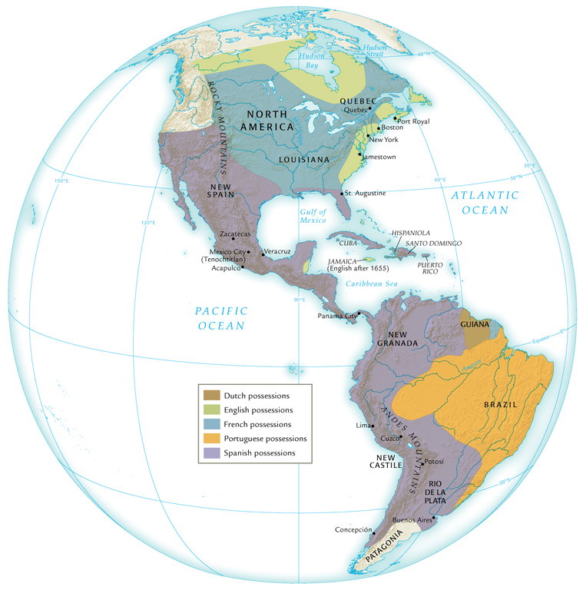
European Empires and Colonies in the Americas, about 1700

Slide 10
Relations with Indigenous Peoples
North American peoples loosely organized, migratory
Unlike Aztec, Inca empires
European colonists stake out forested land, clear it for agriculture
Increasing number of Europeans arrive seeking ample land: 150,000 from England in seventeenth century

Slide 11
Conflict with Indigenous Peoples
Colonists displace indigenous peoples, trespass on hunting grounds
English settlers negotiate treaties, poorly understood by natives
Military conflict frequent
Natives also devastated by epidemic disease

Slide 12
North American Populations

Slide 13
The Formation of Multicultural Societies
European, African migrants primarily men
Relationships with native women formed
Mestizo (mixed) societies formed
People of Spanish and native parentage
Descendants of Spaniards and African slaves (“mulattoes”)
Descendants of African slaves and natives (“zambos”)
Less pronounced in Peru

Slide 14
The Social Hierarchy
Race-based hierarchy
Top: peninsulares, i.e. migrants from Iberian peninsula
Criollos (creoles), i.e. children of migrants
Mestizos, mulattoes, zambos, other combinations of parentage
Bottom: slaves, conquered peoples
Defining factor in social standing: sexual hierarchy

Slide 15
North American Societies
Higher ratio of French, English female migrants than in South America
Higher social stigma attached to relationships with natives, African slaves
Fur traders have relationships with North American native women
Children: métis

Slide 16
Mining in the Spanish Empire
Hunt for gold and silver
Conquistadores loot Aztec, Inca treasures and melt them down for their value as raw precious metals
Gold not extensive in Spanish holdings, but silver relatively plentiful
Extensive employment of natives
Inca, mita system of conscripted labor
Dangerous working conditions
Eventually assimilate into Spanish culture
Fifth reserved for crown (quinto), hugely profitable

Slide 17
Global Significance of Silver
Major resource of income for Spanish crown
Manila galleons take it to the Pacific rim for trading
Very popular with Chinese markets
Also trade in the Atlantic basin

Slide 18
The Hacienda
Large estates produce products of European origin
Wheat, grapes, meat
Encomienda system of utilizing native labor force
Rampant abuses 1520-1540
Gradually replaced by debt peonage
Peasants repay loans with cheap labor

Slide 19
A Hacienda in Chile

Slide 20
Resistance to Spanish Rule
Rebellion
1680 Pueblo Revolt
1780 Túpac Amaru rebellion
Half-hearted work
Retreat into mountains and forests
Appeal to Spanish crown
1,200-page letter of Felipe Guaman Poma de Ayala, 1615

Slide 21
Sugar and Slavery in Portuguese Brazil
Sugar mill: engenho, refers to complex of land, labor, etc. all related to production of sugar
Sugarcane to molasses, or refined to sugar for export
Low profit margins
Unlike Spanish system of forced native labor, Portuguese rely on imported African slaves
Natives continually evaded Portuguese forces
Large-scale importing of slaves begins 1580s
Working conditions poor: 5-10% die annually
Approximately one human life per ton of sugar

Slide 22
Fur Trading in North America
Indigenous peoples trade pelts for wool blankets, iron pots, firearms, alcohol
Beaver hunts cause frequent incursions into neighboring territories, conflicts
Beaver Wars, Iroquois against Hurons
European settler-cultivators also displacing natives from traditional lands
Initially dependent on native assistance, as European grains did not grow well in many areas

Slide 23
Development of Cash Crops
Products developed for European markets
Tobacco
Rice
Indigo
Cotton
Increases demand for imported slave labor
European indentured servants, 4- to 7-year terms
Chronically unemployed, orphans, political prisoners, and criminals

Slide 24
Export of Tobacco from Virginia

Slide 25
Slavery in North America
African slaves in Virginia from 1619
Increasingly replace European indentured laborers, late seventeenth to early eighteenth centuries
Less prominent in north due to weak nature of cash-crop industry
Slave trading still important part of economy
Also, products made through slave labor
Rum, based on sugar from plantations

Slide 26
Missionary Activity in the Americas
Franciscan, Dominican, Jesuit missionaries from sixteenth century
Taught Christian doctrine, literacy
Often accumulated cultural knowledge to better communicate their message
Bernardino de Sahagún
Due to conquest and plague, many natives in Spanish America concluded gods had abandoned them; converted to Catholicism
Often retained elements of pagan religion in Christian worship

Slide 27
The Virgin of Guadalupe

Slide 28
French and English Missions
Less effective than Spanish missions
Spaniards ruled native populations more directly
Migration patterns of North American natives made it more difficult to conduct missions
English colonists had little interest in converting natives

Slide 29
Australia and the Larger World
Broadly similar experiences to American natives
Portuguese mariners long in the region, but Dutch sailors make first recorded sighting of Australia in 1606
VOC surveys territory, conclude it is of little value
Limited contact with indigenous peoples
Nomadic, fishing and foraging societies
British Captain James Cook lands at Botany Bay, 1770
Convicts shipped to Australia, outnumber free settlers until 1830

Slide 30
Australian Aborigine

Slide 31
Pacific Islands and the Larger World
Manila galleons interested in quick trade routes, little exploration of Pacific
Islands of Guam and the Marianas significant, lay on trade routes
1670s-1680s took control of islands, smallpox destroys local population
James Cook visits Hawai`i in 1778
Good relationship with Hawaiians
Sailors spread venereal disease
Cook not welcomed in 1779, killed in dispute over petty thefts

Slide 32
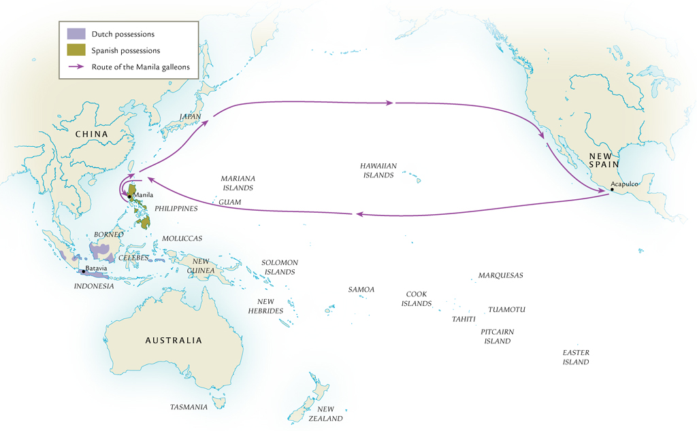
Manila Galleon Route and the Lands of Oceania, 1500-1800

