Slide 1
Chapter 27
The Islamic Empires

Slide 2
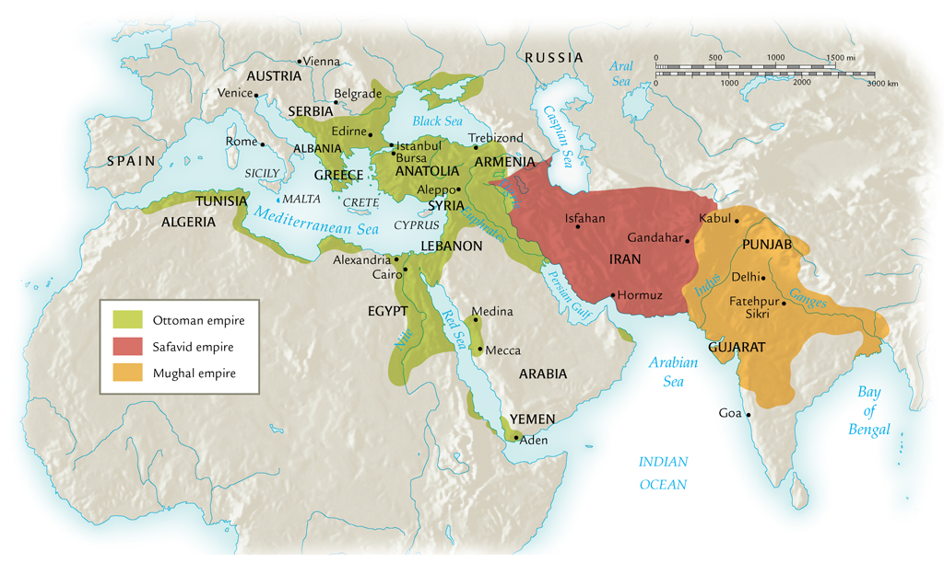
The Islamic Empires, 1500-1800

Slide 3
The Ottoman Empire (1289-1923)
Osman leads bands of semi-nomadic Turks to become ghazi: Muslim religious warriors
Captures Anatolia with light cavalry and volunteer infantry
Later, heavy cavalry
In Balkans, forced Christian families to surrender young boys to military service: devshirme
Often grew up to be exceptionally loyal Janissaries

Slide 4
Mehmed II (“the Conqueror,” r. 1451-1481)
Capture of Constantinople, 1453
Renamed Istanbul
Transformation from warrior sultan to emperor of “two lands” (Europe, Asia) and “two seas” (Black Sea, Mediterranean)
Planned to capture pope, unsuccessful

Slide 5
Süleyman the Magnificent (r. 1520-1566)
Expanded into Asia, Europe
Besieged Vienna, 1529
Develops naval power

Slide 6
The Safavid Empire
Ismail young military leader, r. 1501-1524
Orphaned, parents killed by enemies
Becomes shah, proclaims official religion of realm Twelver Shiism
Twelve infallible imams after Muhammad
Twelfth imam in hiding, ready to take power
Wore distinctive red hat, called qizilbash (“red heads”)
Empire called Safavid after Safi al-Din (1252-1334), Sufi thinker

Slide 7
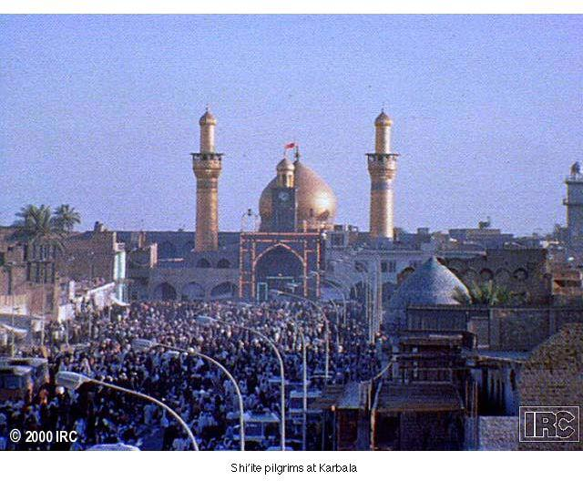
Shiite Pilgrims at Karbala

Slide 8
Battle of Chaldiran (1514)
Ottomans attack Safavids
Heavy use of Ottoman gunpowder technology give them the upper hand
Ismail escapes, two centuries of ongoing conflict
Shah Abbas the Great (r. 1588-1629) revitalizes weakened Safavid empire
Reforms administration, military
Expands trade
Military expansion

Slide 9
The Mughal Empire
Zahir al-Din Muhammad (Babur the Tiger), Chaghatai Turk, invades northern India for plunder, 1523
Gunpowder technology gives Babur advantage
Founds Mughal (Persian for Mongol) dynasty
Expands through most of Indian subcontinent

Slide 10
Akbar (r. 1556-1605)
Grandson of Babur
Wins fear and respect after throwing Adham Khan, leader of the army, out the window twice
Second time just to make sure he was dead
Created centralized government
Destroyed Hindu kingdom of Vijayanagar
Religiously tolerant, promoted “divine faith”
Syncretic form of Islam and Hinduism

Slide 11
Aurangzeb (r. 1659-1707)
Expands Mughal empire into southern India
Hostile to Hinduism
Demolished Hindu temples, replaced with mosques
Tax on Hindus to encourage conversion

Slide 12
Common Elements of Ottoman, Safavid, and Mughal Empires
Empires based on military conquest (“gunpowder empires”)
Prestige of dynasty dependent on piety and military prowess of the ruler
Close relations with Sufism, ghazi tradition
Steppe Turkish traditions
Issuance of unilateral decrees
Intra-family conflicts over power
1595 Sultan massacres nineteen brothers (some infants), fifteen expectant women (strangulation with silk)

Slide 13
Women and Politics
Women officially banned from political activity
But tradition of revering mothers, first wives from Chinggis Khan
Süleyman the Magnificent defers to concubine Hürrem Sultana
Originally Roxelana, Ukrainian woman
Convinces husband to murder eldest son in favor of her own child

Slide 14
Agriculture and Trade
American crops effect less dramatic change in Muslim empires
Coffee, tobacco important
Initial opposition from conservative circles, fearing lax morality of coffee houses
Population growth also reflects territorial additions and losses
Trade with English East India Company, French East India Company, and Dutch VOC

Slide 15
Population Growth

Slide 16
Religious Diversity
Ottoman empire: Christians, Jews
Safavid empire: Zoroastrians, Jews, Christians
Mughal empire: Hindus, Jains, Zoroastrians, Christians, Sikhs
Mughal Akbar most tolerant
Received Jesuits politely, but resented Christian exclusivity
Enthusiastic about syncretic Sikhism, self-serving “divine faith”

Slide 17
Status of Religious Minorities
Non-Muslim protected people: dhimmi
Payment of special tax: jizya
Freedom of worship, property, legal affairs
Ottoman communities: millet system of self-administration
Mughal rule: Muslims supreme, but work in tandem with Hindus
Under Akbar, jizya abolished
Reaction under Aurangzeb

Slide 18
Capital Cities
Istanbul cultural capital of Ottoman empire, massive monumental architecture
Rededication of Hagia Sofia church as Aya Sofya mosque
Isfahan major Persian city
Akbar builds magnificent Fatehpur Sikri
Chooses site without sufficient water supply, abandoned
Taj Mahal example of Mughal architecture

Slide 19
Deterioration of Imperial Leadership
Ottoman princes become lazy through luxury
Selim the Sot (r. 1566-1574), Ibrahim the Crazy (r.1640-1648)
Attempts to isolate them compounds the problem
Religious tensions between conservatives and liberals intensify
Role of women
Wahhabi movement in Arabia denounces Ottomans as unfit to rule
Force destruction of observatory, printing press
Safavid Shiites persecute Sunnis, non-Muslims, and even Sufis

Slide 20
Economic and Military Decline
Foreign trade controlled by Europeans
Military, administrative network expensive to maintain
Janissaries mutiny when paid with debased coinage, 1589; other revolts follow
Unproductive wars
European military technology advances faster than Ottomans can purchase it

Slide 21
Cultural Conservatism
Europeans actively studying Islamic cultures for purposes of trade, missionary activities
Islamic empires less interested in outside world
Swiftly fell behind in technological development
E.g. Jews from Spain establish first printing press in Anatolia in late fifteenth century
But printing of books in Turkish and Arabic forbidden until 1729
Handwritten books preferred, but weak levels of dissemination

