Slide 1
Chapter 31
Societies at Crossroads

Slide 2
The Ottoman Empire in Decline
Ottoman empire reaches peak of military expansion in late seventeenth century
Defeated by Austrians, Russians, largely due to European advances in technology and strategy
Elite Janissary corps involved in palace intrigue
Semi-independent local warlords use mercenaries, slave armies to support sultan in return for imperial favor
Massive corruption, misuse of tax revenues

Slide 3
Territorial Losses
Russia takes territories in Caucasus, central Asia
Nationalist uprisings drive Ottomans out of Balkans
Napoleon’s unsuccessful attack on Egypt spurs local revolt against Ottomans under Muhammad Ali (r. 1805-1848)
Nominally subordinate to Sultan, but threatened capture of Istanbul
British support Ottomans only to avoid possible Russian expansion

Slide 4
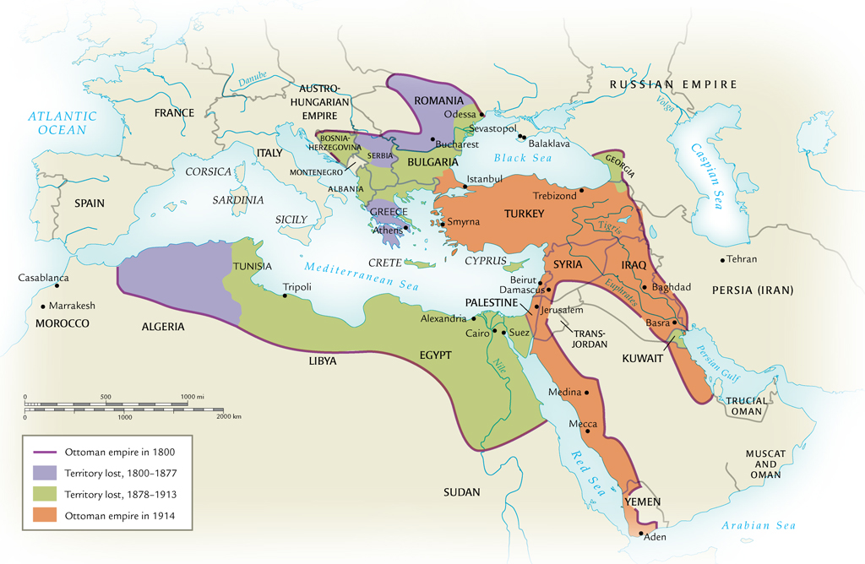
Territorial Losses of the Ottoman Empire, 1800-1923

Slide 5
Ottoman Economy
Imports of cheap manufactured goods place stress on local artisans; urban riots result
Export-dependent Ottoman economy increasingly relies on foreign loans
By 1882 Ottomans unable to pay even interest on loans, forced to accept foreign administration of debts
Capitulations: agreements that exempted Europeans from Ottoman law
Extraterritoriality gives tax-free status to foreign banks, businesses

Slide 6
Early Reforms
Attempts to reform taxation, increase agricultural output, and reduce corruption
Sultan Selim III (r. 1789-1807) remodeled army on European lines
Janissaries revolt, kill new troops, imprison sultan
Sultan Mahmud II (r. 1808-1839) attempts same, has Janissaries massacred
Also reforms schools, taxation; builds telegraph, postal service

Slide 7
Tanzimat (“Reorganization”) Era, 1839-1876
Pace of reform accelerated
Drafted new law codes
Undermined power of traditional religious elite
Fierce opposition from religious conservatives, bureaucracy
Also opposition from radical Young Ottomans, who wanted constitutional government

Slide 8
The Young Turk Era
1876, radical dissident elements stage a coup, install Abdül Hamid II as Sultan (r. 1876-1909)
Constitution, representative government adopted, but suspended within the year, many liberals exiled, executed
Principal organization, Ottoman Society for Union and Progress: the Young Turk Party
Founded by Ottomans in exile in Paris
Called for rapid, secular reforms
Forced Abdül Hamid II to restore parliament, then dethroned in favor of Mehmed V Rashid (r. 1909-1918)

Slide 9
Young Turk Rule
Attempted to establish Turkish hegemony over far-flung empire
Turkish made official language, despite large numbers of Arabic and Slavic language speakers
Yet could not contain forces of decline

Slide 10
The Russian Empire Under Pressure
Russia a massive, multi-cultural empire
Only approximately half speak Russian, observe Russian Orthodox Christianity
Romanov tsars rule autocratic empire
Powerful class of nobles exempt from taxation, military duty
Exploitative serfdom

Slide 11
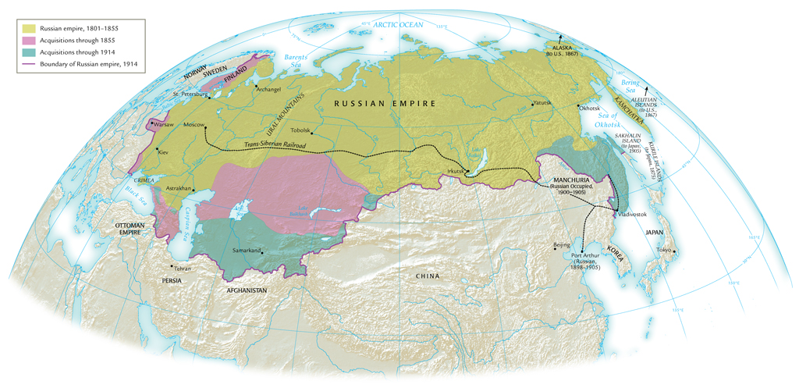
The Russian Empire, 1801-1914

Slide 12
The Crimean War, 1853-1856
Russian expansion into Caucasus in larger attempt to establish control over weakening Ottoman empire
Threatens to upset balance of power; Europeans become involved
Russia driven back from Crimea in humiliating defeat
Demonstration of Russian weakness in the face of western technology, strategy

Slide 13
Reform: Emancipation of the Serfs
Serfdom source of rural instability and peasant revolt
Tsar Alexander II emancipates serfs in 1861, without alleviating poverty, land hunger
Forced to pay for lands they had farmed for generations
Limited attempts to reform administration, small-scale representative government
Network of elected district assemblies called zemstvos

Slide 14
Industrialization in Russia
Witte system
Count Sergei Witte, minister of finance 1892-1903
Massive railroad construction
Trans-Siberian railroad
But massive industrial discontent
Peasants uprooted from rural lifestyle to work for low wages, long hours

Slide 15
Repression
Intelligentsia class spreads radical ideas for social change
Socialists, anarchists
Terror tactics, assassinations
Attempt to connect with the mistrustful peasantry in 1870s, denounced and sent into Siberian exile
Tsarist authorities turn to censorship, secret police
Nationalist sentiment seething in Baltic provinces, Poland, Ukraine, Georgia, and central Asia

Slide 16
Radicalization
1881 radical People’s Will movement assassinates Tsar Alexander II
Prompted widespread pogrom attacks on Jews
Increased repression
Nicholas II (r. 1894-1917) enters into war with Japan (1904-1905)
Humiliating defeat exposes government weaknesses
Social discontent boils over in revolution of 1905
Strikes force government to make concessions

Slide 17
Chinese Restrictions on British Trade
Since 1759, European commercial presence limited to port of Guangzhou
Foreign merchants forced to deal solely with licensed Chinese firms called cohongs, currency of trade: silver bullion
British East India Company heavily involved in opium trade
Opium grown in India, sold in China for silver, silver used to buy other Chinese products

Slide 18
Opium Factory

Slide 19
The Opium Trade
Illegal, but poor enforcement
Increasing trade and social ills evident by late 1830s
Chinese move to enforce ban
British agents engage in military retaliation: the Opium War (1839-1842)
British naval forces easily defeat Chinese

Slide 20
Unequal Treaties
China forced into a series of disadvantageous treaties
Hong Kong ceded to British in Treaty of Nanjing (1842), ports opened to British traders
Extraterritorial status to British subjects
Later, other countries conclude similar treaties

Slide 21
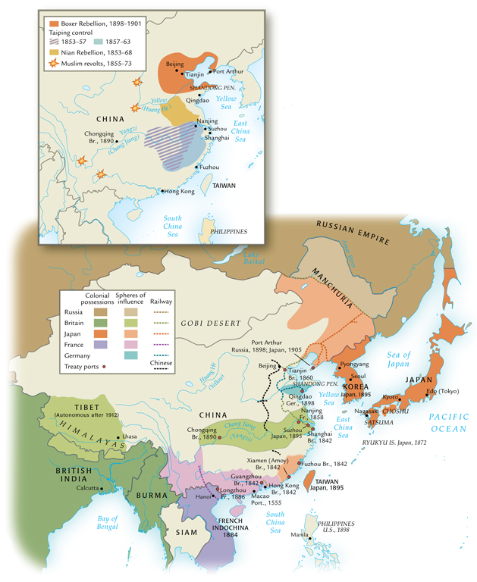
East Asia in the Nineteenth Century

Slide 22
The Taiping Rebellion (1850-1864)
Large-scale rebellions in later nineteenth century reflect poverty, discontent of Chinese peasantry
Population rises 50% between 1800-1900, but land under cultivation remains static
Nian rebellion (1851-1868), Muslim rebellion (1855-1873), Tungan rebellion (1862-1878)
Taiping rebellion led by Hong Xiuquan, schoolteacher; called for destruction of Qing dynasty

Slide 23
Taiping Platform
Abolition of private property
Creation of communal wealth
Prohibition of foot binding, concubines
Free public education, simplification of written Chinese, mass literacy
Prohibition of sexual relations among followers (including married couples)
Yet leaders maintained harems

Slide 24
Taiping Defeat
Nanjing captured in 1858, made into capital
Attack on Beijing with force of 1 million, but turned back
Imperial army unable to contain Taipings, so regional armies created with Manchu soldiers and outfitted with European weaponry
Hong commits suicide in 1864; Nanjing recaptured
100,000 Taipings massacred

Slide 25
The Self-Strengthening Movement (1860-1895)
High point in 1860s-1870s
Slogan “Chinese learning at the base, Western learning for use”
Blend of Chinese cultural traditions with European industrial technology
Shipyards, railroads, academies
Change to Chinese economy and society superficial
Empress dowager Cixi (1835-1908) diverted funds for her own aesthetic purposes

Slide 26
Spheres of Influence
Qing dynasty loses influence in southeast Asia, losing tributary states to Europeans and Japanese
Vietnam: France, 1886
Burma: Great Britain, 1885
Korea, Taiwan, Liaodong Peninsula: Japan, 1895
China itself divided into spheres of influence, 1895

Slide 27
Hundred Days Reforms (1898)
Kang Youwei (1858-1927) and Liang Qichao (1873-1929)
Interpreted Confucianism to allow for radical changes to system
Pro-industrialization
Emperor Guangxu attempts to implement reforms
Empress dowager Cixi nullifies reforms, imprisons emperor

Slide 28
The Boxer Rebellion
Cixi supports Society of Righteous and Harmonious Fists (“Boxers”), anti-foreign militia units
1899 fight to rid China of “foreign devils”
Misled to believe European weapons would not harm them, 140,000 Boxers besiege European embassies in 1900
Crushed by coalition of European forces
China forced to accept stationing of foreign troops

Slide 29
Boxers

Slide 30
Death of the Dowager Empress
Emperor dies a mysterious, sudden death
Cixi dies one day later, November 1908
Two-year-old Puyi placed on the throne
Revolution in 1911
Puyi abdicates, 1912

Slide 31
Transformation of Japan
Japanese society in turmoil in early nineteenth century
Poor agricultural output, famines, high taxes
Daimyo, samurai classes decline, peasants starve
Tokugawa government attempts reforms, 1841-1843
Cancelled daimyo, samurai debts
Abolished merchant guilds
Compelled peasants to return to cultivating rice
Reforms ineffective

Slide 32
Foreign Pressure
Europeans, Americans attempting to establish relations
U.S. in particular look for Pacific ports for whalers, merchants
Japan only allowed Dutch presence in Nagasaki
1853 Matthew Perry sails gunship up to Edo (Tokyo), forces Japanese to open port
Sparks conservative Japanese reaction against shogun, rally around emperor in Kyoto

Slide 33
The Meiji Restoration (1868)
Brief civil war between imperial and Tokugawa forces
1868, Emperor Mutsuhito (Meiji, 1852-1912) takes power
Goals of prosperity and strength: “rich country, strong army”
Resolved to learn western technology

Slide 34
Meiji Reforms
Travelers Fukuzawa Yukichi (1835-1901) and Ito Hirobumi (1841-1909) travel to U.S., Europe
Argue for adoption of western legal proceedings, technology
Meiji government removes privileges for daimyo, samurai
Conscript army replaces samurai mercenaries
Samurai rebellion crushed by national army
Tax reform: payment in cash, not kind

Slide 35
Constitutional Government
1889 constitution promulgated
Conservative: only 5 % of male population allowed to vote in 1890 election
Economic reforms to promote rapid industrialization
Dramatic improvement in literacy rates
Government holdings sold to private investors: zaibatsu financial cliques develop

