Slide 1
Chapter 32
The Building of Global Empires

Slide 2
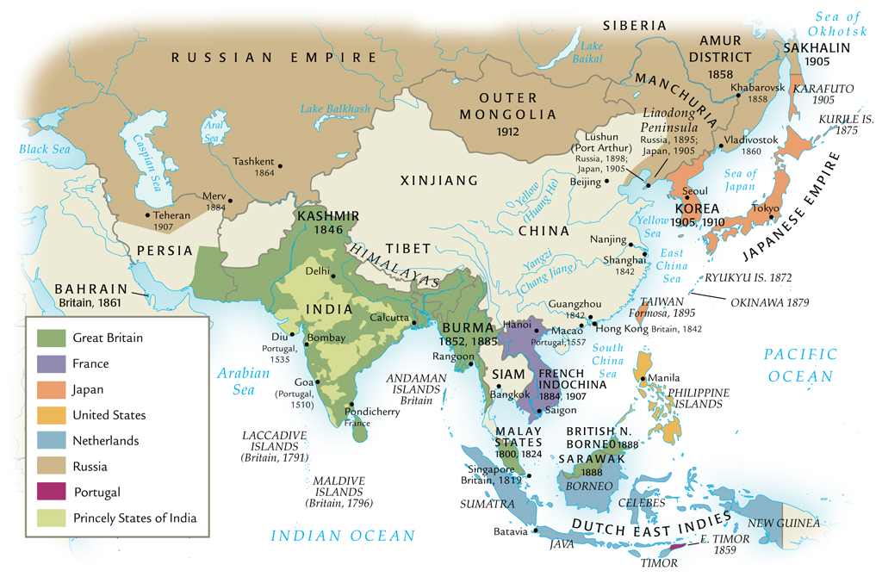
Imperialism in Asia, ca. 1914

Slide 3
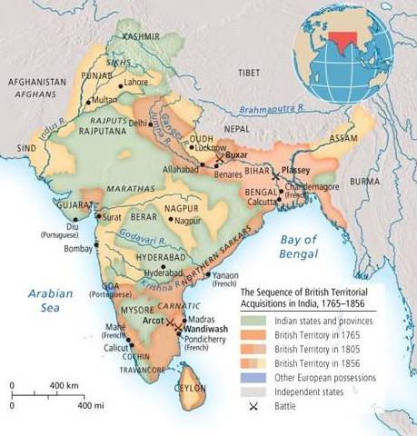

Slide 4
The Idea of Imperialism
Term dates from nineteenth century
In popular discourse by 1880s
Military imperialism
Later, economic and cultural varieties
U.S. imperialism

Slide 5
Motivations for Imperialism
Military
Political
Economic
European capitalism
Religious
Demographic
Criminal populations
Dissident populations

Slide 6
Manifest Destiny
Discovery of natural resources
Exploitation of cheap labor
Expansion of markets
Limited

Slide 7
Geopolitical Considerations
Strategic footholds
Waterways
Supply stations
Imperial rivalries

Slide 8
The “White Man’s Burden”
Rudyard Kipling (1864-1936)
Duty to bring order and enlightenment to distant lands
French: mission civilisatrice
Notes:
Take up the White Man's burden--
Send forth the best ye breed--
Go bind your sons to exile
To serve your captives' need;
To wait, in heavy harness,
On fluttered folk and wild--
Your new-caught, sullen peoples,
Half-devil and half-child.
Take up the White Man's burden--
In patience to abide,
To veil the threat of terror
And check the show of pride;
By open speech and simple,
An hundred times made plain,
To seek another's profit
And work another's gain.
Take up the White Man's burden--
The savage wars of peace--
Fill full the mouth of Famine,
And bid the sickness cease;
And when your goal is nearest
The end for others sought,
Watch Sloth and heathen Folly
Bring all your hope to nought.
Take up the White Man's burden--
No iron rule of kings,
But toil of serf and sweeper--
The tale of common things.
The ports ye shall not enter,
The roads ye shall not tread,
Go make them with your living,
And mark them with your dead.
Take up the White Man's burden,
And reap his old reward:
The blame of those ye better,
The hate of those ye guard--
The cry of hosts ye humor
(Ah, slowly!) toward the light;--
"Why brought ye us from bondage,
Our loved Egyptian night?"
Take up the White Man's burden--
Ye dare not stoop to less--
Nor call too loud on Freedom
To cloak your weariness;
By all ye cry or whisper,
By all ye leave or do,
The silent, sullen peoples
Shall weigh your Gods and you.
Take up the White Man's burden--
Have done with childish days--
The lightly proffered laurel,
The easy ungrudged praise.
Comes now, to search your manhood
Through all the thankless years,
Cold, edged with dear-bought wisdom,
The judgment of your peers!

Slide 9
Domestic Political Considerations
Crises of industrialism
Pressure from emerging socialism
Imperial policies distract proletariat from domestic politics
Cecil Rhodes: imperialism alternative to civil war

Slide 10
Technology and Imperialism
Transportation
Steamships
Railroads
Infrastructure
Suez Canal (1859-1869)
Panama Canal (1904-1914)

Slide 11
Weaponry
Muzzle-loading muskets
Mid-century: breech-loading rifles
Reduce reloading time
1880s: Maxim gun, 11 rounds per second

Slide 12
The Military Advantage
Battle of Omdurman (near Khartoum on Nile), 1898
Five hours of fighting
British: six gunboats, twenty machine guns
British force lost a few hundred men; thousands of Sudanese killed

Slide 13
Communications
Correspondence
1830 Britain-India: 2 years
After Suez Canal, 2 weeks
Telegraph
1870s, development of submarine cables
Britain-India: 5 hours

Slide 14
British Empire in India
East India Company
Monopoly on India trade
Original permission from Mughal emperors
Mughal empire declines after death of Aurangzeb, 1707

Slide 15
Home of a Wealthy Family in Calcutta

Slide 16
British Conquest
Protection of economic interests through political conquest
“Doctrine of lapse”
British and Indian troops (sepoys)

Slide 17
British Colonial Soldiers

Slide 18
Sepoy Revolt, 1857
Newly issued rifles had cartridges in wax paper greased with animal fat
Problem for Hindus: beef
Problem for Muslims: pork
Small-scale rebellion ignites general anti-British revolution
British gained upper hand in late 1857

Slide 19
British Imperial Rule
In response to the rebellion, Britain:
Abolishes Mughal empire
Exiles emperor to Burma
Abolishes East India Company
Establishes direct rule of India by British government

Slide 20
British Rule in India
Organization of agriculture
Crops: tea, coffee, opium
Stamp of British culture on Indian environment

Slide 21
Imperialism in Central Asia
British, French, Russians complete for central Asia
France drops out after Napoleon
Russia active after 1860s in Tashkent, Bokhara, Samarkand; and approached India
The “Great Game”: Russian vs. British intrigue in Afghanistan
Preparation for imperialist war
Russian revolution of 1917 forestalled war

Slide 22
Imperialism in Southeast Asia
Spanish: Philippines
Dutch: Indonesia (Dutch East Indies)
British establish presence from 1820s
Conflict with kings of Burma (Myanmar) 1820s, established colonial authority by 1880s
Thomas Stamford Raffles founds Singapore for trade in Strait of Melaka
Base of British colonization in Malaysia, 1870s-1880s
French: Vietnam, Cambodia, Laos, 1859-1893
Encouraged conversion to Christianity

Slide 23
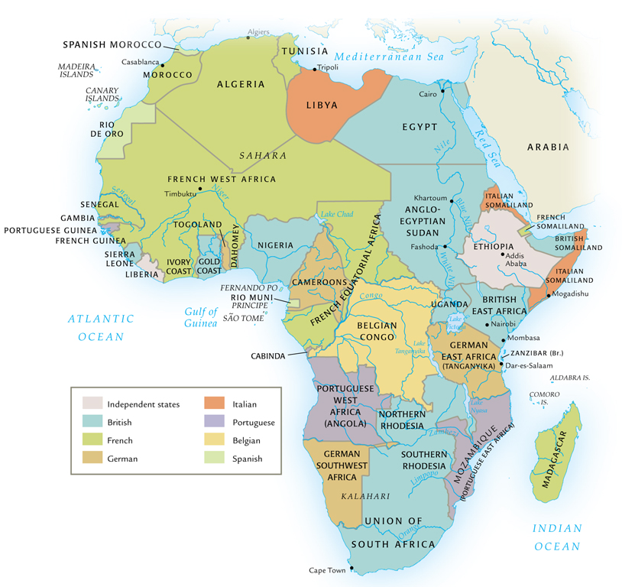
Imperialism in Africa, ca. 1914

Slide 24
The Scramble for Africa (1875-1900)
French, Portuguese, Belgians, and English competing for “the dark continent”
Britain establishes strong presence in Egypt, Rhodesia
Suez Canal
Rhodesian gold, diamonds

Slide 25
Rewriting African History
Ancient Africa
Implications for justification of imperialist rule
European exploration of rivers (Nile, Niger, Congo, Zambesi)
Information on interior of Africa
King Leopold II of Belgium starts Congo Free State, commercial ventures
Takes control of colony in 1908, renamed Belgian Congo

Slide 26
South African (Boer) War 1899-1902
Dutch East India establishes Cape Town (1652)
Farmers (Boers) follow to settle territory, later called Afrikaners
Competition and conflict with indigenous Khoikhoi and Xhosa peoples
(continued)

Slide 27
South African (Boer) War 1899-1902
British takeover in 1806, slavery a major issue of conflict
Afrikaners migrate eastward in the Great Trek, overpower Ndebele and Zulu resistance with superior firepower
Establish independent republics
British tolerate this until gold is discovered
White-white conflict, black soldiers and laborers
Afrikaners concede in 1902; 1910, integrated into Union of South Africa

Slide 28
Village around a Kraal

Slide 29
The Berlin West Africa Conference (1884-1885)
Fourteen European states, United States
No African states present
Rules of colonization: any European state can take “unoccupied” territory after informing other European powers
European firepower dominates Africa
Exceptions: Ethiopia fights off Italy (1896); Liberia a dependency of the U.S.

Slide 30
Systems of Colonial Rule
Concessionary companies
Private companies get large tracts of land to exploit natural resources
Companies get freedom to tax, recruit labor: horrible abuses
Profit margin minimal
Direct rule: France
“Civilizing mission”
Chronic shortage of European personnel; language and cultural barriers
French west Africa: 3,600 Europeans rule 9 million

Slide 31
Indirect Rule
Frederick D. Lugard (Britain, 1858-1945)
The Dual Mandate in British Tropical Africa (1922)
Use of indigenous institutions
Difficulty in establishing tribal categories, imposed arbitrary boundaries

Slide 32
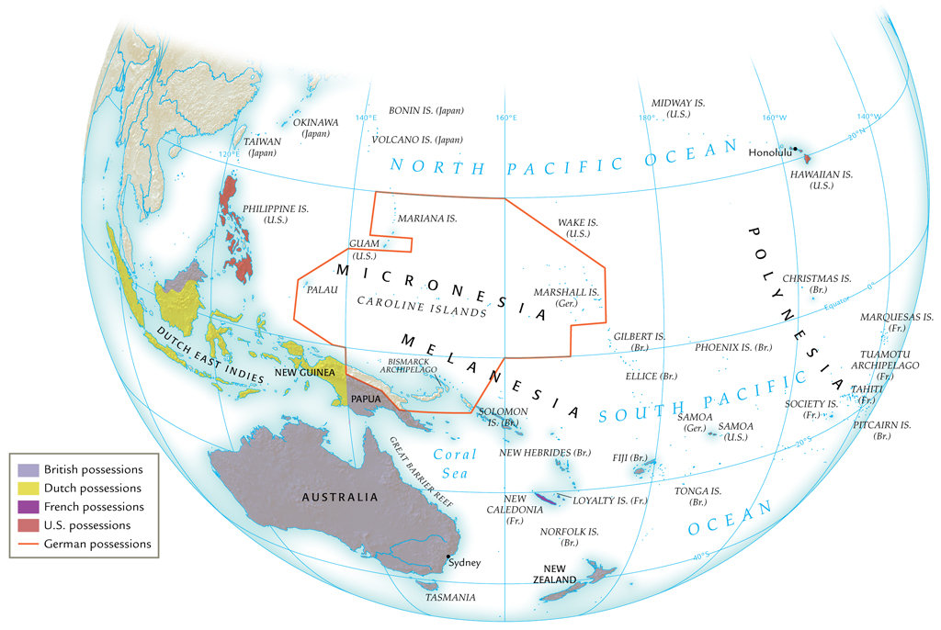
Imperialism in Oceania, ca. 1914

Slide 33
European Imperialism in Australia and New Zealand
English use Australia as a penal colony from 1788
Voluntary migrants follow; gold discovered 1851
Smallpox, measles devastate natives
Territory called terra nullius: “land belonging to no one”
New Zealand: natives forced to sign Treaty of Waitangi (1840), placing New Zealand under British “protection”

Slide 34
Australian Aborigine

Slide 35
European and Native Population in Australia and New Zealand

Slide 36
European Imperialism in the Pacific Islands
Commercial outposts
Whalers seeking port
Merchants seeking sandalwood, sea slugs for sale in China
Missionaries seeking souls
British, French, German, American powers carve up Pacific islands
Tonga remains independent, but relies on Britain

Slide 37
U.S. Imperialism
President James Monroe warns Europeans not to engage in imperialism in western hemisphere (1823)
The Monroe Doctrine: all Americas a U.S. Protectorate
1867 purchased Alaska from Russia
1875 established protectorate over Hawai`i
Locals overthrow queen in 1893, persuade U.S. to acquire islands in 1898

Slide 38
Spanish-Cuban-American War (1898-1899)
U.S. declares war in Spain after battleship Maine sunk in Havana harbor, 1898
Takes possession of Cuba, Puerto Rico, Guam, Philippines
U.S. intervenes in other Caribbean, Central American lands; occupies Dominican Republic, Nicaragua, Honduras, Haiti
Filipinos revolt against Spanish rule, later against U.S. rule

Slide 39
The Panama Canal
President Theodore Roosevelt (in office 1901-1909) supports insurrection against Colombia (1903)
Rebels win, establish state of Panama
U.S. gains territory to build canal, Panama Canal Zone
Roosevelt Corollary of Monroe Doctrine
U.S. right to intervene in domestic affairs of other nations if U.S. investments threatened

Slide 40
Early Japanese Expansion
Resentment over unequal treaties of 1860s
1870s, colonized northern region: Hokkaido, Kurile Islands, southern Okinawa, and Ryukyu Islands as well
1876, Japanese purchase warships from Britain, dominate Korea
Sino-Japanese War (1894-1895) over Korea results in Japanese victory
Russo-Japanese War (1904-1905) also ends in Japanese victory

Slide 41
Economic Legacies of Imperialism
Colonized states encouraged to exploit natural resources rather than build manufacturing centers
Encouraged dependency on imperial power for manufactured goods made from native raw product
Indian cotton
Introduction of new crops
Tea in Ceylon

Slide 42
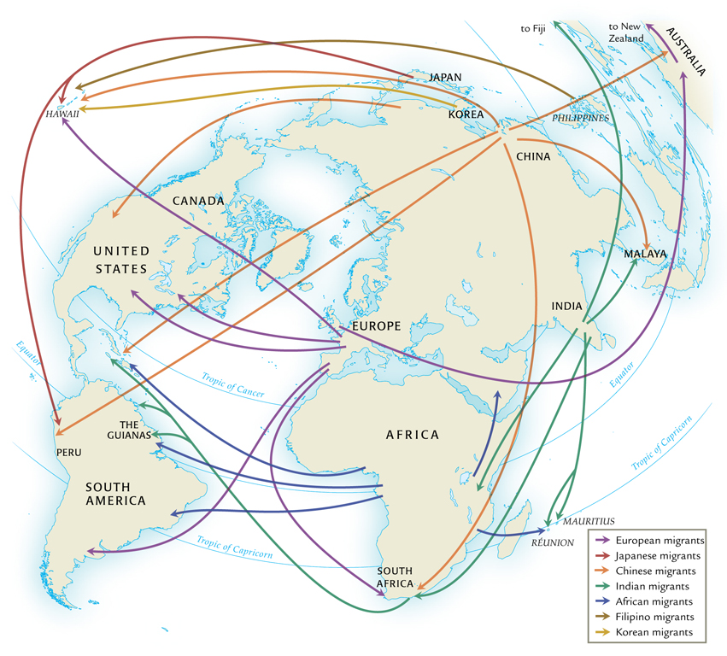
Imperialism and Migration during the Nineteenth and Early Twentieth Century

Slide 43
Labor Migrations
Europeans move to temperate lands
Work as free cultivators, industrial laborers
32 million to the U.S., 1800-1914
Africans, Asians, and Pacific islanders move to tropical/subtropical lands
Indentured laborers, manual laborers
2.5 million between 1820 and 1914

Slide 44
Colonial Conflict
Thousands of insurrections against colonial rule
Tanganyika Maji Maji rebellion against Germans (1905-1906)
Rebels sprinkle selves with magic water (maji-maji) as protection against modern weapons; 75,000 killed
“Scientific” racism developed
Count Joseph Arthur de Gobineau (1816-1882)
Combines with theories of Charles Darwin (1809-1882) to form pernicious doctrine of “social Darwinism”

Slide 45
Nationalism and Anticolonial Movements
Ram Mohan Roy (1772-1883), Bengali called “father of modern India”
Reformers call for self-government, adoption of selected British practices (e.g. ban on sati)
Influence of Enlightenment thought, often obtained in European universities
Indian National Congress formed 1885
1916, joins with All-India Muslim League

