Slide 1
Chapter 34
An Age of Anxiety

Slide 2
Postwar Pessimism
The “lost generation” (Gertrude Stein)
Disillusionment after WWI
Pessimism over idea of human progress
Spengler, Decline of the West

Slide 3
Revolution in Physics
Albert Einstein (1879-1955)
Theory of special relativity
Neither time nor space absolute values; vary with observer
Werner Heisenberg (1901-1976)
The uncertainty principle
Concepts extended to humanities, social sciences

Slide 4
Revolution in Psychology
Sigmund Freud (1856-1939)
The life of the subconscious mind
Repression of sexual desires, fears
Interpretation of dreams
Free association
Application to mythology, religion, literature, art, etc.

Slide 5
Experimentation in Art
Photography makes realism irrelevant
Art as creation, not reproduction
Retreat to abstraction
Les fauves
Pablo Picasso (1881-1973)
Influence of non-western styles

Slide 6
Experimentation in Architecture
The Bauhaus
Director: Walter Gropius (1883-1969)
Form follows function
Square, lifeless, but efficient
Skyscrapers
“Glass boxes”
“International style”
Loved by business, government

Slide 7
European Origins of the Great Depression
Austria/Germany borrow money from U.S. to pay war debts to France and England
France, England pay debts owed to U.S. for WWI
System dependent on flow of cash from U.S.
Investors begin to pull out in 1928

Slide 8
New Technologies and the Great Depression
Single-export countries devastated by declines due to new technology
Reclaimed rubber destroys rubber-based economies of Dutch East Indies, Malaysia, Ceylon

Slide 9
Agricultural Surpluses and the Great Depression
Overproduction in 1920s
Strongest harvests in 1925, 1929
Wheat at lowest price in 400 years
Farm income drops
Less demand for manufactured goods
Inventory surpluses
The Dust Bowl, mid to late 30s

Slide 10
Black Thursday (October 24, 1929)
Stock purchases on margin (3%)
Hints of slowdown in Europe
Investors begin to sell
Snowball effect
Life savings lost
Black Thursday
11 suicides

Slide 11
U.S. Economic Collapse
Inventory surplus leads to layoffs
Layoffs lead to decreased demand, businesses fail
1932 industrial production at half of 1929 levels
44% of U.S. banks out of business
Deposits lost

Slide 12
World Economic Collapse
Hardest hit: countries dependent on export of manufactured goods for essentials
Japan
Single-export countries
South America

Slide 13
Initial Government Attempts to Increase Demand
U.S.: “planned scarcity”
Vegetables, fruits, and animals destroyed
Steinbeck’s The Grapes of Wrath

Slide 14
New U.S. Strategies
Laissez-faire, “planned scarcity” approaches fail
John Maynard Keynes (1883-1946), economist
Stimulate economy by lowering interest rates
Encouraging investment, employment
The New Deal of Franklin Delano Roosevelt
WWII spending

Slide 15
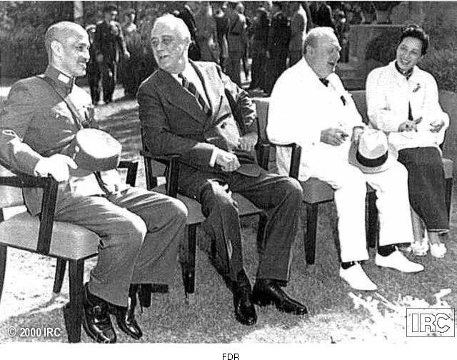
Franklin Delano Roosevelt

Slide 16
The Bolshevik Revolution
October/November 1917
Soviets take over
Civil war, 1918-1920
Red Terror campaign
Execution of Tsar
Whites defeated by Red Army in 1920

Slide 17
War Communism, 1918-1922
Rapid collectivization
Confiscations
Massively unpopular, Lenin backtracks in 1921
New Economic Policy (NEP), partial privatization of the economy

Slide 18
New Economic Policy (NEP)
Temporarily restored market economy; some private enterprise
Allowed peasants to sell surplus at free market prices
Electrification
Establishment of technical schools

Slide 19
Lenin’s Death
Lenin suffers three strokes; dies 1924
Bitter power struggle among Bolshevik leaders ensues

Slide 20
Joseph Stalin (1879-1953)
Georgian
Mother’s influence leads to Orthodox seminary education
Stalin triumphs over party rivals
“Man of steel”
Socialism in one country
Leads Soviet Union by 1928

Slide 21
Stalin and Industrialization
First Five-Year Plan
Gosplan
Massive collectivization of agriculture
Kulaks
Stalin halts collectivization in 1931
Proclaims its success

Slide 22
The Great Purge
“Congress of Victors” / “Congress of Victims”
Intra-party civil war
The “cleansing”
Stalin removes all persons suspected of opposition, 1935-1938
Two-thirds of Central Committee
Half of army’s high ranking officers
Sent to labor camps

Slide 23
The Growth of European Fascism
From fasces, Roman symbol of authority
Axe surrounded by wooden rods
Originates with Benito Mussolini
Influences Europe, Asia, Latin America

Slide 24
Fascism: Common Elements
Primacy of state over individual
Devotion to a strong leader
Ethnocentric
Militaristic
Anti-communist
Chauvinistic
Xenophobic

Slide 25
Fascism in Italy
Poor showing of post-WWI Italian government
Public disappointed with weak territorial gains
Economic and social turmoil
Mussolini, former newspaper editor, electoral successes in 1921
March on Rome, October, King Emmanuel III offers him office of prime minister
Blackshirts
1926, seizes power as Il Duce, “the leader”

Slide 26
Adolf Hitler (1889-1945) and the Nazi Party
1921, becomes chairman of the National Socialist German Workers’ Party (Nazis)
Attempts to overthrow government in 1923
Writes autobiography Mein Kampf in jail, massively popular
Capitalizes on public discontent with postwar era
War guilt clause
Reparation payments
Inability of major parties to come to consensus
Anti-Semitism

Slide 27
Consolidation of Power
Nazis become single largest party in parliament, 1930-1932
Weak president Paul von Hindenburg (1847-1934) appoints Hitler as chancellor
Suppresses opposition, abrogates constitutional and civil rights
Makes the Nazis the sole legal party
Destroys trade unions
Purges judiciary, civil service of perceived enemies

Slide 28
The Racial State
Theories of racial superiority, racial purity
Policies of eugenics
Compulsory sterilization of 30,000 Germans
Abortions illegal for healthy Germans, mandatory for “hereditary ill” and “racial aliens”
Euthanasia program kills 200,000 people with physical or mental handicaps between 1939 and 1945
Precursor to massacres of Jews, gypsies

Slide 29
Anti-Semitism
Influence of nineteenth-century racism
1935, Nuremburg laws define Jew on racial basis
Prohibits marriages between Jews and non-Jews
Removal of Jews from civil service, schools
Liquidation of Jewish-owned businesses or purchase by non-Jews
Kristallnacht: major country-wide pogrom on Jews, November 9-10, 1938
“Night of broken glass”

