Slide 1
Bell Work
“Without math life is undefined’
Elmor Earl Leonor.
What are the tools of geometry?
What are they useful for?

Slide 2
Geometric Art
Real World

Slide 3
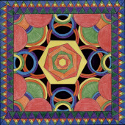
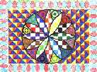

Slide 4
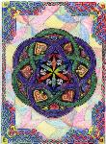
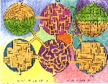

Slide 5
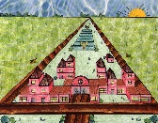

Slide 6
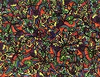

Slide 7
Symmetry
What does this mean? (Explain in your own words.)

Slide 8
Home Learning
Define the following terms.
Symmetry
Reflectional symmetry
Line symmetry
Bilateral symmetry
Rotational symmetry

